Slide 1
2024 DIGITAL PRESERVATION CAPABILITY SELF-ASSESSMENT LAUNCH
February 13, 2024
Notes:
The self-assessment survey based on the Digital Preservation Capability and Maturity Model (DPCMM) is a metric by which CoSA members have been able to measure their digital preservation programs since 2012.
Results of the self-assessment help to benchmark capabilities to preserve and provide access to permanent electronic government records as well as develop action plans for improvements.
As the third self-assessment survey rolls out, we will discuss the history of the model, tips for understanding the component capabilities, and what we have learned from past surveys and hope to learn from the 2022 survey.

Slide 2
UPCOMING WEBINARS & EVENTS
March 12
Chatting with SERI: Cloudy with a Chance of Records
April 9
Stay tuned!
February 19
Best Practices Exchange proposal deadline
May (TBD)
SERI STEER Unconference

Slide 3
ONLINE RESOURCES
SERI Webinar Recordings on YouTube
Resource Center

Slide 4
SERI 2024 SPONSOR

Slide 5
SESSION AGENDA
Welcome & Introductions
BACKER – Building Archival Capacity for Keeping Electronic Records
Digital Preservation Capability Maturity Model
CoSA Digital Preservation Capability Self-Assessment
Questions & Feedback

Slide 6
PRESENTERS
Nick Connizzo
Veronica Martzahl
CoSA
BACKER Project Manager
CoSA
BACKER Consultant

Slide 7
BACKER: Building Archival Capacity for Keeping Electronic Records
CoSA is the recipient of an IMLS National Leadership Grant delivered over three years to develop new and expanded technical assistance, educational programming, and training to state and territorial government archives to strengthen their digital records preservation and accessibility capacities.
The project includes 1) updating self-assessment tools and best practices for digital preservation programs; 2) direct assistance and mentoring to improve digital preservation programs, including digitization planning and related policy development; and 3) accelerating development and implementation of digital preservation planning and cultural competence awareness and skill-building educational and training programs in a variety of formats in order to facilitate continued learning and sharing among archives staff.

Slide 8
THE VALUE OF MEMBER SELF-ASSESSMENTS
Helps CoSA document the effectiveness of SERI’s education and training efforts for most state and territorial archives
Builds on progress and array of tools, training and support structures
Enables CoSA to continue to help state and territorial governments enhance and improve digital management, preservation and access of government records and information to the public

Slide 9
COSA SELF ASSESSMENT OVER TIME
In 2010, CoSA received a LSTA grant from Indiana State Library in cooperation with Indiana State Archives to collect data in surveys and telephone interviews with state/territory Archives
Mapping that data onto the DPCMM, almost half of respondents had a Nominal capability score in all 15 categories
Earlier versions of the self-assessment administered in 2012 and 2015 with near 100% participation
Most recent administration of self-assessment occurred in 2022 as part of the BACKER project
Closing out the BACKER project with a re-administration of the self-assessment

Slide 10
DIGITAL PRESERVATION CAPABILITY MATURITY MODEL (DPCMM)
FOUNDATIONS AND HISTORY

Slide 11
WHAT IS A CAPABILITY MATURITY MODEL (CMM)?
Management tool designed to help implement effective methods in a given management discipline
Structured collection of elements that describe characteristics of processes
Provides a place to start, the benefit of prior experience, a common language, a framework for prioritizing actions and a way to define improvement

Slide 12
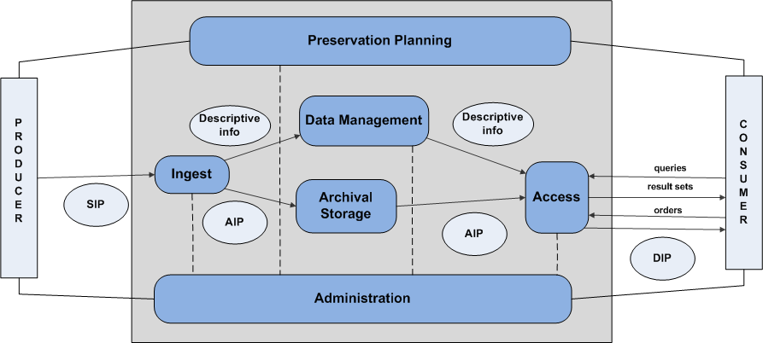
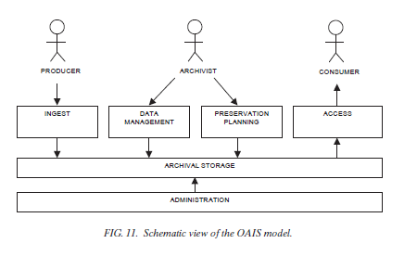
OPEN ARCHIVAL INFORMATION SYSTEM (OAIS) REFERENCE MODEL – ISO 14721
High-level, generic reference model for the environment, producers, users, data types, and information flows of a digital repository
Notes:
Models should be standards based. Key to the Digital Preservation Maturity Model is ISO 14721, the OAIS reference model.

Slide 13
REPOSITORY CERTIFICATION – ISO 16363
Organizational Infrastructure
Governance and Organizational Viability
Organizational Structure and Staffing
Procedural Accountability and Preservation Policy Framework
Financial Sustainability
Contracts, Licenses, and Liabilities
Digital Object Management
Ingest: Acquisition of Content
Ingest: Creation of the AIP
Preservation Planning
AIP Preservation
Information Management
Access Management
Infrastructure and Security Risk Management
Technical Infrastructure Risk Management
Security Risk Management
Notes:
And ISO 16363 which looks at preservation repository certification, including elements of organizational infrastructure, digital object management, and infrastructure and security risk management.

Slide 14
DIGITAL PRESERVATION CAPABILITY MATURITY MODEL (DPCMM)
HOW IT WORKS

Slide 15
DPCMM OVERVIEW
Based on functional specifications of ISO 14721, ISO 16363, and good practices from operational digital repositories
Systems-based tool for charting an evolutionary path towards increasingly mature stages of digital preservation capability
Assessment methodology “scores” organizations on current state capabilities
Helps organizations establish priorities, align to mission and mandates, and communicate effectively with stakeholders
Notes:
ISO 14721 - Open Archival Information System (OAIS)
ISO 16363 - Audit and Certification of Trustworthy Repositories

Slide 16
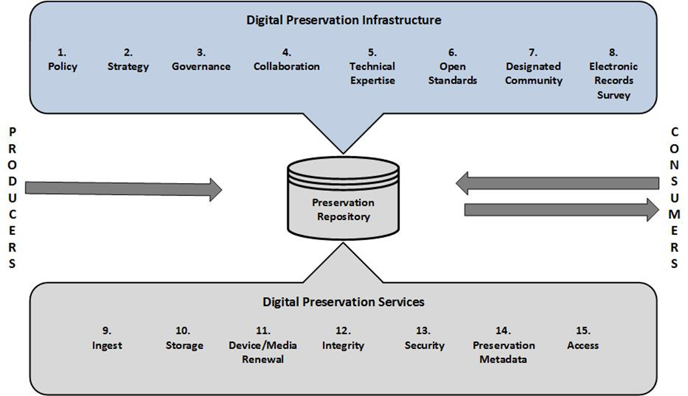
DIGITAL PRESERVATION CAPABILITY MATURITY MODEL (DPCMM)
Notes:
Mapping the 16363 categories into measurable groups, all in support of the OAIS model for a trustworthy digital repository. Breaking down not only the technical considerations, but also the support functions of policy, strategy and governance. Often these less technical aspects can be areas that archivists can exert greater direct control of. There are 15 categories that are encompassed including policy, strategy, governance, collaboration, technical expertise, open standards, designated community, electronic records survey, ingest, storage, device and media renewal, integrity, security, preservation metadata, and access.

Slide 17
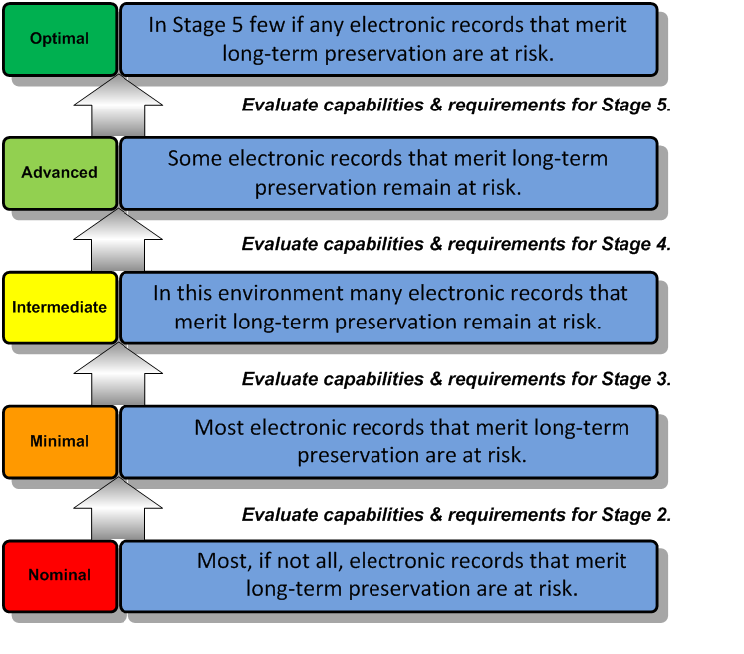
DPCMM CAPABILITY STAGES
Five (5) progressively advanced capability levels
Enables high level assessment of an organization’s current digital preservation capabilities against good practice standard
Facilitates development of strategic roadmap for incremental levels of improvement based on
risk exposure and asset value
business requirements
available resources
Adaptable to virtually any organization
Notes:
There is a maximum score of 5 in each of the 15 areas for a grand total of 60 points. Allows for an overall score, but also a more nuanced view of strength and growth opportunities.

Slide 18
ONE SIZE DOES NOT FIT ALL
DPCMM intended to be a flexible approach that can be adapted to specific requirements and resources
Use to identify current state capabilities of digital preservation which forms the basis for debate and dialogue regarding the desired future state of archival repositories and the level of electronic records management risk that the organization is willing to take on
What is “good enough” to fulfill the organization’s mission and meet the expectations of its stakeholders?

Slide 19
DPCMM STRENGTHS
Breaks digital preservation into clearly defined components
Enables the setting of priorities based on risk, requirements and resources
Supports incremental improvement
Documents and celebrates progress and accomplishments
Establishes business case for additional resources
Can provide basis for virtualized preservation services

Slide 20
Digital Preservation Capability Improvement Road Map
 | Current | Year 1 | Year 2 | Year 3 | Year 4 | Year 5 | Difficulty
Reference Model Components
INFRASTRUCTURE
Policy | 1 | 2 | 🢥 | 🢥 | 3 | 🢥 | LOW
Strategy | 0 | 2 | 🢥 | 🢥 | 3 | 🢥 | MEDIUM
Governance | 0 | 1 | 2 | 3 | 🢥 | 🢥 | MEDIUM
Collaboration | 1 | 2 | 🢥 | 3 | 🢥 | 🢥 | MEDIUM
Technical Expertise | 1 | 🢥 | 🢥 | 2 | 🢥 | 3 | MEDIUM
Open Standard Technology Neutral File Formats | 1 | 🢥 | 2 | 🢥 | 3 | 🢥 | MEDIUM
Designated Community | 1 | 🢥 | 2 | 🢥 | 3 | 🢥 | MEDIUM
Notes:
The model allows institutions to clearly articulate their current state, determine future goals, and proceed via incremental steps to reach them.

Slide 21
Digital Preservation Capability Improvement Road Map
 | Current | Year 1 | Year 2 | Year 3 | Year 4 | Year 5 | Difficulty
Reference Model Components
PROCESSES
Electronic Records Survey | 1 | 🢥 | 2 | 3 | 🢥 | 🢥 | MEDIUM
Ingest | 0 | 🢥 | 🢥 | 1 | 🢥 | 2 | HIGH
Archival Storage | 0 | 🢥 | 🢥 | 1 | 2 | 🢥 | LOW
Media & Device Renewal | 1 | 🢥 | 🢥 | 2 | 🢥 | 3 | MEDIUM
Integrity | 0 | 🢥 | 🢥 | 🢥 | 1 | 2 | MEDIUM
Security | 1 | 🢥 | 🢥 | 2 | 🢥 | 3 | MEDIUM
Preservation Metadata | 0 | 🢥 | 🢥 | 1 | 2 | 3 | MEDIUM
Access | 1 | 🢥 | 🢥 | 🢥 | 2 | 🢥 | MEDIUM
Notes:
This can be a multi-year process with each institution being able to prioritize where they feel they can have the most immediate impact.

Slide 22
2024 DPCMM SELF-ASSESSMENT
WALK THROUGH AND FOLLOW-UP ACTIVITIES

Slide 23
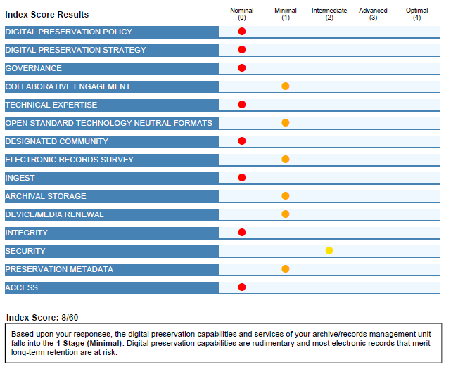
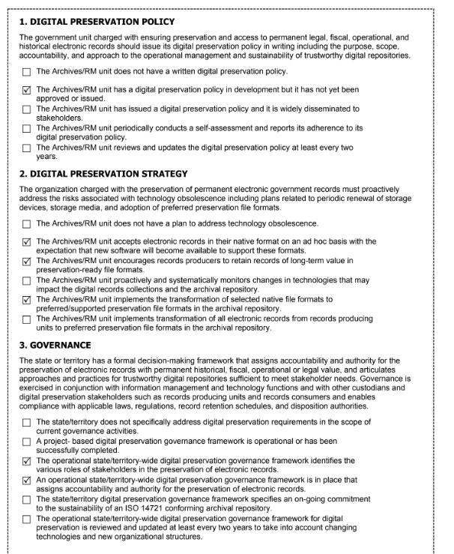
OUTPUTS
Scorecard
Survey with selected responses

Slide 24
POST-SURVEY ACTIVITIES
Scores will be aggregated and analyzed
Report on trends and findings with an executive summary
Live Q&A Session
Best practices and guidelines documents aimed at supporting developing digital preservation activities

Slide 25
BACKER RESOURCES
Introducing BACKER: Building Archival Capacity for Keeping Electronic Records
2022 DPCMM: History of the DPCMM
2022 DPCMM: Archival Repositories
2022 DPCMM: International Standards
2022 DPCMM: GPO Interview Part 1
2022 DPCMM: GPO Interview Part 2
2022 DPCMM: Organization Infrastructure Questions
2022 DPCMM: Organization Infrastructure Questions Part 2
2022 DPCMM: Infrastructure and Risk Questions Part 3
DPCMM 2022: Questions Part 4
DPCMM 2022: Questions Part 5
Why Participate in the Cultural Competency Survey?
https://www.statearchivists.org/electronic-records/state-electronic-records-initiative/backer

Slide 26
QUESTIONS & FEEDBACK
Feel free to reach out with to:
Nick Connizzo
nconnizzo@statearchivists.org
Veronica Martzahl
veronica.martzahl@gmail.com

Slide 27
QUESTIONS & COMMENTS

Slide 28
STAY CONNECTED & INFORMED
CoSA Website
CoSA Resource Center
CoSA X Handle: @StateArchivists
CoSA Facebook Page
CoSA YouTube Channel

