Slide 1
Preserving Email in Multiple Formats: an Overview of the Mailbag Project
Use the chat box at the right of the screen to tell us who you are, where you’re from, and who is participating with you today.
(To open the chat window, click on the CHAT icon in the upper right corner.)
Connect to the audio portion of the webinar through your phone line or through VoIP.

Slide 2
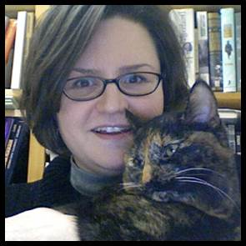
Welcome!
Fall 2021 SERI webinars
October 8: Fantastic Bits and How to Preserve Them: A SERI Webinar for Electronic Records Day
October 12: Advocacy and Electronic Records
In the CoSA Resource Center
150+ resources re: "email"
https://www.statearchivists.org/research-resources/resource-center
CoSA PREPARE (Preparing Archives for Records in Email)
https://www.youtube.com/watch?v=e3hKBLLTi0k
Bonnie Weddle
New York State Archives

Slide 3
SERI 2020-21 Video series
Introduction
https://www.youtube.com/watch?v=OwLx8-E-l8M&list=PLospvJp0HcS9HJHf1e-rYAuk2KJFt5gV5&index=13
Key Concepts in Digital Processing
https://www.youtube.com/watch?v=kYd7sG_3aw8&list=PLospvJp0HcS9HJHf1e-rYAuk2KJFt5gV5&index=12
Making the Pitch for Electronic Records
https://www.youtube.com/watch?v=35xLibzrIew&list=PLospvJp0HcS9HJHf1e-rYAuk2KJFt5gV5&index=6
Long-Term Preservation: File Formats
https://www.youtube.com/watch?v=eJfnuSo_lCQ&list=PLospvJp0HcS9HJHf1e-rYAuk2KJFt5gV5&index=2
Additional videos coming soon!

Slide 4
SERI 2021 Sponsor
Notes:
As part of its continued support of state archives and the great work done by CoSA, Preservica is excited to sponsor the State Electronic Records Initiative and to help spread knowledge of the electronic records management and digital preservation best practices available to the state and territorial government community.

Slide 5
Today’s presenter
Greg Wiedeman
University Archivist
University at Albany, SUNY

Slide 6
Mailbag Project
Currently there is no single effective preservation format for email
Specification & open source tool
Preserves email archives over IMAP or common export formats
Enable basic near-to-capture processing
Mailbag Project Website
Mailbag GitHub

Slide 7
Webinar Overview
Where we’re at with email archives
Project origin
Preservation issues with email
The Mailbag niche
Grant design/process
Specification development
Community feedback process
Tool development

Slide 8
Where we are at/self-assessment

Slide 9
Project origin
How can we document elections in New York?
2016 pilot project to collect fundraising emails from federal-level incumbent candidates
2018 expanded to state Senate and Assembly, Governor’s race
Signed up for email on candidate websites
Used Gmail account
MBOX file export added to repository workflow as SIP

Slide 10
Project origin
I have an MBOX file, now what?
Tried processing in early 2019
Python scripts to extract HTML
Convert to PDF with wkhtmltopdf

Slide 11
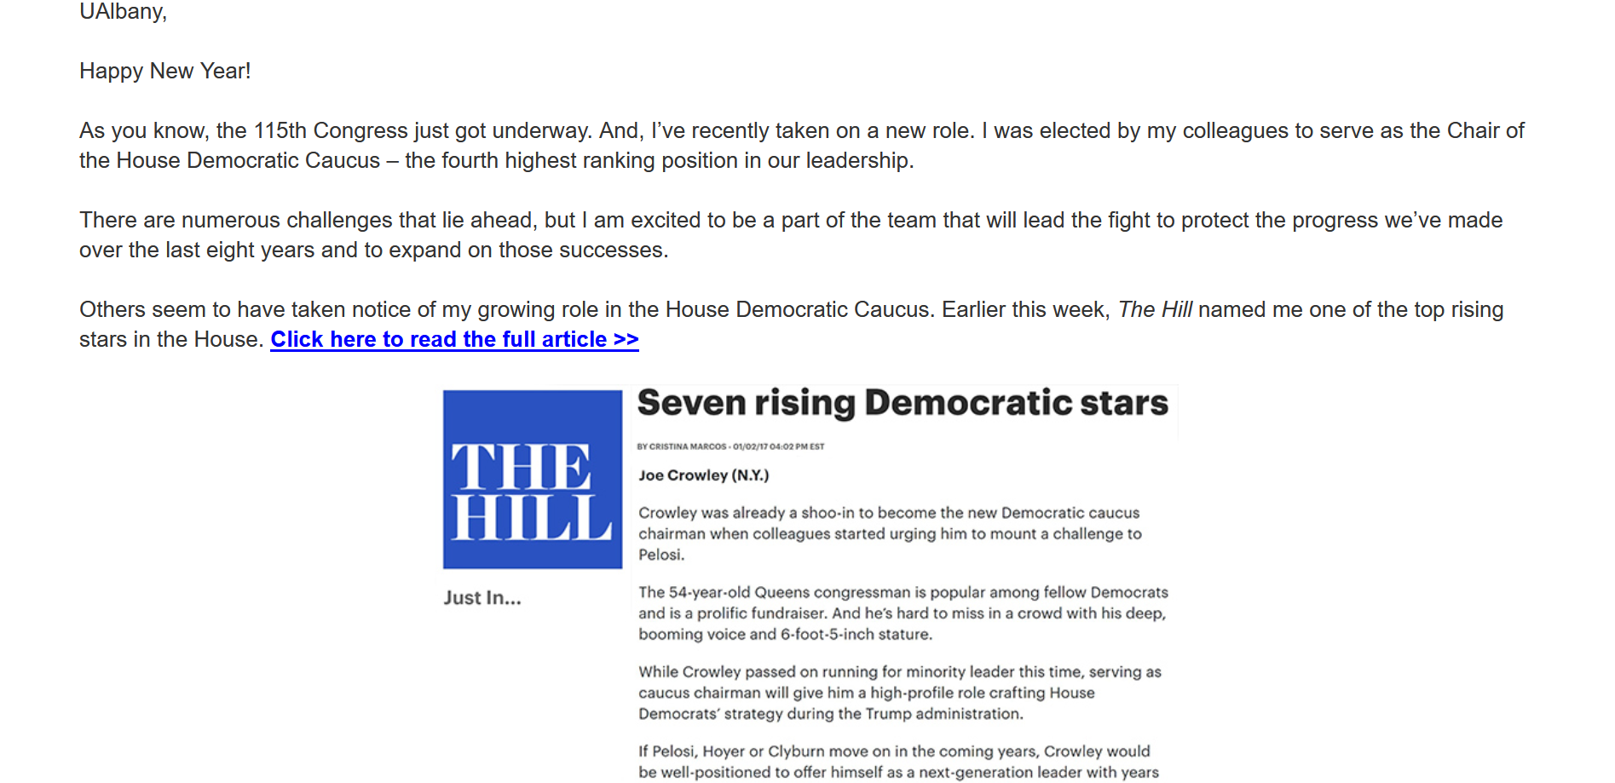
Project origin

Slide 12
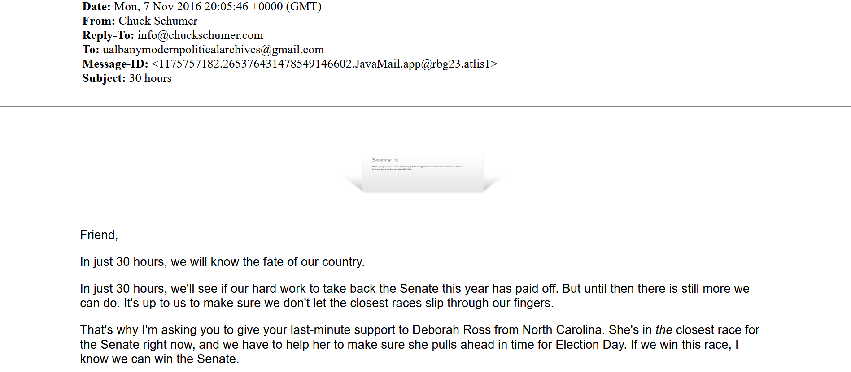
Project origin

Slide 13
Preserving Email
Email exports don’t contain all the information
Images, CSS can be hosted on external servers
Email CSS can be interactive!
Links to other web content
Email marketing software obfuscates URLs
MBOX file was rapidly degrading!

Slide 14
Preserving Email
Raw email exports
Open: MBOX, EML
Proprietary: PST, MSG
Preserve email sufficiently as structured data
Missing data/rapid decay
PDF files
Preserves email well as visual document
Does not structure data well for computational use
WARC files
Preserves visual document experience well
Maintains data structure
Hard to use/low support for email

Slide 15
Let’s use multiple formats!
Multiple preservation formats
Different options for use cases
MBOX + PDFs
MBOX + PDFs + WARCs
PST + EMLs + PDFs
PST + MBOX + PDFs + WARCs
EML + PDFs + WARCs
How do we maintain relationships?
Bagit specification is widely used
Flexible structure
Provides fixity
Bagit-python

Slide 16
Mailbag Niche
Common specification to provide structure for preserving email using multiple preservation formats
Basic open source utility to create and manage mailbags

Slide 17
Mailbag Niche
Aims to solve technical challenges
Preserves email so it won’t degrade if actively managed
Makes acquisition, processing, access easier
Does not solve human challenges
Records management
Personally identifiable information (PII)
Legal risk aversion
These are much harder, require humans
Hopefully make email archives more visible

Slide 18
Mailbag Niche
Feasible project, existing proof of concept
Easy to use
“Separation of concerns” principle
Inclusive, allow the most possible archivists to use
Mailbag will not solve all your email archives problems, but it will do a very good job at solving some email archives problems

Slide 19
Grant Design
Email Archives: Building Capacity and Community program
University of Illinois Mellon Foundation re-grant program
Up to $100,000, no indirect costs/time buyouts
How do we build this?
Paying for stuff is easy, paying for people is hard
Awesome professional community
Great students at UAlbany!
Build sustainably
Constantly keep maintenance in mind
No great vendor for this
Students have diverse experiences

Slide 20
Grant Design
Advisory board of community experts
Hands-on experience
“Bake-in” learning to the work
Experienced developer as consultant
Worked on similar projects with sustainable focus
Two graduate students
Collaborative code review process
Support remote conference attendance
Honorariums to support community project work
Specification development
Code reviews
Documentation writing
Build-in outreach

Slide 21
Grant Design
Graduate Student Developers $47,132
Doubled library GA program rate
Consultant Developer, 100 hours $7,000
Community honorariums $6,400
Conferences $1,350
Cloud servers $1,262
Marketing $700
Total: $63,890
I would have added more consultant/honorarium time
Lots time to administer

Slide 22
Specification Development
Open specification, independent from Mailbag tool
Allow for additional implementations
Support broader use cases than we can resource
Promote interoperability
Honoraria to support, altered original plan
Project team wrote first draft
Initial feedback from advisory board
2 hour specification working meeting
Open call for participants
Collaborative exercises to gather community input
Great feedback, exercises needed more time

Slide 23
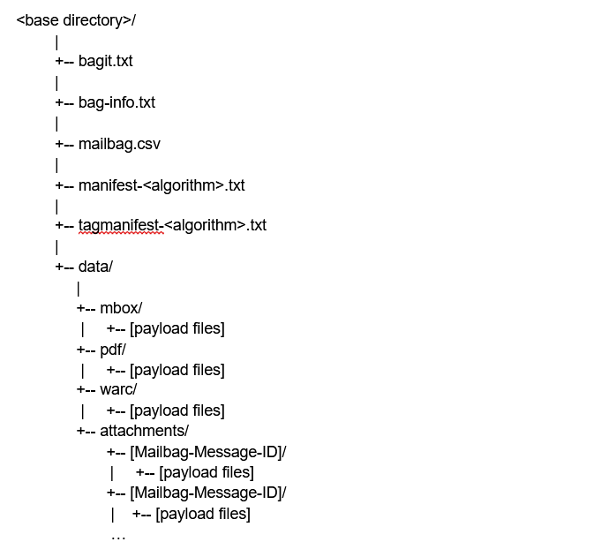
Mailbag Specification

Slide 24
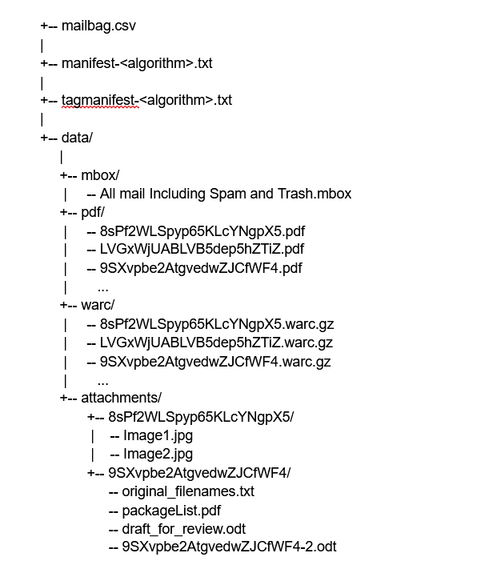
Mailbag payload

Slide 25
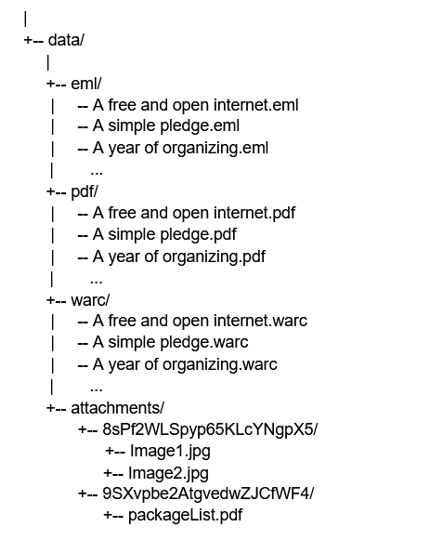
Mailbag file naming

Slide 26
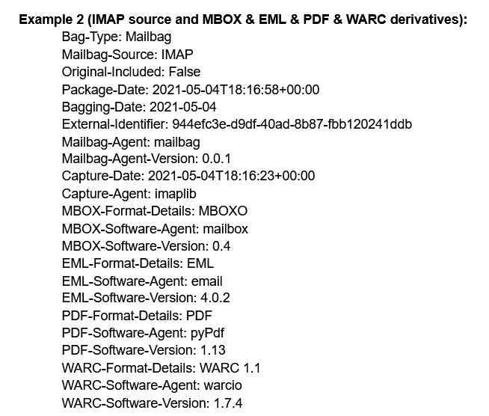
Bag-info.txt

Slide 27
Mailbag.csv
Mailbag-Message-ID (required)
Message-ID (required)
Message-Path (required)
Original-Filename (required)
Attachments (required)
Date
From
To
Cc
Bcc
Subject
Content-Type

Slide 28
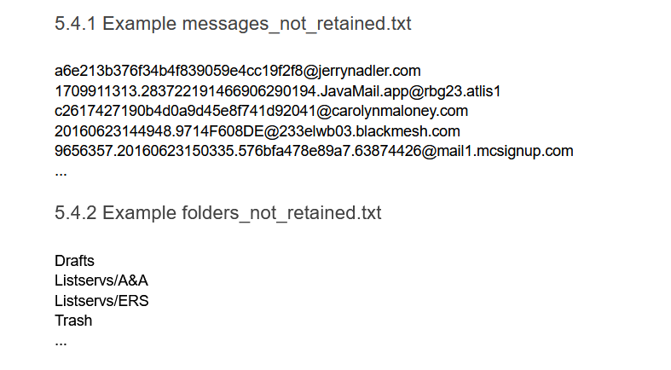
Not retained

Slide 29
Identifier challenges
Message-ID
5aa1201370ea4e8580ca983e77197396@carolynmaloney.com
730de3b1cdef0ab5393a63ed11d02514@bounce.bluestatedigital.com
2751071166.-308783722@democracy.dsccdb.www.democratsenators.org
Mailbag-Message-ID
1, 2, 3
8sPf2WLSpyp65KLcYNgpX5
Original filenames for EML, MSG, etc.
“A year of organizing.eml”

Slide 30
Community Feedback
Open call for feedback on design documents
Personas
Use cases
Requirements
Open call for feedback on specification
Google doc
Github issues
Highlighted major feedback from working meeting

Slide 31
Community Feedback
Multiple export files
Multiple versions
Redactions
Weeding
Descriptive metadata
A Mailbag is not designed to be a Submission Information Package (SIP)
Will support any custom bag-info.txt fields and additional tag files as bagit does
A very different challenge

Slide 32
Multiple email versions
Redaction and weeding are common if not ubiquitous for email archives
There are a wide variety of workflows
We would only be able to support a few kinds of workflows
By
Keeping access copies together with originals may not be great practice

Slide 33
Multiple export files
I have a group of export files from multiple email accounts
I have a group of export files from the same account, over time
I have a group of export files
Really challenging to model
Little technical costs to multiple mailbags
Can put multiple mailbags in a bag
Manage as ZIP or TAR

Slide 34
Multiple export files
Use cases:
I have a group of export files from multiple email accounts
I have a group of export files from the same account, exported over time
I have a group of export files separated for purely technical reasons, such as file size limitations
Really challenging to model
Many-to-one becomes many-to-many
Duplicate messages
Relationships between export files
Little technical costs to multiple mailbags
Limited resources to develop and maintain

Slide 35
Things I’m thinking about
Archivists don’t have good tools to manage born-digital files
Archivists may have to rely on ordinary desktop tools to manage these challenges
We need more tools that give archivists this power/control

Slide 36
Tool Development
Consultant developer outlined structure Summer 2021
GA developers started end of August 2021
Using GitHub tools
Issues
Pull requests
Project

Slide 37
Tool Development
Features described as issues using a template
Assigned to one GA developer
Code reviewed by second GA developer
Collaborative learning
Some contributions reviewed by Consultant developer or community member funded by honorarium

Slide 38
Links
Mailbag Project Website
Mailbag draft specification
Mailbag GitHub

Slide 39
Thanks!
Project Team
Gregory Wiedeman, University at Albany, SUNY
Mark Wolfe, University at Albany, SUNY
Karen Kiorpes, University at Albany, SUNY
Harit Garg, University at Albany, SUNY
Baibhav Rajbhandari, University at Albany, SUNY
Advisory Board
Rachel Appel, University of Pennsylvania
Hillel Arnold, Rockefeller Archive Center
Mat Kelly, Drexel University
Albert Rozo, Penn State University
Nathan Tallman, Penn State University
Bonnie Weddle, New York State Archives
Consultant Developer
Dave Mayo

Slide 40
[Section Title]
Subtitle if applicable

Slide 41
[Heading]

Slide 42
Stay connected & informed
CoSA Website http://www.statearchivists.org
CoSA Twitter Handle @StateArchivists
CoSA Facebook Page www.facebook.com/CouncilOfStateArchivists

Slide 43
Webinar evaluation
We appreciate your feedback!
After you exit the webinar, you will automatically be taken to an online webinar evaluation.
Please take a couple of minutes to complete the survey and help us plan future webinars.

