Slide 1
Archive/IT Coordination and Communication
June 22, 2022

Slide 2
Welcome!
Upcoming SERI webinar lineup
Summer break – see you in the fall!
CoSA’s Online Resources
Resource Center
SERI Webinar Recordings on YouTube

Slide 3
SERI 2022 sponsor

Slide 4
Presenters
Cathy popovitch
Alex dixon
Supervisor, Operations Section, Illinois State Archives
Senior Archival Conservator, Illinois State Archives

Slide 5
Presenters
Suzanne stasiulatis
Bill ward
Digital Outreach Section Head, Pennsylvania State Archives
Business Relationship Manager, Pennsylvania State Archives

Slide 6
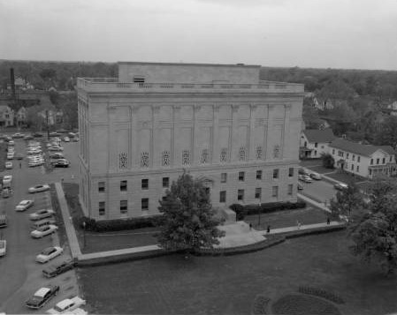
It coordination at the Illinois State Archives
Cathy Popovitch & Alex Dixon

Slide 7
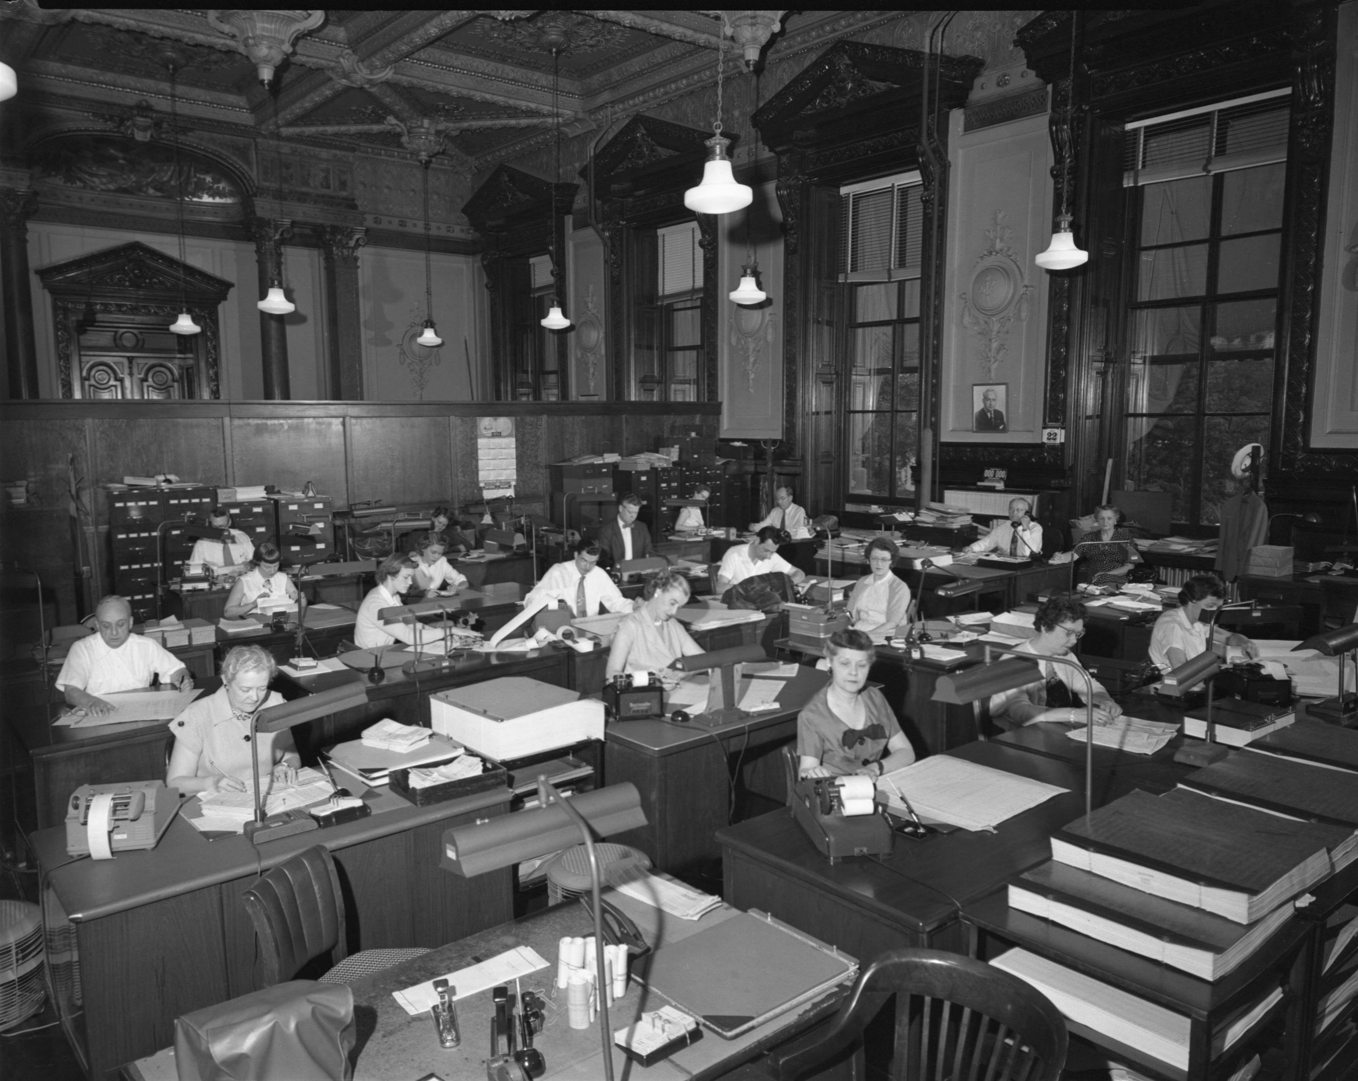
IT Coordination
Secretary of State’s Department of Information Technology (DoIT)
Departmental Liaisons
Created to streamline IT support

Slide 8
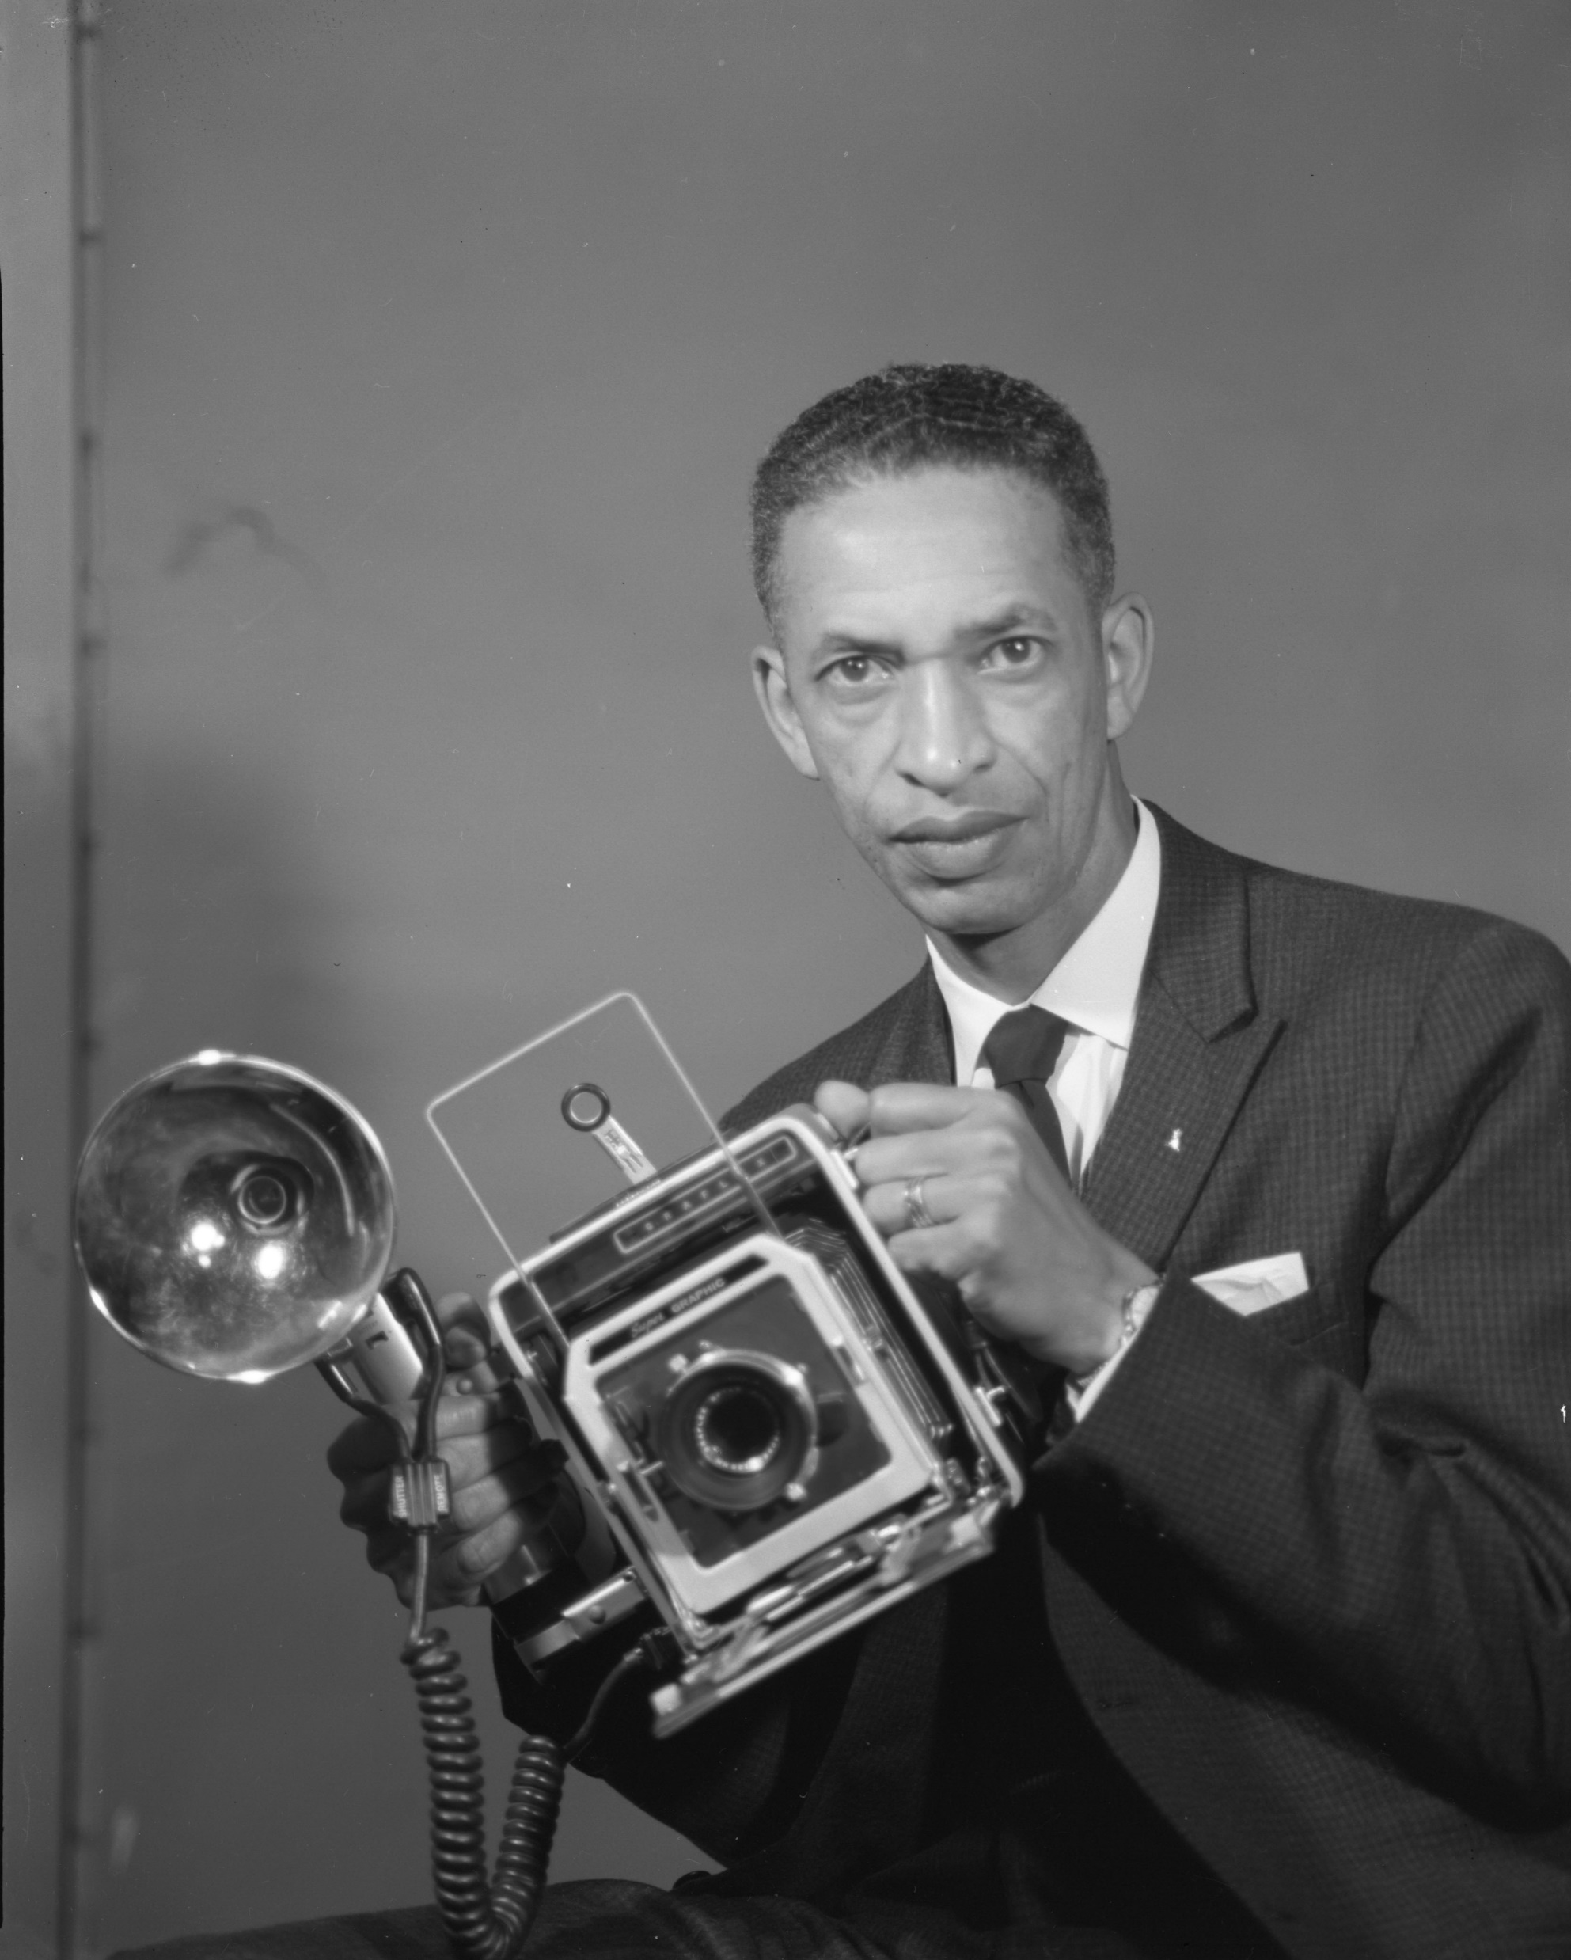
Doc helm Project
State Photographer Eddie Winfred “Doc” Helm (1941-1992)
Estimated 21,000 4x5mm photo negatives
$60,178 NHPRC Grant
Final numbers:
22,042 on Illinois Digital Archives (IDA)
31,282 scanned
45,161 negatives refoldered/basic metadata
http://idaillinois.org/digital/collection/DocHelm/search

Slide 9
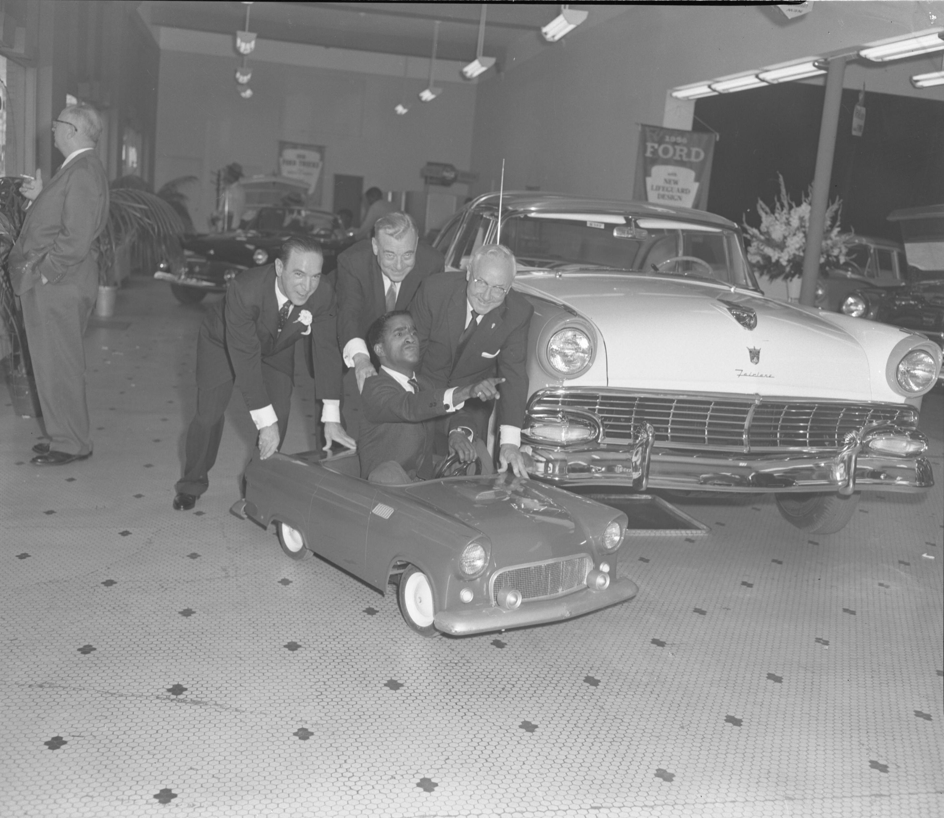
Pre-Grant activities
Discussions with Illinois State Library
Meeting with DoIT Director to discuss needs including:
Equipment
Computer/Monitors
Scanner
Backup hard drives
Server Space

Slide 10
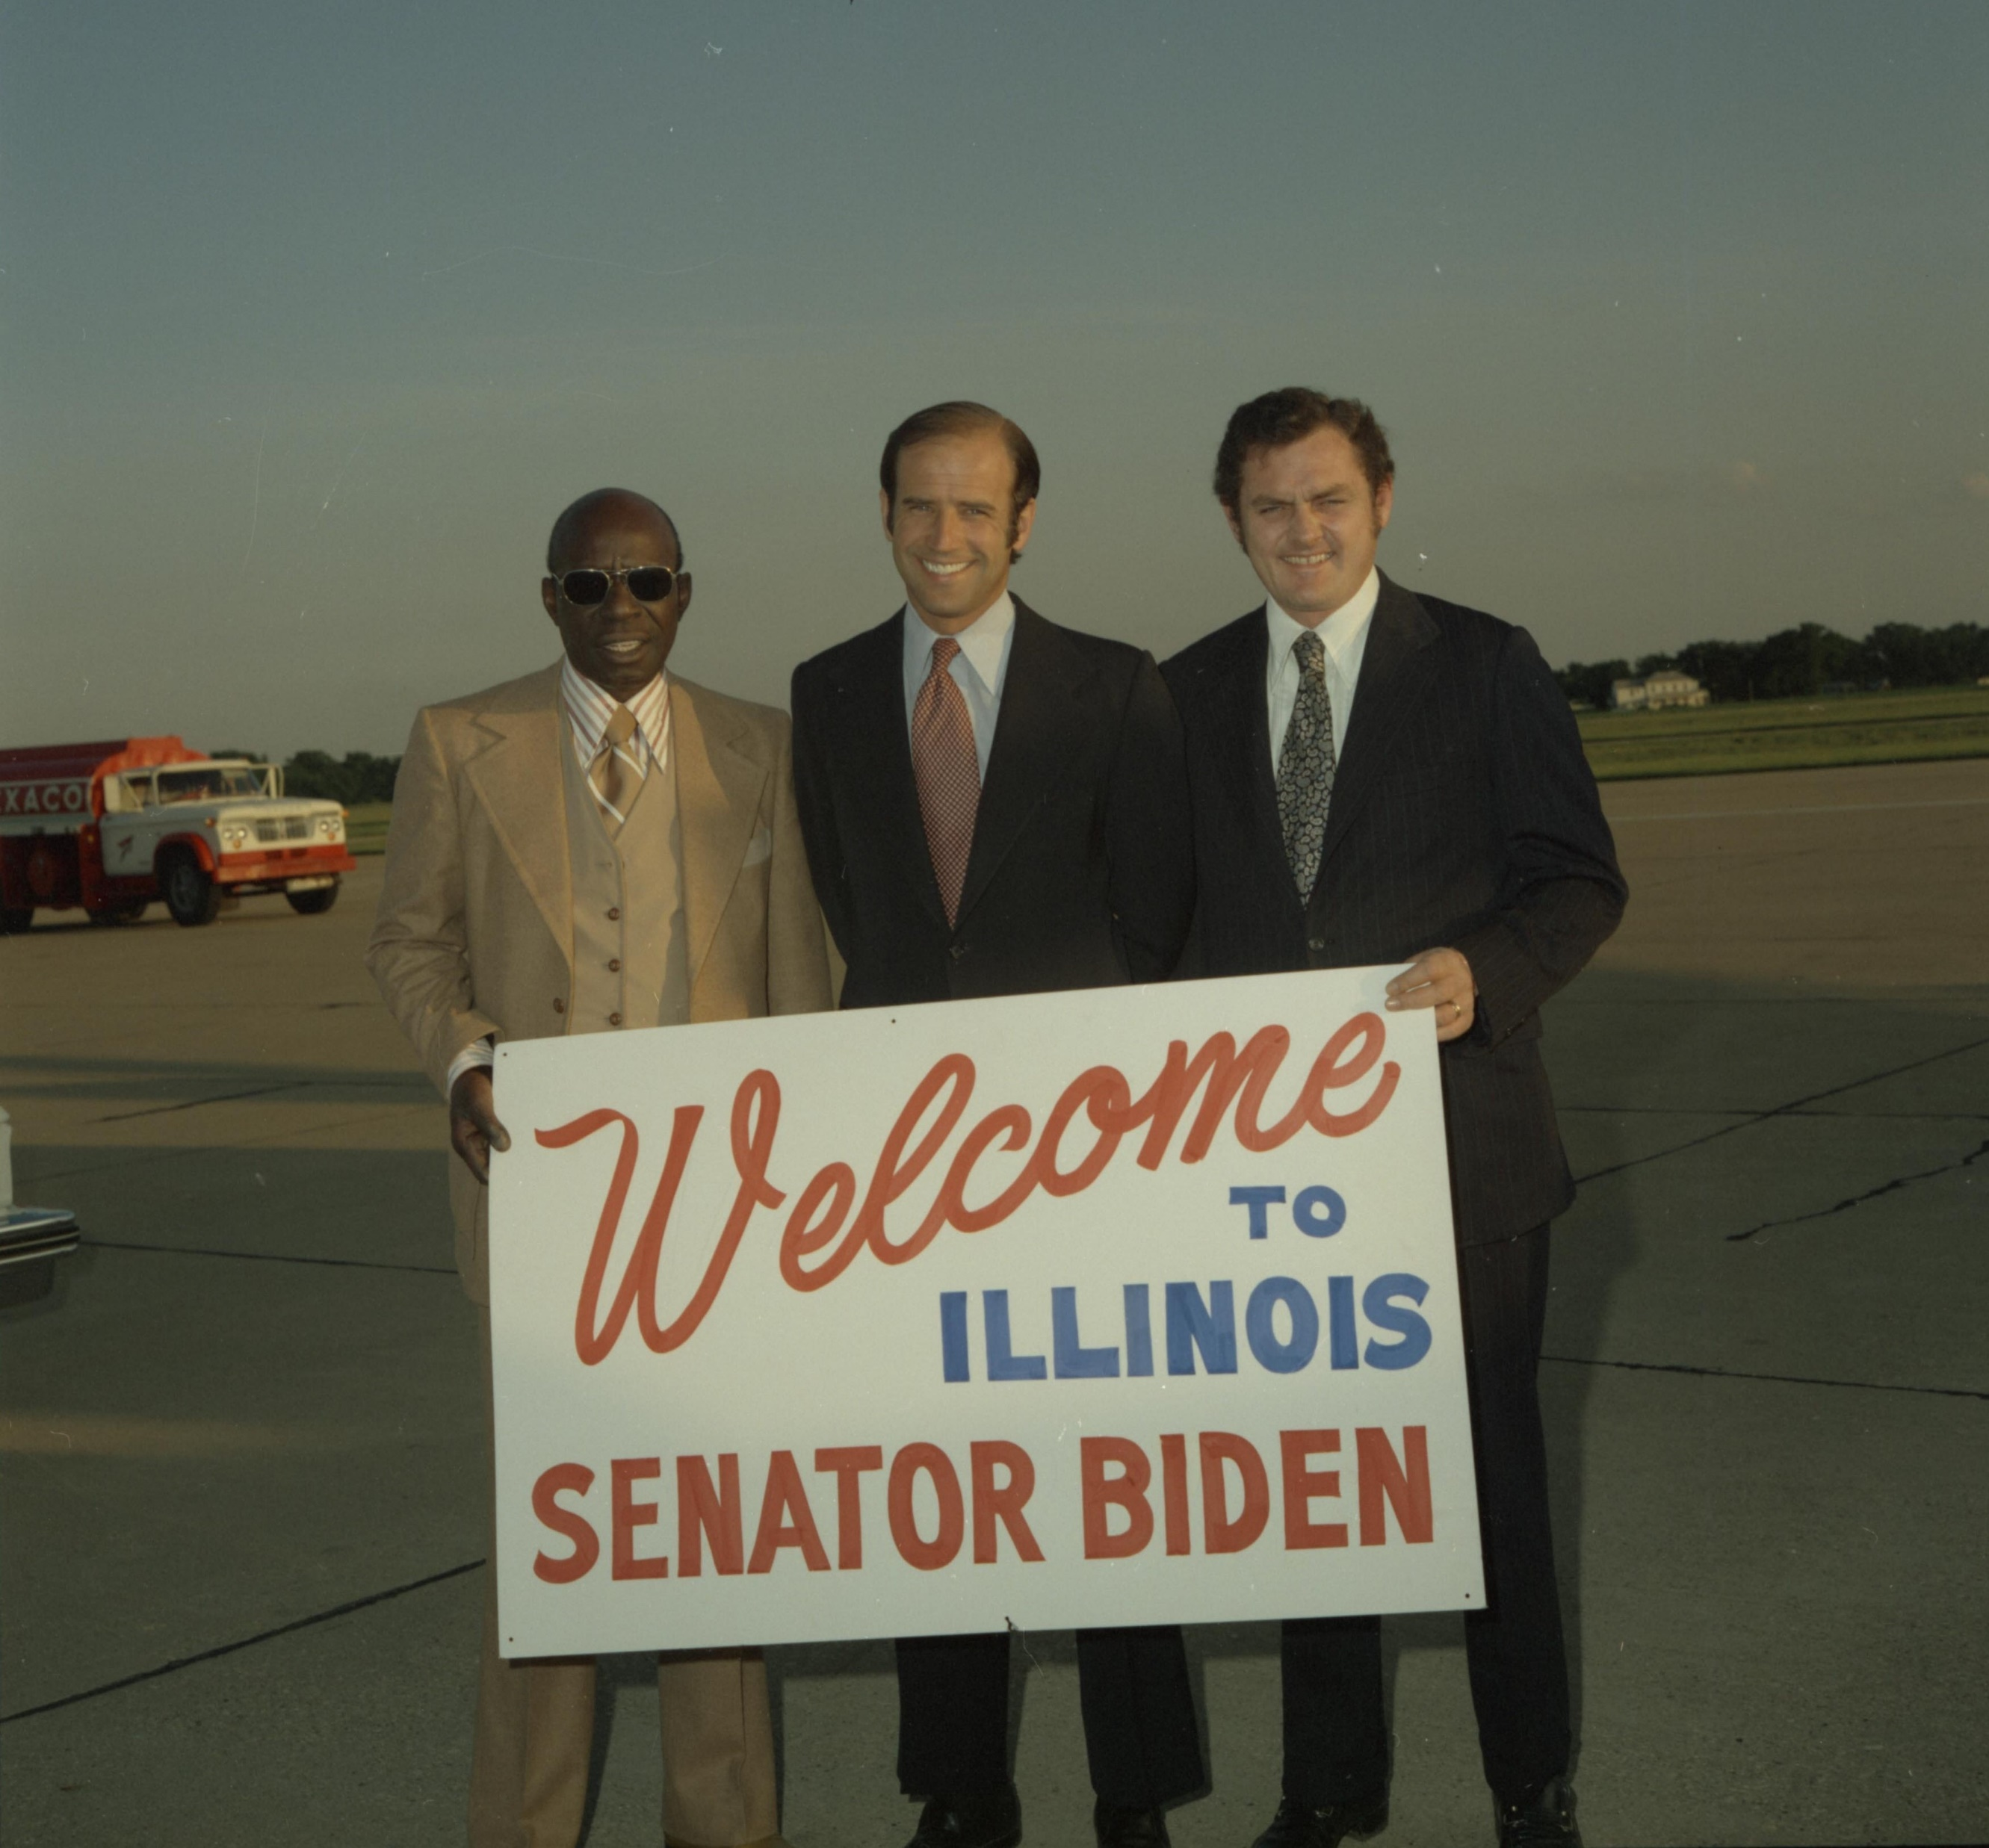
During the grant
New DoIT Director
Issues with server space
Permissions for contractual employees
Security changes
Transfer of photos to IDA

Slide 11
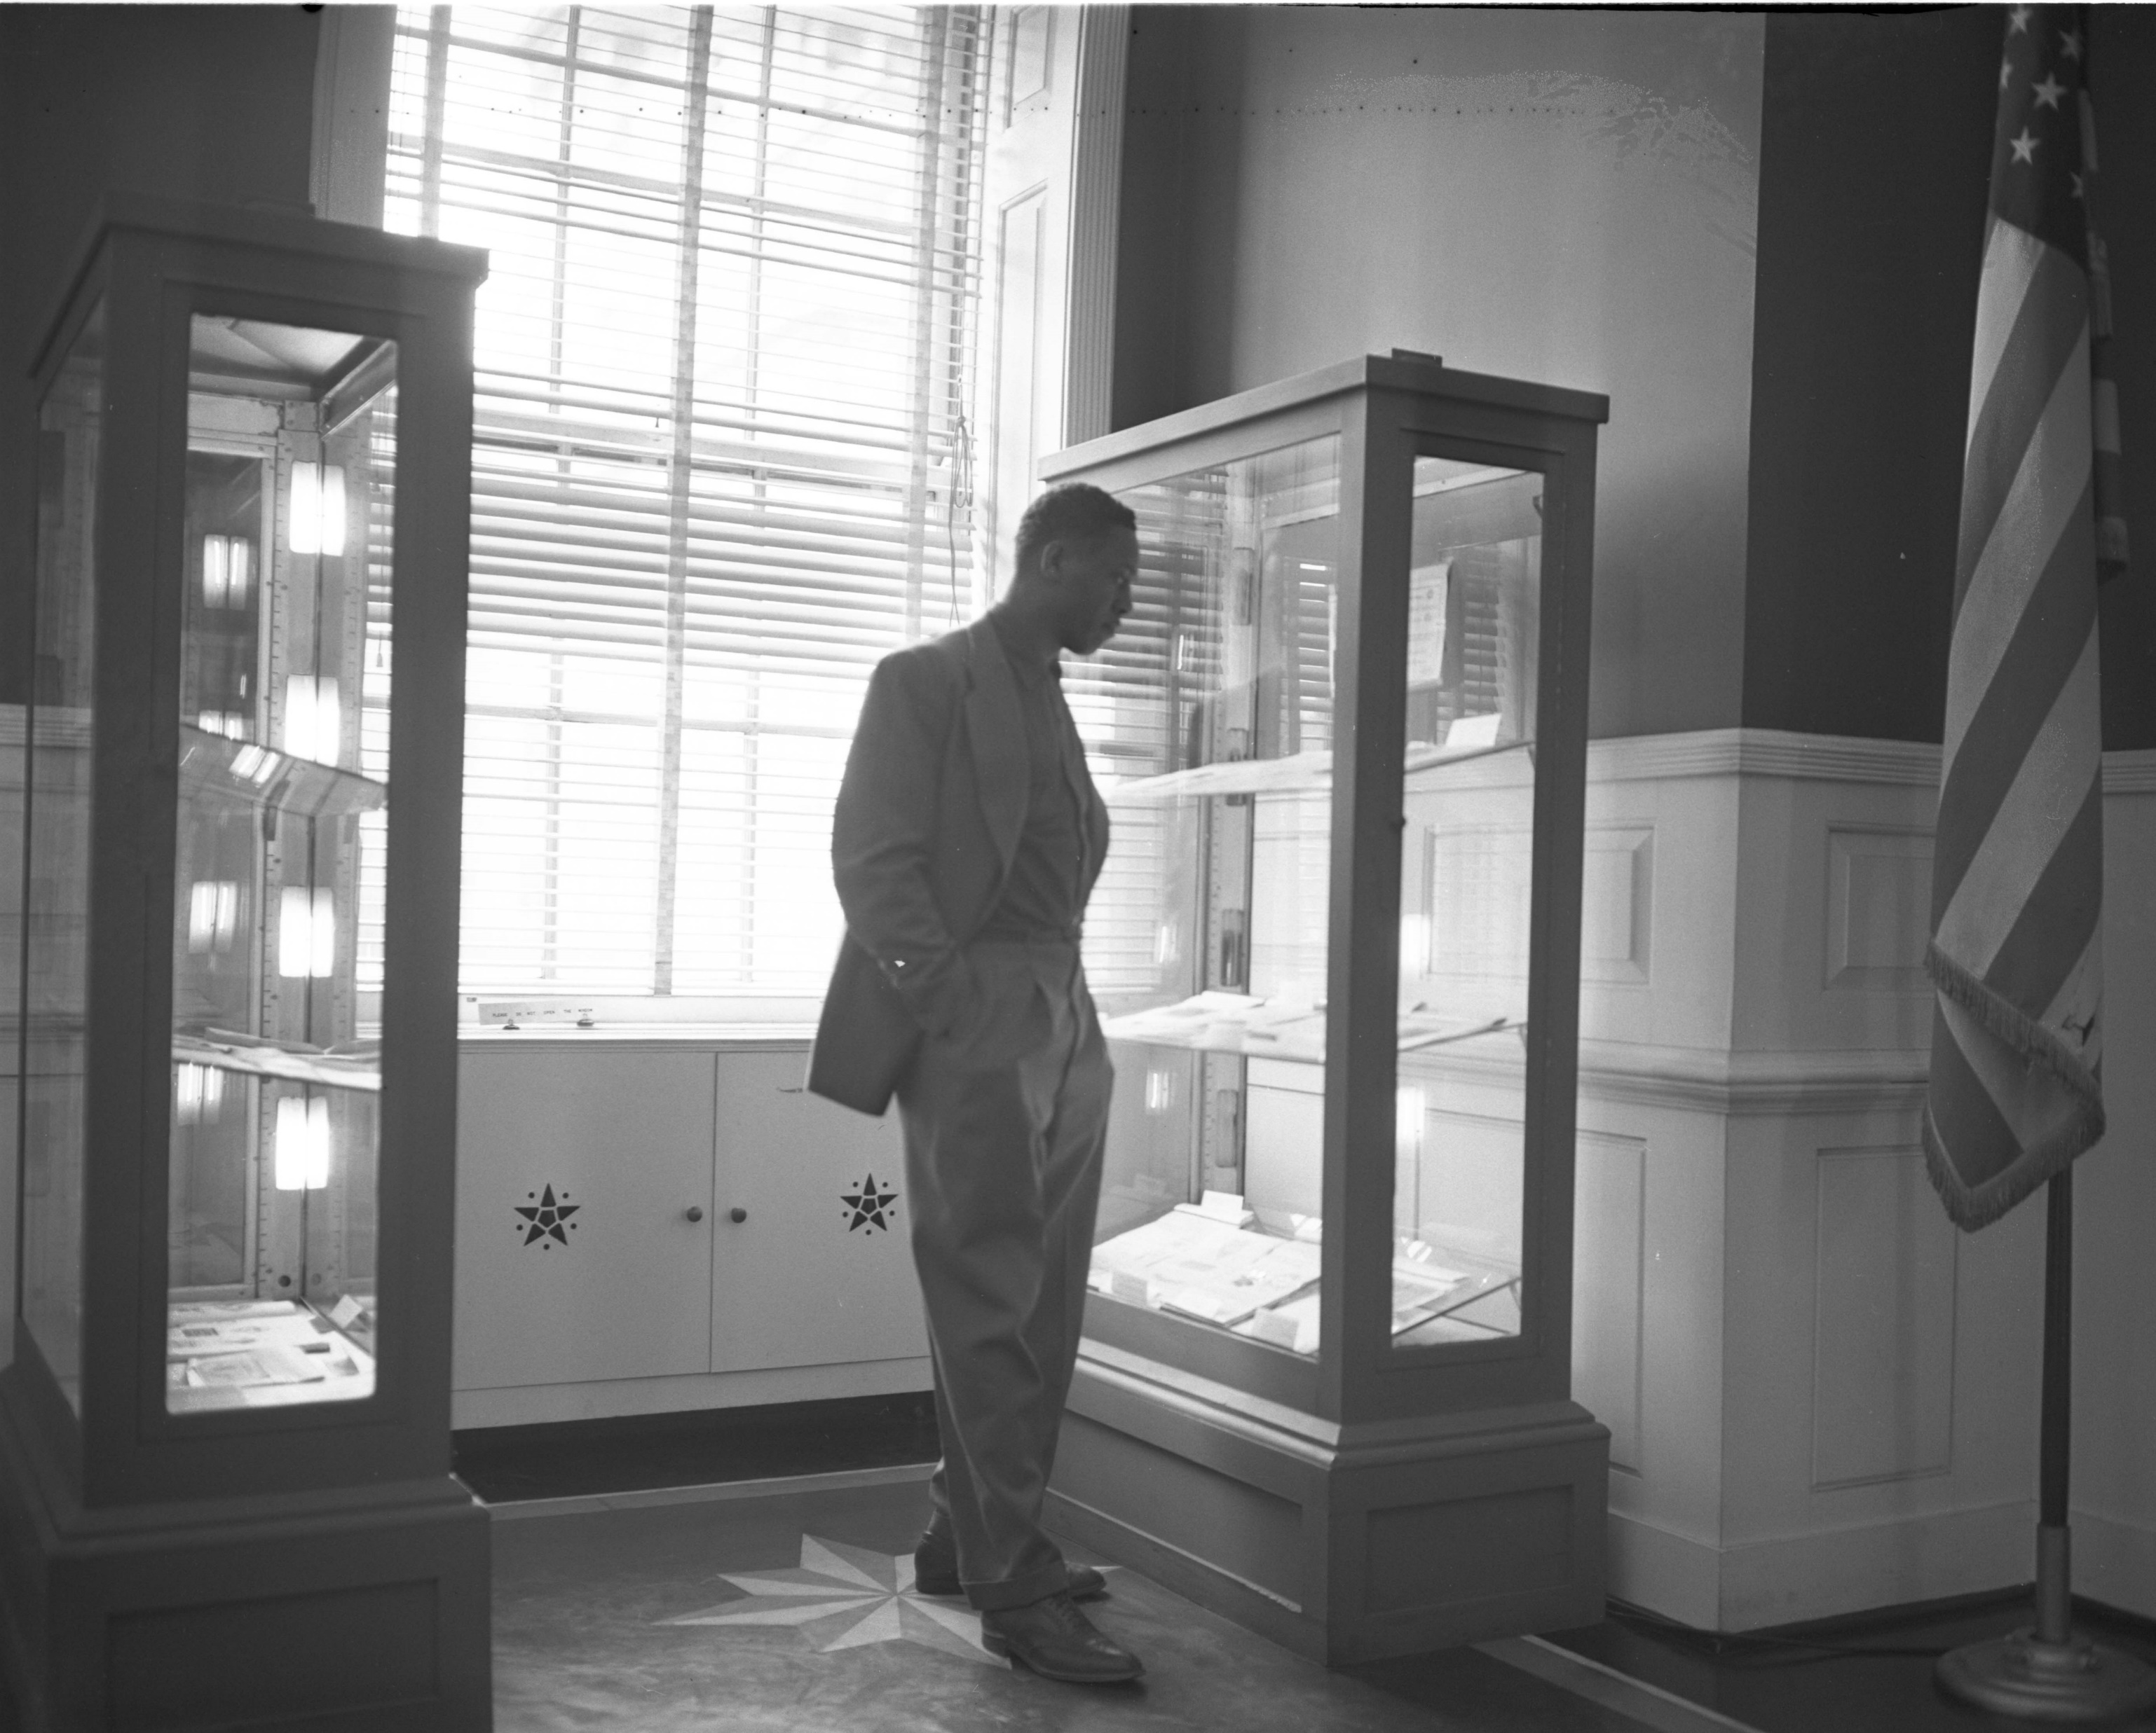
Lessons learned/wish list
Communication is essential
Get things in writing and keep checking in
Sit down meeting before all grants
Better idea of what’s coming
One point of contact with DoIT

Slide 12
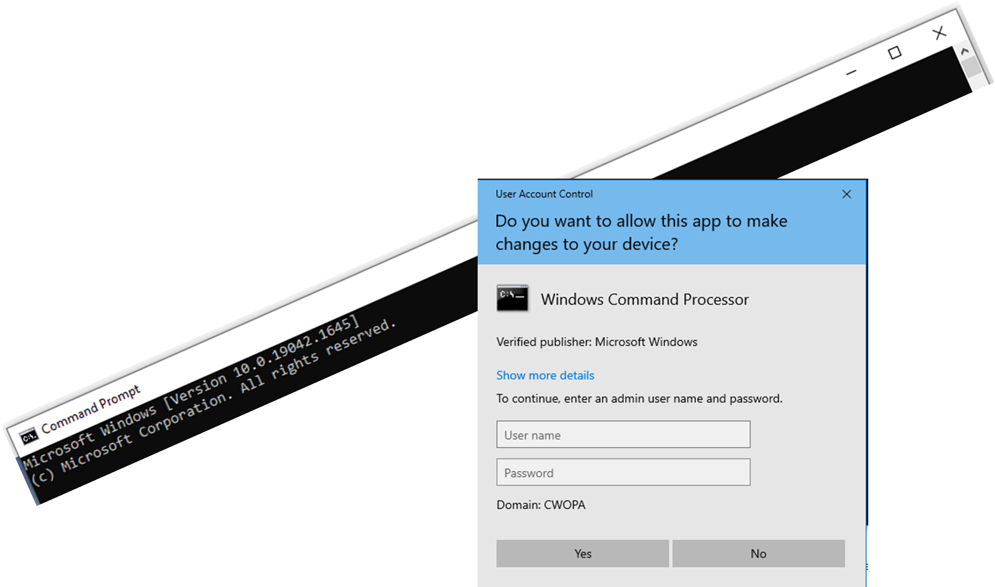
Virtual Machine
Admin access for testing
Ensure product suits needs
Efficiency of evaluation

Slide 13
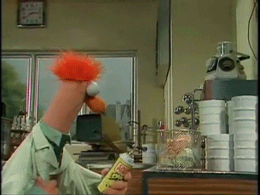
Why is admin access such a hurdle? Why are firewalls so strict?

Slide 14
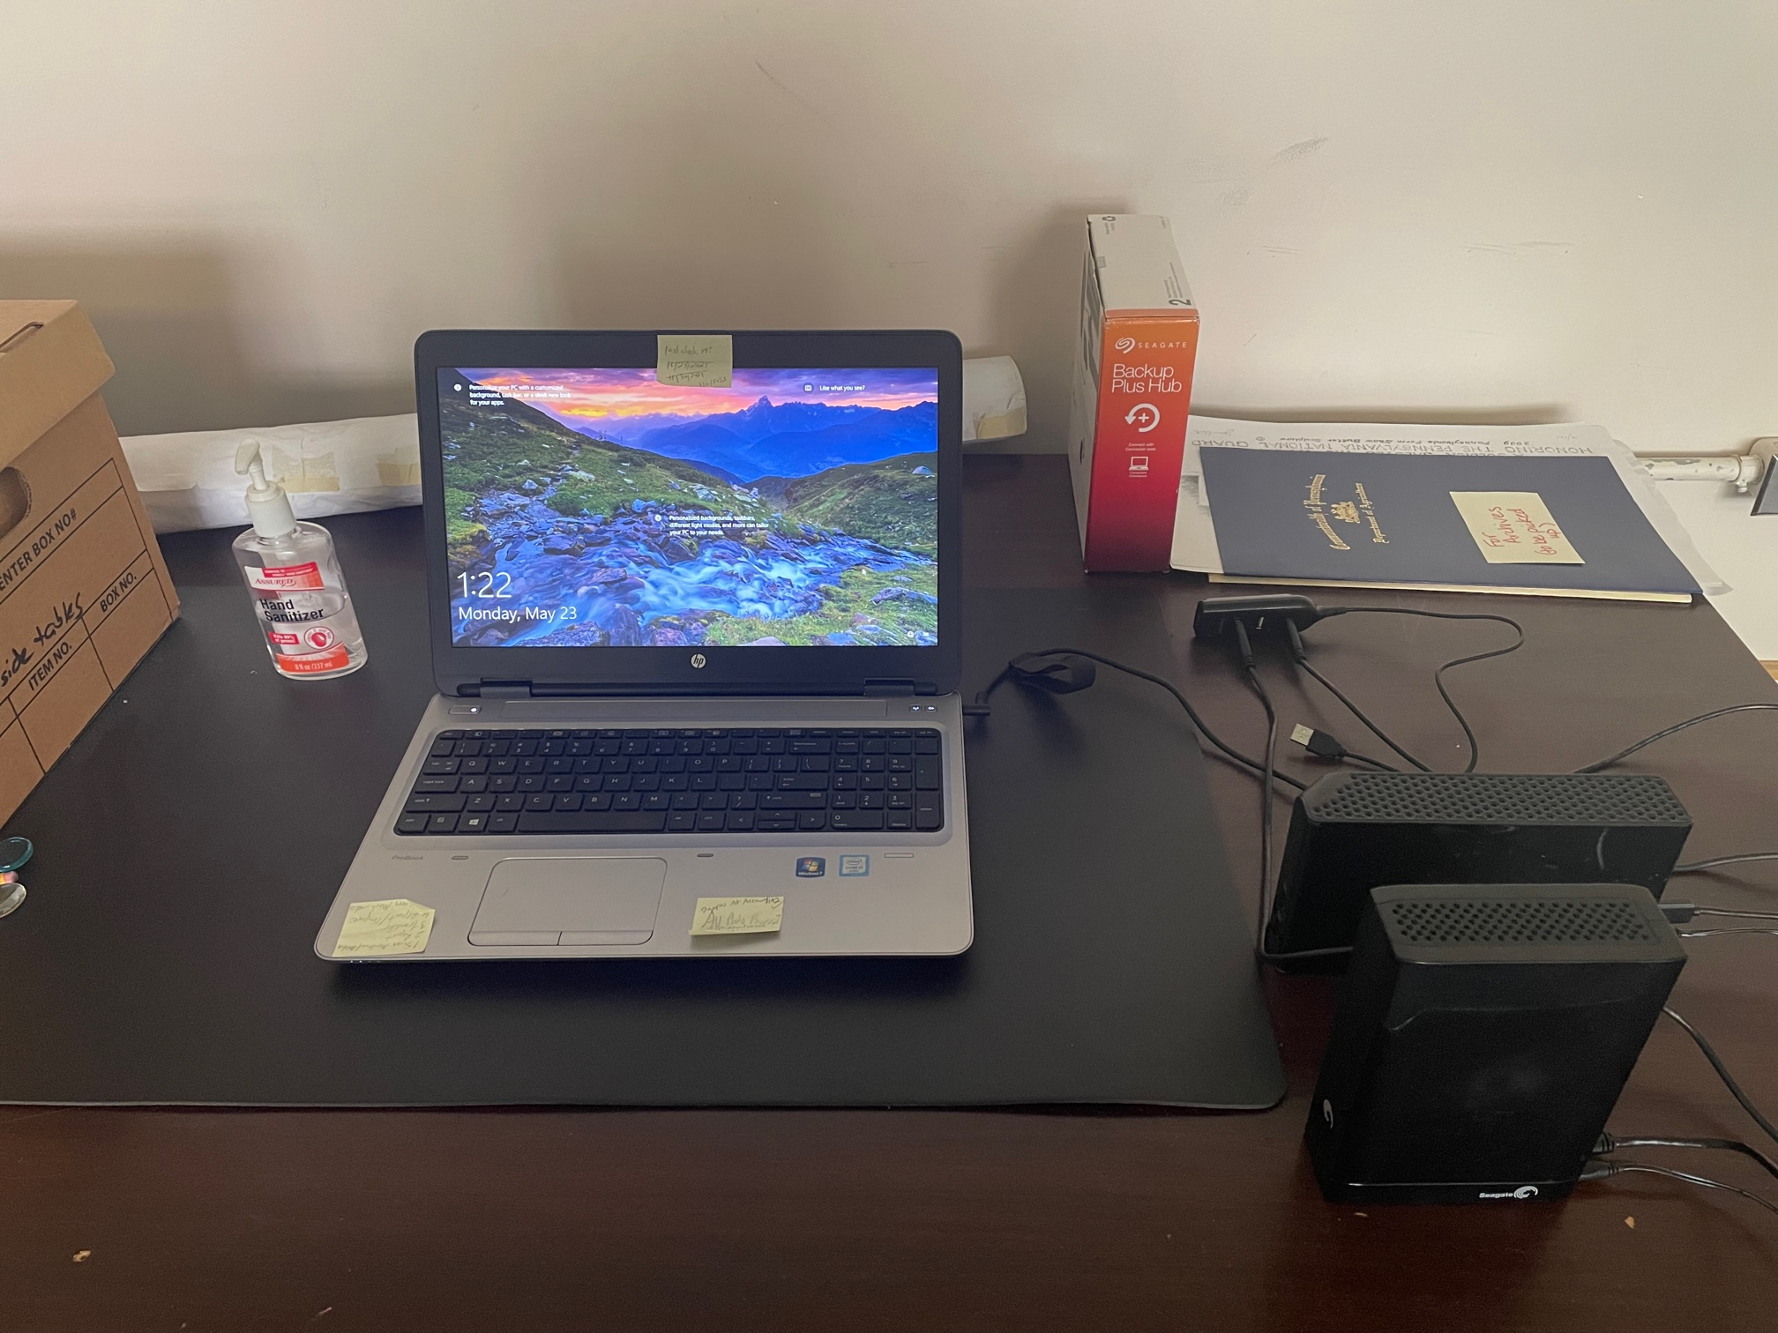
Intake Machine
Security is everyone’s priority
Agreements
Justification and use case
Consensus through discussion
Review and evaluate periodically

Slide 15
What are ITs priority regulations or rules for agency personnel? What is the reasoning behind those regulations?

Slide 16
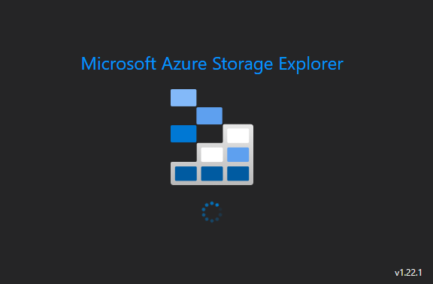
Azure Migration
Collaboration
Peer to Peer Coordination
Language and Communication

Slide 17
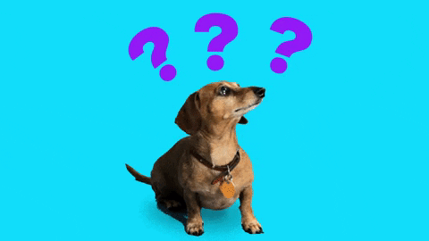
What things have you learned about the IT/Archives language barrier? What makes Archivists unique?

Slide 18
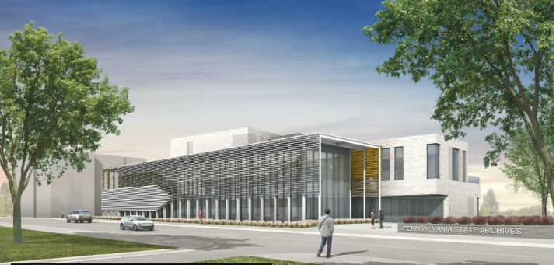
New Building
Everyone’s favorite project
Priority balancing
RG013, PA State Archives

Slide 19
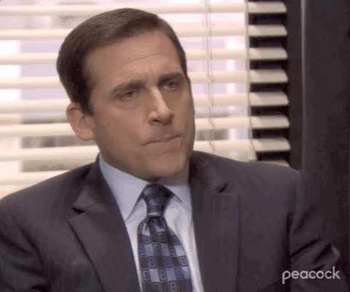
What is the most important priority for the New Building Project in the eyes of IT?

Slide 20
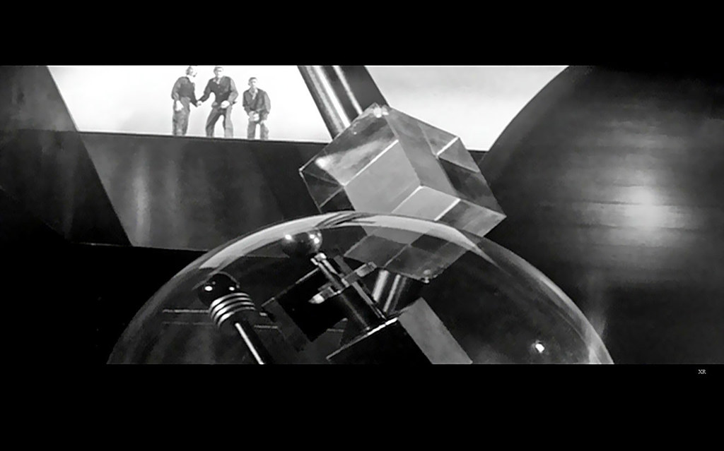
Digital Preservation System
Requirements/Request For Proposal (RFP)
Defined requirements gathering
Systematic Scoring
"1957 ... KRONOS!" by x-ray delta one is licensed under CC BY-NC-SA 2.0.

Slide 21
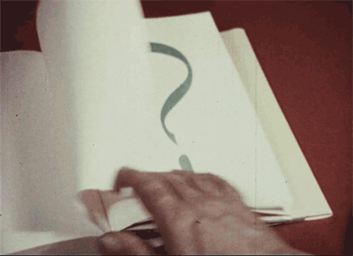
What is the single most thing that Archives wants that IT won’t budge on?

Slide 22
ERMS
Enterprise-Wide Solutions
Stakeholders
SSO
"Files (85)" by Doug Waldron is licensed under CC BY-SA 2.0.

Slide 23
What goes into planning an enterprise solution in IT’s mind?

Slide 24
IT / Archives Collaboration Wisdom Bill Ward
Don’t ask “We need to …”, instead ask “We would like to …” or “How do we …”
Involve IT early in the process, even if you don’t think you need them
Have Patience

Slide 25
Additional Questions??
Suzanne Stasiulatis, Archivist, PA State Archives sustasiula@pa.gov
Bill Ward, Business Relationship Manager, PA Office of Administration wilward@pa.gov

Slide 26
Tips for Working with IT…
Don’t ask “We need to …”, instead ask “We would like to …” or “How do we …”
Involve early in the process
Know your agencies policies … and your higher's policies
Have Patience

Slide 27
Questions & Comments

Slide 28
Stay connected & informed
CoSA Website
CoSA Resource Center
CoSA Twitter Handle: @StateArchivists
CoSA Facebook Page
CoSA YouTube Channel

