Slide 1
CoSA Member Webinar Getting to know Enslaved.org
September 22, 2022
3 pm Eastern
Disclaimer: This webinar is being recorded and will be available for viewing on the CoSA website.

Slide 2
Webinar Agenda
Welcome and Overview
Presentation:
Enslaved.org
Q and A
Upcoming Programs and Webinars

Slide 3
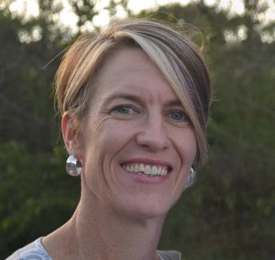
Speakers
Director of Digital Library and Archive Projects at Matrix: Center for Digital Humanities and Social Sciences at Michigan State University
Catherine Foley, Director
Digital Library and Archive Projects at Matrix: Center for Digital Humanities and Social Sciences
Michigan State University
Dr. Daryle Williams, Dean
College of Humanities, Arts, and Social Sciences
University of California - Riverside

Slide 4
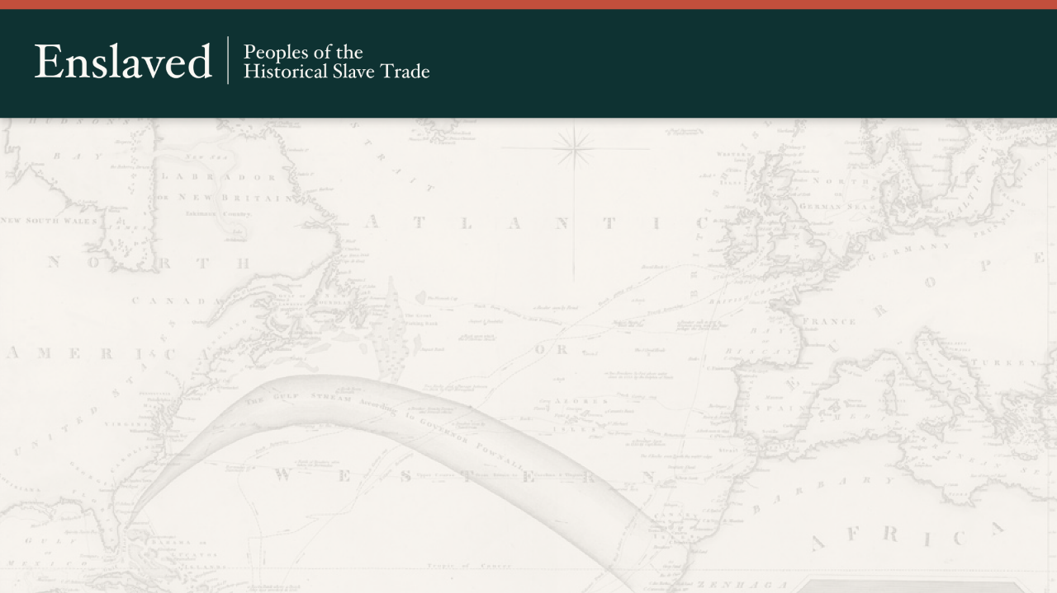
Getting to Know Enslaved.org
Catherine Foley, Director of Digital Library and Archive Projects
Matrix at Michigan State University
Daryle Williams, Dean College of Humanities, Arts, and Social Sciences
University of California, Riverside
Council of State Archivists Webinar
Thursday, September 22, 2022

Slide 5
Presentation Topics
Overview of Enslaved.org: Peoples of the Historical Slave Trade;
Describe the data model that drives the Enslaved.org discovery hub;
Identify resources that can guide the development of historical slavery datasets;
Explain how contributors submit new datasets to Enslaved.org through the Journal of Slavery and Data Preservation.

Slide 6
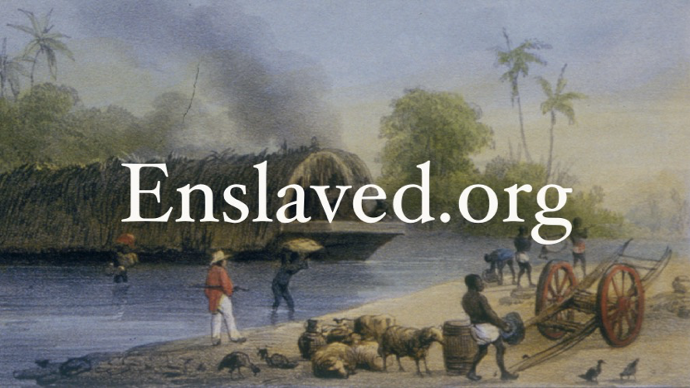
Notes:
Daryle (through slide 10 and any other ones you want to add)
Enslaved.org is a massive online and open-source database that allows users to explore and reconstruct the lives of individuals who were enslaved, owned slaves, or participated in the historical slave trade

Slide 7
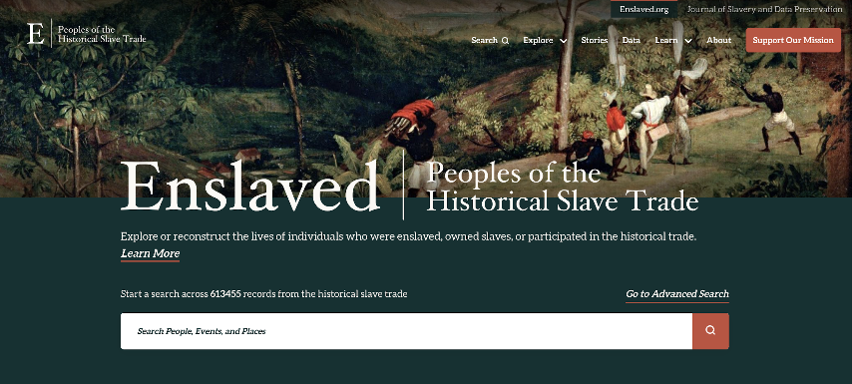
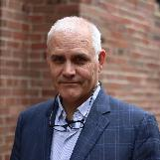
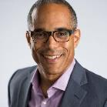
Notes:
Daryle
Funders and team

Slide 8
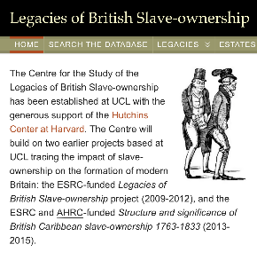
Founding Partners
Notes:
Daryle
Origins of the project

Slide 9
New Partners
Notes:
Daryle
Where the project has gone and continues to go

Slide 10
Importance of Enslaved.org
Humanizes the study of the slave trade by centering it on individuals who were enslaved.
Reveals much about people who have too often been written out of history and gives all of us a new understanding of our shared past.
Preserves for future generations important historical material that is in danger of being lost.
Offers a new approach to publication in the humanities: peer review of datasets and making these materials available free on the internet.
Notes:
Daryle
Importance of the project

Slide 11
What do we do?
Enslaved.org works with contributors who
Extract data from primary source material about individuals who were enslaved, owned slaves, or participated in the historical slave trade.
Enter that data into spreadsheets
Enslaved.org publishes these datasets in its discovery platform, which has tools for searching and analyzing data.
Notes:
Daryle
Importance of the project

Slide 12
How to we do it?
Provide guidance about how to extract data from archival primary source documents
Work with contributors to describe and contextualize the data and the extraction process
Archive datasets and data dictionaries ensuring long-term access
Align the data to the Enslaved.org data model
Integrate datasets into the Enslaved.org discovery hub
Notes:
Daryle
Importance of the project

Slide 13
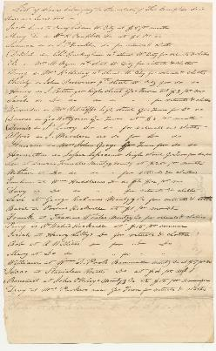
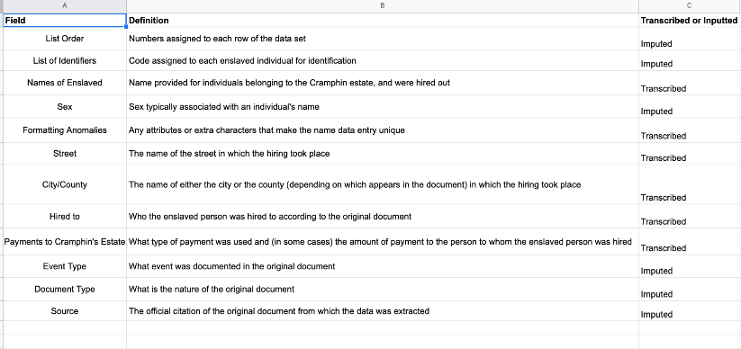
2022 SROP “List of Slaves Belonging to Estate of Thomas Cramphin Deceased that are Hired Out," undated, Riversdale House Museum

Slide 14
Enslaved.org Data Model
People
Events
Places
Sources
Notes:
Catherine - the rest of the slides (11-28)
Enslaved.org project and data model captures data on:
People - who participate in the historical slave trade
Events - things that happened and were recorded about the slave trade
Places - locations where these events took place
Sources - the original documnets from which the other data components were dervived

Slide 15
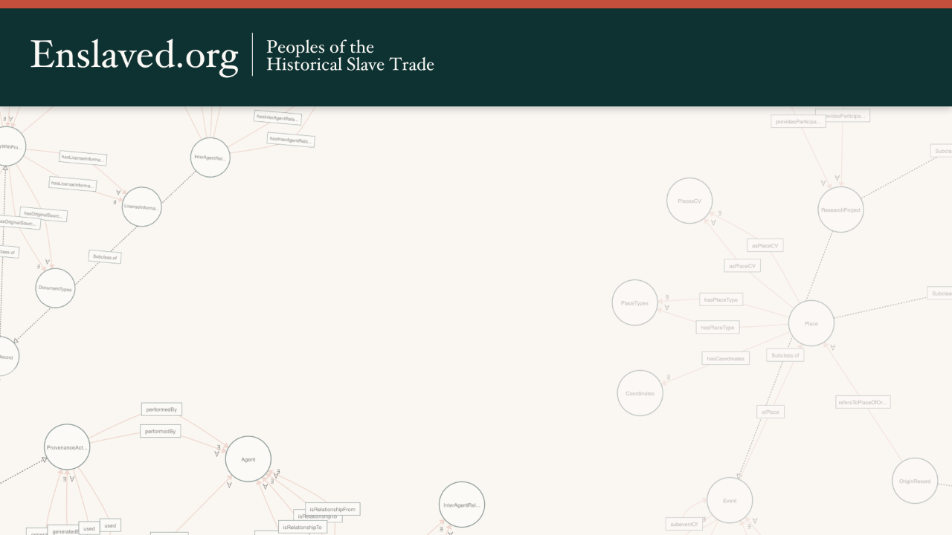
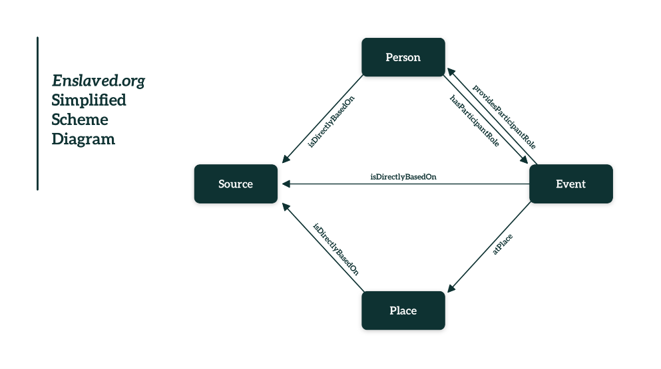
Notes:
Not only does the Enslaved.org data model capture information about these 4 elements, it also records how the elements of the data model are connected.
To unpack this a bit, let’s use this simplified version of our data model. It shows the 4 main entities and minimal/basic relationships b/w them
A Person has a Role within an Event
An Event has Participants.
So Person and Event are connected.
Events happen in Places.
And all data points connect to the Source or historical document at describes these elements.
The arrows show all of the various types of actions between the data types.
This organizational structure is the foundation of Enslaved.org.

Slide 16
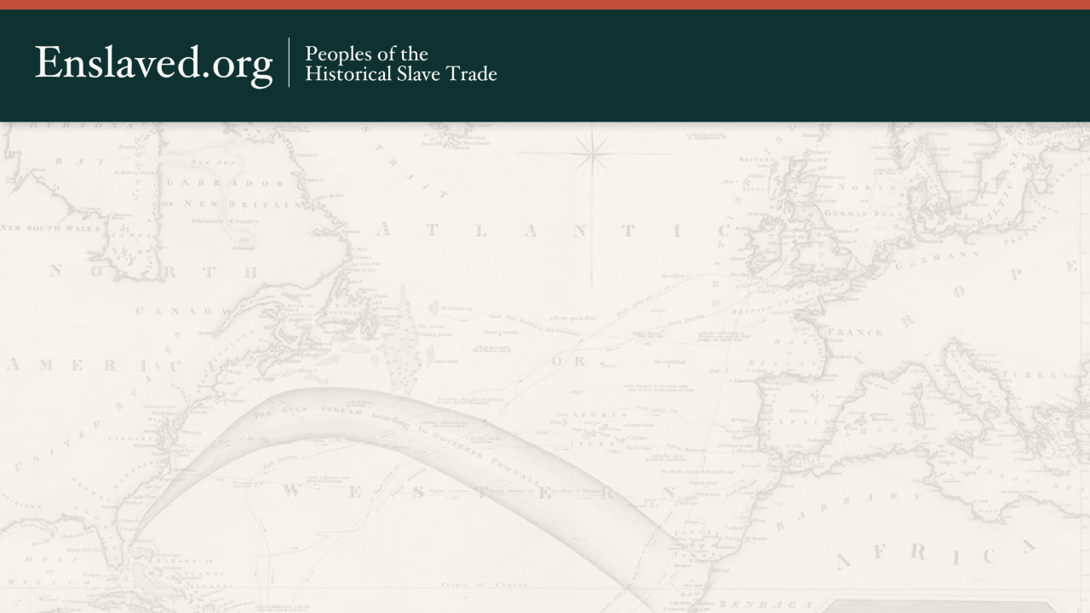
How do we do it?
Providing Guidance
Provide guidance about how to extract data from archival primary source documents
Work with contributors to described and contextualize the data and the extraction process
Align the data to the Enslaved.org data model
Integrate the datasets into the Enslaved.org discovery hub
https://docs.enslaved.org
Notes:
Enslaved.org provides guidance about how to extract data from archival primary sources by publishing important materials on our site including (1) documents that explain our data model, core metadata fields and controlled vocabularies, and (2) recommended practices documentation elaborate on how to transform a will, for example, that includes the names of enslaved women, men, children, and families, into a spreadsheet of data that can be analyzed in ways that can be challenging when working only with a scanned facsimile of a document. These resources are available at…
All of this work starting in 2010, with support from the National Endowment for the Humanities and later the Mellon Foundation. Initially we analyzed a dozen or more datasets from a variety of historians working in the domain of historical slavery studies and found a core set of field or variables that these scholars commonly extracted from documents… including names, occupations, relationships, life events, dates, places and sources. This research allowed us to specify and define the metadata fields that are at the foundation of Enslaved.org; it also helped us design the data model so that it aligned with the data that scholars were already inclined to extract from archival documents. You can learn more about this metadata -- in documentation for People, Events, Places, and Sources on docs.enslaved.org along with other materials that we’ve developed throughout the course of this project including the project’s ontology and our recommended practices.

Slide 17
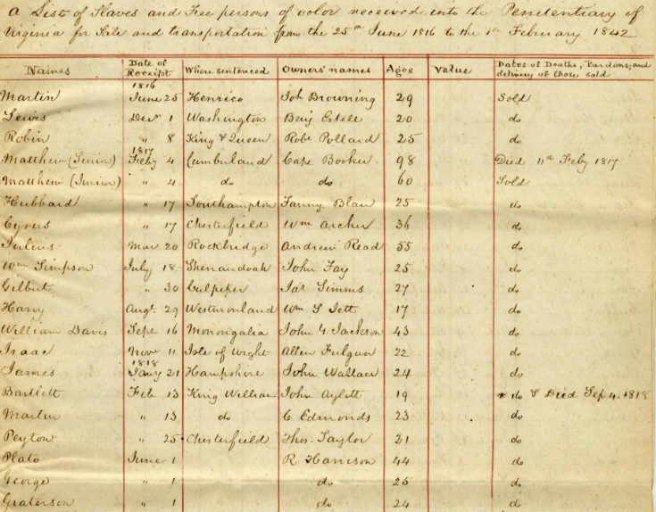
A List of Slaves and Free persons of color received in the Penitentiary of Virginia for Sale and transportation from the 25th June 1816 to the 4th February 1842
Notes:
The Enslaved.org Recommended Practices document includes guidelines and suggestions for extracting data from historical documents such as this one from the Library of Virginia. The title is drawn directly from the original document:
I’m using this to draw attention to some of the guidelines or guidance included in the Enslaved.org recommended practices document.

Slide 18
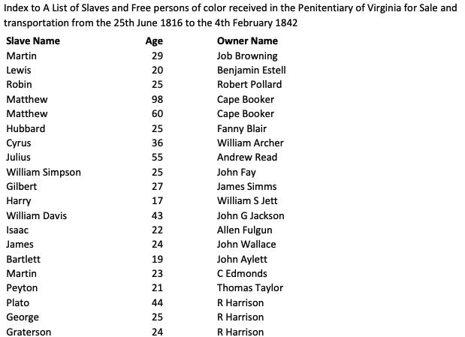
A List of Slaves and Free persons of color received in the Penitentiary of Virginia for Sale and transportation from the 25th June 1816 to the 4th February 1842
Notes:
The Library of Virginia partially transcribed the document and created a dataset that include the names and ages of enslaved people identified in the document and names of those people who asserted ownership over these men, women, and children. The Library of Virginia made a conscious decision to focus on these 3 or 4 pieces specific pieces information (1. name of enslaved person, 2. age of enslaved person, 3. name of the enslaver, and 4. the source, which is implicitly understand - more than recorded). But if we look back at the document, there are other valuable pieces of information that are not included in the dataset.

Slide 19
Notes:
For example, there are specifics dates, place names, and potentially even some family relationships.
I am not saying that these pieces of information have to be included in a dataset submitted to Enslaved.org. In fact we acknowledge and understand that historians, librarians, and archivist approach dataset creation with different goals. A historical might have a specific research goal or personal research interests while librarians might goals for providing better public access to collections for genealogists or family historians. And we know there is also a tension b/w capturing everything possible in a document and doing this for a smaller set of documents and focusing on fewer fields across a much larger collection of documents and materials. Enslaved.org does not require contributors to take one approach over another one.
But thinking about including these other pieces of information can raise questions about how to extract information to create a dataset. For example…
Do you do a verbatim extraction - reproducing the contents of the document exactly or as closely as possible to its original form?
Points: (1) Without the rest of the document for context, someone reading or using the data would not be able to:
Interpret the full dates, including December 1, 1816 or 4 February 4, 1817; or
Place name where Matthew (Junior) was sentenced.
How do you interpret shorthand content like “do” or quotation mark used to indicate ditto, and abbreviations for names like William?

Slide 20
Notes:
Alternatively you could include fields for both verbatim and interpreted/standardized data - or just opt for interpreting the content
On this slide you can see an an example of both interpretation and standardization.
Interpretation: (1) Anywhere there are ditto symbols - a complete date was added - for example December 8, 1816. (2) Anywhere there was an ditto abbreviation “do” - the word was written out in full.
Standardization: dates are standardized using the convention YYYYMMDD. This standardization should be noted in the data dictionary.
And if you wanted to work with family relationships, you could do this using unique identifiers for different people.
These are topics we tackle in the Enslaved.org Recommended Practices document.

Slide 21
Contributing data to Enslaved.org
Mechanism: Journal of Slavery Data Preservation (JSDP)
Elements: Dataset, Data Dictionary, and Data Article
Process: Double-blind peer review or editorial review
Products: (1) Published Data Article; (2) Archived Dataset; (3) Linked Data representation of data integrated into the Enslaved.org
Notes:
How can contributors submit to Enslaved.org.
They do it through the journal…
Submission includes…
These materials go through a formal review process…
At the end of the process, there are 3 products… the published article, the archived dataset and data dictionary, and a LOD representation…

Slide 22
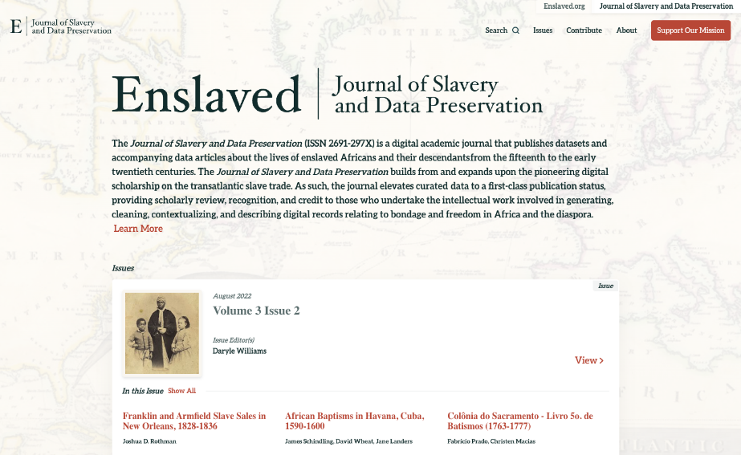
What is JSDP?
Intake mechanism for data onto Enslaved.org
Peer review journal
Access point to data via a data repository and on Enslaved.org
Notes:
The Journal of Slavery and Data Preservation is a digital academic journal that publishes data articles describing original datasets about the lives of enslaved Africans and their descendants from the fifteenth to the early twentieth century

Slide 23
JSDP Goals
Elevate publication of datasets and accompanying data articles to the level of standard journal articles
Ensure the availability of the datasets for current and future use
Notes:
The goals of the JSDP

Slide 24
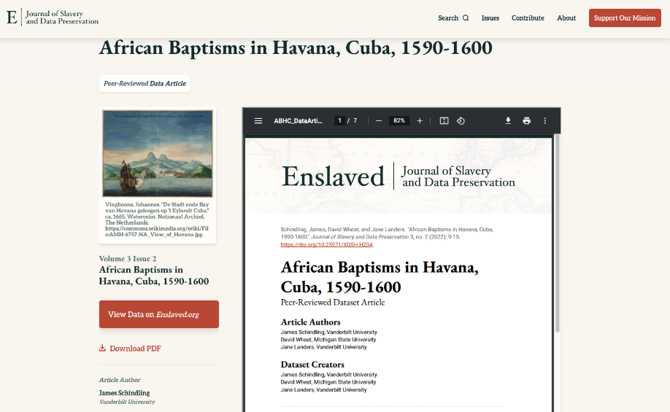
Notes:
This is one of the seven data articles in the most recent issue of the journal. It describes a dataset that includes information about over one thousand Africans and people of African origin as depicted in Havana’s earliest extant baptismal register, which is presently held in the Sagrada Catedral de San Cristóbal de La Habana in Havana, Cuba – and viewable online in digital format via the Slave Societies Digital Archive at Vanderbilt. Each baptismal entry includes the name of the person or persons being baptized, the date of baptism, the name of the priest or sacristan administering the baptism, the names of the baptized person's parents if known, and the names of their godparents.
JSDP data articles describe the methods used to create the dataset such as the names of archives and collections consulted, the extraction process, explanations of the fields present in the dataset, and details on if the data was translated from other languages or if controlled vocabularies were used to standardize terms or concepts in the data.

Slide 25
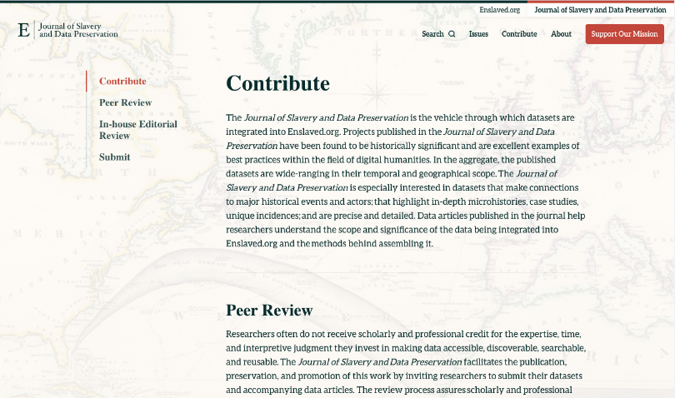
https://jsdp.enslaved.org/contribute
Notes:
To learn more about what the specific parts of a data article, see the contribute page of the JSDP site for an annotated sample data article and for a template for completing the data article -- that prompts contributors to provide the required contextual information.

Slide 26
JSDP Submission Process
Contributor submits (1) dataset, (2) data dictionary, and (3) the data article
Contributor selects review type: peer review or in-house editorial review
JSDP managing editor verifies data is in scope
JSDP/Enslaved.org data analyst conducts a pre-check
Notes:
The JSDP submission process includes these main step.
First a contributor submits materials to the journal.
A JSDP submission has 3 pieces.
Dataset -- structured information extracted from historical document
Data dictionary -- field names and definitions and info about controlled terms used to standard data
Data article -- that describes sources, methodology, and historical significance of the dataset
The data dictionary and data article should provide enough contextualization so that the dataset to be discovered, understood, and used by others, including for long term secondary purposes not envisioned at the time a dataset was created.
Then the contributor selects a review option
There are 2 review options that can accommodate the needs contributors who have different publishing goals and requirements
Peer review is similar to standard journal review -- providing rigorous peer review of the data article and dataset overseen by the managing editor and editorial board, working in conjunction with invited expert reviewers.
In-house submissions are for contributor who want to share datasets publicly on Enslaved.org -- these are reviewed by the Journal's editor or editorial team and accepted or rejected based on the quality of the documentation, data, and relevance to the Journal

Slide 27
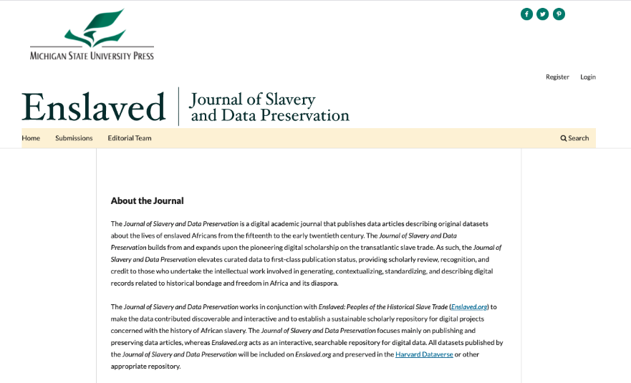
Notes:
Submission and peer review processes are handled through Open Journal Systems (OJS). Enslaved.org established a relationship with the MSU Press in order to leverage the press’ journal management platform, OJS -- is an open source software application for managing and publishing scholarly journals.This collaboration with the MSU Press has helped JSDP address a huge sustainability challenge for the journal, which had been managing all submission, review, and publication activities, including communications with contributors, via GitLab, Google Forms and Google Mail and our individual institutional email accounts. [GitLab git-repository with collaborative version control -- Matrix installed free version of software on our servers -- used for issue tracking across all [or most] Matrix development.] These systems worked but were clunky and time intensive to use for managing the materials and communications. So OJS has streamlined the submission and review processes in important ways.

Slide 28
JSDP Publication Process
Publication on JSDP website via Kora, an open source digital repository application
DOI creation via DataCite
Data remediation and integration into Enslaved.org discovery Hub
Preparation and deposit of metadata, dataset, and documentation into Dataverse
Notes:
Even though we use OJS to manage our submission and review workflows,...
JSDP mangages its publication processes in a different system with supporting tools outside of OJS.
We use our relationship with the MSU Libraries, to leverage the library’s DOI minting platform
Data remediation and integration into Enslaved.org use tools such as OpenRefine and wikibase tooling such as Quick Statements, to integrate data into the enslaved.org graph data base as linked data.
As data articles are published on the journal, data is prepared for publication (as linked data) on Enslaved.org and deposit on Dataverse.

Slide 29
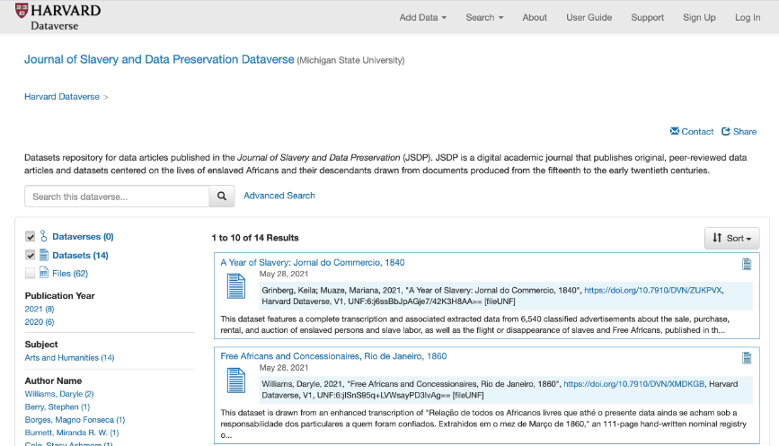
https://dataverse.harvard.edu/dataverse/jsdp
Notes:
As JSDP publishes a new issue of the journal, it deposits the dataset and other descriptive metadata with Dataverse, a general purpose data repository operated by Harvard University, where the dataset is assigned the DOI, preserved, and made searchable alongside data produced and shared by researchers from many disciplines.
JSDP prepares and uploads all of the materials to Dataverse.

Slide 30
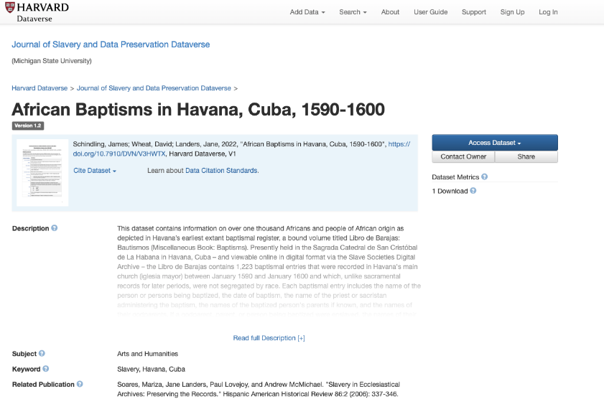
Notes:
Here is an example of a JSDP dataset on Dataverse… this is the same one we looked at previously from the most issue of JSDP
See dataset doi
Use metrics...

Slide 31
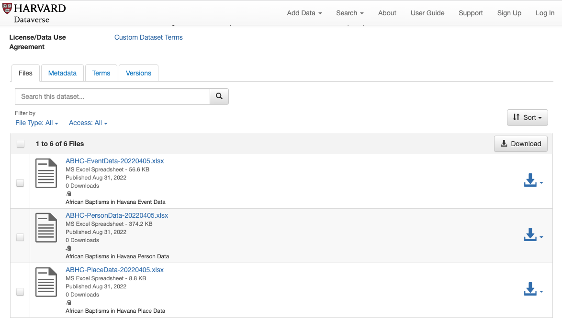
Notes:
Users can see additional metadata about the dataset, terms of use, and versioning information in case the dataset or metadata has been modified -- changes can be viewed.
Importantly, users can view or download the dataset from Dataverse for their own research uses.
Dataverse metadata is open and findable via search engines, further increasing the visibility of the data and serving as yet another access point to the data with pointers back to JSDP.
JSDP looked to Dataverse to help us meet our data stewardship obligations to ensure the availability of the datasets for current and future use.
Harvard hosts the Dataverse repository using Amazon Web Services and S3, and maintains a full backup of all data and directories using Amazon Glacier. Harvard’s FAS (Faculty of Arts & Sciences) Research Computing maintains a backup copy of Dataverse data and directories. These multiple copies of JSDP datasets provide redundancy for the data and documentation stored in Kora. This dual approach, which results in multiple copies of the dataset at Harvard and MSU under differing administrative and technical infrastructures, reduces the likelihood of data loss from class-of-systems failures.

Slide 32
Presentation Topics Reprise
Overview of Enslaved.org
Description of the data model behind Enslaved.org
Information about resources that can guide historical slavery data creation
Explanation of how to contribute to Enslaved.org through the Journal of Slavery and Data Preservation
Notes:
At this point we’ve covered all of the topics we set out to touch on…

Slide 33
Questions?

Slide 34
Thank you!
Visit: https://enslaved.org
Contribute: https://jsdp.enslaved.org
Contact: enslaved.org@gmail.com

Slide 35
Catherine Foley: foleyc@msu.edu
Daryle Williams: daryle.williams@ucr.edu

Slide 36
Upcoming Member Webinars
October 27 – State Archives Showcase – New York and New Jersey
November – In Conversation with…Hilda
To register:
https://www.statearchivists.org/programs-education/cosa-webinars

Slide 37
Upcoming SERI Webinars
Watch for the Fall webinar schedule coming soon!
To register:
https://us02web.zoom.us/meeting/register/tZYsde-qpjoqH9xwnKYrc7lJdTCcJOR2cn84

Slide 38
Upcoming Shop Talks with CoSA sponsors
October 13 - Ancestry
November 10 – Preservica
December 1 – Family Search All at 3 pm eastern time
To register:
https://www.statearchivists.org/programs-education/cosa-webinars/additional-webinars

Slide 39
Contact Us
CoSA Website http://www.statearchivists.org
CoSA Resource Center https://www.statearchivists.org/research-resources/resource-center
CoSA Twitter Handle @StateArchivists
CoSA Facebook Page www.facebook.com/CouncilOfStateArchivists
CoSA You Tube https://www.youtube.com/user/StateArchivists/

Slide 40
Sponsors and Funders

Slide 41
Webinar Evaluation
We really do appreciate your feedback!
Please take a moment and respond to the evaluation following this webinar.

