Slide 1
CoSA Member Webinar State Archives Showcase: Louisiana and California
October 22, 2020
3 pm Eastern

Slide 2
Welcome
Today’s Agenda
Introductions
Presentations
Q and A
Upcoming Programs and Webinars
Disclaimer: This webinar is being recorded and will be available for viewing on the CoSA website

Slide 3
Moderator: Beth Golding, Florida
Presenters:
Catherine Newsome, Louisiana State Archives
Tamara Martin, California State Archives

Slide 4
20/20 ARCHIVAL VISION: HINDSIGHT AND SEEING CLEARLY
Catherine J. Newsome
State Archivist and Executive Director
LOUISIANA STATE ARCHIVES,
A DIVISION OF THE LOUISIANA SECRETARY OF STATE

Slide 5
LOUISIANA STATE ARCHIVES
3851 Essen Lane Baton Rouge Louisiana
70809
225-922-1000

Slide 6
CHANGE

Slide 8
INVITATION FOR ADVANCEMENT

Slide 9
Archives
Cataloguing and Conservation
Exhibits
Multimedia
Reference
Vital Records
Library Services
Public Outreach
Imaging and Preservation Services
Conversion Services

Slide 10
Records
Records Management
Records Center (Warehousing and Disposals)
Executive/Administrative Services
Official Relations
Policy and Budget
Legislation/Legal Obligations/Public Records
Facility Maintenance

Slide 11
Louisiana State Archives Organizational Chart Summary
State Archivist
Archives Manager
Facility Manager
Administration Services
Reference Services Supervisor
Records Management and Center Supervisor
Imaging and Preservations Services Supervisor
Archives Supervisor
Cataloging and Conservation
Records Management Analysts
Conversion Services Analysts
Vital Records
Exhibits
Library Services
Administrative Positions
Multimedia
Reception
Records Center
Staff

Slide 12
Individual empowerment is vitally important
for organizational success.

Slide 13
What did that mean for Louisiana State Archives?
Moving people around...literally! Making people uncomfortable (a little) so they feel empowered to try/learn new things. Many employees have change positions, job descriptions, and assisted in sections that they never did before. What we have learned is the root of our individual and
team’s strengths and weaknesses.

Slide 14
Questions to consider:
How can you excel as a leader/ employee/ researcher/ archivist/ librarian?
How can you contribute to your institution? Do you provide institutional knowledge and perspective?
Do you bring energy or new ideas? Are you physically able to assist where others cannot?

Slide 16
What is the same?
Our mission is to collect, preserve, and make available the governmental records of the State of Louisiana assisting in the preservation and understanding of our state's rich history.
What is new?
We are evolving.

Slide 17
Security and Accessibility

Slide 18
Records Management 2020

Slide 19
Complying with Public Records Laws

Slide 21
Why is all of this important?
BECAUSE OF 2020!!!

Slide 22
The most important thing is having
open lines of communication in place in order to affect changes to the plan as circumstances change.

Slide 23
WHAT WILL BE YOUR RESPONSE?

Slide 24
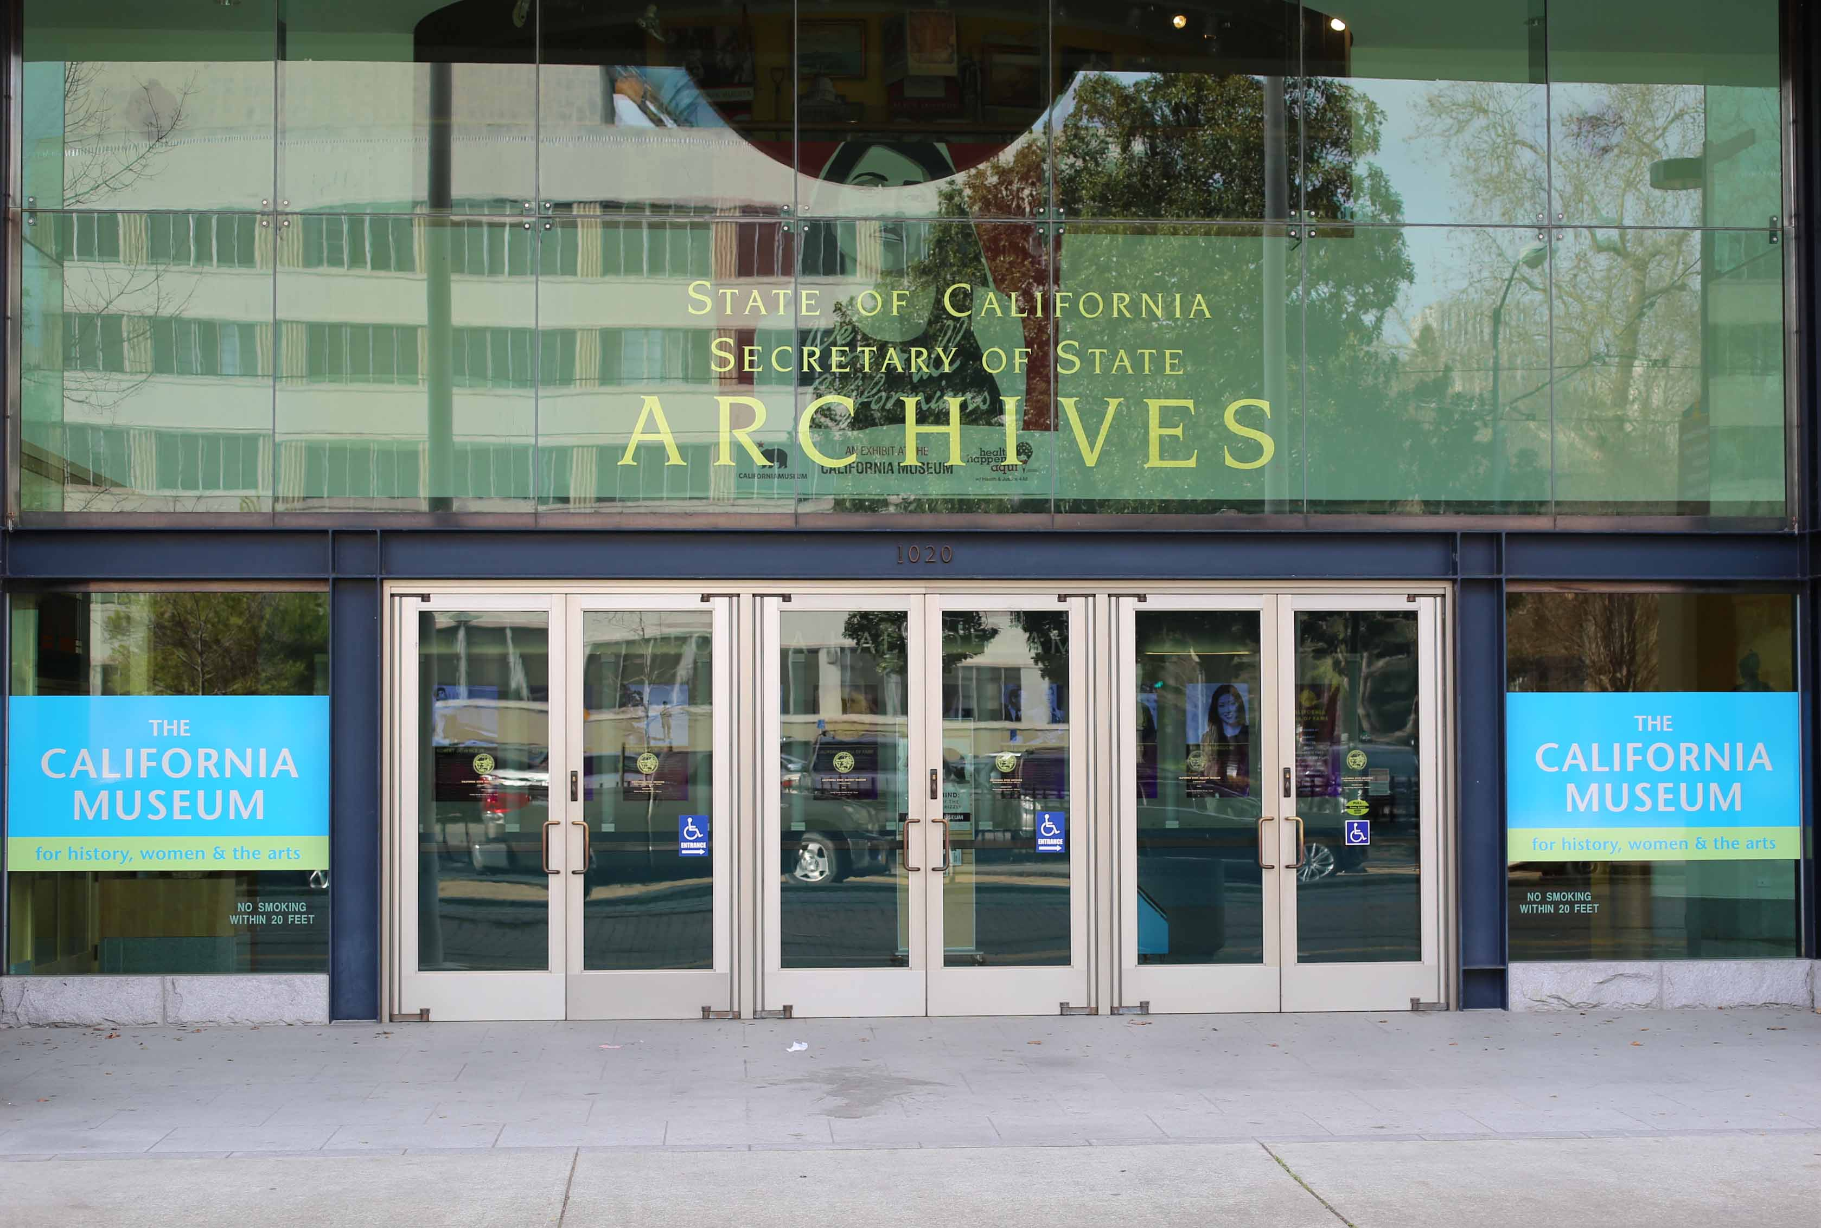
California State Archives
Tamara K. Martin
California State Archivist and Division Chief
California State Archives
Office of the Secretary of State

Slide 25
History and Facilities

Slide 26
On January 5, 1850, nine months before gaining U.S. statehood, the California Legislature passed its first law: “An Act Concerning the Public Archives,” (Statutes of 1850, Chapter 1).
The law created California’s Public Archives, one of the first permanent public archives in the nation.
The Public Archives became a part of the Secretary of State's office to "classify, and safely keep, and preserve" all records that "were connected with the political, civil, and military history, and past administration of the Government in California.“
Since 1850, California has had more than 30 Keepers of the Archives.
Celebrating
170 Years:
1850-2020

Slide 27
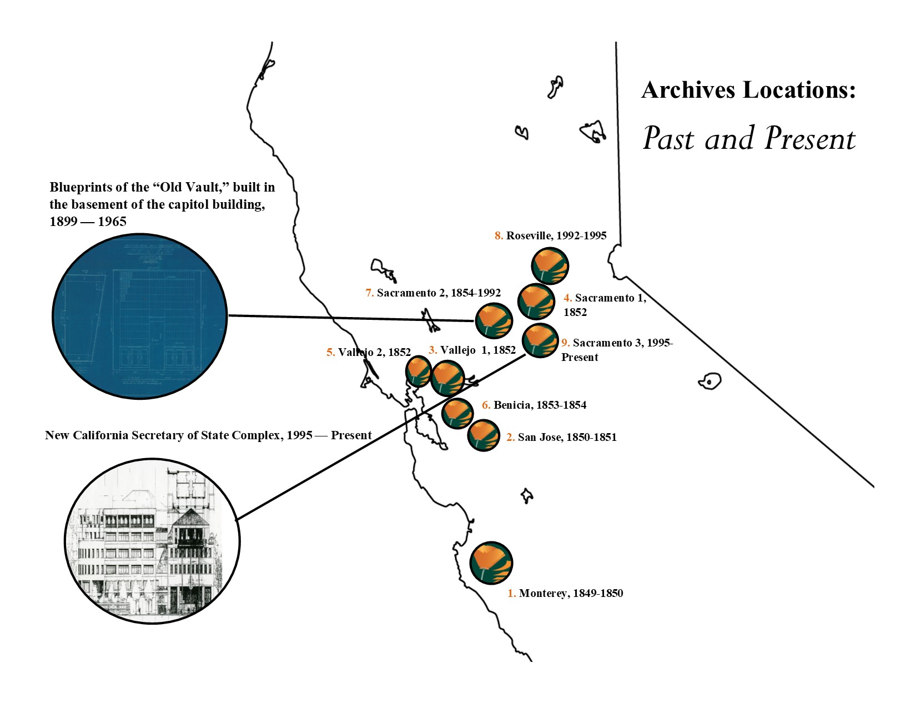
State Archives Locations

Slide 28
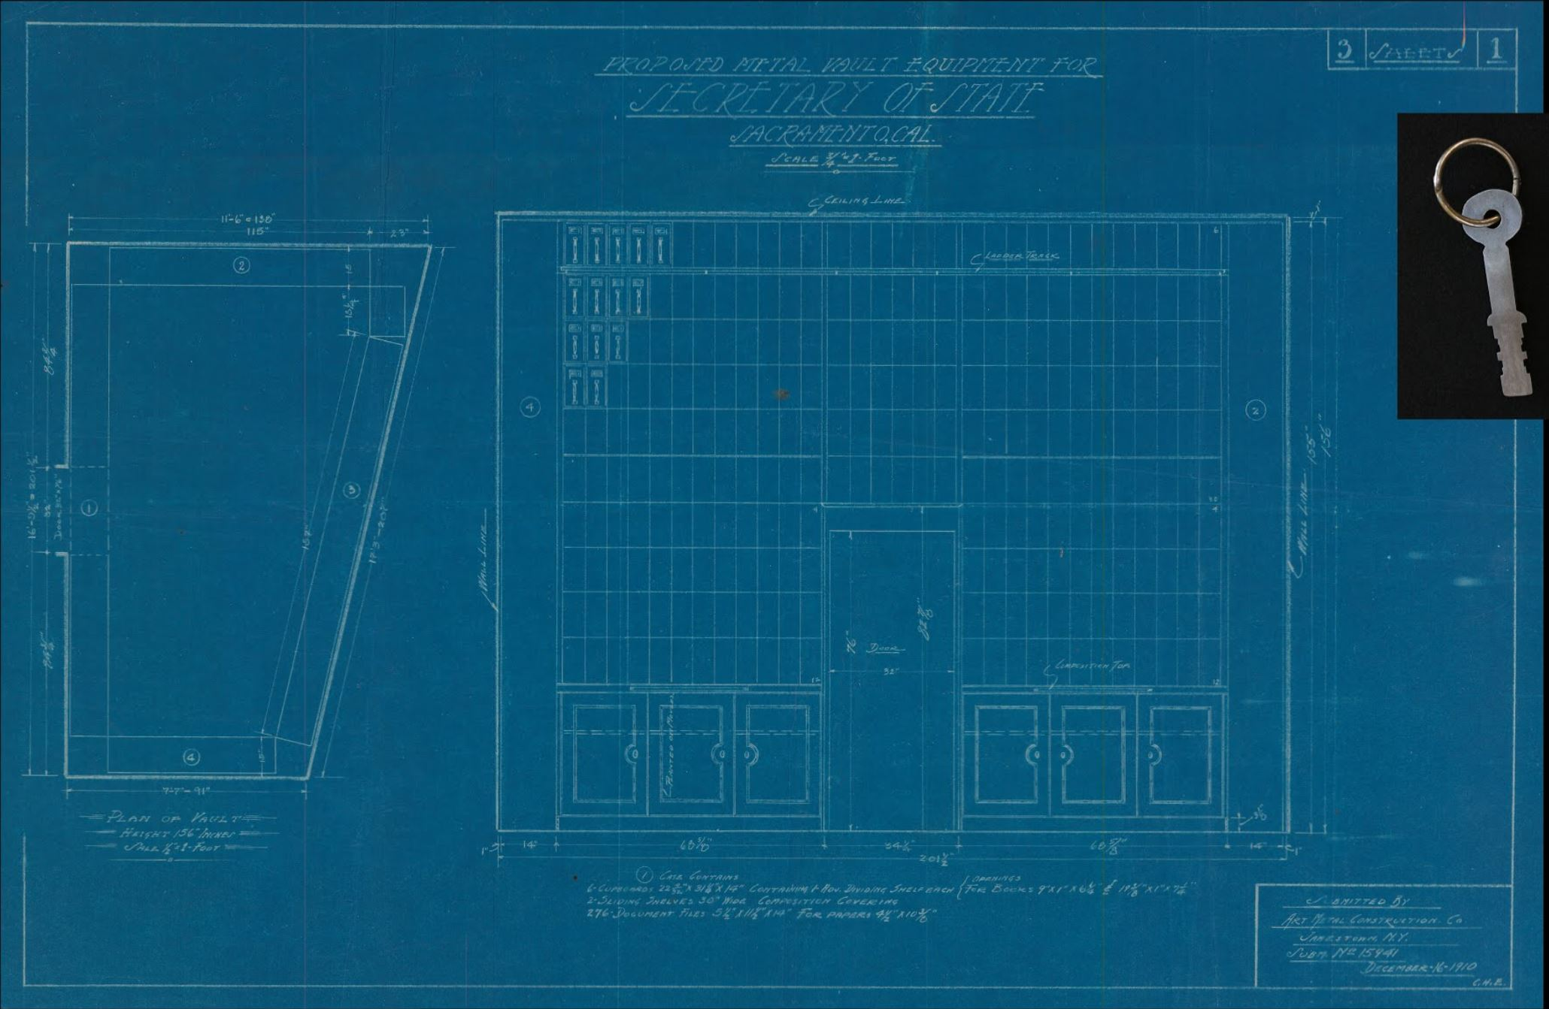
Archives Old Vault
In 1899, the State Legislature approved a “moisture-proof, fire-proof, and burglar-proof” vault to be built in the basement of the capitol building, "for storage and care of such archives as may be delivered to [the Secretary of State] by the various State officials."
Known as the “old vault,” it held California’s most important records until 1965.

Slide 29
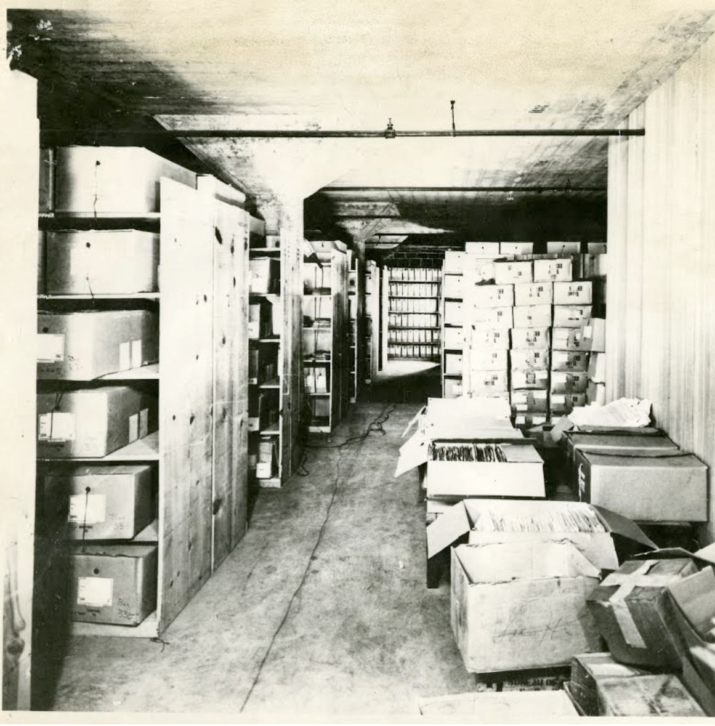
Old Archives Warehouse
By the turn of the twentieth century, the State Archives' vault in the State Capitol building was overflowing.
During a 1914 inspection, members of the American Historical Association noted the “discreditable congestion” in the State Archives’ vault and surrounding rooms at the State Capitol.
In the 1930s, the Secretary of State began to transfer the overflow of documents to a warehouse in downtown Sacramento. Built in 1915, this warehouse had no security or temperature controls.

Slide 30
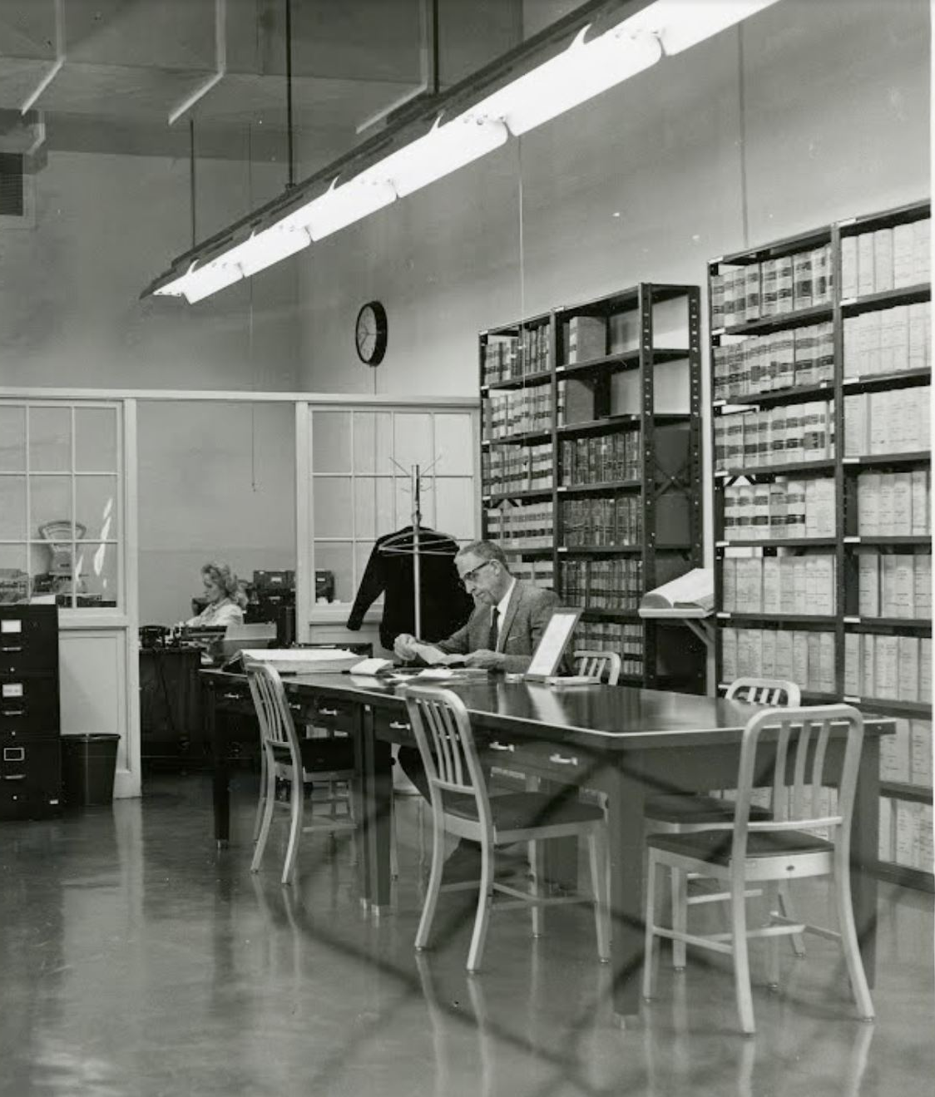
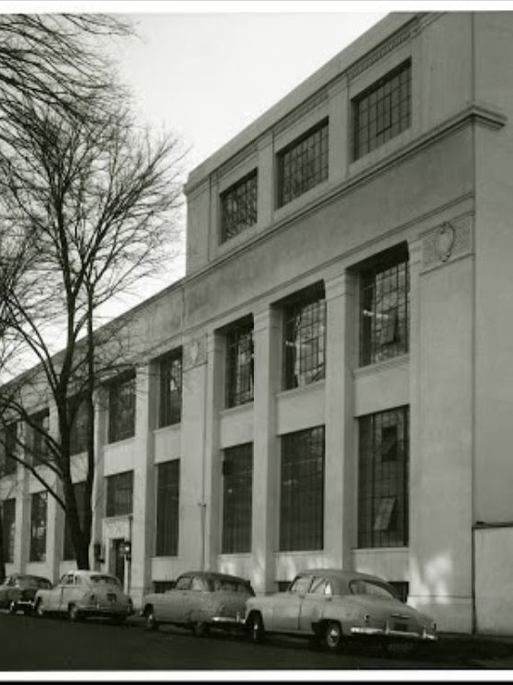
State Printing Plant
The State Archives moved to the State Printing Plant at 10th and O streets in Sacramento in 1955.
The building provided expanded storage areas and rooms dedicated to professional archival activities. Rows of metal filing cabinets and shelving housed over 23,000 cubic feet of documents.
The State Printing Plant building was large enough to provide a dedicated reading room for patrons of the State Archives.
Originally located on the second floor, the reading room was relocated to the first floor for easier access in 1966.
The State Archives remains at this location today, although under the roof of a new building.

Slide 31
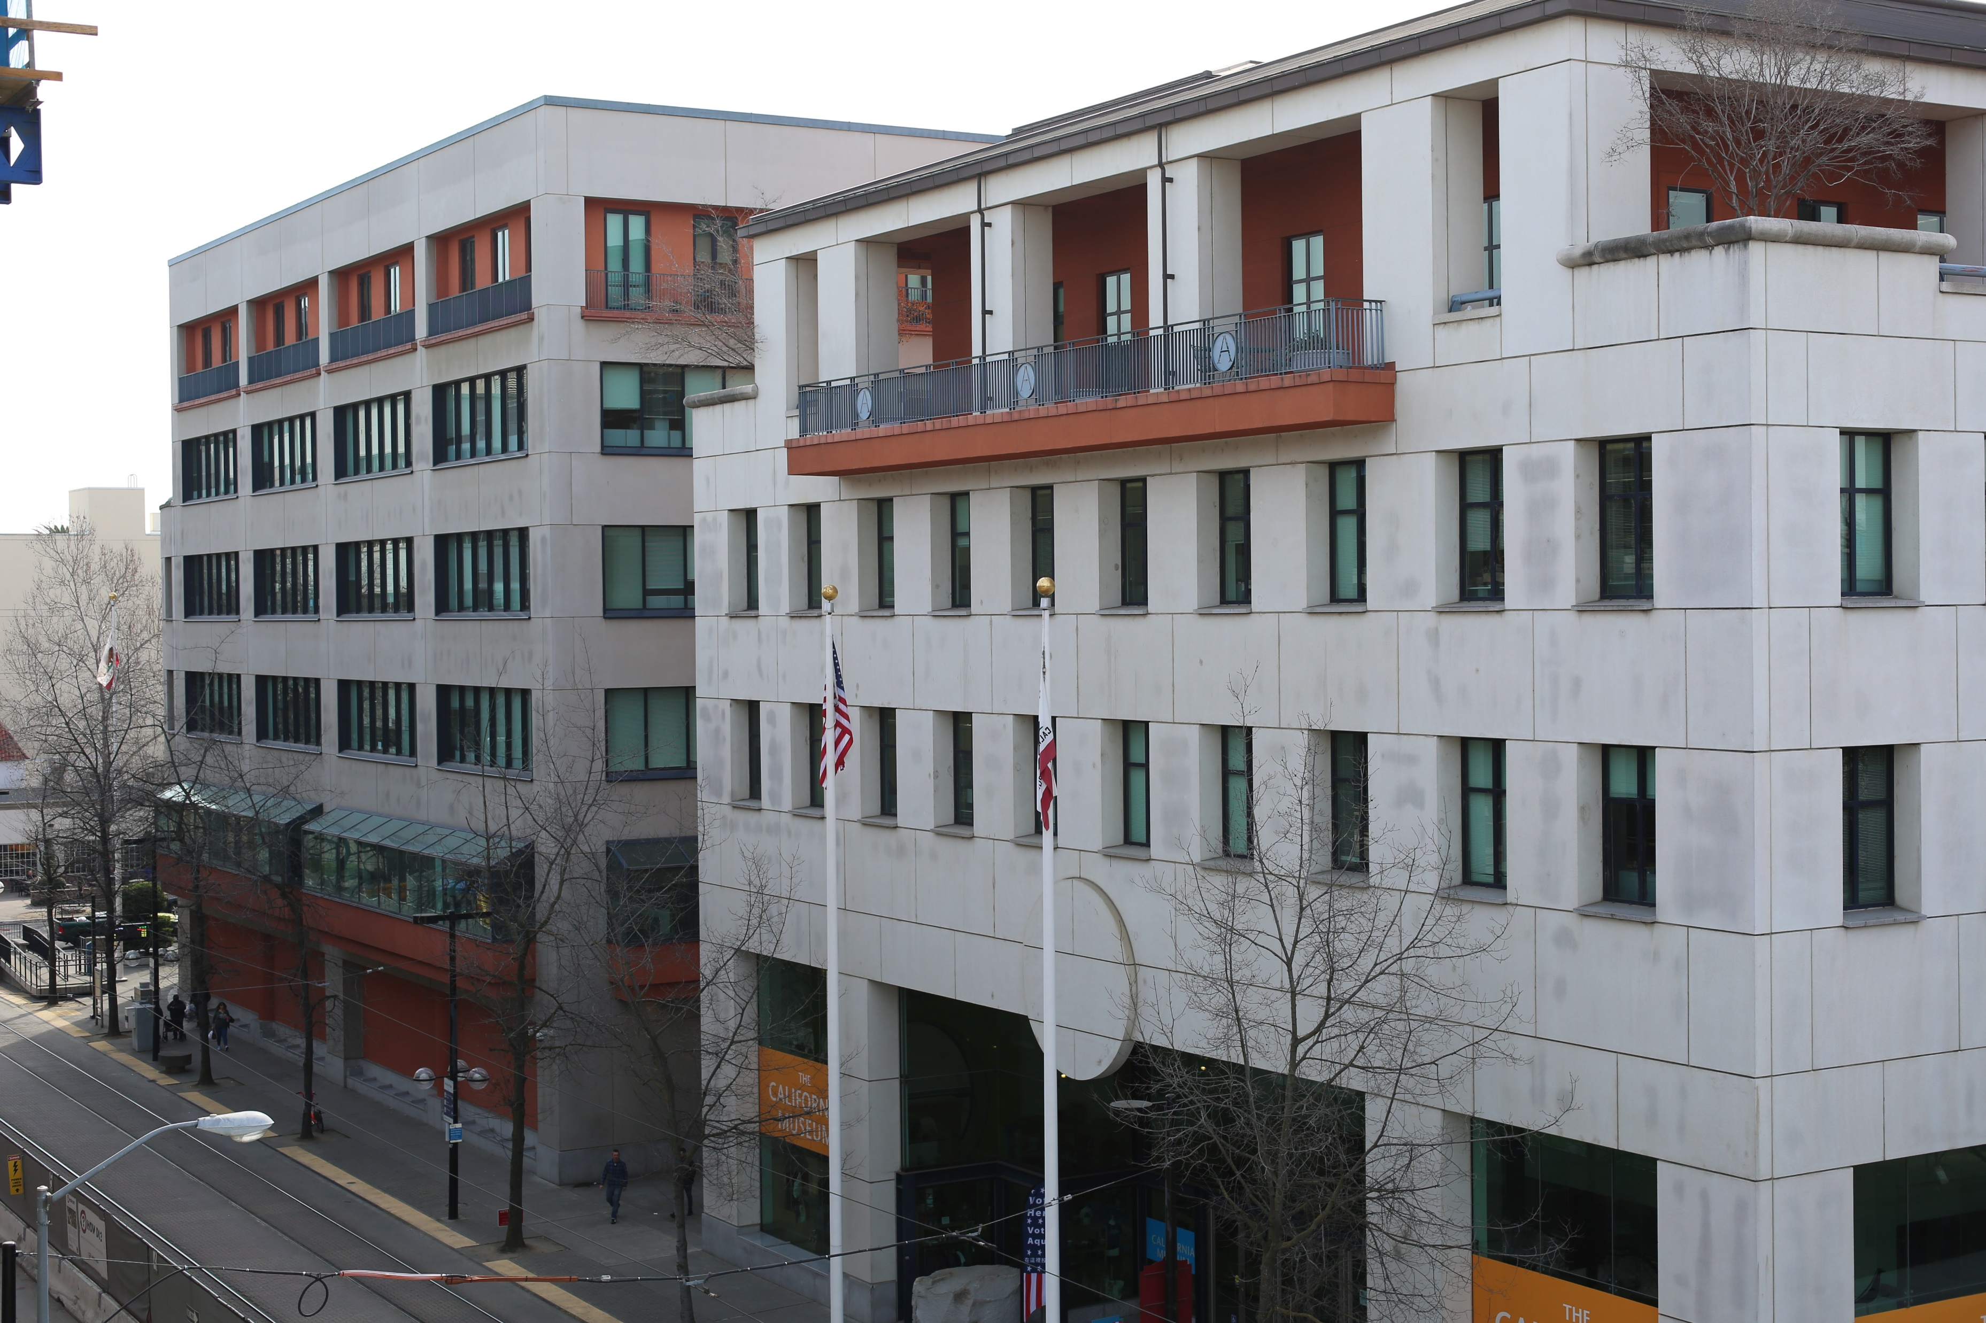
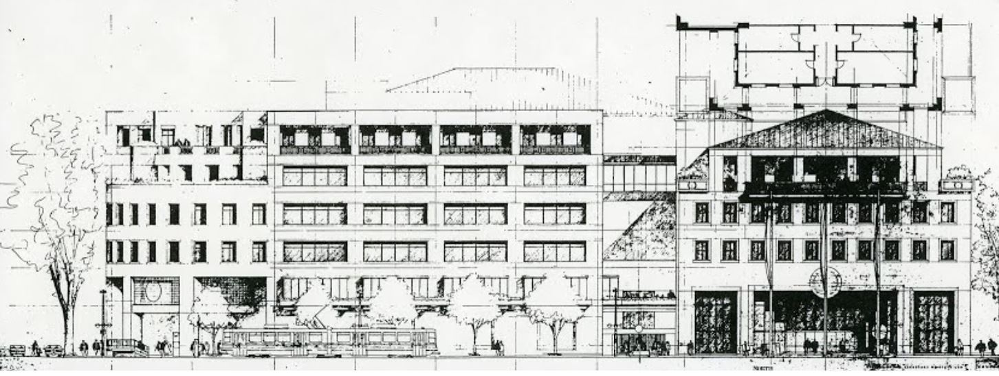
March Fong Eu Secretary of State Building
In 1989, the California State Legislature approved Senate Bill 638, which funded construction of the current Secretary of State and California State Archives complex.
The California State Archives moved into its new facility in 1995.
Today, the Archives Division maintains six floors of stacks containing records; preservation, imaging, and processing labs; a research room; an exhibit gallery; and an artifact collection.
The building was renamed the March Fong Eu Secretary of State Building in early 2019 in honor of the former Secretary of State.

Slide 32
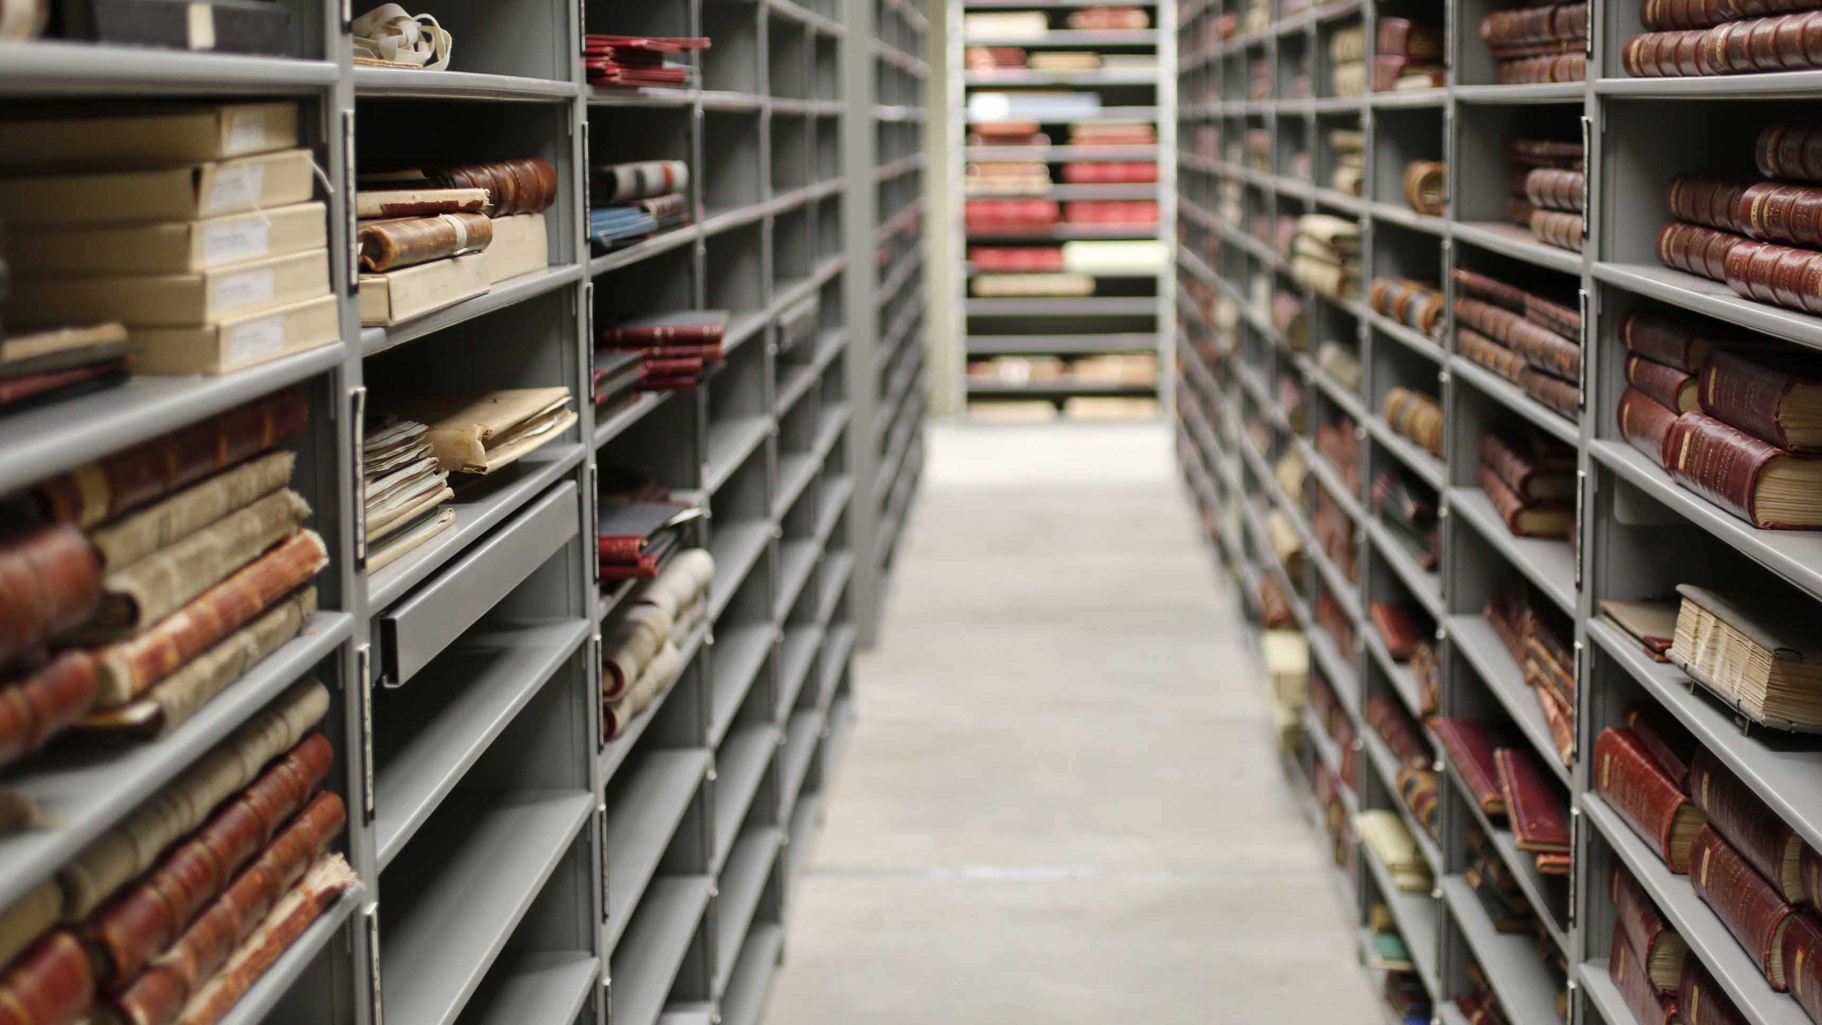
Today, the State Archives holds over 125,000 cubic feet.
The collection contains more 350,000,000 documents, bound volumes, maps and architectural drawings, photographs, audio-visual materials, and artifacts.
It is home to California’s most historic documents, including the 1849 and 1879 State Constitutions; all original laws; and records of the State Legislature, recent governors, state agencies, and California’s Supreme and Appellate Courts.
The State Archives is continuously digitizing and expanding online resources and access to collection materials.
California’s Collection

Slide 33
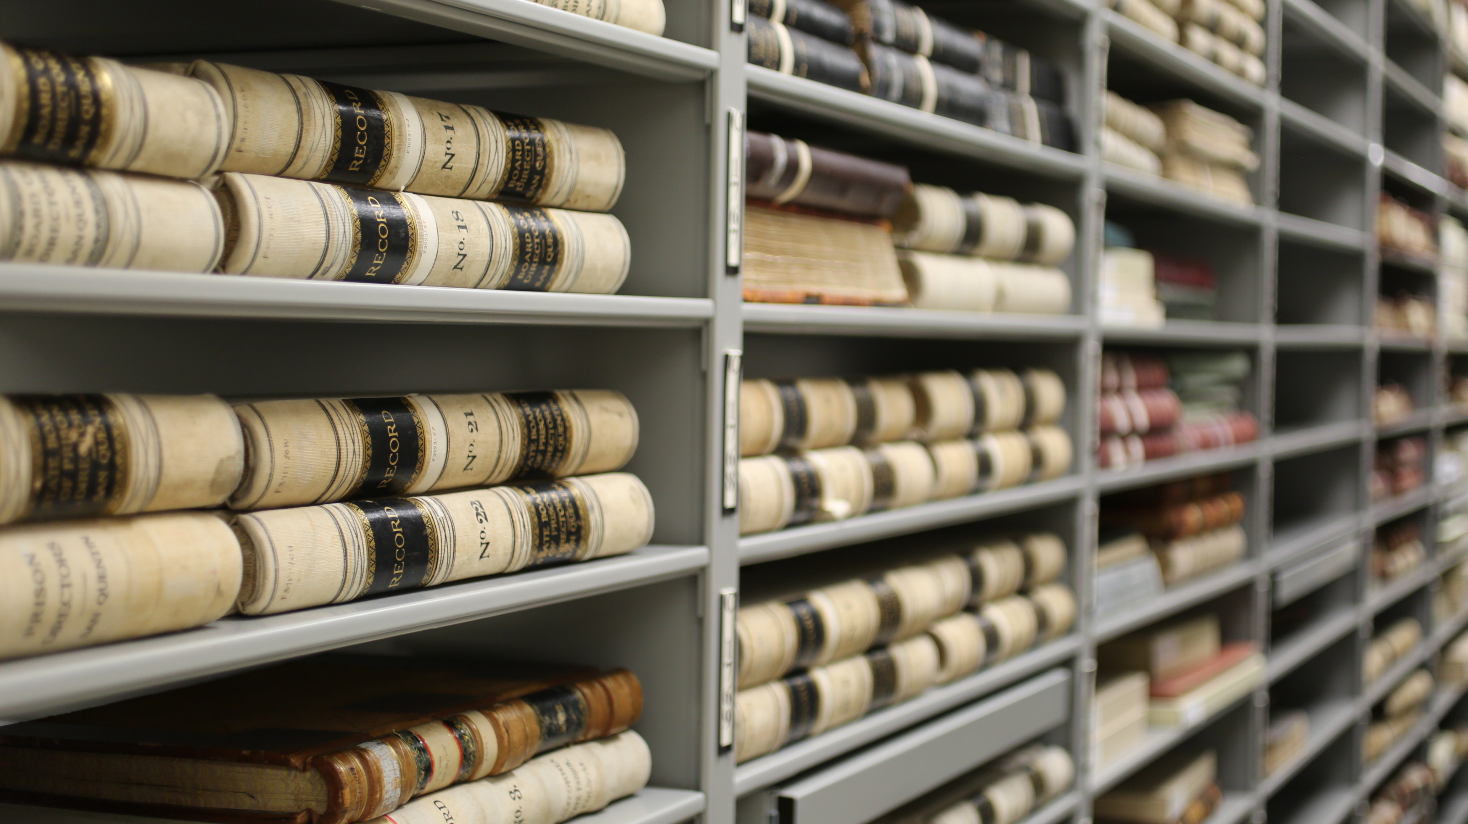
The State Archives administers the State Records Management Act and works with all California state agencies.
The Records Management and Appraisal (RMA) unit is comprised of the California State Records and Information Management Program (CalRIM) and the State Records Appraisal Program (SRAP). RMA assists State entities in achieving these efficient records management programs.
The State Archives works closely with the Department of General Service’s State Records Center.
The State Archives also administers the Local Government Records Program (LoCal).
Statewide Records Management

Slide 34
Programs and Staff

Slide 35
The California State Archives has a dedicated and diverse staff of 41 permanent employees and eight students.
Staff make up seven teams, including the Records Management and Appraisal Unit, Research Services Unit, Collections Management Unit, and Outreach Unit, as well as an Administrative Support Unit, Legal Unit, and management team.
Programs and Staff

Slide 36
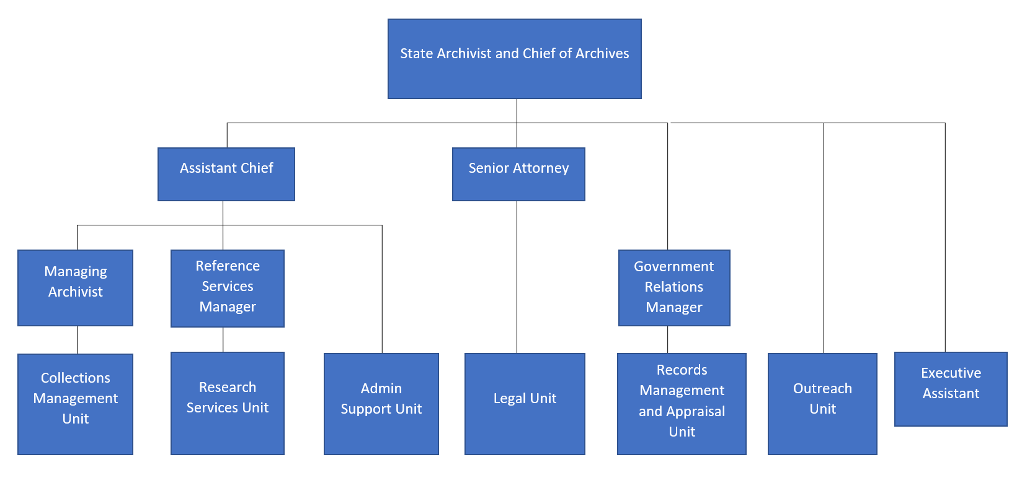

Slide 37
California State Archives in 2020

Slide 38
Changes in 2020
In March of 2020, all public counters at the Secretary of State’s Office were closed due to the COVID-19 pandemic. Drop boxes have been set up in the main lobby.
Though the State Archives’ Research and Reading Room is currently closed, staff are assisting with research via phone, email, and mail. For assistance, you can email archivesweb@sos.ca.gov.
The State Archives has implemented a modified staffing plan, with many staff teleworking 60-80% of their time.
Safety precautions have been implemented, including health screenings, mask requirements, hand washing, social distancing, and increased cleaning and disinfecting of common spaces.
The State Archives is documenting the ongoing pandemic in California through the COVID Chronicles project.
The State Archives has also been providing statewide guidance on essential records and disaster preparedness.

Slide 39
New Technology and Special Projects
The State Archives has prioritized digitization and expanded online access to records for the public.
In 2020, the State Archives has implemented new technologies, including Microsoft Office Teams, Docusign, and Webex.
The State Archives has rolled out new virtual records management services and training classes.
The State Archives has also pivoted to online events and has hosted a panel discussion, as well as virtual tours, and videos.
The State Archives continues working toward expanded technology projects that increase access to historical records, information, and resources.

Slide 40
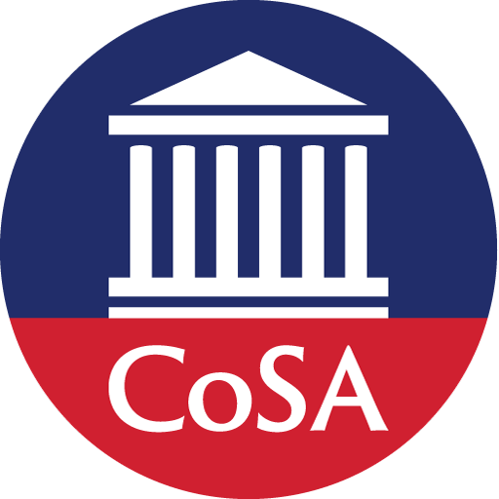
Questions & comments

Slide 41
Upcoming Webinars
SERI Webinars
November 17: Web Archiving in Times of Rapid Change
December 15: Approaches for Self-Assessments
For registration information: https://www.statearchivists.org/programs/state-electronic-records-initiative/seri-webinars/
CoSA Member Webinars
November 19: State Archives Showcase - Utah & District of Columbia
For registration information: https://www.statearchivists.org/programs/cosa-webinar-series/

Slide 42
In Conversation With….
A series of conversations focusing on contemporary issues shaping the work of state archives, funded by CoSA’s NEH CARES grant
First two conversations:
Helen Wong Smith on Cultural Competency
Steve Murray on the Alabama Department of Archives and History's Statement of Recommitment
https://www.statearchivists.org/programs/neh-cares-grant/

Slide 43
Contact Us
CoSA Website http://www.statearchivists.org
CoSA Resource Center https://www.statearchivists.org/resource-center/
CoSA Twitter Handle @StateArchivists
CoSA Facebook Page www.facebook.com/CouncilOfStateArchivists
CoSA You Tube https://www.youtube.com/user/StateArchivists/

Slide 44
Sponsors & Funders: Thank you!

Slide 45
Webinar Evaluation
We really do appreciate your feedback!
When you exit the webinar, you will automatically be taken to an online webinar evaluation. Please take a couple minutes to complete the survey and help us plan future webinars.

