Slide 1
2022 Digital Preservation Capability Self-Assessment Launch
January 11, 2022
Notes:
The self-assessment survey based on the Digital Preservation Capability and Maturity Model (DPCMM) is a metric by which CoSA members have been able to measure their digital preservation programs since 2012.
Results of the self-assessment help to benchmark capabilities to preserve and provide access to permanent electronic government records as well as develop action plans for improvements.
As the third self-assessment survey rolls out, we will discuss the history of the model, tips for understanding the component capabilities, and what we have learned from past surveys and hope to learn from the 2022 survey.

Slide 2
Session Agenda
Welcome & Introductions
BACKER – Building Archival Capacity for Keeping Electronic Records
Digital Preservation Capability Maturity Model
Origin & Foundations
How It Works & How It is Used
CoSA Digital Preservation Capability Self-Assessment
Questions & Feedback

Slide 3
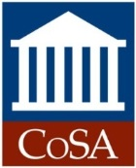
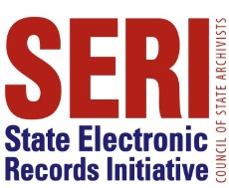
Welcome!
Spring SERI webinar lineup
March 8, 2:00pm Eastern: Follow the Yellow Brick Road: Decision Making for Storage of Electronic Records
CoSA’s Online Resources
Resource Center
SERI Webinar Recordings on YouTube

Slide 4
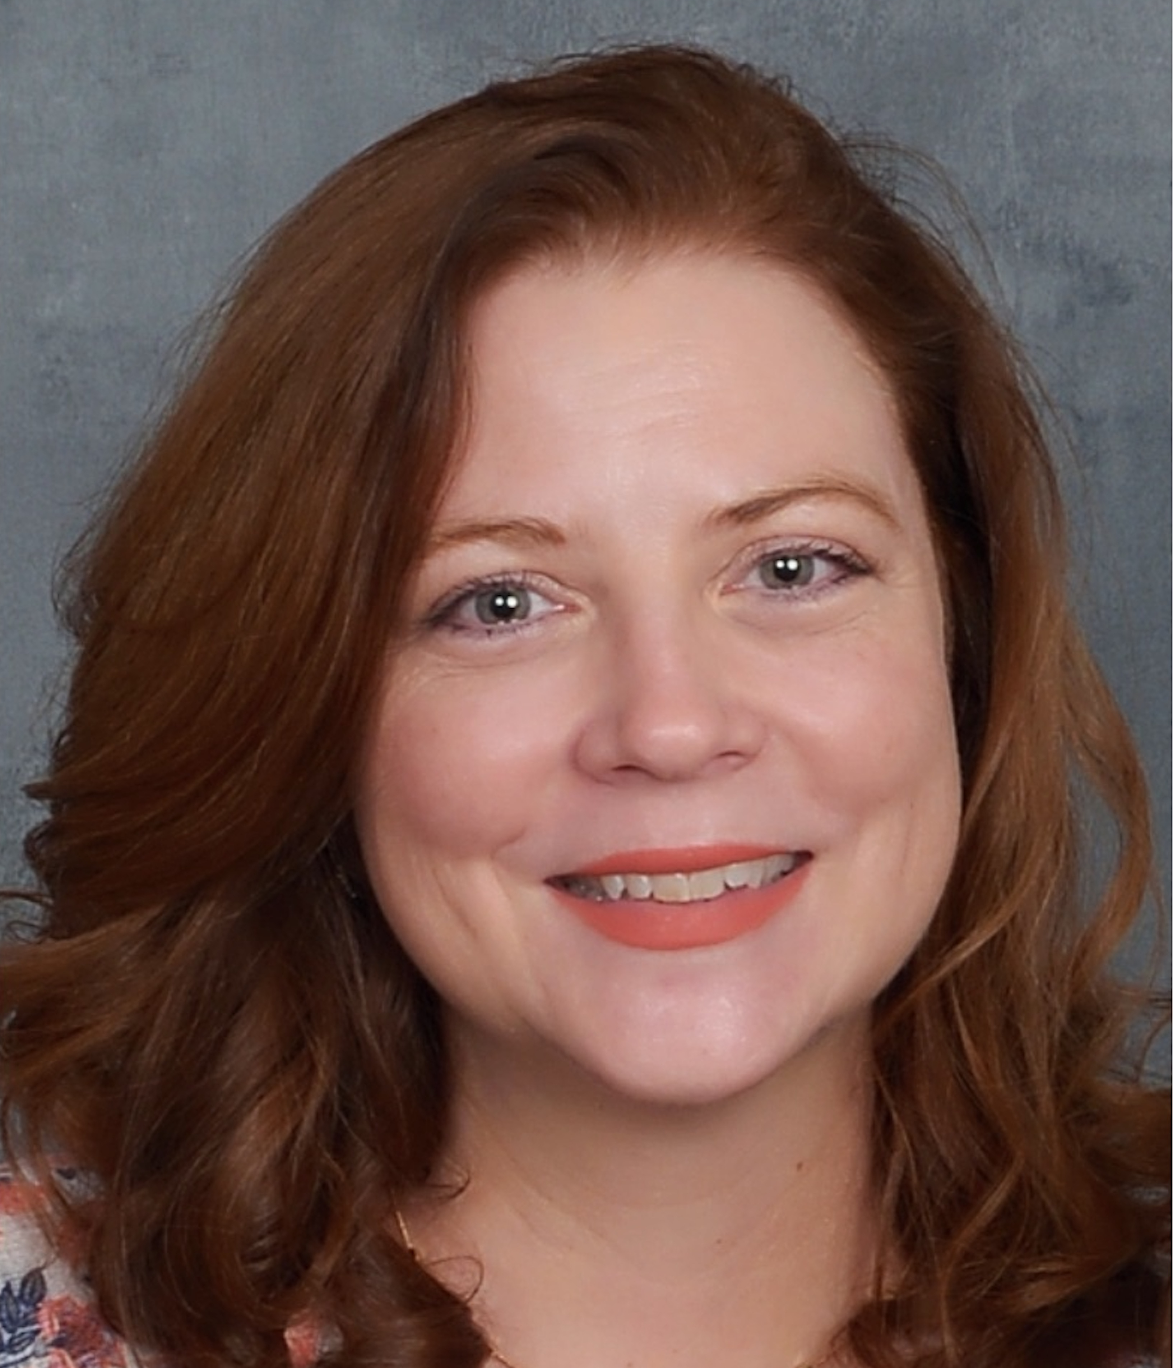
Presenters
Lori Ashley
Michelle gallinger
Tournesol Consulting, LLC
SERI Coordinator

Slide 5
BACKER: Building Archival Capacity for Keeping Electronic Records
CoSA is the recipient of an IMLS National Leadership Grant in the amount of $475,000 over three years to develop and deliver new and expanded technical assistance, educational programming, and training to state and territorial government archives to strengthen their digital records preservation and accessibility capacities.
The project includes 1) updating self-assessment tools and best practices for digital preservation programs; 2) direct assistance and mentoring to improve digital preservation programs, including digitization planning and related policy development; and 3) accelerating development and implementation of digital preservation planning and cultural competence awareness and skill-building educational and training programs in a variety of formats in order to facilitate continued learning and sharing among archives staff.

Slide 6
The value of MEMBER Self-assessmentS
Helps CoSA document the effectiveness of SERI’s education and training efforts for most state and territorial archives
Builds on progress and array of tools, training and support structures
Enables CoSA to continue to help state and territorial governments enhance and improve digital management, preservation and access of government records and information to the public

Slide 7
Backer resources
Introducing BACKER: Building Archival Capacity for Keeping Electronic Records
2022 DPCMM: History of the DPCMM
2022 DPCMM: Archival Repositories
2022 DPCMM: International Standards
2022 DPCMM: GPO Interview Part 1
2022 DPCMM: GPO Interview Part 2
2022 DPCMM: Organization Infrastructure Questions
2022 DPCMM: Organization Infrastructure Questions Part 2
2022 DPCMM: Infrastructure and Risk Questions Part 3
DPCMM 2022: Questions Part 4
DPCMM 2022: Questions Part 5
Why Participate in the Cultural Competency Survey?
https://www.statearchivists.org/electronic-records/state-electronic-records-initiative/backer

Slide 8
Digital preservation capability maturity model (DPCMM)
Origins & FOUNDATIONS

Slide 9
What IS A Capability Maturity Model (CMM)?
Management tool designed to help implement effective methods in a given management discipline
Structured collection of elements that describe characteristics of processes
Provides a place to start, the benefit of prior experience, a common language, a framework for prioritizing actions and a way to define improvement

Slide 10
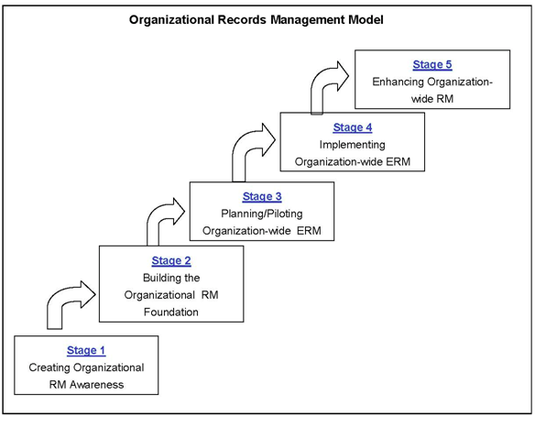
INSPIRATION FOR DPCMM
Dr. Charles Dollar

Slide 11
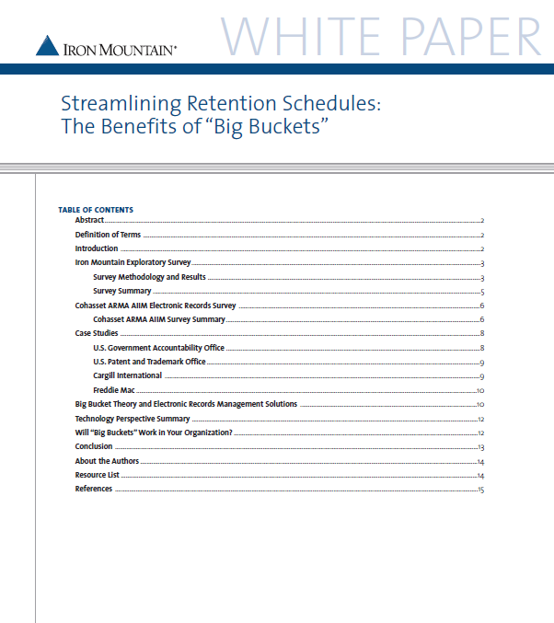
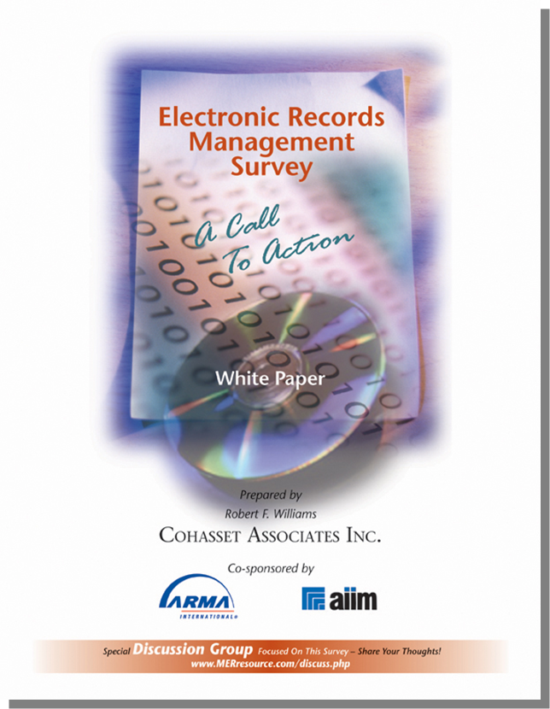
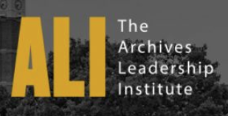
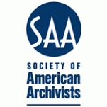
My Path to DP: RIM Consulting & Teaching
Adjunct Instructor in Records Management
Clayton State University - MAS
Archives Curriculum Committee
UW-Madison iSchool
UW-Extension – Summer intro course
State of North Dakota*State of Wyoming*Rockwell Automation*Emerson College*Council of State Archivists (CoSA)*Church Pension Group*City of Toronto*Kansas Historical Society*Waukesha County, WI*IBM*Barr Engineering*DuPont*Chevron Corporation *McKesson Corporation*WEA Trust*National Enrichment Facility (Louisiana Energy Services)*Swiss Colony*Platte River Power Authority*CUNA Mutual Group*Evangelical Christian Credit Union*Madison Gas & Electric Company*Philip Morris International* William D. and Catherine T. MacArthur Foundation*Southern California Edison*EMC Corporation*American Transmission Company*Valero Energy*SC Johnson *Weyerhauser*Wind Lake Solutions*West Bend Mutual Insurance*Actelion

Slide 12
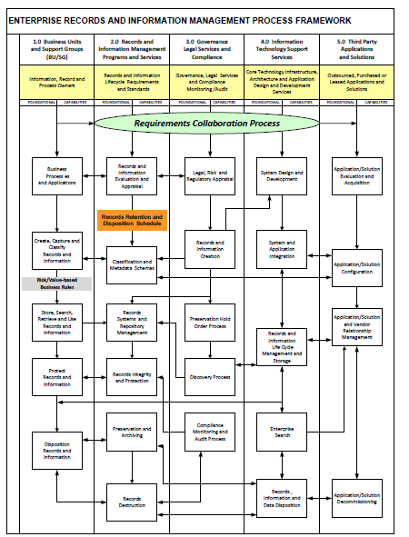
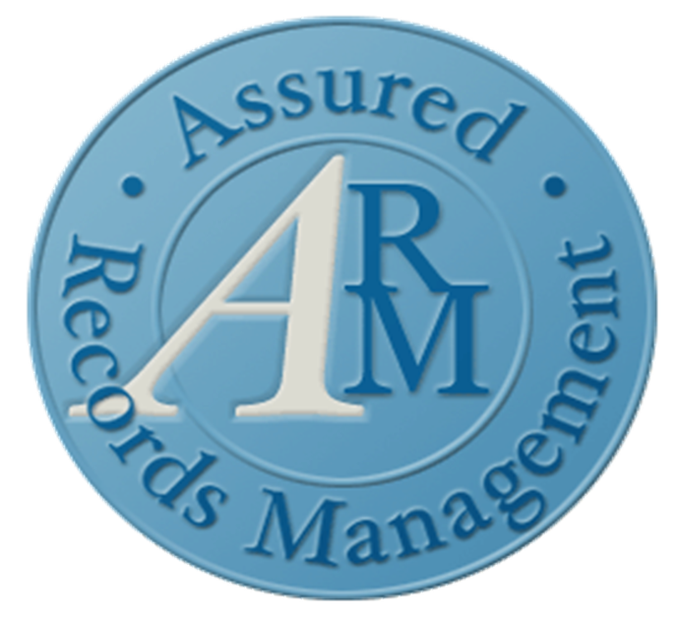
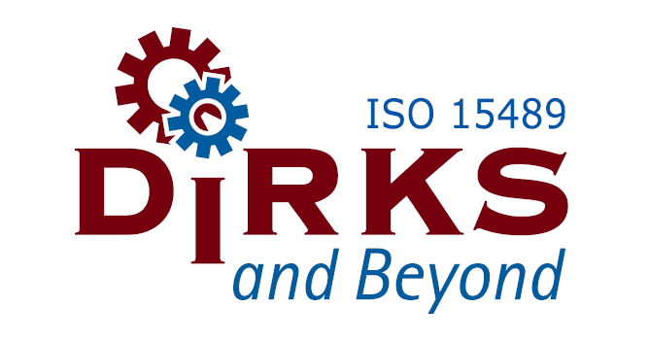
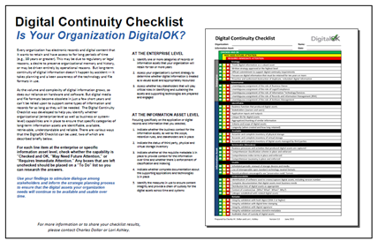
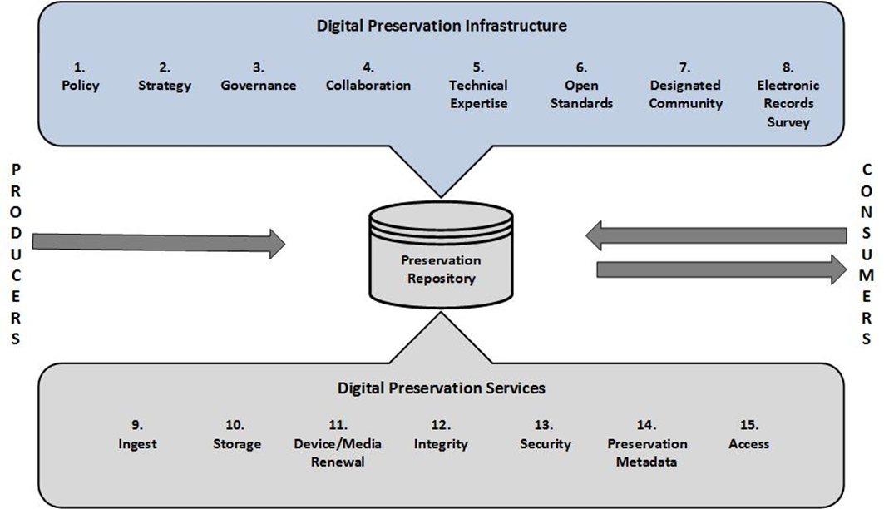
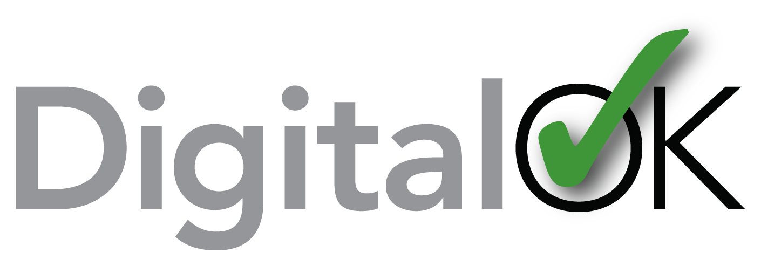
MY PATH TO DP: Continuous Improvement Frameworks
Enterprise Content and Records Management (ECRM) Process Framework
Assured Records Management (ARM)
ISO 15489: DIRKS and Beyond
Digital Preservation Capability Maturity Model (DPCMM)
Notes:
First introduced in 2007, the Digital Preservation Capability Maturity Model (DPCMM) offers 15 elements and corresponding performance metrics based on selected specifications of international standards (ISO 14721 and ISO 16363) and best operational practices and guidelines. The model was designed to assist records and information management practitioners measure the capabilities of current recordkeeping system and repositories; communicate gaps to key stakeholders; and establish priorities and performance metrics for achieving enhanced digital preservation capabilities for long-term and permanent electronic records of operational, legal/regulatory, compliance, and corporate memory vaue.

Slide 13
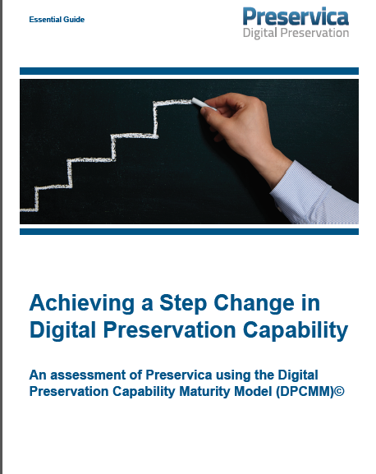
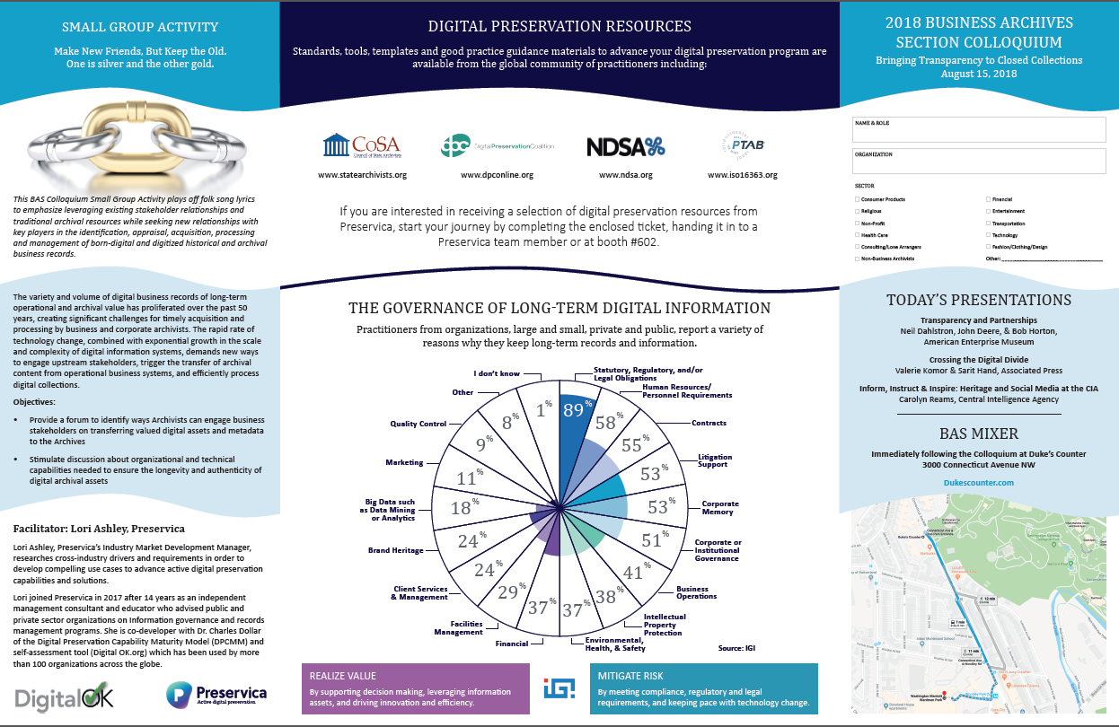
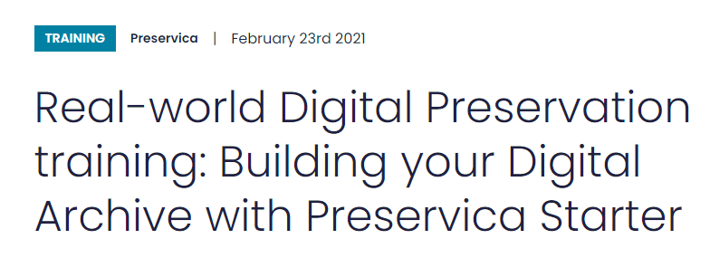
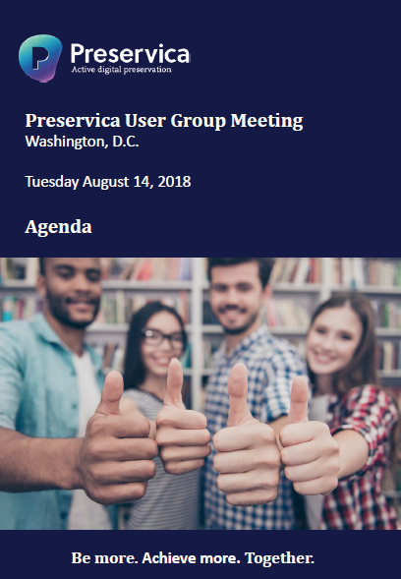
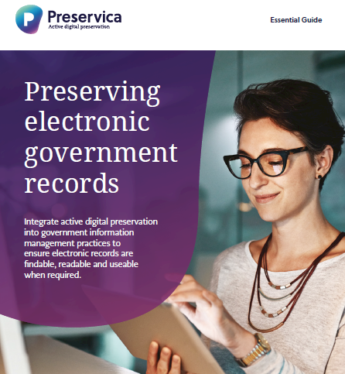
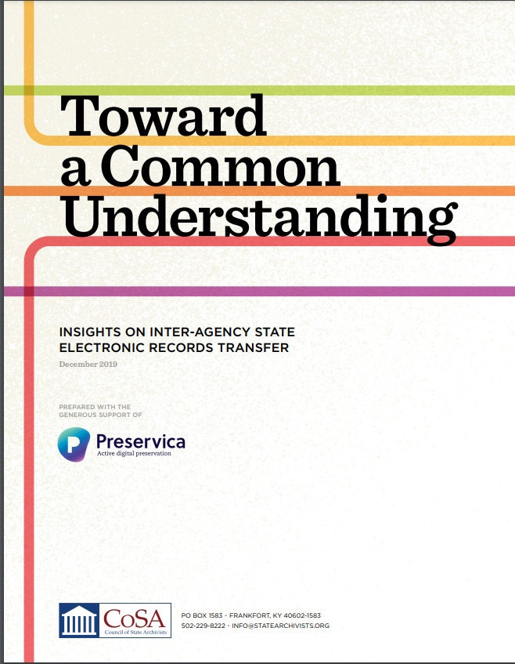
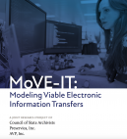
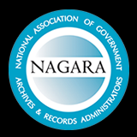
My PATH TO DP: 4 Years @ preservica

Slide 14
Dpcmm Overview
Based on functional specifications of ISO 14721, ISO 16363, and good practices from operational digital repositories
Systems-based tool for charting an evolutionary path towards increasingly mature stages of digital preservation capability
Assessment methodology “scores” organizations on current state capabilities
Helps organizations establish priorities, align to mission and mandates, and communicate effectively with stakeholders

Slide 15
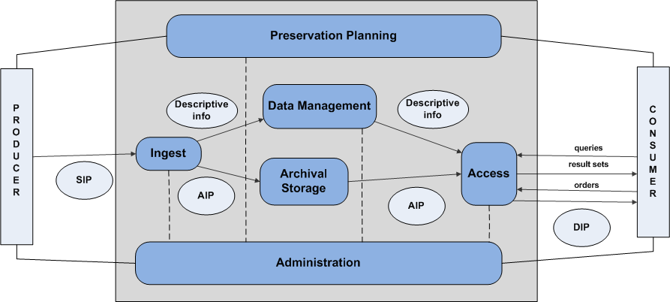
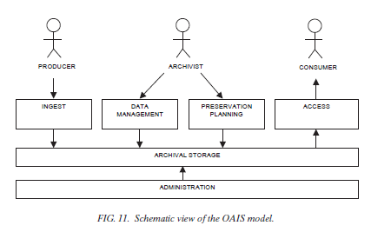
Open Archival Information System (OAIS) Reference Model – ISO 14721
High-level, generic reference model for the environment, producers, users, data types, and information flows of a digital repository

Slide 16
Repository certification – iso 16363
This International Standard defines a recommended practice for assessing the trustworthiness of digital repositories.
Applicable to the entire range of digital repositories.
This International Standard can be used as a basis for certification.

Slide 17
ISO 16363 categories
Organizational Infrastructure
Governance and Organizational Viability
Organizational Structure and Staffing
Procedural Accountability and Preservation Policy Framework
Financial Sustainability
Contracts, Licenses, and Liabilities
Digital Object Management
Ingest: Acquisition of Content
Ingest: Creation of the AIP
Preservation Planning
AIP Preservation
Information Management
Access Management
Infrastructure and Security Risk Management
Technical Infrastructure Risk Management
Security Risk Management

Slide 18
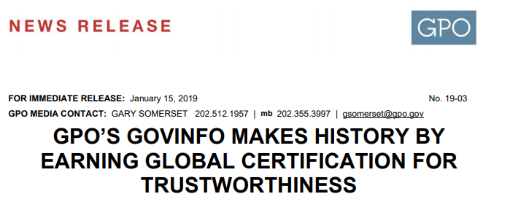
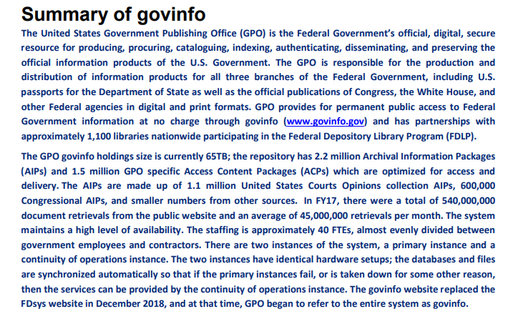
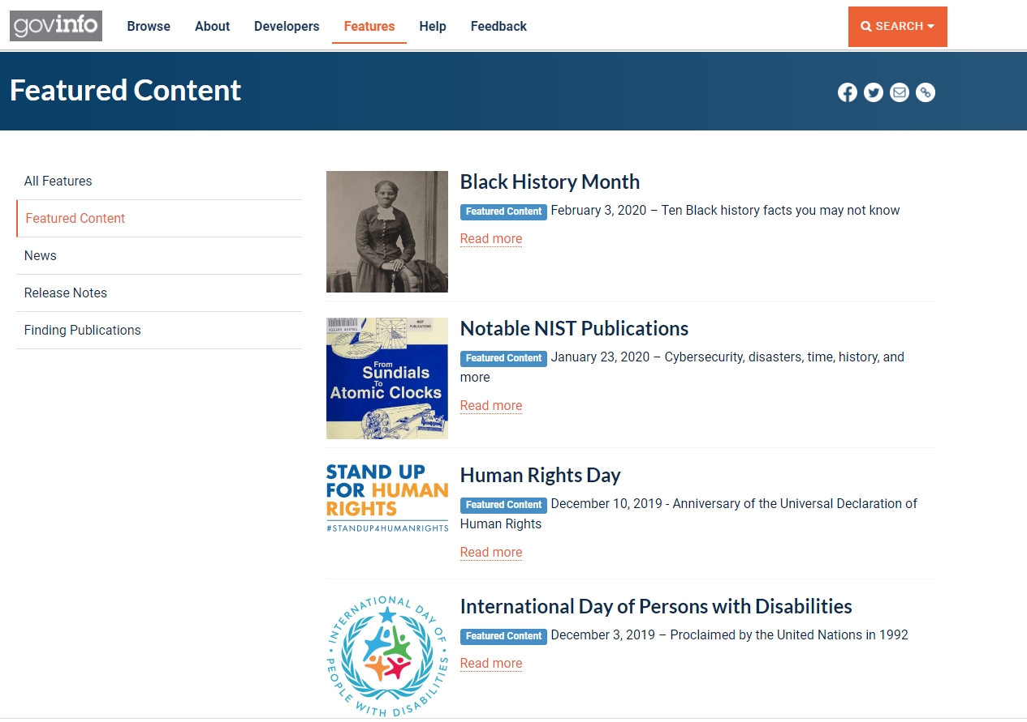
Check out the two BACKER blog posts on GPO
Exemplar –Trusted Digital Repository
certified to ISO 16363
Notes:
GPO is the authoritative national source for descriptive and subject cataloging for Federal Government documents.
In creating full bibliographic records for the Catalog, GPO's Office of Library Technical Information Services (LTIS), Bibliographic Control Section (BCS) adheres to the bibliographic standards set forth in the Resource Description and Access (RDA), Library of Congress Rule Interpretations, MARC21, CONSER, OCLC's Bibliographic Formats and Standards, 2nd ed., GPO Cataloging Guidelines, and other national standards.

Slide 19
Digital preservation capability maturity model (DPCMM)
How it works

Slide 20
Digital Preservation capability maturity model (DPCMM)

Slide 21
Preservation Infrastructure
Digital Preservation Policy
Digital Preservation Strategy
Governance
Collaborative Engagement
Technical Expertise
Open Standard Technology Neutral (OS/TN) Formats
Designated Community
Electronic Records Survey

Slide 22
Preservation Services
Ingest
Archival Storage
Device/Media Renewal
Integrity
Security
Preservation Metadata
Access

Slide 23
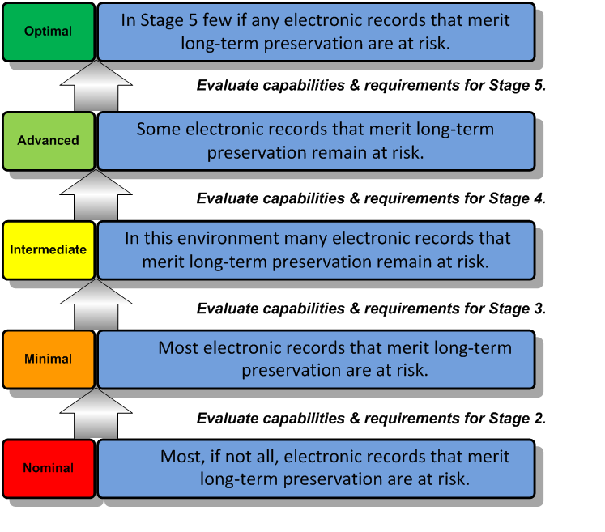
DPcmm Capability Stages
Five (5) progressively advanced capability levels
Enables high level assessment of an organization’s current digital preservation capabilities against good practice standard
Facilitates development of strategic roadmap for incremental levels of improvement based on
risk exposure and asset value
business requirements
available resources
Adaptable to virtually any organization

Slide 24
One Size Does Not Fit All
DPCMM intended to be a flexible approach that can be adapted to specific requirements and resources
Use to identify current state capabilities of digital preservation which forms the basis for debate and dialogue regarding the desired future state of archival repositories and the level of electronic records management risk that the organization is willing to take on
What is “good enough” to fulfill the organization’s mission and meet the expectations of its stakeholders?

Slide 25
Without preservation, there is no access

Slide 26
DPCMM Use Cases
How it is used

Slide 27
DPCMM Strengths
Breaks digital preservation into clearly defined components
Enables the setting of priorities based on risk, requirements and resources
Supports incremental improvement
Documents and celebrates progress and accomplishments
Establishes business case for additional resources
Can provide basis for virtualized preservation services

Slide 28
First DCPMM Use Case - 2010
Public Sector – Major North American City
Phase 1 - Digital Preservation Problem Definition and Best Practices
Phase 2 – Digital Preservation Needs Assessment
Phase 3 – Long-Term Digital Information Preservation Strategy
People
Process
Technology

Slide 29
Digital Preservation Capability Improvement Road Map
 | Current | Year 1 | Year 2 | Year 3 | Year 4 | Year 5 | Difficulty
Reference Model Components
INFRASTRUCTURE
Policy | 1 | 2 |  |  | 3 |  | LOW
Strategy | 0 | 2 |  |  | 3 |  | MEDIUM
Governance | 0 | 1 | 2 | 3 |  |  | MEDIUM
Collaboration | 1 | 2 |  | 3 |  |  | MEDIUM
Technical Expertise | 1 |  |  | 2 |  | 3 | MEDIUM
Open Standard Technology Neutral File Formats | 1 |  | 2 |  | 3 |  | MEDIUM
Designated Community | 1 |  | 2 |  | 3 |  | MEDIUM

Slide 30
Digital Preservation Capability Improvement Road Map
 | Current | Year 1 | Year 2 | Year 3 | Year 4 | Year 5 | Difficulty
Reference Model Components
PROCESSES
Electronic Records Survey | 1 |  | 2 | 3 |  |  | MEDIUM
Ingest | 0 |  |  | 1 |  | 2 | HIGH
Archival Storage | 0 |  |  | 1 | 2 |  | LOW
Media & Device Renewal | 1 |  |  | 2 |  | 3 | MEDIUM
Integrity | 0 |  |  |  | 1 | 2 | MEDIUM
Security | 1 |  |  | 2 |  | 3 | MEDIUM
Preservation Metadata | 0 |  |  | 1 | 2 | 3 | MEDIUM
Access | 1 |  |  |  | 2 |  | MEDIUM

Slide 31
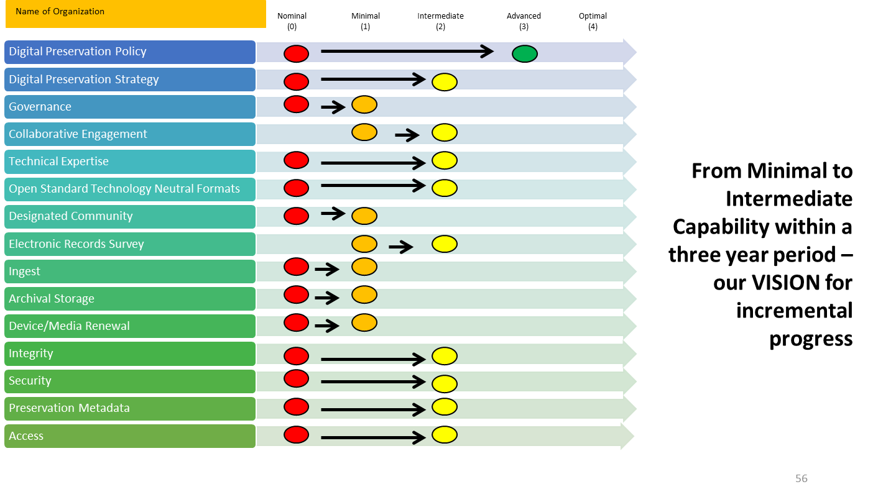
Create a Vision for Improved Digital Preservation Capability

Slide 32
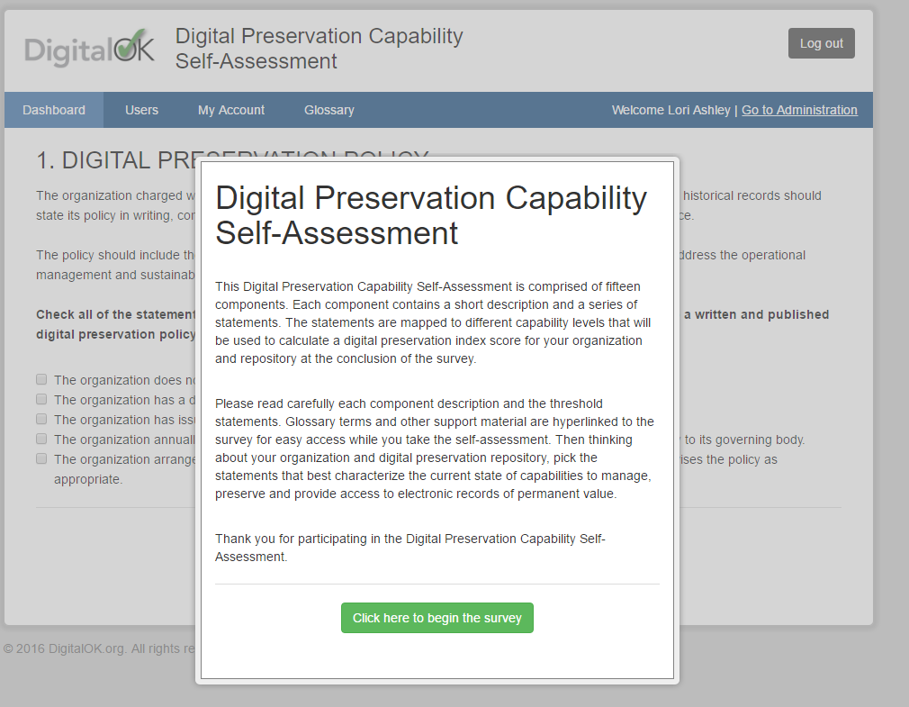

Slide 33
Croatian Government Agency
(analog to US FDA)
Score – 32/60

Slide 34
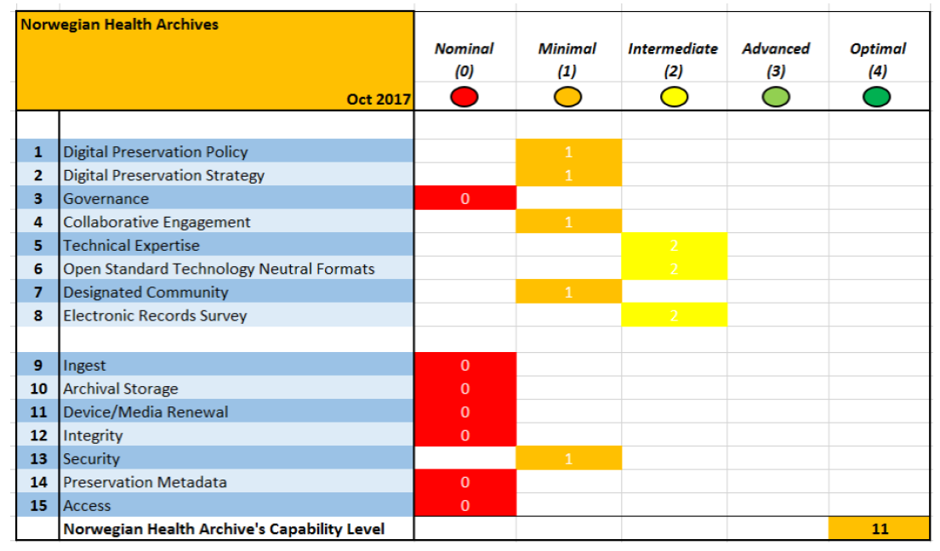
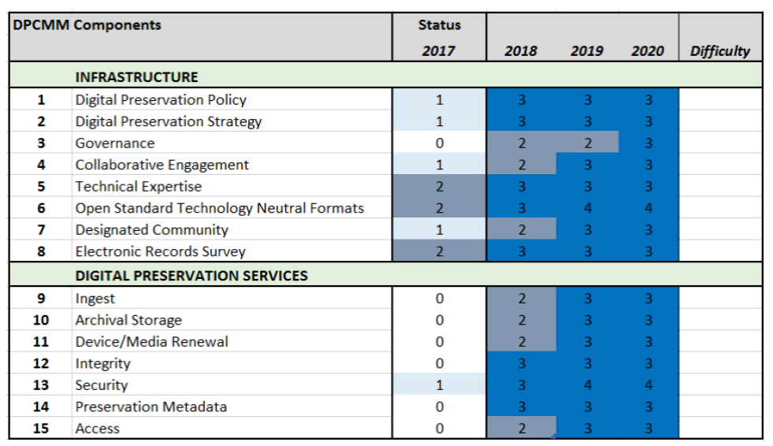
2017-2020 – Norwegian Health Archive
International Council on Archives Mobile Archives Standardization Tool (MAST)
The Mobile Archives Standardization Tool (MAST)© was conceived as a practical tool for records management and archives practitioners who are working in low resource environments, such as Africa, Caribbean and South America. Low resource mean low availability of electrical service, low connectivity, and limited professional records and archives management expertise.
Use of mobile technology, combined with additional functionalities, is intended to directly support implementation of e-government administrative reforms, access to information, and adequate management and preservation of digital records.

Slide 35
2019 SAA Conference Poster Session
Notes:
2019 SAA Annual Conference – Poster Session

Slide 36
How DPCMM helps practitioners
A road-tested assessment methodology to benchmark current capabilities to preserve and provide access to long-term digital records
Supports establishment of priorities and tracking progress
Supports stakeholder engagement and education on requirements and standards

Slide 37
CoSA DPC Self-Assessment
History & Benefits

Slide 38
ELECTRONIC RECORDS SURVEY - 2010
Council of State Archivists (CoSA)
LSTA grant from Indiana State Library in cooperation with Indiana State Archives
Collect data in surveys and telephone interviews with state/territory Archives
Support comprehensive profile of the status of electronic records management programs
Use composite profile along with profiles of selected states to develop high priority needs and recommendations for follow-on actions

Slide 39
Overall Composite Score based on informal DPC ASSESSMENT
Almost one half of respondents registered an absolute Nominal capability score on each of the 15 key elements
Removing these 21 state/territory Archives means the remaining respondents scored nearly 6 – still at the low end of the Minimal capability range
6

Slide 40
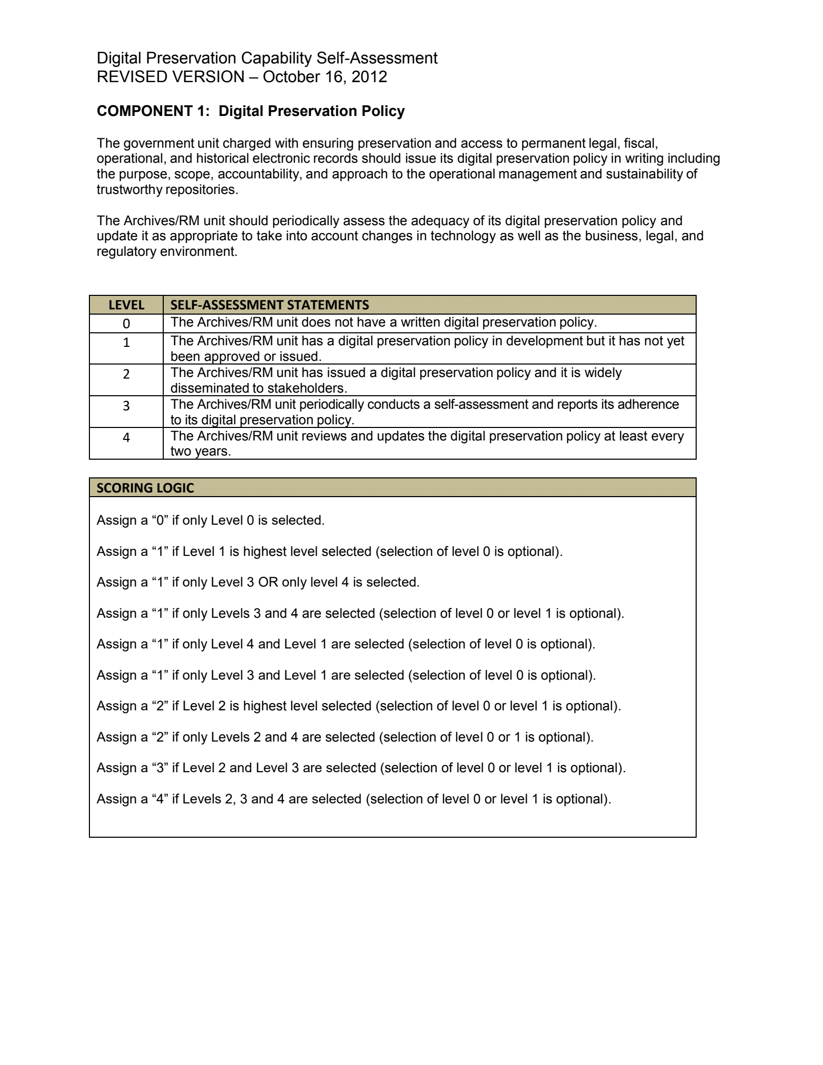
Adapting DPCMM into self-assessment for cosa members
Shout out to Beth Shields (Kentucky) and Matt Veatch (Kansas)

Slide 41
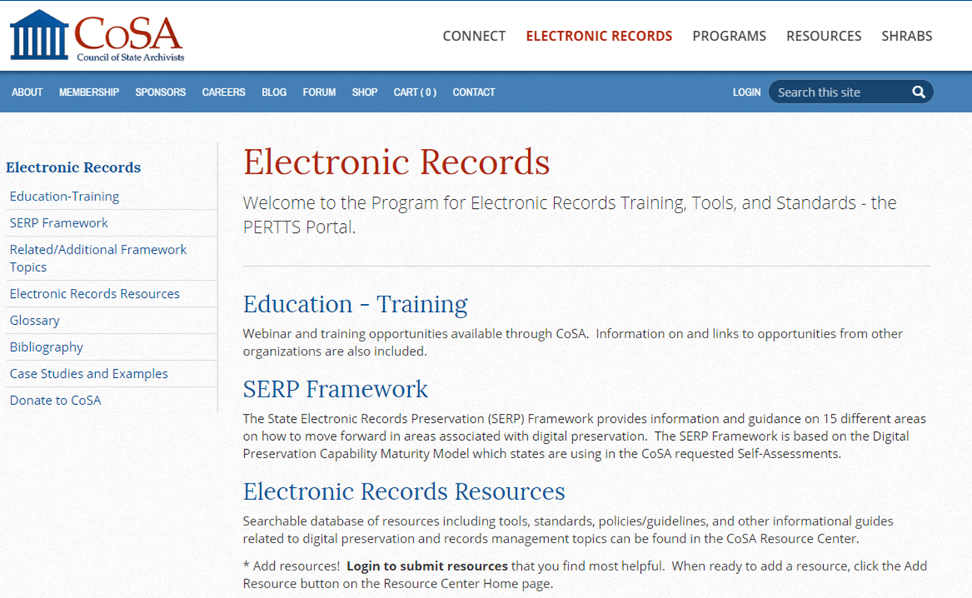
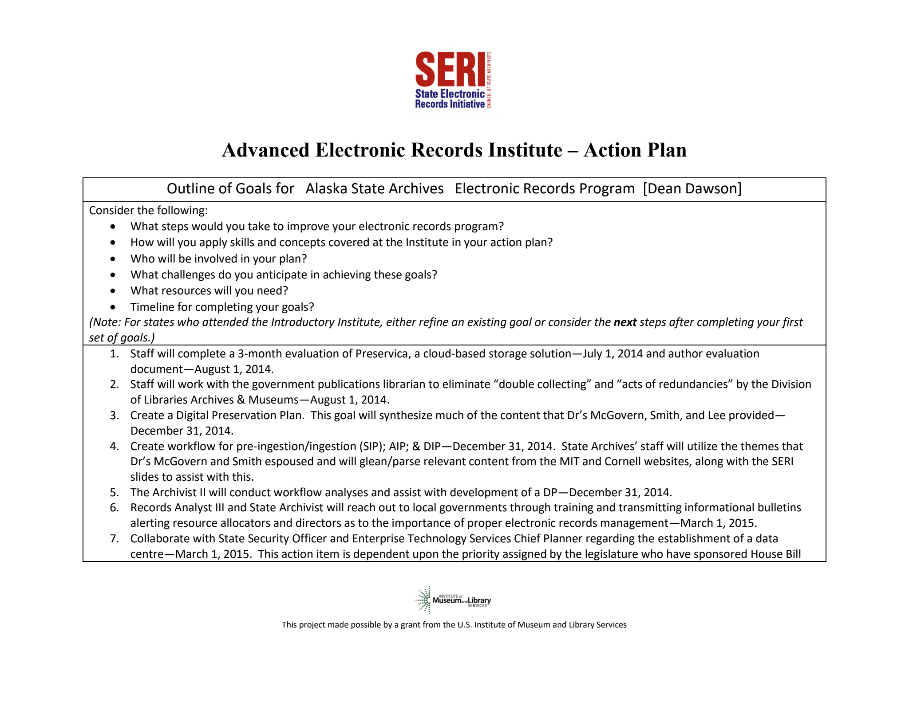
2012 Digital Preservation Capability Self-Assessment based on DPCMM
Notes:
First introduced in 2007, the Digital Preservation Capability Maturity Model (DPCMM) offers 15 elements and corresponding performance metrics based on selected specifications of international standards (ISO 14721 and ISO 16363) and best operational practices and guidelines. DPCMM complements the guidelines of IAEA TRS #467, Long-Term Preservation of Information for Decommissioning Projects.
The model is designed to assist records and information management practitioners in measuring capabilities of current ECM systems and records repositories; report gaps to stakeholders; and establish priorities and performance metrics for achieving enhanced digital preservation capabilities for long-term and permanent electronic records of operational, legal/regulatory, compliance, and corporate memory value.
This presentation provides an overview of a web-based self-assessment tool based on DPCMM that is available at www.DigitalOK.org.

Slide 42
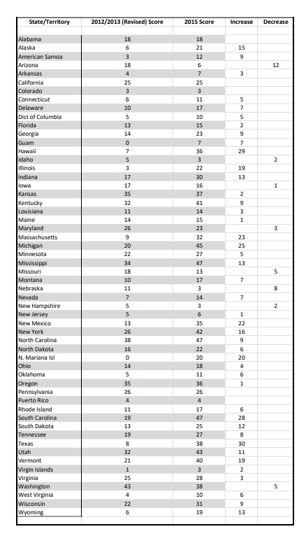
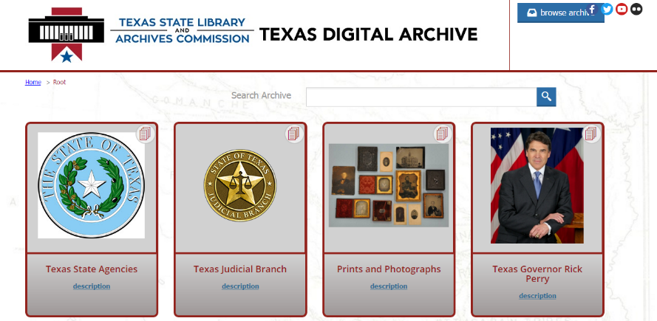
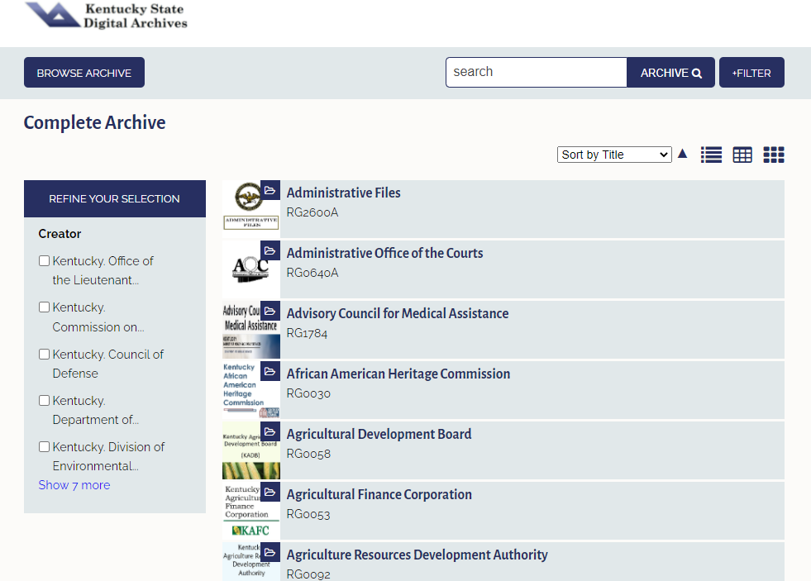
2015 Digital Preservation Capability Self-Assessment based on DPCMM

Slide 43
SERP FRAMEWORK

Slide 44
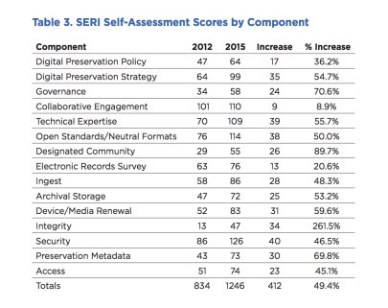
2022 CoSA DPC self-assessment survey

Slide 45
objectives
Gather insight into needed improvements for digital preservation and access in state and territorial archives
Use standard model for mapping progress in various archival components
Analyze longitudinal data to provide the foundation for development and implementation of the BACKER project training, mentoring and educational activities
Support CoSA evaluate effectiveness and efficacy of its efforts
Refresh the State Electronic Records Program (SERP) Framework

Slide 46
Scope
Administer self-assessment at beginning and end of BACKER project (2022 & 2024)
Permanent electronic government records
State or Local Government
Collections from any/all Branches
Seeking to match high level of participation in 2012 and 2015 surveys
Open survey period of approximately 3 weeks
Scorecard and survey response
Responses from each round will be aggregated and analyzed forming the basis of executive summaries of findings

Slide 47
Preservation Infrastructure
Digital Preservation Policy
Digital Preservation Strategy
Governance
Collaborative Engagement
Technical Expertise
Open Standard Technology Neutral (OS/TN) Formats
Designated Community
Electronic Records Survey

Slide 48
1. Digital Preservation Policy
The organization charged with preservation and access to permanent electronic government records should issue its digital preservation policy in writing including the purpose, scope, accountability, and approach to the operational management and sustainability of trustworthy digital repositories.

Slide 49
1. Digital preservation policy
Check all the statements below that accurately describe the status of the Archives/Records Management unit with regard to a written and published digital preservation policy.
The Archives/RM unit does not have a written digital preservation policy.
The Archives/RM unit has a digital preservation policy in development, but it has not yet been approved or issued.
The Archives/RM unit has issued a digital preservation policy and it is widely disseminated to stakeholders.
The digital preservation policy is routinely audited for compliance.
The Archives/RM unit reviews and updates the digital preservation policy at least every two years.
The digital preservation policy is continuously reviewed and updated as needed.
The digital preservation policy serves as a model for at least three other digital preservation programs.

Slide 50
Preservation Services
If you do not currently have a digital repository that conforms to ISO 14721, you will select the FIRST response statement for most of the DPC services components.
Ingest
Archival Storage
Device/Media Renewal
Integrity
Security
Preservation Metadata
Access

Slide 51
Compliance with ISO 14721/ISO 16363
Does your digital archival repository comply with the functional specifications of the ISO 14721 standard on open archival information systems (OAIS)?
Yes No
Does your digital archival repository currently conform to the certification and audit criteria of the ISO 16363 standard? Yes No

Slide 52
15. ACCESS
Organizations with a mandate to support public access to permanent electronic government records are subject to authorized restrictions. An ISO 14721 conforming digital repository will provide consumers with trustworthy records in “disclosure free” Dissemination Information Packages (DIPs) redacted to protect, privacy, confidentiality, and other rights where appropriate, and searchable metadata that users can query to identify and retrieve records of interest to them. Production of DIPs is tracked, especially when they involve extractions, to verify their trustworthiness and to identify query trends that are used to update electronic accessibility tools to support these trends.

Slide 53
15. ACCESS
Check all the statements below that accurately describe the capability of the digital archival repository to support access by users to Dissemination Information Packages (DIPs). NOTE: If there is no current digital repository, please check the first self-assessment statement.
The digital repository has no capability to support access to permanent electronic government records in its custody.
The digital repository provides copies of partially conforming ISO 14721 DIPs in at least one (1) format (e.g., digital photographs in JPEG 2000).
The digital repository supports access only to partially conforming ISO 14721 DIPs in at least one (1) format (e.g., digital photographs in JPEG 2000).
The digital repository provides copies of partially conformation ISO 14721 DIPs in at two (2) open standard technology neutral (OS/TN) file formats (e.g., PDF/A, JPEG 2000, or TIFF).
The ISO 14721 conforming digital repository produces DIPs in at least six (6) open standard technology neutral (OS/TN) file formats.
The ISO 14721 conforming digital repository analyzes user query trends to identify the need for updated accessibility tools.
The ISO 14721 conforming digital repository disseminates DIPs containing records in any format that users request.
The ISO 14721 conforming digital repository enables redaction of electronic records with access restrictions in its custody where appropriate.
The security of permanent electronic records in the digital repository is protected through comprehensive role-based access rights management.
Two live instances of the digital repository are maintained in two separate locations.
Three live instances of the digital repository are maintained in three different locations.
The digital repository continuously monitors security protection processes and revises them in response to evolving technology capabilities and changing business requirements.

Slide 54
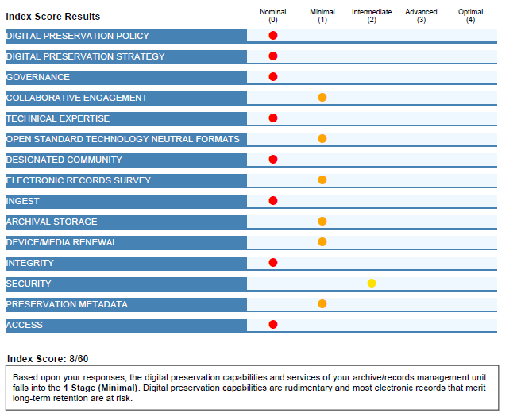
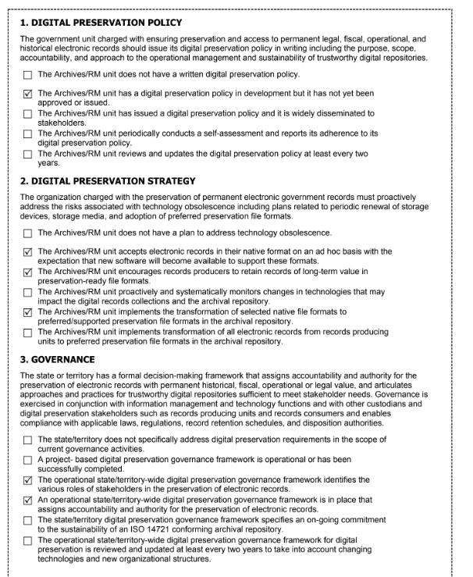
OUTPUTS
Scorecard
Survey with selected responses

Slide 55
POST-Survey activities
Scores will be aggregated and analyzed
Report on trends and findings with an executive summary
Live Q&A Session
Best practices and guidelines documents aimed at supporting developing digital preservation activities

Slide 56
Questions & feedback
Feel free to reach out with to:
Michelle Gallinger
mgallinger@gallingerconsult.com
Lori Ashley
loriashley@wi.rr.com

Slide 57
Stay connected & informed
CoSA Website
CoSA Resource Center
CoSA Twitter Handle: @StateArchivists
CoSA Facebook Page
CoSA YouTube Channel

