Slide 1
Selecting a Preservation Platform
Use the chat box at the right of the screen to tell us who you are, where you’re from, and who is participating with you today.
(To open the chat window, click on the CHAT icon in the upper right corner.)
Connect to the audio portion of the webinar through your phone line or through VoIP.

Slide 2
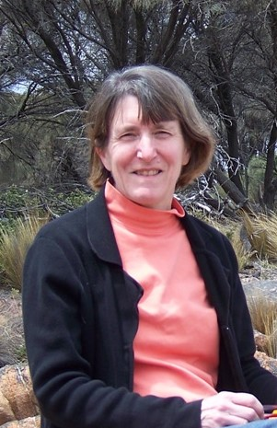
Welcome!
Spring 2020-2021 SERI webinars
April: Wrapping Up RATOM: A Summary and Lessons Learned from the Review, Appraisal, and Triage of Mail Project
May: Building a National Finding Aid Network Update
June: Building Your Resume for the Digital Age
From the Resource Center
Tools
https://www.statearchivists.org/resource-center/resource-library/?resourceType=2
[Community Owned digital Preservation Tool Registry (COPTR)
https://www.statearchivists.org/resource-center/resource-library/community-owned-digital-preservation-tool-registry-coptr/?resourceType=5&ccm_paging_p=2
Barbara Austen
Connecticut State Library

Slide 3
SERI Online recordings
FAQ’s on Bit Rot
https://www.youtube.com/watch?v=a50B801U0RA
Making the Pitch for Electronic Records
https://www.youtube.com/watch?v=35xLibzrIew
Key Concepts in Digital Processing
https://www.youtube.com/watch?v=EIMiIs873uk

Slide 4
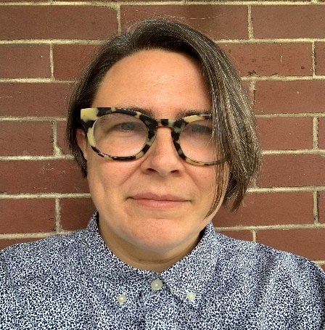
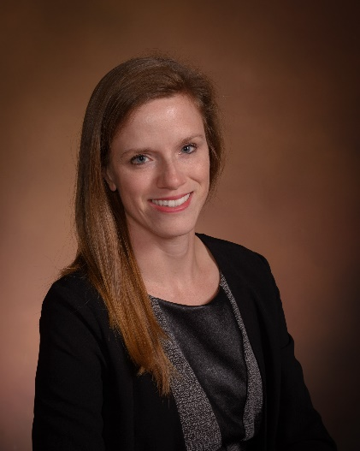
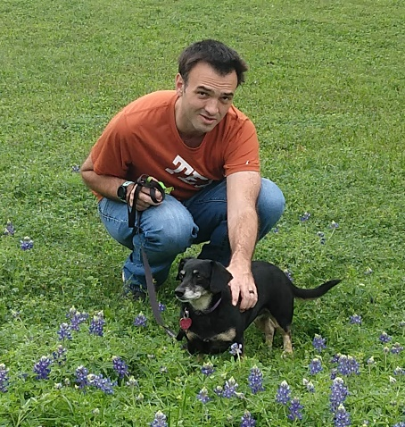
Today’s presenterS
Suzanne Stasiulatis
Pennsylvania State Archives
Brian Thomas
Texas State Library and Archives Commission
Jamie Patrick-Burns
North Carolina State Archives

Slide 5
Digital Preservation: Steps to Procurement
Developed by the SERI Education & Programming Subcommittee
A Program of the Council of State Archivists
2021
Notes:
Welcome to the 2020 Council of State Archivists’ Video Series.
This video has been prepared by the State Electronic Records Initiative subcommittees.
In this video, we will provide guidance on developing an elevator pitch for your organization’s electronic records initiatives.

Slide 6
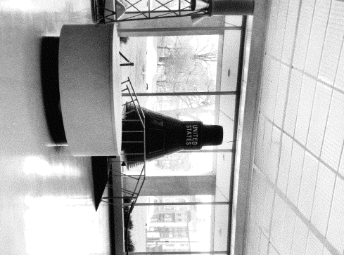
PENNSYLVANIA STATE ARCHIVES
Pennsylvania State Archives Mission
The Pennsylvania State Archives collects, preserves and makes available for study the permanently-valuable public records of the Commonwealth, with particular attention given to the records of state government. The State Archives also collects papers of private citizens and organizations relevant to Pennsylvania history.
Notes:
First, what is an elevator pitch?
An elevator pitch is a short, persuasive speech designed to promote a product, service, or project in the time it takes to ride an elevator.
It’s a great way to engage new stakeholders in a world where time and attention are precious commodities.

Slide 7
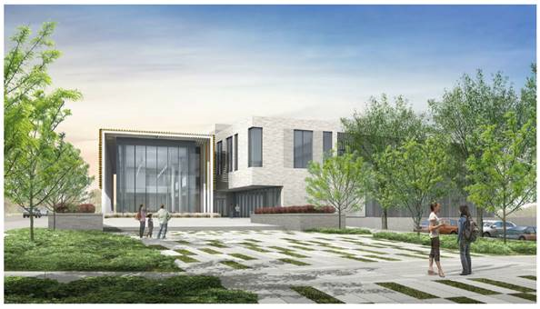
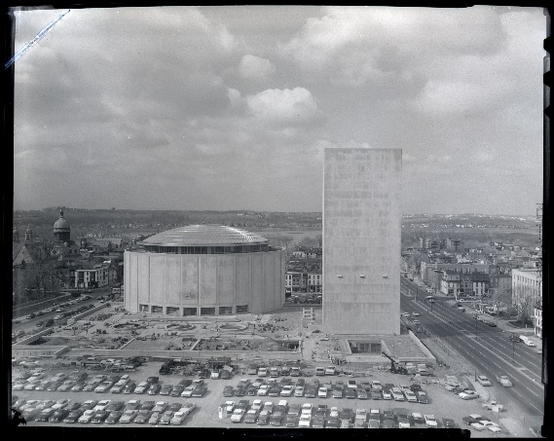
BACKGROUND
PSA is in the process of procuring a digital preservation system. We do not endorse any one program or system.
Ongoing Process – Eyes on a digital preservation system procurement since 2015
Current - Joint Digital Archives/Digital Records Center approach Goal: New Building, New Preservation System
Notes:
Before you can create your elevator speech, you must first determine your:
Objective - what are you advocating for? what do you hope to achieve?
Audience - who are you talking to and why should they care?
Needs - what resources do you require to achieve your objective?
Solution - how can this person help you? do you need money, volunteers, or technical support?

Slide 8
PRELIMINARY PROCESSES AND PROCEDURES
Digital World Challenges:
Inherent complexity of bits and bytes
Integrity
Renderability
Transfer
Obsolescence of programs and formats
Bit rot
Notes:
Before you can create your elevator speech, you must first determine your:
Objective - what are you advocating for? what do you hope to achieve?
Audience - who are you talking to and why should they care?
Needs - what resources do you require to achieve your objective?
Solution - how can this person help you? do you need money, volunteers, or technical support?

Slide 9
TOOL IMPLEMENTATION – KEY FACTORS
ASSESSMENT:
Research tools and systems
COSA Resource Center: https://www.statearchivists.org/resource-center/resource-library/
COPTR: https://coptr.digipres.org/Main_Page
Input from Other States
Input from the preservation community
TESTING
STAFF TRAINING
Digital Preservation tools and methods are constantly changing
Basic ideas persist
Notes:
Before you can create your elevator speech, you must first determine your:
Objective - what are you advocating for? what do you hope to achieve?
Audience - who are you talking to and why should they care?
Needs - what resources do you require to achieve your objective?
Solution - how can this person help you? do you need money, volunteers, or technical support?

Slide 10
TOOL IMPLEMENTATION – PROCESS Example: File Renaming
Stated Need
Solution Comparison
Buy-In
Download to VM
Document/Test Features
Buy-in
Develop Workflow
Implement
Notes:
Before you can create your elevator speech, you must first determine your:
Objective - what are you advocating for? what do you hope to achieve?
Audience - who are you talking to and why should they care?
Needs - what resources do you require to achieve your objective?
Solution - how can this person help you? do you need money, volunteers, or technical support?

Slide 11
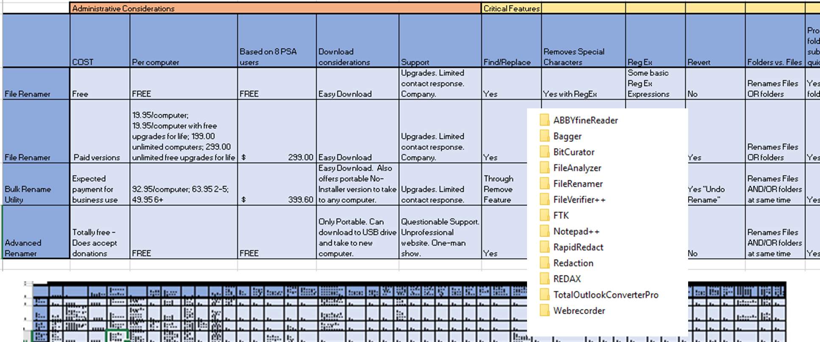
ASSESSEMENT MEASURES Assessment Matrixes
Notes:
Before you can create your elevator speech, you must first determine your:
Objective - what are you advocating for? what do you hope to achieve?
Audience - who are you talking to and why should they care?
Needs - what resources do you require to achieve your objective?
Solution - how can this person help you? do you need money, volunteers, or technical support?

Slide 12
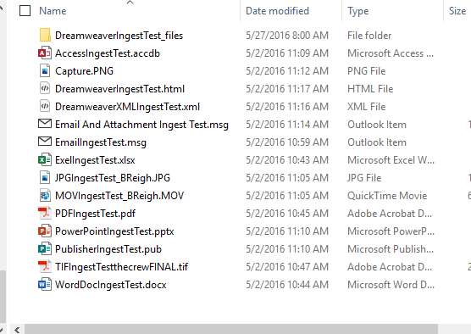
TESTING FORMATS
Notes:
Before you can create your elevator speech, you must first determine your:
Objective - what are you advocating for? what do you hope to achieve?
Audience - who are you talking to and why should they care?
Needs - what resources do you require to achieve your objective?
Solution - how can this person help you? do you need money, volunteers, or technical support?

Slide 13
TESTING LENGTH
Notes:
Before you can create your elevator speech, you must first determine your:
Objective - what are you advocating for? what do you hope to achieve?
Audience - who are you talking to and why should they care?
Needs - what resources do you require to achieve your objective?
Solution - how can this person help you? do you need money, volunteers, or technical support?

Slide 14
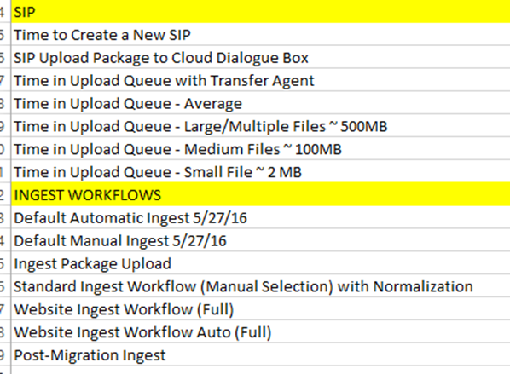
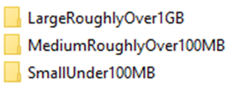
TESTING PERFORMANCE
Notes:
Before you can create your elevator speech, you must first determine your:
Objective - what are you advocating for? what do you hope to achieve?
Audience - who are you talking to and why should they care?
Needs - what resources do you require to achieve your objective?
Solution - how can this person help you? do you need money, volunteers, or technical support?

Slide 15
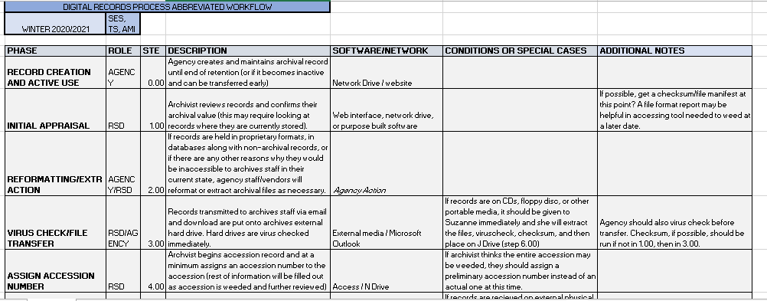
WORKFLOWS
Community Input
Evaluation
Tweaked at every step
Before implementation
During implementation
After implementation

Slide 16
ADDITONAL ITEMS – SUPPORT TOOLS
Crosswalks
XML Transform Tools
Support spreadsheets
Notes:
Before you can create your elevator speech, you must first determine your:
Objective - what are you advocating for? what do you hope to achieve?
Audience - who are you talking to and why should they care?
Needs - what resources do you require to achieve your objective?
Solution - how can this person help you? do you need money, volunteers, or technical support?

Slide 17
DIGI-PRES TEMPORARY SOLUTIONS
Procurement is a lengthy process
Ask what can you do now
Bagger/Bag-IT Specification
Ingestable
Open Source
Issues Persist, Develop
Video Files
Profile Changes
VPN
Notes:
Before you can create your elevator speech, you must first determine your:
Objective - what are you advocating for? what do you hope to achieve?
Audience - who are you talking to and why should they care?
Needs - what resources do you require to achieve your objective?
Solution - how can this person help you? do you need money, volunteers, or technical support?

Slide 18
PREVIEWING SOLUTIONS
Optional Trial Versions
Demos If Offered
Allows for
Training/Awareness
Encourages Dialogue
Notes:
Before you can create your elevator speech, you must first determine your:
Objective - what are you advocating for? what do you hope to achieve?
Audience - who are you talking to and why should they care?
Needs - what resources do you require to achieve your objective?
Solution - how can this person help you? do you need money, volunteers, or technical support?

Slide 19
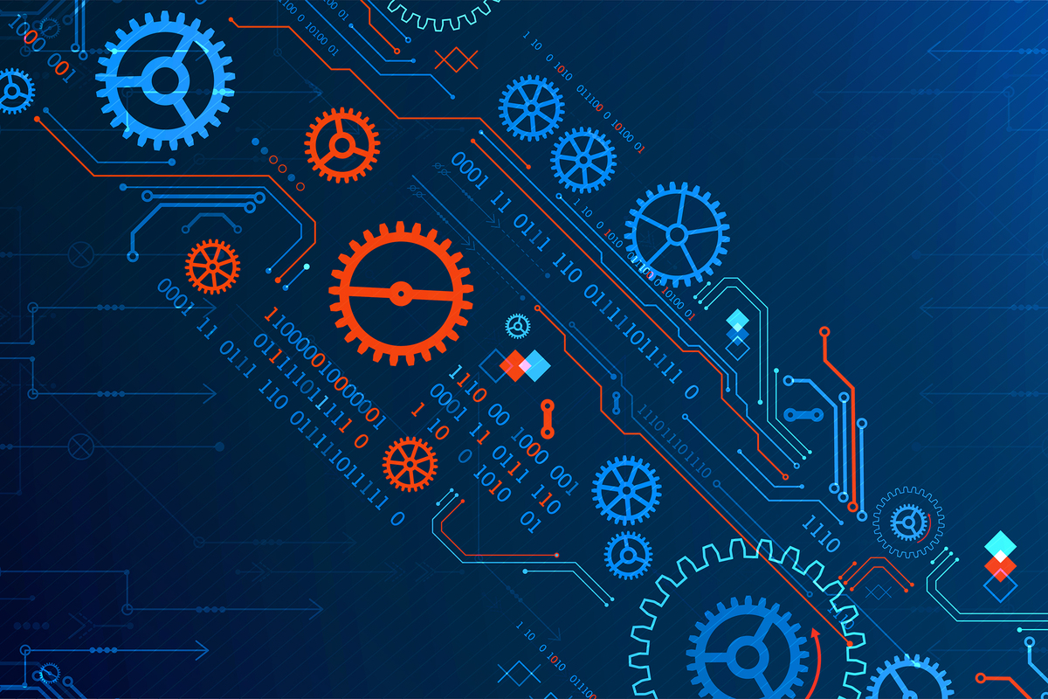
Virtual Machine

Slide 20
PRELIMINARY STEPS
Review TDR/TRAC Guidance
redline, highlight, debate – repeat
open discussion
Find intersections with current processes, team interactions, knowledge
What is implemented in other institutions
What works, what doesn’t
Model justifications
Notes:
Before you can create your elevator speech, you must first determine your:
Objective - what are you advocating for? what do you hope to achieve?
Audience - who are you talking to and why should they care?
Needs - what resources do you require to achieve your objective?
Solution - how can this person help you? do you need money, volunteers, or technical support?

Slide 21
PROJECT MANAGEMENT
Purpose / Need
Project Manager (PM)
Cooperation with OAIT
Defined process for procurement
Staff support
3 Phases
Notes:
Before you can create your elevator speech, you must first determine your:
Objective - what are you advocating for? what do you hope to achieve?
Audience - who are you talking to and why should they care?
Needs - what resources do you require to achieve your objective?
Solution - how can this person help you? do you need money, volunteers, or technical support?

Slide 22
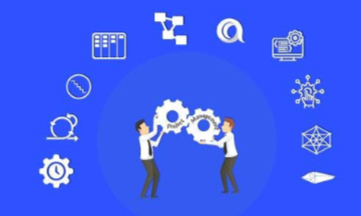
PROJECT MANAGEMENT PROCESS
Planning
Identify Stakeholders
Stakeholder responsibility and communication
Document the notional To-Be processes
Compile functional requirements
Notes:
Before you can create your elevator speech, you must first determine your:
Objective - what are you advocating for? what do you hope to achieve?
Audience - who are you talking to and why should they care?
Needs - what resources do you require to achieve your objective?
Solution - how can this person help you? do you need money, volunteers, or technical support?

Slide 23
PROJECT MANAGEMENT PROCESS
Solution Selection and Procurement
Produce an RFP and solicit vendors for responses
Evaluate vendor responses and product demonstrations
Select the most appropriate solution and execute procurement contracts pursuant to the Procurement Code
Notes:
Before you can create your elevator speech, you must first determine your:
Objective - what are you advocating for? what do you hope to achieve?
Audience - who are you talking to and why should they care?
Needs - what resources do you require to achieve your objective?
Solution - how can this person help you? do you need money, volunteers, or technical support?

Slide 24
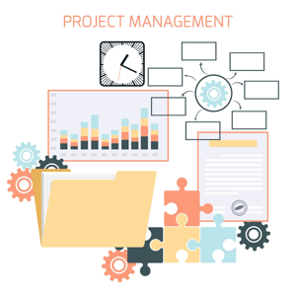
PROJECT MANAGEMENT PROCESS
Solution Implementation and Training
Configure and develop workflow
Establish corresponding processes, workflows and policies, including processes for migrating existing digital objects from disparate storage locations.
Fully test functionality, workflows, and processes
Produce user documentation
Provide Training and Knowledge Transfer
Notes:
Before you can create your elevator speech, you must first determine your:
Objective - what are you advocating for? what do you hope to achieve?
Audience - who are you talking to and why should they care?
Needs - what resources do you require to achieve your objective?
Solution - how can this person help you? do you need money, volunteers, or technical support?

Slide 25
Background
Process continues
On track for 2021 objectives
Notes:
Before you can create your elevator speech, you must first determine your:
Objective - what are you advocating for? what do you hope to achieve?
Audience - who are you talking to and why should they care?
Needs - what resources do you require to achieve your objective?
Solution - how can this person help you? do you need money, volunteers, or technical support?

Slide 26
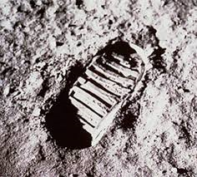
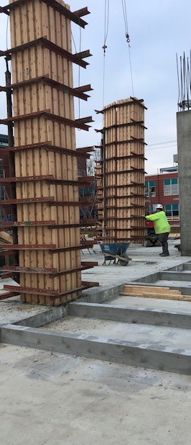
CONTACT
Suzanne Stasiulatis, Digital Archives Specialist,
Pennsylvania State Archives
Contact: sustasiula@pa.gov
https://www.nasa.gov/audience/forstudents/k-4/home/F_Apollo_11.html
Notes:
Before you can create your elevator speech, you must first determine your:
Objective - what are you advocating for? what do you hope to achieve?
Audience - who are you talking to and why should they care?
Needs - what resources do you require to achieve your objective?
Solution - how can this person help you? do you need money, volunteers, or technical support?

Slide 27
Selecting a digital preservation platform in north carolina
Jamie Patrick-Burns, Digital Archivist

Slide 28
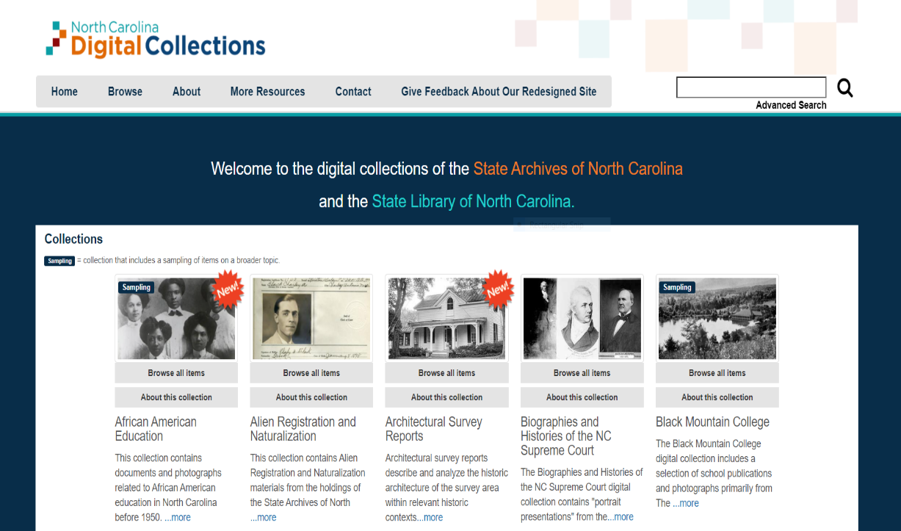
background
Digital preservation collaboration between State Archives and State Library
We selected and tested three different digital preservation platforms . . .
“We” being institutional, as there was staff turnover between testing
Notes:
For the state of NC, digital preservation is a joint effort between the State Archives and the State Library. We have distinctive but related collecting mandates and we’ve developed our digital preservation guidelines jointly, working closely together on things like storage management, subscriptions, and systems. Our digital repository houses state agency records, state publications, and special collections materials. I have here an image of our online access portal for digital collections, which as will discuss – is distinct from our digital preservation system or digital repository but it’s a snapshot into what we have in the way of digitized and born-digital records.
In 2014 the state archives and state library began the process of testing and selecting a digital preservation platform to bring together storage, tools, services and workflows that we had chained together in house. And by “we,” I mean the royal or institutional we; it’s been a process over several years with some turnover so I’m sharing institutional memory as well as my own.
I’ll talk through our experiences with the three systems we ended up testing, lessons learned from each round and some overall thoughts and recommendations.

Slide 29
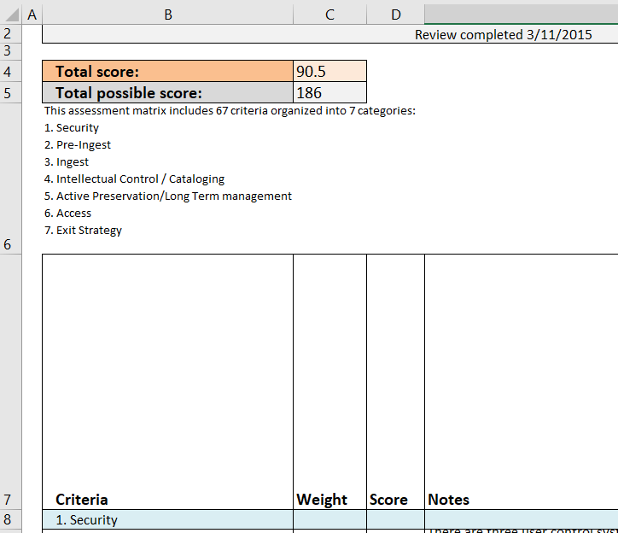
System 1
Testing began in November 2014
Staff created a spreadsheet of requirements/desired features based on the in-house repository requirements document
Categories of evaluation:
Security
Pre-ingest
Ingest
Intellectual Control/Cataloging
Active Preservation/Long Term Management
Access
Exit Strategy
Features were given a weight and scored on a scale of 1-5
Notes:
For the first digital preservation system, testing began in 2014. Staff took their existing repository requirements document and worked it into a spreadsheet of features to test, grouped into categories of security, pre-ingest, ingest, intellectual control or cataloging, active preservation, access, and exit strategy. Each feature was given a weight based on its importance and scored on a scale.

Slide 30
Lessons From First Evaluation
Method pros
Testing plan based on our own elaborated requirements
Note taking and reporting
Useful categories
Method cons
Staff turnover
Scoring subjective and not easily compared across systems
Test steps and data not easily reproduced
Notes:
From the first round of evaluation, there was a good foundation of evaluating the system against our state repository requirements. The groupings of different functions was a useful way of organizing the spreadsheet, and staff took notes and wrote up a final report. However, when it came time to test the next system, there were some challenges. First was staff turnover, and some loss of knowledge about the experiences with the first system. Next and relatedly, it was a challenge to reproduce the tests and compare results because of a lack of documentation and definition of the tests, or why the scores were given. The tests could not be reproduced, nor were the scores easily compared across systems

Slide 31
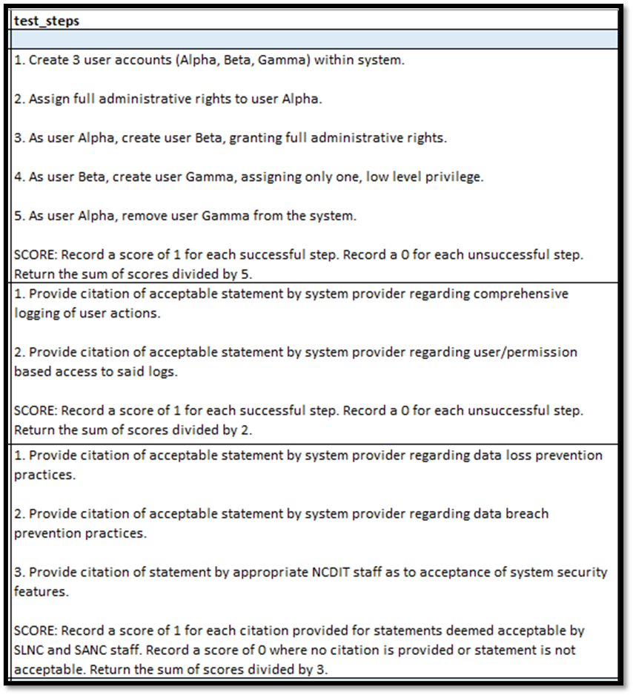
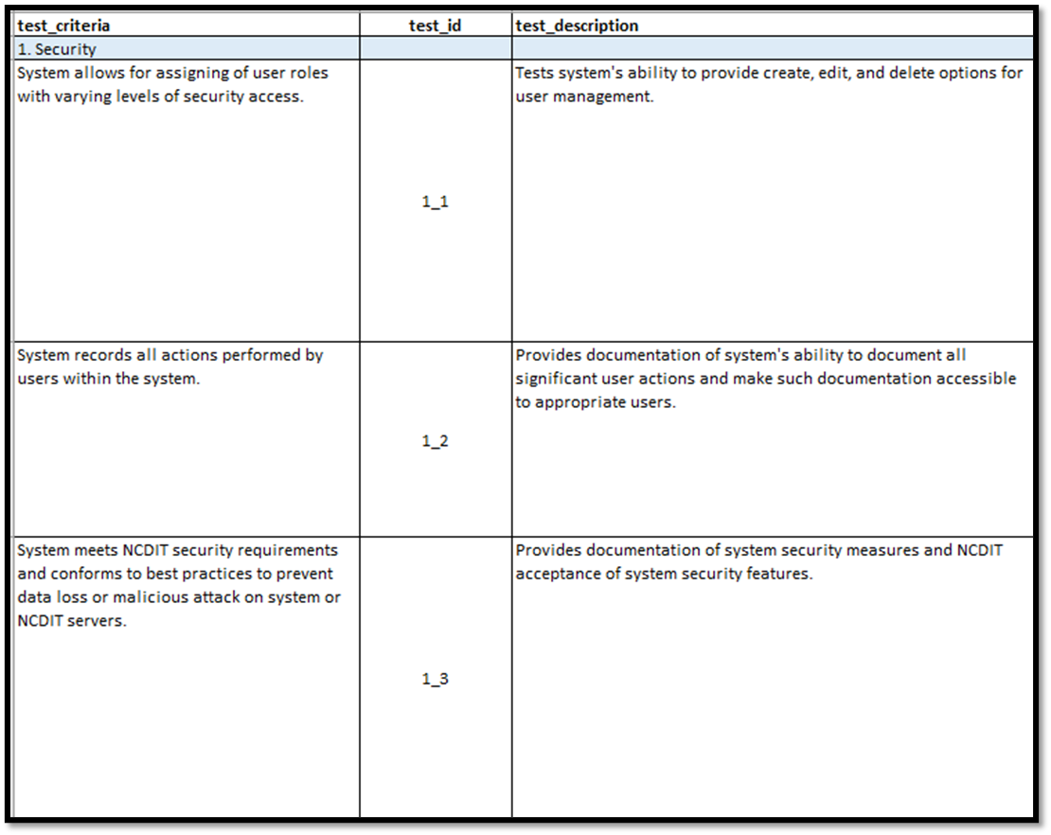
System 2
The spreadsheet of requirements was re-evaluated and updated
Digital preservation specific (not access, catalog integration, etc.)
Language in alignment with TRAC; defining criteria
Reproducible, pass/fail tests with specific instructions
Clarification of functional requirements (required vs. nice to have)
Notes:
So in 2015, the state library received a grant to test a new preservation system.
Half of the testing team was new hires, which was a challenge but also presented the opportunity to revisit the testing spreadsheet.
Existing document was thorough but based on pie in the sky criteria, not core requirements. Staff needed clarity on which requirements were key to digital preservation vs. what was a nice to have but not necessary feature, for example an access system and integration with the catalog.
Took 6-9 months to flesh out and revise the testing spreadsheet Took advantage of testing teams’ background in software testing and development. It was refined to include core digital preservation requirements, clearer definitions of terms in alignment with TRAC Trustworthy Repositories and Audit Certification criteria.
to be a matrix of clear, step-by-step tests that could be reproduced. Scoring was based on passing/failing tests and then taking an average of scores, so that approaching 1 meant it met the requirements. Here are a couple of screenshots of some tests, the description and steps to take in order to complete the test.

Slide 32
Lessons from second evaluation
Method pros
Datasets, detailed tests and evaluation criteria
Focus on digital preservation
Deep bench of software testing knowledge
Method cons
Took time to develop the matrix, but worth it
Notes:
For the second round of testing, test datasets and more objective tests made it easier to compare systems together and score them. There was a better sense of the requirements for digital preservation, rather than all desirable features and add ons for a repository. Taking time to develop the matrix took away from testing but left them with better evaluation; and staff turnover was again, an issue.

Slide 33
System 3
Testing began November 2016
Library and Archives used the same matrix and performed their tests separately, meeting occasionally and at the end to share results and questions
Archives team: Digital Services Head, Systems Integration Librarian, Digital Archivist
In early 2018, selected LibSafe and moved forward with purchasing, justification, and pilot project with more of our actual data
Notes:
Bringing us to – the third round of testing. We started in November of 2016, and when I joined in summer of 2017 testing was still underway. The library and archives used the same matrix developed previously and performed their tests separately, taking detailed notes and meeting occasionally and especially at the end to discuss our scoring, issues, any questions. In the Archives, it was me the digital archivist, digital services section head, and systems integration librarian doing the testing. And in early 2018 began moving forward with recommendation to purchase the system, justification for purchasing and piloting LibSafe.

Slide 34
Lessons from third evaluation
Method pros
Had a well-developed matrix to use for testing
Method cons
Some tests specific to the previous system
Some tests still didn’t anticipate issues with the real data
Extended timeline/turnover
Notes:
For the testing and selection of the third system, we definitely benefitted from the testing matrix. There were some tests that we found were specific to the previous system and we noted these, so as much as we were aiming for a matrix that could be applied across platforms, there was some amount of adaptation needed. Another issue was that the tests didn’t always anticipate the real messiness of our unstructured data that we found in piloting actual use, although it did deal with a good number of them. And the staff turnover/long testing timeline sometimes made keeping momentum difficult.

Slide 35
Overall recommendations
Detailed requirements
Clear, well-documented tests and evaluation
Knowing your IT, your infrastructure, your laws/requirements
Preparedness for staff turnover
Being flexible/adaptable
https://digital.ncdcr.gov/digital/collection/p16062coll10/id/36/rec/1 “Be a Marine--Free a Marine to Fight,” MilColl.WWII.Posters.2.5, WWII Papers, Military Collection
Notes:
Overall, lessons learned from the entire process include the importance of having well-established, documented requirements for your repository that distinguish between required vs. nice-to-have functionality or capabilities. Having clear, detailed tests that can be repeated and that are scored on a rubric or some kind of evaluation that can be documented. Knowing your IT and infrastructure capabilities and your IT’s restrictions or legal requirements – for example, having a local copy for us was required by statute so that you can work within your parameters. With all the planning you can do, it may be a lengthy process and staff turnover is always a challenge, in this arena as in others – so being adaptable, modifying as you go, and documenting what you do.

Slide 36
Questions?
Jamie Patrick-Burns
Digital Archivist, State Archives of North Carolina
Jamie.patrickburns@ncdcr.gov
919 814 6905

Slide 37
Selecting an Electronic Records Repository Platform
My experience at the South Carolina Department of Archives and History
Brian Thomas

Slide 38
2014: A new attempt
2009: New Director
2014: An electronic records issue prompts hardware/software funding
Installed August 2015
Search for an Electronic Records Archivist
Hired June 2014
4 step Process begins

Slide 39
The parameters
Records must be stored within the borders of South Carolina
Regional Backup/redundancy
Software must be easy to maintain
SaaS possible
On-premise is better
Maintenance package is okay too
If comparable products available, must go out for bid
Can do sole source if comparable does not exist
Allowed for testing/investigation

Slide 40
The plan
Research/literature review
Policy writing (draft)
Testing and evaluation
Self-assessment
Testing
Final recommendation and acquisition

Slide 41
Research/literature review
OAIS Standards
CCSDS 652.0-M-1: Audit and Certification of Trustworthy Digital Repositories
CCSDS 650.0-M-2: Reference Model for an Open Archival Information System
CCSDS 651.0-M-1: Producer-Archive Interface…Standard
LOC: TRAC Criteria and Checklist
Most useful of the bunch

Slide 42
Research/literature review continued
Metadata Standards
PREMIS
Dublin Core
EAD
EAC-CPF
ISAAD(G)
ISAAR
PROV
Linked Data
METS
MODS

Slide 43
Research/literature review continued
Articles
Format Standards and Recommendations
Repository Platform Options

Slide 44
Policy writing
Policy writing
Why policy writing before testing?
TRAC criteria used as guidelines
Metadata requirements drafted

Slide 45
Self-assessment
Self-assessment
What are the current financial resources?
What are the future financial resources?
Technology resources?
What about staffing?
What about cost of maintenance?

Slide 46
Policies and self-assessment

Slide 47
Policies and self-assessment

Slide 48
Policies and self-assessment

Slide 49
Policies and self-assessment

Slide 50
Policies and self-assessment

Slide 51
Policies and self-assessment

Slide 52
Policies and self-assessment

Slide 53
Final criteria reached
TIER 1
Integrated Repository Platform
Integrated access tools
TIER 2
Unintegrated Repository Platform
Some or all automated repository services
TIER 3
Manual preservation tools resulting in a repository
Automated repository services
Manual DIP connection to access or mediated access

Slide 54
testing
TIER 2
DAITSS
Digital Preservation Software Platform (DPSP)
Fedora
TIER 1
Hydra (not tested)
Dspace (previous experience)
Islandora
Archivematica/AtoM
Preservica

Slide 55
Method: Virtual Machines
PREP
Read platform documentation
Read dependency documentation
INSTALL
VMWare or VirtualBox
Install OS (typically Ubuntu 12.04 at the time)
TEST
Checklist of functionality/wishlist
Usability
Lesson learned: follow directions to the letter
Side-by-side testing

Slide 56
Final recommendation
Preservica as SOLE SOURCE
Full process outlined in article published with the Journal of Contemporary Archival Studies: https://elischolar.library.yale.edu/jcas/vol2/iss1/2

Slide 57
Notes about Selecting a repository platform for Texas
Prompted by Governor Perry’s leaving office in 2015
In-house or SaaS options available
No Geo-restrictions
In-house hosted by state data center
SaaS in Cloud requires an IT exemption, special data security
REQUIRED to seek bids as a “Request for Proposal” (RFP)
1: Electronic Records Staff hired
2: RFP drafted and published
3: Receipt and review of bids
4: Final selection on criteria match and cost

Slide 58
Questions?
About Texas
Brian Thomas
bthomas@tsl.texas.gov
512-475-3374
About South Carolina
Brian Thomas
brian.the.archivist@gmail.com
Bryan Collars
BCollars@scdah.sc.gov

Slide 59
Stay connected & informed
CoSA Website http://www.statearchivists.org
CoSA Twitter Handle @StateArchivists
CoSA Facebook Page www.facebook.com/CouncilOfStateArchivists

Slide 60
Webinar evaluation
We appreciate your feedback!
After you exit the webinar, you will automatically be taken to an online webinar evaluation.
Please take a couple of minutes to complete the survey and help us plan future webinars.

