Slide 1
CoSA Shop Talk Webinar
September 14, 2023
3 pm Eastern
Shop Talk with FamilySearch –
Recent Updates and Projects with FamilySearch
Disclaimer: This webinar is being recorded and will be available for viewing on the CoSA website.

Slide 2
Webinar Agenda
Welcome
Presentation from FamilySearch
Q and A
Announcements

Slide 3
Preservation and Access Acceleration
Recent Updates and Projects with FamilySearch
John de Jong – Area Manager – North America

Slide 4
Key Topics
Computer Assisted Indexing
Linking to Existing Images/Indexes
Hastening with Industry Friends

Slide 5
1. Computer Assisted Indexing

Slide 6
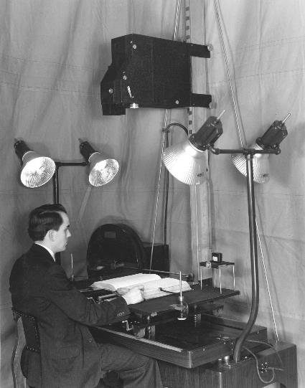
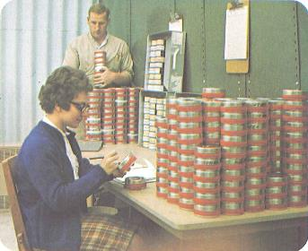
Microfilming started 1938
2.4 million rolls digitized by 2022

Slide 7
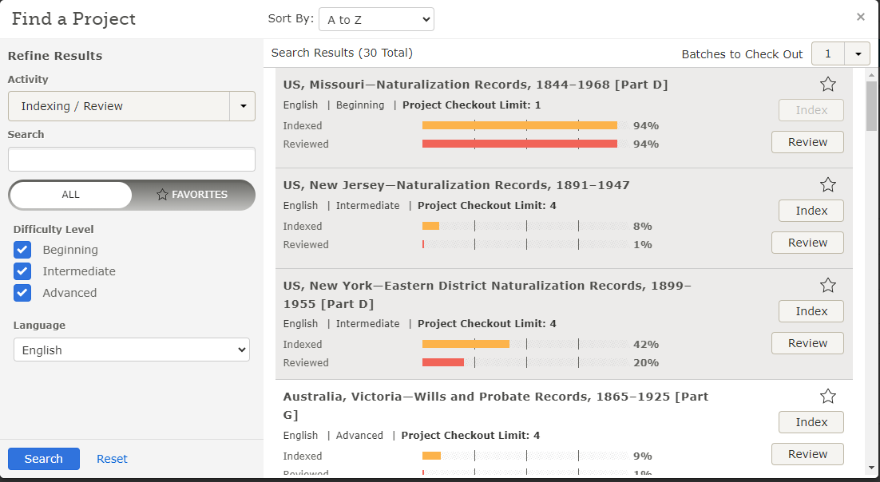
Why Linking?
More traffic to your website!
Sample Slides

Slide 8
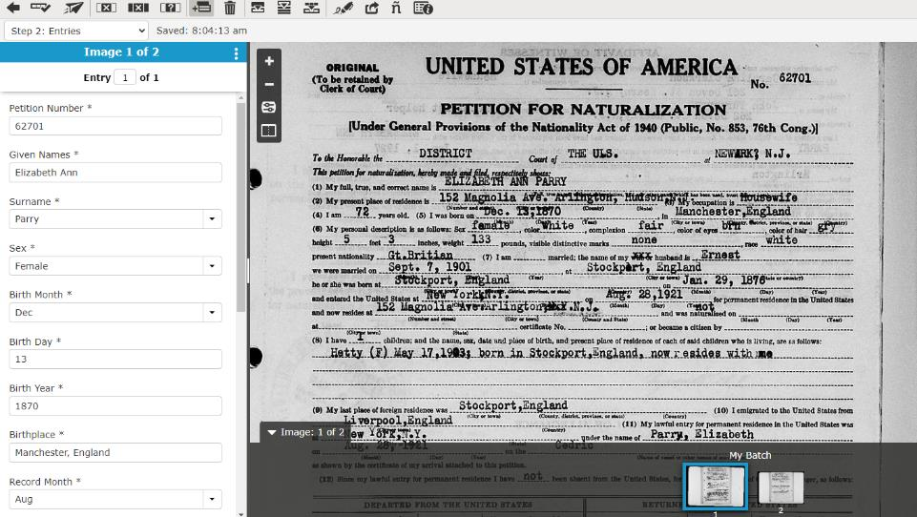
Why Linking?
More traffic to your website!
Sample Slides

Slide 9
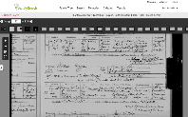
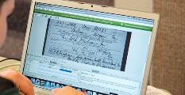
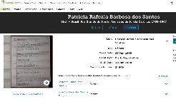
Increasing Volume of Digital Content
FamilySearch Indexing
Historical Images: 4.9 B
Historical Images added daily: 1-2M
Indexed Historical Images: 1.2B
Searchable Names in Indexes: 11.47 B
Increasing Backlog of Unindexed Images

Slide 10
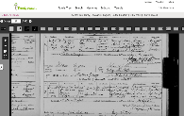
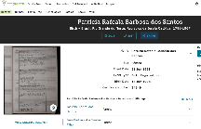
Computer Assisted Indexing
Image Classification, Line Segmentation,
Handwriting and Text Recognition
Natural Language Processing, Searchable Index Creation
372 Million Indexed Names so far

Slide 11
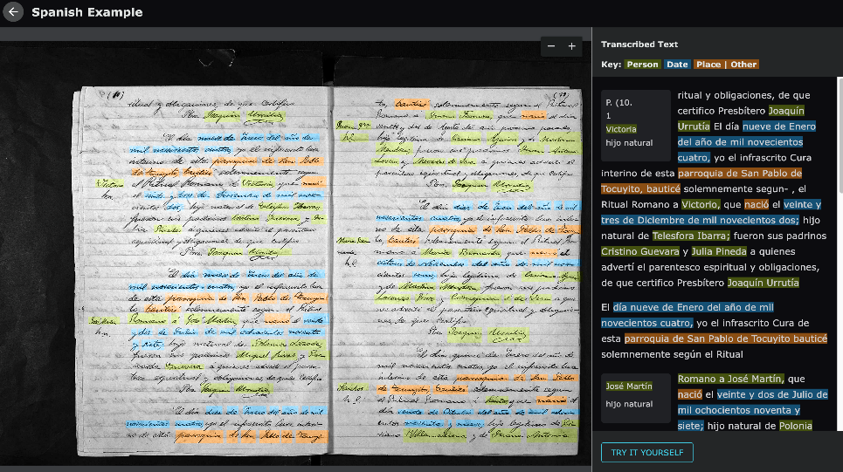
FHD PPT Template
Sample Slides

Slide 12
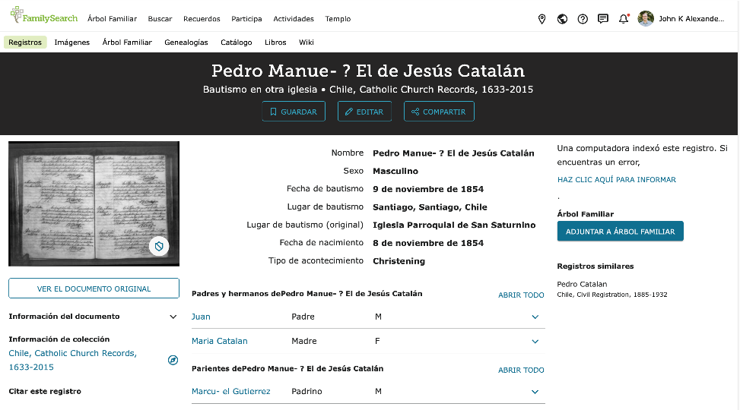
FHD PPT Template
Sample Slides

Slide 13
Challenges
Data quality errors
Variety of Languages/Handwriting/Formats
Training data acquisition and creation
New types of metadata needed (visual dimensions)

Slide 14
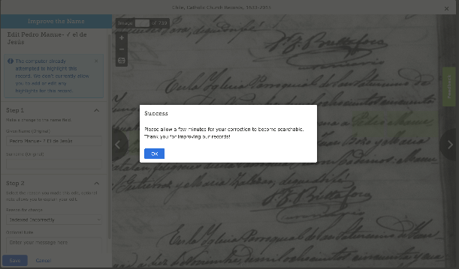
Allow our users to improve data

Slide 15
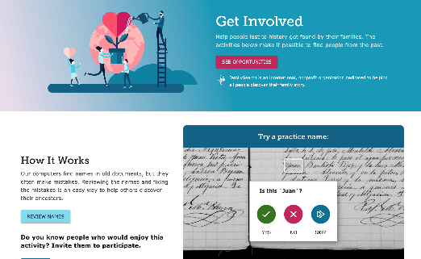
Engaging new experiences for people to help
Small and simple tasks
Unique for each
Continually adding and improving data for all
Mobile friendly

Slide 16
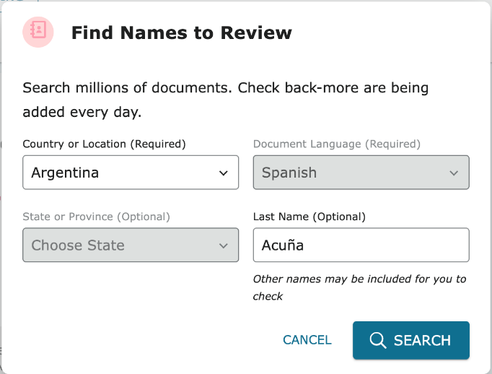

Slide 17
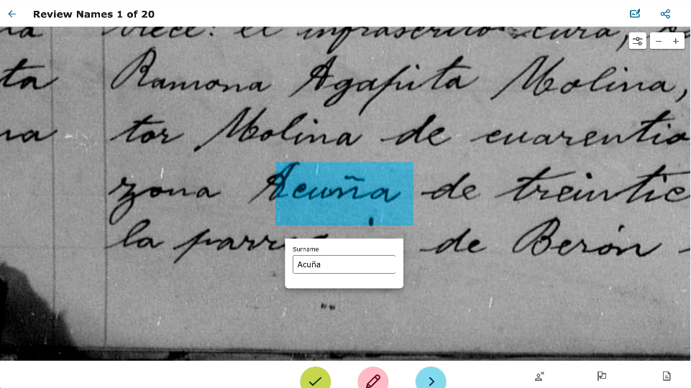

Slide 18
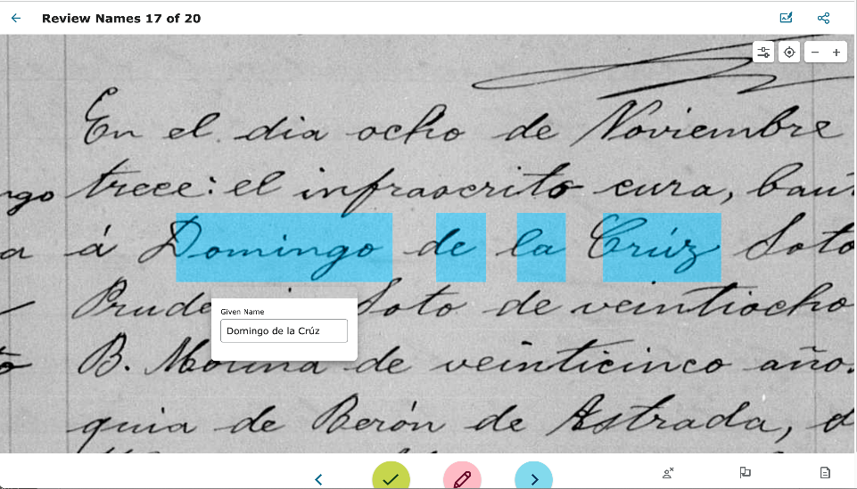

Slide 19
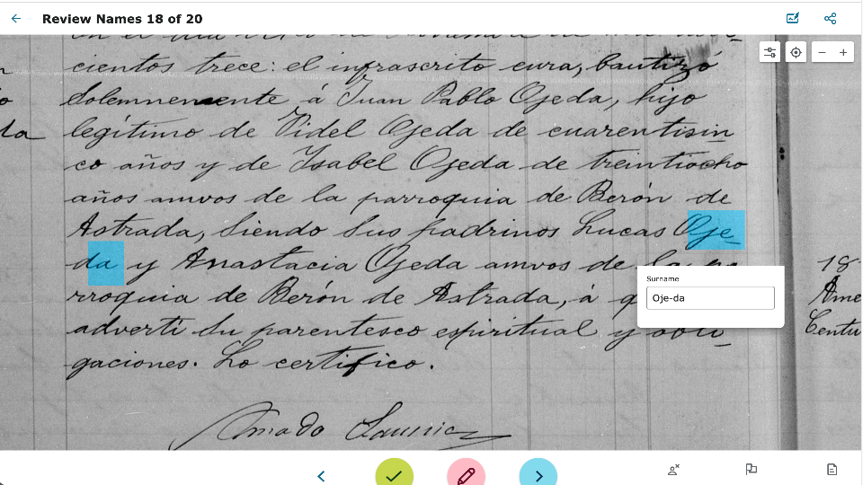

Slide 20
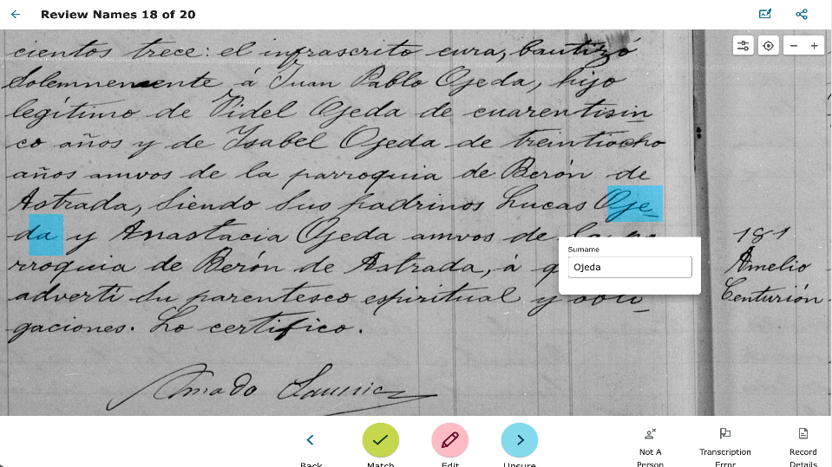

Slide 21
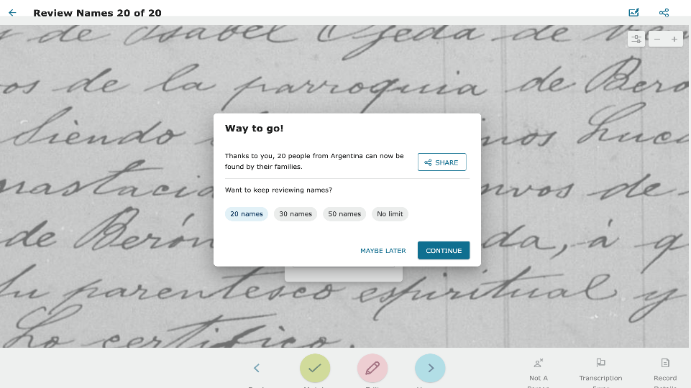

Slide 22
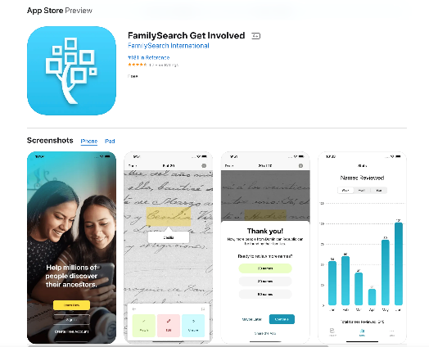
FamilySearch Get Involved Mobile App
218,445 Users
372 Million Names Reviewed
More languages/Countries coming soon!

Slide 23
Give it a Try!
www.familysearch.org/getinvolved

Slide 24
Impact of CAI/HWR
Computer AI will learn to read all handwritten documents
Involving people will increase quality and accuracy
New types of metadata and search experiences will become possible

Slide 25
2. Linking to Existing Images/Indexes

Slide 26
Why Linking?
More traffic to your website!
Sample Slides

Slide 27
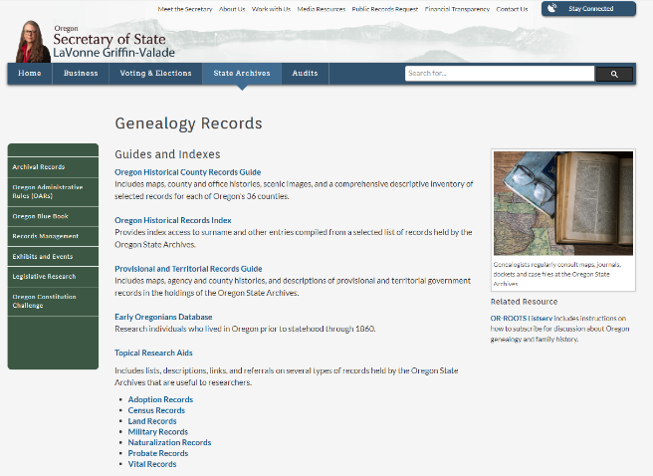
Oregon
Sample Slides

Slide 28
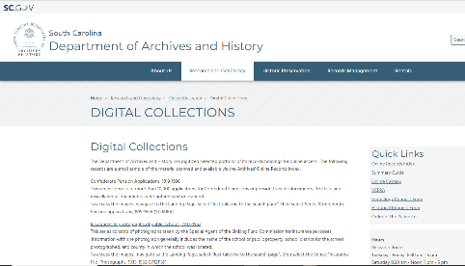
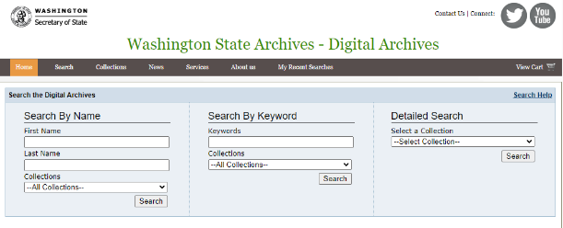
South Carolina
Washington
Sample Slides

Slide 29
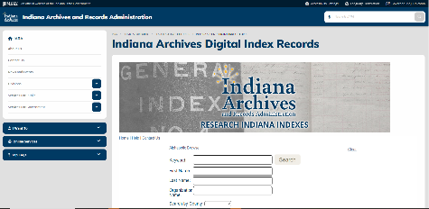
Indiana - Alabama
Sample Slides

Slide 30
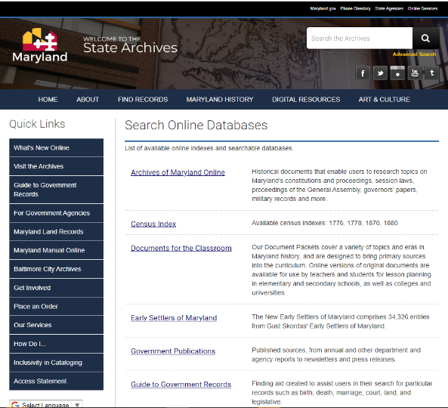
Maryland
Sample Slides

Slide 31
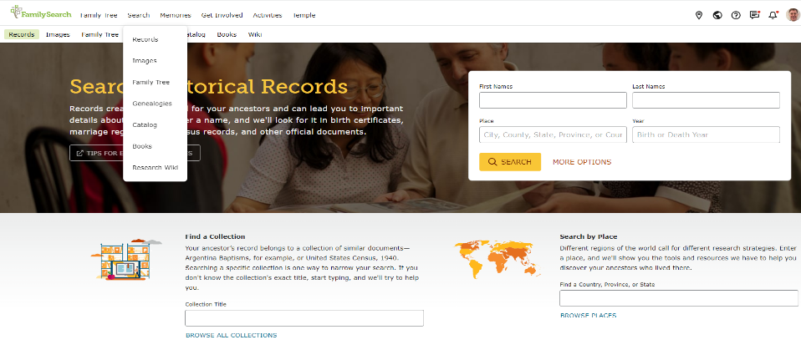
How do we Link?

Slide 32
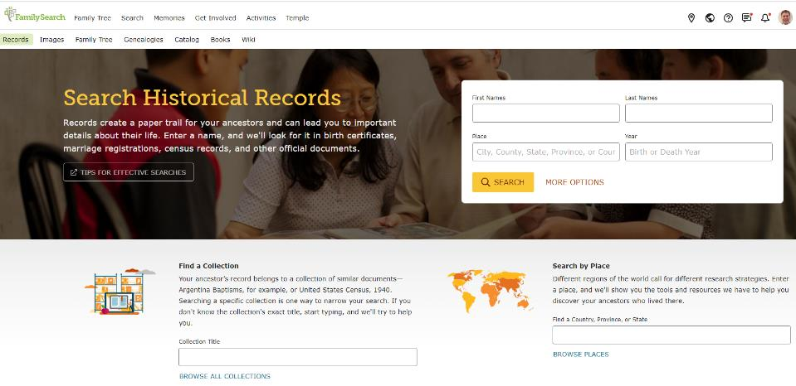
Sample Slides

Slide 33
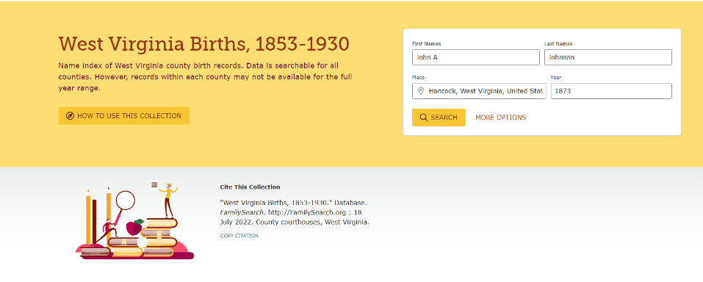
Current Link:
Sample Slides

Slide 34
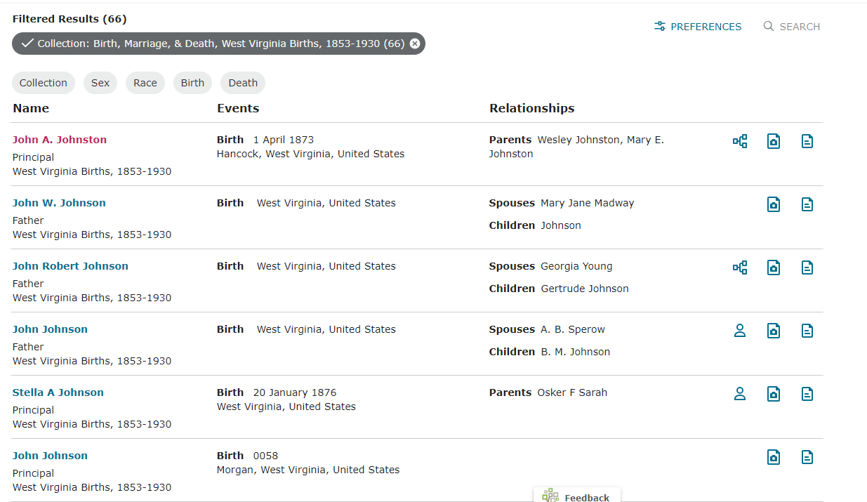
FHD PPT Template
Sample Slides

Slide 35
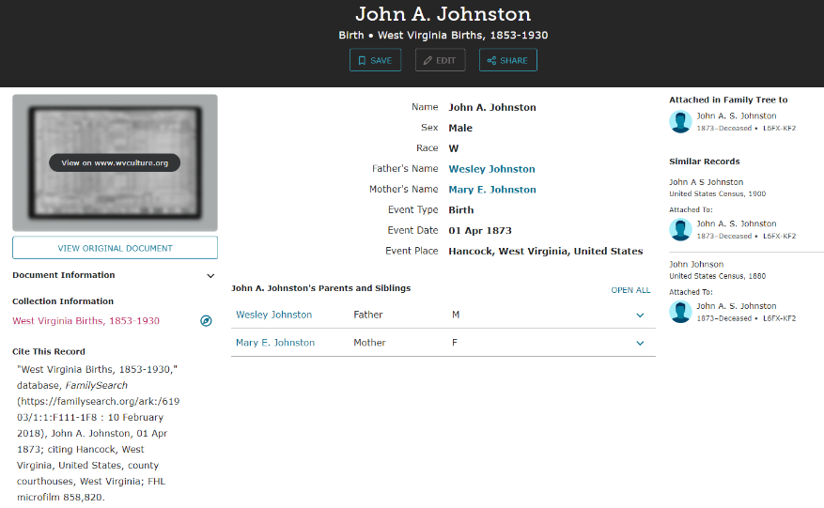
FHD PPT Template
Sample Slides

Slide 36
Let’s Link Together
Link to your site – bring you traffic
Help with indexing
Be your insurance company

Slide 37
Let’s Link Together
Provide Access through Preservation

Slide 38
3. Hastening with Industry Friends
Digitization of records with Industry Friends
Ancestry.com pilot project
Other Friends coming shortly
WHY???

Slide 39
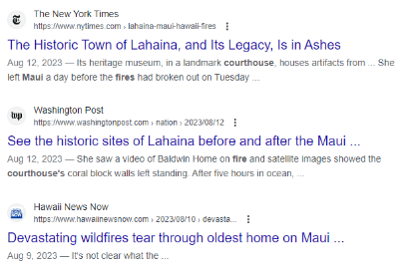
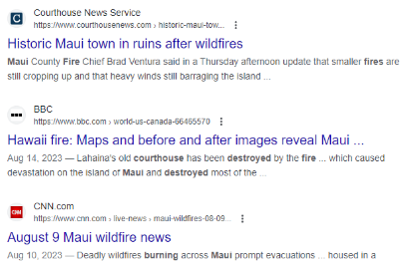
Maui…
Sample Slides

Slide 40
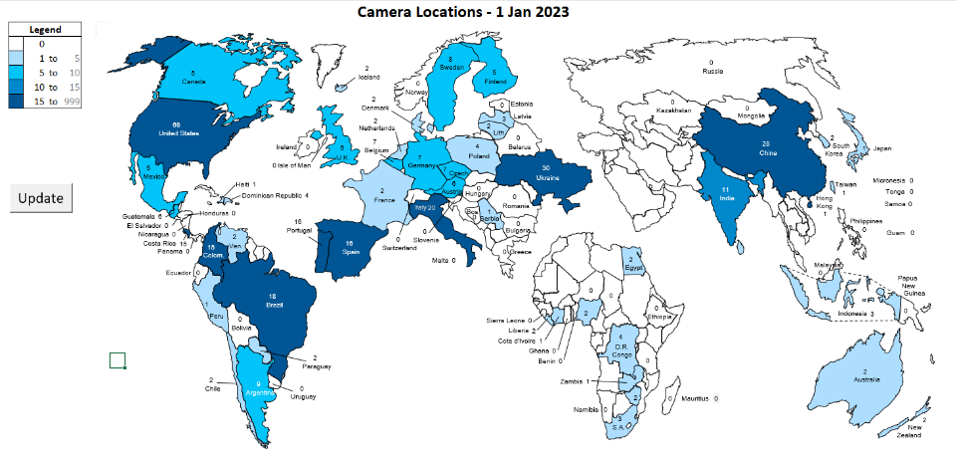
We are Global… 350+ cameras
175 Million Images

Slide 41
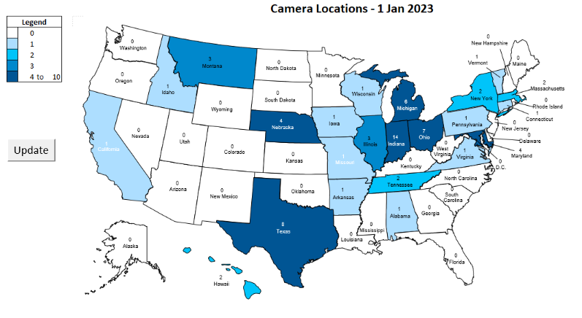
US… 72+ Cameras
Sample Slides
30 Million Images

Slide 42
Opportunity – Build the Global Tree of Humankind
80 Billion Humans in past 2,000 years
Chinese records go back 3,500 years
Historical records of Billions of people have yet to be preserved

Slide 43
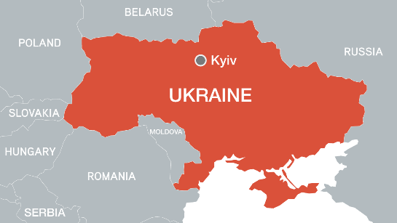
Ukraine

Slide 44
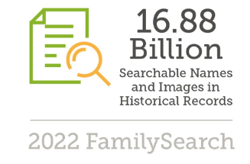
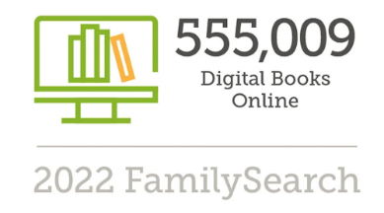
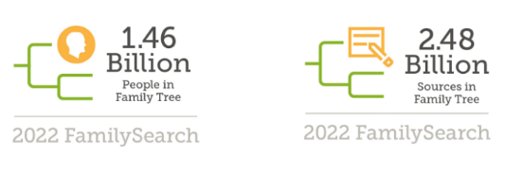
Just Getting Started:

Slide 45
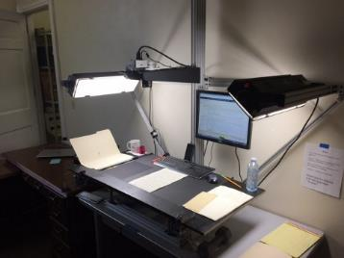
Digitization with Friends
Pilot program with Ancestry
Images and Indexes
Free copies for Archives, Free online at FS, also available on Friends’ website
Participation is optional
Expand Preservation capability

Slide 46
We Invite you to Join us:
Benefit from CAI/HWR
Link existing collections
Hasten Preservation
Contact:
Rob Jackson - robertjackson@familysearch.org
Dan Peay – Dan@familysearch.org
Manuel Sanhueza – SanuezaMR@familysearch.org
Steve Waters – waterssl@familysearch.org
John de Jong – jdejong@familysearch.org

Slide 47
Thank you…

Slide 48
Questions?

Slide 49
Upcoming Webinars
September 28, 3 pm eastern – Advocacy for Archives: From The Hill to Your Hill
For registration information
https://www.youtube.com/watch?v=u-trGs_1Gmo&list=PLospvJp0HcS88SS48w-4ruZwZNVdh7b5_&index=2

Slide 50
Upcoming SERI Webinars
October 10, 1 pm eastern – Electronic Records Day program
For registration information: https://www.statearchivists.org/electronic-records/state-electronic-records-initiative/seri-webinars

Slide 51
Contact Us
CoSA Website http://www.statearchivists.org
CoSA Resource Center https://www.statearchivists.org/research-resources/resource-center
CoSA Twitter Handle @StateArchivists
CoSA Facebook Page www.facebook.com/CouncilOfStateArchivists
CoSA You Tube https://www.youtube.com/user/StateArchivists/

Slide 52
Webinar Evaluation
We really do appreciate your feedback!
Please take a moment and respond to the evaluation following this webinar or send your comments to: info@statearchivists.org

