Slide 1
CoSA Member Webinar What’s On Tap in 2024: Engaging with CoSA
January 25, 2024
3 pm Eastern
Disclaimer: This webinar is being recorded and will be available for viewing on the CoSA website.

Slide 2
Sponsors
Notes:
Thank sponsors – we’re especially excited to continue many of our long standing relationships with our corporate partners in the new year. We’ll be launching a new sponsorship model in the next month to encourage broader engagement and have special opportunities to support just our annual meeting activities. If you have any recommendations on who we should reach out to, send them our way.

Slide 3
Funders
Notes:
We are also grateful for the grant support of the Institute of Museum and Library Services (or IMLS), for two active grants, and the Mellon Foundation, for a special planning grant opportunity we’ll hear more about later. We could not achieve many of our strategic goals without this type of funding.

Slide 4
Webinar Agenda
Welcome and Overview
Community Engagement
Special Projects
2024 Annual Meeting
Q and A
Notes:
Our agenda today is a bit different than in year’s past as we want to really focus on how you can engage with the many exciting projects we have in store this year. I’ll welcome everyone and give a brief overview of CoSA’s strategic plan and then pass the presentation to Joy for more details about community engagement, special projects, and our annual meeting. Lisa Johnston will close out our presentation with some administrative reminders.

Slide 5
Speakers
Jami Awalt, President
Joy Banks, CoSA Executive Director
Lisa Johnston, Upcoming Meetings and Events

Slide 6
Welcome
Jami Awalt, CoSA President
Assistant State Archivist, Tennessee

Slide 7
President’s Welcome & Overview
CoSA MISSION
The Council of State Archivists provides leadership to strengthen and support state and territorial archives leaders and staff in their work to preserve and provide access to government records.
Documenting Government | Promoting History | Securing Rights
Notes:
As we enter the 3rd year of our current strategic plan, we continue to focus our work on our core mission: providing leadership to strengthen and support state and territorial archives leaders and staff in their work to preserve and provide access to government records.
In our 2023 Annual Report, we worked to link all of our work to each of our values statements: Relevant, Inclusive and Collaborative. We hope that you continue to see these values reflected in all of the work that we do.
*****
Hot off the (digital) presses: https://www.statearchivists.org/viewdocument/2023-cosa-year-in-review

Slide 8
President’s Welcome & Overview
2024 – Looking to the future
Education and Training – Look for a full calendar of webinars and learning opportunities through the year.
Research – New reports and recommendations are on the horizon
Advocacy – Advancing the issues and priorities of our community of practice
Sustainability and Excellence – Our goal for all we do
Notes:
Looking ahead to this year, we really have much in store.
- Our CoSA and SERI Education committees are busy at work planning another engaging year of learning. They’ve already set most of the content for the first year, and we’ll be working to add those to the website so you can save the date. And we’ll be talking specifically today about our in-person annual meeting in September.
- We continue to engage in an active research agenda for our members. In the next few weeks, we’ll be opening the next iteration of the Digital Preservation Capability Maturity Model (or DPCMM) survey as we close out our 3-year IMLS funded BACKER project. We have plans to produce several “Best Practices” documents, including one summarizing the results from our recent social media survey. We are also starting a planning grant focused on the territories to help identify and articulate their specific support needs. More on how you can engage in several of these projects later.
- Our Advocacy committees are thinking ahead to issues and priorities that are top of mind in 2024. Relying on the recent feedback from the State of State Records Report, ongoing Calls to the Members being conducted by the Board of Directors, and an upcoming priorities ballot, your colleagues will seek ways that we can amplify our impact to support your work.
- CoSA continues to seek a sustainable and excellent path forward for our community. We’ve instituted a number of operational procedures that make us a more efficient and nimble organization. We also launched a new project generously funded by the Mellon Foundation to help us be better stewards of the rich data sets under our care, making them more accessible to our members and external partners.

Slide 9
Community Engagement
Joy Banks, CoSA
Executive Director
Notes:
Thanks, Jami. It’s been great the last few weeks reflecting on where we’ve been to plan ahead for where we’re going.

Slide 10
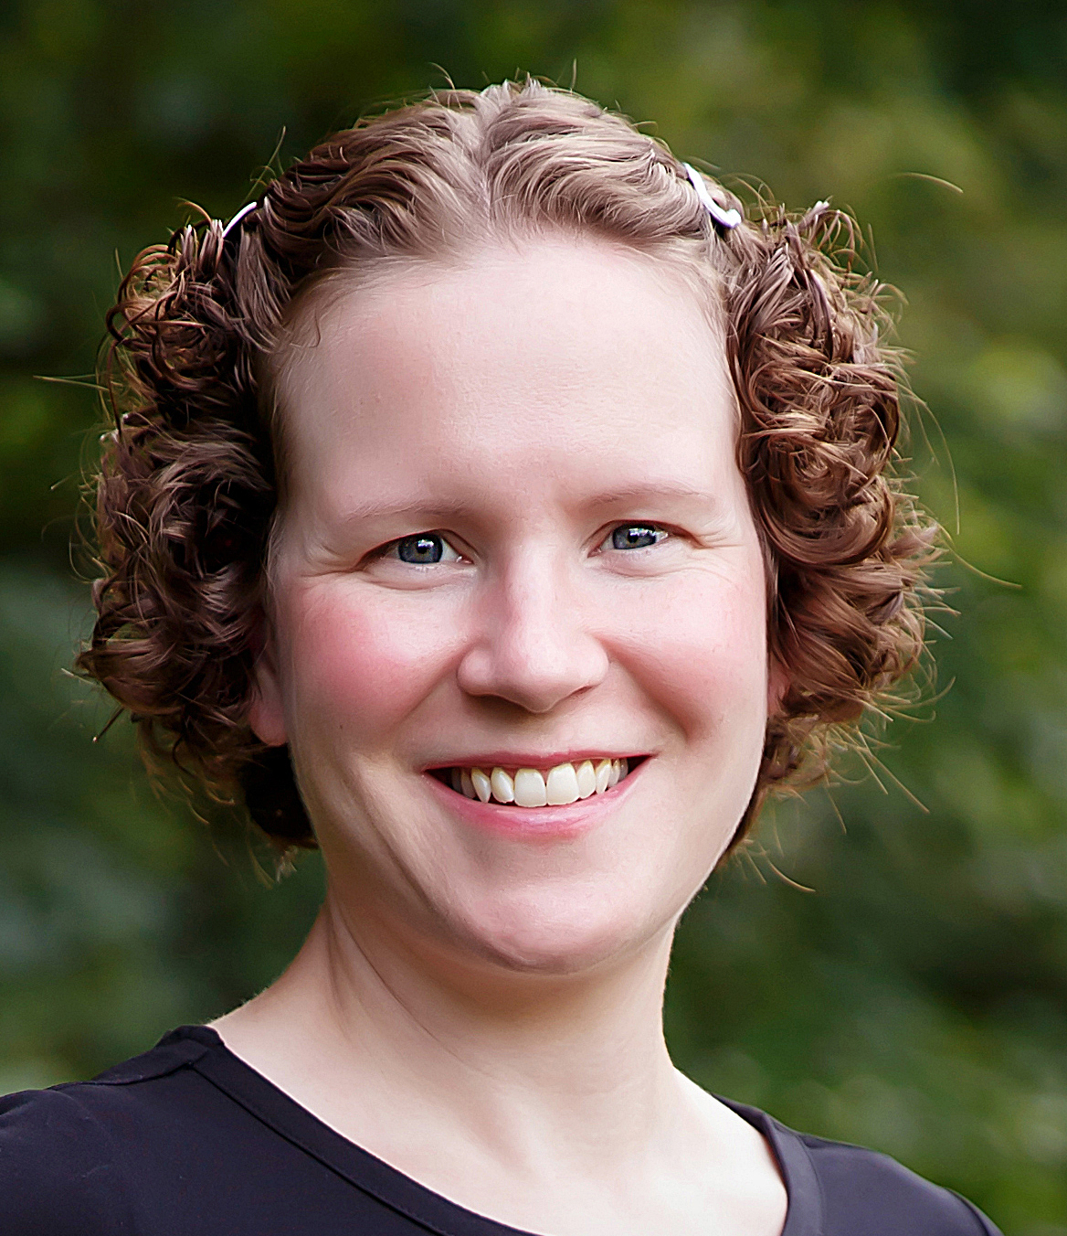
New Hire
Rebecca Julson
Community Coordinator
Notes:
We’re glad to share for those who have not heard that Rebecca Julson was recently hired as our new part-time Community Coordinator. Becky is a long-time contractor with CoSA, most recently serving as our IT Coordinator, and we jumped at the opportunity to retain her in a staff position. In this newly created role, Becky will serve the CoSA membership through engagement with committees and affinity groups, facilitation of mission-aligned activities, and participation in grant-funded projects. One of our concerns as we were shaping this position was finding someone who would know and understand our community, and there is truly no better person than Becky.
We are working to shape a new contractor role that will include portions of our technology support and other tasks – such as graphic design - so that we are expanding our capacity for the work ahead.

Slide 11
CoSA Committees
Advocacy Committee – seeking a co-chair
ARM Survey Committee – assessment + visioning
Awards Committee – small commitment, big impact
Development Committee – seeking new members
Education & Training Committee – shape our monthly learning opportunities
IDEA Committee – start something new
Finance Committee – learn more about our funding
Nominating Committee – find our next leaders
Notes:
For the past several years, we’ve used this webinar to highlight the many ways to get involved with CoSA as those who work at our member institutions. This slide features the active CoSA committees. Several are currently looking for volunteers.
- Advocacy is in search for a new co-chair as they start tackling our 2024 advocacy agenda
- While we won’t be issuing an ARM survey this year, we will convene that committee to develop a plan for the survey’s future. If you’ve served in the past or have opinions about CoSA’s flagship Archives and Records Management Survey mechanism, be in touch
- If you’re looking for a fun and rewarding short term commitment, consider joining the Awards committee. Ken Williams, as the immediate Past President, will chair that work
- Development committee is in need of more volunteers to help as we expand our corporate sponsorships, build an annual meeting sponsorship program, and look for more ways to diversify our revenue streams.
- Education & Training is well on their way to filling our 2024 calendar, but they are always looking for new ideas, speakers, and individuals to join their group.
- The IDEA committee is also still getting its footing and looking for ways to introduce the tenets we’ve been investigating through our cultural competency work to CoSA and our community
- If you’ve ever had an interest in finances or would like to assist in our nominating process, we have a place for you.

Slide 12
SERI Sub-committees
Advocacy & Outreach - be the voice for government electronic records and records management
Education & Programming – shape the programming opportunities that we offer
Tools & Resources – contribute to the guidance and resources that we share and create
Notes:
Similarly, the SERI subcommittees are busy finalizing their work plans for 2024 and looking ahead to the future of electronic records.
If you’d like to serve on any of these or the CoSA groups, Feel free to reach out to me or our info email account to ask questions or volunteer.

Slide 13
Upcoming opportunities
2024 Focus: Accessibility
February 13 – Come learn about completing your Digital Preservation Capability Maturity Model (DPCMM) self-assessment
February 22 – Issues regarding health records in state archives
March 12 – Chatting with SERI: Cloudy with a chance of records
March + April – Hiring in and navigating the government job market
May 16 – 2nd annual SERI STEER Unconference
October 10 – Electronic Records Day webinar
Notes:
To highlight some of the amazing work of our volunteers, here are a few of our upcoming opportunities over the next few months.
On February 13, join consultants Nick Connizzo and Veronica Martzahl to learn more about the DPCMM self-assessment. They’ cover some of the updates we’ve made to simplify the survey and encourage you to bring your questions and even your survey so you can work on it during the webinar.
Also in February, we’ll be hosting a conversation on issues surrounding health records in government archives, featuring several of your colleagues.
Our events page is updated as details are finalized, so be sure to check back frequently.
https://www.statearchivists.org/programs-education/upcoming-events

Slide 14
Special Projects
Notes:
That brings us into some conversation about some special projects for the coming year

Slide 15
Volunteers needed!
ARM Survey
One year commitment
SERI Strategic Planning
12-month commitment
To help shape the next strategic plan
2024 Annual Meeting Planning Committee
9-month commitment (January – September)
Launch meeting: January 31
Notes:
We know that its hard to commit to long term committee service, so we are looking for ways to identify short-term projects and other clearly defined opportunities so that we can engage more of our community in our work.
- ARM Survey – to review and assess the mechanism and make a plan for frequency and structure of future survey activities and plan a path forward to continue collecting this data in a more sustainable way.
- SERI Planning – Join the SERI Leadership group as we plan for the next strategic chapter for the State Electronic Records Initiative
- 2024 Annual Meeting Planning Committee

Slide 16
CoSA Data Aggregation Project
State and Territorial Archive Data Aggregation Planning Grant
18-month project
To support a planning effort and sustainable path forward for CoSA to be excellent stewards of our rich information resources
Project consultants: AVP
Currently seeking advisory council and focus group participants to provide input (approx. 6-month commitment)
Notes:
CoSA Data Aggregation project – seeking individuals interested in serving on an advisory board as well as those who may want to participate in focus groups or conversations to provide feedback on

Slide 17
BACKER
Building Archival Capacity for Keeping Electronic Records (BACKER)
36-month project ending July 2024
Digital Preservation Capability Maturity Model (DPCMM) Self-Assessment (February – March)
Direct Assistance
Managing Cross-Cultural Differences
Notes:
Building Archival Capacity for Keeping Electronic Records (BACKER)
36-month project ending July 2024
Digital Preservation Capability Maturity Model (DPCMM) Self-Assessment (February – March)
Direct Assistance
Managing Cross-Cultural Differences
Continuation after the project – developing self-guided instruction modules and guidance documents to help carry this work into the future

Slide 18
AWARE Project
Archives Working Across Remote Environments (AWARE): Connecting the Government Archives of the U.S. Territories, Hawaii, and Alaska
24-month IMLS funded National Leadership Planning Grant
Direct response to feedback from our members
Building a foundation of community and support and making recommendations for the next steps
Notes:
AWARE project
24-month IMLS funded National Leadership Planning Grant
Direct response to feedback from our members
Building a foundation of community and support and making recommendations for the next steps
The project includes funding to support the travel of our territorial members along with Alaska and Hawaii to attend the annual meeting in September, allowing them face-to face time with each other and the rest of the CoSA community.
Celebrate our full membership 50 states 5 territoris DC

Slide 19
2024 Annual Meeting

Slide 20
See you in St. Louis!
Tuesday, Sept. 17 – Territorial Summit
Wednesday, Sept. 18
Morning repository tour (optional)
Welcome and opening session (late afternoon)
Opening reception (evening)
Thursday, Sept. 19
Programming all day
Breakfast, lunch, reception (included)
Friday, Sept. 20
Programming through the afternoon
Breakfast and lunch (included)
Notes:
As we’ve mentioned, the annual meeting program planning committee will be convening next week on January 31st to start planning in earnest. We anticipate that the shape and flow of our meeting will be similar to an unconference – in line with BPE or the regional SARC meeting. Meeting by ourselves truly gives us the opportunity to shapes our time together to best meet our needs.
Working with our hotel, we have a general outline of events, but this is really just a preliminary overview to help you with travel planning. Times and specifics may vary.
The Board is discussing hosting our annual business meeting virtually in the summer and separate from our gathering in St. Louis. This will allow the broadest participation in the business of CoSA and add more time to our schedule.

Slide 21
See you in St. Louis!
Hotel: Announcing very soon!
$149/night
Complimentary parking and wifi
Conference information
https://www.statearchivists.org/programs-education/cosa-meetings/annual-meeting

Slide 22
Questions and Comments

Slide 23
Give us your feedback
Complete the CoSA Webinar Feedback survey:
https://www.surveymonkey.com/r/CoSAwebinar

Slide 24
Upcoming Events
February 13 – Come learn about completing your Digital Preservation Capability Maturity Model (DPCMM) self-assessment
February 14 – Chatting with CoSA
February 22 – Issues regarding health records in state archives
March 12 – Chatting with SERI: Cloudy with a chance of records
March + April – Hiring in and navigating the government job market
More details + registration: https://bit.ly/CoSAEvents

Slide 25
Contact Us
CoSA Website http://www.statearchivists.org
CoSA Resource Center https://www.statearchivists.org/research-resources/resource-center
CoSA Twitter Handle @StateArchivists
CoSA Facebook Page www.facebook.com/CouncilOfStateArchivists
CoSA You Tube https://www.youtube.com/user/StateArchivists/

Slide 26
Sponsors

