Slide 1
CoSA-NARA Webinar Preservation Activities at NARA and at the Tennessee State Library and Archives
February 24, 2022
3 pm Eastern
Disclaimer: This webinar is being recorded and will be available for viewing on the CoSA website.

Slide 2
Webinar Agenda
Welcome and Overview
Presentations:
Preservation Activities at NARA
Preservation Activities at TSLA
Q and A
Upcoming Programs and Webinars

Slide 3
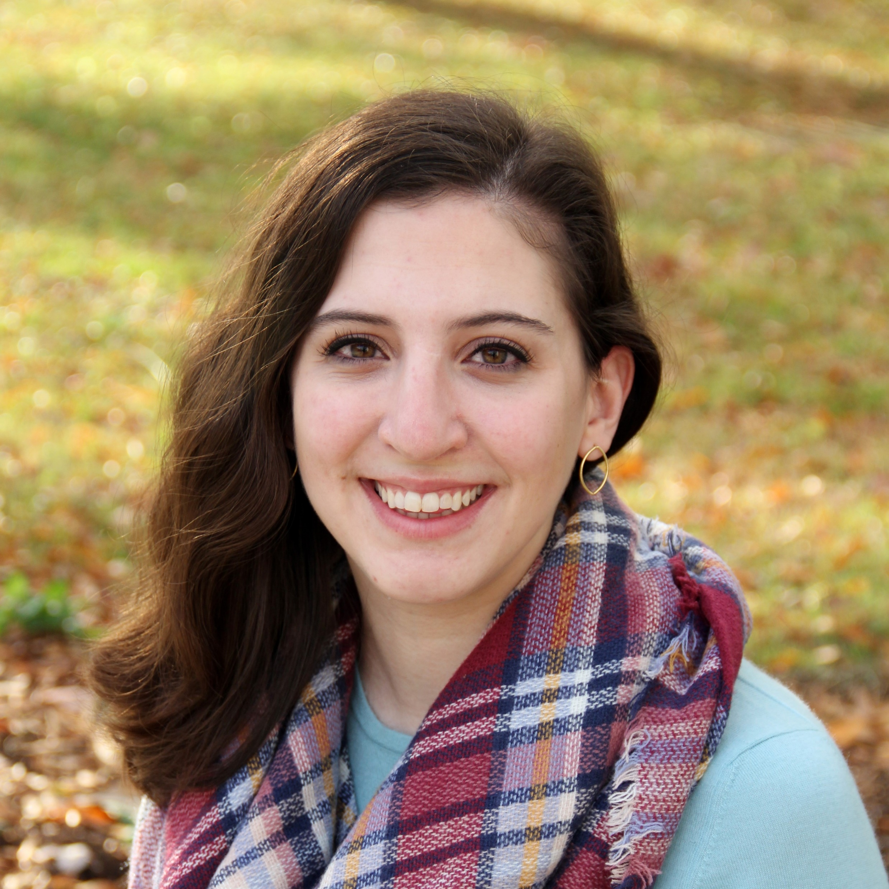
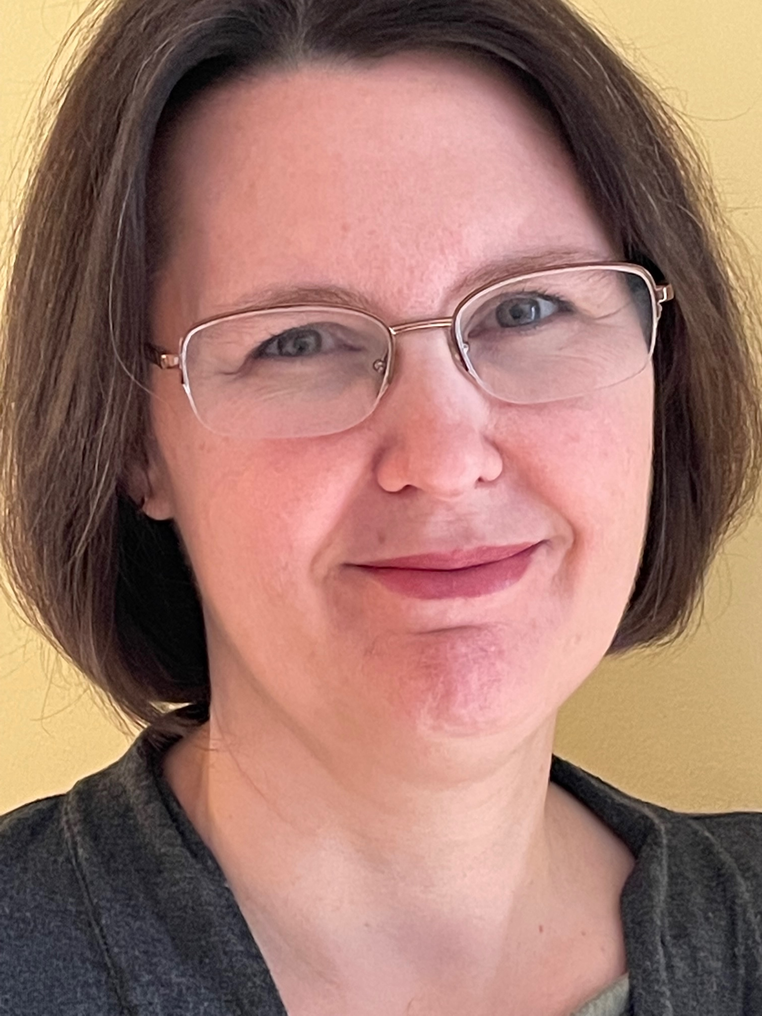
Speakers
Allison Olson
Director of Preservation Programs
NARA
Emily Farek
Conservation Manager
Tennessee State Library and Archives

Slide 4
A Look at Preservation Activities at NARA
Council of State Archives
Allison Olson, Director of Preservation Programs
Allison.Olson@nara.gov
February 24, 2022

Slide 5
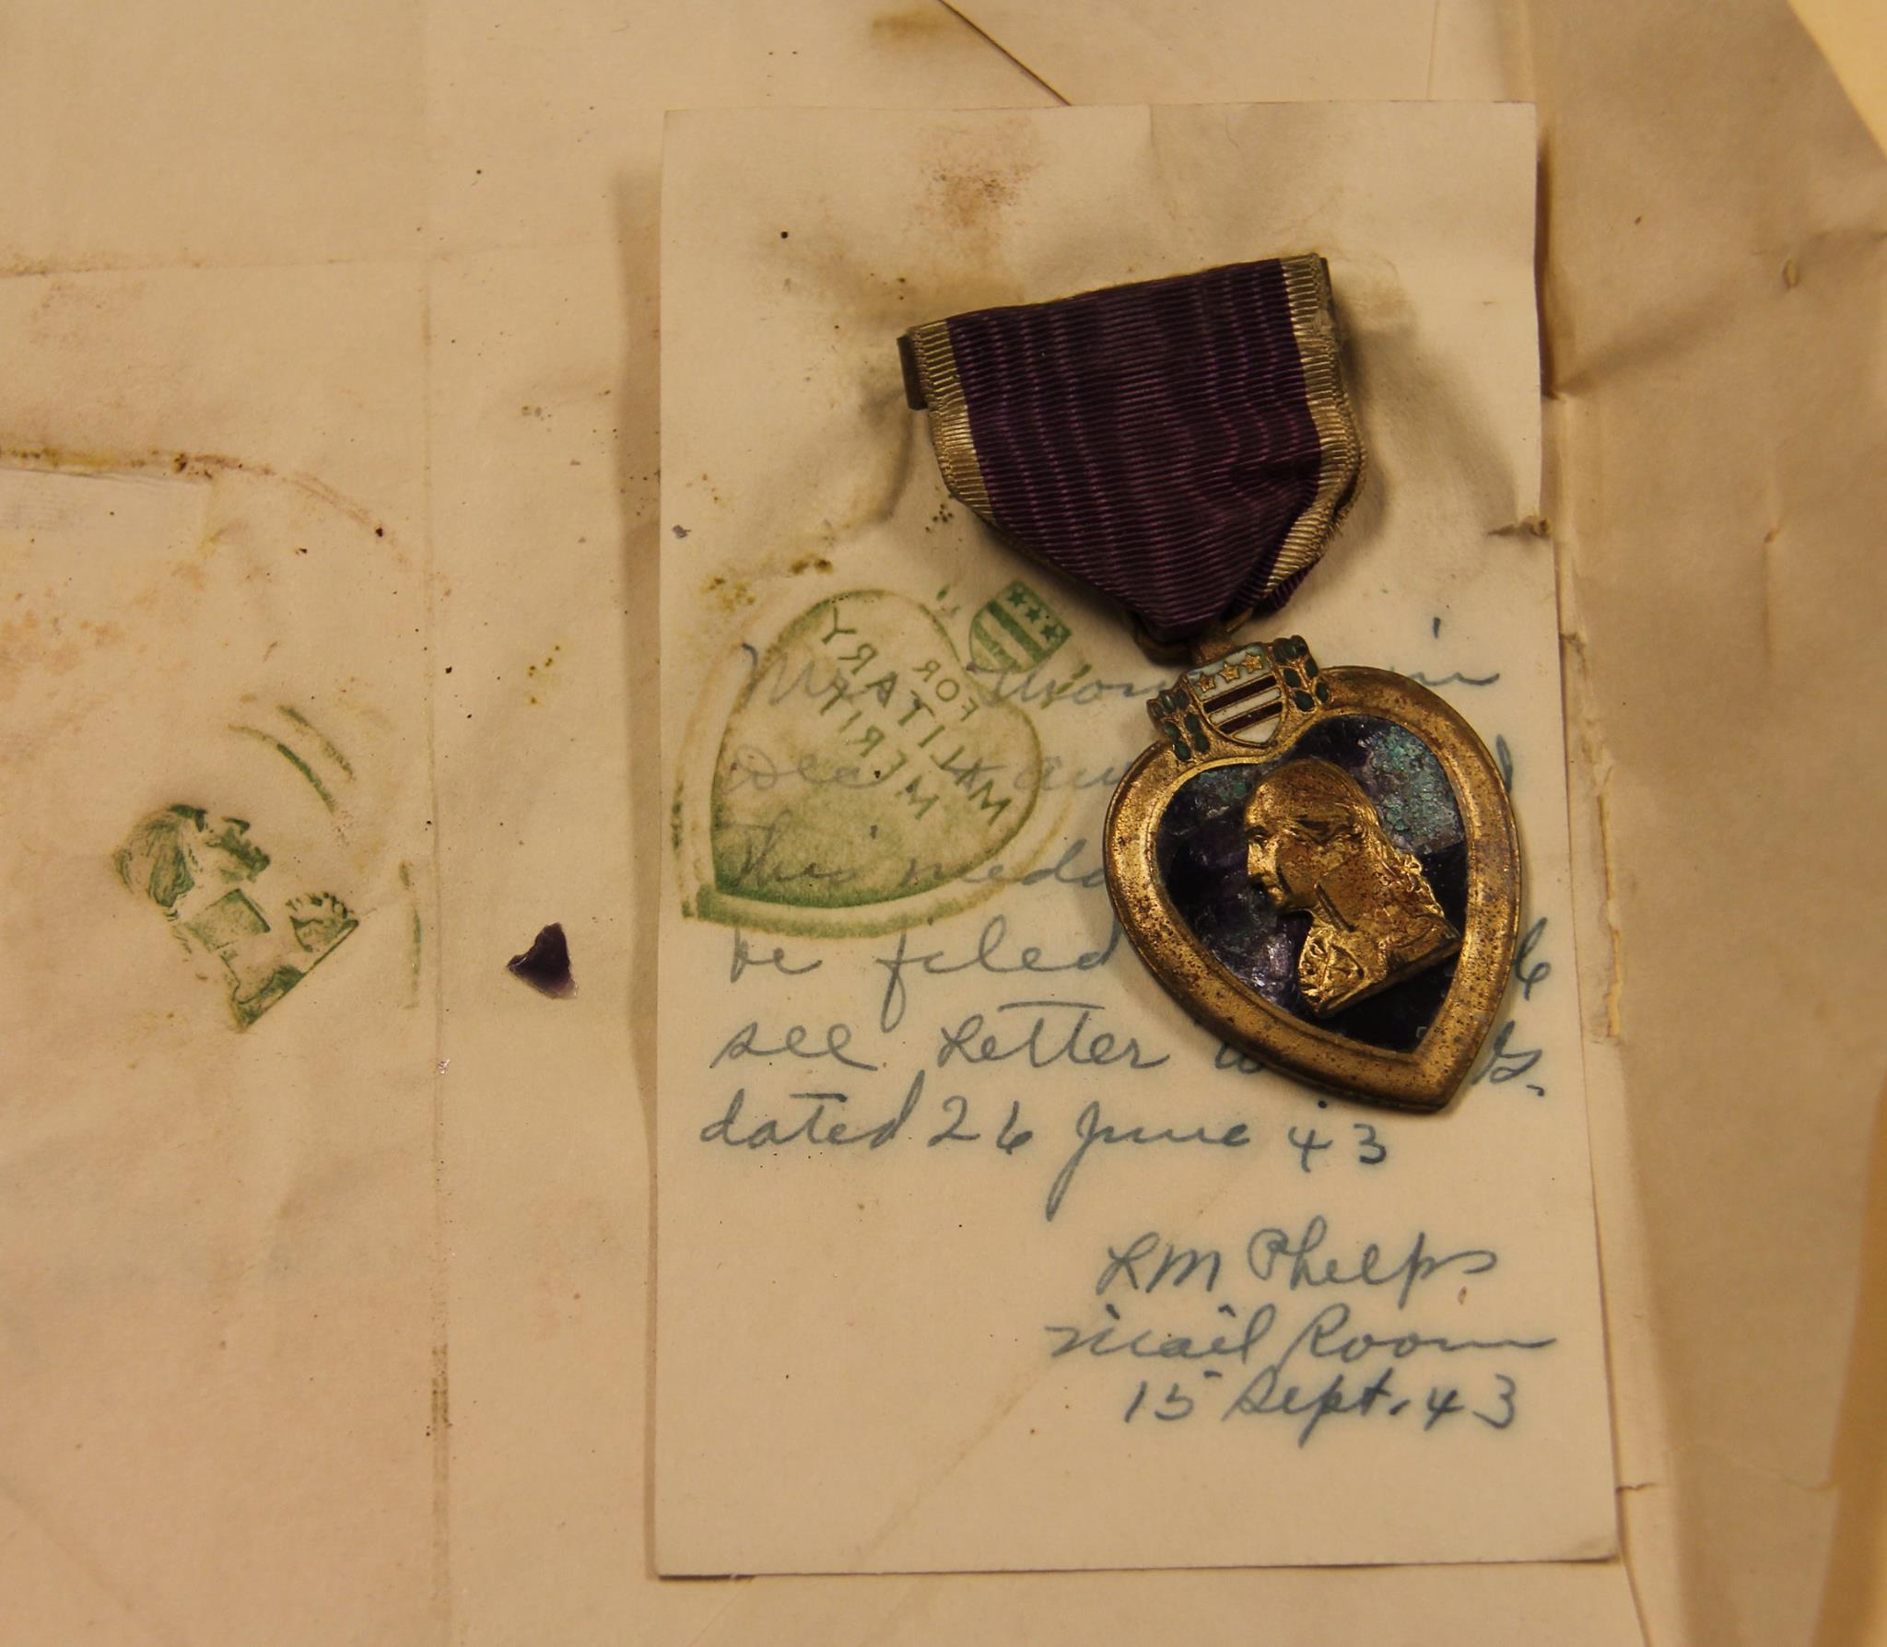
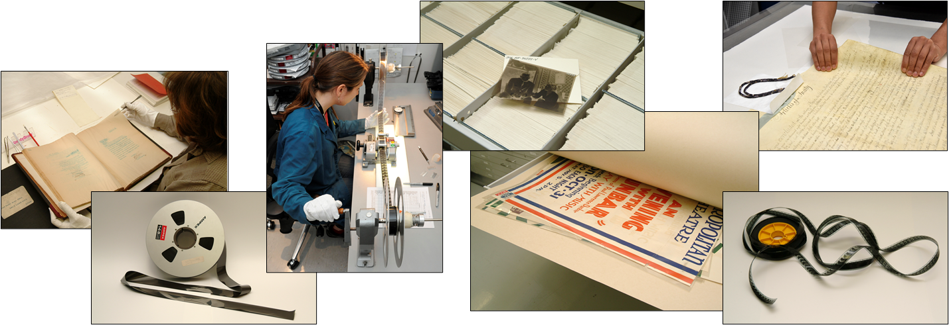

Slide 7
Preservation Strategy 2019- 2024
https://www.archives.gov/files/preservation/pres-strategy-2019-2024.docx-1.pdf
The Transformative Outcomes
Proactive cross-agency engagement, in recognition that challenges are not confined to one policy or program area.
Use of evidence to inform preservation planning and policy.
Empowered stakeholders who have a sense of collective responsibility for sustainable access to holdings.
Recognition of NARA as a leader in archival preservation.

Slide 8
Strategic Goal 1: Predict, understand, and act to mitigate the risks to NARA’s holdings.
Notes:
Some additional example projects supporting each research objective if there is more interest – also on our website for applicants to see!

Slide 9
Risk Guidance Groups
Guidance and Training | Dynamic Media | Environmental Management
Records Emergency Management | Exhibitions | Digitization
To exercise a critical voice, asking: Is there a better way to do this? Do we need to keep doing it in the same way? Are there other priorities?
Sharing expertise, building relationships, and enabling others to take responsibility for managing preservation risks

Slide 10
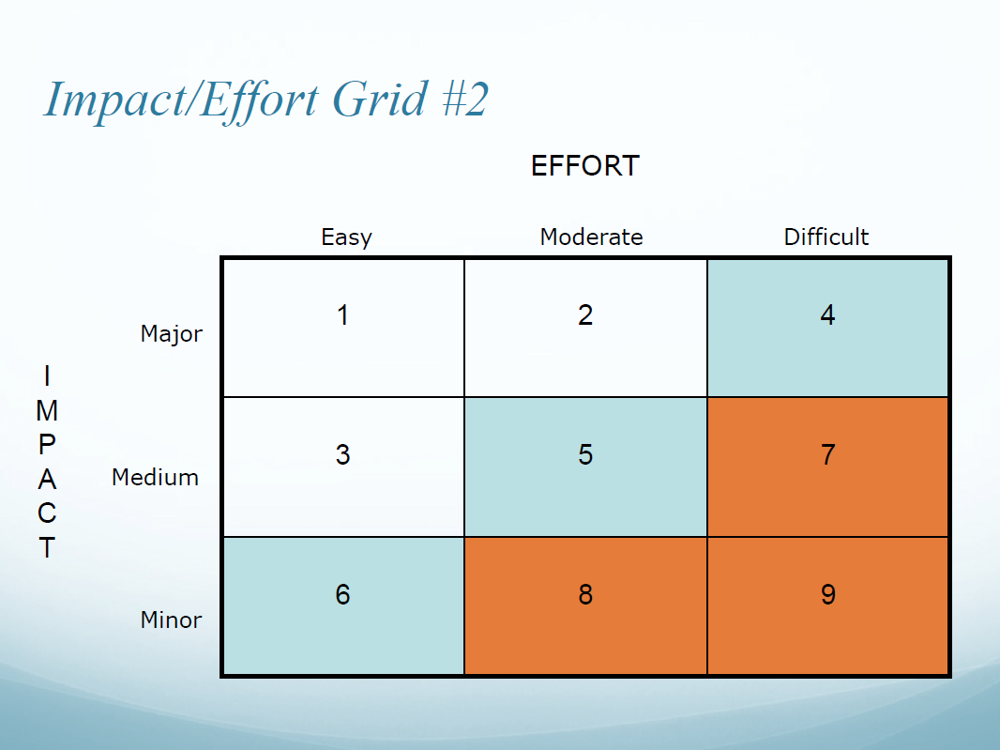
Risk Based Prioritization
Mitigating Strategies to Prevent or Limit Damage
Potential for Damage
and Impact on Access

Slide 11
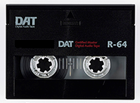
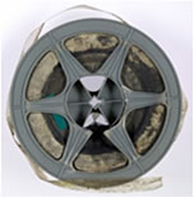
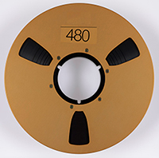
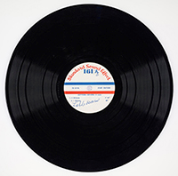
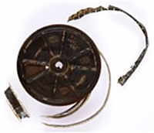
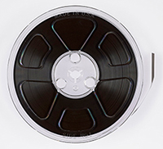
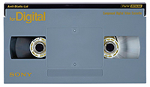
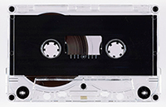
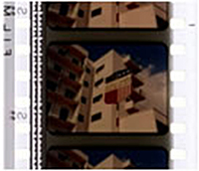
Dynamic Media Risks

Slide 12
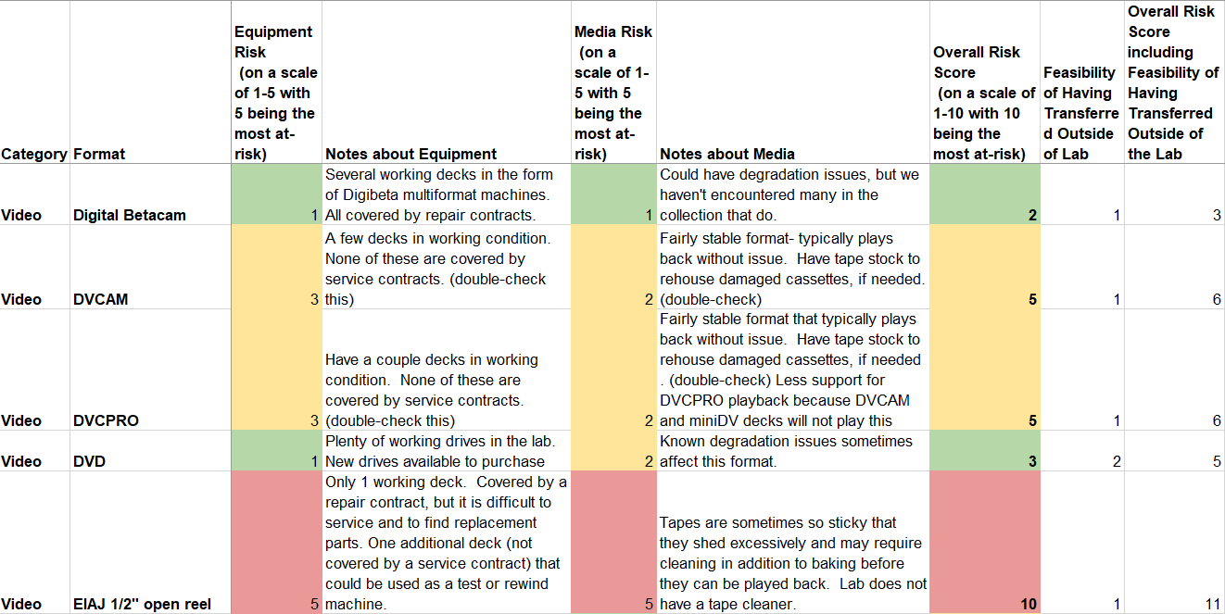
Audio & Video Risk Matrix
Notes:
T

Slide 13
Audio/Video/Motion Picture Risk Identification & Prioritization
Research Significance
Preservation Risk
Research Significance weighed with Preservation Risk are the basis for Prioritization
Weighted Matrices as tools for gaining insight and determining priorities

Slide 15
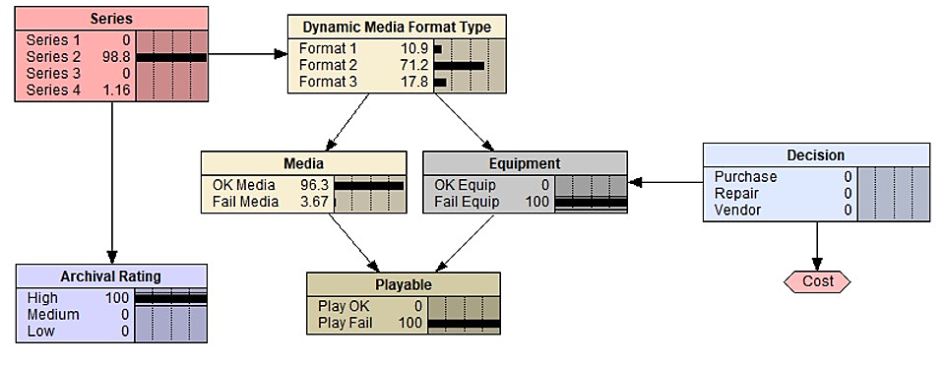
Evaluating options for increasing the probability that high archival value records will be playable

Slide 16
Strategic Goal 2: Delivering products and services our stakeholders need to support access to NARA’s holdings.

Slide 17
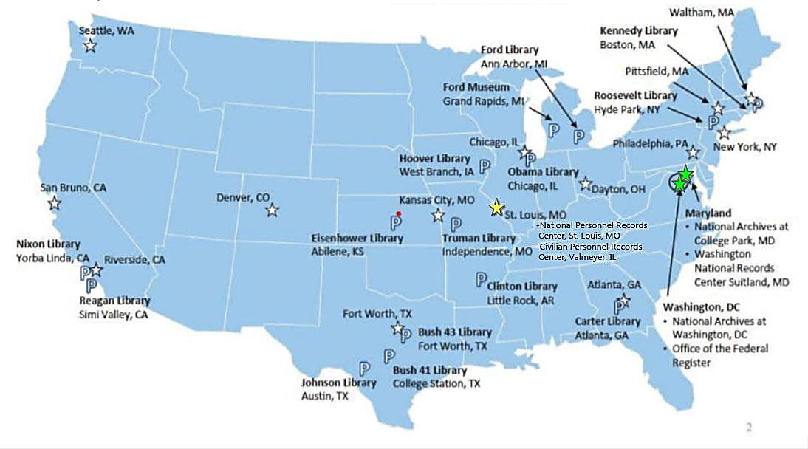
Strategic Goal 2: Grow capacity to support digitization.

Slide 18
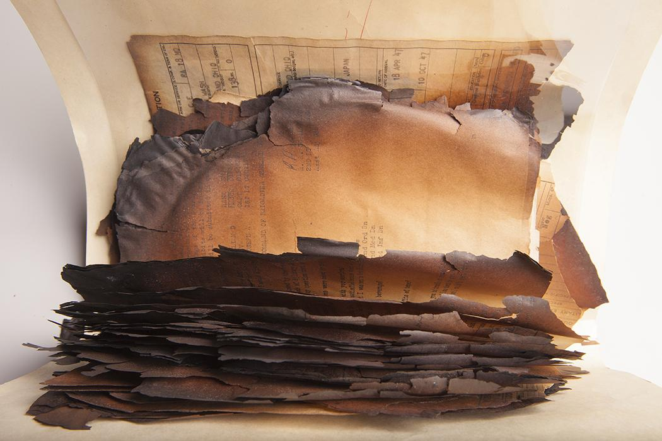
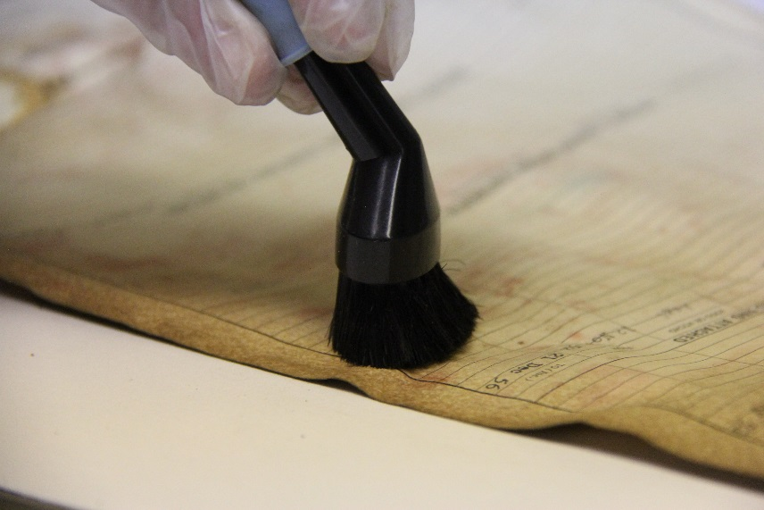
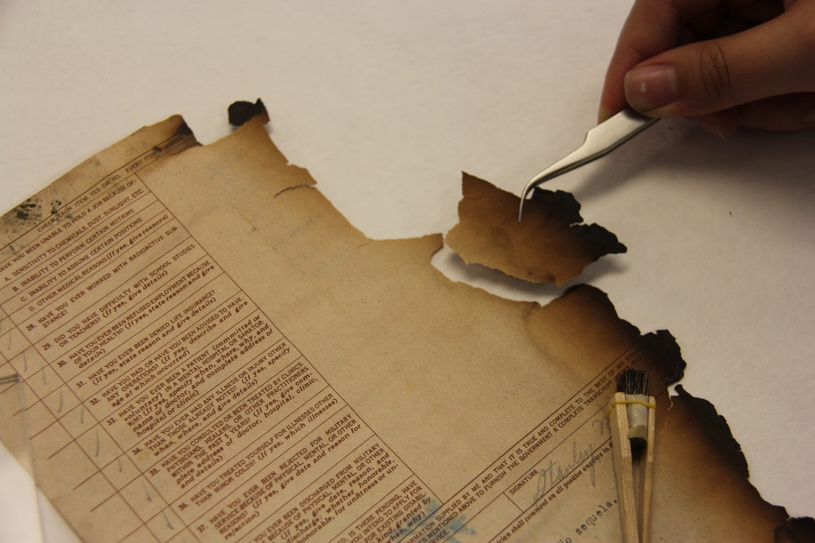
St. Louis Preservation Treatment of Burned Records

Slide 19
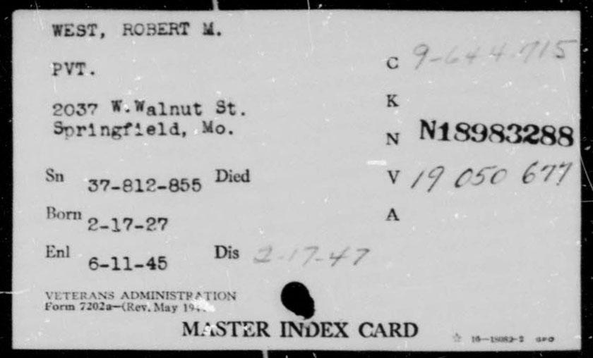
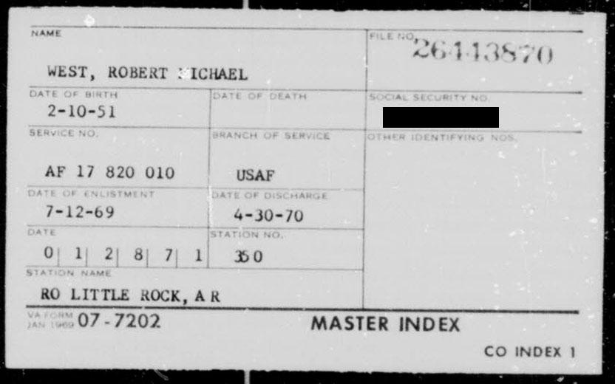
St. Louis Preservation- Digitizing the VA Index Microfilm

Slide 20
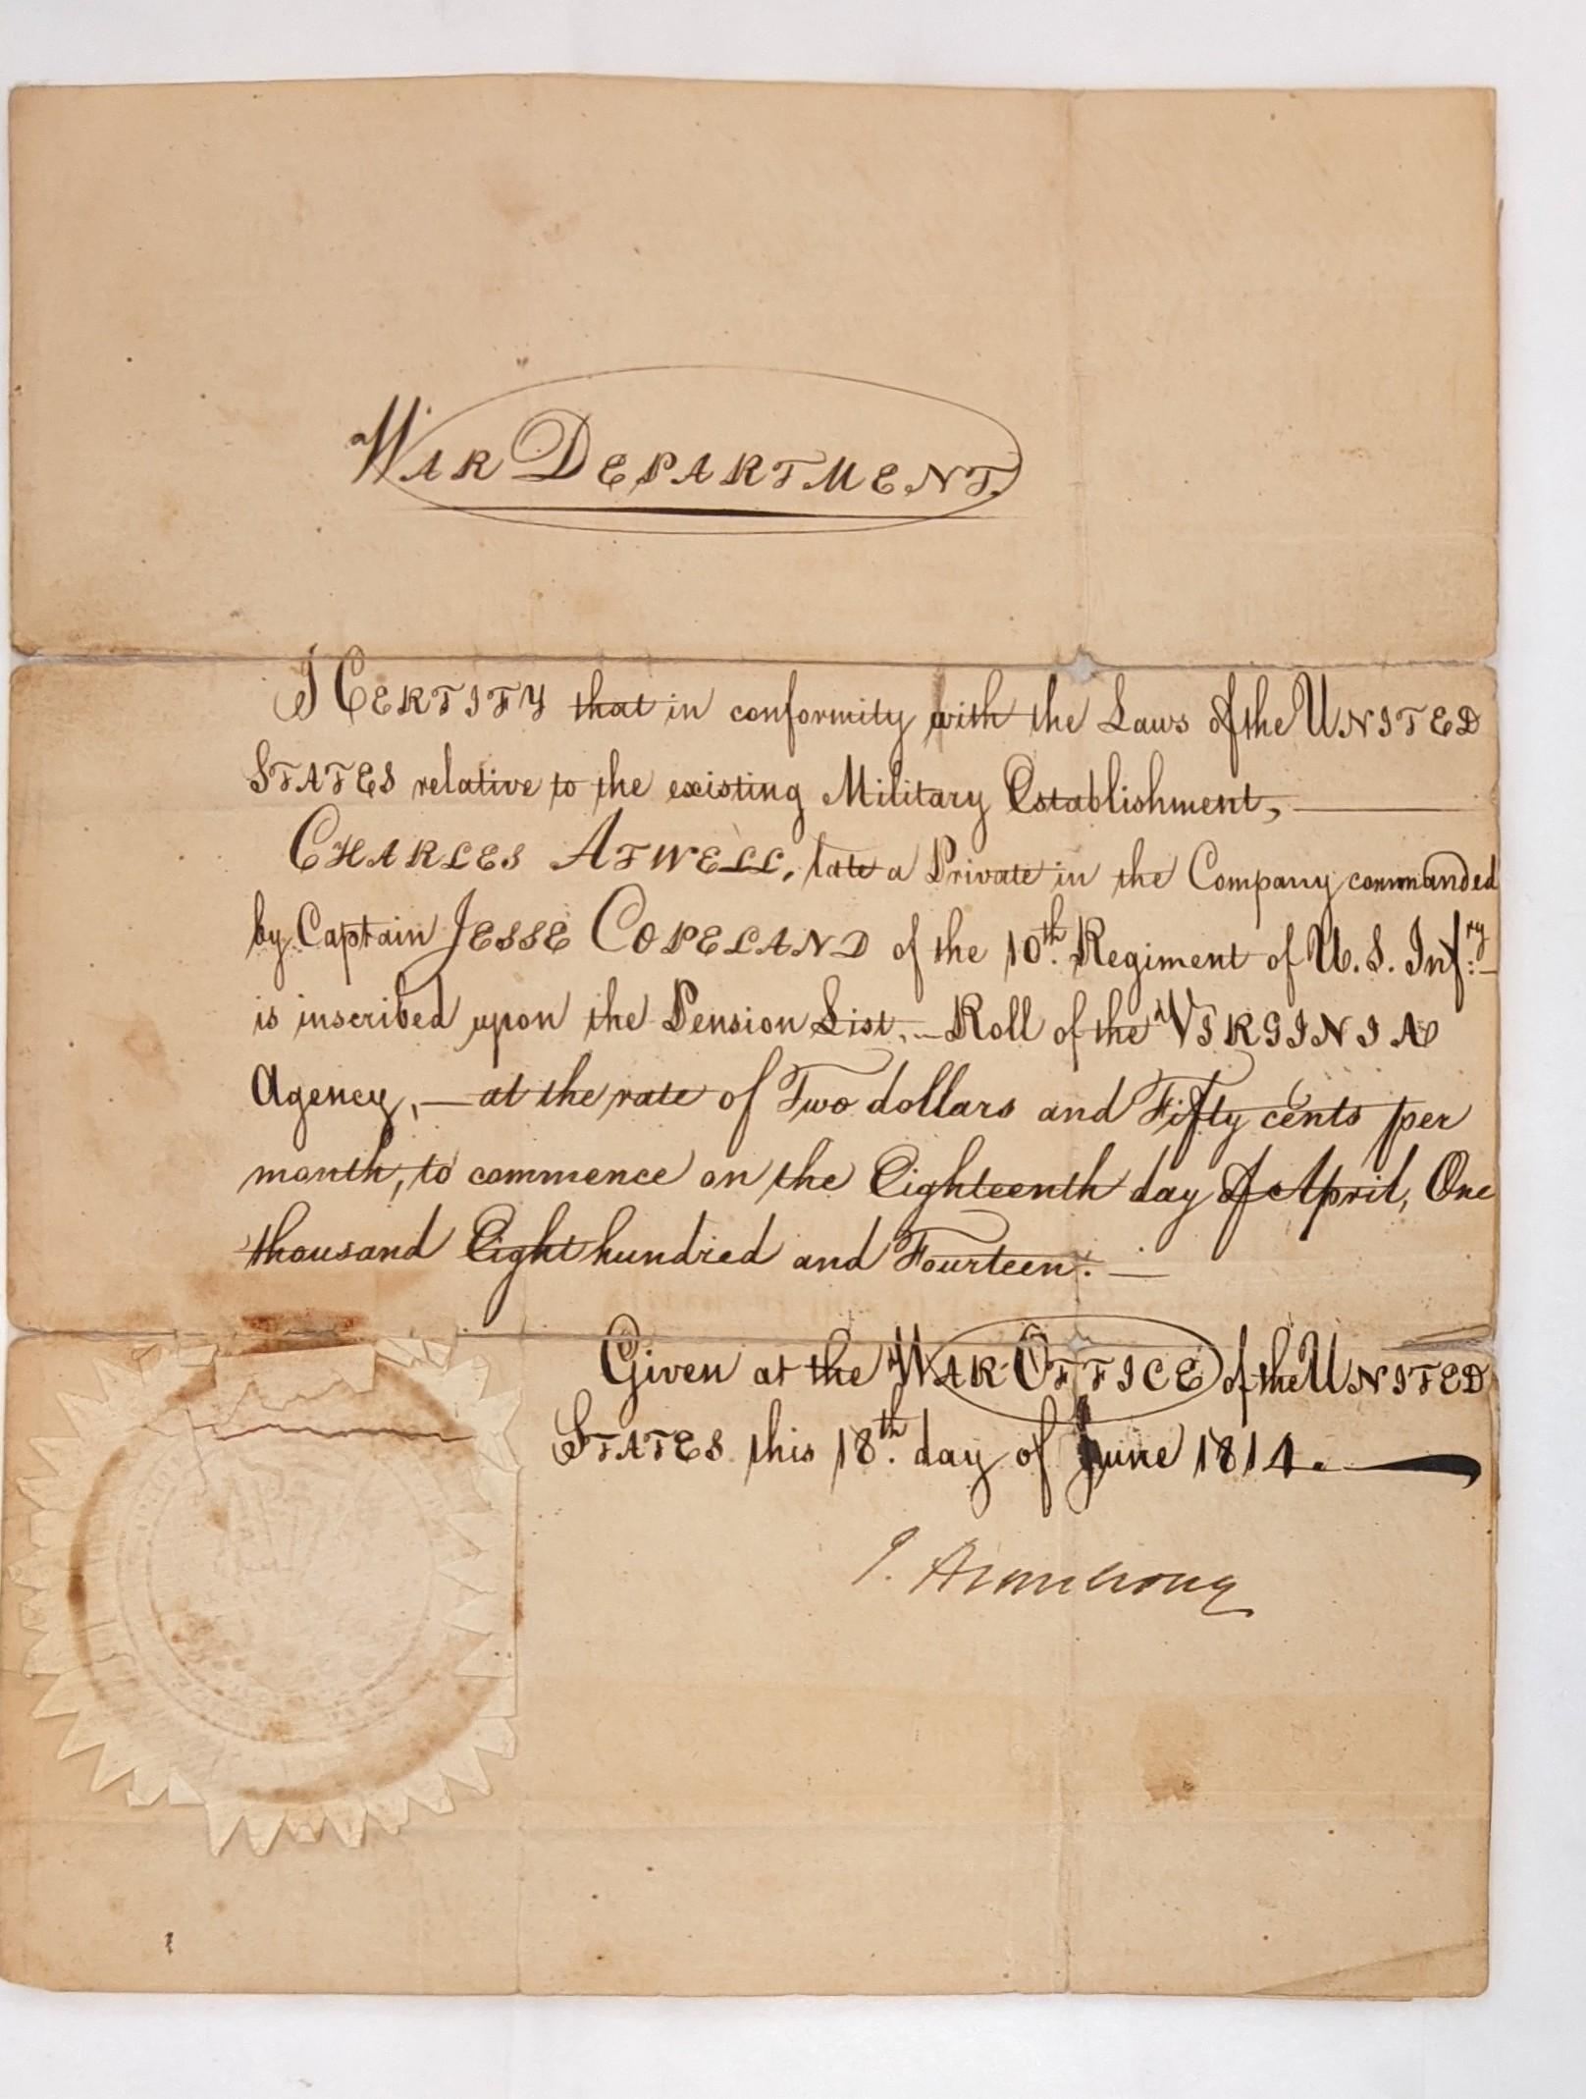
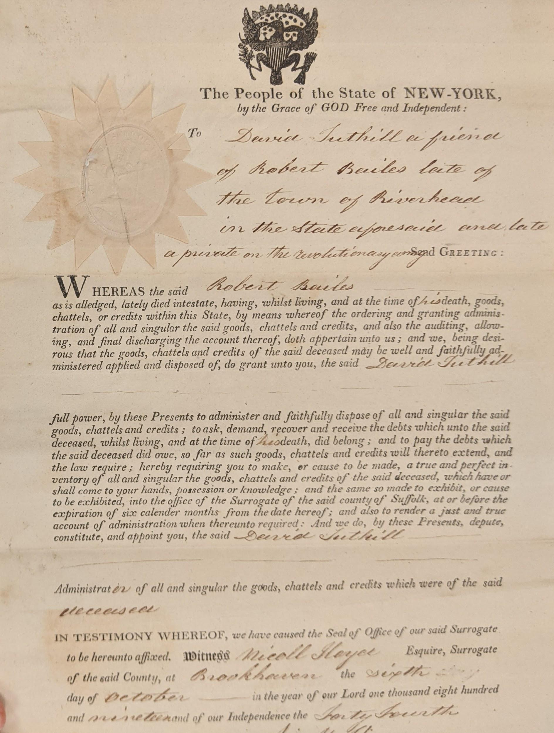
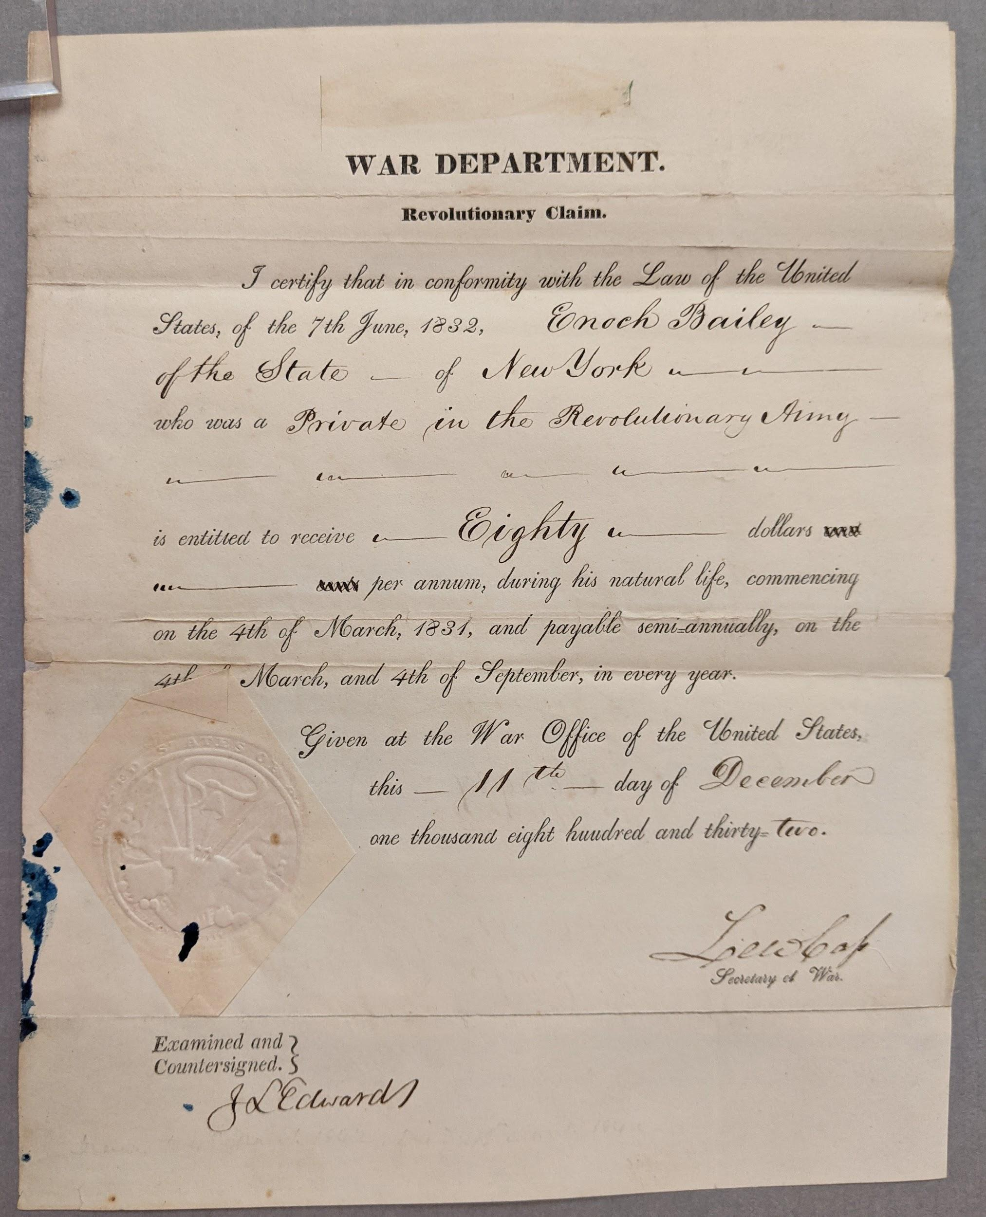
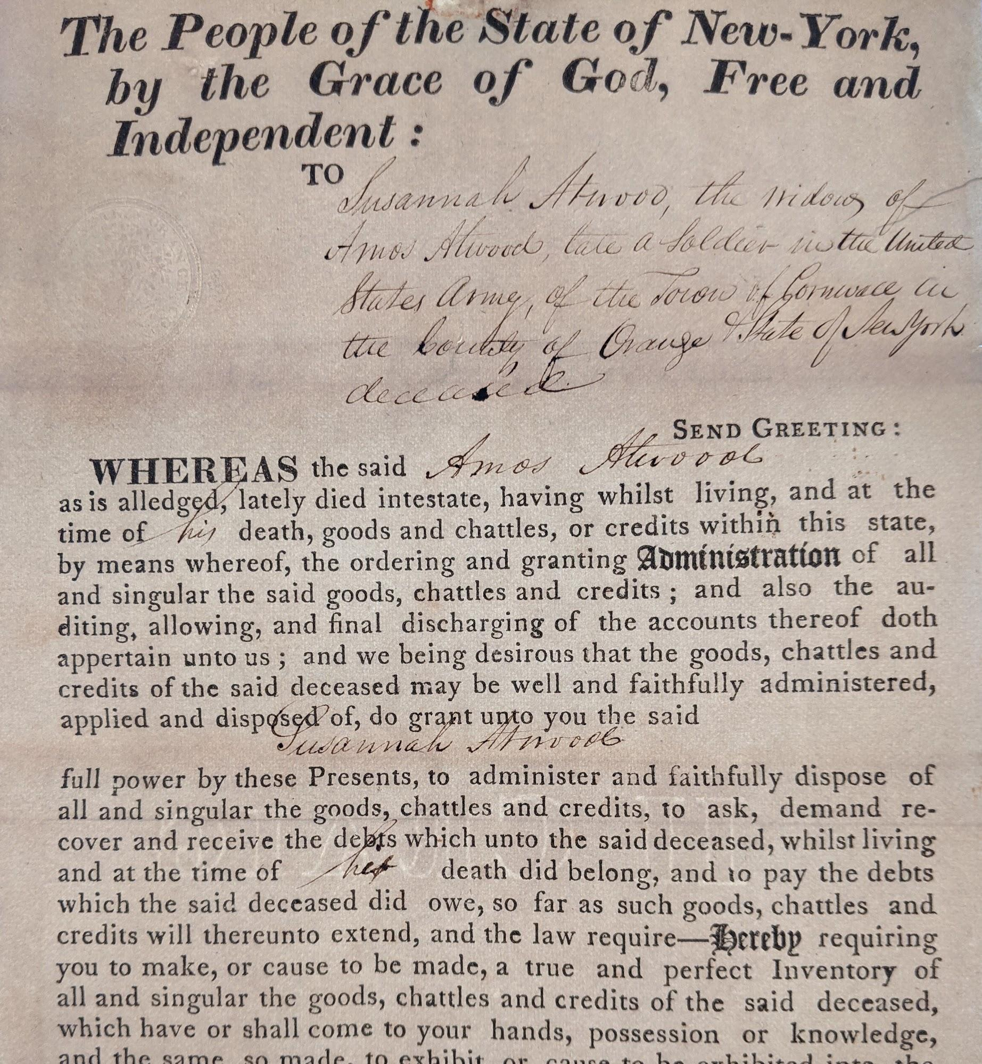
Conservation Branch-Revolutionary War Pensions

Slide 21
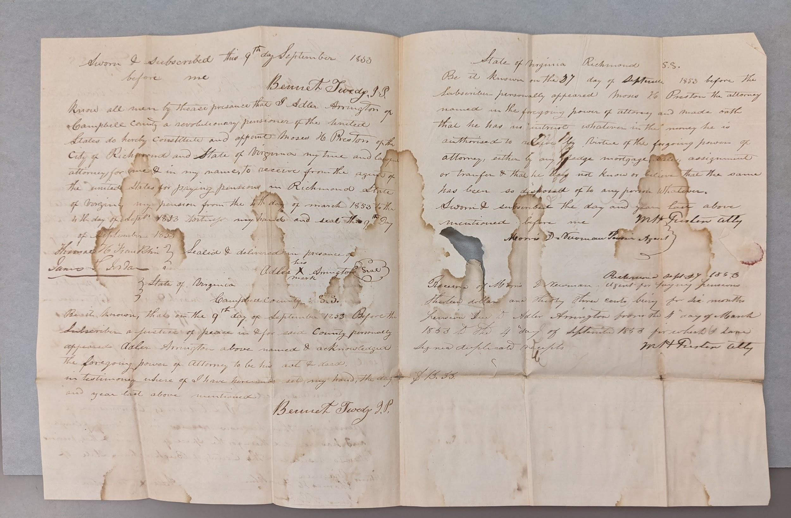
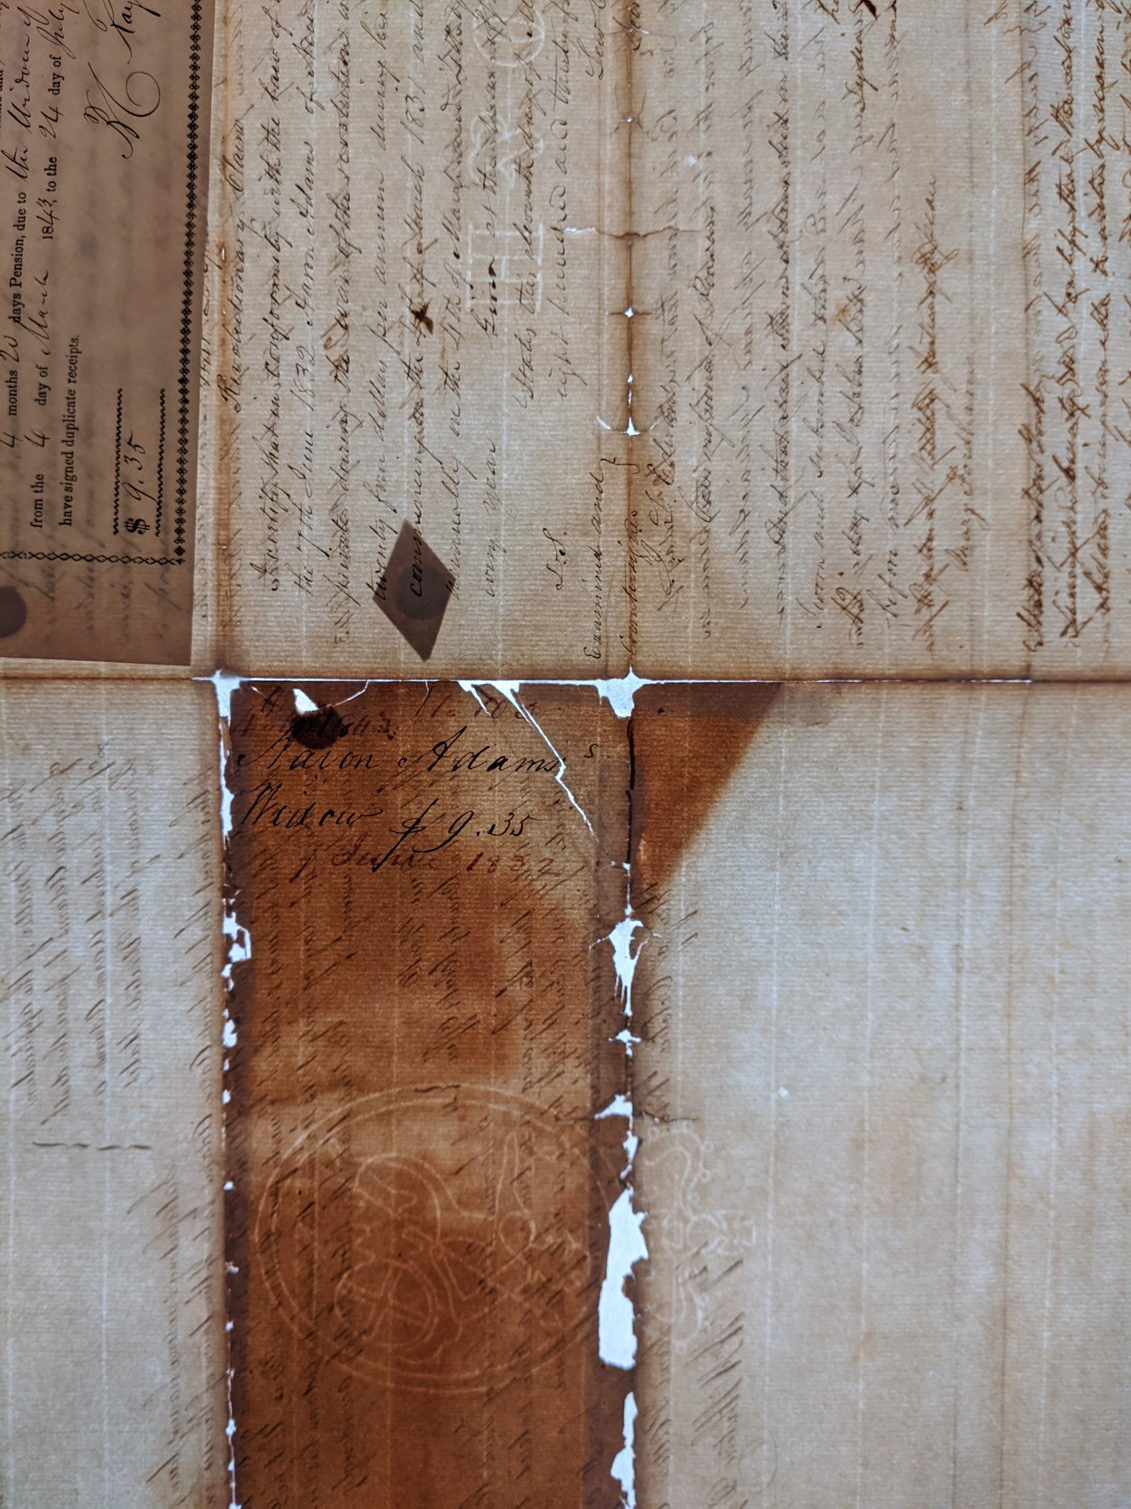
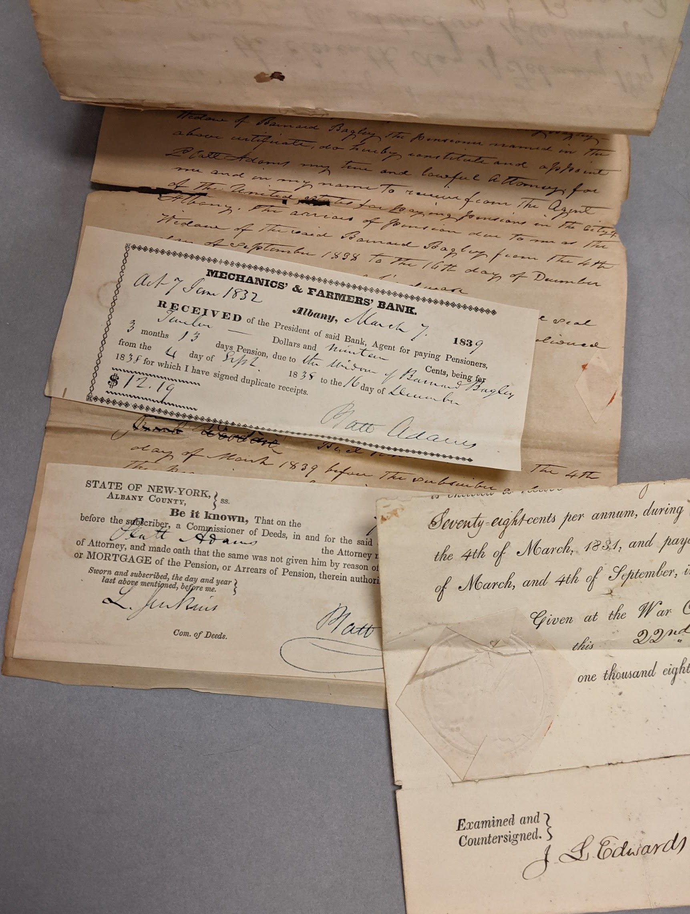
Conservation Branch-Revolutionary War Pensions
The condition differs. Most documents are brittle, stained, discolored with multiple attachments often obscuring original text.

Slide 22
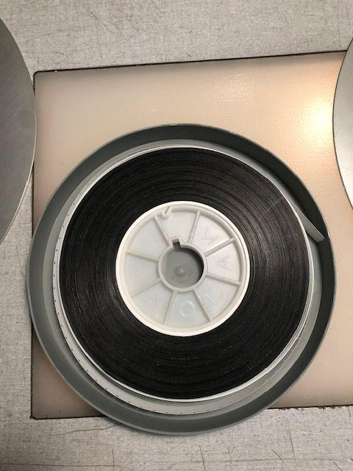
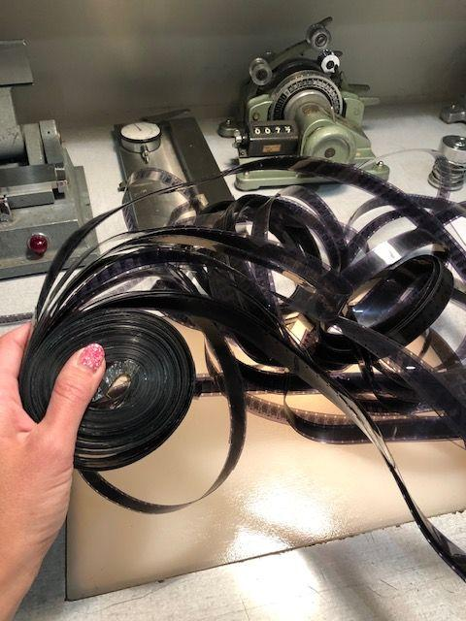
Motion Picture Preservation Lab- Outtakes from President Carter in Nigeria.

Slide 23
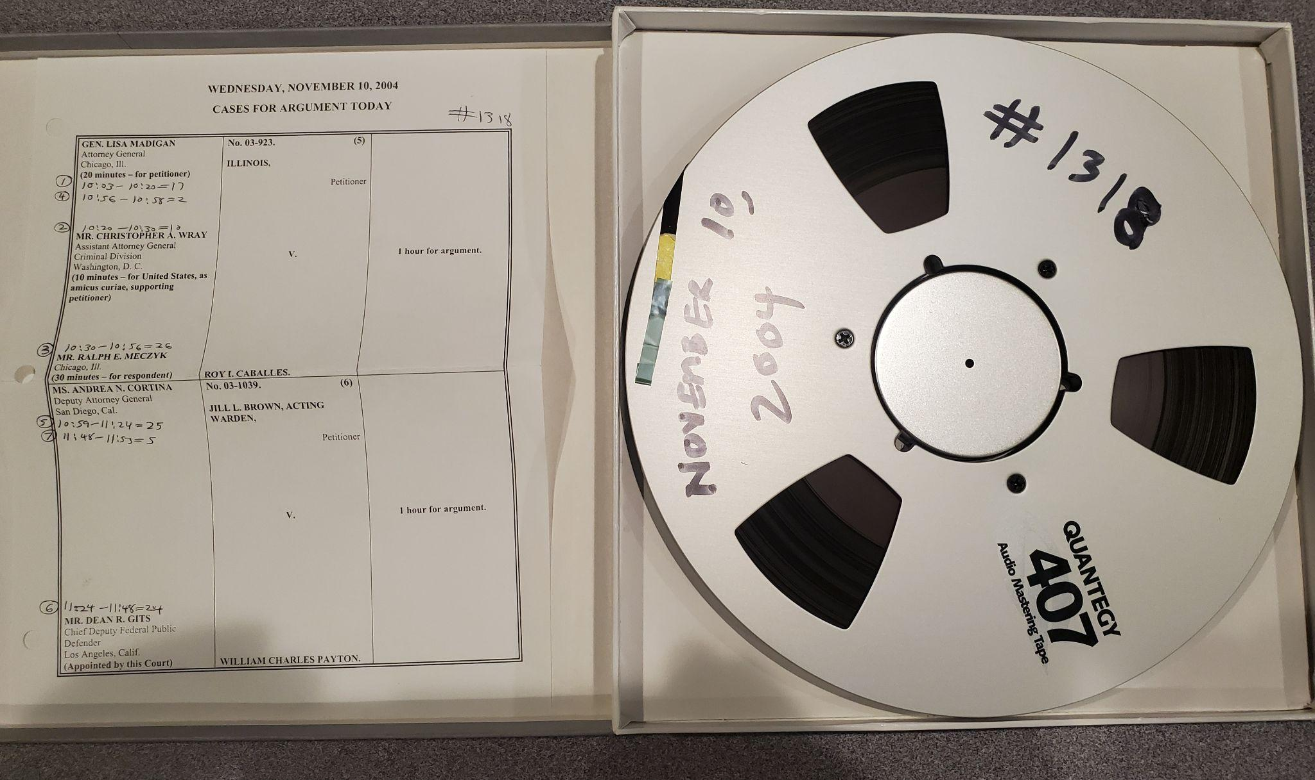
Audio Video Preservation Lab- Supreme Court Digitization

Slide 24
Strategy 3: Exploit science and technology for improved practice.
Notes:
Some additional example projects supporting each research objective if there is more interest – also on our website for applicants to see!

Slide 25
What is Heritage Science?
How can we best preserve and protect cultural heritage of all forms?
Heritage Science is:
Cross – disciplinary
Collaborative by nature
Emerging as a discipline world-wide
Science & Engineering
Technology
Math
Heritage Science can be described as use-inspired, basic research.
Heritage Science

Slide 26
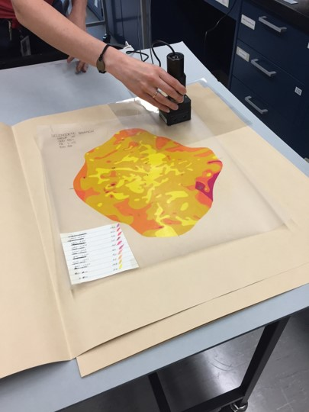
Heritage Science at NARA
https://www.archives.gov/preservation/heritage-science
Scientists have been working at NARA since 1950, currently have a team of four.
Develop and execute applied research program
Long or short term
Object/collection inspired
Goal for work to support transformational outcomes
Provide technical expertise and services
Material evaluation for exhibits, housings and anything used in proximity to records
Specifications and QC testing

Slide 27
National Archives Fulbright Heritage Scholar Program
Annually host One International Scholar to work on a proposed Heritage Science Research Project.
First scholar will start in Fall of 2022.

Slide 28
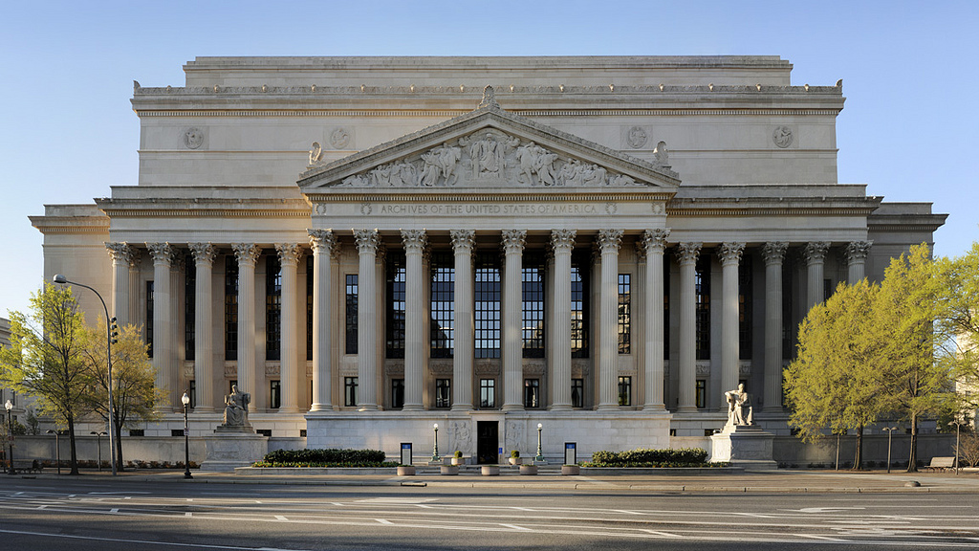
Integrating Risk Assessment for Pollutants into Energy-Saving Strategies for Sustainable Environmental Management of Collection Storage Spaces
Our flagship building National Archives in Washington DC, a selected site.
A research partner in RIT’s study on Pollutants and Energy Saving Strategies in collection spaces.

Slide 29
NARA Directive 1571 Archival Storage Standards
Revising NARA’s Archival Storage Standards (NARA 1571)
Updated to include research findings since 2002.
Includes more explanation of the why the requirements are in place and a bibliography.
Emphasize energy savings.

Slide 30
Temperature and Relative Humidity Standards in 1571

Slide 31
Major changes to NARA's preservation environment directive:
change exhibition parameters
modify acetic acid ppm limits
address SO2, NO2, and Ozone
endorse passive methods of measuring pollutants
consider the context of significance in determining storage parameters

Slide 32
Strategy 4: Defining competencies and skills needed to deliver Preservation Programs’ future programs.

Slide 33
Leadership in Archival Preservation

Slide 34
Co-Hosted Conferences
35th IPH congress: Washington, D.C. June 7-11, 2021
Co-hosted with National Gallery of Art and Library of Congress
Organized by: Beatriz Centeno-Pineiro, Amy Lubick,
Halaina Demba, Yoonjoo Strumfels
Presented:
Developing a watermark database for the First Federal Congress records of the United States, March 1789-1791. Halaina Demba, Yoonjoo Strumfels.

Slide 35
Co-Hosted Conferences
April 7-9, 2021
Co-Hosted with University of Maryland Cinema and Media Studies Program and the National Archives and Records Administration Special Media Records Division
Organizers: Audrey Amidon, Heidi Holmstrom.
Supporting staff: Ivy Donnell, Ken Myers, Criss Austin
Presented: Uncle Sam Presents: 75 Years of Government Films A compilation of clips from NARA’s holdings, edited by staff from the Motion Picture Preservation Lab

Slide 36
Publish in Peer-Reviewed Journals
https://www.archives.gov/preservation/heritage-science/publications-presentations
Herrmann, J., Strumfels, Y., Ludwig, K. “Examination of date tampering on Abraham Lincoln's pardon of Patrick Murphy, RG 153 entry 15, case MM761 (ARC identifier: 1839980), ” Forensic Science International Synergy, 3, (2021).
Herrmann, J., Kim, D. “Virtual Deinstallation During the COVID-19 Pandemic ,” Journal of Conservation and Museum Studies,19, no.1 (2021): 1-5.
Kelly, K. Herrmann, J., Chipman, A, Davis, A., Khan, Y. Loew, S. Morrison Danzis, K. Ohanyan, T. Varga, L., Witty, A. Youket, M. “Heat- and Solvent- Set Repair Tissues ,” Journal of the American Institute for Conservation, (2020):1-31 .
Kelly, K., Herrmann, J., Chipman, A, Davis, A., Khan, Y. Loew, S. Morrison Danzis, K. Ohanyan, T. Varga, L., Witty, A. Youket, M. “Heat- and Solvent-Set Repair Tissues (extended abstract and handouts).” The Book and Paper Group Annual, 38 (2019): 40-42.

Slide 37
Conference Presentation (2019-2022)
An Investigation into the Stability of Thermal Copying Records / Henry Duan, Lisa Isbell, Jennifer Herrmann, Book and Paper Session (AIC) 2021
Library and Archives Conservation: Priorities of the Past, Present, and Future / Amy Lubick (AIC) 2021
Archives as a Borderland: Navigating USIA Research at NARA/ Audrey Amidon, Heidi Holmstrom, & Ivy Donnell for the Association of Moving Image Archivists 2021
Unfolding the Visual History of the Holocaust through American Liberation Footage: Digitizing NARA’s Evidential Moving Images/ Criss Austin for FDR Library Examining American Responses to the Holocaust 2021
Returning Loans Safely during the COVID 19 Pandemic / Jennifer Herrmann and Dong Eun Kim, Library and Archives Discussion Group 2021
Lessons Learned From 45 years of Fire Recovery, Cindy Pierce, Poster (AIC) 2021
An Introduction to Identifying and Preserving Motion Picture Film / Criss Austin for Connecting to Collections Care 2020
A Future Facing Preservation Programs at the National Archives and Records Administration (NARA) - Allison Olson - Library and Archives Discussion Group - AIC 2019
(Photographic Materials) Analytical Testing of Heat and Solvent Set Repair Tissues, Jennifer K. Herrmann, Anne Witty, Lauren M. Varga, Steven Loew - AIC 2019

Slide 38
Working Groups and Standards Participation
American Institute for Conservation
Book and Paper Group Assistant Program Chair: Morgan Browning
Bylaws and Nominating: Sarah Stauderman
Emergency Committee Co-chair: Sonya Barron
Held in Trust Science and Materials: Lindsay Oakley
Library and Archives Discussion Group Co-chair: Amy Lubick
Materials Working Group: Jennifer Herrmann
Anoxic Encasements Working Group: Jennifer Herrmann, Dong Eun Kim, Amy Lubick, Mark Ormsby, Sara Shpargel
Cultural Heritage Coordinating Committee (CHCC): Allison Olson
Federal Agency Digitization Guidelines Initiative (FADGI) http://www.digitizationguidelines.gov/: Martin Jacobson
Guild of Book Workers Potomac Chapter, Chair: Shannon Kerner
International Organization for Standardization: Henry Duan, Sara Shpargel (leadership in ISO TC 42), Pamela Najar-Simpson
REALM Project - REopening Libraries, Archives, and Museums https://www.oclc.org/realm/home.html: Jennifer Herrman (Scientific Working Group) and Allison Olson (Executive Steering Committee)
Washington Conservation Guild Nominating: Sarah Stauderman

Slide 39
Acknowledgements
David Ferriero, Archivist of the United States; Jay Bosanko, Chief Operating Officer; Ann Cummings, retired Executive for Research Services; Chris Naylor, Acting Executive for Research Services
Preservation Consultant: Nancy Bell
Preservation Leadership Team: Christina Austin, Jody Beenk, Nancy Davis, Noah Durham, Vicki Lee, Jason Love, Amy Lubick, Martin Jacobson, Pamela Najar-Simpson, Lindsay Oakley, Marta O’Neill, Sarah Stauderman
NARA 1571 Drafting Committee: Nancy Bell, Nancy Davis, Pamela Najar Simpson, Mark Ormsby
Preservation Programs Staff: Pamela Kirschner, Richard Schneider, Abigail Thompson, Anne Witty, Beatriz Centeno-Pineiro, Dong Eun Kim, Douglas Mcrae, Halaina Demba, Lisa Isbell, Morgan Browning, Rachel Bartgis, Richard Hnat, Sara Shpargel, Shannon Kerner, Sonya Barron, Yoonjoo Strumfels, Kenneth Drummond, Martin Jacobson, Donnell Barnes, Courtney Egan, Jerry Jackson, Jessica Sims, Ryan Davis, Audrey Amidon, Edward Scheuermann, Heidi Holmstrom, Ivy Donnell, Ken Myers, Thomas Neufeld, Ashley Cox, Carol Gorecki, Cindy Pierce, John Nkenchor, Keith Owens, Noah Durham, Sara Holmes, Sean Derrick, Shannon Clark, Stephanie Casey, Tammy Pitt, Thomas Schmidt, Tiffany Marshall, Valerie Helton, Henry Duan, Jennifer Herrmann, Mark Ormsby

Slide 40
A Look at Preservation Activities at the Tennessee State Library & Archives
CoSA-NARA Webinar
Emily Farek, Conservation Manager, Tennessee State Library & Archives
February 24, 2022

Slide 41
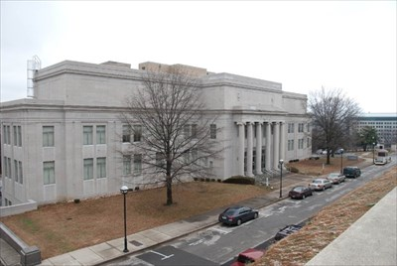
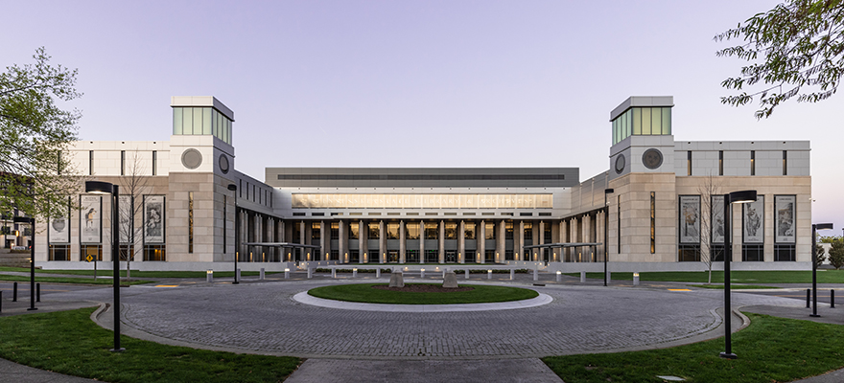
Old → New!
https://www.waymarking.com/waymarks/wm5V29_Tennessee_State_Library_and_Archives_Nashville_TN
https://tslablog.blogspot.com/

Slide 42
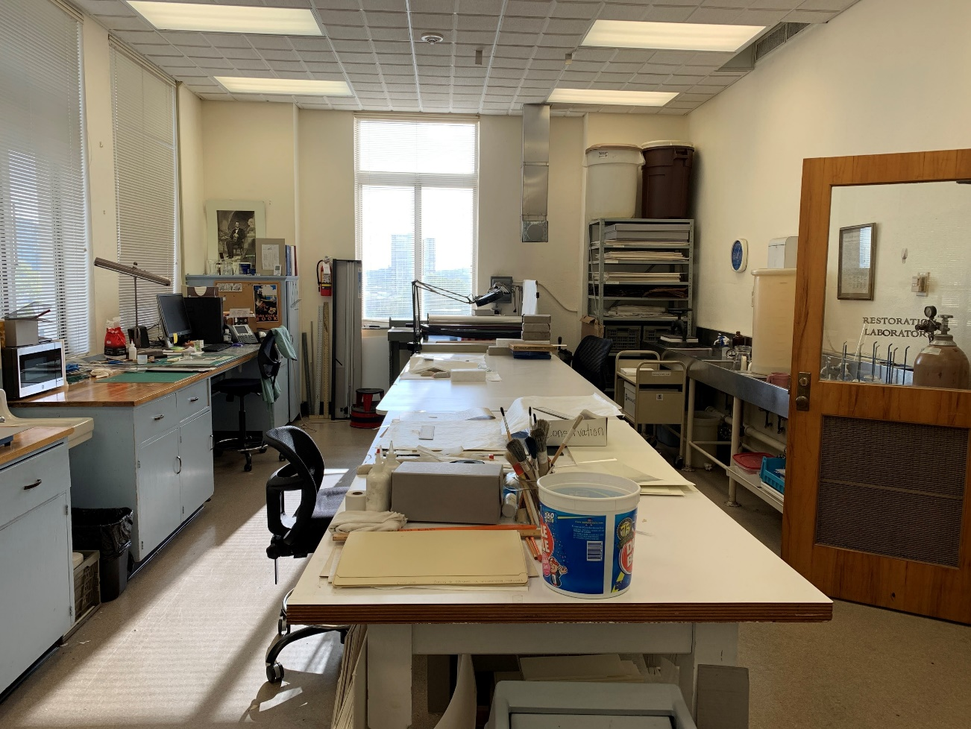
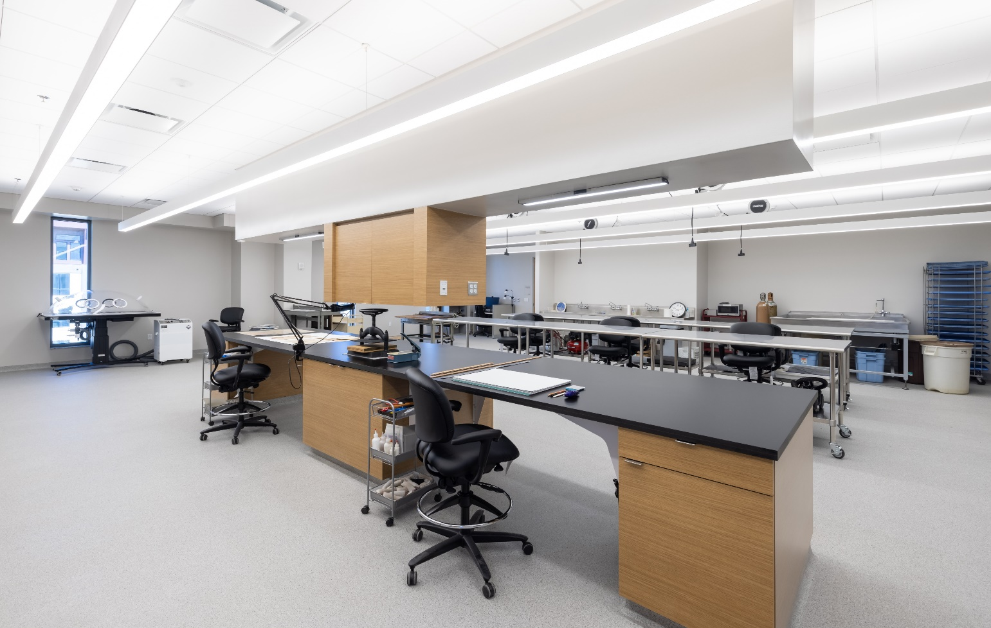
Old → New!
5x larger!

Slide 43
New Conservation Lab Features/Capabilities
Equipment – microscope, board shear, oversize sink, deionized water system, suction table/humidification chamber, ductless fume hood, Nilfisk HEPA vacuum, blast freezer
Storage – dedicated room for conservation supplies, space for oversize supplies
Outreach – tables and space to host tours, workshops, trainings, interns, and volunteers
Updated Lab Procedures – workflow incorporating conservation database record keeping and photographic and written documentation of treatments

Slide 44
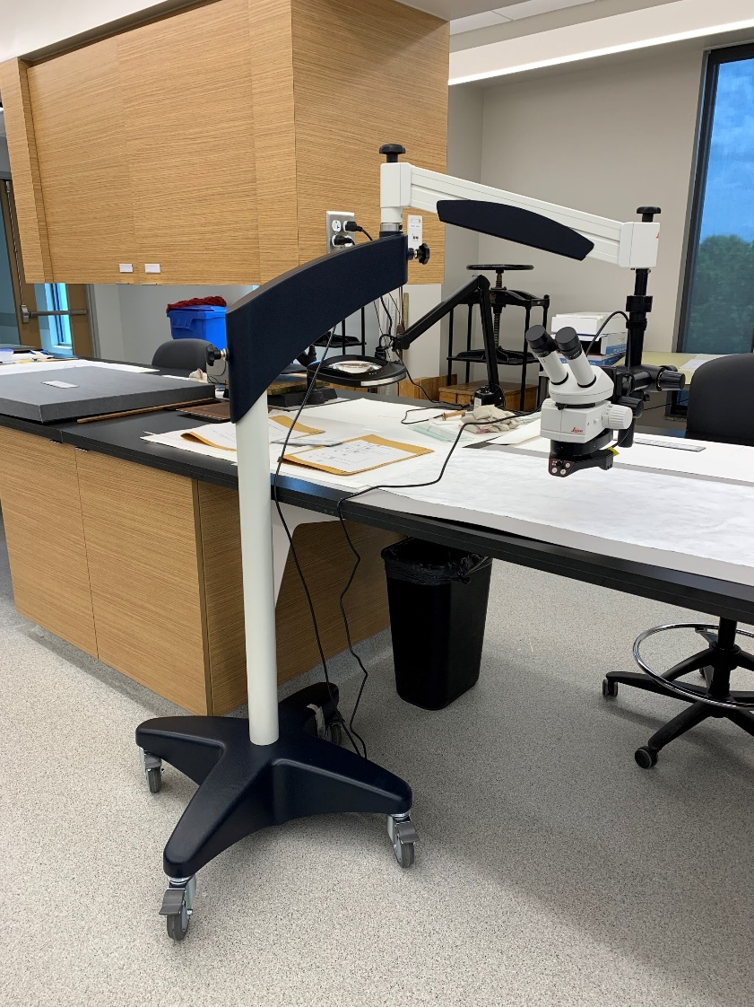
Equipment - Stereomicroscope
For detailed work and close observation/examination

Slide 45
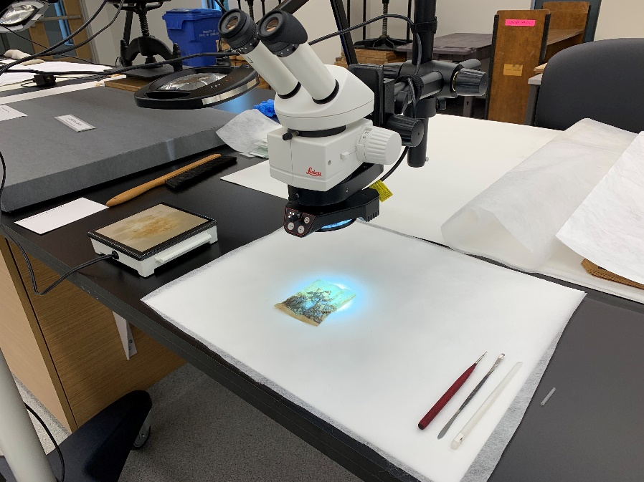
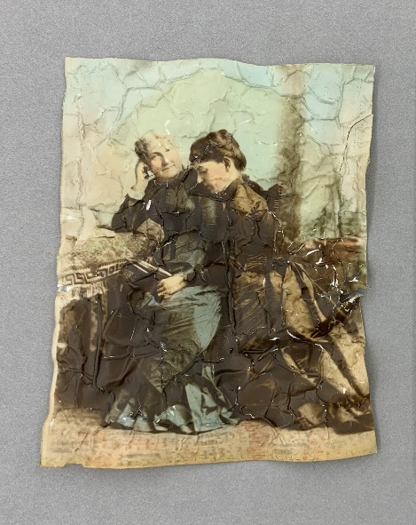
Equipment - Stereomicroscope
For detailed work and close observation/examination

Slide 46
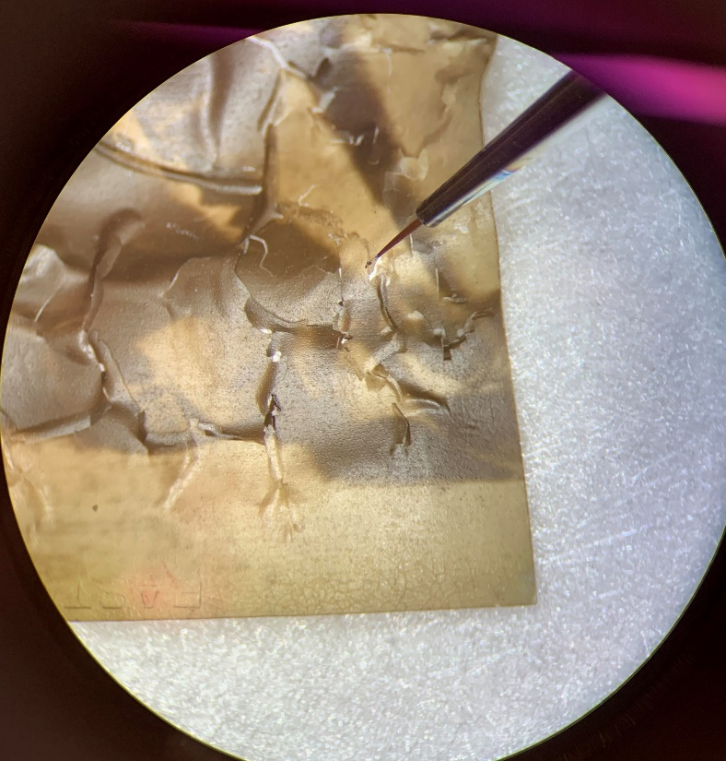
Equipment - Stereomicroscope
For detailed work and close observation/examination

Slide 47
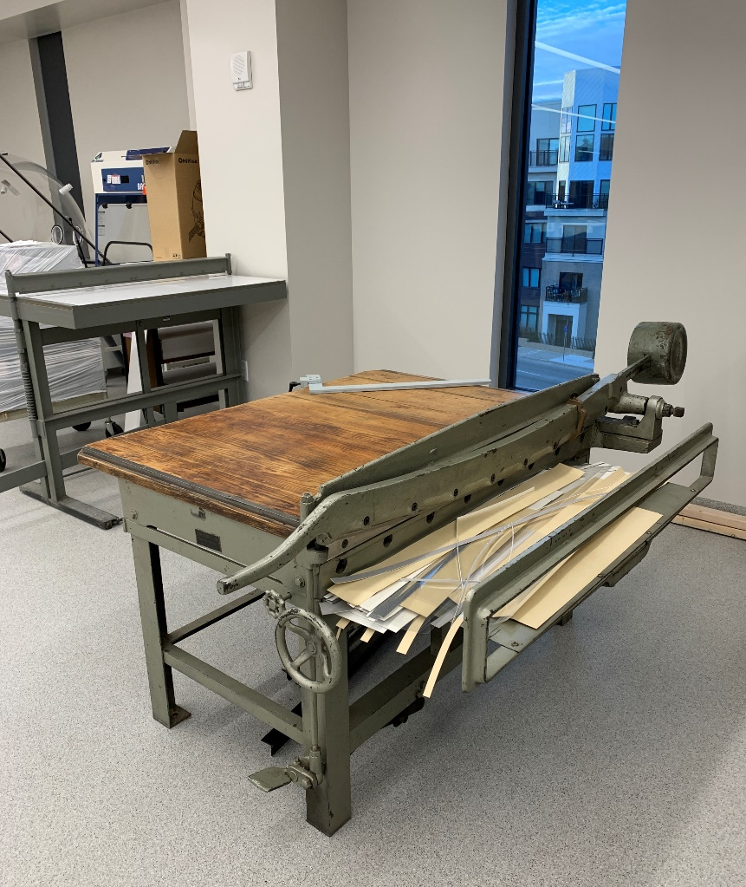
Equipment – Board shear
For cutting large sheets of paper, folder stock, and board

Slide 48
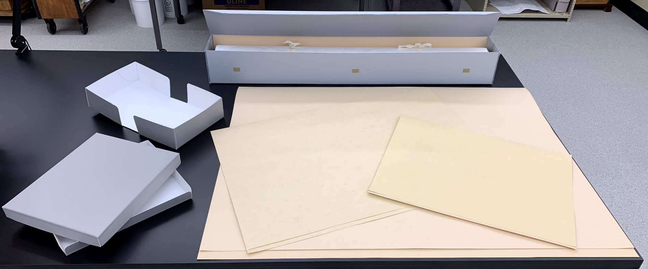
Equipment – Board shear
For cutting large sheets of paper, folder stock, and board

Slide 49
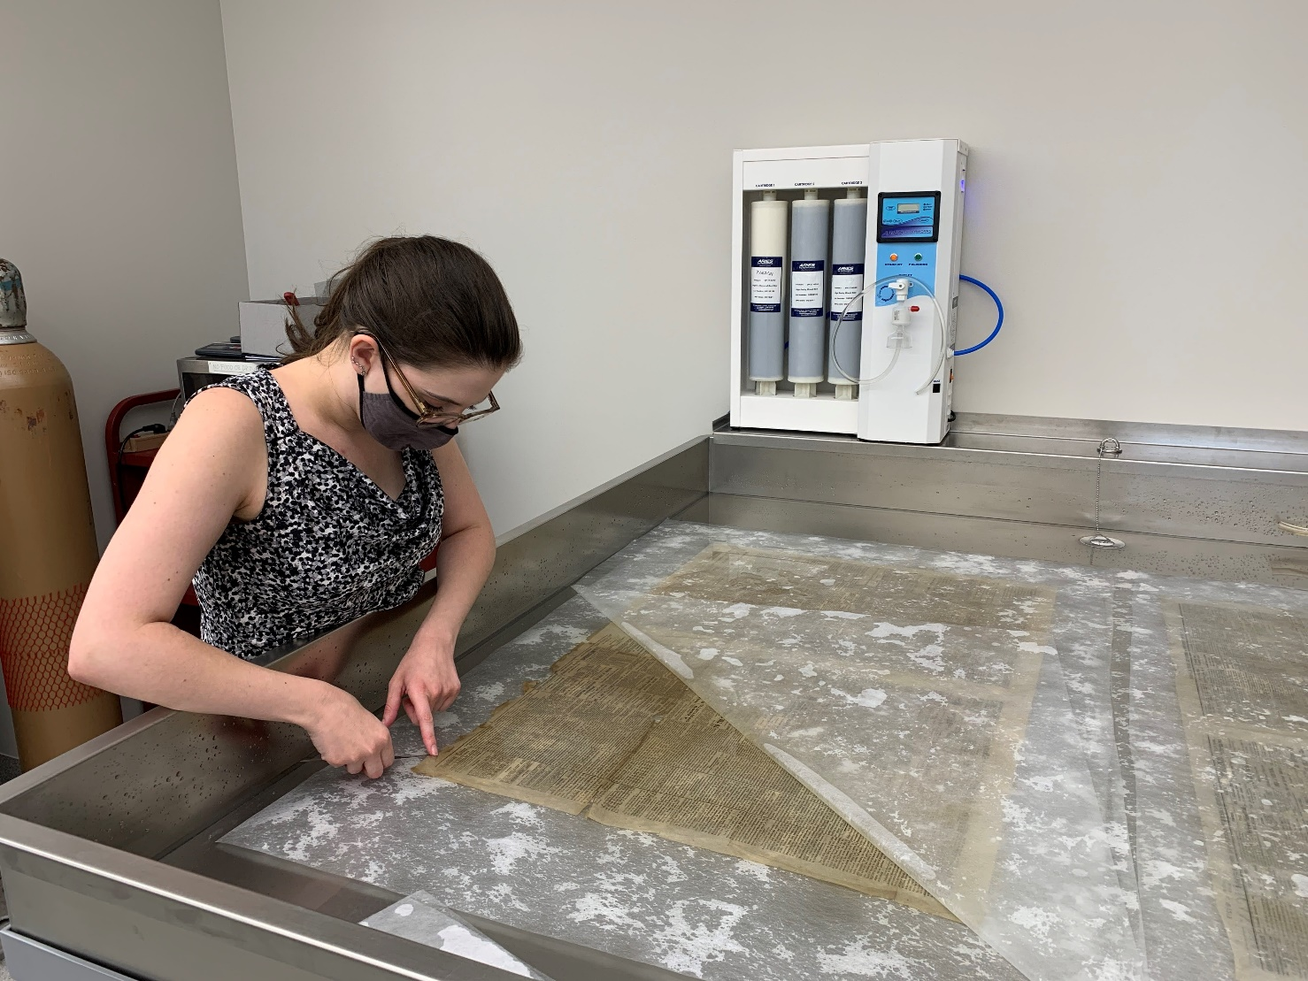
Equipment – Oversize sink and deionized water system
For bathing and other aqueous treatments

Slide 50
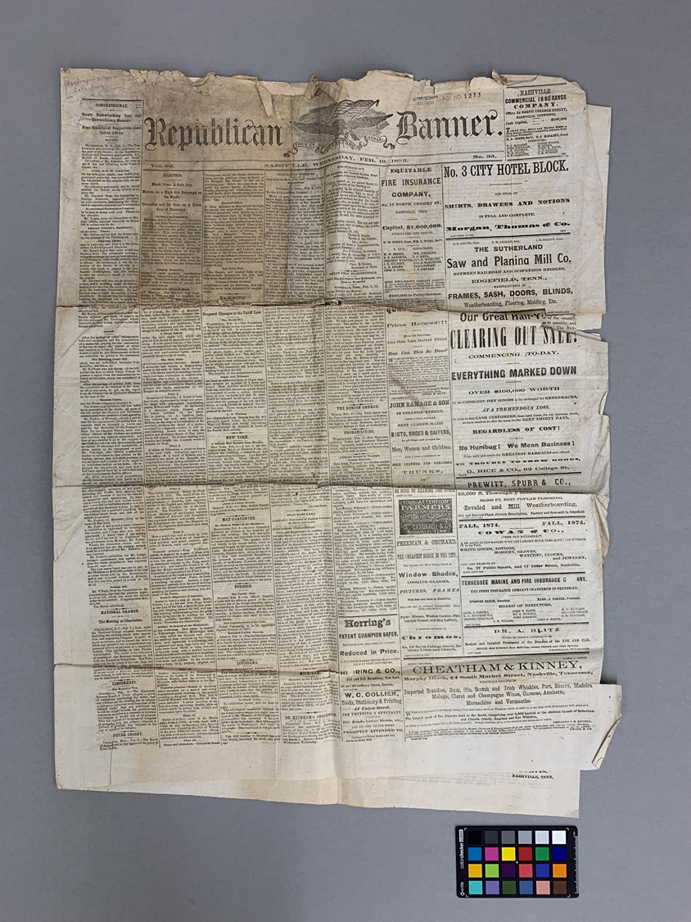
Equipment – Oversize sink and deionized water system
For bathing and other aqueous treatments
Before treatment, recto

Slide 51
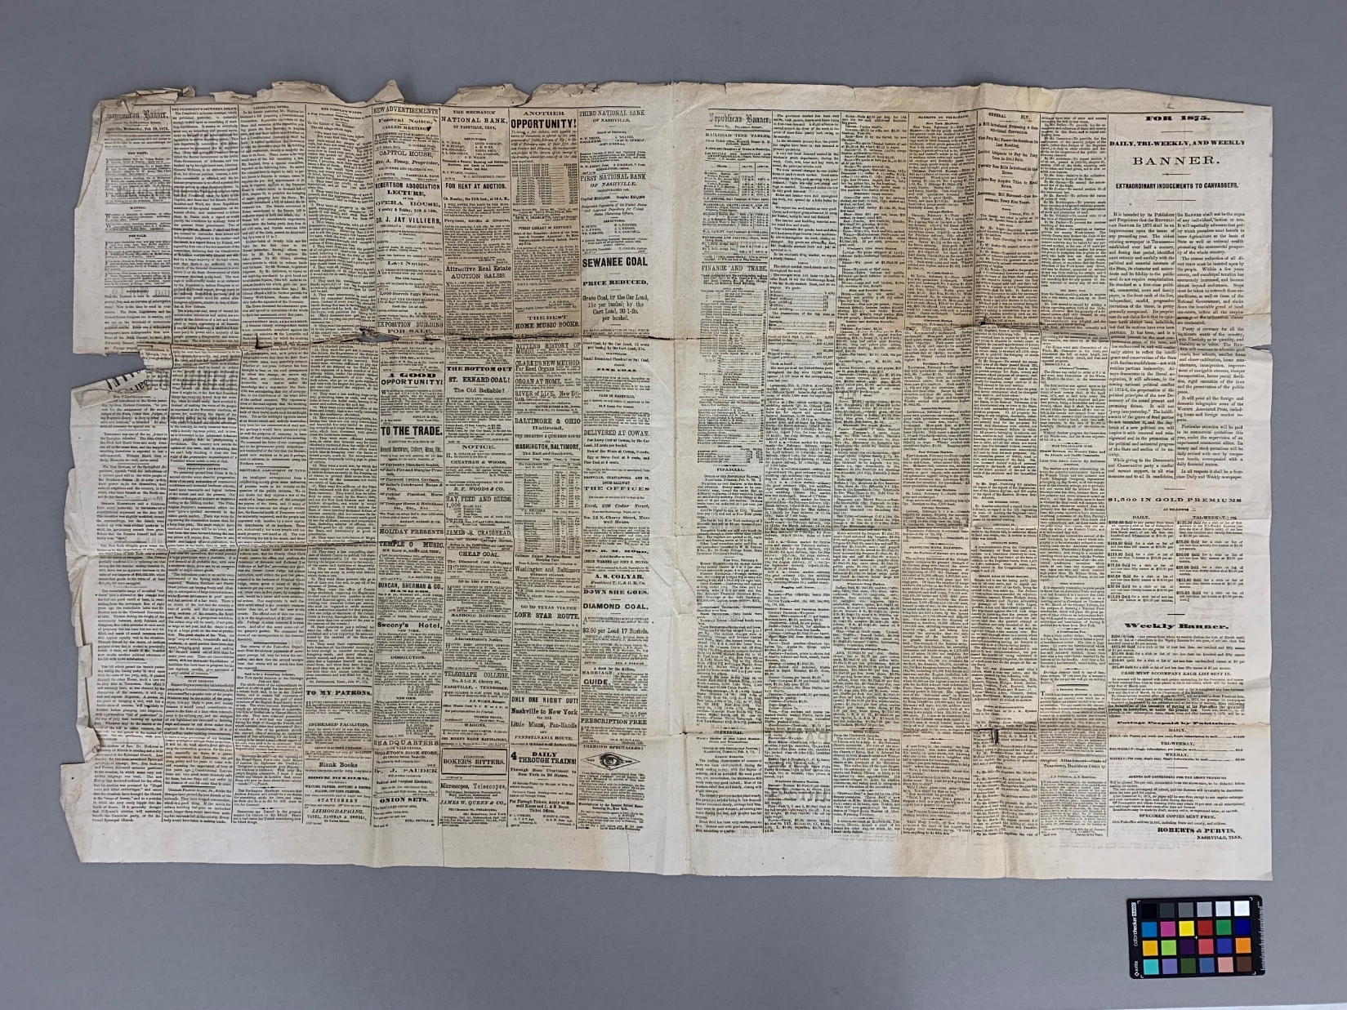
Equipment – Oversize sink and deionized water system
Before treatment, center
Republican Banner, Vol. 62, Nashville, Wednesday, Feb. 10, 1875, No. 35

Slide 52
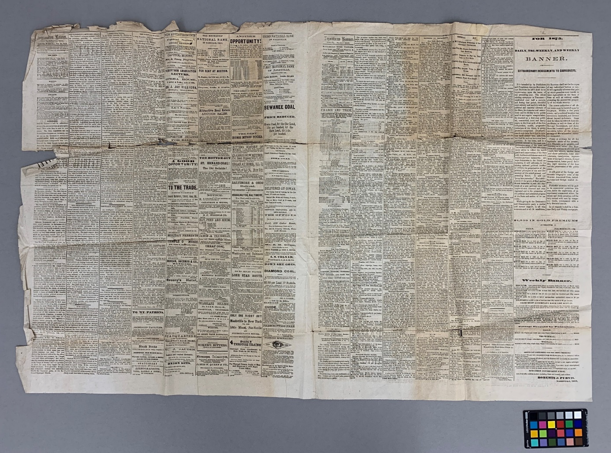
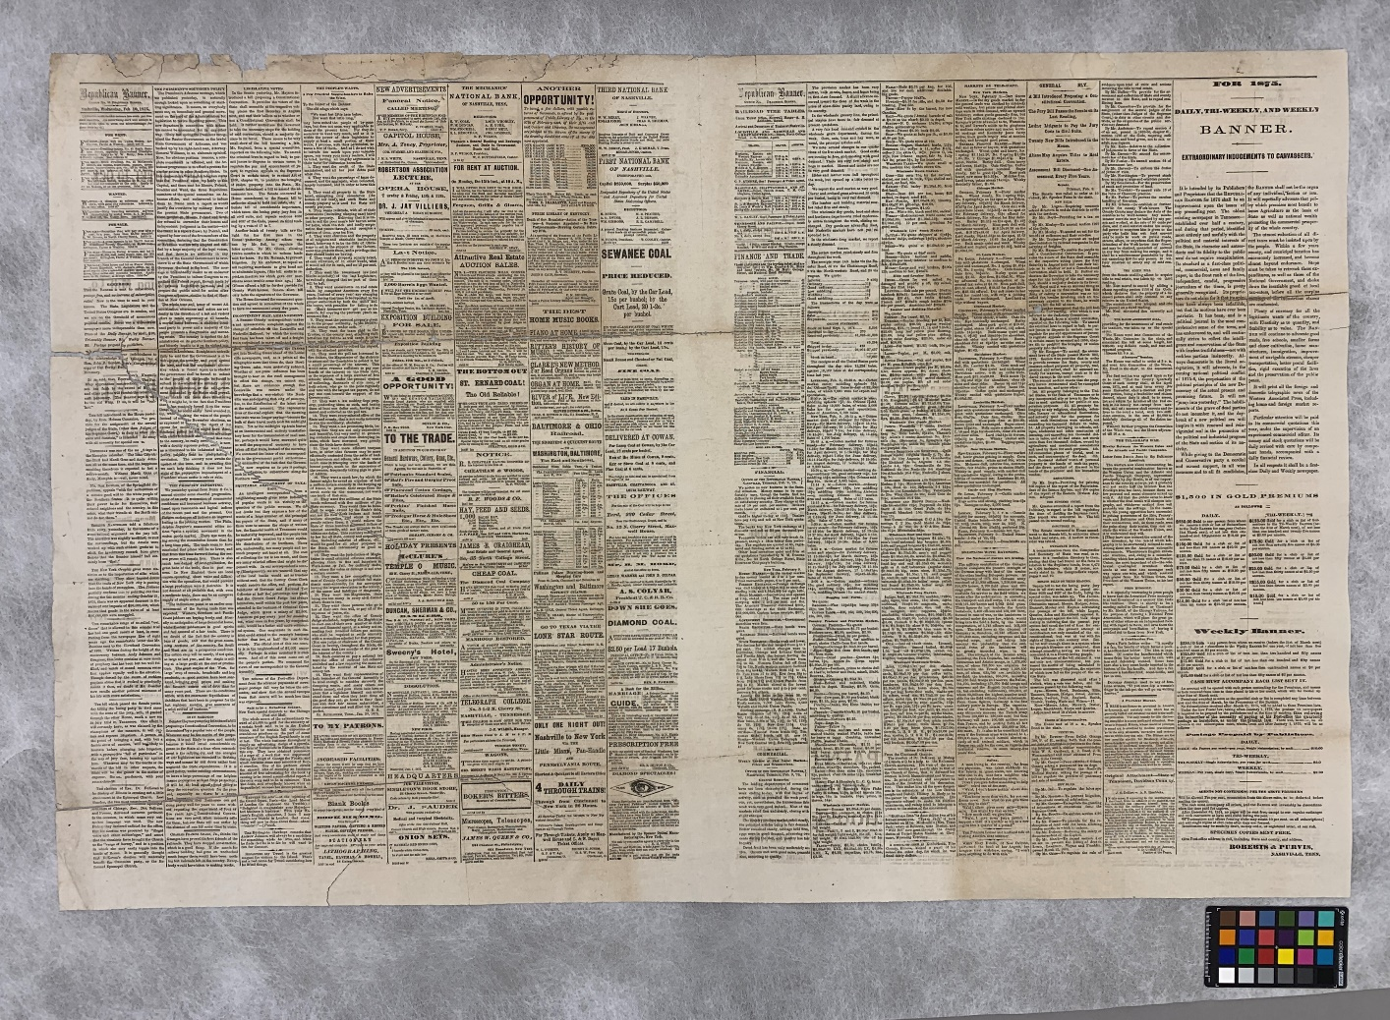
Equipment – Oversize sink and deionized water system
Before treatment
During treatment, after bathing and drying under weight
Republican Banner, Vol. 62, Nashville, Wednesday, Feb. 10, 1875, No. 35

Slide 53
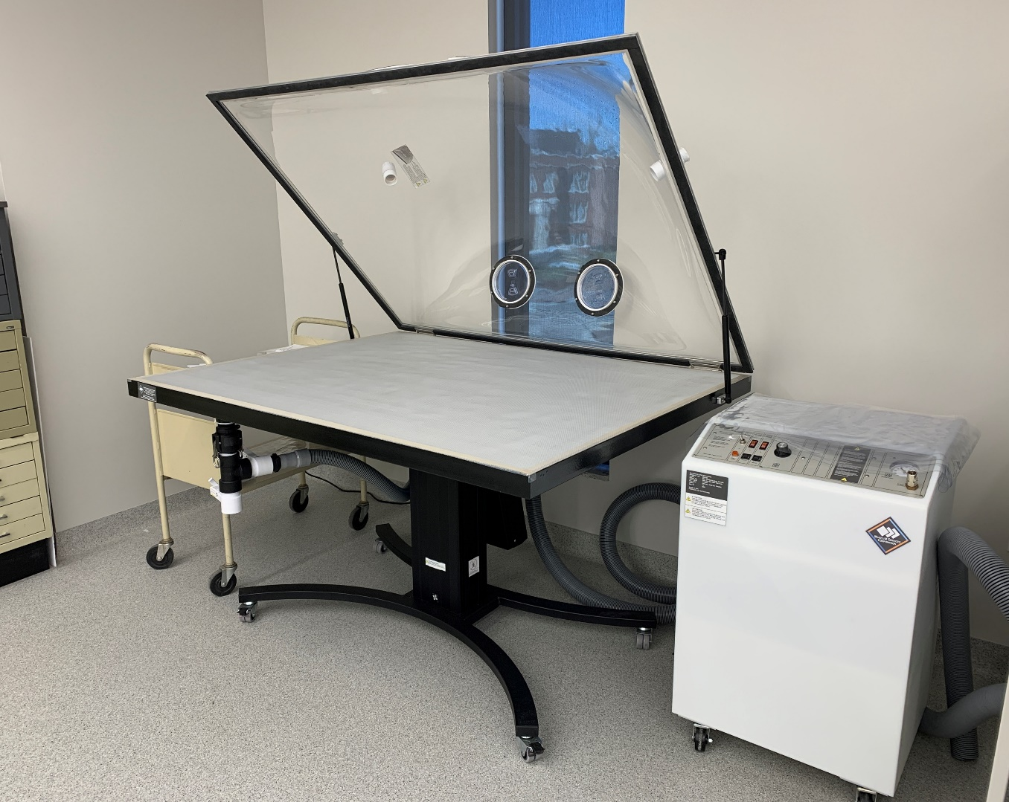
Equipment – Suction table/Humidification chamber
For spot treatments, aqueous treatments on fragile documents, humidification, etc.

Slide 54
Equipment – Suction table/Humidification chamber
During treatment
Before treatment
Carnival Edition of The Picayune
Krewe of Proteus, The Queen of Serpents, 26th Representation, New Orleans Feb. 11th, 1907

Slide 55
Equipment – Suction table/Humidification chamber
Before treatment
After treatment
Carnival Edition of The Picayune
Krewe of Proteus, The Queen of Serpents, 26th Representation, New Orleans Feb. 11th, 1907

Slide 56
Equipment – Ductless fume hood and Nilfisk HEPA vacuum

Slide 57
Equipment – Ductless fume hood and Nilfisk HEPA vacuum
For mold remediation and surface cleaning

Slide 58
Equipment – Ductless fume hood and Nilfisk HEPA vacuum
Variable suction

Slide 59
Equipment – Ductless fume hood and Nilfisk HEPA vacuum
Micro attachments for hose

Slide 60
Equipment – Ductless fume hood and Nilfisk HEPA vacuum
Nylon mesh screens

Slide 61
Equipment – Blast freezer
For pest management/eradication and emergency/disaster response

Slide 62
Storage
Conservation materials and supplies

Slide 63
Outreach
Volunteer opportunities – we currently have one volunteer working on creating boxes for vital records
Tennessee Archives Institute (TAI) – we will be able to host workshops in the lab for the conservation portion of the annual TAI
County archives and libraries – we can better help and advise with their preservation needs
Patron inquiries – we can better serve library & archives patrons who have questions about their private collections
Tours – the new lab can accommodate tour groups

Slide 64
Preservation Policies for New Building
Integrated Pest Management (IPM)
Environmental Monitoring
Handling trainings
Disaster Planning/Emergency Response
Housing systems for collections
Surveys of vulnerable collections

Slide 65
Integrated Pest Management (IPM) – quarterly pest monitor checks, communication with Orkin, designated Food/Drink areas
Pest monitors!

Slide 66
Environmental Monitoring – Conserv software/sensors, biweekly meetings

Slide 67
Environmental Monitoring – Conserv software/sensors, biweekly meetings

Slide 68
Disaster Planning/Emergency Response – planning team in place; goal for the plan to be complete by May 1, 2022

Slide 69
Housing systems for collections – new ways to house materials to accommodate the new building’s storage systems
ASRS – shelving units
ASRS - bins

Slide 70
Housing systems for collections – new ways to house materials to accommodate the new building’s storage systems
Compact shelving

Slide 71
Surveys of vulnerable collections – creating plans for improved storage and preservation of public access microfilm and oversize materials
Creating improved storage within flat files
Testing acetate microfilm with A-D strips

Slide 72
Thank you!
e-mail: emily.farek@tn.gov

Slide 73
Questions and Comments

Slide 74
Upcoming Member Webinars
March 24 - 2022 Advocacy Tune-up
To register:
https://www.statearchivists.org/programs-education/cosa-webinars

Slide 75
Upcoming SERI Webinars
March 8 - Follow the Yellow Brick Road: Decision Making for Storage of Electronic Records
April 12 - Taking Action Before It's Too Late: Monitoring File Formats for Risk
To register:
https://us02web.zoom.us/meeting/register/tZYsde-qpjoqH9xwnKYrc7lJdTCcJOR2cn84

Slide 76
Contact Us
CoSA Website http://www.statearchivists.org
CoSA Resource Center https://www.statearchivists.org/research-resources/resource-center
CoSA Twitter Handle @StateArchivists
CoSA Facebook Page www.facebook.com/CouncilOfStateArchivists
CoSA You Tube https://www.youtube.com/user/StateArchivists/

Slide 77
Sponsors and Funders

Slide 78
Webinar Evaluation
We really do appreciate your feedback!
We are developing a new evaluation format for future webinars. Watch for that new form with future webinars!

