Slide 1
CoSA Member Webinar America 250 -A Look at National Plans and Activities in North Carolina and Utah
July 28, 2022
3 pm Eastern
Disclaimer: This webinar is being recorded and will be available for viewing on the CoSA website.

Slide 2
Webinar Agenda
Welcome and Overview
Presentations:
America 250 - National perspective
America 250 - North Carolina
America 250 - Utah
Q and A
Upcoming Programs and Webinars

Slide 3
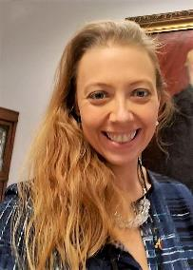
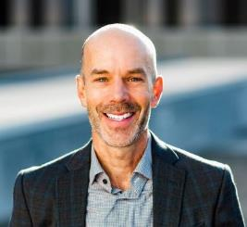
Speakers
John Dichtl
AASLH President & CEO
Jennifer Ortiz
Director
Utah Division of State History
LeRae Umfleet
North Carolina Department of Natural and Cultural Resources

Slide 4
John Dichtl, President & CEO American Association for State and Local History
dichtl@aaslh.org

Slide 5
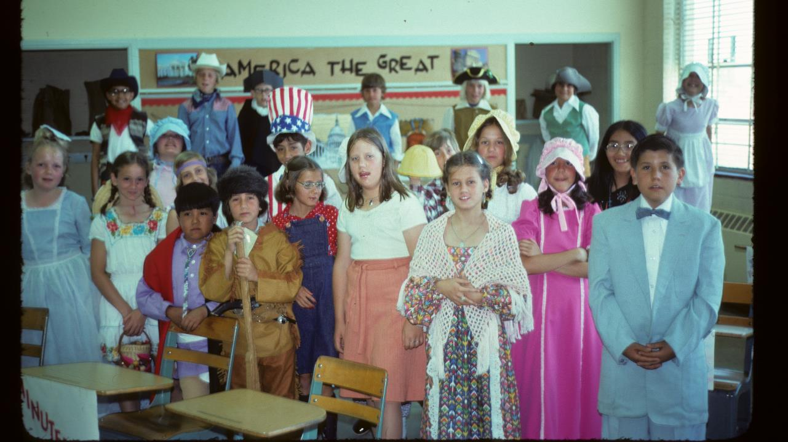
Albuquerque, New Mexico, 1976

Slide 6
America 250 Foundation, the nonprofit admin arm of the U.S. Semiquincentennial Commission

Slide 7
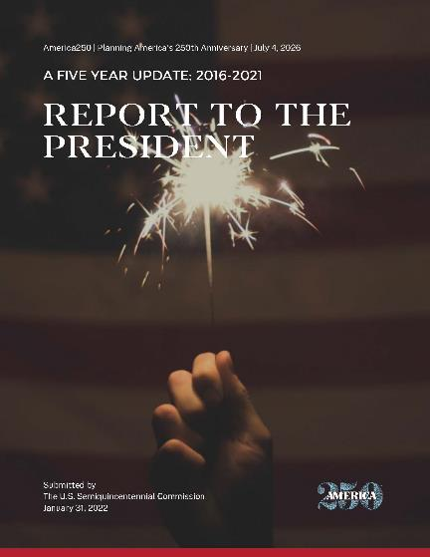
National Level Planning
https://america250.org/about/

Slide 8
Advisory Councils
Arts & Culture
Civics & Civic Engagement
Health & Wellness
History Education
Hospitality & Tourism
Innovation, Science & Entrepreneurship
International
Parks, Preservation & Public Spaces
Sports & Entertainment
Veterans, Military & Family Members
Youth Engagement
Young Leaders
https://america250.org/about/ leadership/

Slide 9
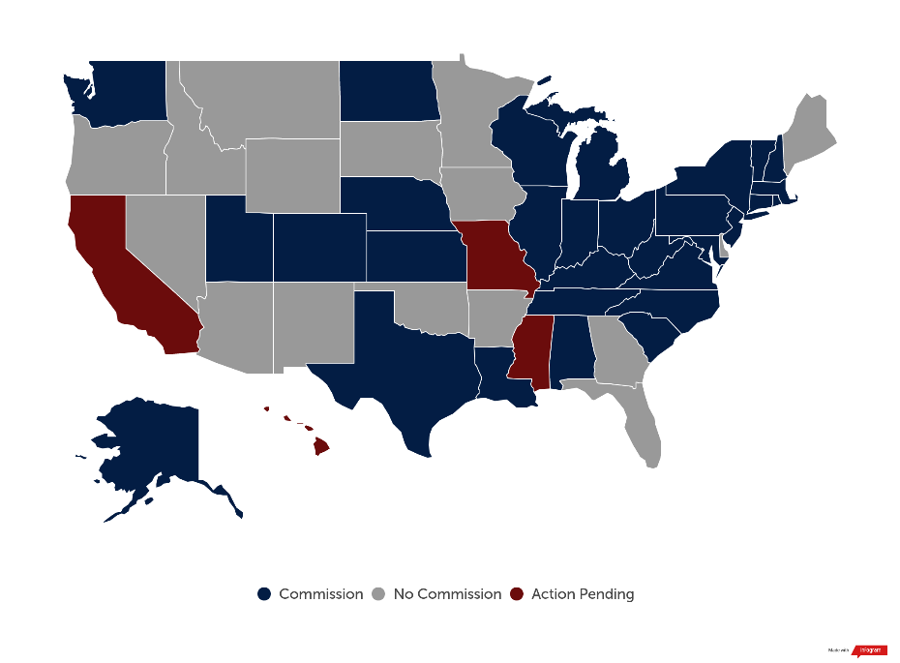
State Level Planning

Slide 10
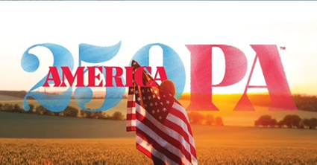

Slide 11
We know that the 1976 Bicentennial helped increase the number of history organizations by 30 to 40 percent.
https://aaslh.org/census/

Slide 14
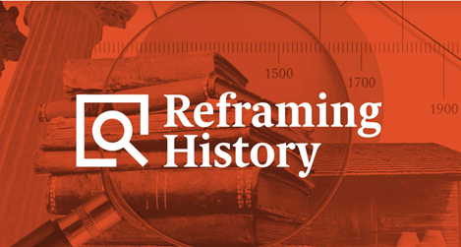
1. History involves critical thinking. 2. Historical work is like detective work. 3. History helps us make progress toward justice. 4. Use concrete, location-specific, examples.

Slide 15
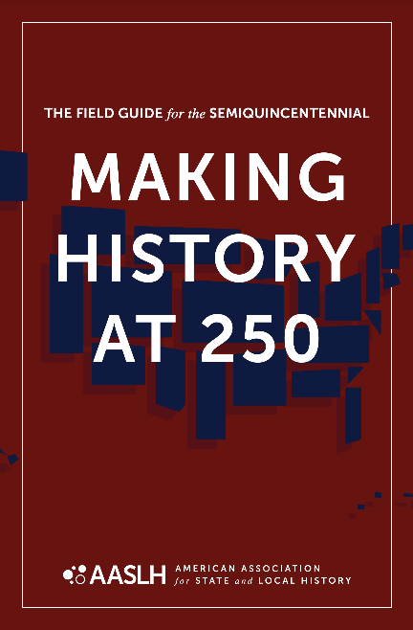
Themes
> Unfinished Revolutions
> Power of Place
> We the People
> American Experiment
> Doing History

Slide 16
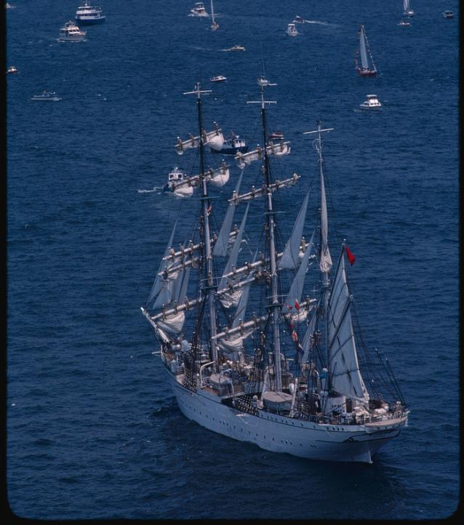
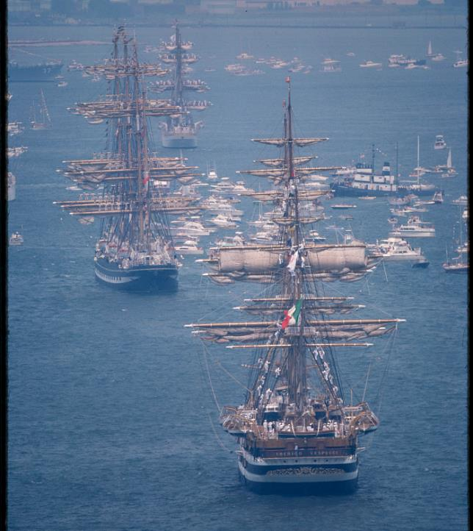

Slide 17
”Beyond 250”
What will the legacy of this anniversary be?

Slide 18
THANK YOU!
Visit AASLH.org/250 to download the Field Guide, or for Reframing History.

Slide 19
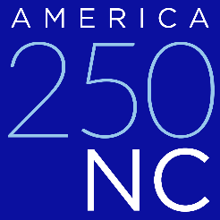
NC Department of Natural and Cultural Resources
Notes:
DNCR began planning the commemoration in 2018, and had a draft plan for commemorative activities by the end of 2019, which is being refined after a pandemic
hiatus. In 2019, Governor Roy Cooper recognized DNCR as the state agency charged with overseeing this important commemoration alongside a large statewide stakeholders
committee. I’d like to share some of our goals and thematic approaches to the commemoration in these few minutes. I would then like to have a quick conversation with
interested participants on how best to involve groups across NC because this commemoration can mean many different things to the diversity of our state’s residents.

Slide 20
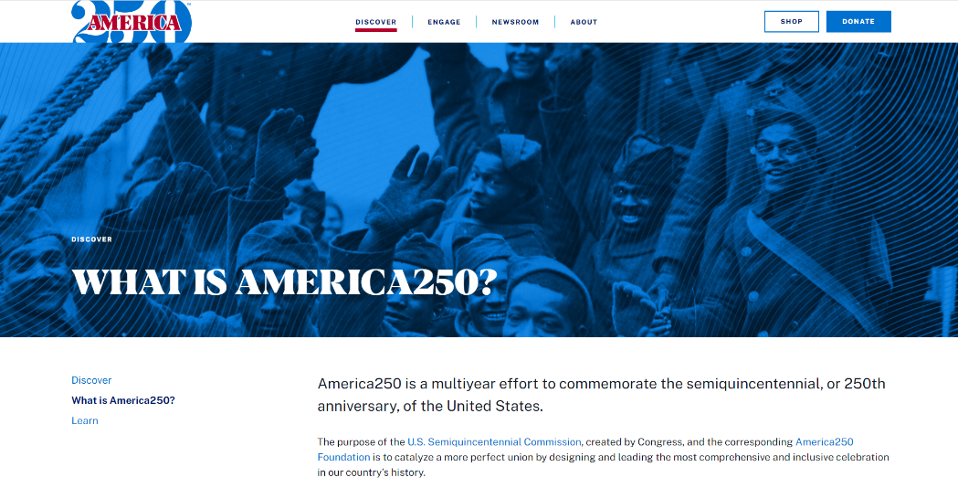
www.america250.org
Notes:
We are partnering with the organization charged by Congress with spearheading a nation-wide series of events focused on 2026, the 250th anniversary of the Declaration of Independence. In North Carolina we realize that the events that led to the Revolution did not start in 1776, nor did they conclude in that year. Therefore, our commemoration will have a larger scope and timeline to address the historical events that affected how North Carolina residents transitioned from British Colonial rule to that of the new American experiment in democracy.

Slide 21
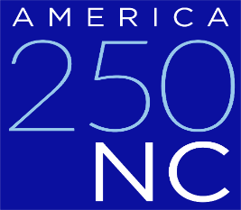
COMMEMORATION ACTIVITIES SUMMARY
Overview
North Carolina will mark the 250th Anniversary of the American Revolution with wide ranging activities across a multi-year commemoration beginning in 2024. A focused emphasis will take place in 2026, although additional events will continue through 2032. As we prepare to mark this anniversary, we are focused on lifting the voices (both historical and present) of North Carolinians to provide a more complete narrative of our state’s role in our country. The Department of Natural and Cultural Resources is the state agency charged with overseeing this important commemoration by Governor Roy Cooper.
Thematic Approach
Two interpretive pillars with three thematic avenues to further explore these concepts
• Revolutionary NC: the historical events of the Revolution & NC as an incubator for revolutions in thought, history, and technology
• When Are We US?: exploration of the concepts of freedom, civic responsibility, overcoming challenges - leaning into the ideals of democracy
Online and Other Resources
• Website, including a dynamic statewide joint calendar
• New digital archival materials
• Interactive media (maps, exhibits, podcasts, etc)
• Documentaries/videos
• Publications
Educational Outreach
• Development of curriculum materials
• ANCHOR and online educational materials
• Tar Heel Junior Historian/National History Day
• Civics education
• Archaeological digs with student engagement
• Art contests
• Library programs
Events
• Large commemorative events
• Community Events
• Special Programming
• Permanent and traveling exhibits across the state
Key to Success
Involvement of partners in planning and implementation

Slide 22
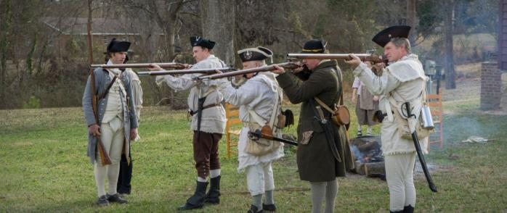
America 250 in North Carolina
Halifax State Historic Site
North Carolina will mark the 250th Anniversary of the American Revolution with wide ranging activities across a multi-year commemoration beginning in 2024.
Notes:
We will launch our commemoration at Halifax State Historic Site, the location of the Halifax Resolves in April 1776, which was the first official action by a colony calling for severance of ties to Britain and independence for the colonies. The town then became the site of milia musters and a major supply depot for the war effort, seeing enlistments of many men, including American Indians and free people of color for the Continental Line.

Slide 23
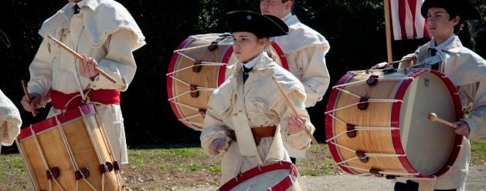
Revolutionary NC
historical events of the Revolution and NC as an incubator for revolutions in thought, history and technology
When Are We US?
exploration of the concepts of freedom, civic responsibility, overcoming challenges, and leaning into the ideals
of democracy
Notes:
The commemoration will focus on two interpretive concepts with additional thematic avenues to further explore these concepts:

Slide 24
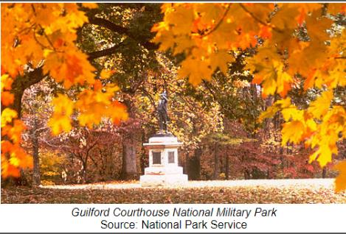
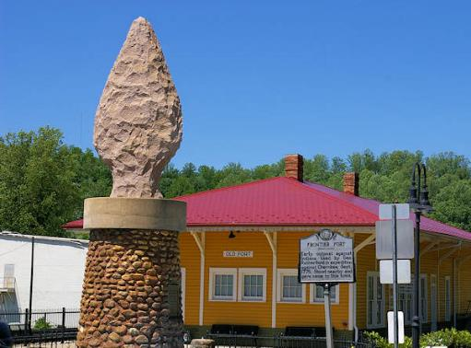
Visions of Freedom
The American Revolution was a beginning of a continual journey for North Carolinians to seek true freedom.
Old Fort was an outpost established to protect colonists from Cherokee attacks
Notes:
This conceptual theme is that of the making/remaking of America through visions of freedom – the Revolution of the 18th century was the start of a continuous process for North Carolinians seeking to envision true freedom. Here we will be able to highlight those movements that created a better version of our state and nation – concepts of the Civil Rights Movement, Women’s Suffrage, even scientific and industrial developments, have grown who and what we are as North Carolinians - pushing for the promises of the Revolution.

Slide 25
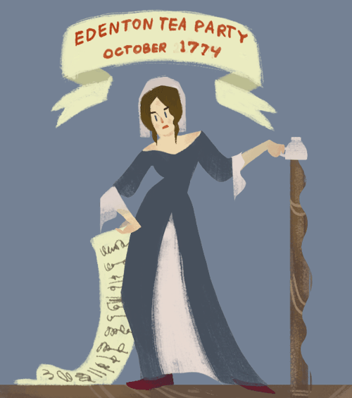
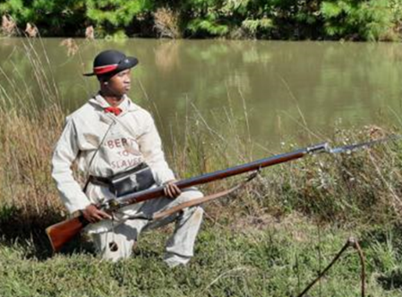
A Gathering of Voices
North Carolina's many voices inspire future generations to create and lead
Notes:
This commemoration is not one that can be told through one voice or experience – historic voices and stories will inspire others and we want all voices heard in the narrative of our collective history.

Slide 26
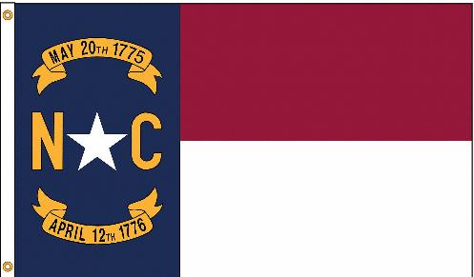
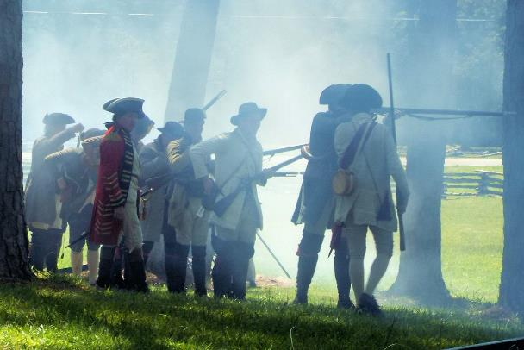
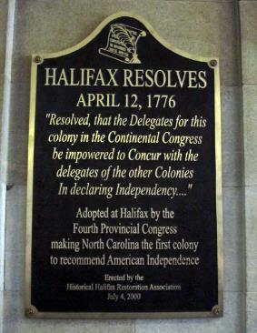
Common Ground
Places carry our stories of struggle, creation, and connection to one another.
Battle of Alamance Reenactment
Notes:
All North Carolinians should recognize that we are students of history, witnesses too, but we are also makers of history. Our spaces of reverence (battlefields, historic spaces, the natural world) can be places of happiness, painful memories, evidence of struggles, rebirth, and growth. Yet all carry our stories of collective struggle, creativity, and humanities’ relationships to one another. We come together on common ground to find connections and ways to make our state a better place.

Slide 27
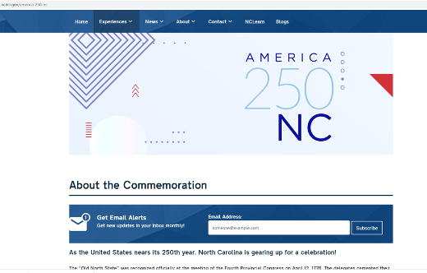
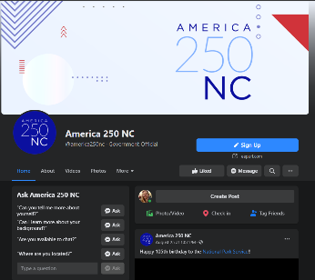
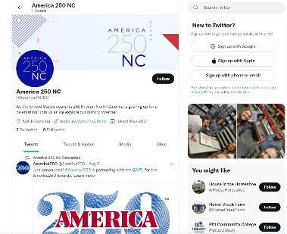
Website: https://www.ncdcr.gov/america-250-nc/
Facebook: https://www.facebook.com/america250nc
Twitter: https://twitter.com/America250NC
National website: https://america250.org/
Notes:
We have a plan for a robust online and social media campaign to share the news of the activities of the commemoration for both DNCR activities and those of our stakeholder partners. I encourage you to visit the website, we will be sending links out following today’s presentation. Another tool that we have is that we are seeking to host a comprehensive calendar of events on our website, and we will share your events widely across all platforms if you send them along. In addition to the links to our web and social media pages, I will also include a link to our event submission form.

Slide 28
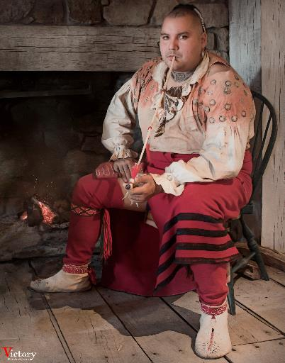
Statewide Activities
Online Resources
Educational Outreach
Events
Trails and Waysides
Cherokee living historian, photo courtesy of Victory Productions
Notes:
We seek to have a balanced commemoration to empower North Carolinians to consider what the concepts of democracy and “life, liberty, and the pursuit of happiness” mean both historically and for modern day residents. WE hope to work with communities to ensure that all of the tools and resources we are developing for the commemoration will be widely available. One piece that we just released is a tool kit that includes logos, event planning tool kits, and future additions will contain downloadable customizable mini exhibits, and press kits for our partners.

Slide 29
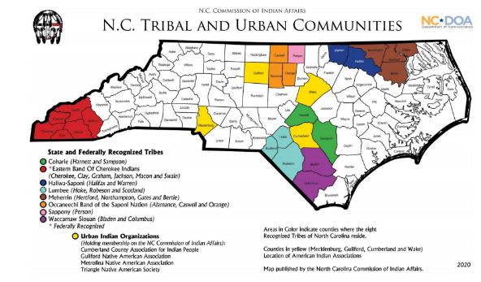
Our Goal: Robust, comprehensive, and inclusive statewide programs
Reach all 100 counties
Broad and inclusive programming
Foster local partnerships to promote planning of community events
Connect to the national commemoration
Notes:
As can be seen from the commemorative activities summary, we are planning a variety of ways in which to reach North Carolinians through online tools, educational outreach, and events, all driven by our goal of a robust, comprehensive commemoration. Remember that we have another thematic pillar of our planning, one we call “When are we US?” – allowing our emphasis to grow beyond the Revolutionary era and look to the causes and movements that have opened up the ideals of democracy to a broad spectrum of North Carolinians, especially as we consider that there is still unfinished business in forming our “More Perfect Union.”
As part of the commemoration, we will also have a major focus on 2026, encouraging all 100 counties and as many organizations as possible to host a 250th themed event at some point in the year, perhaps associated with annual celebrations, festivals, or community events. I would be happy to work with communities in the coming year to find opportunities to commemorate the 250th in ways that best reflect local identity, culture, and history. Even though it seems as if 2026 is far off, now is the time to work through the planning process for communities to discover the most effective ways to commemorate the Revolutionary War and its legacy. It can be as simple as a reading of the Declaration of Independence or as complex as a festival or exhibit at town hall that we help you develop

Slide 30
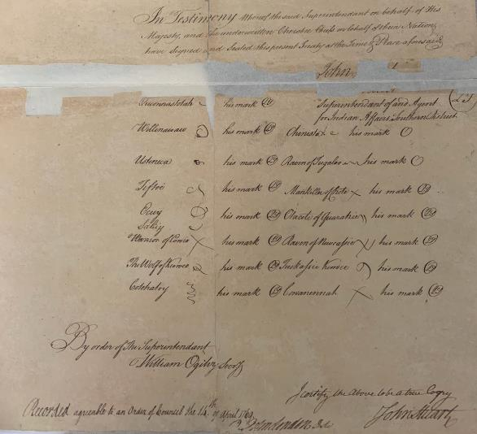
Thoughtful Inclusivity
Historical Research
Modern Reflections
Power of Place
Notes:
Finally, this commemoration is not one that can be told through one voice or experience – the historic voices and stories of North Carolinians will serve to inspire others and to guarantee that all voices are heard in the telling and re-telling of our collective history – ALL North Carolinians should see themselves in our commemoration and appreciate its relevance.
To improve our understanding of the Revolutionary Era, we are looking at a variety of documents again with a critical eye. For example, this treaty between the Cherokee and the Crown from 1759 essentially ceded from the Cherokee what is mostly modern-day West Virginia in order to open the area to white settlers. Not only does this document found in our State Archives give us insight into the loss of lands, it also shares the names of 15 tribal representatives, which is very useful for a wide variety of research needs.

Slide 31
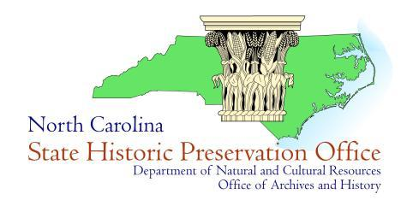
Revolutionary War places in the carolinas
Ramona Bartos, Deputy State Historic Preservation Officer

Slide 32
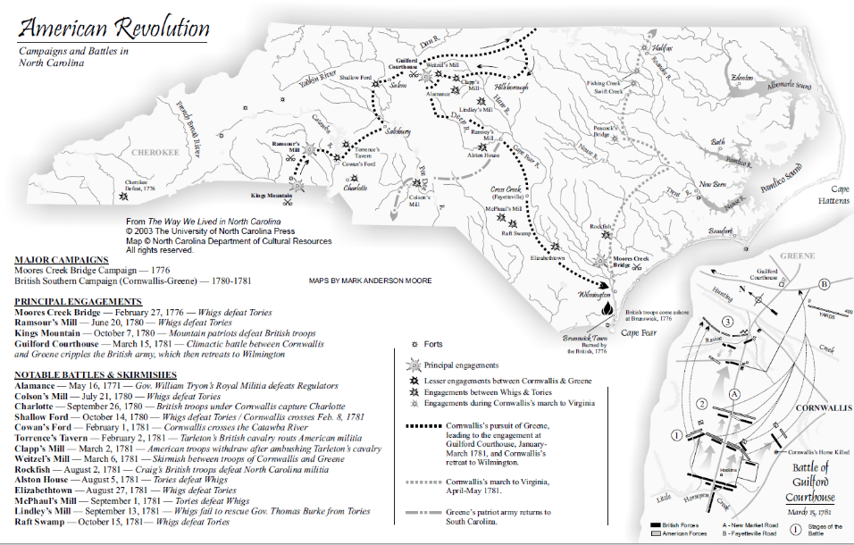

Slide 33
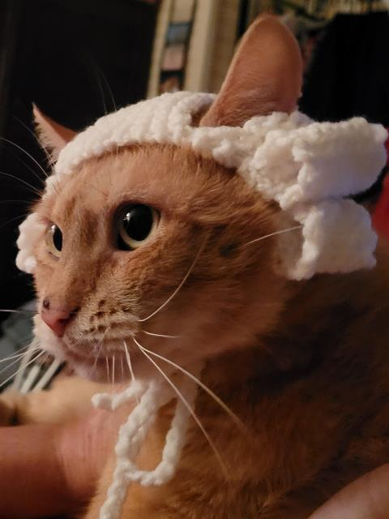
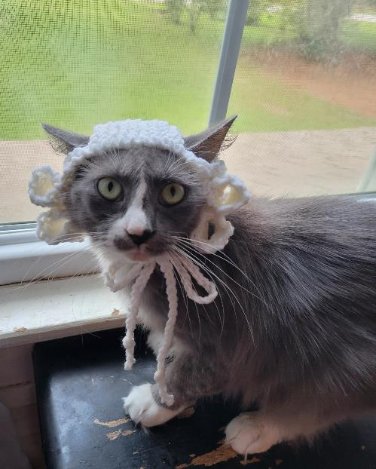

Slide 34
For more information:
Sarah Koonts, State Archivist
Sarah.Koonts@ncdcr.gov
LeRae Umfleet, America250 NC Project Administrator
Lerae.Umfleet@ncdcr.gov
DNCR TEMPLATE
NC Department of Natural and Cultural Resources
▪ Website: https://www.ncdcr.gov/america-250-nc/
▪ Facebook: https://www.facebook.com/america250nc
▪ Twitter: https://twitter.com/America250NC
▪ National America250 website: https://america250.org/
Notes:
Thank you for your time and I look forward to finding partnerships across our communities.

Slide 35
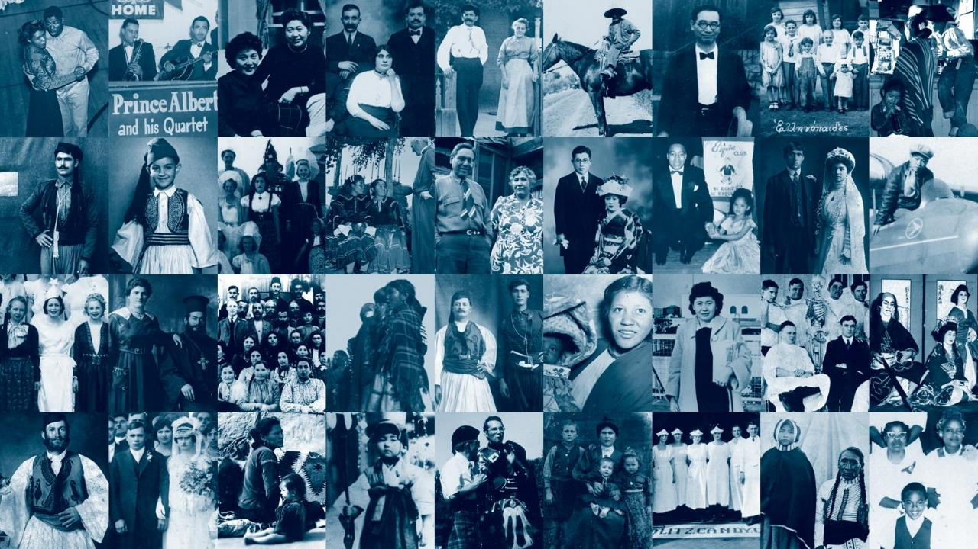
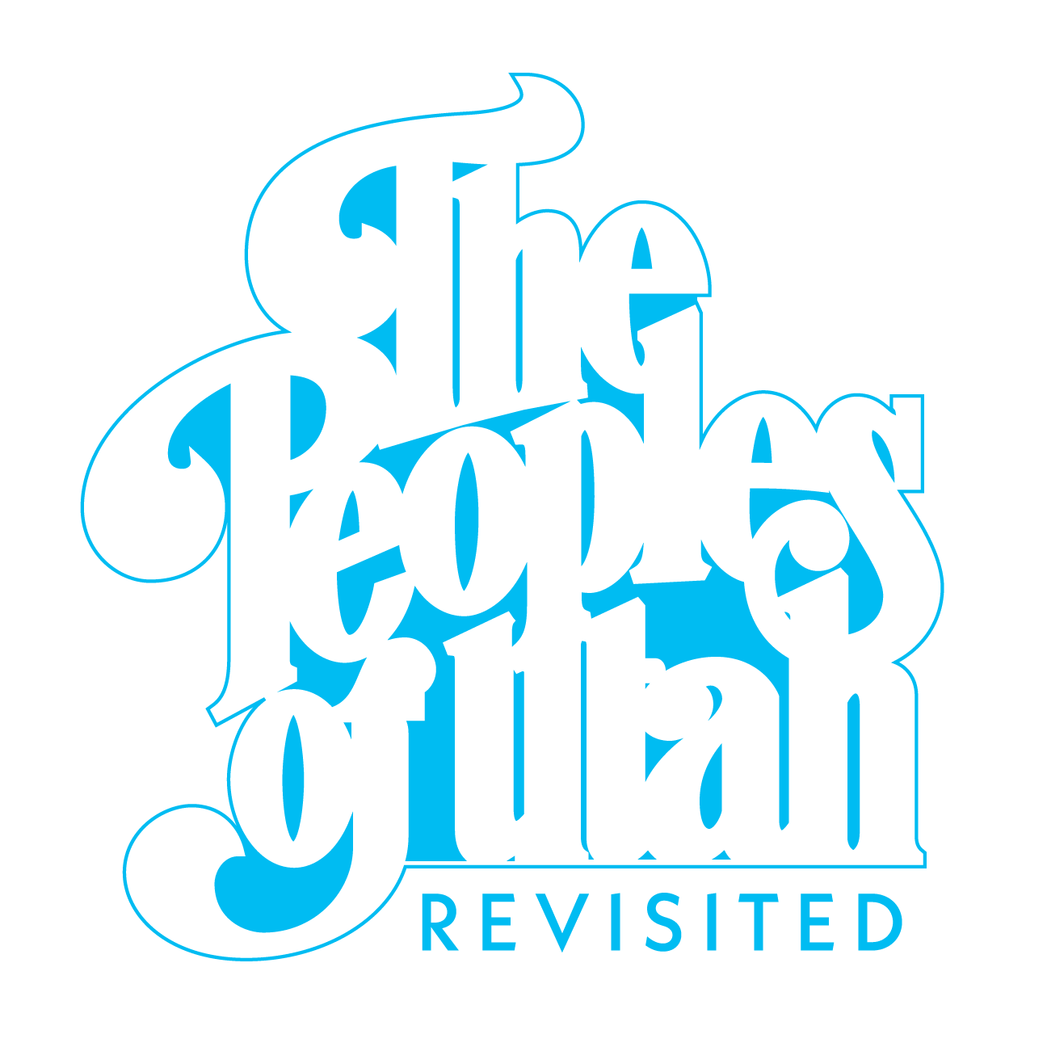

Slide 36
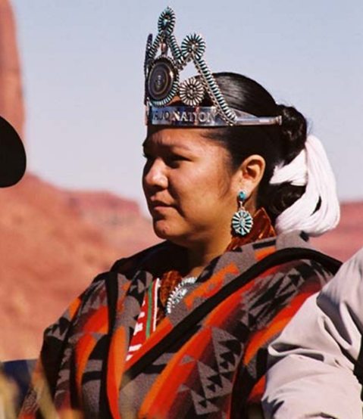
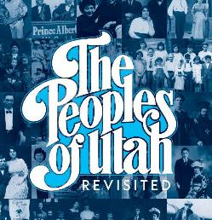
What is it?
A multiyear initiative to recognize, document, and celebrate the diverse communities that reside in Utah and shape the state
A two pronged approach: scholarship & community history
Goals:
Gather under-told and untold stories from across the state
Amplify marginalized voices
Preserve this history through representative archives and collections, a public facing resource online in 2026, impact on Museum of Utah to open in 2026.
Miss Navajo Nation, 2002. Governor's Olympic Photo Collection.

Slide 37
Why Peoples of Utah Revisited?
Flagship Utah250 project
A need to identify opportunities to widen the lens and be more inclusive to our approach as we look to 2026
This is a legacy project and builds off of a bicentennial project titled The Peoples of Utah by Helen Papanikolas

Slide 38
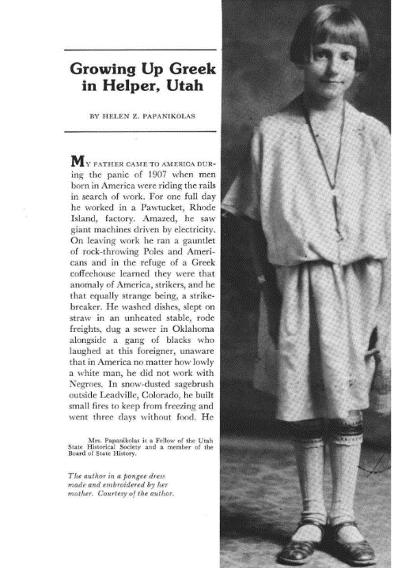
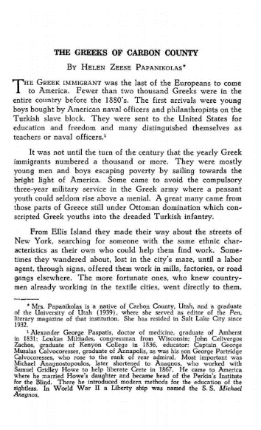
Left: Utah Historical Quarterly, (1980).
Right: Papanikolas’s 1954 article

Slide 39
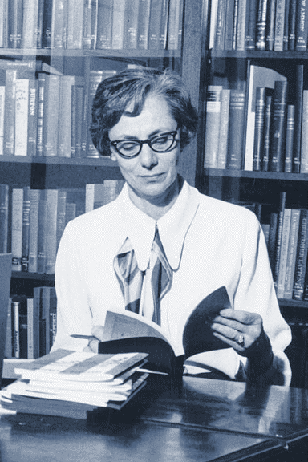
“Helen loved being a Utahn, and her attachment to the people and scenery of the Mountain West helped make others proud of their home state and home communities.”
Katherine Kitterman
Better Days 2020
Notes:
Hello, my name is Jennifer Ortiz

Slide 40
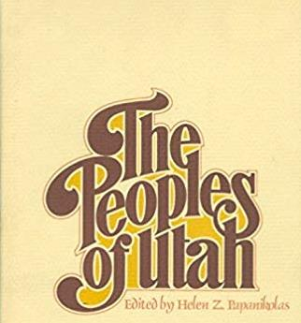
The Original Peoples of Utah
1976 Bicentennial Legacy Project
Documenting Utah’s Ethnic and Religious Diversity, 1800s–1970s
African American
British LDS
Canadian
Chinese
Greek
Italian
Japanese
Jewish
Mexican American
Middle Eastern (Armenian, Lebanese, Syrian)
Native American
Scandinavian LDS
Western European LDS
Yugoslavian
“She was a champion of the underdog, always seeing those who were down through the eyes of a writer who knew their true worth and could relate to the woe and wonder of their lives.”
Deseret News, Nov. 4, 2004

Slide 41
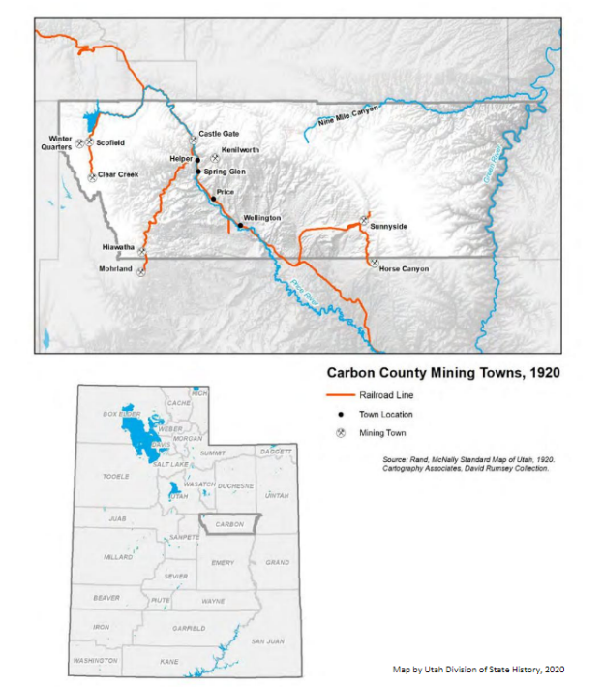
Nationalities, Ethnic, and Racial Communities in Carbon County, 1920
• Albanian • African American • Austrian • Belgian • Canadian • Chinese • Croatian • Danish • Dutch • English • Euro-American • Finnish • French Basque • German • Greek • Hungarian • Irish | • Italian • Japanese • Mexican • Montenegrin • Norwegian • Polish • Russian • Scottish • Serbian • Slovenian • Spanish • Swedish • Swiss • Syrian • Welsh • Yugoslav
From Our Past, Their Present: Danger and Diversity in Carbon County, history.utah.gov.

Slide 42
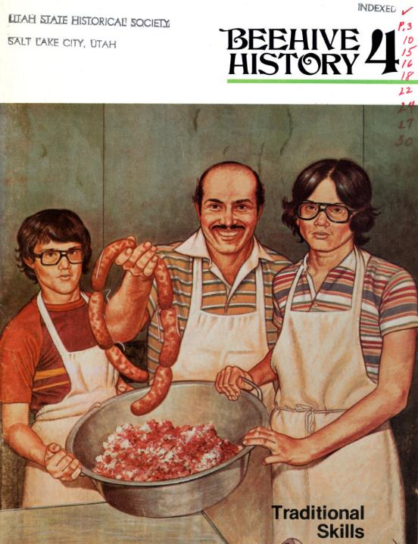
The Peoples of Utah: Legacy & Impact
“The best comprehensive book dealing with issues of historical diversity in Utah.” -Ron Coleman
Laid the foundation for diversity in teaching and scholarship on Utah history, ethnic studies, and in our historical collections. Inspired scholars, students, teachers, activists, as well as community programing and oral history projects.
Right: Phil Notarianni, center, was one of the scholars inspired by Papanikolas.

Slide 43
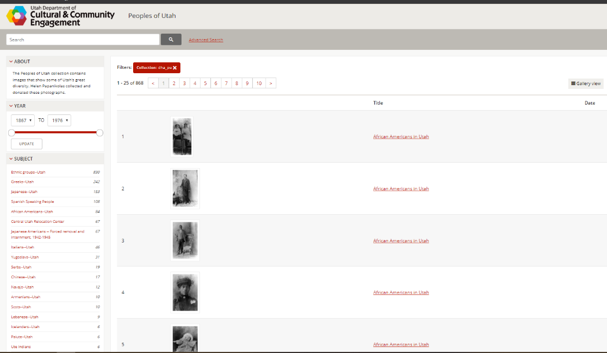
collections.lib.utah.edu/search?facet_setname_s=dha_pu

Slide 44
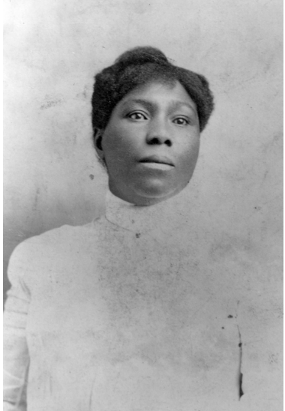
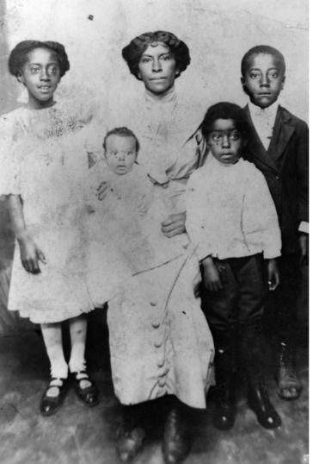
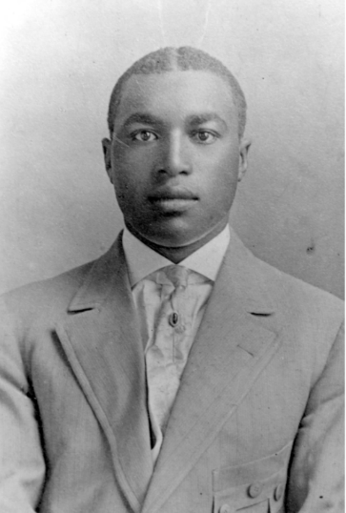
Peoples of Utah Historic Photograph Collection
Celia Bankhead Grice.
Martha Ann J. Stevens Perkins, the granddaughter of Green and Martha Crosby Flake, and children. Ca. 1909.
Hyrum Leggroan, son of Henry and Esther J. James Leggroan.

Slide 45
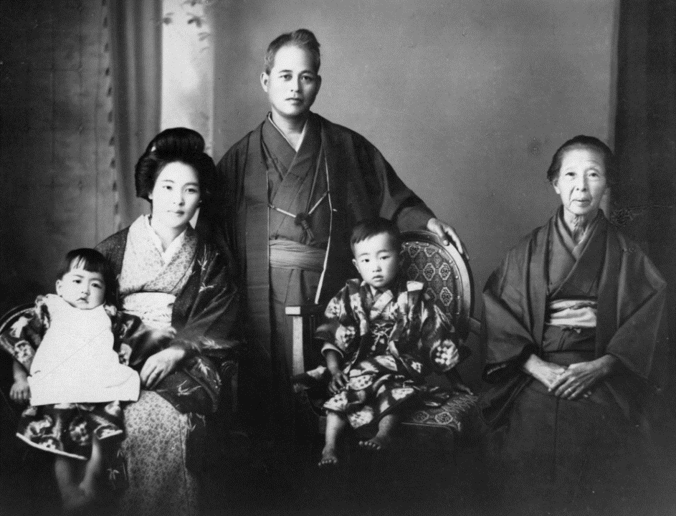
Sunnyside coal camp boss Nakagi and his family.Sunnyside coal camp boss Nakagi and his family.

Slide 46
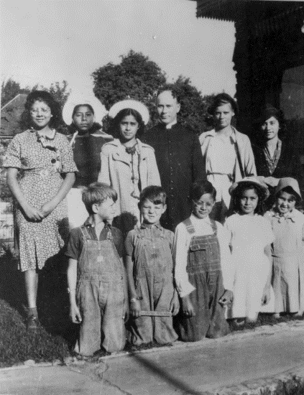
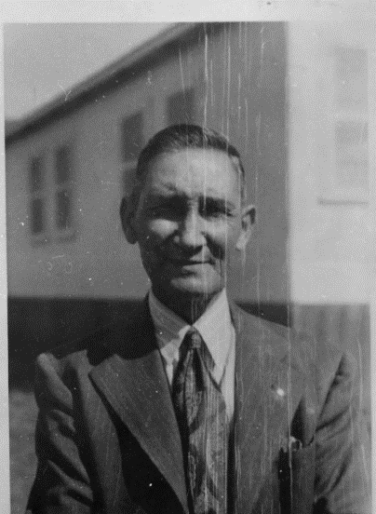
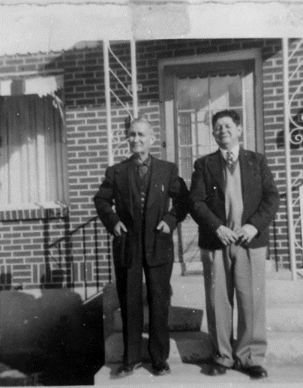
“Spanish-speaking People of Utah”

Slide 47
Looking Ahead
Utah’s demographics are rapidly changing. Communities are diversifying and changing the landscape of the state. A Need for representation across communities. Much like its predecessor, Peoples of Utah Revisited provides our organization with the opportunity to develop more inclusive collections and archives and tap into new scholarship across the state.

Slide 48
What does this look like?
Investment in Scholarship from up and coming voices
Paying scholars for their time and expertise
Working with universities and colleges across the state as “hubs” of scholarship
Community History
A focus on non-academic spaces, community oriented
Elevating the significance of Community History Work
Scanning/Digitizing Historical Materials
Photographs
Printed materials (letters, newspapers, etc.)
Recipes
Art (poetry, music, visual, literary)
Objects (tools, memorabilia)
Memory workshops
Youth programs (how-to oral histories)
Preservation workshops
Co-created archival collections

Slide 49
What are the deliverables?
Tangible
Themed Utah Historical Quarterly in 2026
Website landing page with portals to new collections
Pipeline of new scholarship to the Museum of Utah, to open in 2026
Intangible
Organic, meaningful relationships with ethnic, religious, and other community groups not historically connected to the Utah Division of State History
A state agency more fully representative of the population of the state
Polynesian Student Union event, Utah State University, February 2018.

Slide 50
For more information, contact Jennifer Ortiz at jenniferortiz@utah.gov

Slide 51
Questions and Comments

Slide 52
Upcoming Member Webinars
September 22 – Getting to know Enslaved.org
To register:
https://www.statearchivists.org/programs-education/cosa-webinars

Slide 53
Upcoming SERI Webinars
Watch for the Fall webinar schedule coming soon!

Slide 54
Upcoming Shop Talks with CoSA sponsors
August 11 – 3 pm eastern - APPX
August 18 – 3 pm eastern - AVP
To register:
https://www.statearchivists.org/programs-education/cosa-webinars

Slide 55
Get Connected!
CoSA Website http://www.statearchivists.org
CoSA Resource Center https://www.statearchivists.org/research-resources/resource-center
CoSA Twitter Handle @StateArchivists
CoSA Facebook Page www.facebook.com/CouncilOfStateArchivists
CoSA You Tube https://www.youtube.com/user/StateArchivists/

Slide 56
Sponsors and Funders

Slide 57
Webinar Evaluation
We really do appreciate your feedback!
Please take a moment and respond to the evaluation following this webinar.

