Slide 1
AI Strategy, Pilots, and Projects to Increase Access and Protect Privacy at the National Archives and Records Administration
Jill Reilly
Digital Engagement Director, Office of Innovation
October 10, 2023

Slide 2
Overview
About the US National Archives
AI Framework
External Collaboration
AI Strategies
Use Cases
Key Content Sources
Pilots and Proofs of Concept
Protecting Privacy: PII Screening
Increasing Access: Semantic Search
Connect

Slide 3
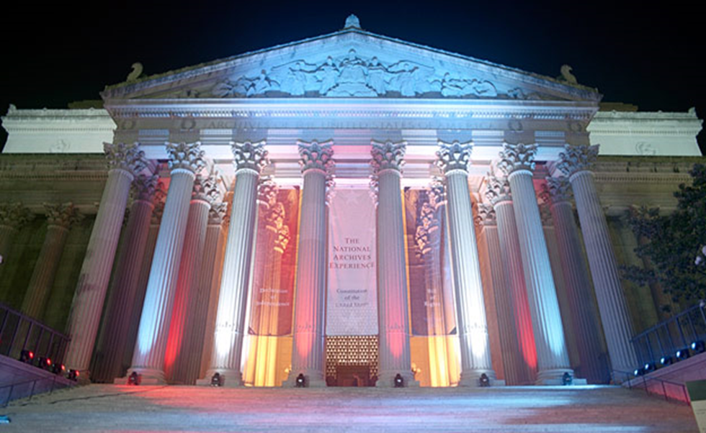
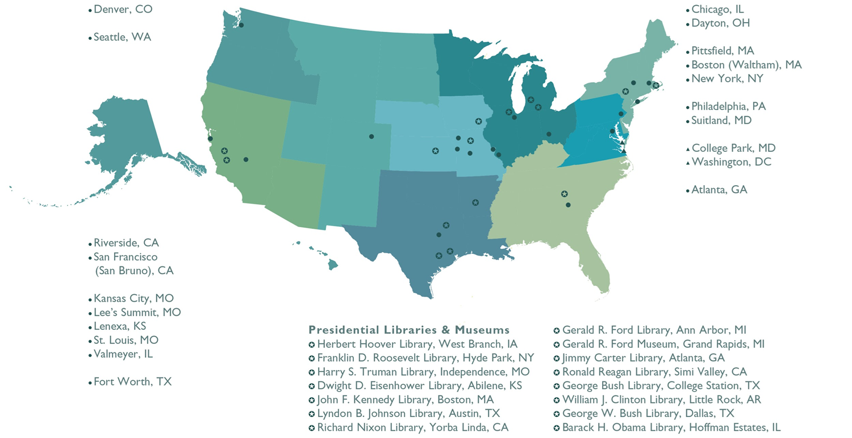
About NARA

Slide 4
AI Framework
Responsible AI and Governance:
transparency / notice and clear explanations
risk management
ethics / discrimination protections
data privacy
innovation
collaboration and engagement
Resources:
Executive Order (EO) 13960, Promoting the Use of Trustworthy Artificial Intelligence in the Federal Government (2020)
Federal Government Blueprint for an AI Bill of Rights (2022)
NIST’s Artificial Intelligence Risk Management Framework (2023)

Slide 5
External Collaboration
NARA, Library of Congress LC Labs, Virginia Tech University Libraries and Center for Humanities, and Smithsonian Institution (SI) Office of the Chief Information Officer (OCIO) Data Science Lab on artificial intelligence (AI) for libraries, archives, and museums
Co-hosted workshops: April-May 2021, May 2022, and November 2022
Panel “AI and Public Archives: Collaborative Leadership for Responsible Adoption” at the Association for Computing Machinery and Institute of Electrical and Electronics Engineers (ACM/IEEE) Joint Conference on Digital Libraries: Rethinking Digital Records
“AI and Public Archives: Collaborative Leadership for Responsible Adoption” / participation at the Artificial Intelligence for Libraries, Archives, and Museums (AI4LAM) Annual International Conference “Fantastic Futures,” hosted by Internet Archive Canada in Vancouver in November 2023

Slide 6
AI Strategies
Planning for the Future: Pilots and Innovation
Internal Collaboration
Office of Innovation
Information Services
Research Services
Presidential Libraries and Legislative Archives
Contractor Support
Archivists in the Loop
Citizen Archivists in the Loop
Sharing Knowledge

Slide 7
AI Use Cases
NARA’s Inventory of AI Use Cases
AI Pilot Project to Screen and Flag for Personally Identifiable Information (PII) in Digitized Archival Records
AI Pilot for National Declassification Center (NDC) at NARA / Automated Data Discovery and Classification Pilot
Freedom of Information Act (FOIA) Discovery AI Pilot
Self-Describing Records: Descriptive Metadata for Archival Descriptions
AI based Semantic Search for National Archives Catalog / Topic Summarizer and Entity extraction using AI
Develop a new Large Language Model (LLM) for to use in Generative AI
Develop a natural language based chat interface (like ChatGPT)
Create an AI based knowledge articles chat interface for working with Veterans documents
Generative AI for Google Workspace for Internal Employees

Slide 8
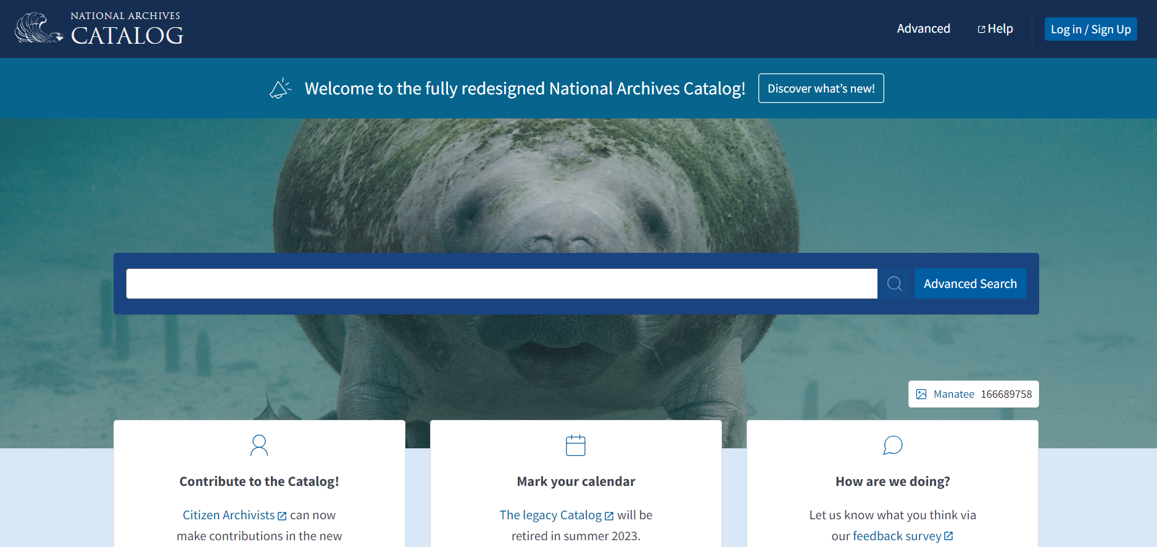
The Catalog

Slide 9
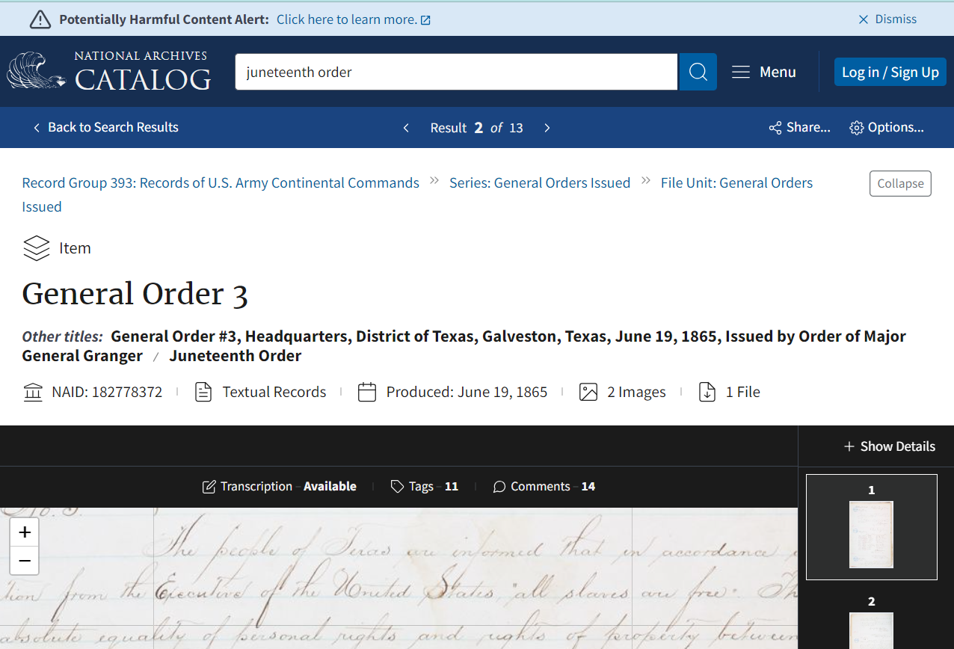

Slide 10
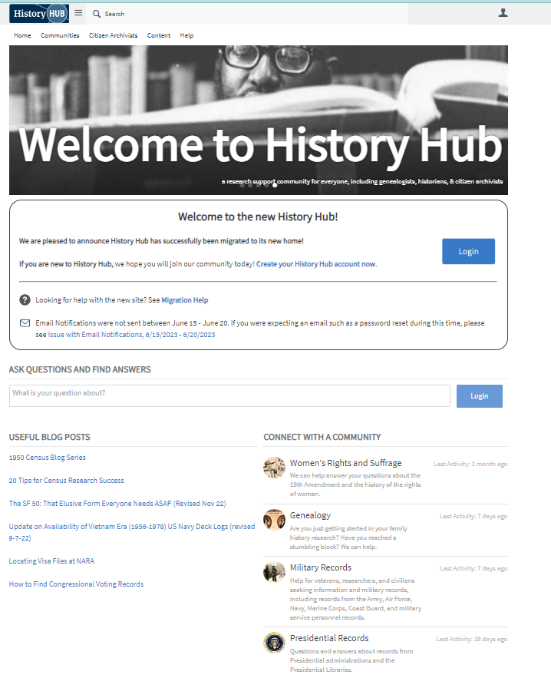
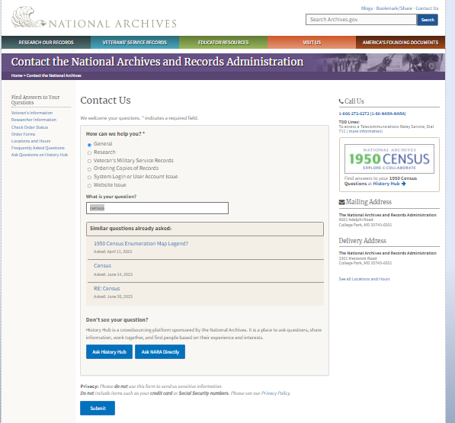
History Hub

Slide 11
Protecting Privacy: Identifying PII in Digitized Records
Pilot with Amazon Web Services Tools in FY23
Challenges with out of the box models
Developed a custom model
Pilot, comparison with Google Suite Tools in FY24
Testing and assessment
Lessons learned

Slide 12
Increasing Access: Semantic Search
Pilot comparing semantic search tools compatible with OpenSearch
BERT and some others
Proof of concept to determine if semantic search and knowledge graph mappings with existing models improves search retrieval
Based on identifying entities in the OCR of digitized, textual, typewritten records
Integrated Project Team
Progress so far

Slide 13
Connect
Archives.gov: https://archives.gov
National Archives Catalog: https://catalog.archives.gov
History Hub: https://history.gov
Subscribe to the Catalog Newsletter: https://www.archives.gov/research/catalog/newsletter
Contact us: Archives.gov/contact or Catalog@nara.gov
Contact me (Jill Reilly): jill.reilly@nara.gov

