Slide 1
Conscious Editing
May 27, 2021
3 pm Eastern
Disclaimer: This webinar is being recorded and will be available for viewing on the CoSA website.

Slide 2
Webinar Agenda
Introduction of Presenters
Presentation: Conscious Editing
Q and A
Upcoming Programs and Webinars
Disclaimer: This webinar is being recorded and will be available for viewing on the CoSA website.

Slide 3
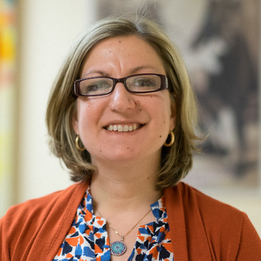
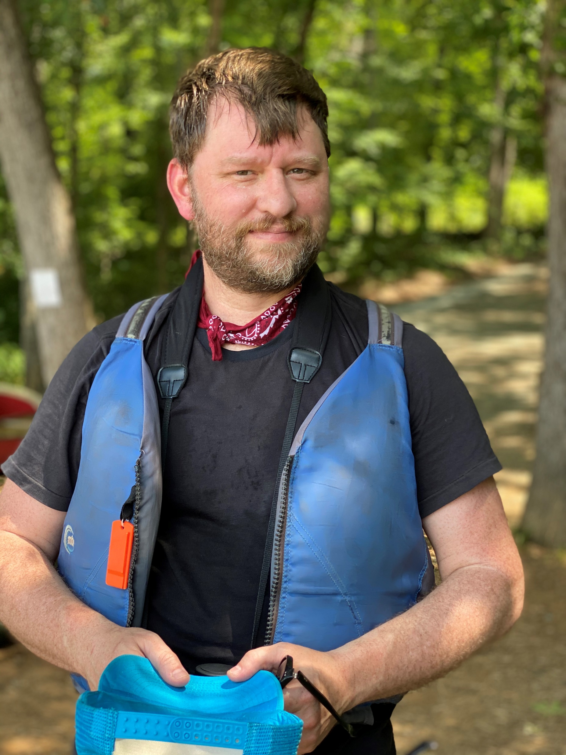
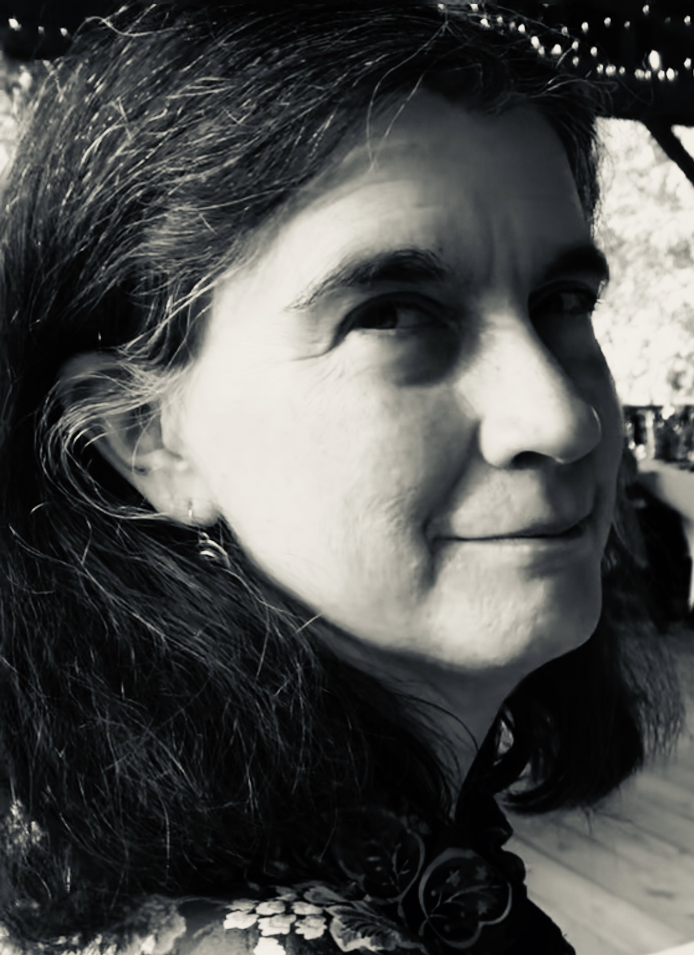
Speakers
Laura Hart
Technical Services Archivist Wilson Library, UNC
Dawn Lucas
Technical Services Archivist
Wilson Library, UNC
Aaron Smithers
Special Collections Research and Instruction Librarian
Wilson Library, UNC

Slide 4
Conscious Editing

Slide 5
Land acknowledgment

Slide 6
Land acknowledgment continued

Slide 7
Conscious Editing Steering Committee

Slide 8
Acknowledgment of hidden labor

Slide 9
Historically white university

Slide 10
Jim Crow Archive

Slide 11
Colonialist collections

Slide 12
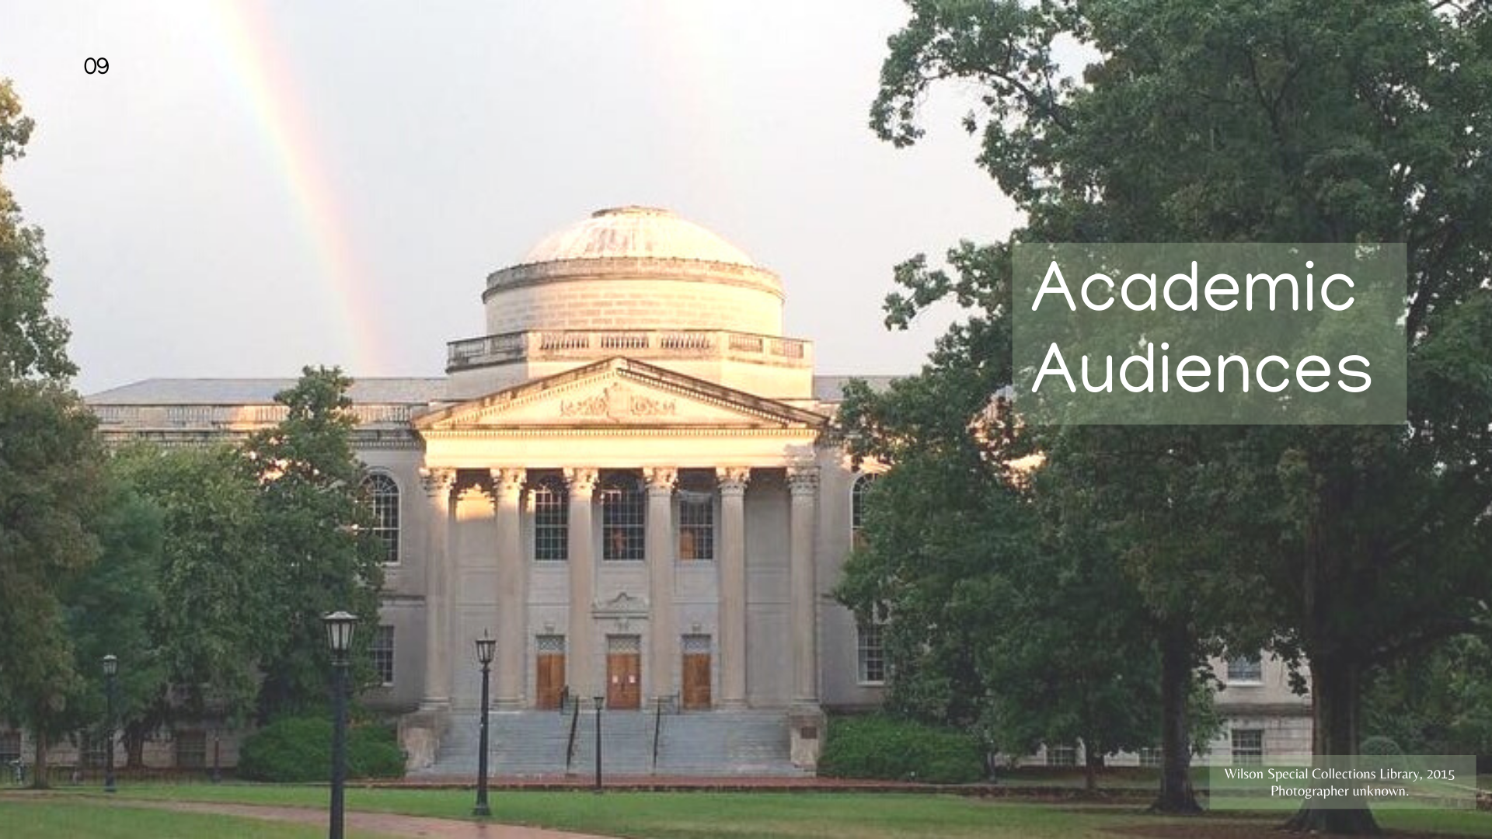
Academic Audiences

Slide 13
Reckoning Initiative at UNC Chapel Hill Libraries

Slide 14
Definition of conscious editing

Slide 15
Vision

Slide 16
Values

Slide 17
Conscious Editing in Practice

Slide 18
Centering Indigenous Epistemologies

Slide 19
Problematic Library of Congress Subject Headings

Slide 20
Unhiding the Invisible Norm of Whiteness

Slide 21
Identifying People Claimed as Property

Slide 22
Invisible Norm of Protestant Christianity

Slide 23
Rectifying Ableist Language

Slide 24
Misrepresentation of People of Color

Slide 25
Equitable Metadata and Inclusive Alt-Text

Slide 26
Historically White Universities

Slide 27
White Racial Violence

Slide 28
Racist Language in Transcribed Texts

Slide 29
Lost Cause Mythology

Slide 30
Content warnings for exhibitions

Slide 31
Content warnings for metadata

Slide 32
Content warnings for finding aids

Slide 33
Contact information and credits

Slide 34
Questions and Comments

Slide 35
Upcoming Webinars
June 8: Building Your Resume for the Digital Age For registration information: https://www.statearchivists.org/programs/state-electronic-records-initiative/seri-webinars/
June 24: CoSA Member Webinar – “In Conversation with Mark A. Puentes, Associate Dean for Organizational Development, Inclusion and Diversity at Purdue Libraries”
For registration information: https://www.statearchivists.org/programs/cosa-webinar-series/

Slide 36
Contact Us
CoSA Website http://www.statearchivists.org
CoSA Resource Center https://www.statearchivists.org/resource-center/
CoSA Twitter Handle @StateArchivists
CoSA Facebook Page www.facebook.com/CouncilOfStateArchivists
CoSA You Tube https://www.youtube.com/user/StateArchivists/

Slide 37
Sponsors and Funders

Slide 38
Webinar Evaluation
We really do appreciate your feedback!
When you exit the webinar, you will automatically be taken to an online webinar evaluation. Please take a couple minutes to complete the survey and help us plan future webinars.

