Slide 1
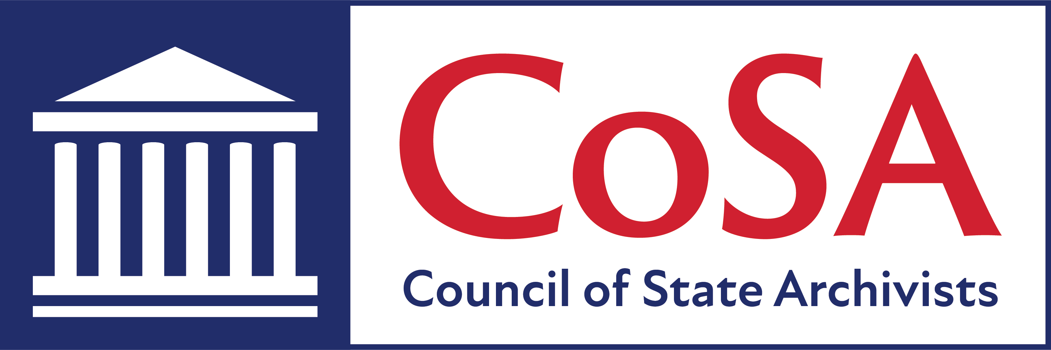
CoSA Member Webinar SHRAB Roundtable Report
October 1, 2020
3 pm Eastern

Slide 2
Welcome
Today’s Agenda
Introductions
Presentations
Q and A
Upcoming Programs and Webinars

Slide 3
CoSA thanks
for sponsoring the SHRAB Roundtables and this webinar

Slide 4
Moderator, Allen Ramsey, Connecticut
Presenters:
Dave Joens, Illinois
SHRAB Funding
Kathy Marquis, Wyoming
Traveling Archivist Programs
Dennis Preisler, Arizona
Regrants

Slide 5
SHRAB Funding
Dave Joens, Illinois

Slide 6
SHRAB Funding
State Board Programming Grants (formerly SNAP Grant)
Draft Deadline (optional): early April
Final Deadline: June
NHPRC support begins: January of following year
Two Levels of Funding:
Level I: Up to $12,000 for one year
Level II: Up to $40,000 for one year OR up to $80,000 for two years
Grants are only awarded to SHRAB’s in each state or to the state agency responsible for the state board.
Cost Sharing: Total costs of a project are shared between the NHPRC and the applicant organization. The Commission provides no more than 75% of total project costs.

Slide 7
SHRAB Funding
Tips and Ideas
Other NHPRC grant categories – open to any non-profit
NHPRC staff can read and comment on drafts, with lead time
Can include CoSA dues as part of grant request, or include CoSA dues as cost-share, if paid by state or other funds
Be sure to publicize grant products and activities – and share with NHPRC and CoSA
Best practices and ideas for funding and cost share:
legislative appropriation
archives foundation or friends group assistance,

Slide 8
SHRAB Funding
For more information regarding the State Board Programming Grants and how to apply:
https://www.archives.gov/nhprc/announcement/state.html

Slide 9
Traveling Archivist Programs
Kathy Marquis, Wyoming

Slide 10
Our esteemed guests:
Rachel Onuf, Roving Archivist, State of Vermont
Irene Gates, Roving Archivist, State of Massachusetts
Jack Warner, Archivist of the Commonwealth of Massachusetts
Jodie Foley, Montana State Archivist
Dan Stokes, Director for State Programs, NHPRC

Slide 11
Programs
VERMONT: Full time roving archivist - state position. Assessment, inventories and follow up support.
MASSACHUSETTS: Roving archivist; sites apply for a strategic assessment review. Also have Field Fellowships - Simmons students provide processing assistance.
MONTANA: Student traveling archivist provides processing support; Board mentors student.
CONNECTICUT: Use personnel service agreements with consulting archivists who conduct site visits.
Don’t forget 2019 SHRAB Webinar with more details: https://bit.ly/33lgDyh

Slide 12
How do you market your program?
Media
Networks:
local government contacts
state historical organizations
state library networks, lists
Use workshops, like emergency preparedness, to vitalize program, encourage applications for assistance

Slide 13
What do you actually do with clients?
Start with a tour
Assess their need on site; figure out where they’re stuck
LISTEN
Train: processing, collection and other policies
Encourage an inventory
Follow up when they have questions

Slide 14
What are the biggest challenges?
(where do clients get “stuck”?)
Getting people to act, after you’ve consulted with them
Getting past their inertia, lack of confidence to implement recommendations
We can’t process the collections for them

Slide 15
Recommendations for other programs? pt. 1
Keep applications simple!
Start small and build bigger
Make sure your board is fully committed to promoting historical records
Start with a survey – what needs to people have? (baseline requirement): know your audience
Figure out what they actually need

Slide 16
Recommendations, pt. 2
Building moves and disasters are pressure points for local institutions to reach out for assistance
Use recommendations from traveling archivist in follow-up grant and re-grant applications
Ongoing relationship - keep an open door
Keep notes and statistics!
New CoSA listserv could allow for traveling archivist
sub-listserv to facilitate communication

Slide 17
What hasn’t worked?
MT: has to be a second year student - need some grounding in archival science
MA: start with roving archivist, follow up with regrant request (rather than other way around)

Slide 18
What can you do during the pandemic?
Virtual workshops on grant writing, policies and procedures, etc.?
Follow up with attendees, and roving archivist sites
Working on digital exhibits and collection portals – Map Missoula (https://storymaps.arcgis.com/stories/649bd3e0729d4a3988c5c7fe7720cf73)
Building networks, digitization support, emergency response networks

Slide 19
SHRAB Regrant Programs
Dennis Preisler, Arizona

Slide 20
CoSA/SHRAB Roundtable Panelists
Dennis Preisler, Deputy State Coordinator, Arizona
Jim Kichas, State Coordinator, Utah
Rick Hendricks, State Coordinator, New Mexico

Slide 21
Utah State Historic Records Advisory Board Re-Grant Program
Administrator dedicated to the re-grant program
Total funding of $65,000 to $70,000 per year
Archives, cultural heritage sites, special collections and libraries are eligible
Currently using a paper application
One to one match
Grant recipients provide an interim report and a final report
Both the Ute and Shoshone Northwest Tribes

Slide 22
New Mexico State Historic Records Advisory Board Re-Grant Program
$65,000 in re-grants each year
Non-profit state entities including Tribal governments
In-kind match
Application simplified from 17 pages to 3 pages, project description, work plan and audience
Panel of experts conduct the review process
Site visits in January to check on progress
Digitized Orville Wanzer’s The Devil’s Mistress a 1965 acid western

Slide 23
Arizona Historic Records Advisory Board Re-Grant program
$25,000 in grants each year
Archives, museums and libraries with archival collections
Twenty-five percent match, in-kind support can serve as the match
Simple three-page application process
The Arizona Historic Records Advisory Board members evaluate the grants
Institutions host an Archive 101 Workshops and provide a end of year report
Lowell Observatory received assistance in digitizing 70 years of glass plate negatives

Slide 24
Upcoming Webinars
CoSA -NARA Webinar
October 8: Preserving Audiovisual Materials at NARA and the Pennsylvania State Archives
CoSA Member Webinars
October 22: State Archives Showcase - California & Louisiana
October 19: State Archives Showcase - Utah & District of Columbia
For registration information: https://www.statearchivists.org/programs/cosa-webinar-series/

Slide 25
Questions & comments

Slide 26
2020 Electronic Records Day: October 9, 2020
State Electronic Records Initiative (SERI) Webinar
October 13: Home is Where the Records Are: Managing Records in a Teleworking World

Slide 27
Contact Us
CoSA Website http://www.statearchivists.org
CoSA Resource Center https://www.statearchivists.org/resource-center/
CoSA Twitter Handle @StateArchivists
CoSA Facebook Page www.facebook.com/CouncilOfStateArchivists
CoSA You Tube https://www.youtube.com/user/StateArchivists/

Slide 28
Sponsors & Funders: Thank you!

Slide 29
Webinar Evaluation
We really do appreciate your feedback!
When you exit the webinar, you will automatically be taken to an online webinar evaluation. Please take a couple minutes to complete the survey and help us plan future webinars.

