Slide 1
CoSA Shop Talk Webinar
December 9, 2021
3 pm Eastern
AVP Shop Talk Webinar –
Digital Preservation Maturity Assessments: DIY and DPGo!
Disclaimer: This webinar is being recorded and will be available for viewing on the CoSA website.

Slide 2
Webinar Agenda
Welcome
Presentations from AVP
Q and A
Announcements

Slide 3
Presenters
AVP
Amy Rudersdorf

Slide 4
An in Introduction to Digital Preservation Maturity Assessments: DIY and DPGo!
Amy Rudersdorf, Senior Consultant, AVP
amy@weareavp.com / @rudeamy
weareavp.com
info@weareavp.com
Notes:
Have you performed an assessment of your digital preservation program? Yes / No If yes, how did you do it? Self Peer Vended If yes, which tools did you use? CoreTrustSeal
ISO 16363 (TDR)
Levels of Digital Preservation
NEDCC Peer Assessment
Rapid Assessment Model
Vendor assessment
Other (please explain)

Slide 5
Who am I?
Amy Rudersdorf
Senior Consultant
amy@weareavp.com
@rudeamy
weareavp.com/people/amy-rudersdorf
Notes:
Senior Consultant living in Madison, Wisconsin
Have been performing assessments and other digital preservation related work (technology selection, technology implementation) for nearly 6 yeras with AVP. Prior to that I worked at the Digital Public Library of America, the State library of North Carolina, and at several academic institutions in the Southern and Midwestern US. In all of these positions, I managed digital collections and digital preservation projects and programs. I come to this work with lots of experience.

Slide 6
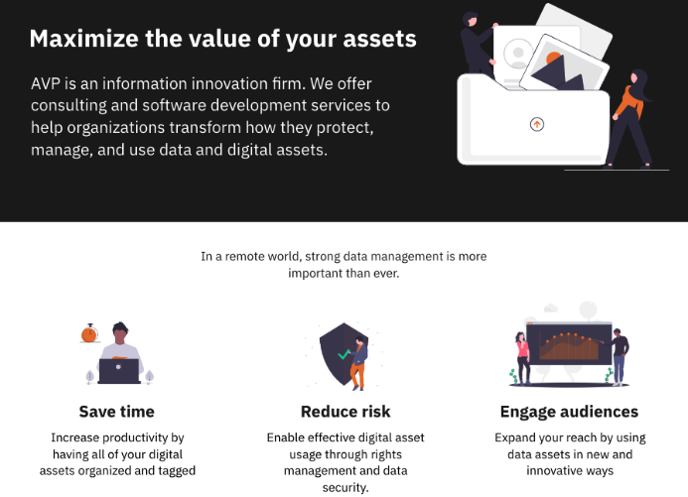
Notes:
Who is AVP? We are an information innovation firm. We offer consulting and software development services to help organizations transform how they protect, manage, and use data and digital assets. We aren’t strangers to the digital preservation community. In fact, most of our digital preservation consultants come straight from the cultural heritage world.
The benefit of a combined consultancy and software firm is that we can provide a soup to nuts approach -- we can help you define your goals and then, if you wish, we can take the next steps with you to bring those goals to fruition with technical support where needed.

Slide 7
AVP’s Vision
To free organizations from the obstacles of information management and maximize the usability of data.
Core Values
Be honest & maintain integrity
We ensure integrity in business practices, professional activities, and client interactions.
Be socially conscious
We operate in a respectful manner, by being inclusive, generous, and equitable.
Be committed to excellence
We are leaders, both within the company and in the fields in which we work.
Notes:
Our goal is to help you achieve your goals. We do this with honesty and a commitment to inclusivity and excellence.

Slide 8
Sample Digital Preservation Clients

Slide 9
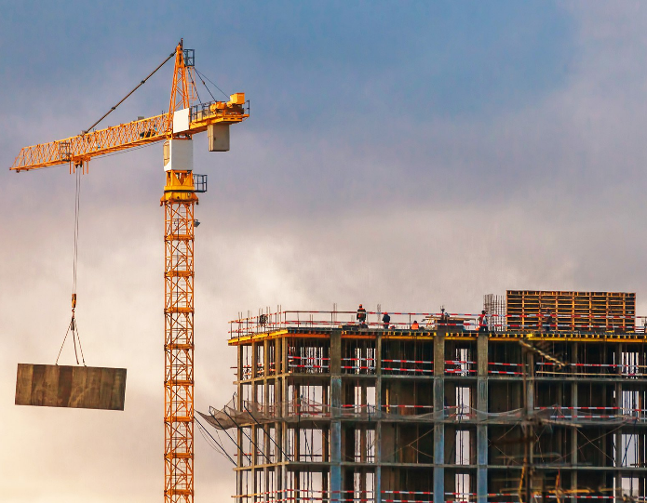
“[A]. . .flaw in the human character is that everybody wants to build and nobody wants to do maintenance.”
— Kurt Vonnegut
Notes:
Why do I start with this quote? Because, ultimately, digital preservation is about maintenance. It isn’t about new and innovative, but steady practicality. Within that practicality there may be moments of innovation (updated tools, new schools of thought), but those are folded into our day-to-day management practices.

Slide 10
Notes:
Maintenance is a long road, with changes happening all around. Periodically, it is important to check in and assess how you are doing on different aspects like workflows, data management, organizational infrastructure, and planning for technical change

Slide 11
Performing A Digital Preservation Assessment
Outline
Definition
Why do it?
DPGo!
How DPGo! works
What to expect?
What’s the cost?
Using the outcomes
Other AVP services
Notes:
Outline

Slide 12
What is. . . ?
Digital Preservation Maturity Assessment; Self Assessment
Digital preservation maturity assessments are performed to identify gaps and challenges (and successes!) that a repository faces.
Self Assessment - DIY for your repository!
The goal is to address those gaps to improve /implement processes, policies, governance, and workflows.

Slide 13
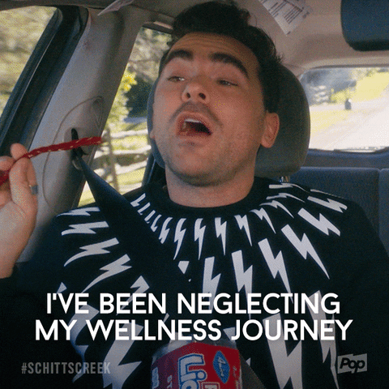
Why do it?
Answer the questions . . .
Where are we? (Status check)
Where do we want to go? (Goal planning)
How do we get there? (Roadmapping)
And ultimately, how do we get buy-in? (Communication)
Notes:
You can also think of a maturity assessment as a wellness journey -- and just like mindfulness and other wellness techniques, you are going to gain an understanding of what you are doing today, set goals for the future, and figure out how to meet those goals. And then, share your journey with anyone who will listen and help you meet those goals.

Slide 14
Why do it?
To address the gaps and challenges in current practice.
To understand where your program is today.
To understand where you want to go.
To understand how you get there.
What is the current status of your repository?
Gaps
Challenges
Successes
Set goals.
Align with best practices/standards.
Identify internal factors influencing decision making.
What resources will it take to achieve goals in box #2?
How do you prioritize?
How long will it take?

Slide 15
What are your options?
Digital Preservation Assessment Tools landscape (sampling)
Tool | Managed by? | Area of Focus | Cost to Use | Complexity | Certification
CoreTrustSeal | CoreTrustSeal organization | Data | Free to use; €1,000 for certification | Low/Medium | Yes, but not required
ISO 16363 (TDR) | International Standards Organization (ISO) | Holistic audit of org as relates to the OAIS framework | Must purchase the standard (~$180) from ISO | High | Yes, but not required
Levels of Preservation | NDSA | Technology and metadata focused | Free | Low/Medium | No
NEDCC Peer Assessment | Northeast Document Conservation Center | Holistic; aligns with 16363 | Free | Low/Medium | No
Rapid Assessment Model | Digital Preservation Coalition (DPC) | Holistic; aligns with 16363 | Free | Low/Medium | No
Vendor assessment | Vendor | Aligned with institutional need | Vendor fees | Low | Maybe

Slide 16
What to Expect?
Digital Preservation Maturity Assessment
Resource intensive, and not only for digital preservation staff (consider other stakeholders, such as administration and IT)
Deep analysis of governance models, finances, legal commitments, designated communities, in addition to technology
Honest discussions about challenges and gaps
Documenting outcomes for a wide audience (depending on goals)

Slide 17
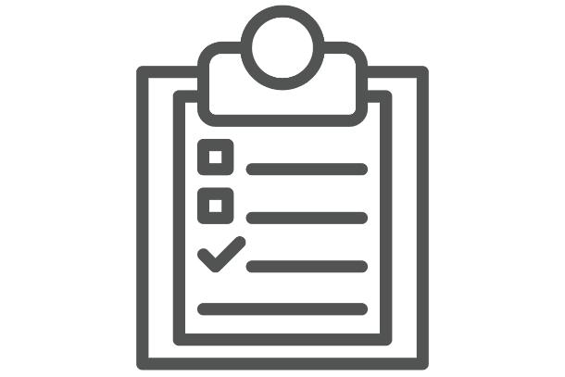
What will you do during the assessment?
Digital Preservation Assessment
Documentation review
Discovery
Gap analysis
Recommendations
Reporting
Roadmapping

Slide 18
How to perform a self assessment?
Step-by-step process
Choose a tool
Gather documentation
Perform discovery
Analyse results
Document results
Build a roadmap

Slide 19
Select a Tool
Digital Preservation Assessment Tools landscape (sampling)
Tool | Managed by? | Area of Focus | Cost to Use | Complexity | Certification
CoreTrustSeal | CoreTrustSeal organization | Data | Free to use; €1,000 for certification | Low/Medium | Yes, but not required
ISO 16363 (TDR) | International Standards Organization (ISO) | Holistic audit of org as relates to the OAIS framework | Must purchase the standard (~$180) from ISO | High | Yes, but not required
Levels of Preservation | NDSA | Technology and metadata focused | Free | Low/Medium | No
NEDCC Peer Assessment | Northeast Document Conservation Center | Holistic; aligns with 16363 | Free | Low/Medium | No
Rapid Assessment Model | Digital Preservation Coalition (DPC) | Holistic; aligns with 16363 | Free | Low/Medium | No
DPGo! | Vendor | Aligned with institutional need | $4,000 | Low/Medium | No

Slide 20
How to perform a self assessment?
Step-by-step process
Choose a tool
Gather documentation
Perform discovery
Analyse results
Document results
Build a roadmap

Slide 21
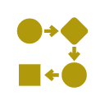
Gather documentation
Supplement the discovery interviews you perform and support findings.
Policies & planning documents
Workflows, process docs, & infrastructure /tech diagrams
Org charts, staffing & resource docs
Program reports & directives

Slide 22
How to perform a self assessment?
Step-by-step process
Choose a tool
Gather documentation
Perform discovery
Analyse results
Document results
Build a roadmap

Slide 23
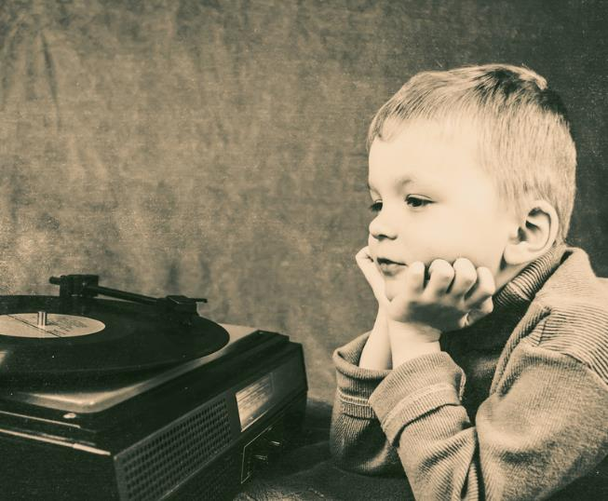
“Listening is not understanding the words of the question asked, listening is understanding why the question was asked in the first place.”
— Simon Sinek
Notes:
As you interview your colleagues, decision makers, and users, listen well with openness and acceptance. Your goal is understand the challenges and gaps, not to illustrate what your institution is doing wrong, but to identify what needs improvement (and maintenance). So, try really hard to not go into meetings with perceptions that may cloud how you listen and what you hear.

Slide 24
Discovery
Face-to-face meetings sample questions
Creators / Collectors
Administration
Technology support
Tell us about what you do. What’s your relation to your org’s collections?
How are your digital materials created and/or collected? What types of content? Generally give us background on the collections you work with.
What technologies do you use for digitization, file management, etc.? What dp activities are you not performing (or not performing regularly)?
Describe, at a high-level, the digitization workflow for your assets.
What would you say are the biggest gaps in the preservation of your collections?
Why types of metadata are you creating /storing with your files? What is missing?
What are the guiding principles for current and future digital collections and digital preservation systems?
What is the vision for how digital collections are managed within the organization? This might relate to resources, staffing, technology, access, etc.
From your vantage point, what are the pain points for digital collections management and organization? Where are the successes?
What type of fiscal and organizational support is there for digital collections and digital preservation now and moving forward?
Support for staffing growth and/or professional development?
What is your primary responsibility to the administration/management of technology supporting the creation, collection, use, and/or preservation of digital collections?
Talk about hosting and storage policies, including redundancy, geographic distribution of storage systems, and security. What types of storage are in place (spinning disk, LTO, cloud, etc.)? What is their current capacity? Are there plans for growth? Are there plans for adopting a new/different approach?
How much storage is required now? Future growth in # of files and size in TB/PB?
Do your storage devices allow for dynamic fixity checks?

Slide 25
How to perform a self assessment?
Step-by-step process
Choose a tool
Gather documentation
Perform discovery
Analyse results
Document results
Build a roadmap

Slide 26
Analysing discovery interviews and documentation
Identifying gaps, challenges, and successes
1. Color code & map
2. De-dupe & synthesize
3. Identify gaps
Read through and mark up your documentation and discovery interview info first. Color code areas relevant to the RAM model. For example, references to metadata are blue; storage are yellow. Now you can map your findings to the RAM categories (or other model).
You’ve mapped all of the relevant findings. There’ll be duplicates where two people say the same thing, for example. De-dupe and synthesize those responses. You don’t need long narratives; keep verbosity to a minimum.
Once you’ve synthesized all findings and mapped them to your tool, you can score your results to identify gaps and successes. Your recommendations will be based on the gaps you have identified.

Slide 27
How to perform a self assessment?
Step-by-step process
Choose a tool
Gather documentation
Perform discovery
Analyse results
Document results
Build a roadmap

Slide 28
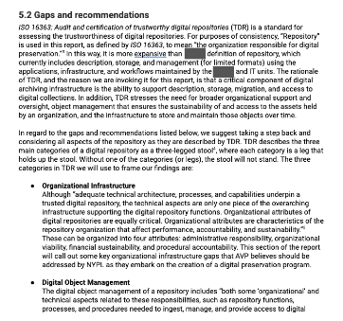
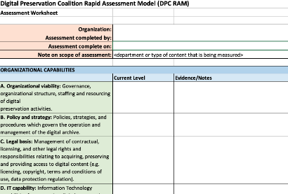
Documenting results
Who is your audience/what is your goal?
Note: Other stakeholders may need a more narrative report in which you clearly state the challenges and your recommended responses.
Note: Document findings in DPC RAM spreadsheet for digital staff.
Reminder: To gain buy-in, document your findings in a way that communicates best to your decision makers.

Slide 29
How to perform a self assessment?
Step-by-step process
Choose a tool
Gather documentation
Perform discovery
Analyse results
Document results
Build a roadmap

Slide 30
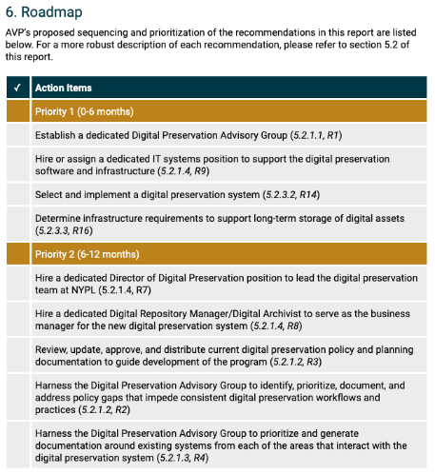
Plan/roadmap the future
Prioritize activities
Once you’ve identified the activities to address the gaps and challenges, create a roadmap for achieving this work.
DON’T SKIP THIS STEP!
Priority 1 (0-6 months)
Priority 2 (6-12 months)
Priority 3 (12-24 months)
Priority 4 (24-36 months)
Recommendation: always include a new assessment activity in the Priority 4 section.

Slide 31
How to perform a self assessment?
Step-by-step process
Choose a tool
Gather documentation
Perform discovery
Analyse results
Document results
Build a roadmap

Slide 32
What do you do with your findings?
Share!
For Digital Staff
For Admin
For IT
For Other Stakeholders
Acknowledge gaps
Use recommendations to address gaps
Use roadmap to prioritize your work
Use report to communicate - value of program - plan for improvement - need for policies
Use report to push for formal programmatic support.
Use report to communicate - infrastructure gaps - storage needs - required dp actions
Use report to push for formal programmatic support.
Use report to communicate - program successes - plan for growth and programmatic improvements
Use report to develop trust.

Slide 33
weareavp.com
info@weareavp.com
Notes:
Our newest offering is Digital Preservation Go (DPGO for short)! AVP can help you take your first next step with this low-cost digital preservation maturity assessment service.

Slide 34
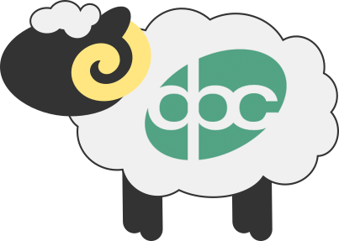
https://www.dpconline.org/digipres/dpc-ram
weareavp.com
info@weareavp.com
Notes:
DPGo! is based on the awesome, standards-based work of the Digital Preservation Coalition (DPC) and their Rapid Assessment Model (RAM). We took the DPC RAM and turned it into a series of surveys that enable us to help you assess your digital preservation program and give you real-world solutions to the challenges you face.
The difference between performing the RAM assessment yourself and doing the assessment with AVP is that at the end of our engagement, you will walk away with recommendations, a roadmap for implementation, and a professional slide deck you can share with your stakeholders and admin.

Slide 35
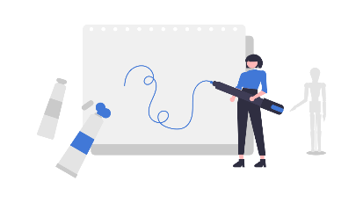
HOW DOES
DPGo! WORK?
weareavp.com
info@weareavp.com
35
Notes:
An AVP Consultant, working in either Spanish or English, will guide your organization through a process of self-reflection. Then, your consultant analyzes and reports back to your organization on your digital preservation maturity, offering recommendations and roadmap for implementation.

Slide 36
THE DPGo! DETAILS
weareavp.com
info@weareavp.com
36
Notes:
DPGo! takes about two months to complete. During the first month, your AVP consultant meets with your team for an hour to kick off the project, provide an overview, and answer any logistics questions you have.

Slide 37
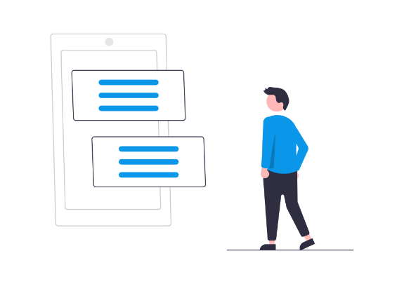
weareavp.com
info@weareavp.com
Notes:
Then, your team completes a number of surveys on a variety of topics that ask questions about your organization’s digital preservation maturity.
Starting in the second month, after the surveys have been completed, your consultant analyses your survey results to understand your gaps and challenges and your successes, and also to review any questions you had during the survey process.

Slide 38
weareavp.com
info@weareavp.com
Notes:
Then, we all get together for a two-hour workshop to work together to review your responses, answer your questions, and discuss any other issues that you have.

Slide 39
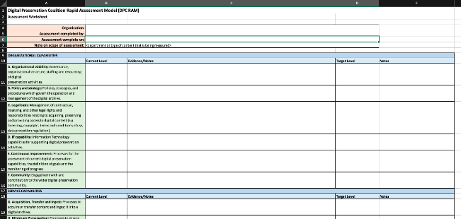
DPC RAM
Documenting results
Notes:
Based on this conversation and your survey responses, your consultant completes the DPC RAM worksheet, drafts recommendations and a roadmap, and puts it all together into a professional slide deck that you can use to present to your stakeholders.

Slide 40
R03 - Identify, prioritize, document, and address policy gaps that impede consistent digital preservation workflows and practices
We recommend the Library reviews and updates or drafts the necessary digital preservation policies, plans, and guidelines for your program. The following is a comprehensive list to get the Library started:
Deed of Gift (see R04)
Digital Collections Disaster Recovery Plan
Digital Collections Preservation Scoping Plan
Digital Preservation Policy (see R02)
Integration Guidelines (between the DAM and Chronopolis)
Migration & Normalization Policy (even if the policy is to not do it)
Storage Policy
Sustainability Policy

Slide 41
ROADMAP*
Immediate (6-9 months)
R02 - Update the digital preservation policy R06 - Actively manage user access to the “Digital Staging” environment R07 - Create opportunities for cross-unit coordination
Short-term (10-18 months)
R01 - Establish digital preservation as a management program with its own ongoing and stable operational budget line R03 - Identify, prioritize, document, and address policy gaps that impede consistent digital preservation workflows and practices R04 - Clarify when your organization accepts preservation duties and what ownership rights depositors retain for digital assets in your care R05 - Implement active stewardship of all Library assets that require long-term access
Long-term (19-36 months)
R08 - Investigate versioning in Chronopolis R09 - Assess your program regularly to ensure continuous improvement
*The order in which your organization should address the recommendations.

Slide 42
HOW MUCH DOES DPGo! COST?
weareavp.com
info@weareavp.com
42
Notes:
At $4,000 US, DPGo! Is affordable for a variety of organization sizes and budgets.

Slide 43
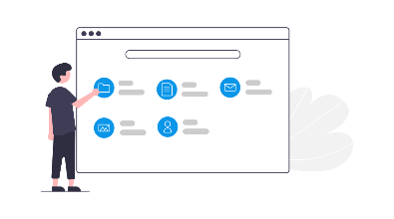
AVP’S OTHER DIGITAL PRESERVATION SERVICES
weareavp.com
info@weareavp.com
43
Notes:
But that’s not all AVP has to offer

Slide 44
AVP’s Other Digital Preservation Services
Visioning
Selection & Prioritization
Decision-making
How to . . .
Larger-scale assessments beyond what DPGo! offers
Workshops
Assessments
RFP drafting, vendor management, proposal analysis
Support for implementation or growth of digital preservation systems and technology (e.g., Preservica, LibSafe, Archivematica)
Technology selection
Technology implementation

Slide 45
Why a consultant?
Unbiased analysis
Rapid
Experience
Third-party
Notes:
Consultants are valuable for several reasons.

Slide 46
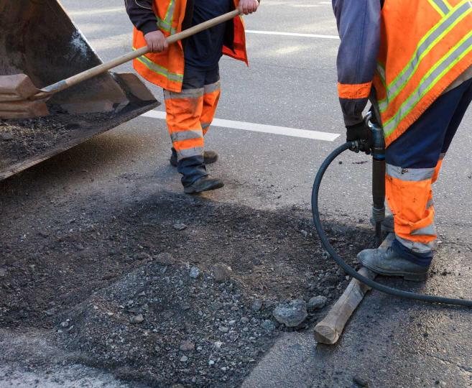
“Our culture's obsession with innovation and hype has led us to neglect maintenance and maintainers. . . . There's not only a need, but a certain nobility in taking care of what you've already created, and maybe we shouldn't look at maintenance as the enemy of innovation.”
— In Praise of Maintenance, Freakonomics podcast, 2017.
Notes:
I love innovation. It’s really, really important. But, our job is to grow our maintenance programs, perhaps in innovative ways, to nobly take care of our valuable shared cultural heritage and ensure our records are authentic and persist. Your assessment is the blueprint for rebuilding your road, the tools for making sure your roller coaster is safe, and the assets you steward today and secure for stewardship by future generations.

Slide 47
HOW DO I GET MORE INFO?
weareavp.com/dpgo
amy@weareavp.com
weareavp.com
info@weareavp.com
47
Notes:
Follow the link on the screen where you can find more details about DPGo!

Slide 48
Questions and Comments

Slide 49
Upcoming Webinars
January 27: What’s on Tap for CoSA in 2022
For registration information: https://www.statearchivists.org/programs/cosa-webinar-series/
February 24: CoSA-NARA webinar: Preservation at NARA and at the Tennessee State Archives
For registration information: https://www.statearchivists.org/programs-education/cosa-webinars/additional-webinars

Slide 50
Upcoming SERI Webinars
January 11: 2022 Digital Preservation Capability Self-Assessment Launch, a SERI webinar
For registration information: https://www.statearchivists.org/electronic-records/state-electronic-records-initiative/seri-webinars

Slide 51
Contact Us
CoSA Website http://www.statearchivists.org
CoSA Resource Center https://www.statearchivists.org/research-resources/resource-center
CoSA Twitter Handle @StateArchivists
CoSA Facebook Page www.facebook.com/CouncilOfStateArchivists
CoSA You Tube https://www.youtube.com/user/StateArchivists/

Slide 52
Webinar Evaluation
We really do appreciate your feedback!
When you exit the webinar, you will automatically be taken to an online webinar evaluation. Please take a couple minutes to complete the survey and help us plan future webinars.

