Slide 1
Cultural Competency's Role in DEIA in Cultural Heritage Institutions
Institute of Museum and Library and Museum Services
August 2, 2022
Helen Wong Smith, MLIS, CA, FSAA Archivist for University Records University of Hawai`i

Slide 2
“What shapes archival processes and concepts?
Culture. What is remembered or recorded is shaped by culture. The archive’s form is shape by culture…”
~Kelvin White
Shared actions of groups of people, expressed daily, that are the results of historically or socially transmitted customs and traditions
~Motiel-Overall, Nunez, Reyes-Escudero

Slide 3
… the profession is behind in its efforts to address the foundational issues of racism and disparities in LIS research in and library services for multicultural communities.
The incorporation of cultural competency standards throughout the field of [LIS] would improve its climate for diversity, address the lack of diversity, and enhance retention as well as improve its service outcomes.
~ Jaeger et al, 2011

Slide 4
“…the application of diversity is…a central framework of twenty-first century library and information science practice.
The very existence of libraries rests on our ability to create institutions and resource centers where would-be users see their information needs and themselves reflected.”
[W]e will no longer be considered a relevant profession by individual we seek to recruit to the profession or by the communities with which we seek to work.
~ Alexandra Rivera
~Davis and Hall

Slide 5
Cultural Competency
The ability to function with awareness, knowledge, and interpersonal skill when engaging people of different backgrounds, assumptions, beliefs, values, and behaviors.

Slide 6
It Should
Combine cultural-mindedness with culturally centered communication skills for effective relationships with all people forming the basis for culturally competent organizations, communities and societies

Slide 7
Definitions of Culture
“The accumulated store of shared values, ideas (attitudes, beliefs, values, and norms), understandings, symbols, material products, and practices of a group of people” ~Institute of Medicine, 2003
“Totality of socially transmitted behavioral patterns, arts, beliefs, values, customs, life ways, and all other products of human work and thought characteristics of a population of people that guide their worldview and decision making”
~Purnell and Paulanka, 2003

Slide 8
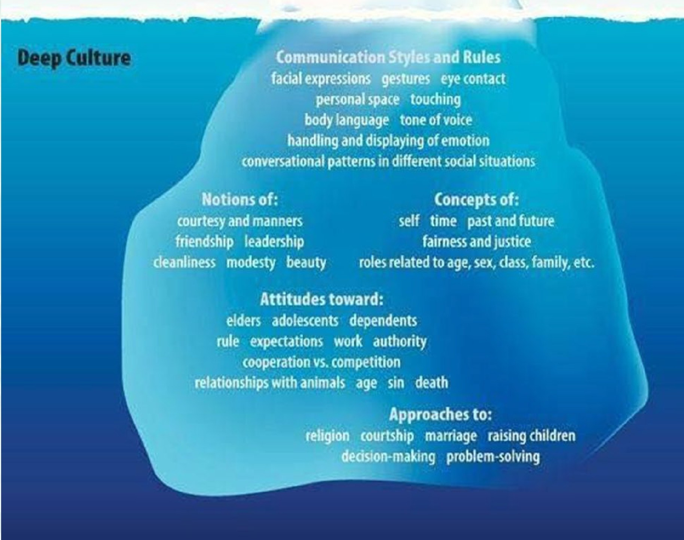
Food Flags Festivals
Fashion Holidays tusk Performances Dances Games
Arts & Crafts Uterature Language
Surface Culture

Slide 9
Social-Cultural Groups
Diversity of human experience
Ethnicity
Upbringing
Religion
Physical Disabilities
Sexual Orientation
Education
Living/working conditions
Trauma
Refugee
Muslim
HIV/AIDS
Weight
LGBT Elders
Unions
Caregiver
Veterans
Identify knowledge and skills necessary to foster working relations
Notes:
Sasha Kim returning to Korea

Slide 10
Dyad discussion
When have you been the recipient of cultural stereotyping?
What did you feel?
How did you respond?
Were there any lessons learned?

Slide 11
Cultural Competence Continuum
Cultural Destructiveness
Cultural Incapacity
Cultural Denials/Indifference

Slide 12
Cultural Competence Continuum
Cultural Pre-Compet ence
Cultural Competence
Cultural Proficiency

Slide 13
Facets of cultural competency
cognitive elements (intellectual awareness, knowledge, interpret information)
affective elements (emotional awareness and responses)
behavioral components
(skill-building behavior change and actions
Cognitive
••Thoughts
••Awareness
Affective
••Attitudes
••Values, Beliefs
••Judgements
Behavioral
••Actions
~Mendenhall, Arnardottir, Oddou, and Burke
2013:437
~Lloyd and Härtel 2010

Slide 14
Cognitive (Knowledge)
Culturally competent professionals deliberately seek out various worldviews which can help promote understanding between cultures.
Professionals need to seek knowledge about other cultures and use that knowledge to inform their skills and practice.

Slide 15
Know your communities
Social determinants
Political determinants
Resources
Businesses
Organizations
Disadvantaged populations
Human rights violations
Economic Disparities
Influx of Immigrants
◻ Immigrant status need not be disadvantaged, i.e. Hong Kong residents relocation to Vancouver, B.C.

Slide 16
How can these three facets be integrated into your cross-cultural interactions?
What’s missing?
Outreach to a culture telling them about the significance of your holdings to their culture.
Working with one culture and assuming you know about all related cultures, i.e. Vietnamese and you now know about all Asians.
Giving the same presentation to all cultures.
Deducting points for candidate for not making eye contact
Any previous efforts lacked one of the three?
Cognitive/knowledge
Affective/Core
Behavior

Slide 17
Affective (Attitudes)
Positive attitudes are needed toward your own culture(s) as well as the cultural heritage of your colleagues and patrons.
This begins by being able to appreciate, value and respect differences between your own heritage and that of your broad community in areas such as race, ethnicity, socioeconomic status, religion, sexual orientation and cultural beliefs.

Slide 18
Self-awareness of our own cultural identities and stereotypes will allow us to improve cross-cultural interactions.
We often label people or things we do not understand as “weird”, “bad”, or “wrong”.
Acknowledging our cultural differences need not divide or paralyze us with fear of not saying or doing the “right thing”.
Distinguish between the “intent” and the “impact” of your behavior
Notice how you assign status and importance to individuals
Review your negative reactions to others and ask yourself “What am I responding to and why?”

Slide 19
Behavior
Sensitivity to social group differences and the ability to adjust behavior is a virtue of membership in a social group
Variability of our identity relations has consequences for determining behaviors adopted and expected
Research evidence suggests that a change in behavior can modify beliefs and attitudes.

Slide 20
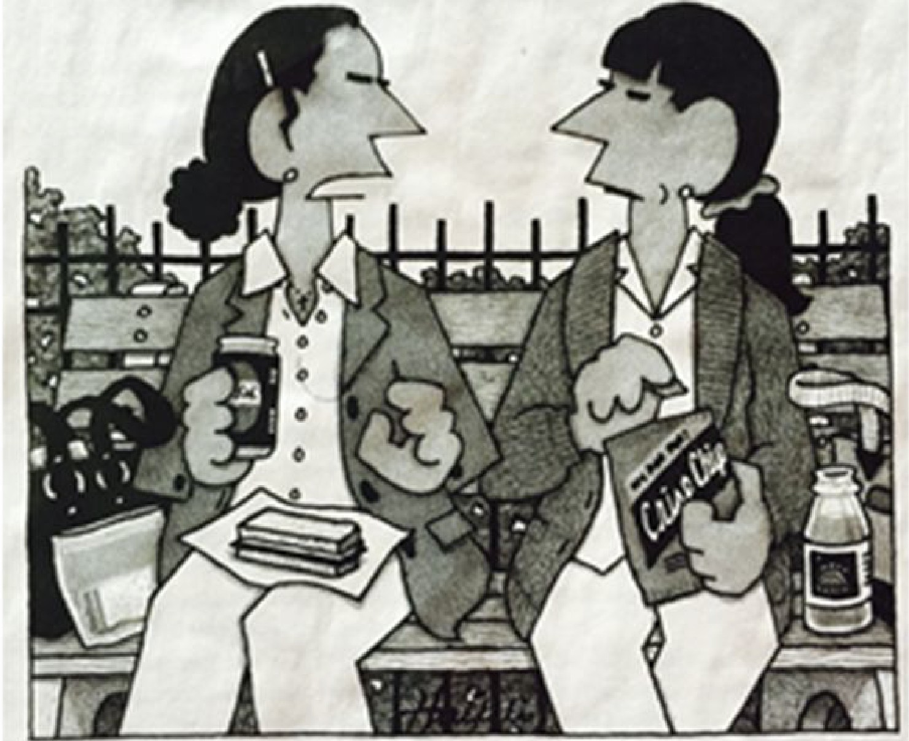
They learn how to say ʻGracias’ and we're supposed to be thankful.
The New Yorker, August 31, 2015

Slide 21
Active Process
Cultural Relativism – Self-reflection and nonjudgement
Emic Contextualization and Comparison – Obtaining information on attitudes, values orientations, and social relations directly from the people involved.
Holistic approach to change

Slide 22
Multilevel Challenges
Individuals learn how to recognize and value diversity in themselves and in the people with whom they interact – Micro Level
This growth of respect between individuals and the expansion of their ability to communicate effectively within the diverse work and community environments impacts the Organization – Meso Level
As the Organization becomes culturally competent change at the institutional level is fostered – Macro Level

Slide 23
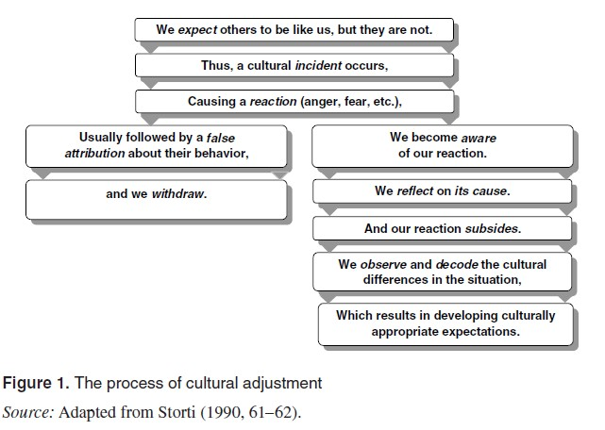
~Bird and Osland 2006

Slide 24
Four Skills of Cultural Diversity Competence
Skill 1: Understand Culture as Multilevel & Multidimensional
Skill 2: Understand the Six Barriers to Effective Relationships
Skill 3: Practice Culturally Centered Communication
Skill 4: Design and Implement Organization-wide Cultural Competence

Slide 25
Skill 1: Understand Culture as Multilevel & Multidimensional: personal, subcultures, mainstream U.S. (National) culture, & organization culture(s)
Skill 2: Understand the Six Barriers to Effective Relationships: language (verbal), nonverbal, judgment, stress, stereotyping and discrimination, & organization/ institution-wide barriers.
~Mikel Hogan

Slide 26
Skill 1: Level One
Culture at the personal level
One's personal identity is formed through interacting within one's social group (for example, interacting within one's family, neighborhood, school, work).

Slide 27
Skill 1: Understand culture as multilevel & multidimensional
Aspects of Culture: the following categories are designed as a thinking tool for cultural observation and understanding:
History
Social Status Factors
Social Group Interaction Patterns:
Intra-group & Inter-group
Value Orientations
Language and Communication:
Verbal & Non-verbal
Family Life Processes
Healing Beliefs and Practices
Religion
Art and Expressive Forms
Diet/Food 11.Recreation
12.Clothes

Slide 28
Skill 1: Level One
ASPECTS OF PERSONAL CULTURE: EXAMPLES
One's personal culture or meaning system is comprised of various aspects, with some aspects being more conscious than others- To name a few:
Verbal Communication
-voice loudness and inflection
-degree of directness
-topics perceived as appropriate for conversation
Nonverbal Communication
-one's orientation to space and time
-facial expressions
-eye contact
-use of silence
Values
Family Life Processes: Decision-Making Style, Work Habits and Behaviors
Religion: Spiritual Beliefs and Practices
Food and Eating Habits
Dress and Appearance

Slide 29
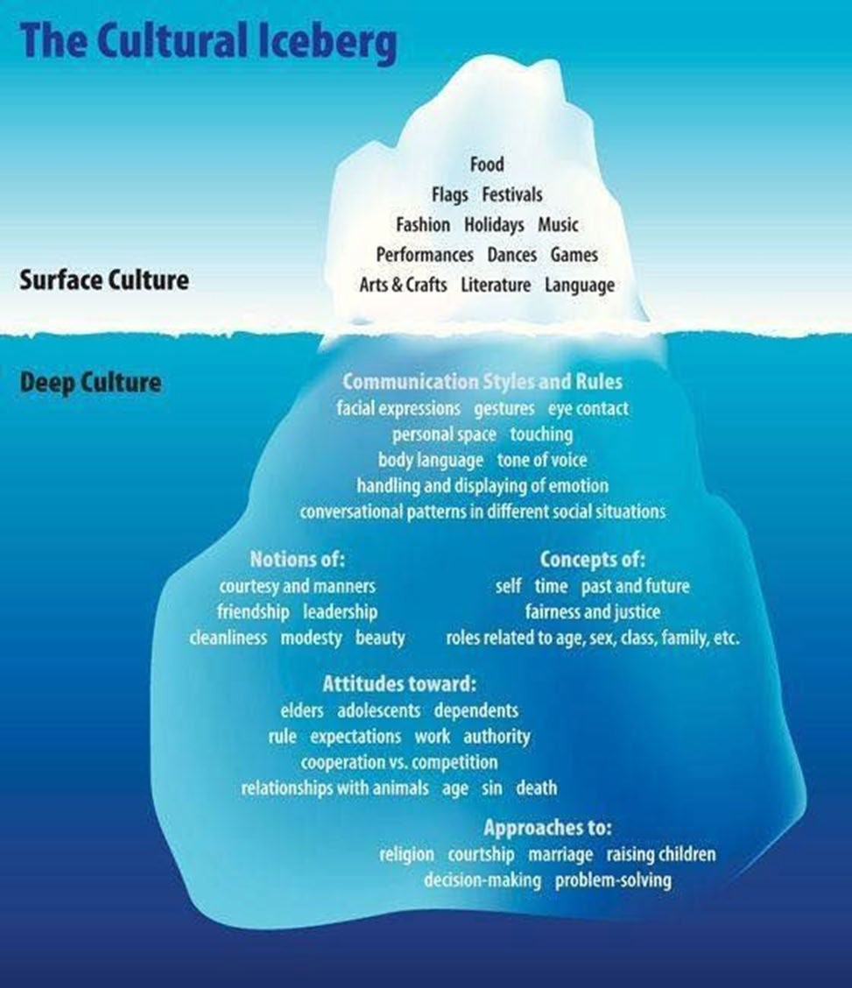
Which part of the iceberg has impacted your interactions with other cultures?
How did you respond?
Would knowing cultural attributes below the surface have changed your response?
Would this knowledge change your core beliefs?

Slide 30
Skill 2: Understand the Six Barriers
Personal and Interpersonal Barriers:
VERBAL BEHAVIOR: language
NONVERBAL BEHAVIOR: greetings, body gestures, eye behavior, vocal cues, body smell, expressions of emotion, time and space orientation, thinking style (linear or holistic)
STEREOTYPES and DISCRIMINATION: misinformation, missing information, and overgeneralizing; stereotypes provide psychological permission for discrimination
JUDGMENT: negative thoughts and feelings that accompany stereotypes
STRESS: the discomfort felt in culturally diverse situations. It is useful to examine stress in terms of layers
Organizational/Institutional Barriers: Organization norms, policies, procedures, and programs unfriendly to cultural diversity

Slide 31
“The Americans think, if everybody is like me, they’re less likely to attack me. The Chinese don’t think like that. They don’t try to make the world be like them. Their strategy is to make economic linkages, so if you break these economic linkages it’s going to hurt you as much as it hurts them”
~Asian Diplomat
“Learning to speak Lingerie” The New Yorker Aug 10 and 17 2015

Slide 32
Four Skills of Cultural Diversity Competence
Outcomes of Skill 1 and 2:
Cultural Mindedness - an inquiring way of thinking and keen interpretive skills
-Will recognize different ways of thinking and communicating
-Will recognize culture is multilevel & multidimensional
-Will recognize the six barriers to communication

Slide 33
Four Skills of Cultural Competence
Skill 3: Practice Culturally Centered Communication
Personal competencies
Dialogue
Conflict recovery
Problem-solving skills
Skill 4:Design and Implement Organization-wide Cultural Competence

Slide 34
Skill 3: Practicing Culturally Centered Communication Skills
Be nonjudgmental.
Be flexible.
Be resourceful.
Personalize observations.
Pay attention to thoughts and feelings.
Listen carefully.
Observe attentively
Assume complexity.
Tolerate the stress of uncertainty.
Have patience.
Manage personal biases and stereotypes.
Keep a sense of humor.
Show respect.
Show empathy.

Slide 35
Situational learning
Learning that takes place in the same context in which it is applied, thus learning and doing are inseparable
+
Ethnography of communication is a specific ethnographic approach to the analysis of situated communicative practices
Notes:
Making attributions:
Monitor your attitude and mood.
Consider whether sophisticated stereotypes apply.
Focus on the individual.
Build your knowledge and experience base so that you make more accurate attributions.
Suspend judgment.
Share your attributions with the “other”; seek feedback.

Slide 36
Change at the Organizational Level
Stage 1 :
Stage 2 :
Stage 3 :
Stage 4 :
Relative Equilibrium
Storming Stage
Proactive problem-solving
Attainment of new relative equilibrium
~Rosen, 1991; Smith 1993

Slide 37
Skill 4: Culturally Competent Organizational Strategies
Internal Organizational Strategies:
Maintain cultural awareness at all levels of the organization
Recruit culturally diverse employees
Provide career development opportunities for all employees
Create flexible benefit and service plans that meet the needs of diverse employees
Monitor the change process
Notes:
An appropriate opportunity is creating a reparative decription team, i.e. https://snaccooperative.org/ winners of the 2015 C.F.W. Coker Award or Yaleʻs Reparative Archival Description Working Group https://guides.library.yale.edu/reparativearchivaldescription
NARA Guidance https://www.archives.gov/news/topics/recommendations-from-internal-task-force-on-racism
Executive Order 13985 Jan 20, 2021 Advancing Racial Equity and Support for Underserved Communiites through the Federal Government
https://www.federalregister.gov/documents/2021/01/25/2021-01753/advancing-racial-equity-and-support-for-underserved-communities-through-the-federal-government

Slide 38
Skill 4 Culturally Competent Organizational Strategies
External Organizational Strategies:
Establish culturally competent relationships with client communities/organizations
Review the ethics and social responsibility of the organization
Strive for customer/client satisfaction in culturally relevant ways
Employ cultural diversity competence in service delivery to clients

Slide 39
Four Skills of Cultural Competence
Outcomes of Skills 3 & 4
Effective Communication and Problem-Solving Personal Competency Behaviors
Dialogue, Negotiation, Conflict Recovery Coaching, Mentoring, and Teamwork Organization-wide cultural competence

Slide 40
Skill 4: Culturally Competent Organizational Strategies
External Organizational Strategies:
Establish culturally competent relationships with client communities/organizations
Review the ethics and social responsibility of the organization
Strive for customer/client satisfaction in culturally relevant ways
Employ cultural diversity competence in service delivery to clients

Slide 41
It is not our differences that divide us. It is our inability to recognize, accept, and celebrate those differences.
~ Audre Lorde

