Slide 1
CoSA Member Webinar Advocacy for Archives: From The Hill to Your Hill
September 28, 2023
3 pm Eastern
Disclaimer: This webinar is being recorded and will be available for viewing on the CoSA website.

Slide 2
Webinar Agenda
Welcome and Overview
Presentations: Overview of Archives on the Hill Advocacy work at the Louisiana State Archives
Discussion – Archives on the Hill attendees perspectives
Q and A
Upcoming Programs and Webinars

Slide 3
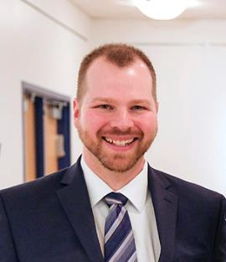
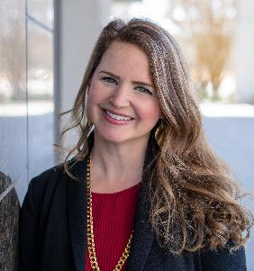
Speakers
Bryan Whitledge
Archivist University Digital Records
Central Michigan University
Catherine Newsome
State Archivist
Louisiana State Archives

Slide 4
Archives on the Hill
A collaborative project of:
Council of State Archivists,
National Association of Government Archives and Records Administrators,
and Society of American Archivists

Slide 5
ARCHIVES ON THE HILL: THE BEGINNINGS
Archivists have been doing public policy advocacy for a long time.
In the mid-2010s, archivists attended the National Humanities Alliance’s Humanities Advocacy Day.
2018 – Joint meeting of CoSA-NAGARA-SAA in Washington…
The perfect opportunity for Archives!

Slide 6
2018 – WHAT DID WE ACCOMPLISH
67 Archivists participated
30 States
45 meetings with legislative staffs and staffers
We forged a few long-running connections with legislative staffs
Developed a couple of new champions
for archives advocacy in our profession

Slide 7
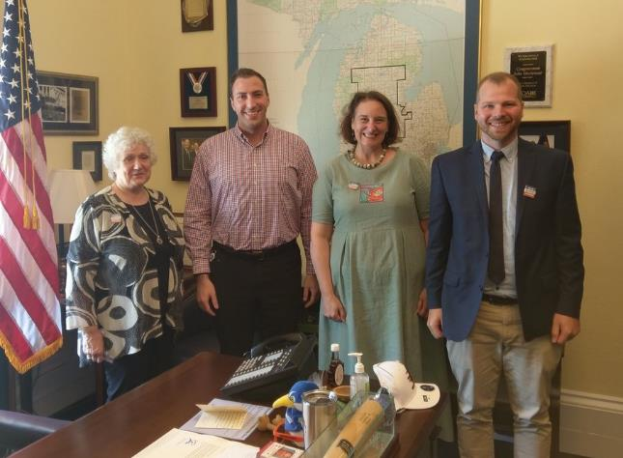
2018 – WHAT DID WE ACCOMPLISH

Slide 8
PREPARING FOR 2023
In 2022, we realized that 2023 presented us with the opportunity for Archives on the Hill II: The Return of the Archivists.
In late 2022, we formed the Archives on the Hill Coordinating Committee with members from CoSA, NAGARA, and SAA.
We also applied for SAA Foundation Grant.

Slide 9
WHAT DID WE AIM TO ACCOMPLISH?
Raise awareness in Congress of archival issues
Strengthen connections and impact for archives
Develop skills for legislative advocacy

Slide 10
PLANNING: HOW TO GET THIS DONE
Draw on previous experience – particularly Kathleen Roe and Dennis Riley.
Post-pandemic Hill-visit tips from our friends in the National Humanities Alliance
Attending NHA Day
Set up a calendar for accomplishments

Slide 11
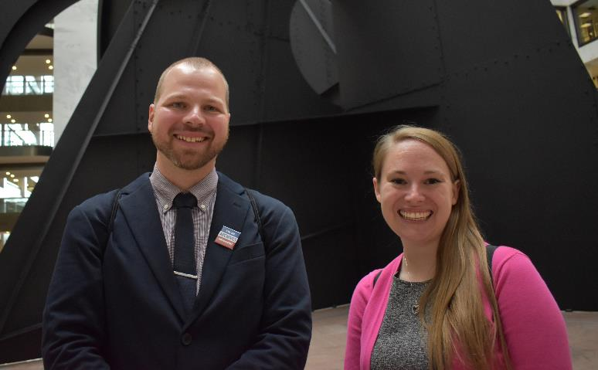
PLANNING: RELYING ON ALEX KLEIN, NHA

Slide 12
PLANNING: RECRUITING ADVOCATES
Recruitment via:
General CoSA/NAGARA/SAA announcements, word of mouth, past AotH participants, folks who we thought “would be good.”
Initially, about 55 interested, down to 40 on day-of.

Slide 13
PLANNING: SCHEDULING
Draw on members and their geographic locations to arrange for meetings with their Representatives and Senators
Brought on intern scheduler, who started scheduling July 5 for July 25 event.
Lots of considerations
Availability, House/Senate, Teams of States
“From what I understand it's like nailing
jello to the wall.”

Slide 14
PLANNING: 3 WEEKS OF NAIL-BITING
A lot of unknowns and uncertainty
Unanswered calls and e-mails to legislative offices
Participants arranging for travel
Meeting space availability
“It will all come together and 15 minutes
after things get moving, you’ll see it’ll
be fine.”

Slide 15
WHAT DID WE ACCOMPLISH?
It all came together.
Near 40 Archives Advocates – this includes non-archivists!
Some “veterans,” some “rookies,” all excellent.
20 states represented
55 different meetings w/ legislative staffs
A couple prospective new champions!

Slide 16
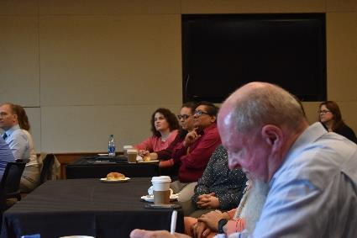
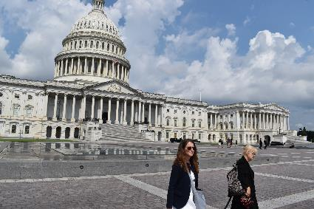
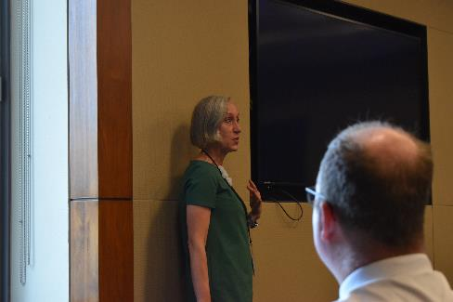
WHAT DID WE ACCOMPLISH?

Slide 17
GOING FORWARD
American Archives Month as a chance to reach out to legislatives staffs… maybe.
Draw on team of archives advocates to bring messages to DC policymakers 20 states represented.
Undertake another Archives on the Hill
Virtual, because in-person can be tricky
Encourage archivists to join NHA Day

Slide 18
Advocacy for Archives:
Advocating Your State Government
Catherine J. Newsome
State Archivist
and Executive Director
LOUISIANA STATE ARCHIVES,
A DIVISION OF THE LOUISIANA SECRETARY OF STATE

Slide 19
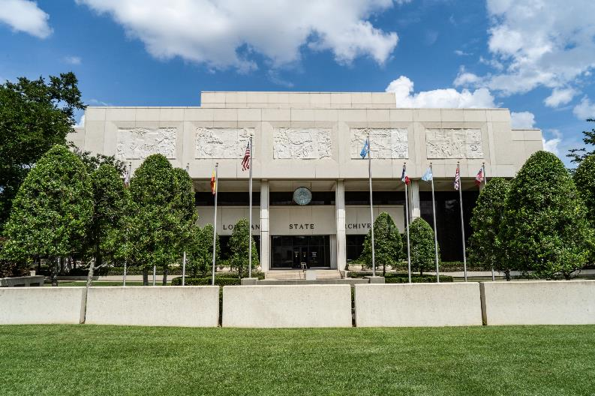
LOUISIANA STATE ARCHIVES

Slide 20
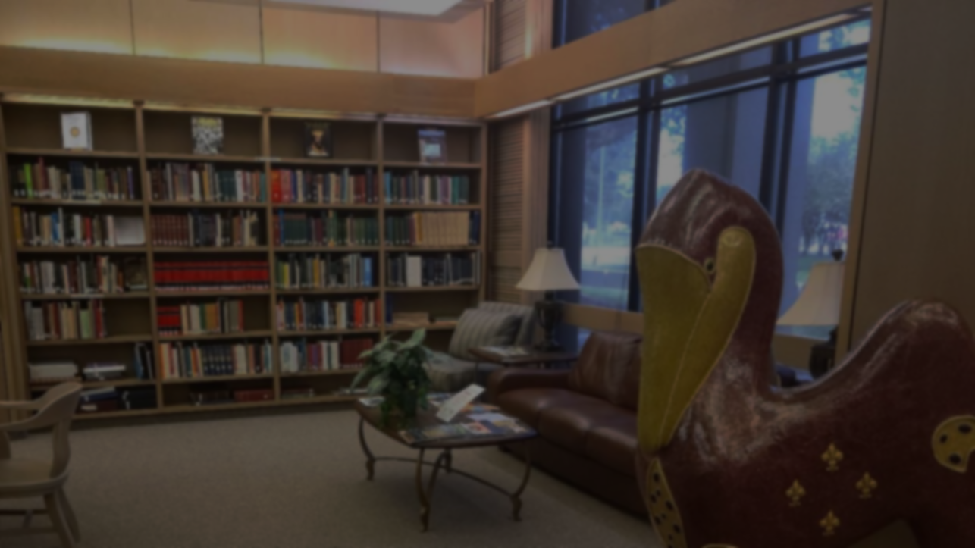
Organizational
Structure

Slide 21
Archives Administration &
Facility Management

Slide 22
Collections Management
Document Processing
Audiovisual
Reference Services
Vital Records
Library
Imaging and Preservation Services
Conversion Services
Records Services
Records Management
Records Center
Conservation Services
Conservation Lab
Exhibits

Slide 23
Who are the internal stakeholders?
Executive Suite
Human Resources
Information Technology (IT)
Accounting
Who are the external stakeholders?
Division of Administration
State Civil Service
Facility Planning
State Legislature
Create a compelling reason why they should help you. What is the benefit to them?

Slide 24
Be prepared for opposition!
Who are your adversaries?
Legislative Auditor
Associations
The key players are not necessarily elected officials.
Make friends: chief deputy, executive assistant, law clerk, staff attorney

Slide 25
Active Advocacy
Be Persistent
Be Present
Be Prepared

Slide 26
Successful Projects in Louisiana:
Funding for special projects and equipment
6 full time positions
Increase in base budget
Increase in reoccurring expenditures
Open Meetings Law

Slide 27
Rest in your diligence and wait for your next opportunity to strike.

Slide 28
Discussion: Archives on the Hill attendees

Slide 29
Questions and Comments

Slide 30
Upcoming Member Webinars
October 26, 2023: State Archives Spotlight – Pennsylvania and American Samoa [Note start time of 3:30 pm eastern!]
For Member webinars:
https://www.statearchivists.org/programs-education/cosa-webinars

Slide 31
Upcoming SERI Webinars
October 10, 2023: Electronic Records Day
For SERI webinars:
https://www.statearchivists.org/events/event-description?CalendarEventKey=a0df8f77-af44-4ffb-9638-0187521a5374&Home=%2fevents%2fmanage-events

Slide 32
Upcoming Shop Talk Webinars
November 9, 2023: Shop Talk with Preservica
For Shop Talk webinars:
https://www.statearchivists.org/programs-education/cosa-webinars

Slide 33
Contact Us
CoSA Website http://www.statearchivists.org
CoSA Resource Center https://www.statearchivists.org/research-resources/resource-center
CoSA Twitter Handle @StateArchivists
CoSA Facebook Page www.facebook.com/CouncilOfStateArchivists
CoSA You Tube https://www.youtube.com/user/StateArchivists/

Slide 34
Sponsors

Slide 35
Webinar Evaluation
We really do appreciate your feedback!
Please take a moment and respond to the evaluation following this webinar.

