Slide 1
CoSA Member Webinar Disaster Preparedness: Monitoring Your Collections During Adverse Conditions
May 26, 2022
3 pm Eastern
Disclaimer: This webinar is being recorded and will be available for viewing on the CoSA website.

Slide 2
Webinar Agenda
Welcome and Overview
Presentations:
Patrick McCawley – South Carolina Department of Archives and History
Jennifer Simmons – Colorado State Archives
Todd Topper – Minnesota Historical Society
Q and A
Upcoming Programs and Webinars

Slide 3
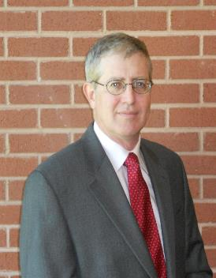
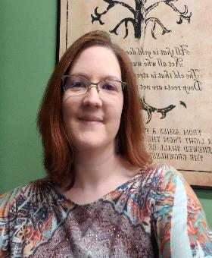
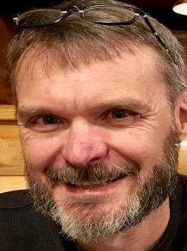
Speakers
Patrick McCawley
Records Services Supervisor
South Carolina Department of Archives and History
Jennifer Simmons
Research Desk Supervisor/ Program Administrator
Colorado State Archives
Todd Topper
Collection Management Supervisor
Minnesota Historical Society

Slide 4
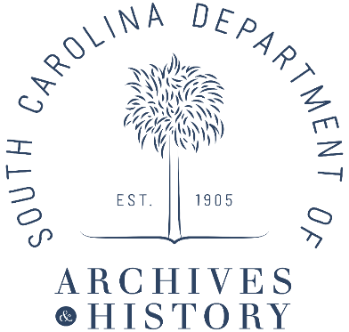
Water Incident Response
Notes:
Thank you, Dorothy. I am Patrick McCawley, supervisor of Record Services at the South Carolina Dept. of Archives and History. I served as coordinator of the agency’s recent multi-year effort to conserve our seven state constitutions. The constitutions are the written expression of our state authority and sovereignty and illustrate the historic and political pathway to the present.

Slide 5
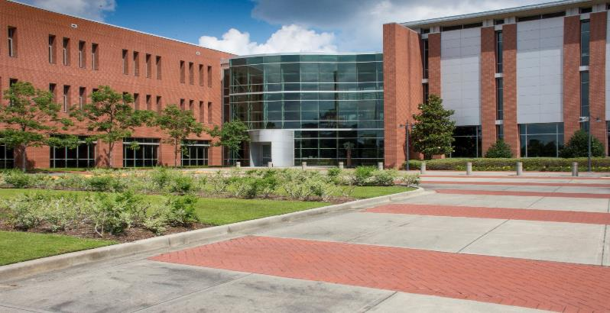
SC Archive and History Center
Opened in May 1998
Notes:
Thank you, Dorothy. I am Patrick McCawley, supervisor of Record Services at the South Carolina Dept. of Archives and History. I served as coordinator of the agency’s recent multi-year effort to conserve our seven state constitutions. The constitutions are the written expression of our state authority and sovereignty and illustrate the historic and political pathway to the present.

Slide 6
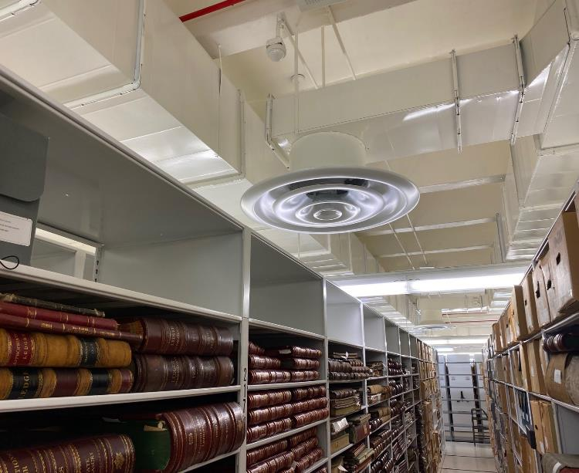
The Culprit. Most of the water fell from this vent. The shelf to the right was sitting directly underneath it.

Slide 7
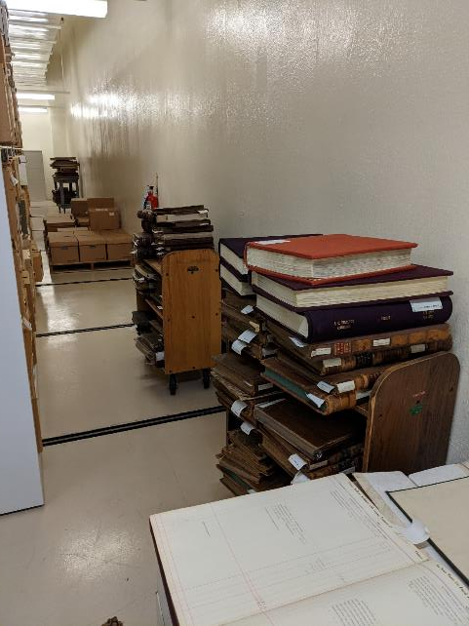
First step was to move wet records.

Slide 8
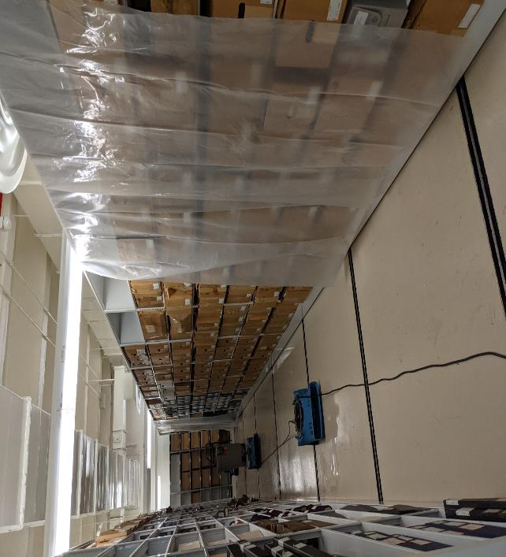
Second step was to protect from further damage.

Slide 9
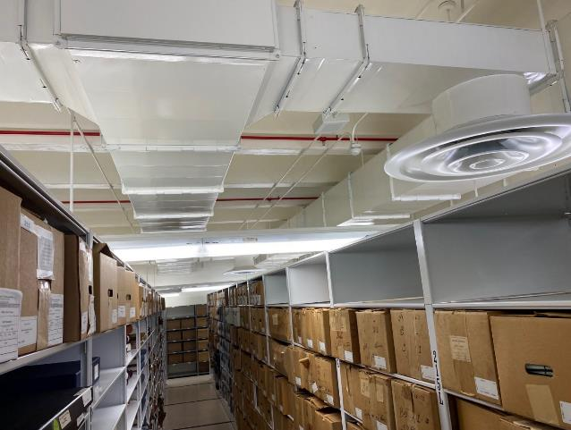
Additional water leaked from this duct work extending to this second vent.

Slide 10
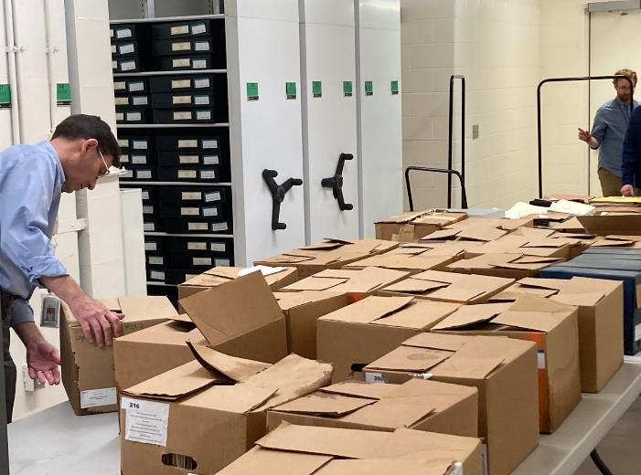
A triage area was set up to do initial assessments.

Slide 11
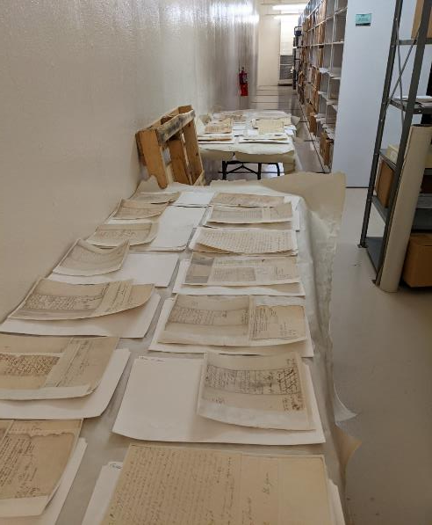
Drying stations for Revolutionary War Audited Accounts.

Slide 12
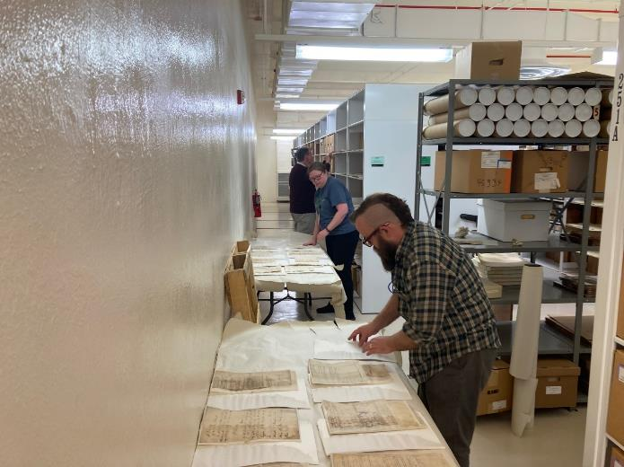
Checking the status of the drying process.

Slide 13
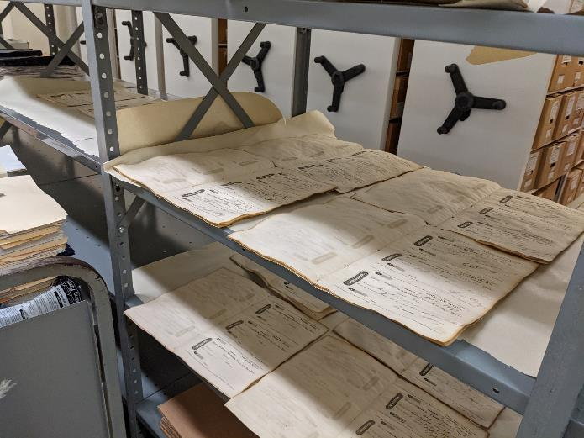
Every available space was utilized.

Slide 14
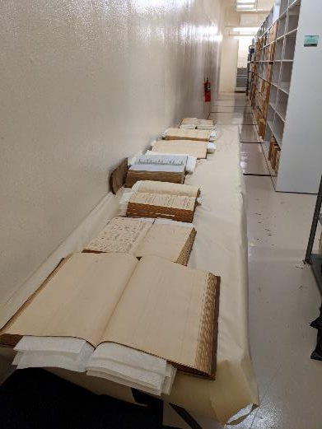
Volumes interleaved with blotting paper.

Slide 15
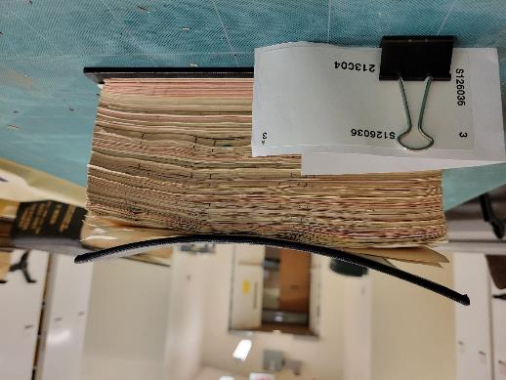
A warped cover board.

Slide 16
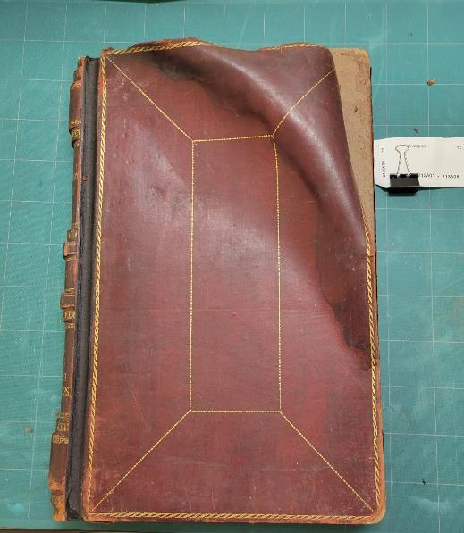
A damaged volume cover.

Slide 17
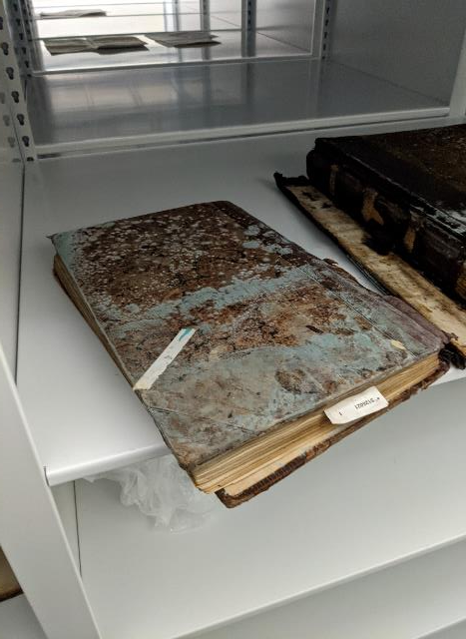
A mold outbreak.

Slide 18
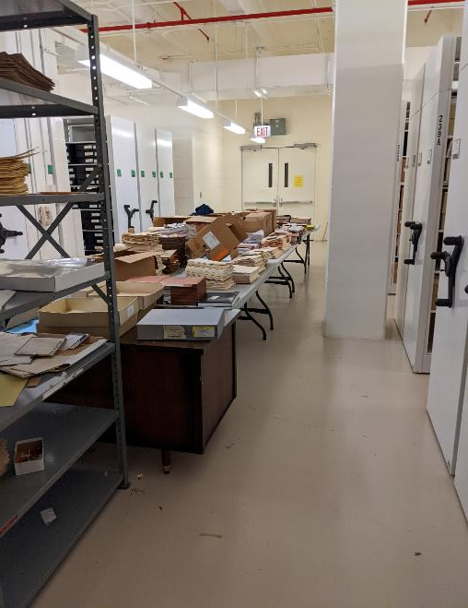
Comptroller General correspondence files.

Slide 19
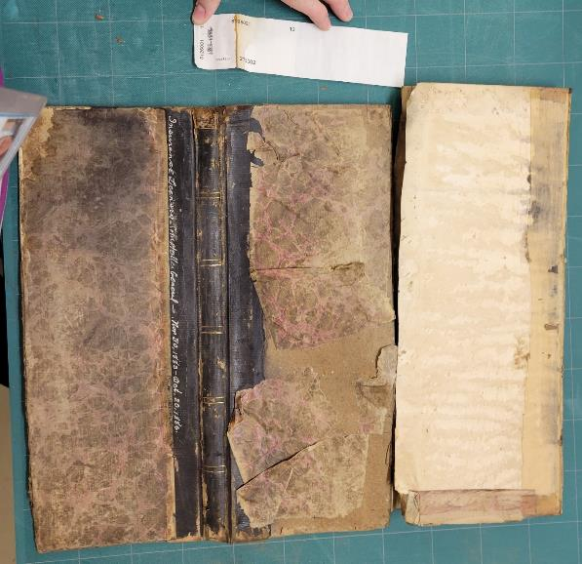
Damaged volume and label.

Slide 20
Lesson learned
Flexibility
Leadership
Organization
Triage
Patience

Slide 21
Patrick McCawley Supervisor, Record Services SC Dept. of Archives and History 8301 Parklane Road Columbia, SC 29223 803-896-6203 pmccawley@scdah.sc.gov
Notes:
I want to thank Dr. Emerson, Nathan Dawson, Michael Lee and Katie Boodle at NEDCC for their help in the project. Thank you and I will turn it over to Kathy.

Slide 22
Colorado State Archives: Providing Access to Records During Times of Civil Unrest
Presented by: Jennifer Simmons
Research Desk Supervisor and Program Administrator
Colorado State Archives

Slide 23
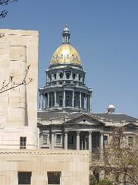
Background
CSA is located in downtown Denver, a block south of the Capitol bldg.
CSA serves all 50 states and several countries, including the Armed Forces
Need for modern records meant CSA
was open for requests during
COVID-19 and protests during
summer, 2020.

Slide 24
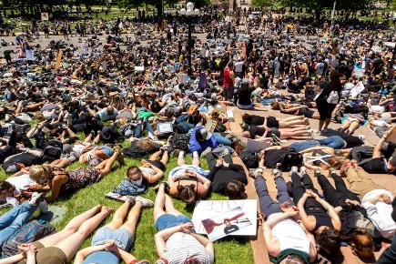
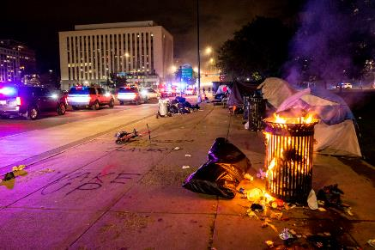
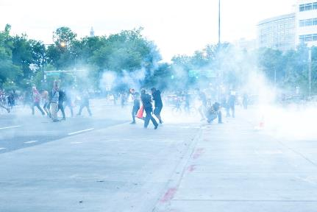
Civil Unrest – Death of George Floyd
May 28th, 2020 first protest
~2 weeks straight of protests
~120 arrests over first 4 days
~150 complaints concerning police behavior
Photos: Colorado Public Radio: https://www.cpr.org/2020/06/01/photos-denver-protests-george-floyd-death/

Slide 25
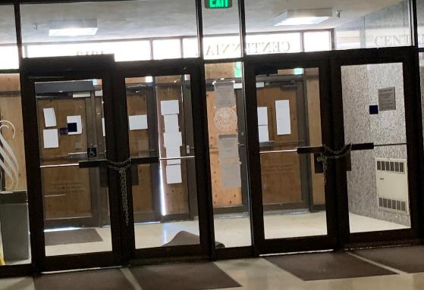
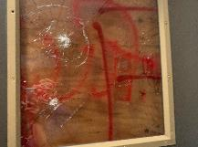
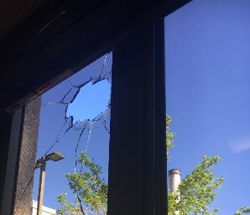
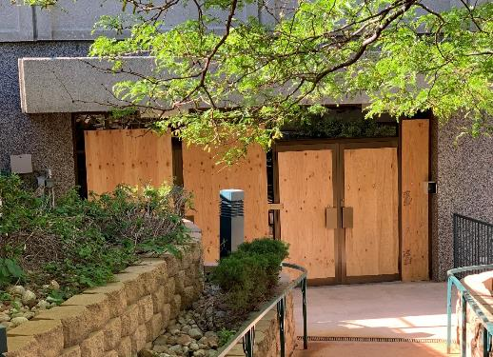
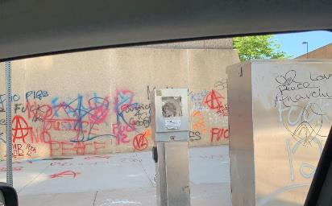
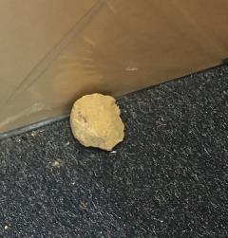
Archives Building

Slide 26
Concerns For Staff and Customers
SAFETY OF STAFF
SAFETY OF RECORDS
COMMUNICATION WITH OUR CUSTOMERS
PROVIDING ACCESS TO IMMEDIATE REQUESTS

Slide 27
Adapting to the Situation
Keep Informed!
Someone always knows when you go into the office and when you leave
Avoid protestors / do not engage
Open lines of communication with customers
Website, phone, email, newsletter, social media, etc.
Be honest about the situation / firm with expectations
Empathize with customers needing records ASAP
Prioritize requests and get CREATIVE!

Slide 28
Tools to Use
ALREADY IN PLACE
NEW ACTION ITEMS
Emergency notifications through CO State Patrol
Shared calendar for staff going into the office
Staff experience with conflict resolution
One person to the office in morning to walk areas
Online request process
Daily email updates with State Archivist during protests
Ability to answer phone calls from home

Slide 29
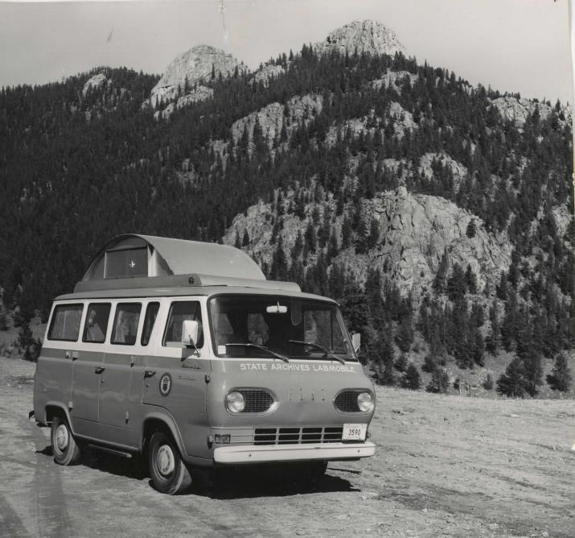
Thank you!

Slide 30
Unexpected Closure
Protecting Collections During the Chaos of
2020
Todd Topper – Minnesota Historical Society
Notes:
Hello,
My name is Todd Topper. I am the manager of the Collections Management department for the Minnesota Historical Society. My team consists of conservators, registrars, database managers and of course collections managers. The Summer of 2020 gave us challenges know one could have predicted. This presentation will cover how we as collections managers changed our habits, methods, and expectations during the Spring and Summer of 2020 to address specific needs based on perceived and real threats. Let me start with context of place.

Slide 31
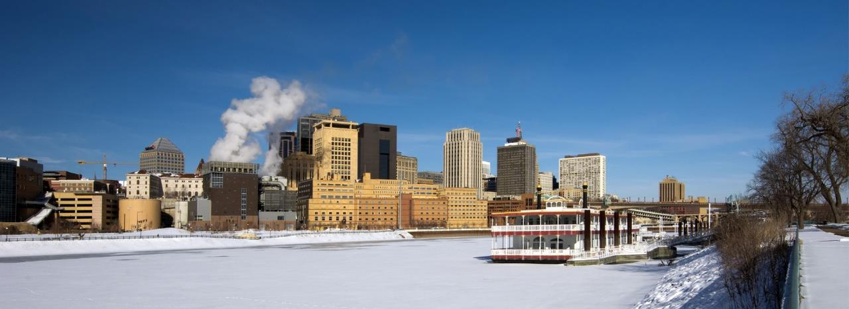
Notes:
Saint Paul, Minnesota – on the Mississippi River. The homebase of the Minnesota Historical Society.

Slide 32
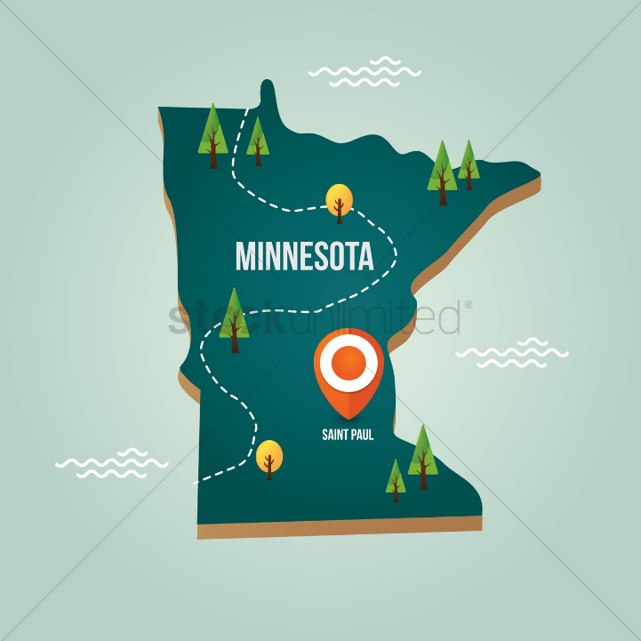
Notes:
Minnesota,...

Slide 33
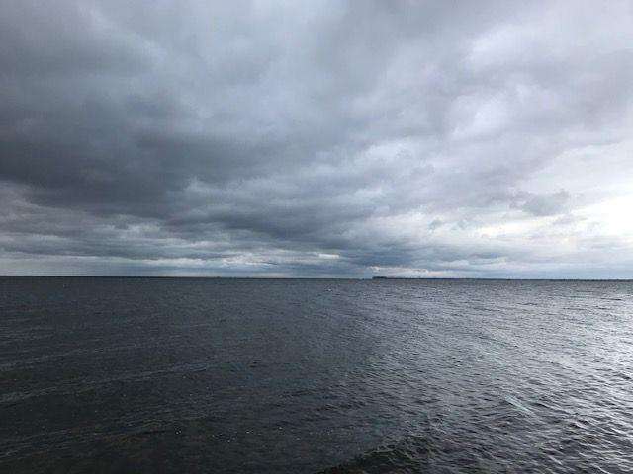
Notes:
… known as the land of 10,000 lakes. But also known for….

Slide 34
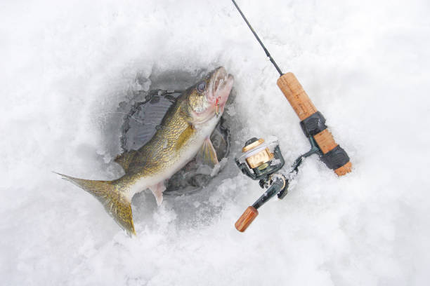
Notes:
Cold weather, ice, and walleye fishing;

Slide 35
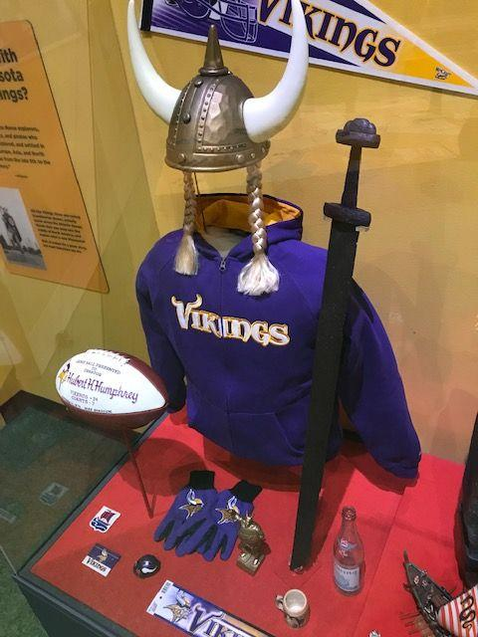
Notes:
…and Vikings,

Slide 36
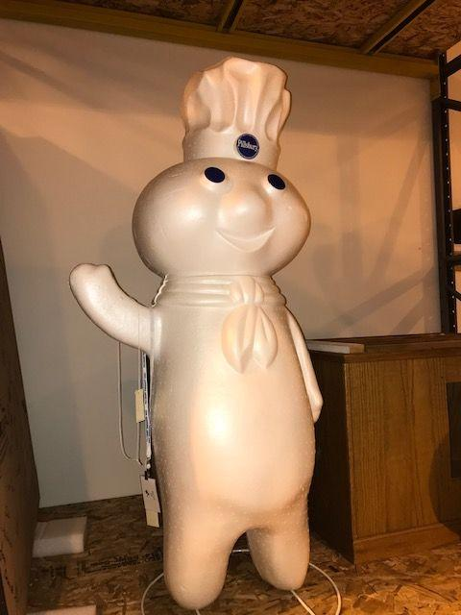
Notes:
the Pilsbury doughboy,

Slide 37
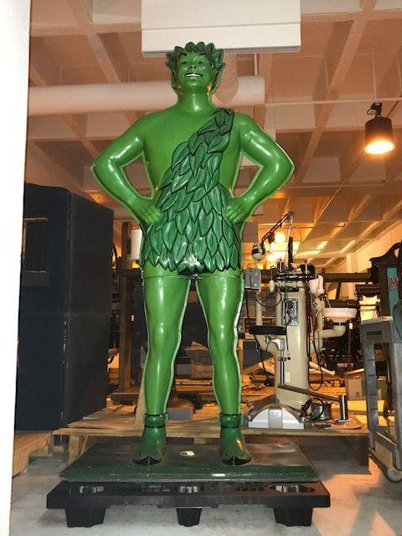
Notes:
and the Jolly Green Giant.

Slide 38
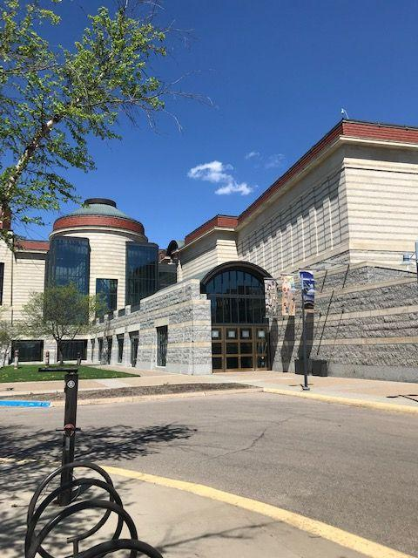
Notes:
This is the Minnesota History Center located in Saint Paul. Opened in 1992, this building serves as a central hub for the Minnesota Historical Society – now in its 171st year. It is home to a comprehensive and accessible collection of archival records and artifacts.

Slide 39
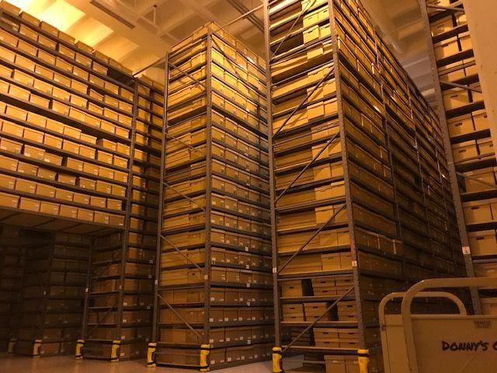
Notes:
Such as the Minnesota state archives. This collection plus manuscripts comprises over 100,000 linear feet of state documents, private business and personal records.

Slide 40
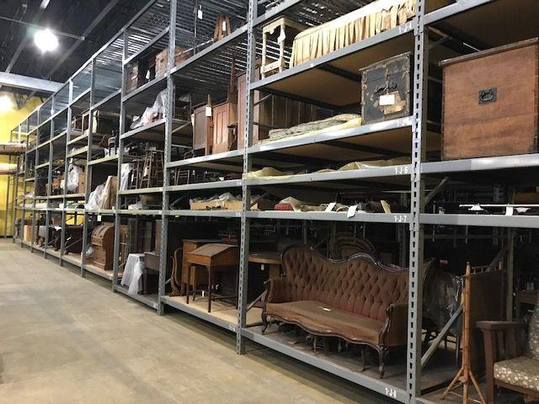
Notes:
We also hold about 250,000 Museum artifacts,…

Slide 41
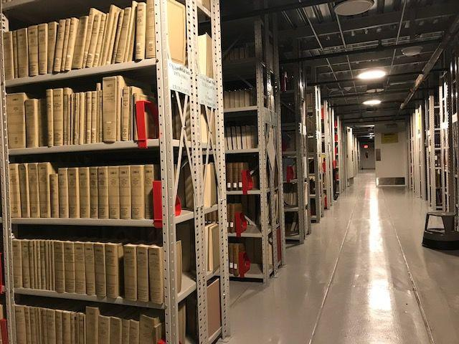
Notes:
…closed stacks of some 500,000 volumes

Slide 42
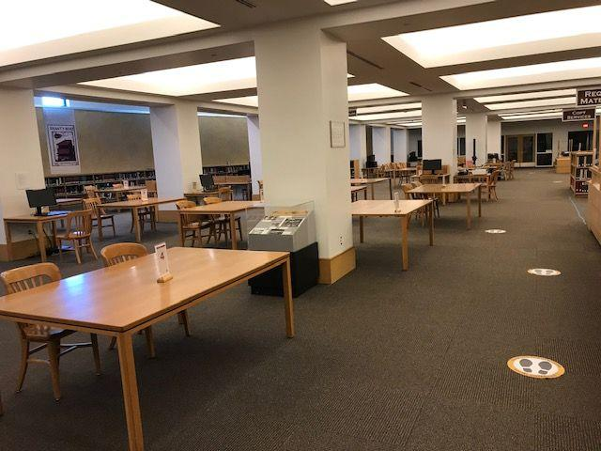
Notes:
…the reference collection

Slide 43
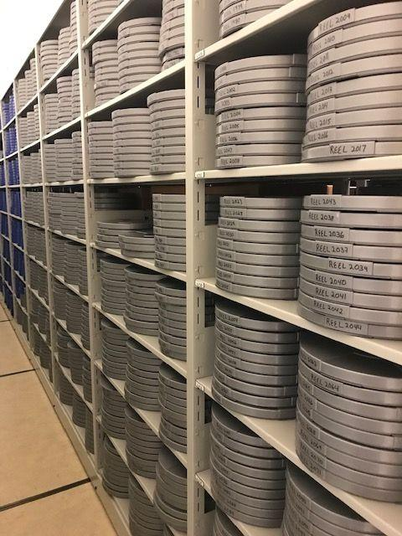
Notes:
As well as tens of thousands of sound and visual recordings

Slide 44
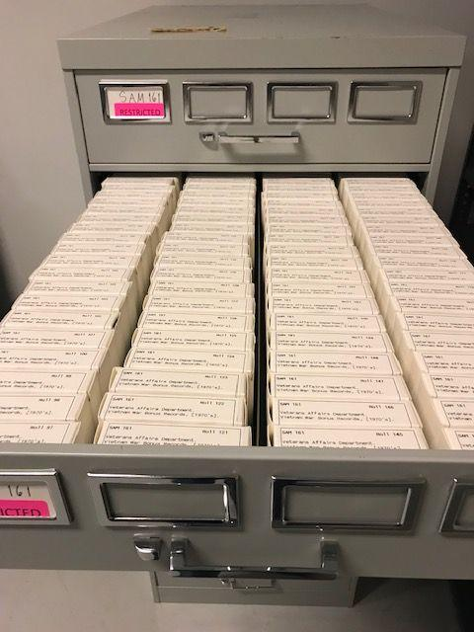
Notes:
And tens of thousands of microfilmed newspapers and documents

Slide 45
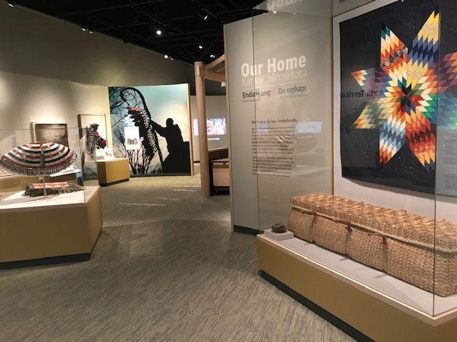
Notes:
Permanent and borrowed collections objects are also found in our exhibits. These are all places where we must consider special security and environmental systems.

Slide 46
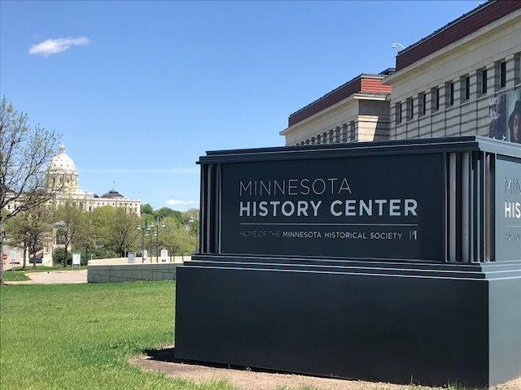
Notes:
MNHS collections are encyclopedic and voluminous. Although the historical society maintains 26 sites throughout Minnesota, most collections are stored and accessed at the Minnesota History Center. The History Center sits within the state capitol complex grounds. We are a private not for profit that has a unique partnership with the state. The History Center is a state building that the historical society leases. The lease agreement includes a state patrol security presence and maintenance staff. The MNHS building and security management team does not direct the work of security or physical plant maintenance. Security and maintenance staff have 24/7 building access and control their own schedules. Communication between the two entities is a challenge. As you can see in this photo, the MN History Center is in very close proximity to the State Capitol building…

Slide 47
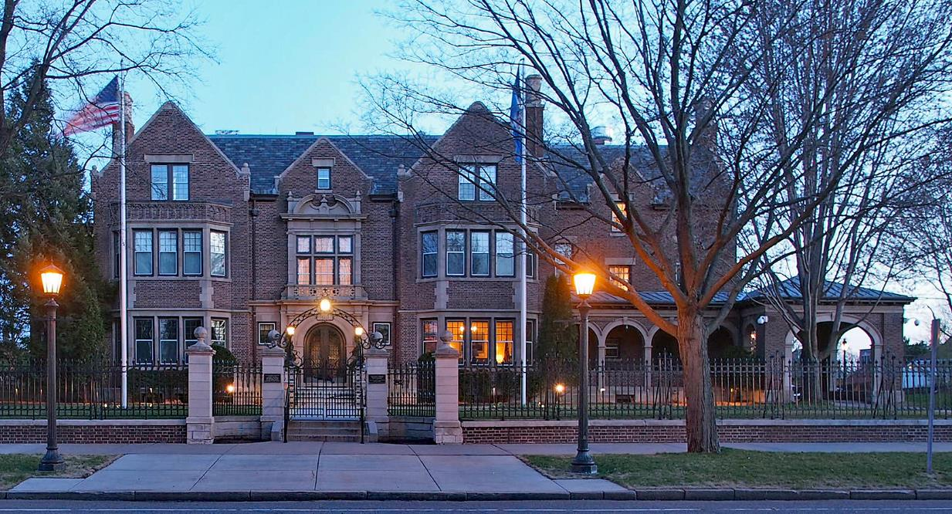
Notes:
…and is on a main avenue connecting the capitol with the governor’s residence – only a few miles away. The location of the History Center is key to understanding the events of and responses to the Summer 2020.

Slide 48
March, 2020
Notes:
On Friday, March 13 MN Governor Walz issued executive order 20-20 ordering non-essential Minnesotan’s to stay home due to the increasing COVID-19 cases. On Sunday, March 15. MNHS administration issued orders for staff to work from home. Over the next several weeks, MNHS administrators created and initiated a continuity of operations plan determining essential work and essential rolls. History Center access was restricted to a handful of staff. We are very fortunate that Collections management was determined to play an essential function in continuity of operations. We asked for continued building access and were allowed special permission to enter the building daily for collections inspection rounds.

Slide 49
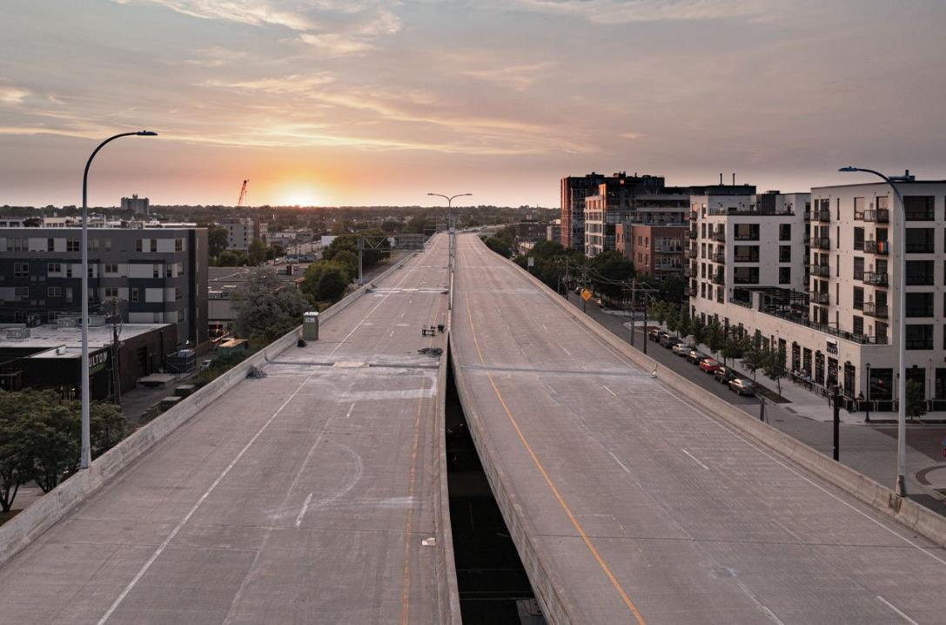
Notes:
And most everyone else worked from home.

Slide 50
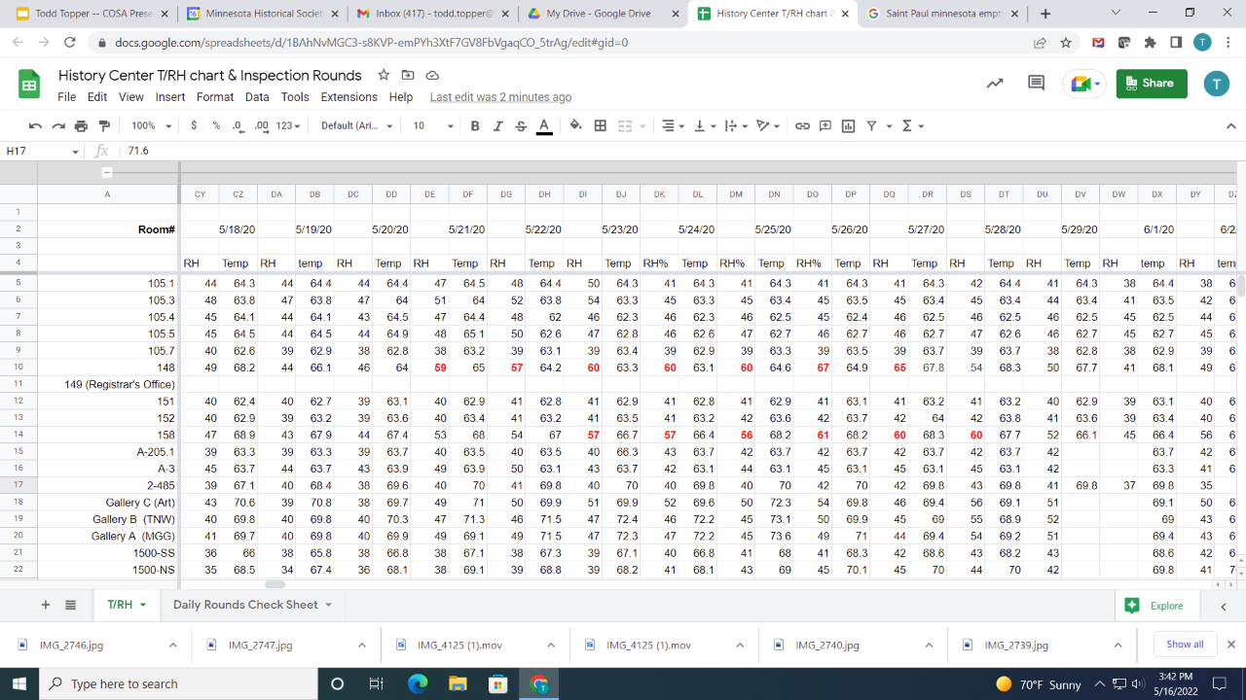
Notes:
For daily inspection rounds, Collections Management staff created a standardized list of all areas within the history center and off-site storage. We payed attention to room environment, security and systems anomalies (such as pipe leaks, smells, pests etc) We created this spreadsheet to record and track temperature, relative humidity and to note anything out of the ordinary. Notice the numbers in red indicating a troublesome trend in relative humidity. Daily Inspection rounds were rotated between staff every day including holidays.

Slide 51
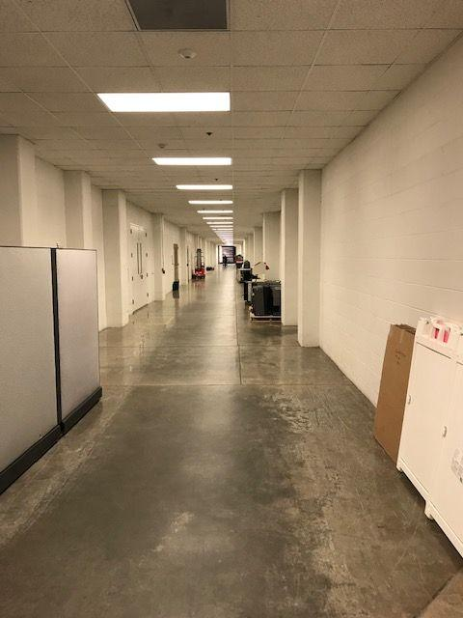
Notes:
This system of room inspections continued through March, April, and May with myself and the collections manager alone.. The state shut down created a fiscal emergency for the MN Historical Society. Of the approximately 700 employees on payroll, approximately 40 were determined “essential” to business continuity. The rest were furloughed on May16. Layoffs representing a 40% reduction in staff occurred in mid July. Events in the Twin Cities over the course of the Summer prompted administration to bring some staff out of furlough status and were allowed to enter the building. We added a collections associate to the building inspection rounds schedule.

Slide 53
Notes:
…400,000sqft of mostly empty building. Later there would be scores of contractors working on restrooms, doors, and outside projects

Slide 54
Notes:
From the Mixed-up Files of Mrs. Basil E. Frankweiler. Two runaways who hid out in the Metropolitan Museum of Art. If you read this book when you were a kid, you may understand how odd it was to be the only person in an enormous museum building.

Slide 55
Notes:
We would also inspect off site storage. A cavernous building in a sketchy neighborhood. We watched out for water leaks, pest activity, and vandals. Small roof leaks, trash dumping and tagging were problems at this site.

Slide 56
Notes:
We quickly learned that although History Center staff were required to telework, state facilities staff and contractors were still coming in. They were considered essential staff and continue their preventative maintenance and capital projects. There were many scheduled projects – such as the construction of two sets of rest rooms adjacent to exhibit galleries. There were also several ad hoc projects.

Slide 57
Notes:
For example the HVAC room behind this storage vault was scheduled to receive several pallets of special filter replacement right after the stay at home order. This was going to happen regardless of a collections, library, or archives staff presence.

Slide 58
Notes:
During our rounds, we discovered leaking pipes in our archives processing suite located directly below the cafe dishroom. This leak was found in June during one of our walk throughs. Four minor leaks in total were discovered that Summer and Fall.

Slide 59
Notes:
The pipe replacement project started with a leaking pipe and continues today as a nearly full system replacement in this area.

Slide 60
Notes:
Meanwhile…on Memorial Day George Floyd was murdered in South Minneapolis.

Slide 61
Notes:
Protests began the next day

Slide 62
Notes:
Three days later; protest turned to riot along a five mile stretch of Lake street and surrounding blocks. This scene is about seven miles from the History Center. We could smell the smoke of the burning buildings.

Slide 63
Notes:
Protest marches continued the rest of the Year from the state capitol, walking past the History Center…

Slide 64
Notes:
…and on to the governor’s residence

Slide 65
Notes:
In July, the Christopher Columbus statue on the front plaza of the capitol building was toppled as a symbol of colonization and indiginous suppression. There was at least one instance when on site History Center staff and contractors were asked to leave early due to potentially violent protests.

Slide 66
Notes:
Our objects conservator was brought back from furlough to consult on the various damaged monuments on the capitol complex.

Slide 67
Notes:
Fears of violent protest and vandalism based on what we saw locally and at institutions across the country prompted us to create an ad hoc artifact evacuation plan for the galleries. At the request of lenders, a few borrowed objects were removed from display and secured.

Slide 68
InI2020 Summarymmer In 2020Take Aways
The routine of daily inspections allowed us to notice patterns within…
the history center security presence
the history center facilities and maintenance staff
the homeless encampment presence…and random people
indoor temperature and relative humidity vs outdoor environment
locked and unlocked doors
sounds and smells
of pest activity (or its absence)
For example, drain fly issues in unused kitchen sinks
A drop in mouse activity
2) We created an “unexpected closure” section of the emergency preparedness and response plan.
3) We developed a closer working relationship with our facilities department.

Slide 69
Today
We are still adjusting to a hybrid work environment and staff reductions
The History Center is only open to in-person visits Thursday through Sunday
The Gale Research Library is only open Thursday through Saturday
Certain collections work is sidelined or distributed among remaining staff
The necessity for virtual communication continues
Hybrid work environment and COVID quarentining means fewer staff onsite to notice potential problems and monitor contractor activities
Routine collections area monitoring and communication continues on a reduced basis. This is the most meaningful, impactful, and long lasting change to come out of this pandemic and social upheaval period.

Slide 70
Questions and Comments

Slide 71
Upcoming CoSA-NARA Webinars
June 23 - Reparative Description at NARA and at the Alabama Department of History and the North Carolina State Archives
To register:
https://www.statearchivists.org/programs-education/cosa-webinars
Watch for an “In Conversation with…” on Reparative Description!

Slide 72
Upcoming SERI Webinars
June 7 - Focus Group: Automating Records Preservation in a Microsoft 365 World
June 22 - Archive/IT Coordination and Communication
To register:
https://us02web.zoom.us/meeting/register/tZYsde-qpjoqH9xwnKYrc7lJdTCcJOR2cn84

Slide 73
Contact Us
CoSA Website http://www.statearchivists.org
CoSA Resource Center https://www.statearchivists.org/research-resources/resource-center
CoSA Twitter Handle @StateArchivists
CoSA Facebook Page www.facebook.com/CouncilOfStateArchivists
CoSA You Tube https://www.youtube.com/user/StateArchivists/

Slide 74
Sponsors and Funders

Slide 75
Webinar Evaluation
We really do appreciate your feedback!
We hope you will take a few minutes to respond to the questions to help us plan future webinars!

