Slide 1
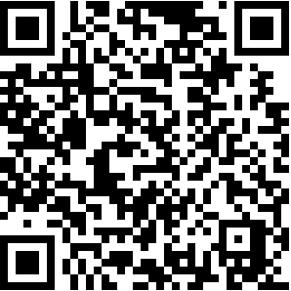
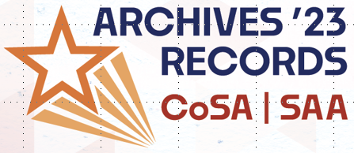
Please use this code to answer Survey Questions online OR manually below
Which organization are you a member of?
⃝ Society of American Archivists
⃝ Council of State Archivists
⃝ Both
⃝ Neither
Have you experienced or observed a lack of cultural competency in the archival workspace? (Can be past or present)
⃝ Yes
⃝ No
⃝ Unsure
Which are the three top challenges you’d like your archives to address?
⃝ Community Outreach (Communities can include agencies)
⃝ Recruitment and retention
⃝ Harmful content and reparative description
⃝ Increasing knowledge of records facilitating cultural viewpoints
⃝ Enhancing patron services (in-person or virtual)
⃝ Normalizing and adoption of cultural competency practices
⃝ Implementing work plans toward cultural competency
⃝ Recognition of diverse uses/users of records in light of restricted scope of collections.
Please use this code to answer Survey Questions online OR manually below
Which organization are you a member of?
⃝ Society of American Archivists
⃝ Council of State Archivists
⃝ Both
⃝ Neither
Have you experienced or observed a lack of cultural competency in the archival workspace? (Can be past or present)
⃝ Yes
⃝ No
⃝ Unsure
Which are the three top challenges you’d like your archives to address?
⃝ Community Outreach (Communities can include agencies)
⃝ Recruitment and retention
⃝ Harmful content and reparative description
⃝ Increasing knowledge of records facilitating cultural viewpoints
⃝ Enhancing patron services (in-person or virtual)
⃝ Normalizing and adoption of cultural competency practices
⃝ Implementing work plans toward cultural competency
⃝ Recognition of diverse uses/users of records in light of restricted scope of collections.

