Slide 1
CoSA Shop Talk Webinar
April 13, 2023
3 pm Eastern
Shop Talk with Ancestry –
Handwriting Recognition Technology: Now and the Future
Disclaimer: This webinar is being recorded and will be available for viewing on the CoSA website.

Slide 2
Webinar Agenda
Welcome
Presentation from Ancestry
Q and A
Announcements

Slide 4
Handwriting Recognition
Technology
Now, and Future

Slide 5
Agenda
AI and Machine Learning
Handwriting Recognition (HWR) Technology
HWR at Ancestry
Example Projects
What’s next?

Slide 6
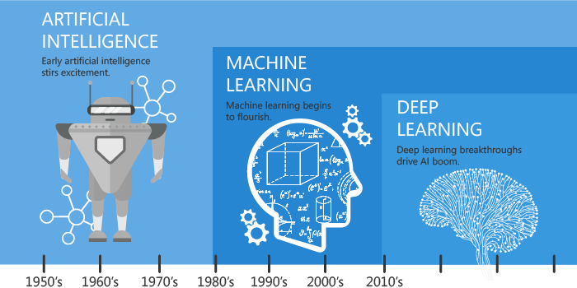
The AI Journey

Slide 7
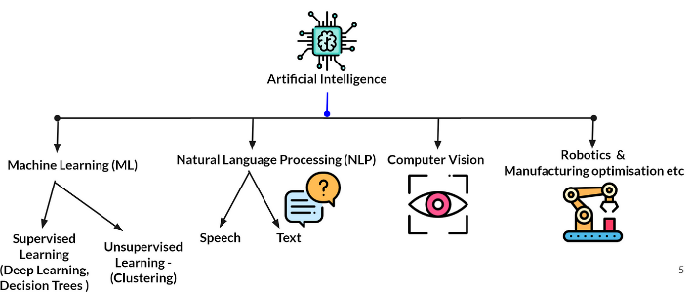
AI and Machine Learning Applications

Slide 8
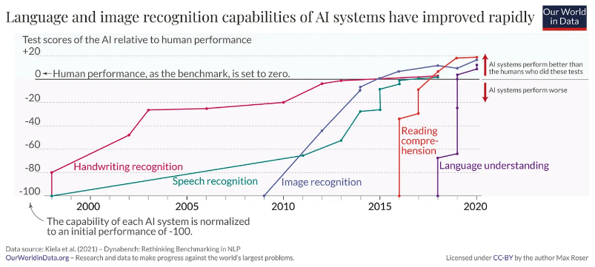

Slide 9
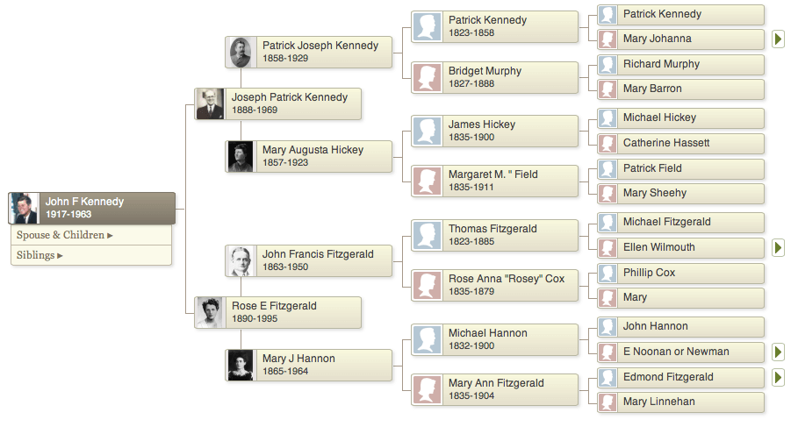
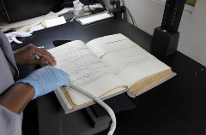
Ancestry Content Processing

Slide 10
BUILDING OUR OWN SOLUTION
Why?
Security
Scalability
Quality
Cost

Slide 11
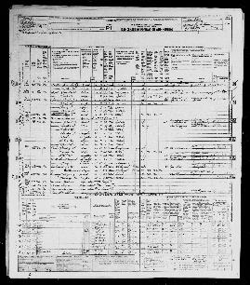
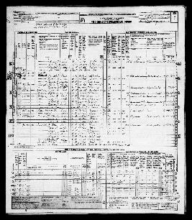
Variety of Form Types

Slide 12
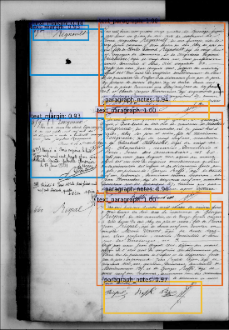
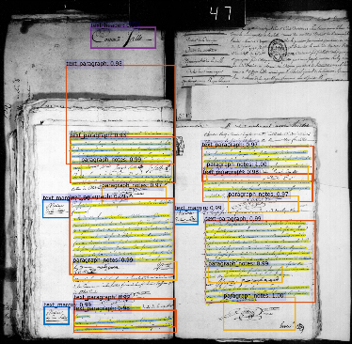
Variety of Form Types

Slide 13
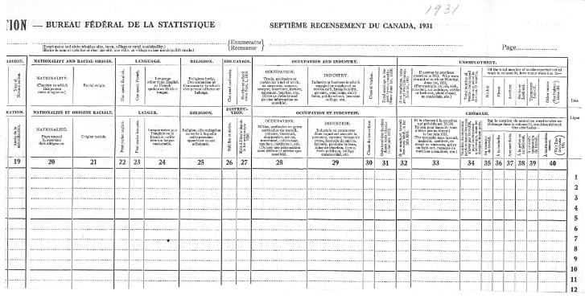
Variety of Form Types

Slide 14
Our Standard Process
1
2
3

Slide 15
1950 Census

Slide 16
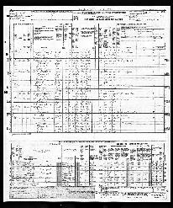
1950 Census Process
Layout
Transcription
---, Radia |daughter
---, Barbara |wife
1
2

Slide 17
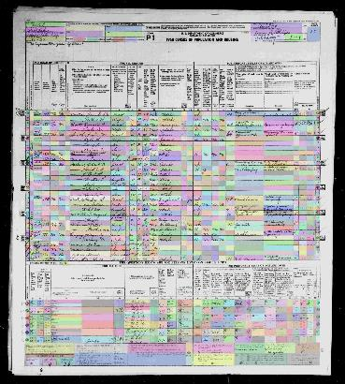
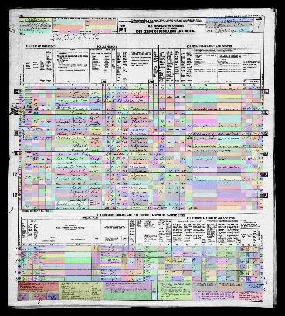

Slide 18
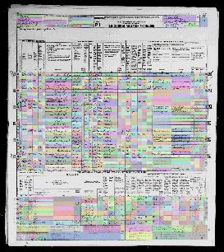
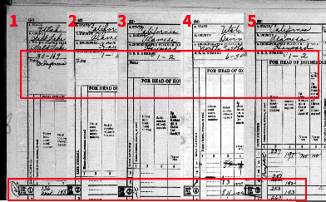
HANDWRITING RECOGNITION (HWR)
1950 census form types
Layout Detection
Notes:
1. Page segmentation – break up image and determine where fields are expected to be.
2. Define what is in each box or cell

Slide 19
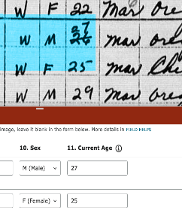
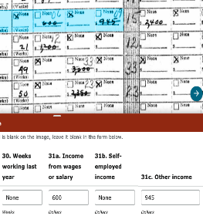
Transcription
4. Curate the Results
---, Radia |daughter
---, Barbara |wife
Notes:
3.

Slide 20
THE RESULTS
1940 US CENSUS | 1950 US CENSUS
132 million names 3,853,191 Images 6 months to create an Index | 151 million names 6,604,602 Images 9 Days to create a HWR Index
Quality & Cost
41 out of 77 fields published at a 95% or higher accuracy 2/3rd cost reduction
Notes:
Add image count perhaps???
Costs?

Slide 21
French BMD
&
Canadian Census

Slide 22
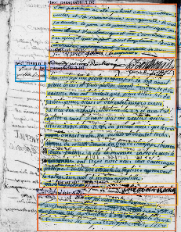
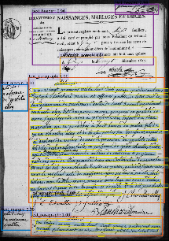
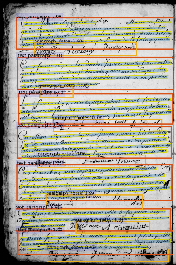
Variety of Form Types
Notes:
One call out no NLP

Slide 23
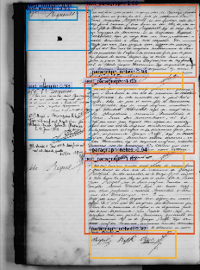
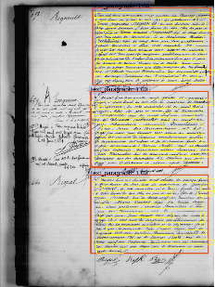
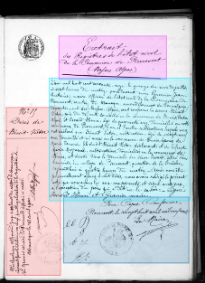
French BMD Steps
Paragraph Layout Model
Line Layout Model
French Transcription Model
L'an mil huit cent quatre vingt quatre, le vingt \\n Février, à dix heures du matin. Acte de naissance de \\n : : : Charles Charles Duguet, du sexe masculin, né le vingt \\n vingt trois février courant, à onze heures du matin, chez ses père et mère, fils de \\n Charles Duguet, âgé de vingt neuf ans, et de Marie \\n Lerosros, âgée de vingt trois ans, sans profession, mariés,
1
1.5
2
Transcribed text

Slide 24
French BMD Steps
French Transcription Model
Natural Language Processing (NLP Model)
3
L'an mil huit cent quatre vingt quatre, le vingt \\n Février, à dix heures du matin. Acte de naissance de \\n : : : Charles Charles Duguet, du sexe masculin, né le vingt \\n vingt trois février courant, à onze heures du matin, chez ses père et mère, fils de \\n Charles Duguet, âgé de vingt neuf ans, et de Marie \\n Lerosros, âgée de vingt trois ans, sans profession, mariés,
Transcribed text
2

Slide 25
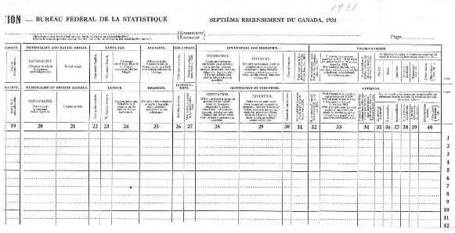
Canadian Census
1931 Canadian Census
Ancestry, Family Search & LAC 10.5 million names 234,678 Images Images released June 1, 2023
Notes:
Add image count perhaps???
Costs?

Slide 26
What’s Next?

Slide 27
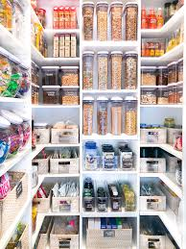
THE FUTURE
Creating different models for variety of document types
Plug & Play
Off the shelf solution that pulls different models for specific collections
A suite of content specific models

Slide 28
WHAT DOES THIS MEAN?
More Indexing
More Countries
More Record Types
More Discoveries
Less Time
Less Expense
Notes:
-We are now working on French Census with HWR
-Years of work ahead to create models that work for more records types and collections
-We are on a path. We’ve cracked the census,

Slide 29
Building new Models
French BMD/Census
US BMD
UK Parish
Canadian Census
Korean War Draft
NYC Voters List
Belgium BMD
Spain BMD
Portugal BMD
…
Data Prep
for Labeling
Data Labeling
Model Development
many
iterations
(10’s)
Model Deployment
Content QA
Code Base
Update
DS Model QA
Completed Models are added to store for future reuse by other collections
2023 Models*
French Transcription
NLP Entity Detection (BMD)
Layout (Grid)
Model Store
Paragraph Layout
NLP Entity Detection (Dates)
SuperFormat
Field Componentization
AutoQA
MCM Model
MCM Model
Parish Layout
Paragraph Transcription
*25 generic models available by early 2025 to be used by content team

Slide 30
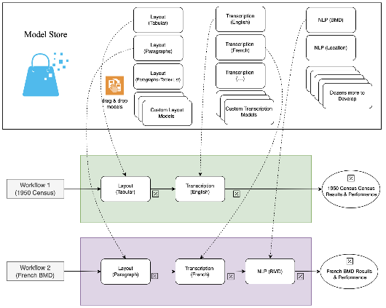
Plug and Play Platform

Slide 31
Thank you!

Slide 32
Questions?

Slide 33
Upcoming Webinars
April 27, 3 pm eastern - Building and Remodeling Archives Part 1: Planning Your Project
June 22,3 pm eastern – Building and Remodeling Archives Part 2: Construction and Lessons Learned
For registration information
https://www.youtube.com/watch?v=u-trGs_1Gmo&list=PLospvJp0HcS88SS48w-4ruZwZNVdh7b5_&index=2

Slide 34
Upcoming SERI Webinars
April 18, 2 pm eastern – Mutual Assured “Protection” (MAP): Records Management’s Role in Litigation Holds
For registration information: https://www.statearchivists.org/electronic-records/state-electronic-records-initiative/seri-webinars

Slide 35
Contact Us
CoSA Website http://www.statearchivists.org
CoSA Resource Center https://www.statearchivists.org/research-resources/resource-center
CoSA Twitter Handle @StateArchivists
CoSA Facebook Page www.facebook.com/CouncilOfStateArchivists
CoSA You Tube https://www.youtube.com/user/StateArchivists/

Slide 36
Webinar Evaluation
We really do appreciate your feedback!
When you exit the webinar, you will automatically be taken to an online webinar evaluation. Please take a couple minutes to complete the survey and help us plan future webinars.

