Slide 1
CoSA Shop Talk Webinar
November 10, 2022
3 pm Eastern
Shop Talk with Preservica –
Continuing the Conversation: Modeling Public Sector Records-to-Archives Transfers
Disclaimer: This webinar is being recorded and will be available for viewing on the CoSA website.

Slide 2
Webinar Agenda
Welcome
Presentations from Preservica
Q and A
Announcements

Slide 3
Continuing the Conversation: Modeling Public Sector Records-to-Archives Transfers
November 10, 2022
Notes:
Shop Talk Continuing the Conversation: Modeling Public Sector Records-to-Archives Transfers
November 10, 2022
Join Preservica and the CoSA community for a Shop Talk listening session on November 10th to explore requirements, workflows, tools, and strategies for simplifying and improving the efficacy of transferring archival electronic records from state and local government agencies to archives. This interactive session will offer opportunities for public sector practitioners to articulate preservation requirements for long-term and permanent electronic government records as well as describe pain points in current agency-to-archives transfer processes. Polls and surveys will be used to develop a community “wish list” of flexible, practicable packaging, validation and transfer tools for commonly used enterprise or government-wide systems that hold archival records. The wish list will be shared with Shop Talk registrants.
Following on from the joint summer focus group session and associated report (LINK TO REPORT: Preservica-CoSA-Automating-Preservation-in-M365_final.pdf (assets-servd.host)), Preservica will provide updates on its design and development efforts to integrate in-place digital preservation and archiving actions in the Microsoft 365 ecosystem. Preservica will also share highlights from a recent ‘transfer-to-archives’ focus group session held with UK-based archives managers.

Slide 4
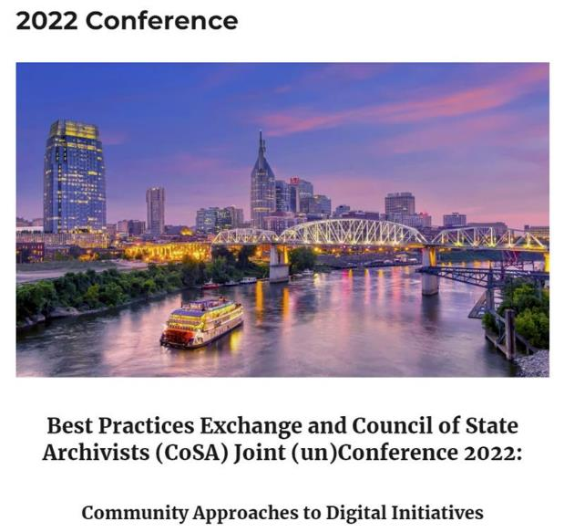

Slide 5
Introducing today's facilitators
Michael Hope
Preservica VP Marketing
Lori Ashley
Tournesol Consulting Principal Consultant
Halley Grogan
Preservica
Digital Archiving Success Manager

Slide 6
Agenda
Welcome and introductions
Session format and objectives
Focus Group highlights
Preservica transfer options and strategies
Transfer requirements ideation
Wrap-up & Preserve365 Early Access Group invitation

Slide 7
Leaders in Active Digital Preservation™ archiving for compliance and long-term value protection
500M+
Assets
protected
1,094
Formats
preserved
3,000+
Organizations
worldwide
ISO 9001
ISO 27001
ISO 14721
SOC 2 Type II
Instant access to records you can trust and read over decades – no matter what format they were created in.
Notes:
4 of the 10 Top UK largest businesses
26 US State Archives
16 national and pan-national archives and libraries
Including: NAME DROP

Slide 8
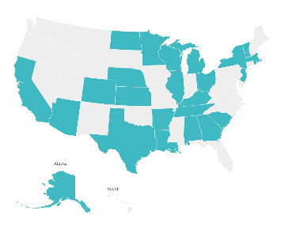
Trusted by US government institutions
26 State Archives
County customers
City & town customers
Notes:
UK:
17 Local authorities
4 Central gov depts
NL:
1 National archive
5 regional archives

Slide 9
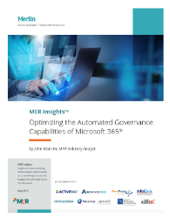
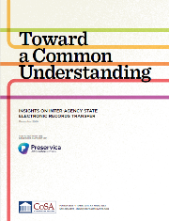
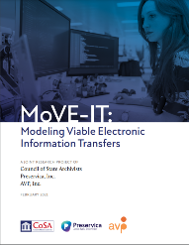
Active collaboration with records management and archives communities
Strategic relationships
Electronic records projects & surveys
Education, engagement, & research on long-term and permanent digital records

Slide 10
Session Format and Objectives
Rekindle the conversation about preservation requirements for long-term and permanent electronic government records
Describe current transfer options and share an update on in-place digital preservation and archiving actions in the Microsoft 365 ecosystem
Brainstorm workflows, tools, and strategies for simplifying and improving the efficacy of transferring archival electronic records from state and local government agencies to archives

Slide 11
Poll Question
Does your Archives currently accession permanent electronic government records?
Yes
No
I Don’t Know

Slide 12
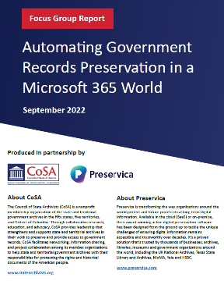
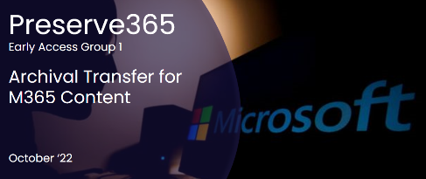
Focus Group highlights
M365 adoption and maturity in the public sector
Archives and records management priorities
In-place preservation during records lifecycle
Metadata management issues during transfer
Accessioning from SharePoint
Notes:
Summary of lessons learned from MoVE-IT report – Producer-Archive Transfer Requirements lists was blatantly copied from this MoVE-IT CoSA powerpoint - seri_webinar_8-25-2020_MoVEIT.pptx (live.com)
HG: "This is a familiar process for most archivists – how are records/papers/manuscripts, etc. getting into your collection? The specific steps may vary depending on the type of archives. Today we're focusing on state and territory archives which have particular procedures. This is a very simplified list of those procedures. And I think it's important to start here because with born digital records, the question is how technology can support the traditional transfer to the archives. Technology is essential when working with born digital records but without the internal procedures created by an archives and the relationships the archives has built with agency staff, technology can only do so much."

Slide 13
Preservica support for streamlining archival transfers
Get started quickly
Lower volume | Manual
Operate at scale
Higher volume | Automated
Agencies transfer via browser drag & drop - NEW
Archives / IT cloud transfer content in bulk
Archives drag & drop directly to archive
Archives set & forget bulk ingest workflows

Slide 14
NEW: Invite and manage transfers
Notes:
External Submissions screenshots?
HG: "A new feature from Preservica is our External Submissions – MORE STANDARD TEXT ABOUT THIS FEATURE HERE. To me, the external submissions feature replaces the email that you receive with minutes or agendas as attachments. Instead, the RMO or record creator can submit the minutes and agendas directly via the external submission link. The back and forth via email discussing a transfer is very typical and what a benefit to end that interaction with a link and request for submission? I have ideas of how this feature can support documenting transfers but I'm also really interested in your ideas about how this could be used to support archival transfers. I see lots of scenarios but please add your specific use cases. "

Slide 15
Preservica support for streamlining archival transfers
Get started quickly
Lower volume | Manual
Operate at scale
Higher volume | Automated
Preserve365
Preserve365
Agencies or Archives transfer using SharePoint
Agencies upload or move records to folder
Agencies/Archives use Microsoft Purview labels to automatically preserve long-term records and/or transfer records deemed archival

Slide 16
Automate records retention, preservation and transfer at scale
Manually preserve records from within M365
Use Purview records life-cycle management
Records Producing Agency
Search and retrieve using M365
One solution for SharePoint, Teams, OneDrive & Exchange
Select pre-defined retention labels
legacy records
Preserve365
embedded Active Digital Preservation archiving
Archives
Records automatically maintained in preferred/supported preservation formats
Upload, transfer and curate records in Archive
automated file format recycling
Embedded within Microsoft 365

Slide 17
The Same But Different
Requirements and techniques for preserving the authenticity and trustworthiness of long-term or indefinite temporary electronic records are identical to those for permanent records. Essential differences involve legal custody and access: Temporary records remain under the legal custody of the originating business entity and this same entity controls access In an archive the institution has legal custody of the records and controls assess in accordance with established rights and permissions Transfer of ownership and access rights occurs when electronic records in a logical temporary records repository are transferred to the logical permanent records repository

Slide 18
Records Retention Re-imagined

Slide 19
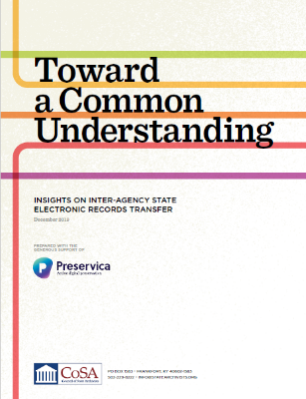
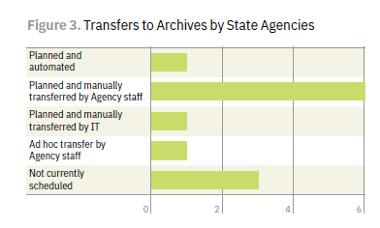
Inter-agency Records Transfer circa 2018-19
Records Eligibility
Transfer Requirements
Preservation Planning
Systems of Record

Slide 20
Poll Question
Which are pain points and obstacles in the current producer-to-archives transfers? Select all that apply.
Lack of sufficient producer records resources and expertise to initiate and/or manage transfers
Lack of in-depth knowledge about where and how producers are managing records
Lack of adequate metadata requires significant arrangement and description effort before transfer
Difficulty extracting records from proprietary third-party managed platforms

Slide 21
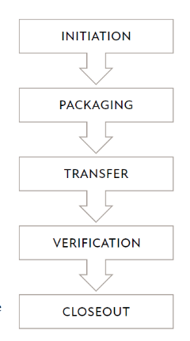
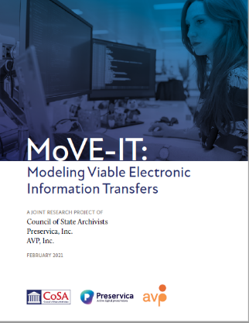
Successful Records Transfer
Collaborative relationships
Shared goals and a common understanding of electronic records management and preservation requirements
Knowledge of technological context
Flexible workflows

Slide 22
Transfer Stakeholders
Records Creators & Owners
Information Technology
Archives
State Agencies that produce electronic state government records appraised for permanent preservation and have an obligation to transfer the records to the Archives.
Internal agency, central state IT, or third-party IT support units that manage records or storage systems used by Agencies and/or the communications systems used during interagency records transfers.
State Agency with mandate to appraise, describe, ingest, preserve and make accessible permanent archival state government records.
MoVE-IT data collection inquired about three major groups of staff roles
Communications/Administration
Technicians
Authorizers

Slide 23
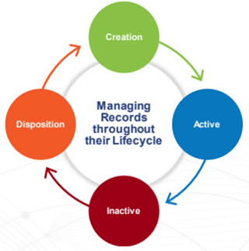
Ideation
Tools and processes to survey, inventory and classify records “in place” to determine their organization, metadata elements, and requirements
Simple, flexible tools for archivists to use for a variety of transfer situations
Mechanisms to verify transfer and streamline coordination with stakeholders

Slide 24
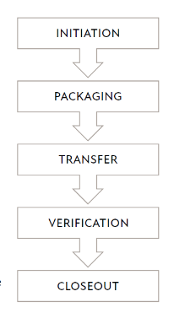
Transfer Options and Strategies
Stakeholder in the transfer process initiates a transfer
Eligible records are selected and organized into a transfer package
Physical exchange of custody of the transfer package
Verification mechanisms used to confirm authenticity and integrity
Stakeholder sign off on the legal and intellectual transfer
MoVE-IT Transfer Model
Notes:
Summary of lessons learned from MoVE-IT report – Producer-Archive Transfer Requirements lists was blatantly copied from this MoVE-IT CoSA powerpoint - seri_webinar_8-25-2020_MoVEIT.pptx (live.com)
HG: "This is a familiar process for most archivists – how are records/papers/manuscripts, etc. getting into your collection? The specific steps may vary depending on the type of archives. Today we're focusing on state and territory archives which have particular procedures. This is a very simplified list of those procedures. And I think it's important to start here because with born digital records, the question is how technology can support the traditional transfer to the archives. Technology is essential when working with born digital records but without the internal procedures created by an archives and the relationships the archives has built with agency staff, technology can only do so much."

Slide 25
IDEA BOARD PLACEHOLDER
Initiation & Packaging
Transfer
Verification & Closeout

Slide 26
Thank you!

Slide 27
Join our early access group and learn more about Preserve365
Build your M365 and records preservation expertise
Collaborate with like-minded organizations
Keep up to date with the latest innovations
Get hands-on: be part of our Preserve365 product trial
Scan to Sign Up
Notes:
Continue the conversation
https://preservica.com/the-embedded-archive-that-automatically-keeps-long-term-information-alive

Slide 28
Upcoming Webinars
November - “In Conversation With...“ Hilda T. Ayala-Gonzalez Discusses the Archives of Puerto Rico
For registration information
https://www.youtube.com/watch?v=u-trGs_1Gmo&list=PLospvJp0HcS88SS48w-4ruZwZNVdh7b5_&index=2

Slide 29
Upcoming SERI Webinars
Watch for upcoming schedule in 2023
For registration information: https://www.statearchivists.org/electronic-records/state-electronic-records-initiative/seri-webinars

Slide 30
Contact Us
CoSA Website http://www.statearchivists.org
CoSA Resource Center https://www.statearchivists.org/research-resources/resource-center
CoSA Twitter Handle @StateArchivists
CoSA Facebook Page www.facebook.com/CouncilOfStateArchivists
CoSA You Tube https://www.youtube.com/user/StateArchivists/

Slide 31
Webinar Evaluation
We really do appreciate your feedback!
When you exit the webinar, you will automatically be taken to an online webinar evaluation. Please take a couple minutes to complete the survey and help us plan future webinars.

