Slide 1
CoSA Member Webinar Keeping Confidences: Health Records Windfalls and Pitfalls
February 22, 2024
3 pm Eastern
Disclaimer: This webinar is being recorded and will be available for viewing on the CoSA website.

Slide 2
Webinar Agenda
Welcome and Overview
Presentations
Q and A

Slide 3
Speakers
David Ware, State Historian, Director of Arkansas State Archives
Chuck Hardin, Attorney and Privacy Officer, Arkansas Department of Health
Allen Ramsey, Asst. State Archivist, Connecticut State Library

Slide 4
Retrieving records from the Booneville San, 2020-2023
A co-adventure of the Arkansas State Archives
and the Arkansas Department of Health

Slide 5
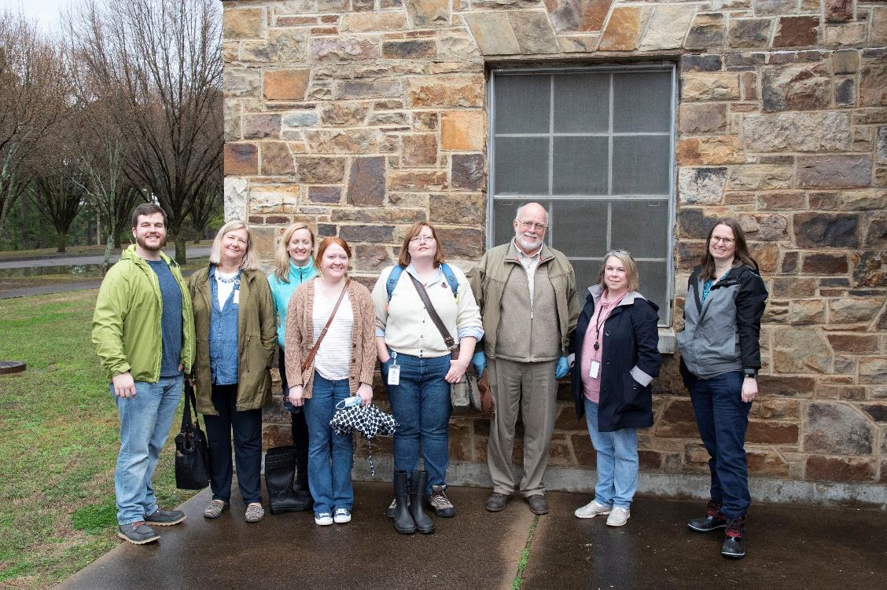
Initial visit, February 23 2020

Slide 6
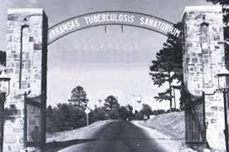
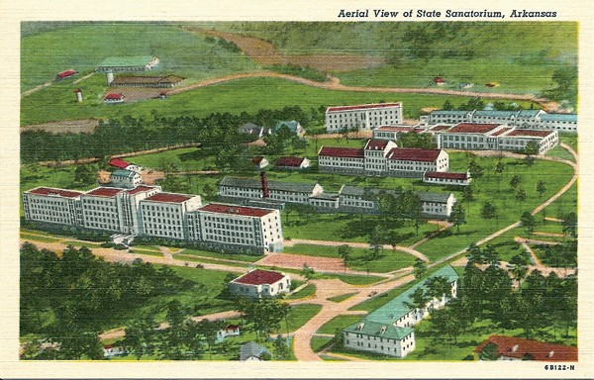
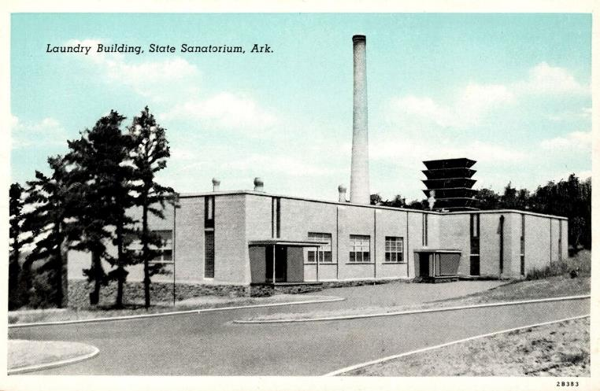

Slide 7
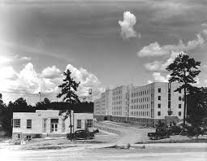

Slide 8
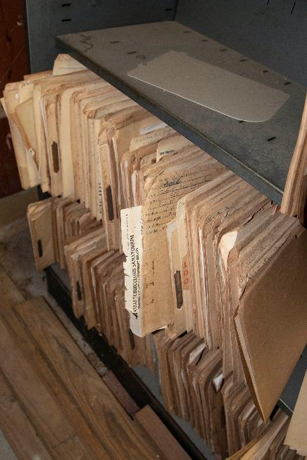
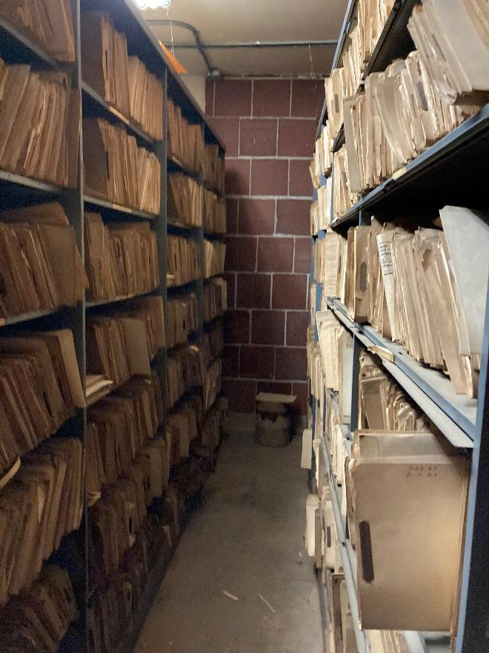
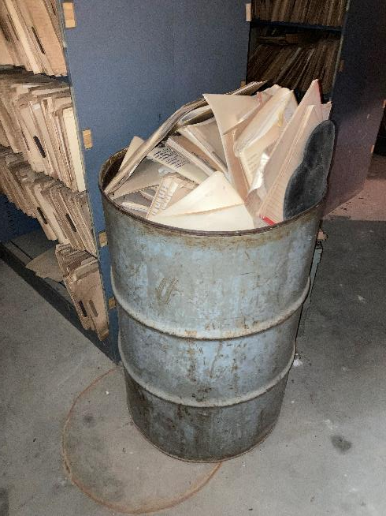

Slide 9
March 2023:
The adventure begins.

Slide 10
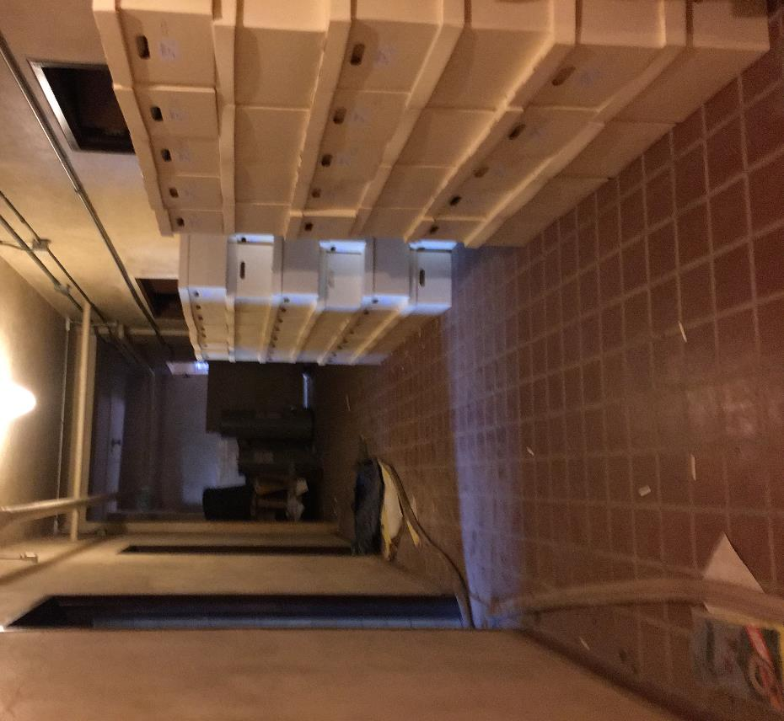

Slide 11
Countryside Inn of Booneville:
a must – see – to - believe.

Slide 12
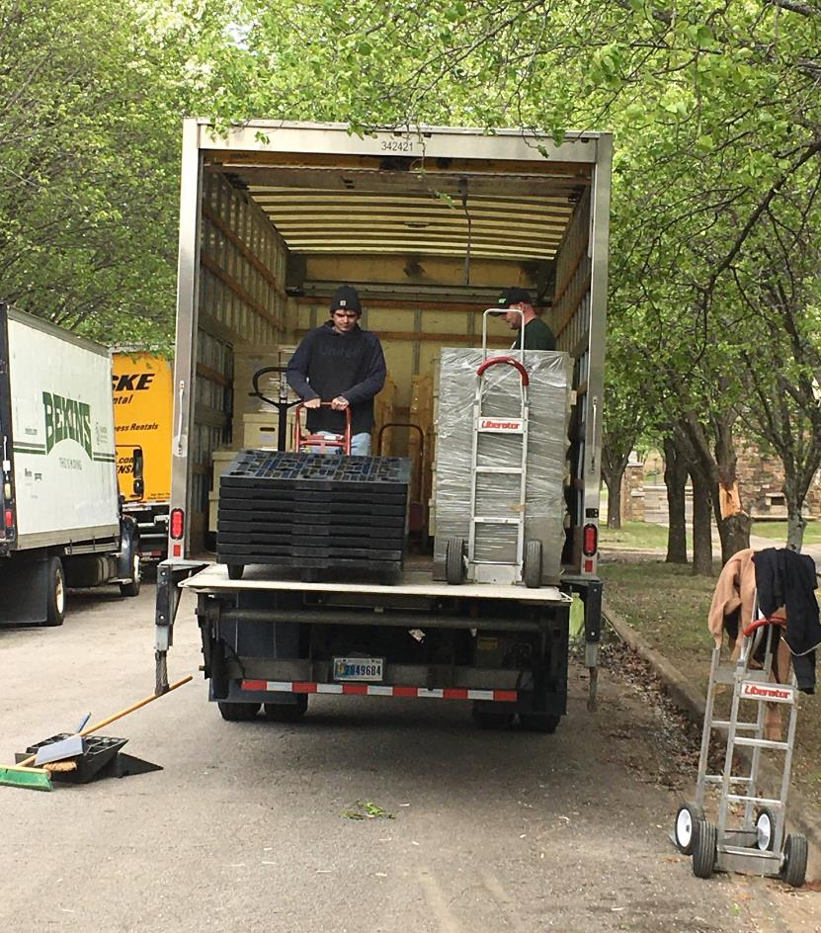
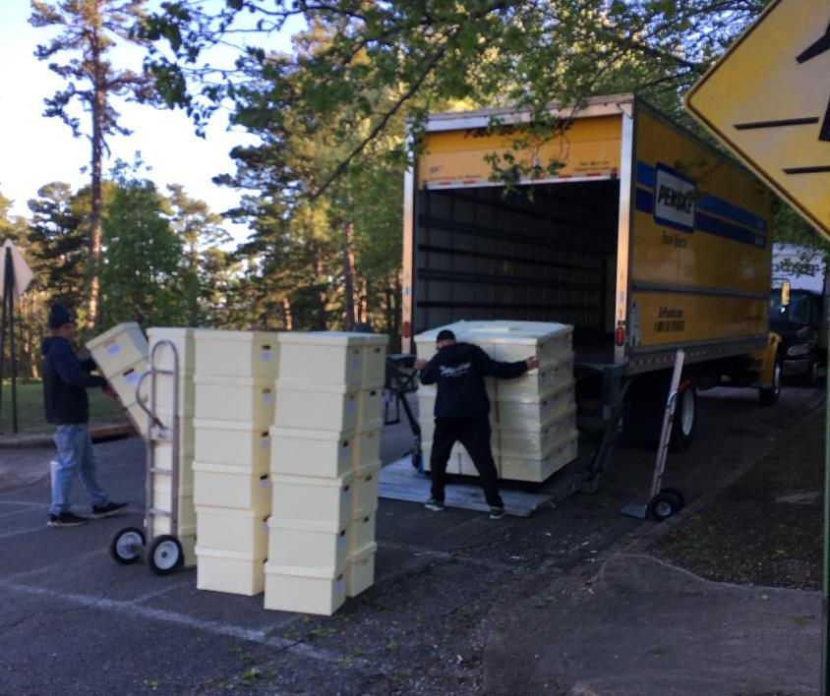
Removals by Larry, Daryl and his other brother Darrell: Three trucks, three guys, two liftgates, brought one dolly. Sigh.

Slide 13
How HIPPA HIPPO HIPAA actually applies
Chuck Hardin
Arkansas department of Health HIPAA Privacy Officer

Slide 14
The Fine Print Right Up Front
HIPAA is the privacy and security floor for medical records
Your state law may address specific situations where HIPAA is silent or requires less protections

Slide 15
Does HIPAA apply?
Two things dictate whether health information is covered under HIPAA
Who created/holds the record
Why was the record created
HIPAA applies to Covered Entities (Health care providers, health plans, health care clearinghouses) and those they contract with, Business Associates.
Protected Health Information is created by a covered entity and relates to the past, present, or future physical or mental health or condition of an individual; the provision of health care to an individual; or the past, present, or future payment for the provision of health care to an individual.

Slide 16
Other notable exceptions
Medical records when the patient has been deceased 50 years.
De-identified records
Court orders
Public health

Slide 17
Booneville from my perspective
We have no state laws specific to the situation
How I got here - timing was everything
Hospital closed in ’73, HIPAA was enacted in ‘96 why does it apply?
Has any Privacy Officer every dealt with this?
Creates a unique relationship with the Archives under HIPAA

Slide 18
Connecticut Historical Patient Records: Privacy versus Access
Allen Ramsey, Assistant State Archivist
February 22, 2024

Slide 19
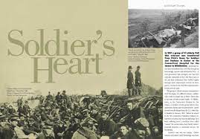
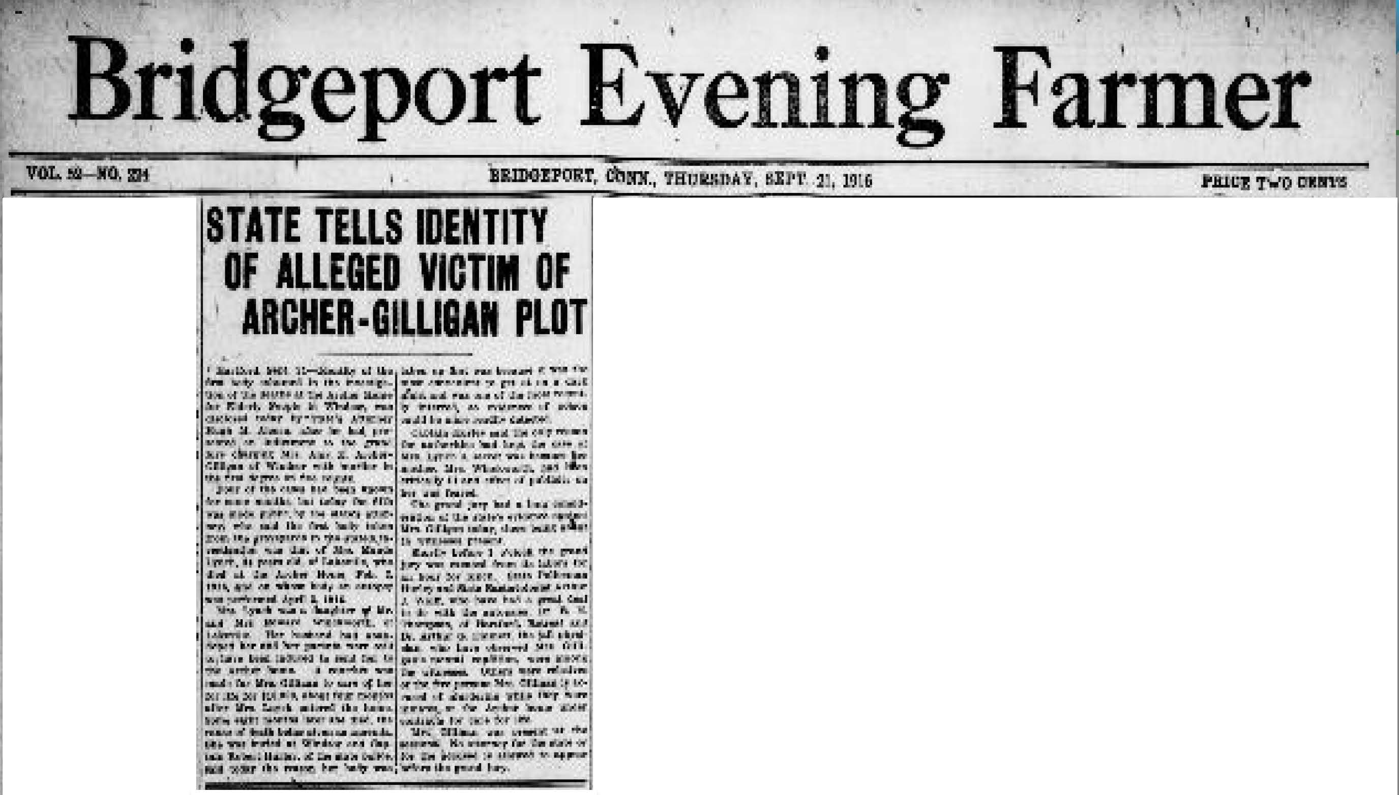
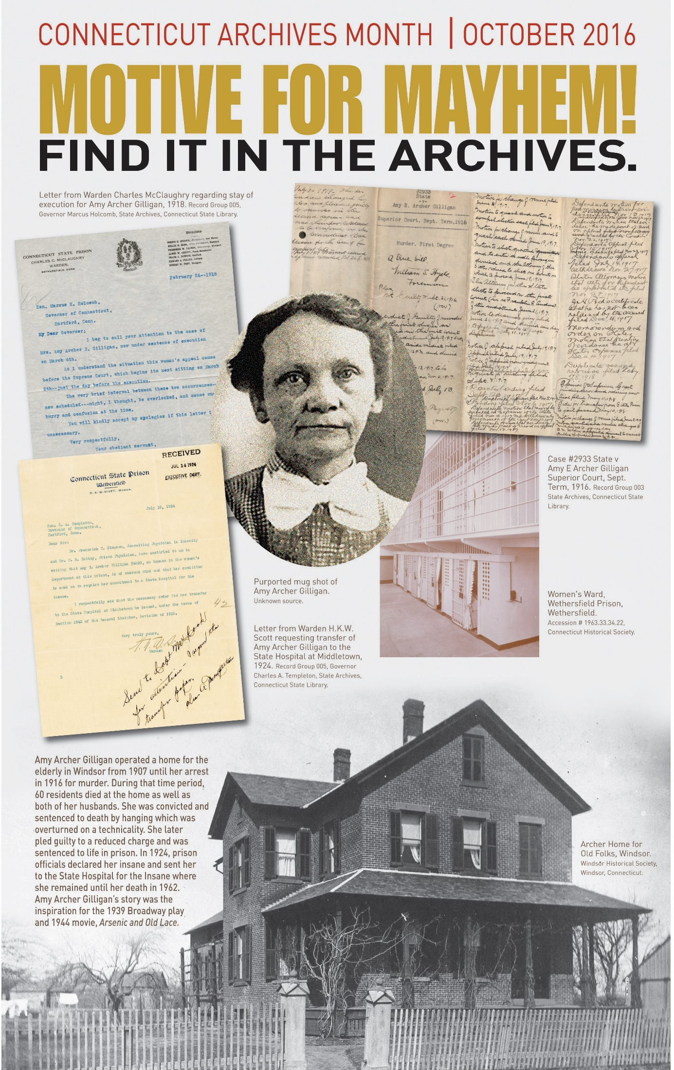
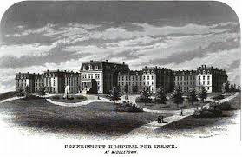
Historical Patient Records
Civil War Veterans
Infamous Serial Murder Case

Slide 20
Exemption Statutes
CGS§1-210. Access to public records. Exempt records.
(b) Nothing in the Freedom of Information Act shall be construed to require disclosure of:
(2) Personnel or medical files and similar files the disclosure of which would constitute an invasion of personal privacy.
(10) … communications privileged by the attorney-client relationship. [marital relationship, clergy-penitent relationship, doctor-patient relationship, therapist-patient relationship or any other privilege established by the common law or the general statutes, including any such records, tax returns, reports or communications that were created or made prior to the establishment of the applicable privilege under the common law or the general statutes - P.A. 11-242 emphasis added]
CGS§ 52-146e. Privileged communications between psychiatric mental health provider and patient. Definitions.
(2) … means all oral and written communications and records … relating to diagnosis or treatment of a patient's mental condition between the patient and a psychiatric mental health provider, or … a member of the patient's family and a psychiatric mental health provider, or … any of such persons and a person participating under the supervision of a psychiatric mental health provider … , wherever made … ;

Slide 21
Attempts at Legislation
2010-2011: Connecticut State Historical Records Advisory Board (CT SHRAB) formed Access Advisory Committee
2014: HB 5124 “An Act Concerning the Preservation of Historical Records and Access to Restricted Records in the State Archives”
2016: HB 5499 “An Act Concerning the Preservation of Historical Records and Access to Restricted Records in the State Archives”
2017: HB 5735 “An Act Concerning Access to Public Records in the State Archives”
2019: HB 7211 “An Act Concerning the Preservation of Historical Records and Access to Restricted Records in the State Archives”

Slide 22
Questions and Comments

Slide 23
Upcoming Member Webinars
March 28, 3pm – Hiring at the Archives: Part 1 – Attracting applicants
April 25, 3 pm – Hiring at the Archives: Part 2 – What an applicant needs to know
May 23, 3 pm – Christmas Leak at the Colorado State Archives
For Member webinars:
https://www.statearchivists.org/programs-education/cosa-webinars

Slide 24
Upcoming SERI Webinars
Watch for their spring schedule!
For SERI webinars:
https://www.statearchivists.org/events/event-description?CalendarEventKey=a0df8f77-af44-4ffb-9638-0187521a5374&Home=%2fevents%2fmanage-events

Slide 25
Contact Us
CoSA Website http://www.statearchivists.org
CoSA Resource Center https://www.statearchivists.org/research-resources/resource-center
CoSA Twitter Handle @StateArchivists
CoSA Facebook Page www.facebook.com/CouncilOfStateArchivists
CoSA You Tube https://www.youtube.com/user/StateArchivists/

Slide 26
Funders

Slide 27
Sponsors

Slide 28
Webinar Evaluation
We really do appreciate your feedback!
Please take a moment and respond to the evaluation following this webinar.

