Slide 1
CoSA Member Webinar State Archives Showcase: New Jersey and New York
October 27, 2022
3 pm Eastern
Disclaimer: This webinar is being recorded and will be available for viewing on the CoSA website.

Slide 2
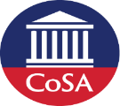
Webinar Agenda
Welcome and Overview
Presentation:
New Jersey State Archives
New York State Archives
Q and A
Upcoming Programs and Webinars

Slide 3
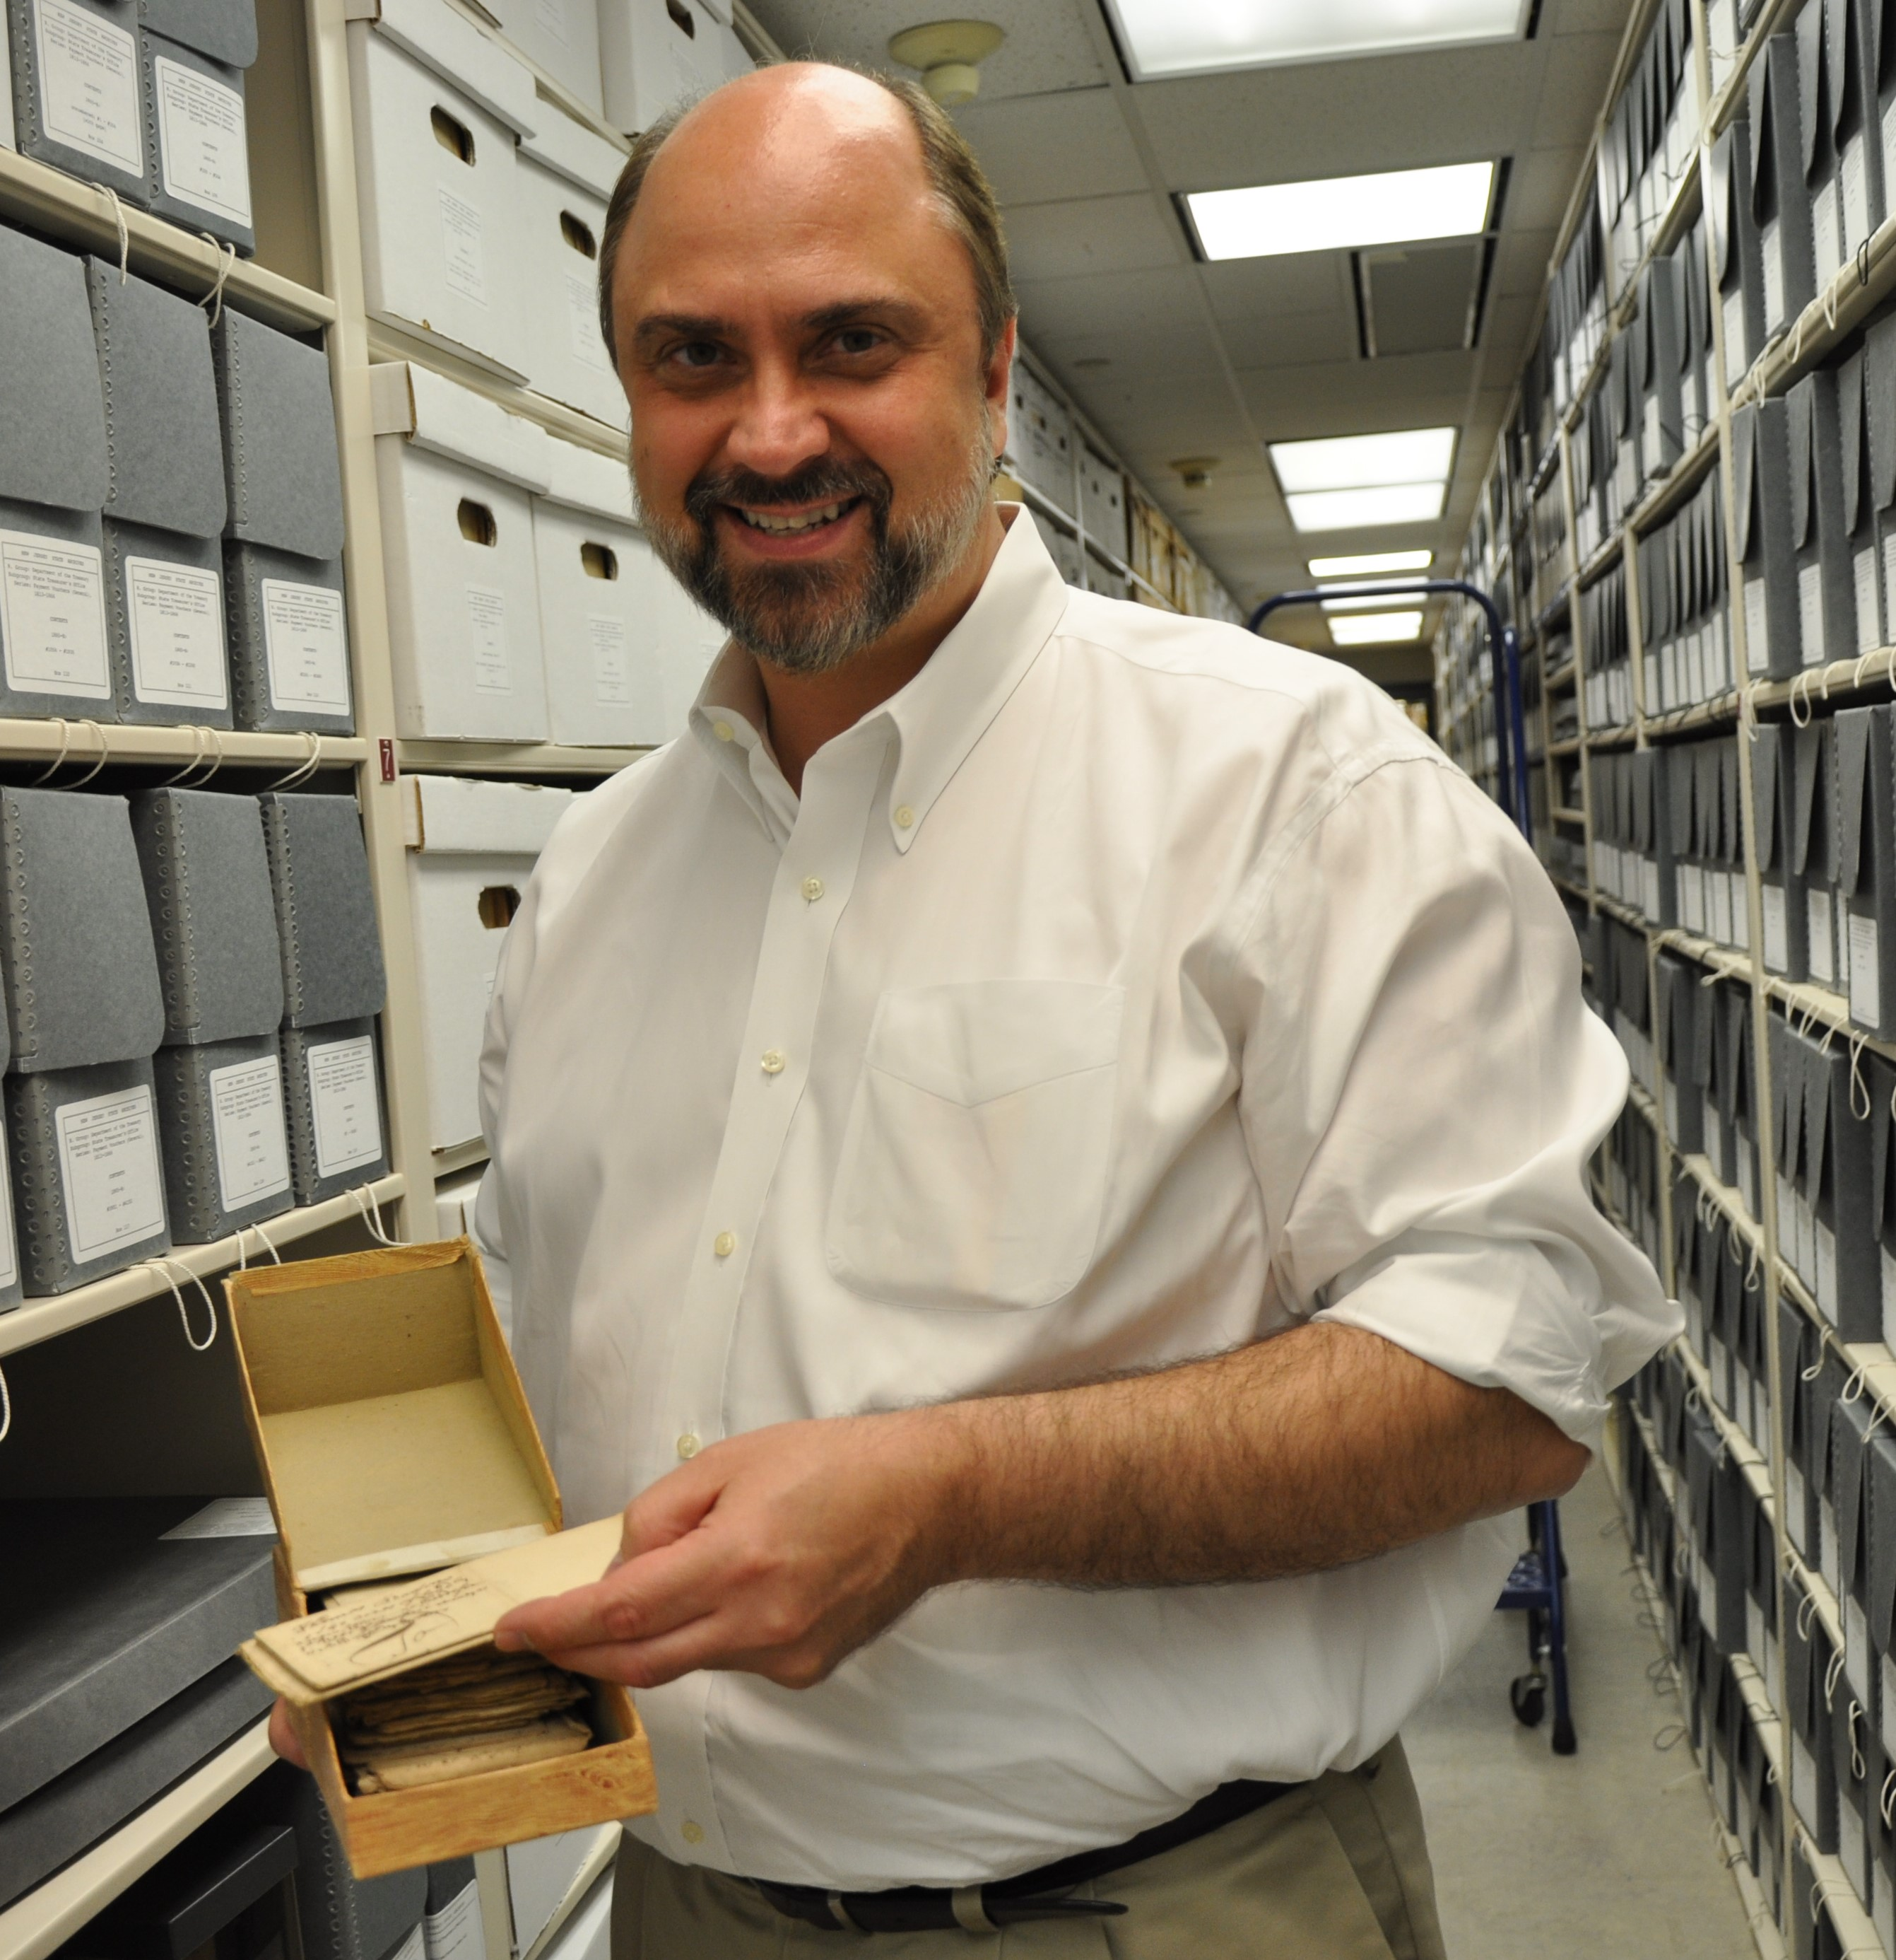
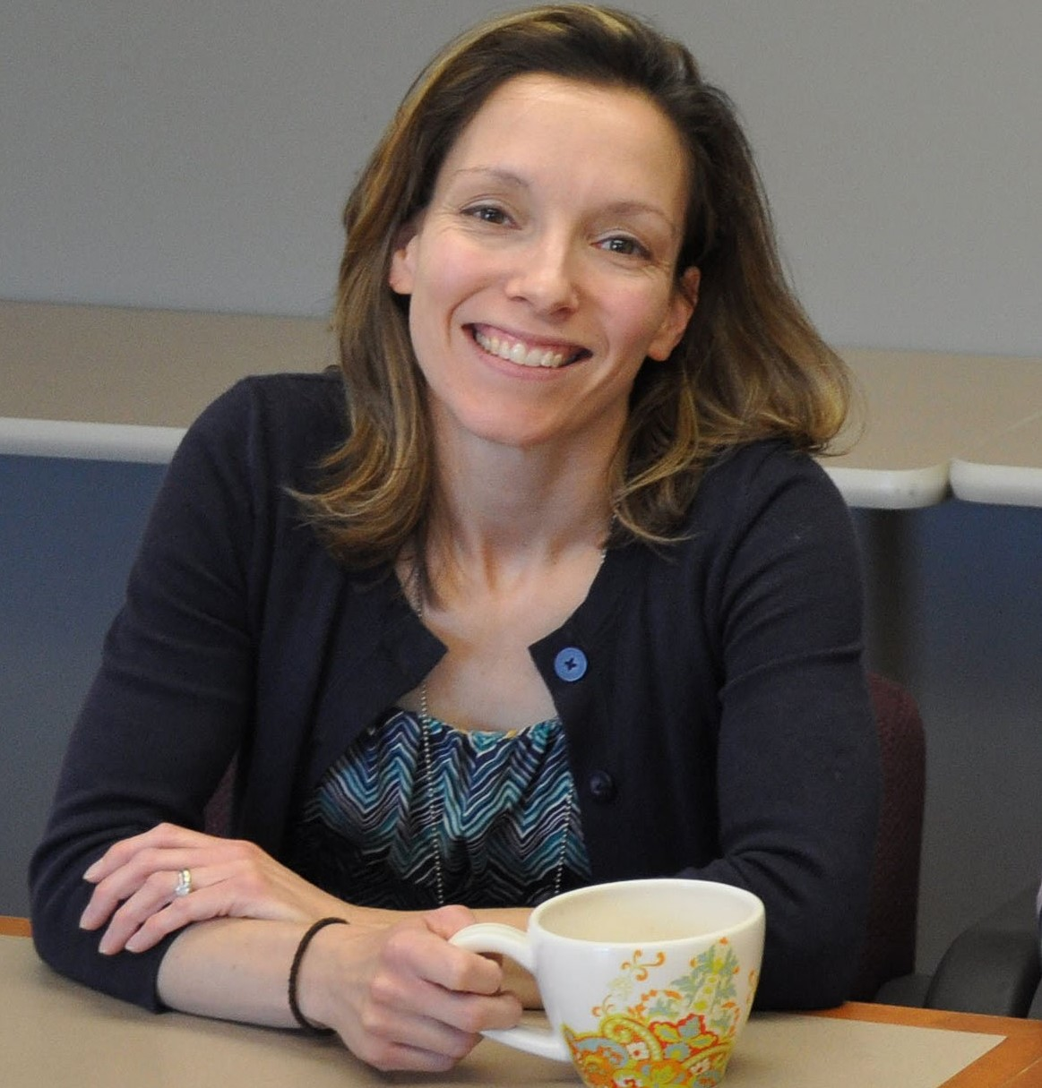
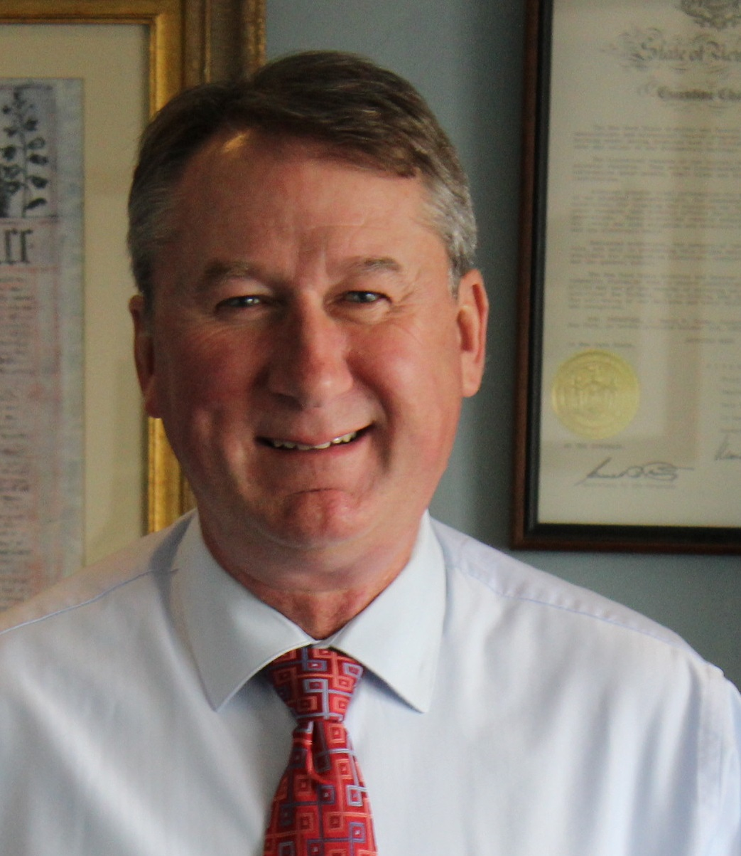
Speakers
Joseph Klett
State Archivist
New Jersey State Archives
Veronica Calder
Archivist
New Jersey State Archives
Tom Ruller
State Archivist
New York State Archives

Slide 4
New Jersey State Archives
COSA spotlight

Slide 5
NJSA Mission
"New Jersey State Archives (NJSA) has statutory responsibility for the management and preservation of public records of enduring historical value. This includes records in all formats, either designated as permanent by law/regulation or deemed historically, significant through appraisal (“archival review”). This includes paper records, microfilm and other physical media, and electronic files. The State Archives’ mission is tied, historically, to the records-filing functions of the Secretary of State’s Office."

Slide 6
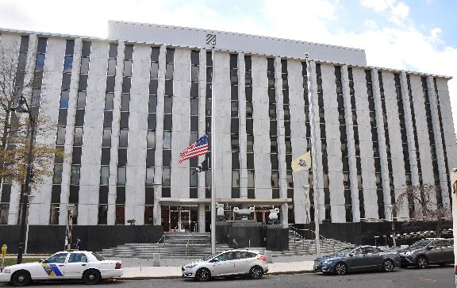
Where are we?
Located at 225 West State Street

Slide 7
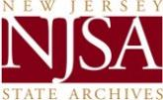
Where are we in State Government?
Organizationally, the State Archives is successor to the former New Jersey Public Records Office and the State Library’s Bureau of Archives and History. The services and holdings of these agencies were vested in the Division of Archives and Records Management (DARM), created in the Department of State by an executive reorganization plan in 1983. By MOU between the departments of State and Treasury, DARM’s records management, records storage and micrographics functions were assigned to the management of the Division of Revenue and Enterprise Services (DORES) in the Department of the Treasury effective 1 July 2012.

Slide 8
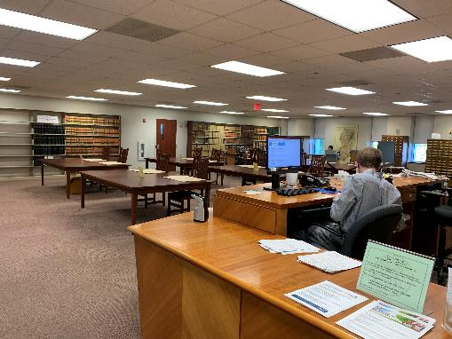
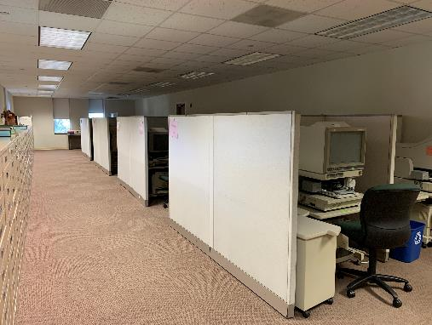
Inside NJSA: Public Areas

Slide 9
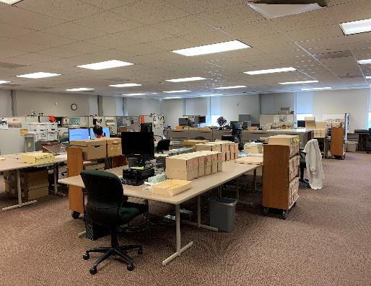
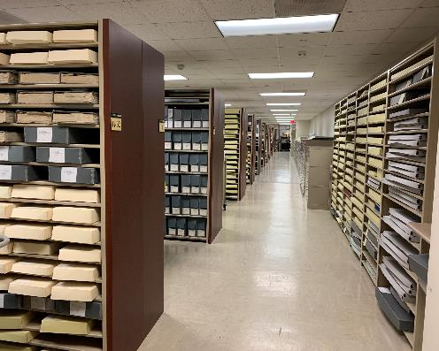
Inside NJSA: Staff Areas – Main Floor

Slide 10
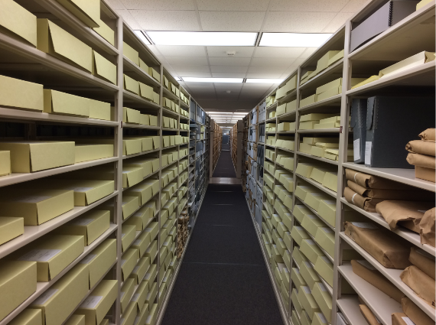
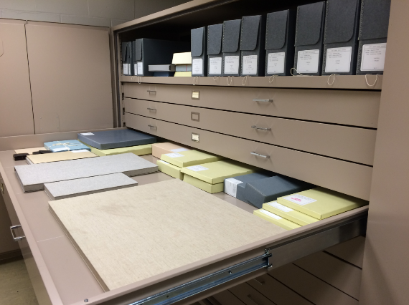
Inside NJSA: Level 0

Slide 11
Organization
Reference, Outreach, and Data Services
Collection Management
Electronic Records

Slide 12
Genealogical Records
Majority of our Researchers are looking for ancestors
Collections include vital statistics, land, court, military, and naturalization records
Provide in-person research hours and online orders

Slide 13
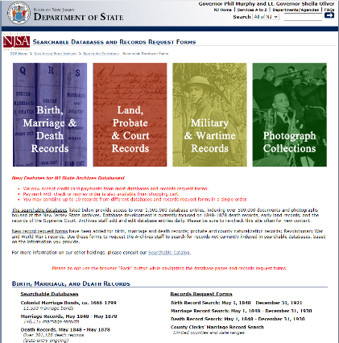
Searchable Databases and Ordering Records Online
Searchable Databases:
Colonial Marriages, Marriage Records (1848-1878), Death Records (1878-1900), Supreme Court Case Files, Legal Name Changes, Revolutionary War Damages, Civil War Service Records and Payment Vouchers, WWI Deaths, and Photographic Databases.
Records Request Forms:
Births (1848-1921), Marriages and Deaths (1848-1930), Probate Records (1600s-1952), County Naturalizations, Revolutionary and Civil War Service

Slide 14
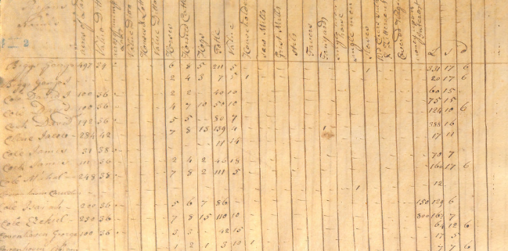
Projects: Tax Ratable Lists
This series includes original tax ratable lists from the period 1773-1822
120 boxes, 79 cu.ft.
Currently scanning into archival PDFs and creating database index

Slide 15
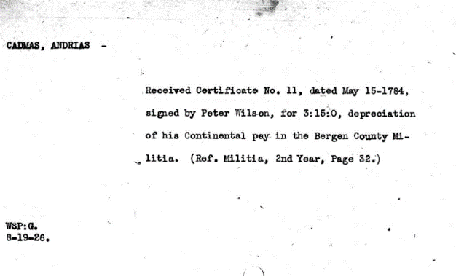
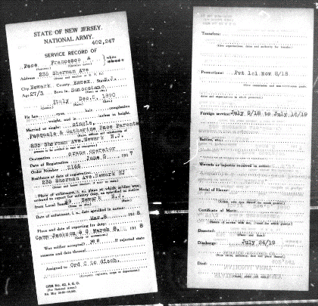
Projects: Military Service Cards
Revolutionary War Service Card
WWI Service Card

Slide 16
Projects: Early Land Records Project
Overall Goals:
Index all known New Jersey colonial land records in a single, free, online database as a genealogical, land-surveying, title-history, archaeological, and mapping resource.
Digitize (initially) 15,000 of them and link images to database records.
Conserve selected documents for stabilization and exhibition purposes.
Enable full-abstracting (i.e., extraction of metes and bounds)—possibly through crowdsourcing—and develop plotting application to encourage local mapping projects.

Slide 17
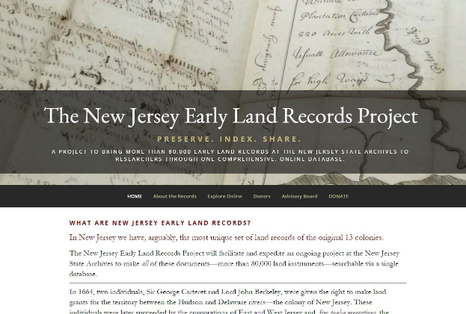
Projects: Early Land Records Project
Partnered with Genealogical Society of New Jersey
Over $275,000 raised for the project through grants and donations

Slide 18
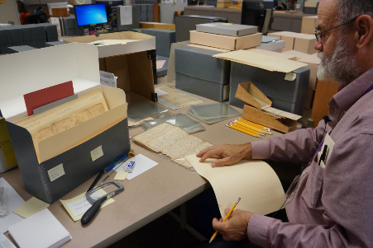
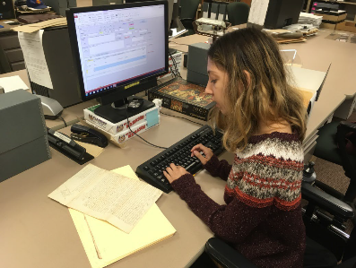
Projects: Early Land Records Project
Processing and data entry for over 76,000 records

Slide 19
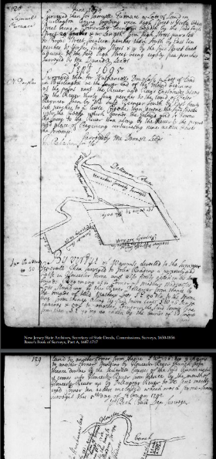
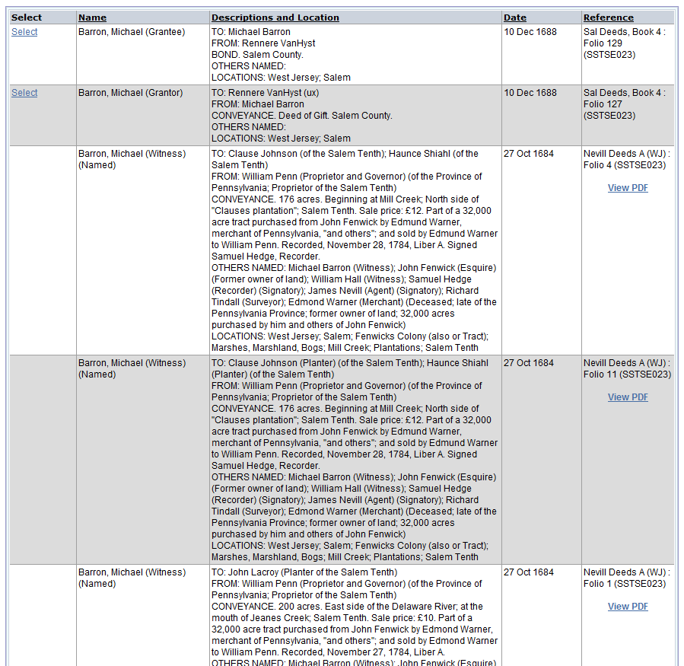
Projects: Early Land Records Project
Digitization

Slide 20
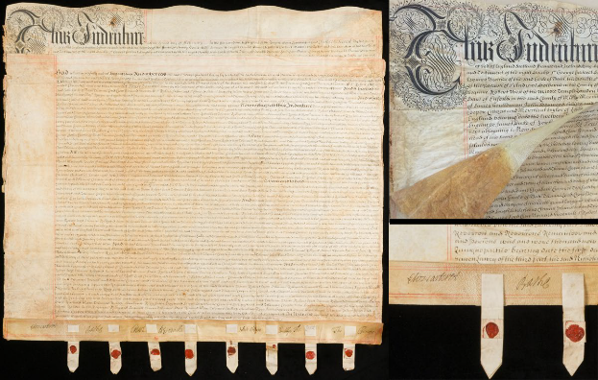
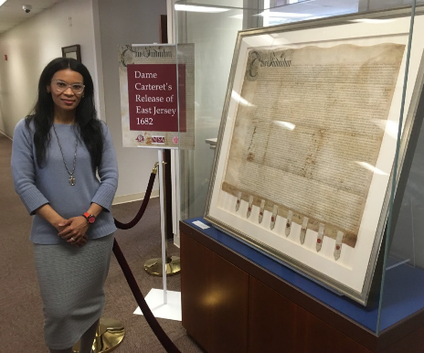
Projects: Early Land Records Project
Conservation – Before and After

Slide 21
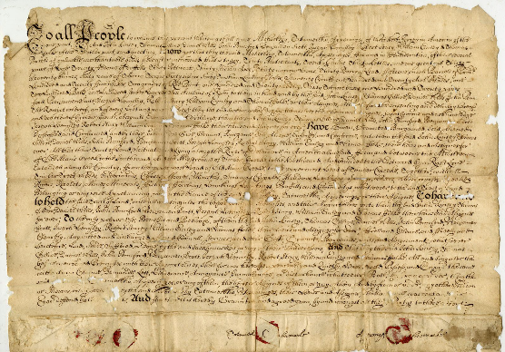
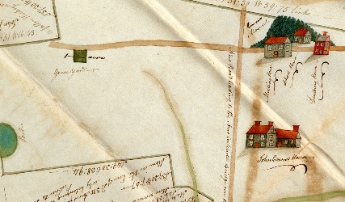
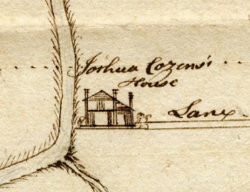
Projects: Early Land Records Project
Unexpected Finds

Slide 22
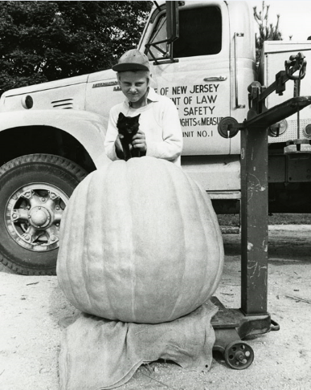
THANK YOU!

Slide 23
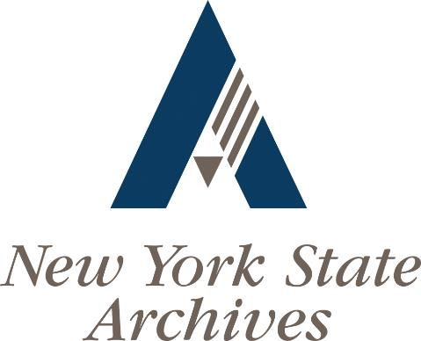

Slide 24
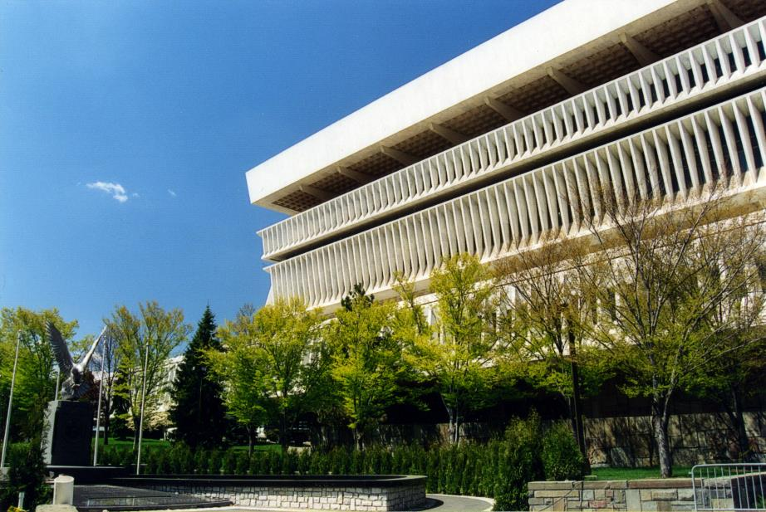
Notes:
The State Archives facility is in Albany in the Cultural Education Center at the Empire State Plaza. Our state-of-the-art stewardship facility covers nearly an acre on the 11th floor of the Cultural Education Center

Slide 25
Background
Established in 1971 as a component of the State Education Department
Governed by the Board of Regents who oversee all educational and knowledge preservation institutions in New York including the State Museum and State Library
First state archivist, Edward Weldon, was appointed in 1973.
Archival facility opened in 1978
Major program expansion in 1987 and 1988 under Larry Hackman

Slide 26
NYS Archives Organization
Three major components
Government Records Services
Archival Services
Archives Partnership Trust
75 Full time staff
$14M annual budget
Primary facility in downtown Albany

Slide 27
NYS Archives Organization
Archival Services Division
Administers the archival records of the State
Focused on state government records. We have limited responsibility for private or local government records
33 miles of records dating from 1630 to today
Approximately 10 tb of digital records
Extensive online resources for discovery
Support for 2000 repositories statewide

Slide 28
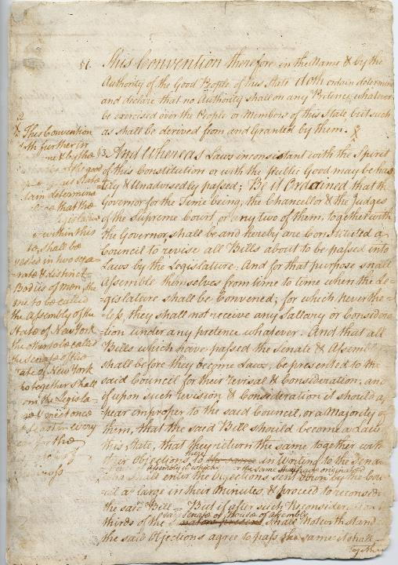
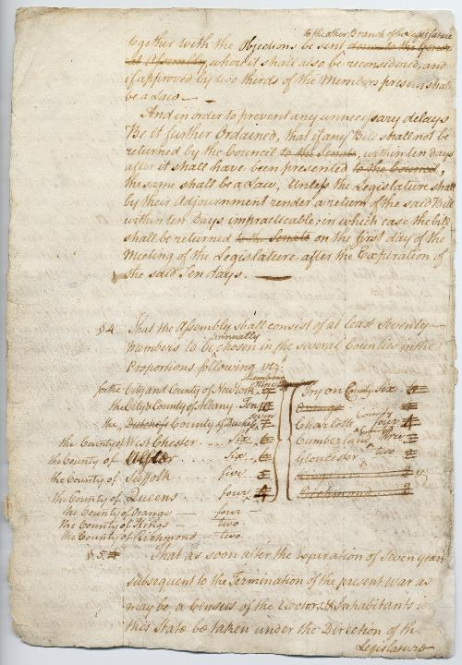
Notes:
We preserve the essential documentation of our state, documents like the 1777 constitution of the State of New York, pages three and four of which are displayed here.

Slide 29
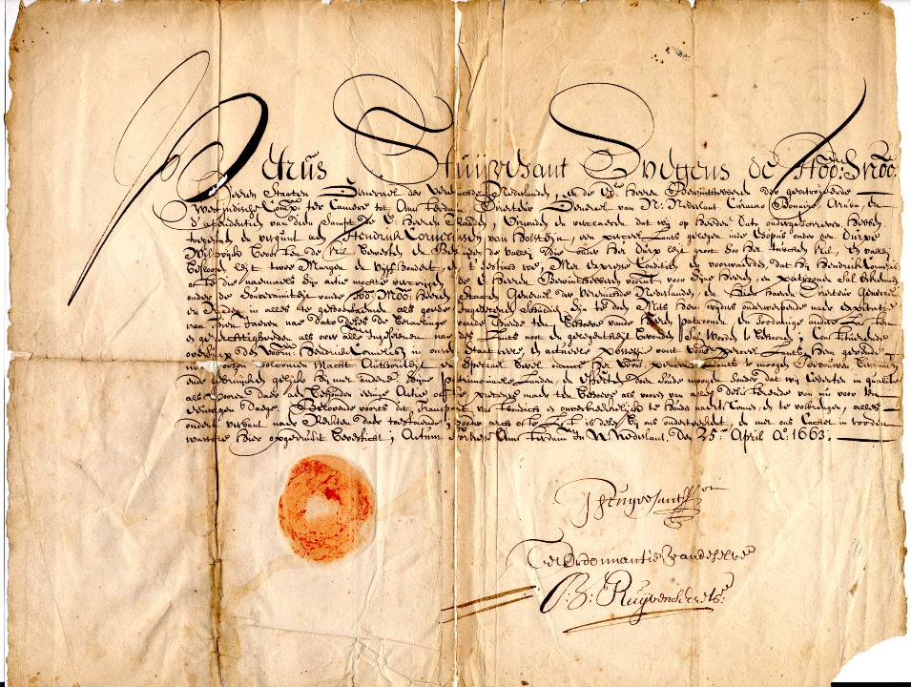
Notes:
We hold the entire corpus of documents from the administration of the New Netherland Colony from 1630 to 1664. Nearly 13,000 documents have been digitized and we have made all of the digital versions and any available english translation available online through our web site.

Slide 30
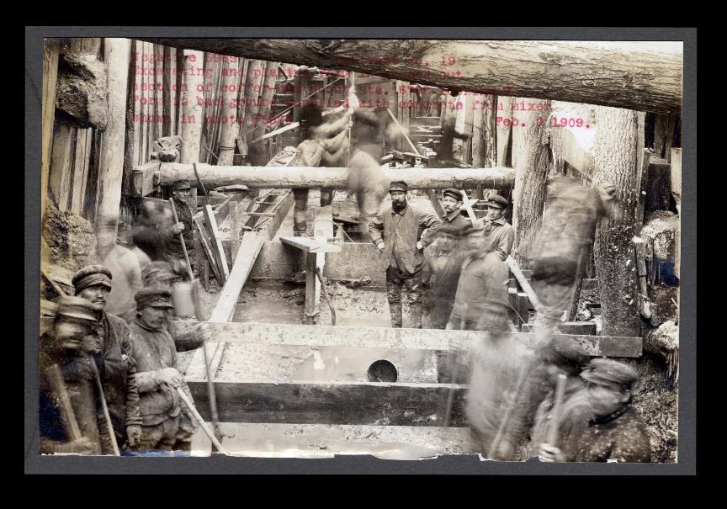
Notes:
We hold hundreds of thousands of photographs, negatives and glass plates, including this 1909 photograph of workers building the New York State barge canal.

Slide 31
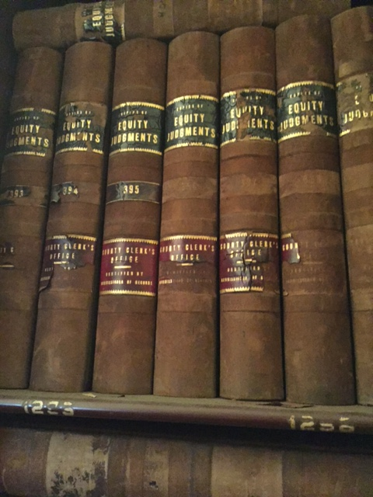
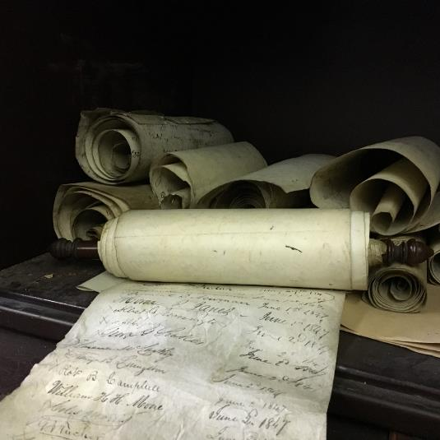
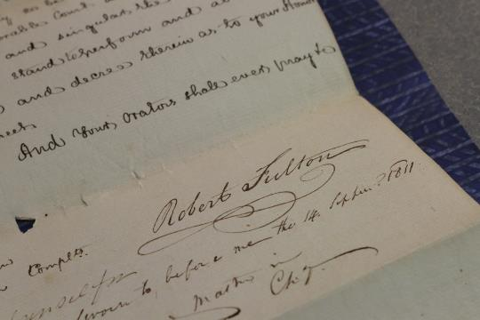
Notes:
And a year ago we acquired nearly 2,000 containers of critically valuable statewide court records from the New York County Clerk. These records complement the nearly 5,000 containers of pre-1847 statewide court records that were transferred to us in the early 1980’s by the Court of Appeals. Together this body of over 7,000 containers provides nearly complete documentation of New York’s statewide legal activities.

Slide 32
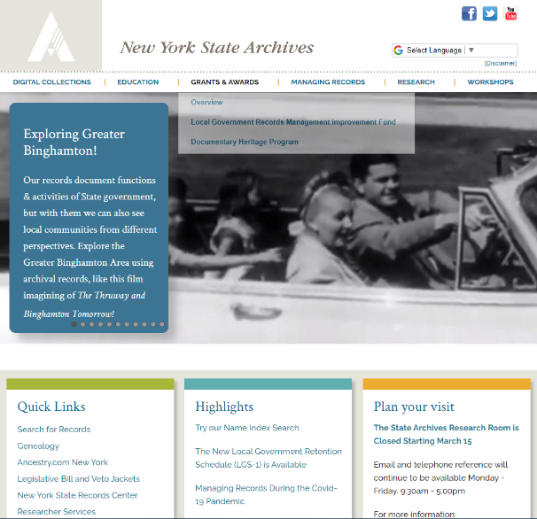

Slide 33
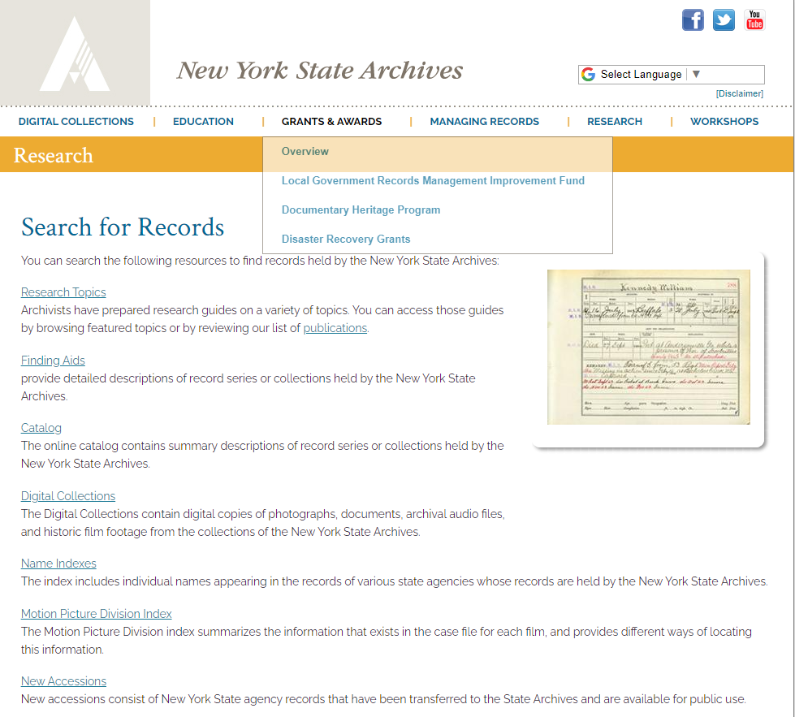

Slide 34
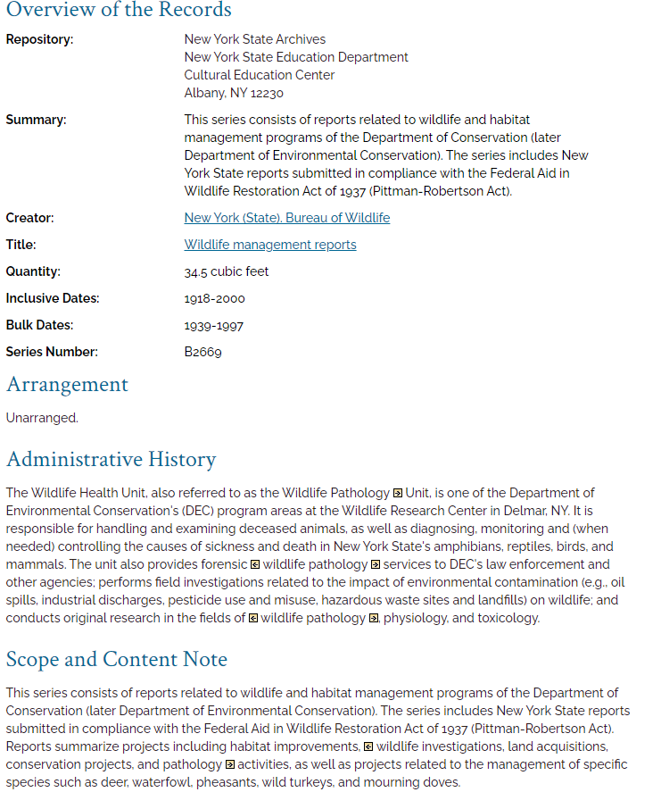

Slide 35
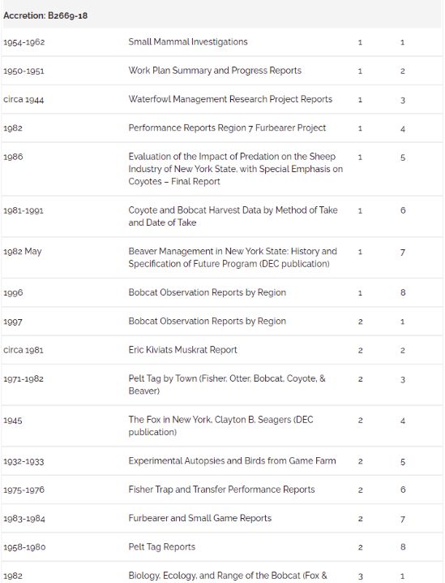

Slide 36
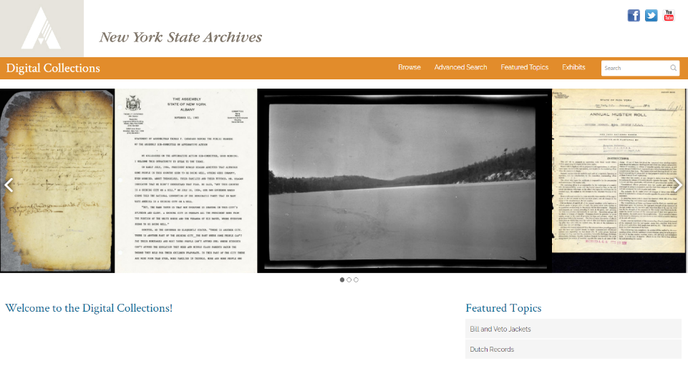

Slide 37
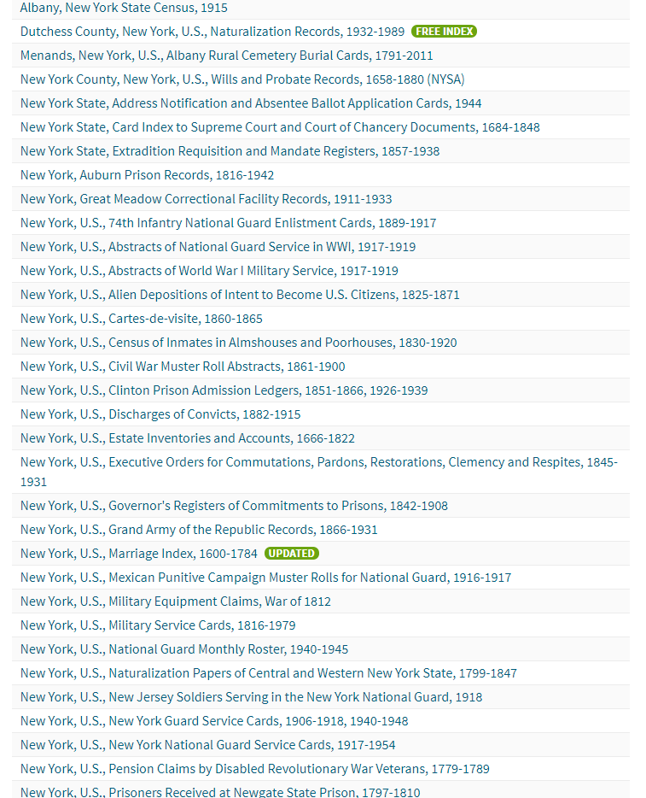

Slide 38
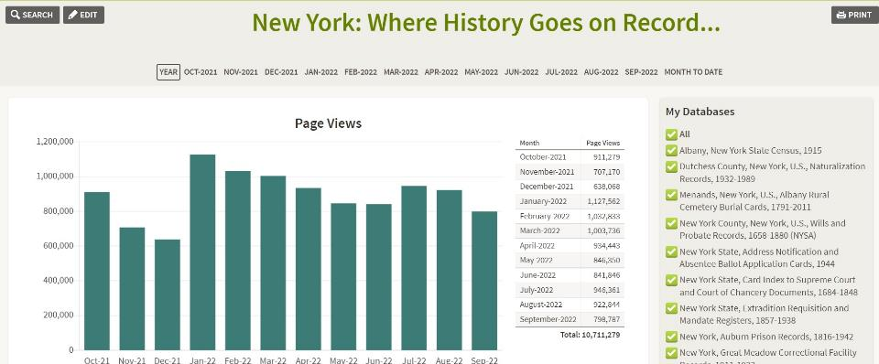

Slide 39
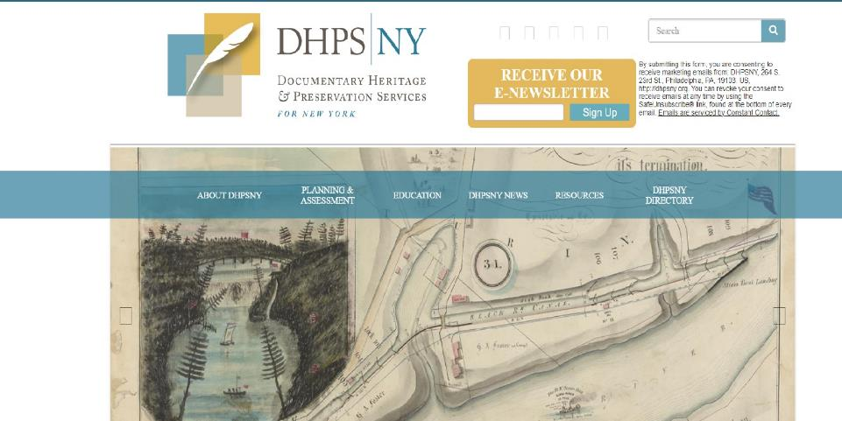

Slide 40
NYS Archives Organization
Government Records Services
Training and technical assistance to state agencies and local governments
Records retention and disposition authority for state and local government records
Grants to support local government records management improvement and preservation of records

Slide 41
Government Records Services
Retention and disposition scheduling
State Agency General Schedule
Local Government General Schedule
Elections General Schedule
Agency Specific Retention Schedules
Training and education
Webinars
Publications
5 dedicated field staff for local governments

Slide 42
Facts and Figures
2500 units of local government in New York
62 Counties
Over 900 towns
Over 90 cities
750+ school districts
Special purpose local governments
Over 100 state agencies and public authorities

Slide 45
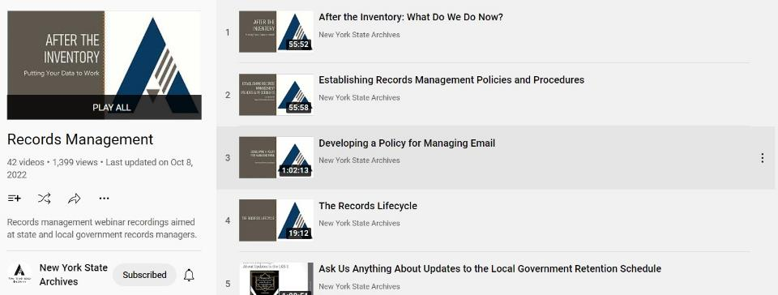

Slide 46
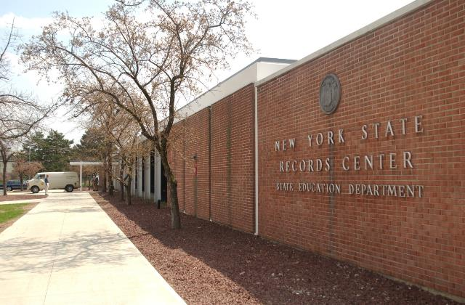

Slide 47
State Archives Organization
Archives Partnership Trust
Public-Private partnership to raise funds to support the programs and collections preservation of the State Archives
501(c)(3) charity able to accept private donations and philanthropy
Governed by a board of trustees who oversee the endowment and program operations of the Trust

Slide 48
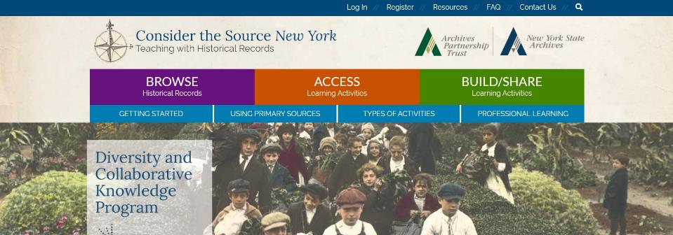

Slide 49
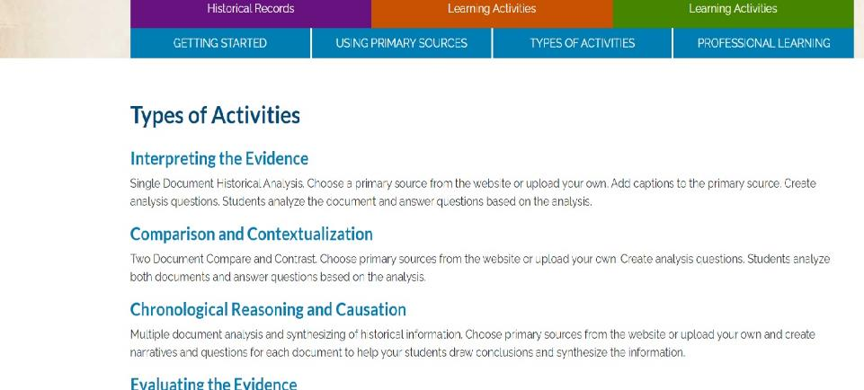

Slide 50
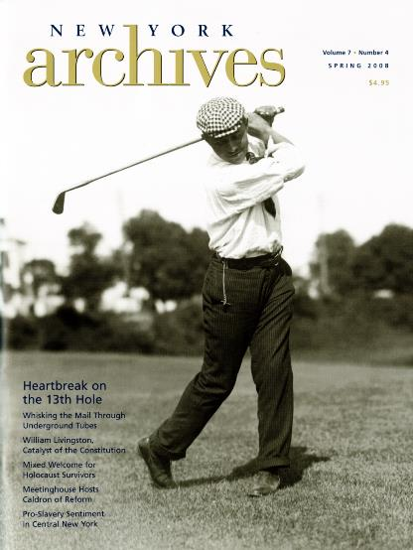

Slide 51
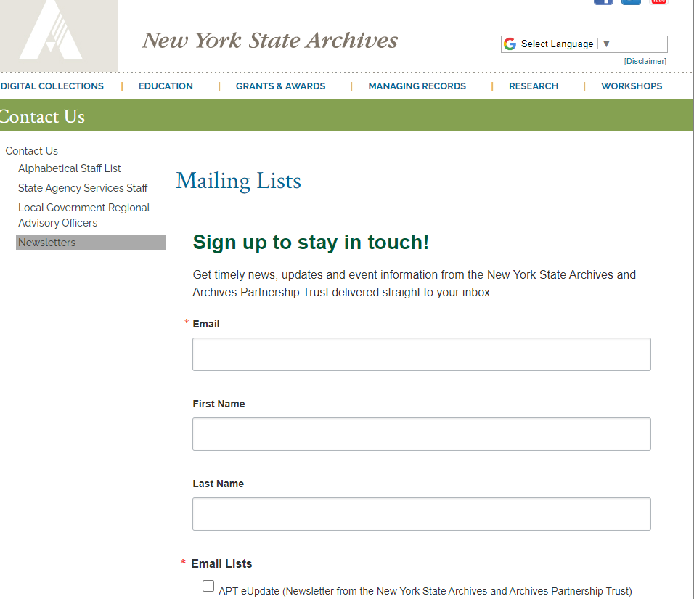

Slide 52
https://www.youtube.com/user/nysarchives/

Slide 53
New York State Archives
11th floor
Cultural Education Center
Albany, NY 12230
archref@nysed.gov
518-474-8955

Slide 54
Upcoming Member Webinars
November –
"In Conversation With..." Hilda Ayala Gonzalez Archives of Puerto Rico
To register:
https://www.statearchivists.org/programs-education/cosa-webinars

Slide 55
Upcoming SERI Webinars
Nov 8, 2 pm eastern
DPCMM Assessment Insights and SERP Framework Revisions
To register:
https://us02web.zoom.us/meeting/register/tZYsde-qpjoqH9xwnKYrc7lJdTCcJOR2cn84

Slide 56
Upcoming Shop Talks with CoSA sponsors
November 10 – Preservica
December 1 – Family Search All at 3 pm eastern time
To register:
https://www.statearchivists.org/programs-education/cosa-webinars

Slide 57
Contact Us
CoSA Website http://www.statearchivists.org
CoSA Resource Center https://www.statearchivists.org/research-resources/resource-center
CoSA Twitter Handle @StateArchivists
CoSA Facebook Page www.facebook.com/CouncilOfStateArchivists
CoSA You Tube https://www.youtube.com/user/StateArchivists/

Slide 58
Sponsors and Funders

Slide 59
Webinar Evaluation
We really do appreciate your feedback!
Please take a moment and respond to the evaluation following this webinar.

