Slide 1
Approaches to Electronic Records Transfers
September 12, 2023

Slide 2
Welcome!
Upcoming SERI webinar line up
Chatting with SERI: Web Harvesting, November 14
Upcoming Events
Electronic Records Day Webinar, October 10
CoSA’s Online Resources
SERI Webinar Recordings on YouTube
Resource Center

Slide 3
SERI 2023 sponsor

Slide 4
Presenters
Krista Sorenson
Rachel Smith
Electronic Records & Digital Preservation Archivist, Wisconsin Historical Society
Presenter
Collections Archivist, Alabama Department of Archives and History
Moderator

Slide 5
Transferring E-Records to WHS
Krista Sorenson, Wisconsin Historical Society
Notes:
Hello and thank you for joining us today. The following presentation is adapted slightly from the presentation I gave at BPE 2023 in Athens, Georgia, this past June.
I will also preface this presentation by sharing that while it focuses on electronic records transfers, it does not focus on transferring records that natively live in cloud storage environments such as Microsoft 365 or Google Drive. Instead it focuses on the transfer of electronic records, often from one network storage environment to another.

Slide 6
Agenda
WHS Context
Transfer procedure successes
Transfer procedure failures
Exploring approaches to electronic records transfers
Current state
WHS Image ID 8330
Notes:
The presentation will cover, the WHS context for transferring records. Our early electronic records transfer procedure success and how it failed. Then I’ll move into an overview of the various approaches to electronic records transfers that we researched, and wrap up with a brief look at our current method for handling transfers.
Left side slide image: A question is fed into a “computer” created by the mathematics club at John Marshall Junior High School in Milwaukee. This was a project in observance of American Education Week in November 1963. Wisconsin Historical Society Image ID 8330.

Slide 7
Records Transfers at WHS
Receive about 1110 cubic feet paper records each year
Electronic records make up a much smaller portion of transfers, but growing
First electronic state records date back to late 1970s
Passive collecting late 1980s to early 2000s
WiSPER NHPRC Grant Project (2015-2019)
Active collecting, processing, and providing access since 2017
Notes:
Every year we acquire about 1100 cubic feet of paper records. A representation of those unprocessed boxes stacked in one of our building’s storage areas is shown on the right side image in the slide.
Electronic records transfers make up a much smaller portion each year. However, that number is growing and will continue to grow as transfer schedules catch up with records creation.
The first electronic state records in our collection date back to the late 1970s. From the late 1980s to early 2000s, we passively collected electronic records, often on whatever external media they were stored on. The thought being that eventually we’d get around to dealing with them.
In the 2010s, we began to more seriously develop our electronic records program. This took the form of WiSPER, a set of NHPRC Grants funded between 2015 to 2019, in which we collaborated with state agencies to develop transfer procedures, set up our own workflows, opted into Preservica as our digital preservation system, and began processing and providing access to state records through the Wisconsin Electronic Records Portal.

Slide 8
Wisconsin Administrative Code Chapter Admin 12
Maintain electronic records that are:
Accessible
Accurate
Authentic
Reliable
Legible
Readable
throughout the record lifecycle
Full text at: https://docs.legis.wisconsin.gov/code/admin_code/adm/12.pdf
Notes:
Contributing to our efforts, and almost a guiding principle, is a state law, Wisconsin Administrative Code Chapter Admin 12. Full text at available at https://docs.legis.wisconsin.gov/code/admin_code/adm/12.pdf. It lays out the requirements for the electronic records management. The law states that agencies must maintain electronic records that are accessible, accurate, authentic, reliable, legible and readable throughout the records lifecycle.
This law applies to state agencies as they create, retain, and disposition their records. And it applies to WHS as we receive and provide longer term access to electronic records.

Slide 9
State Agency Transfer Procedure 2017-2022
Agencies identify records eligible for transfer by consulting records schedules and RDAs.
Complete an Electronic Records Survey and send it to WHS.
If it is a first time transfer, set up Exactly and SFTP client.
Prepare files for transfer.
Complete an Electronic Records Transfer Agreement.
Transfer electronic records via Exactly.
Receive confirmation of transfer for records.
Delete files from drives.
Notes:
So from the NHPRC Grant, and keeping in mind Chapter Admin 12, we developed the state agency transfer procedure you see on the slide.
Agencies identify eligible records for transfer. Complete an electronic records survey (https://www.wisconsinhistory.org/pdfs/la/ERecordsSurvey-Final.pdf) and notify WHS. If it is the first time the agency transferred records, we set them up with Exactly and create profiles in the SFTP client. The agencies prepare the files for transfer, and complete and electronic records transfer agreement (https://www.wisconsinhistory.org/pdfs/la/ERecordsTransferAgreement-Final.pdf). Then, they work with the tool Exactly to package and transfer records via SFTP to WHS. We receive and validate the records, confirm the transfer, and notify agencies that they could delete the files on their end.

Slide 10
Why Exactly and SFTP?
Free, open source
Safe remote transfer of digital data
Features:
“Enhanced” BagIt packages (bags)
Customizable metadata templates
Fixity checking
Email notifications
Supports FTP/SFTP transfer
Integrates into file sharing workflows with Dropbox, etc.
Notes:
Exactly is an application developed in 2015 by AVP, https://www.weareavp.com/.
At the time of the grant we chose Exactly, because it is a free open source application that facilitates the safe remote transfer of digital data. Exactly creates “enhanced” BagIt packages. It also enables users to create and fill out customizable metadata templates, performs fixity checking for transfers, sends automatic email notifications after transfers, supports FTP and SFTP transfers, and integrates into file sharing workflows with cloud services like Dropbox and Google Drive.
Right side slide image: A screen capture of the Exactly graphical user interface.

Slide 11
Exactly Bag Structure
<bag> /
| bagit.txt | Bag declaration – required BagIt element
| bag-info.txt | Bag metadata – optional BagIt element
| bag-info.csv | Bag metadata (csv) – Exactly
| bag-info.xml | Bag metadata (xml) – Exactly
| manifest-md5.txt | Payload manifest – required BagIt element
| tagmanifest-md5.txt | Tag manifest – optional BagIt element
| FileSystemData.txt | File system information – Exactly
| TransferComplete.txt | Transfer report – Exactly
| data / | Payload directory – required BagIt element
| [payload files]
Notes:
Digging in a little deeper, Exactly creates transfer packages that enhance the basic BagIt bag structure—seen here in white text. This is the declaration, metadata, payload manifest which lists files with their checksums, a tag manifest, and payload directory.
Exactly bags include all these elements, plus a few more. The first two are bag metadata files in csv and xml formats, which is useful for integration with different accessioning and ingest tools that archives might use.
It also includes a File System Data file, which records information about the sender’s file system, including a directory listing of where the files were located. This can be helpful in determining issues of provenance for some archives.
Lastly, it includes a transfer report, which is a confirmation of the files, the sender, and the recipient. This report is also included in email confirmations sent to both senders and recipients.
The process mentioned before and the use of Exactly worked well for us from around 2017-2022.

Slide 12
Break Down: Setting Up and Managing Exactly and SFTPs
State Agency
ER Archivist
WHS IT
WHS Network Service Provider
Agency IT
AVP
Communication and coordination between all interested parties often became complicated
Notes:
Unfortunately, starting in 2021 we began to encounter some breakdowns in the process.
The first was that setting up and managing Exactly and SFTP permissions was burdensome. Communication and coordination between all interested parties often became complicated. As the electronic records archivist, I was often stuck as middle man between:
state agencies who wanted to set up Exactly;
the IT Department at WHS who had the actual control and ability to set up permissions to the SFTP which was managed by a separate network service provider;
the state agency’s IT department who might be assisting with downloading Exactly; and
AVP, who might provide troubleshooting support.

Slide 13
Break Down: Can Exactly Scale to a Variety of Users?
State agency records officers
Records management may only be 2% of job duties
County and municipal clerks
Potentially limited IT support
Manuscript collections and donors
Wide range of skill with technology
All the user personas have a wide variety of skill and comfort levels with technology
Notes:
A second breakdown emerged as we started to think about collecting materials beyond state agencies. Could Exactly scale to a variety of users? Top of mind were state agency records officers whose job duties might only list records management as 2% of their allotted time. How much IT support would county and municipal clerks receive? And what about individuals and organizations donating their papers to our manuscript collections?
All the additional user personas we came up with we assumed had a wide variety of skill and comfort levels with technology. Could we easily explain, install, set-up, and run Exactly in these environments when we already were have communication issues with more established state agency partners and our IT? Could our IT manage the support needed for these additional users? Was the effort worth it for scenarios that might only result in one time transfers?

Slide 14
Break Down: Loss of Support for Exactly in 2022
“… The reality is that Exactly is now quite dated and in need of an overhaul requiring extensive resources. Continuing to offer support for the application in its current form is an exercise in using band aids and bubble gum to hold things together. …”
Chris Lacinak, AVP CEO | September 1, 2022 | Via Exactly-Users Google Group Message https://groups.google.com/g/exactly-users/c/vNfPuTN2lVg
Notes:
And then a third and major breakdown was the loss of support and development for Exactly by AVP in 2022.
Quote: “… The reality is that Exactly is now quite dated and in need of an overhaul requiring extensive resources. Continuing to offer support for the application in its current form is an exercise in using band aids and bubble gum to hold things together. …”
Chris Lacinak, AVP CEO
September 1, 2022
Via Exactly-Users Google Group Message
https://groups.google.com/g/exactly-users/c/vNfPuTN2lVg
This coincided with AVP’s shift as a company to a more purely consultation based service. You can still download Exactly from AVP’s GitHub account, https://github.com/WeAreAVP/uk-exactly, but that use will be unsupported by AVP.

Slide 15
Investigating Alternative Approaches Fall 2022-Spring 2023
Easy to explain and use
Allow for remote contribution
Requires limited IT support or intervention
Have methods for collecting metadata and/or generate fixity information
Ability to handle large data transfers
WHS Image ID 95738
Notes:
That left us in late 2022 trying to find a new method for electronic records transfers. We began investigating alternative approaches, and honestly, are still doing so.
Pie in the sky, we identified that we would like an approach that is easy to explain and use, allows for remote contribution if at all possible, requires limited IT support or intervention, has methods or could support collecting metadata and or generating fixity information, and has the ability to handle large data transfers.
What follows are some of our findings and incomplete thoughts about the available options.
Right side slide image: Black and white photograph with a view from behind of a young woman wearing a t-shirt with the title Dungeon Mistress printed on the back while she plays an adventure game called Telengard on a Commodore PET computer. In the background is a blackboard. Wisconsin Historical Society Image ID 95738.

Slide 16
External Media
Pros
Established procedure
Easy to explain
Rarely need IT support
Handles large data transfers
Cons
No remote contributions
Possible security issues
A lot to manage and track
Additional steps for metadata and fixity generation
Notes:
Of course the stand-by option is to fall back on the use of external media.
On the plus side: it is an established procedure, easy to explain, rarely needs IT support, and depending on the storage size of the medium can handle large amounts of data.
On the minus side: it is not a remote contribution method, the are possibly security issues from the potential presence of viruses to what’s allowed connection to any given network by IT departments, if we end up sending out drives and devices or even need to return items it becomes a lot to manage and track, and there’s a need for additional steps for metadata and fixity generation.
Left side slide image: A photograph of external media and media readers arranged on a table. Going clockwise a external hard drive, a 5.25” floppy disc, a CD, an external CD Drive, a 3.5” floppy disc, a 3.5” floppy drive, and a USB drive.

Slide 17
Cloud Based Tools
Pros
Remote contribution
Understandable to the novice user
Set up links or landing pages for contributions
Might not need IT support
Potentially handles large data transfers
Cons
Might need IT support
May change metadata information, such as date and time
Potential security issues with some IT departments
Notes:
There are also the cloud based tool options, such as Box, Microsoft 365, Google Drive, or Dropbox.
Positively, these allow for remote contribution, they’re understandable to a novice user, you can often set up links or landing pages for contributions, may not need IT support, and potentially can handle large data transfers.
Negatively, you’re trusting a third party system, you may still need IT support to have access and permission to the tool, upon upload to the service there might be loss of critical metadata, and there still might be security issues for some IT departments.
Right side slide image: A group of four business logos. Going clockwise for Box written as box in blue text, Microsoft 365 as a white box on orange background, an open top blue box for Dropbox, and a yellow, blue and green triangle for Google Drive.

Slide 18
SFTPs
Pros
Remote contribution
Relatively easy to set up
More acceptable to external IT
Does not change metadata information, such as time and date
Handles large data transfers
Cons
Reliant on IT to manage
Slightly more difficult to explain to a less technical user
Notes:
We could investigate better ways to utilize SFTPs.
Pros: remote contribution, relatively easy to set up, more acceptable to external IT departments, does not change metadata information and handles large amounts of data.
Cons: we’d be reliant on IT to manage, and its slightly more difficult to explain to a less technical user.
Left side slide image: A screen capture of an SFTP server graphical user interface with a login window in the foreground.

Slide 19
But what about fixity? Directory manifests?
Proof that what some one intended to give us is what we received?
Notes:
Of course, with the three options mentioned—external media, cloud based tools, SFTPs—you’re also missing the fixity information, file manifests, directory information that was so usefully contained in Exactly. Remember, WI Code Chapter Admin 12 states we need to manage electronic records that are authentic and reliable.

Slide 20
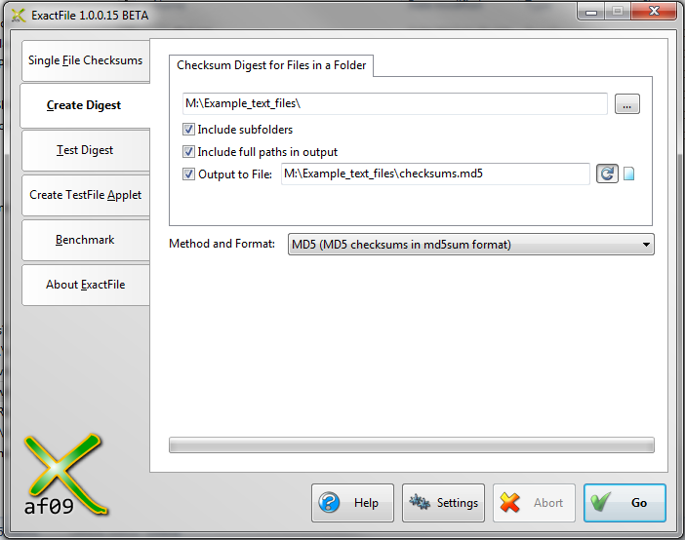
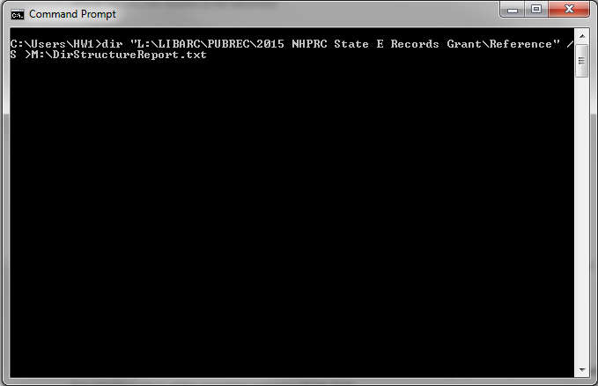
Individual Desktop Tools
Pros
Generates metadata and fixity
Limited need for IT support
Handles large amounts of data
Cons
Not a method for transfer
Harder to navigate for novice users
Extra steps and multiple interfaces
ExactFile (https://www.exactfile.com/) and Windows Command Prompt
Notes:
Maybe we could use one of those transfer tools, but pair it with other tools that can generate the information we need. There are individual tools, such as ExactFile (https://www.exactfile.com/), which can generate checksums, or the Windows Command Prompt, which will create directory reports.
Advantages: we get the information we want, beyond installation and updates there isn’t much need for support from IT, and they handle large amounts of data.
Disadvantages: they’re not transfer methods, harder to navigate for novice user, potentially time consuming to do these extra steps in multiple interfaces.
Right side slide image: A screen capture of the program ExactFile’s graphical user interface in the background and a screen capture of the Windows command prompt displayed as black box with white text in the foreground.

Slide 21
FileLister by NARA
Pros
One tool
Gathers metadata and fixity
Easy to use and explain
Does not require installation or administrative privileges to use
Limited need for IT support
Seems to handle large amounts of data
Cons
Not a method for transfer
Java based tool
Available at https://github.com/usnationalarchives/Electronic-Records-Accessioning-Support-Tools
Notes:
The National Archives and Records Administration (NARA) created FileLister in response to federal agency requests for support with preparing metadata and compliance with federal transfer requirements. It allows users to pull the file name, full file path, size in bytes, file extension, date modified, and SHA-256 Hash of in a file directory. The information can then be exported into a comma separated value (.csv) file.
FileLister is a Java tool in a JAR file format. It does not require installation or administrative privileges to use, but it does require installation of Java to run. It is available via NARA’s GitHub at https://github.com/usnationalarchives/Electronic-Records-Accessioning-Support-Tools.
As you might gather, on the positive this is one tool that gathers metadata and fixity, its fairly straightforward to use and explain, does not require a lot of IT support and seems to hand large amounts of data.
A major negative, is that it runs on Java which many state IT department’s are leery about using in its form from Oracle. So using this tool would require investigating, promoting, and trying to get adoption of other open Java formats and providers. Which may or may not be easy to do.
Left side slide image: A screen capture of the FileLister software’s graphical user interface listing out the metadata collected after the program completes a scan of a folder space.

Slide 22
Bagger by Library of Congress
Pros
Captures pertinent file information
Limited need for IT support
Can handle large data packages
Cons
Data packaging, not transfer
Written in Java
Possibly in a transition phase
Takes more effort to explain to novice user
Available at https://github.com/LibraryOfCongress/bagger
Notes:
And there is Bagger by Library of Congress, which again captures pertinent file information, handles large data packages, an possibly has limited need for IT support. Find Bagger at Library of Congress’s GitHub at https://github.com/LibraryOfCongress/bagger
But also, it is data packaging not transfer, is written in Java, and may be in a transition phase for support. It also takes more effort to explain to a novice user.
Right side slide image: A screen capture of a form in the Bagger graphical user interface used to submit data about the a package.

Slide 23
Leverage Features from Preservica
Pros
Numerous features
Remote Contributor
OPEX and SFTP integration with secret keys
Preserve365
Removes some need for agencies to prepare fixity and digital preservation information
Reduces the number of participants in the workflow
Cons
All our eggs are in one basket
We are Professional tier users
Transfers often contain messy data that requires some amount of processing
Some tools won’t work for our state’s records management and archives environment.
Notes:
Lastly, as Preservica users, we could try to leverage their features.
On this plus side, there are a number of features which could be of use. Including the remote contributor option available to starter users and some professional users. Or the use of OPEX and SFTP integration with secret keys. Or looking down as we consider the Preserve365 feature.
This also removes some of the need for agencies to prepare fixity and digital preservation information before ingest, and reduces the number of participants in the workflow.
What is holding us back is that we are hesitant to put all our eggs in one basket like we did with Exactly. We are also in the middle Professional tier of Preservica users and as such implementing those features falls more to us rather than Preservica. And our electronic records transfers often contain messy data that requires some amount of processing before we feel it is ready to go into the preservation environment. Lastly, some tools won’t work for our state’s records management and archives environment.

Slide 24
Where We’re At Today
Gathered information in June at BPE 2023
Met with our IT in July 2023
Developed a new placeholder strategy
Shared new method with state agency records officers in August 2023
Presently, testing new procedures
WHS Image ID 81752
Notes:
Where we’re at today. We gathered information and feedback from peers at BPE 2023. And met with internal IT in July to discuss options. Then we developed a new placeholder strategy which we shared with state agency records officers in August.
Presently, we are testing new procedures by accepting transfers from state agencies.
Right side slide image: Black and white image from 1961. A student studies key punch operation in a data processing class. What looks like a desk is actually a very large computer. Wisconsin Historical Society Image ID 81752.

Slide 25
State Agency Transfer Procedure 2023
Consult records schedules and identify records with a transfer status
Complete an Electronic Records Survey for Government Units
Prepare your files for transfer
If possible, create an inventory of your records
Complete an Electronic Records Transfer Agreement
Transfer electronic records
Receive confirmation of transfer for your records
Delete files from you electronic storage locations
Notes:
The procedure we currently have, has not changed much from what I showed you at the beginning of the presentation.

Slide 26
Electronic Records Survey
Microsoft form
Collects data about the transfer
Transfer info
Contextual information
Arrangement
Legal concerns and restrictions
Personally identifiable information in the files
File inventory
File formats identification
Notes:
One minor change is to make the Electronic Records Survey electronic and applicable to both state and local units of government. It also acts as our mechanism for collecting data. We also developed a similar survey for Manuscript collections.

Slide 27
Steps to Transfer Records
Add files to the transfer medium
Include completed Electronic Records Agreement and an inventory (if possible)
Email govarc@wisconsinhistory.org when the transfer package is ready
If using external media coordinate hand off
Receive confirmation from WHS that they have received the transfer
Delete all copies of files
Preferred transfer mediums
An SFTP managed by the creating agency (or WHS after Fall 2023)
Dropbox, a file hosting service
External media (e.g. hard drives, CDs/DVDs)
Notes:
And for now when it comes down to step 6 transfer records – we’ve removed Exactly from the equation and we are relying on talking with the agency transferring e-records to identify the best and preferred transfer medium. This includes an SFTP, Dropbox, or external media and arranging times to meet.

Slide 28
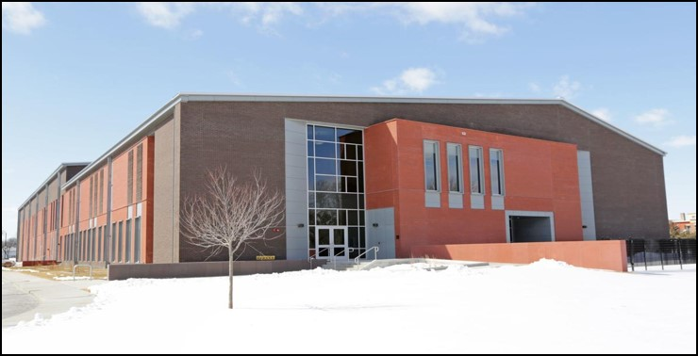
Going Forward
Gather more feedback from peers
Work through internal IT transition
Adopt an SFTP platform
Leverage other tools available, such as Preservica
Develop, implement, and iterate on procedures
Notes:
Lastly, going forward we hope to continue to gather more feedback and learn from our peers in opportunities like today. We will work through an internal IT transition this fall, then look to adopt an SFTP platform once more and leverage other tools available to us such as Preservica. All the while continuing to develop, implement, and iterate on the procedures we have in place.
Thank you for your attention and I look forward to further discussion.
Left side slide images: The top right image is an exterior photograph of the main historical society building in the spring. Bottom right image is an exterior photograph of the State Archive Preservation Facility in the winter.

Slide 29
Discussion
Rachel Smith, Moderator

Slide 30
Questions I
What transfer methods are you implementing?
General thoughts or questions about anything I’ve presented
What information is needed for electronic transfers?
How do you collect that information?
Do your procedures adapt to a variety of donor types? If so, how?
What questions or thoughts do you have about electronic records transfers?

Slide 31
Questions & Comments

Slide 32
Stay connected & informed
CoSA Website
CoSA Resource Center
CoSA Twitter Handle: @StateArchivists
CoSA Facebook Page
CoSA YouTube Channel

