Slide 1
CoSA Member Webinar 2022 Advocacy Tune-up
March 24, 2022
3 pm Eastern
Disclaimer: This webinar is being recorded and will be available for viewing on the CoSA website.

Slide 2
Webinar Agenda
Welcome and Overview
Presentations:
Advocacy Tune-up
Q and A
Upcoming Programs and Webinars

Slide 3
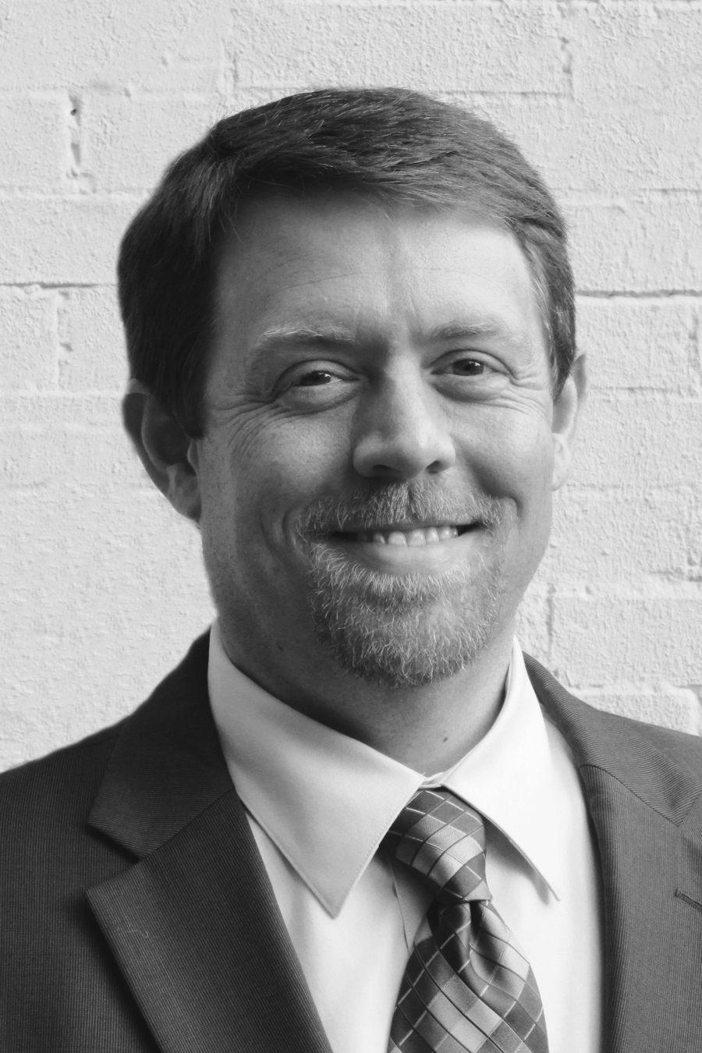
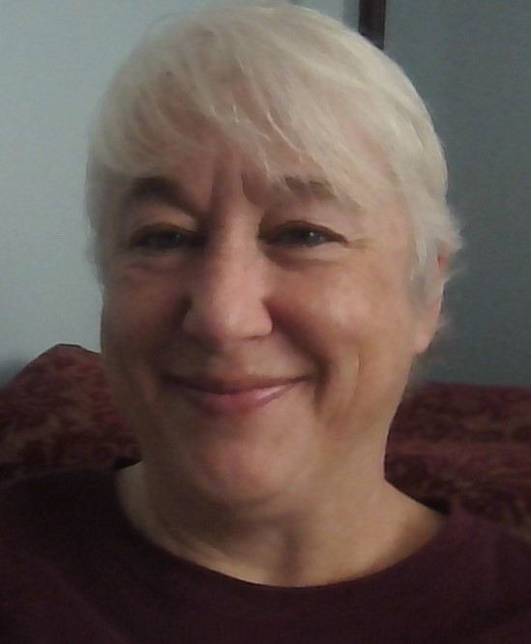
Speakers
Steve Murray
Director
Alabama Dept. of Archives and History
irector of Preservation Programs
NARA
Jodie Foley
State Archivist (retired)
Montanta

Slide 4
2022 Advocacy Tune-up CoSA Member Webinar
March 24, 2022
Steve Murray, Director Alabama Department of Archives & History
Jodie Foley, Montana State Archivist (retired)

Slide 5
“Fortune favors the prepared” Howard Hawks, Hollywood film director (Bringing Up Baby, Scarface)
“We all need to … really think through what we are going to say and the approach we are going to use. … find out what kind of message will resonate, a compelling story, data that speaks to an issue. [It]needs to be tailored to the audience—we can’t tell the same story and expect it will reach everyone with equal impact. Advocacy takes time, preparation and patience.” Kathleen Roe, SAA past president

Slide 6
Making the Most of Cosa resources
Language
Structure
Authority

Slide 7
CoSA advocacy Resources https://www.statearchivists.org/home (see Advocacy tab)
Advocacy Alerts
Issues Briefs & Statements
Advocacy Resources (including those of allied organizations)

Slide 8
CoSA advocacy Resources https://www.statearchivists.org/home (see Programs, Research, Electronic Records tabs)
CoSA Member Webinars
CoSA SERI Webinars
Resource Center

Slide 9
Specific examples, webinars
Pandemic Peril for Archives and Special Collections: An Advocacy Story from Alabama
Advocacy and Electronic Records
Archival Advocacy at Home: Preparing and Messaging for Visiting District Congressional Offices

Slide 10
Advocacy efforts
Finding Models in Other Advocacy Efforts
Training and Resources by Allied National Associations
SAA Committee on Public Policy’s Advocacy Guide
NAGARA
AAM
NHA
NHC
Training and Resources by State Organizations
Nonpartisan Public Policy Organizations
League of Women Voters

Slide 11
Advocacy efforts
Finding Models in Other Advocacy Efforts
Campaign to Save the Georgia State Archives

Slide 12
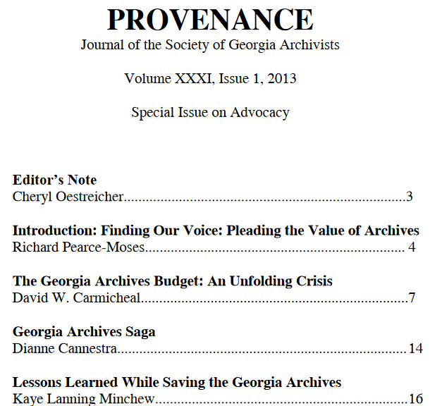
Finding Models in Other Advocacy Efforts
Campaign to Save the Georgia State Archives
https://digitalcommons.kennesaw.edu/provenance/

Slide 13
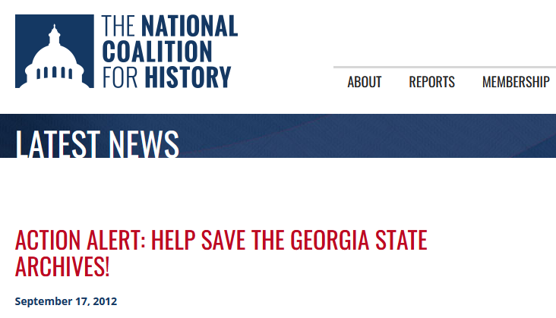
Finding Models in Other Advocacy Efforts
Campaign to Save the Georgia State Archives

Slide 14
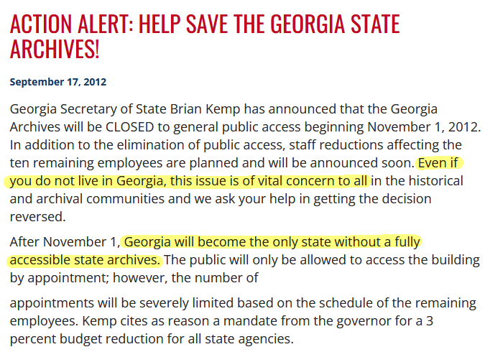
Finding Models in Other Advocacy Efforts
Campaign to Save the Georgia State Archives

Slide 15
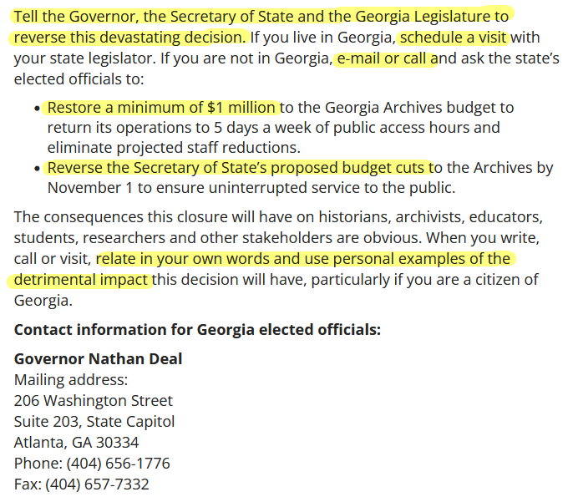
Finding Models in Other Advocacy Efforts
Campaign to Save the Georgia State Archives

Slide 16
Training and Resources by Allied National Associations
SAA Committee on Public Policy’s Advocacy Guide
http://files.archivists.org/advocacy/SAA-Advocacy-Guide-2020.pdf

Slide 17
Training and Resources by Allied National Associations
NAGARA Webinars
https://nagara.org//

Slide 18
Training and Resources by Allied National Associations
American Alliance of Museums
https://www.aam-us.org/

Slide 19
Training and Resources by Allied National Associations
National Humanities Alliance
https://www.aam-us.org/

Slide 20
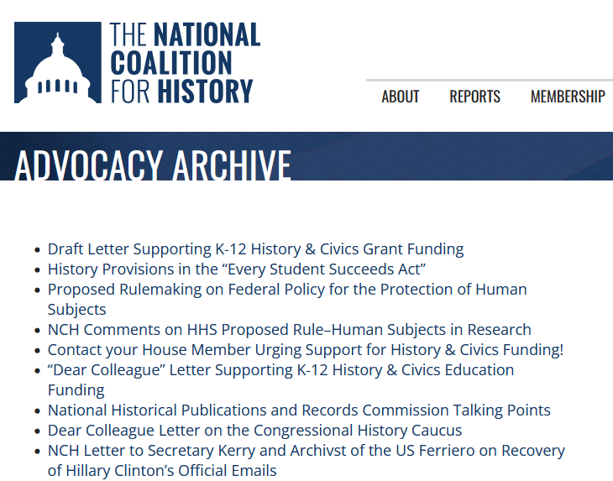
Training and Resources by Allied National Associations
National History Coalition
https://historycoalition.org/advocacy-archive/

Slide 21
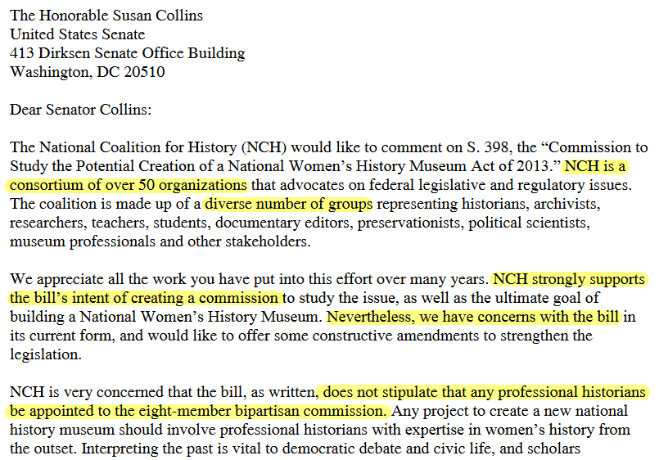
Training and Resources by Allied National Associations
National History Coalition

Slide 22
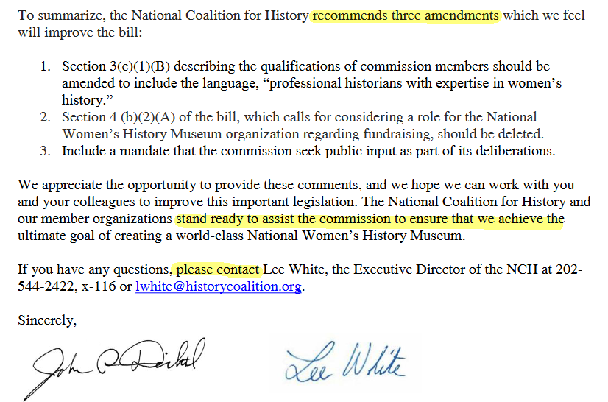
Training and Resources by Allied National Associations
National History Coalition

Slide 23
Training and Resources by Allied National Associations
Reframing History
by AASLH
https://aaslh.org/reframing-history/

Slide 24
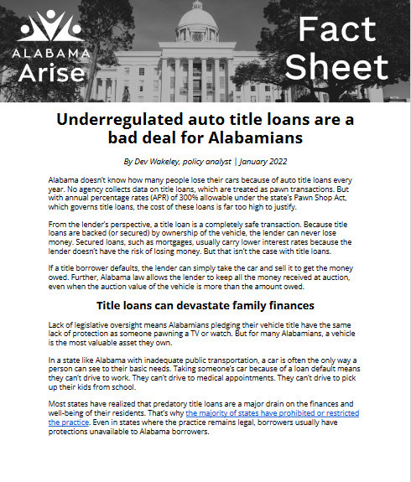
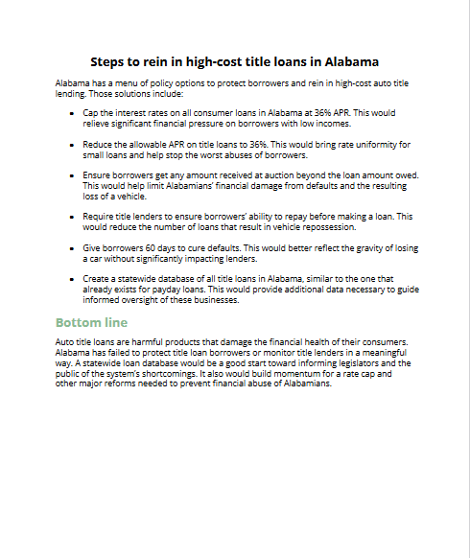
Training and Resources by State Organizations
Alabama Arise
https://www.alarise.org/

Slide 25
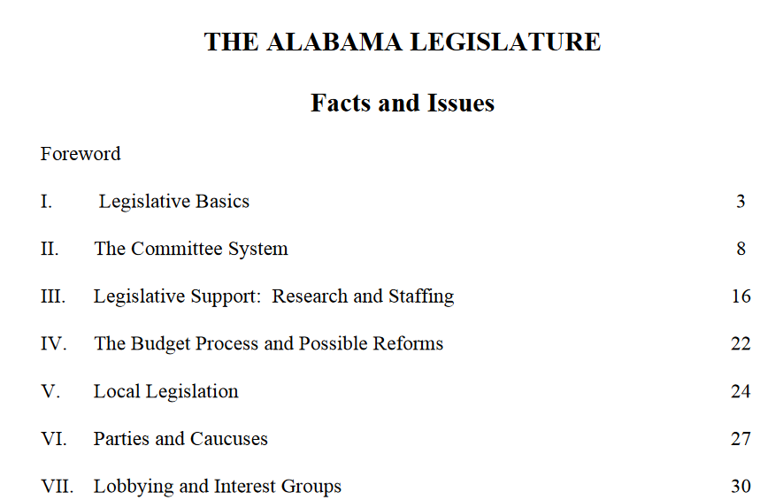
Training and Resources by State Organizations
League of Women Voters of Alabama
https://lwval.org/legstudy/factsandissues/index.html

Slide 26
Questions / suggestions?
What resources do your use the most for Advocacy?
What more can CoSA provide or do to help with regional/ local efforts?
Are there specific tools that you need or want?
Do you have your own tools that you would share?
How would you like to see the “importance of state archives document” updated or improved?

Slide 27
Questions and Comments

Slide 28
Upcoming Member Webinars
April 28 - Restarting or Revitalizing your SHRAB
To register:
https://www.statearchivists.org/programs-education/cosa-webinars

Slide 29
Upcoming SERI Webinars
April 12 - Taking Action Before It's Too Late: Monitoring File Formats for Risk
To register:
https://us02web.zoom.us/meeting/register/tZYsde-qpjoqH9xwnKYrc7lJdTCcJOR2cn84

Slide 30
Contact Us
CoSA Website http://www.statearchivists.org
CoSA Resource Center https://www.statearchivists.org/research-resources/resource-center
CoSA Twitter Handle @StateArchivists
CoSA Facebook Page www.facebook.com/CouncilOfStateArchivists
CoSA You Tube https://www.youtube.com/user/StateArchivists/

Slide 31
Sponsors and Funders

Slide 32
Webinar Evaluation
We really do appreciate your feedback!
We are developing a new evaluation format for future webinars. Watch for that new form with future webinars!

