Slide 1
Follow the yellow brick road
Decision Making for Storage of Electronic Records
presented by
Lauren Kelly, Records Program Supervisor &
Deidre Thieman, Electronic Records Management Analyst
Multnomah County Records Management & Archives
Notes:
Thank you for joining us today for our presentation “Follow the Yellow Brick Road: Decision Making for Storage of Electronic Records.”

Slide 2
SERI 2022 sponsor

Slide 3
Today’s Presenters
Lauren Kelly Multnomah County Archives
Deidre Thieman Multnomah County Archives

Slide 4
Welcome and introduction
Notes:
My name is Lauren Kelly and I’m the Records Program Supervisor for Multnomah County, OR.
I’m joined today by Deidre Thieman, our Electronic Records Management Analyst.
We are part of a team of six which also includes two archivists, a Records Management Technician, and a Records Administration Assistant.

Slide 5
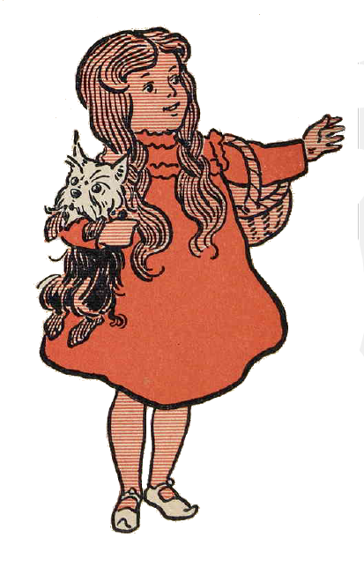
agenda
About Multnomah County
Why did we need a tool?
How did we develop the tool?
Demonstration
Lessons learned and next steps
Notes:
Today’s session is about our two-year journey to standardize storage recommendations for different types of electronic records while continuing to embrace agency-specific business processes.
We’ll start with a brief introduction to our organization in order to provide context to the project.
Next we'll describe the situation that led us to consider creating this type of tool, and why we thought a tool would be an improvement.
Then we will describe the development process, and lead you through the evolution of the tool from our original conception to the final product.
Next we’ll provide a demonstration of the tool.
Lastly, we’ll discuss lessons learned and next steps, and how we hope we can help our users answer the question: Where should I store this?

Slide 6
Learning objectives
By the end of today’s session, you will understand how to:
Identify
Identify key characteristics of your records and records systems
Develop
Develop a standardized process for making recommendations
Customize
Develop customizable tools
Empower partners and users to analyze their own records and make appropriate decisions
Identify desired functionality users need for interacting with records
Incorporate compliance requirements
Notes:
By the end of today’s session you will understand how to:
Help your users identify key characteristics and desired functionality needed for interacting with their electronic records
Develop a standardized process for making recommendations for compliant and useful records storage, and
Develop customizable tools to assist IT partners and business units to analyze their own records and make appropriate decisions

Slide 7
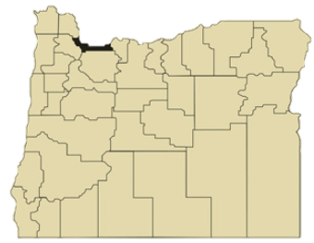
About Multnomah county
Department of Community Services
Property taxes; permitting; animal shelter; bridge and road maintenance; libraries; surveyor’s office; elections
Department of County Management
Law enforcement; supervision and treatment services; victim & survivor and family court services
Department of Community Justice
Sheriff’s Office
District Attorney
Medical clinics; aging, disability, & veterans, intellectual & developmental disabilities, and youth & family services
Health Department
Department of County Human Services
Board of County Commissioners
Joint Office of Homeless Services
Records management; information technology; facilities and property management
Department of County Assets
Notes:
Multnomah County is located along the Columbia and Willamette rivers along Oregon’s northern border. We are home to a fifth of the total population of the state and include Portland and Gresham, two of the state’s largest cities.
The county employs more than 6000 people, and this workforce is distributed across 150 buildings, as well as thousands of virtual home offices.
Our records program of 6 supports our Board of County Commissioners and all departments, whose work includes: community services, public safety, justice, health and human services, and internal support services.
We’re providing this snapshot in order to illustrate the diversity of services, and therefore the diversity of applications and software that support those services. At Multnomah County records management activities are decentralized. This means that our team is responsible for providing guidance across the organization so that ANY office within ANY division within ANY department can manage their records in a way that balances their business needs with Public Records law and other regulatory requirements. Ideally we also help them follow records and information management best practices.
As you can imagine, this requires a lot of one-on-one consultation on a variety of topics.
One common question is: “Where should I store these records?”

Slide 8
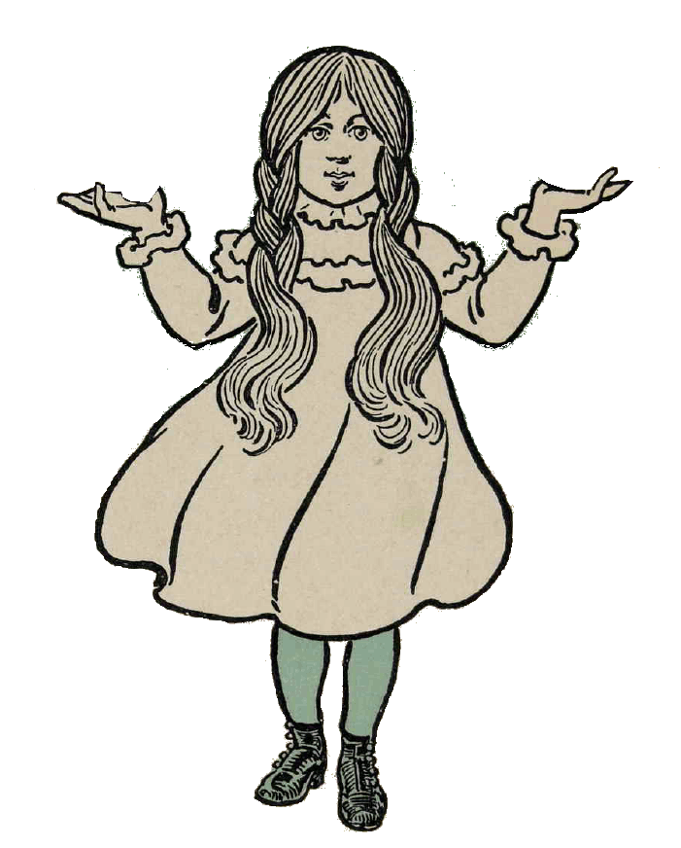
Where should I store these records?
?
?
Employees approach us for three reasons:
Current situation isn’t working (too many files are moved or deleted; no version control)
Concern that sensitive information is stored in an inappropriate or non-compliant place
Aware that public records law exists; want to make sure they’re meeting all requirements
?
?
?
Notes:
Employees approach us for three main reasons.
First is that the way they are currently organizing their records isn’t working for their team, usually because too many items are moved or deleted.
The second is that they’re concerned they’re potentially storing sensitive information such as personally identifiable information, protected health information, or criminal justice information in an inappropriate or non-compliant place.
The third is that some folks are aware of public records law and want to know if there’s anything they’re missing or doing incorrectly.
Traditionally the way to determine the best place to store these electronic records is through a consultation. We can interview people and ask as many questions as needed to be able to provide sound advice.

Slide 9
2018 – The situation
Could we be more efficient but no less effective?
Could we replicate the complexity in a tool and make the results repeatable?
Could we account for subjectivity and be more consistent?
Notes:
Back in 2018 our team was smaller, so I was the only person responsible for holding these conversations. It was then, in the midst of feeling a bit overwhelmed, and like I was repeating myself a lot, that I first thought “is there a way to do this that is more efficient but no less effective?”
These conversations DO have a certain level of complexity that seemed like it might be difficult to replicate in another format. After all, the answer to one question might lead to any series of further questions and our role is to use our subject matter expertise to synthesize the information and make a recommendation, right?
However, it was also clear that certain patterns of responses tended to lead to the same recommendations. And while there is some subjectivity involved, we could see that managing active records is based more in functionality, business need, and requirements, than expert judgment.

Slide 10
2019 – assemble the team
Notes:
Fast forward to 2019. Deidre and our digital archivist Paige Monlux joined the county, so it was suddenly possible to assemble a team to try to figure out if we could create such a tool.
The three of us enlisted our colleague from a different department, Sara Mae O’Brien-Scott, and we were set.
Could the four of us create a tool that makes a recommendation as accurately and appropriately as we would?

Slide 11
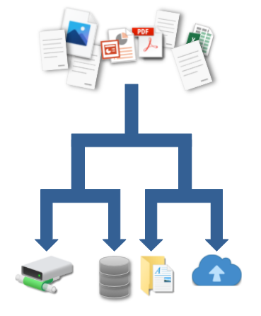
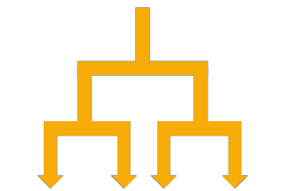
Proposal: flowchart
Goals:
Repeatable and consistent
Flexible and scalable
Easy and efficient
Empower users
Notes:
Initially we proposed a flowchart as a replacement or supplemental tool. After all, this type of consultation was a series of questions, with further questions based on particular responses.
We imagined that a person could journey along our flowchart, and like Dorothy on the yellow brick road to Oz, our users would be on a path to the ultimate repository for their unique situations.
With that vision in mind, I will hand it off to Deidre to talk about what the development process was like to build our yellow brick road.

Slide 12
developing the flowchart
part 2: deidre thieman
Notes:
Thank you Lauren. Now that you understand the context in which we work, we wanted to share a bit about our development process and some of the challenges and pitfalls we encountered along the way.

Slide 13
The flowchart: phase 1
We thought we could reach
with a flow chart…
Notes:
It was obvious from our various case studies that consultations involved a Records representative asking a series of questions and making a recommendation based on the answers that the users gave, so a flow chart seemed to be an obvious solution. Who doesn’t love a good flowchart?
We thought that anyone on the Records team could use the flow chart to move through the questions and, depending on the answers, would consistently, and repeatedly, land on the same advice for an appropriate repository for the type of records the user had inquired about. In this way, we hoped to reach the Emerald City, an improvement in the consistency of the advice Records offered, and to have a scalable solution. There would be no exceptions. And the answer would always be easy.
Of course, it didn’t work. Let me bring you along as we traveled down the yellow brick road.

Slide 14
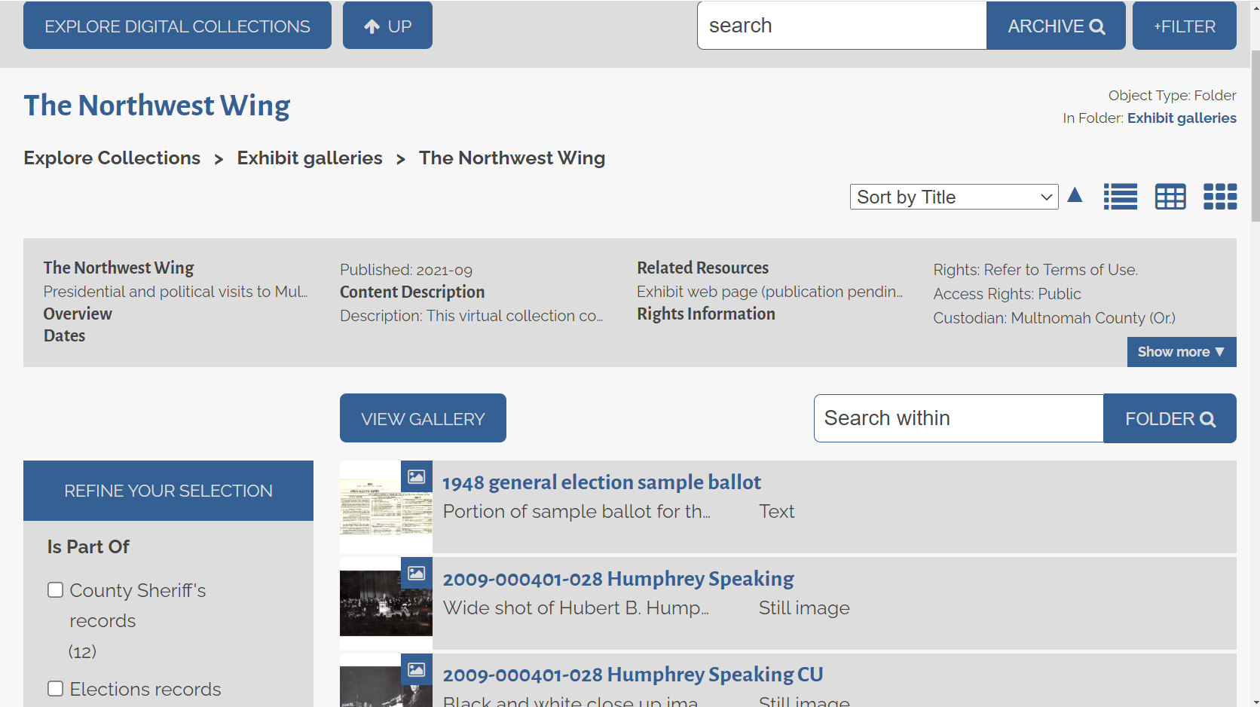
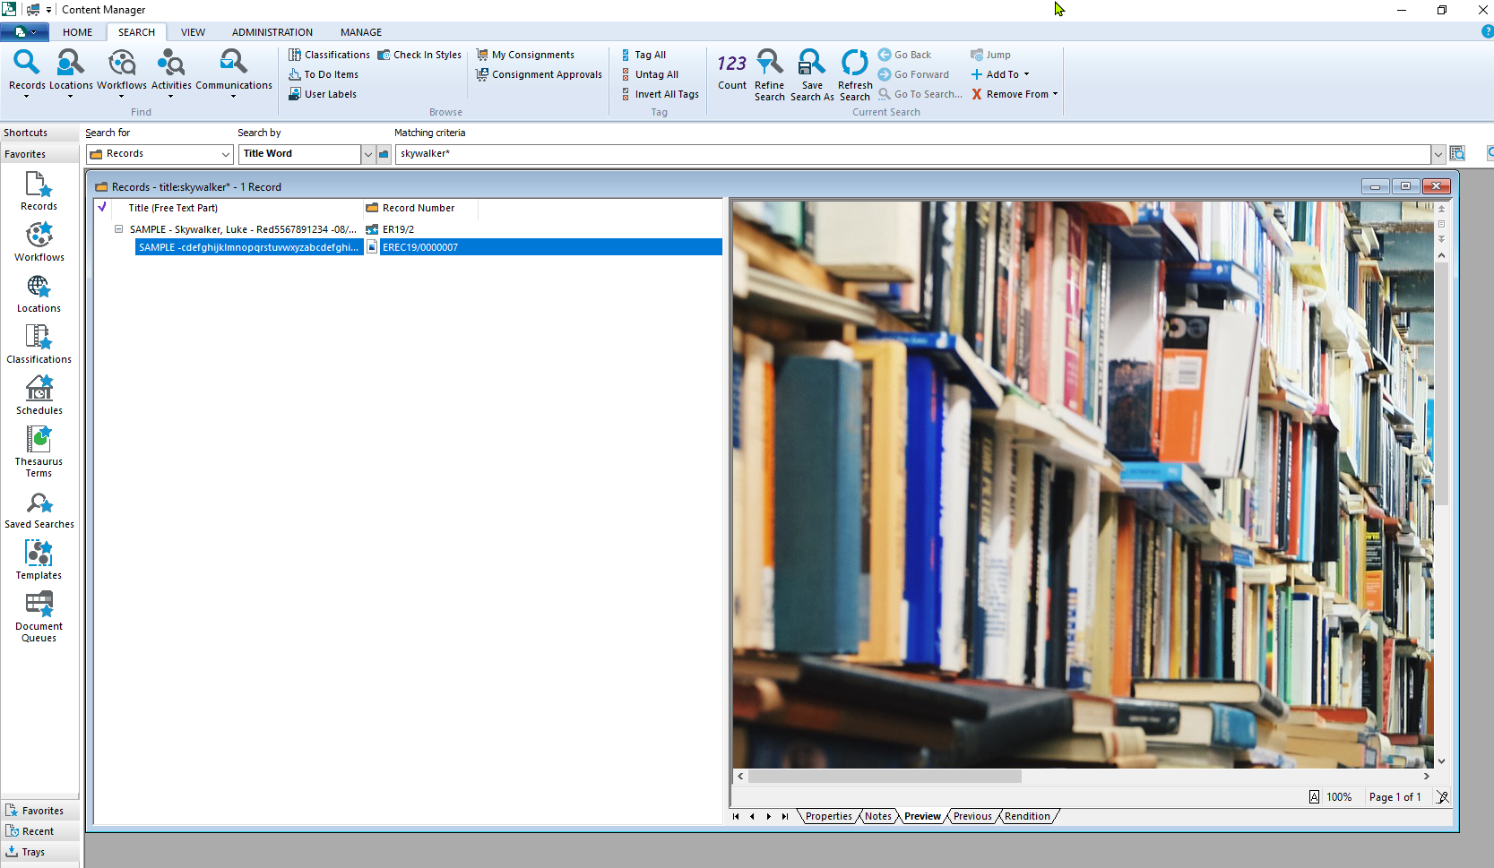
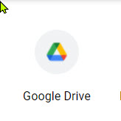
The flowchart: end points
Notes:
We began by identifying the endpoints for our flowchart. These endpoints represent the various electronic repositories that are readily available to staff at Multnomah County. Some of them are simply storage locations, while others are fully functional applications with very specific intentions for use. Please note, these are not system endorsements; they are simply the systems in use at Multnomah County.
Flowchart endpoints include our network drives, consisting of both shared drives accessed by members of a particular program, and individual drives for staff to maintain their own records. These storage repositories are the oldest available and have grown exponentially over time. Often these drives are abandoned when an employee leaves the County.
As of 2010, the County migrated to a Google environment at the enterprise level, so we also have shared and individual Google Drives as options for records storage. One of the great advantages to the Google storage is that, at the time we began this project, it was unlimited storage with our enterprise licenses, but of course, as we long suspected and learned for certain last year, nothing stays free forever.
Finally, we have the Records Management and Archives program’s the favored systems: our eDRMS (MicroFocus’ Content Manager) and our digital preservation system (Preservica).
Our eDRMS is an excellent place to store short and long term active and inactive electronic records which will eventually be destroyed according to the appropriate retention series in our County retention schedule. The system offers several advantages over network or Google storage, including:
powerful keyword, document content, and Boolean searching
sorting and filtering
access controls
and an in-system viewer
Perhaps most importantly the system calculates date due for destruction, so that Records can follow up with the records’ owners to get things disposed in a timely fashion. We’ve noticed that while programs have been getting better at understanding what official records are and that they need to keep them, there is often no disposition of records built into business processes, so they tend to sit on network and Google drives long past the date when they should have been destroyed, or transferred to the Archives.
Our digital preservation system facilitates access and preservation of unchanging, inactive, permanent records through format migrations, metadata schema, and online access to the general public. Here you see the public facing version of an artificial collection created for a virtual display.
Obviously, as Records people, we vastly prefer these two systems and recommend them strongly when possible, but not all of our users want to move away from those repositories that are more familiar to them, or have time to learn whole new applications. Since we are a program that recommends but does not require, we promote, but do not force their use.

Slide 15
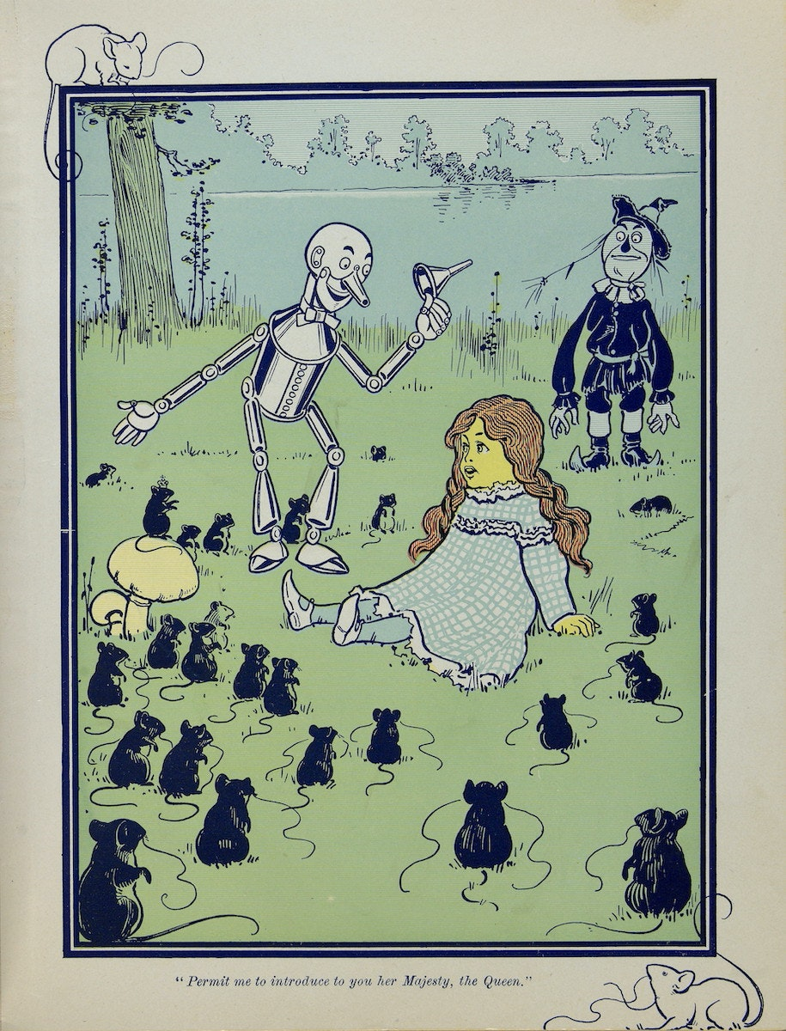
The flowchart: even more end points
And hundreds of
other SaaS applications
used by staff to create records...
Notes:
Of course, we would also be remiss if we didn’t acknowledge that thousands of public records are also created and continue to reside in place in different software as a service, or SaaS systems, custom built applications, and vendor based software.
There was our first roadblock, how do you get a handle on all the different capabilities, or more often lack thereof, of all these different systems? Many of these are legacy systems that were acquired before there was a strong records management program in place, or are required by outside agencies and business partners for collaboration and reporting. Additionally, since the County reviews software, but has no formal process for revoking access to denied or unapproved systems, rogue systems continue to be identified frequently.
We work on this roadblock by participating in various IT meetings such as our Software and Hardware Review Group (SHRG) and our IT Pipeline/Project Governance group where we raise records issues with systems being built internally, or being acquired from external vendors. Awareness is rising, although SHRG is probably very tired of me saying “So, those are public records and we need to make sure the system does X”
Since we had other methods to address SaaS systems, we set those to the side for this project.

Slide 16
The flowchart: approach
Google Suite Capabilities
What questions should be asked?
Required Retention?
Restricted Data?
Transactional?
Off-Network Access?
Essential?
Keyword searching on titles
Ability to create folders for documents
Synch Collaboration
Owned by 1 person
Search by: Modified, Shared With, Title, Date Created/Shared/Modified, Creator, Type, Location, Item Name (within the file itself), Suggestions/Action Items
Priorities Section - Grouping files by separate workspaces
Add/Assign action items to people
Integrations with Calendar and other G Suite Apps
Sharing via URL
Good way to share large files without needing external FTP, Drop Box, Email, etc.
Auto saves to Drive
Ability to disable downloads
But NOT:
Transferrable to a new person
URL not static, new URL for each new version; changes with different security settings
Ever changing and no transparency about updates
No Boolean searching/ Metadata tagging
Difficult to manage permissions and security - too easy to share
Difficult to know what is the authoritative file
Requires download to move into other systems/no bulk export
Version control very; not available in Forms at all
Can’t export comments
No way to lock down hierarchy
No retention capability
Files into unorganized Drive by default
Notes:
With our endpoints identified, we began defining the characteristics of records that would affect their eligibility to be stored in a particular system.
We looked again at our case studies for questions we’d asked in the past. Some of them included:
How long do the records need to be kept? - short term, long term, permanently
Do the records contain protected information that requires specific security measures?
Do the records change over time? Are they transacted upon?
Do staff need to access the records remotely and/or when not logged into the County’s network?
Are the records essential? Do they protect the legal and financial rights of individuals, or are they required for the continuity of operations?
Some of these questions would become the decision points in our flowchart.
At the same time, we looked at the different endpoint repositories and brainstormed what each system could and could not do. On the slide you see our early attempt to define Google drive’s capabilities. We quickly came to understand that we needed much more information about the capabilities of the different repositories. So, while we tried to figure out how to accommodate all these different pieces of criteria in the flowchart, we did additional research, speaking with both our network administrators and our Google IT Project Manager.

Slide 17
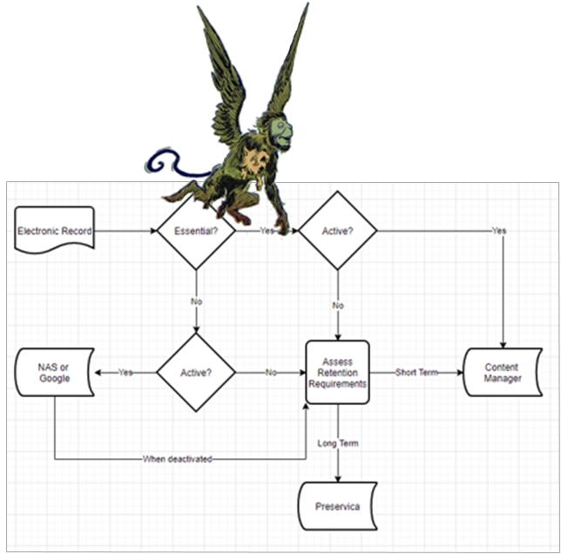
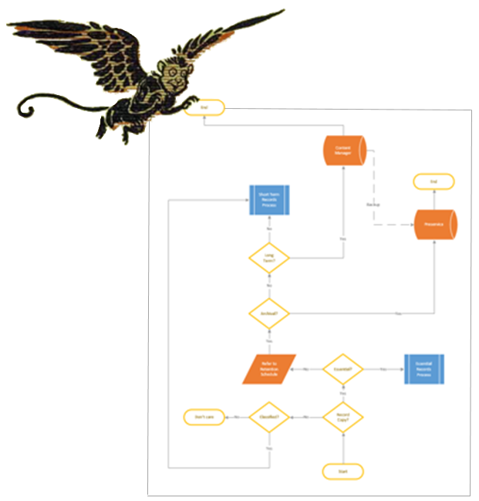
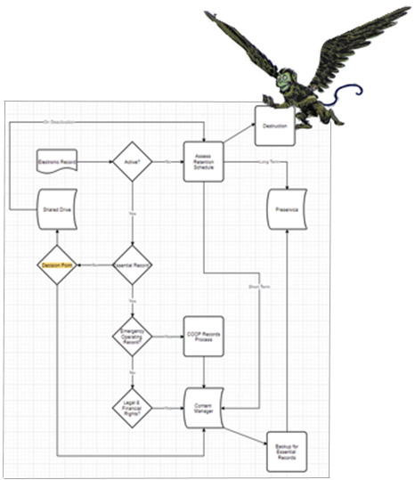
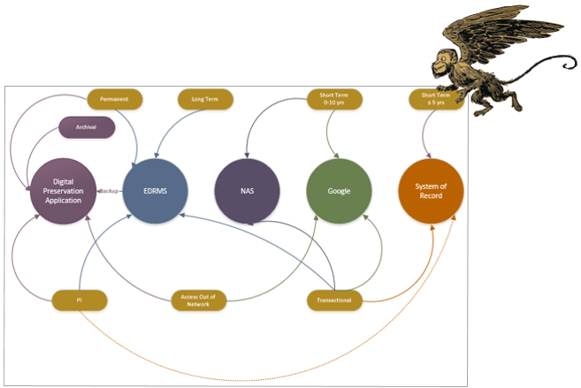
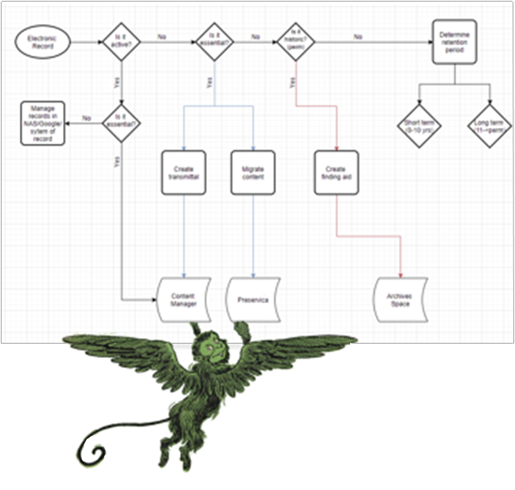
The Flowchart: Iterations
Notes:
Our flowchart iterations quickly became a pack of flying monkeys. We went through iteration after iteration after iteration trying to capture the complexities of the consultations in the simplest workable form. We began in one program, but were changing versions so often that we had to switch to another so we could edit them on the fly as we were meeting. Ultimately, none them worked.
We spent many a meeting just trying to determine the order of the decision points. What was the single most important decision point that would serve as the opening question? Was it Whether or not a records were essential? Or whether or not they had protected information? Or how long they were retained? Or how secure they needed to be? Finally, we determined that the first question was much simpler, we needed to ask if the files the user was asking about were even records at all.
After all, if the user was asking about duplicates of official records, or electronic files that were not records, the conclusion was obvious, put them wherever works for you.
We ran through the various past case studies with the different flowcharts until it also became readily apparently that each case possessed its own nuances which were not being captured. Trying to capture all of those different nuances of business use would bloat our flowchart beyond utility. Some of the case studies even resulted in multiple appropriate endpoints. Choices often did not follow a “yes/no” path, but rather an “if/then” kind of flow.

Slide 18
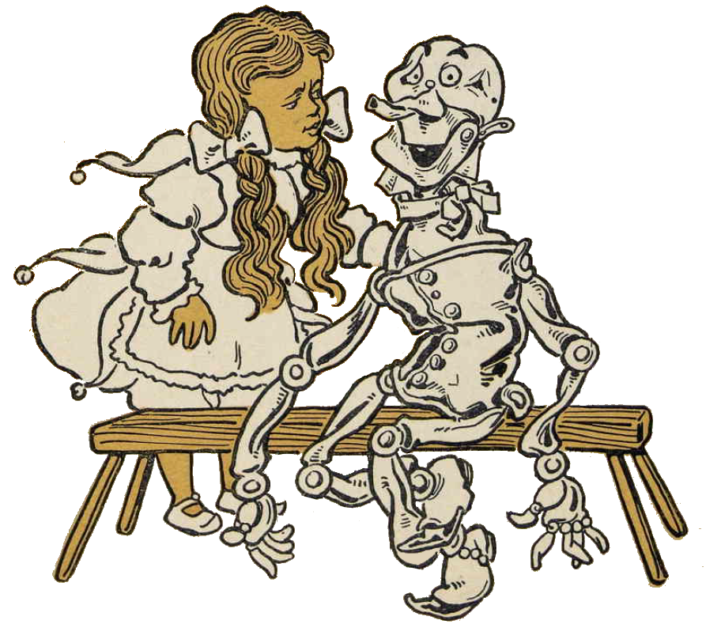
The flowchart: obstacles
Notes:
The flowchart simply oversimplified the situation, so we began to think of other ways to capture all the different decision points, rescuing ourselves from the idea that flow chart was the be all and end all to this solution. Lauren is back to tell you more about that.

Slide 19
Developing the matrices & the it tool
Part 3: lauren kelly
19
Notes:
We went back to the drawing board. Literally.

Slide 20
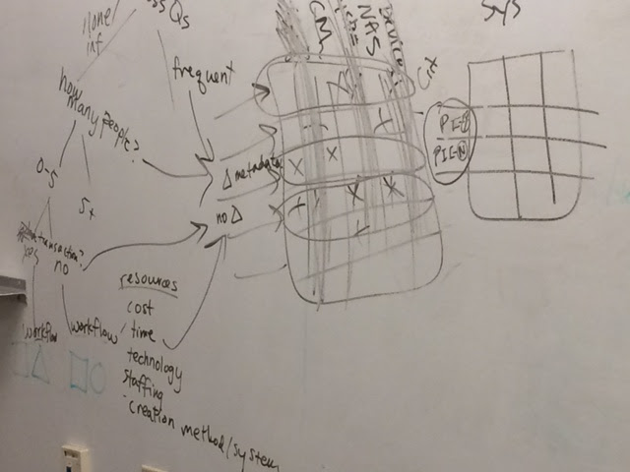
Back to the drawing board
Notes:
We revisited the case studies we’d created from previous conversations with record owners. What were the questions we asked during those conversations? Why didn’t they translate into a obvious flowchart?

Slide 21
Epiphany!
Records characteristics:
Flowchart OK
System functionality:
Flowchart Failed X
User interaction with records:
Flowchart Failed X
Notes:
And we had an epiphany.
We knew we needed to identify and include characteristics of records. There were obvious cases when it was clearly inappropriate to store certain records in certain repositories. For example, we wouldn’t store permanent archival records in Google. And we wouldn’t store short term records in our digital preservation system. When we think about records characteristics we’re able to narrow down our options pretty easily.
We also knew we needed to describe the functionality of the systems, however, we realized that what we were actually describing were the ways that users interact with their records, which is based on available functionality. The combination of these two sets of characteristics is what made it impossible to use a flowchart. Too numerous to depict as a branching tree, and impossible to weight or score against each other, we realized a matrix could bring all these characteristics and functionality into a format where a user would be able to compare across multiple possible repositories.

Slide 22
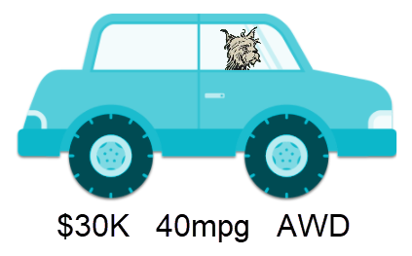
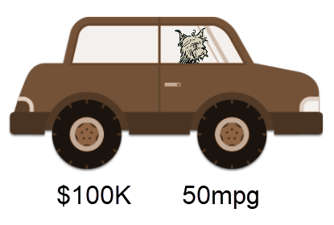
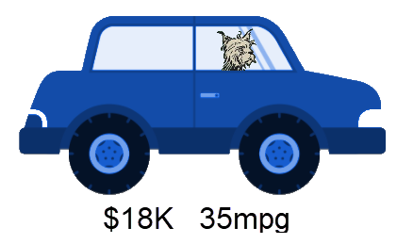
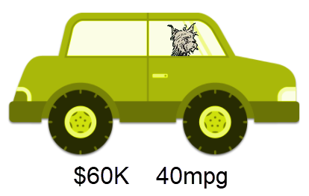
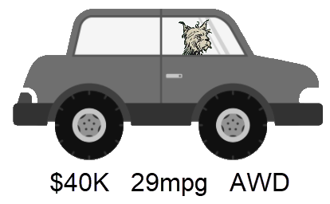
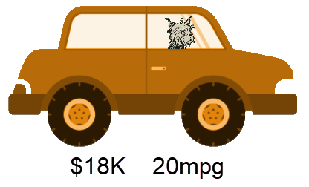
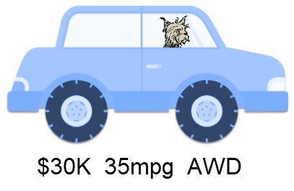
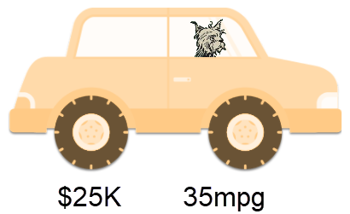
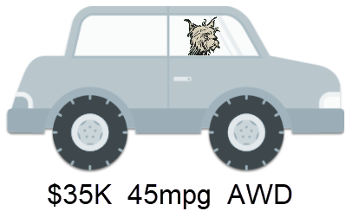
How do we narrow our choices?
Notes:
We realized the process was similar to tools used by shoppers to review options. Let’s say you’re shopping for a new car. You know you have a spending limit, so that instantly eliminates some options that are out of your price range. Then maybe you have a minimum miles per gallon in mind. Lastly you know it must be all wheel drive. While this has narrowed down the list of possible cars it still hasn’t provided you with one option. You no longer have “make or break” criteria. At this point you are really left with cars that meet your needs but have different advantages and disadvantages. What is important to you?? A moon roof? Electric lift gate? Amazing stereo?
How could we build something similar for determining where to store records? And how could we help users narrow it down from multiple similar options to just one ideal choice? We realized that our tool could be a combination of a flowchart and a matrix.

Slide 23
Building the flowchart
Step 1: Flowchart
Start
Records characteristics:
Flowchart OK
Four critical questions
Yes or no answers
-------------
Is it a record?
Does it have long-term retention?
Does it contain protected information?
Is it an essential record?
?
Notes:
Step one was to build to the flowchart. We knew from our epiphany that records characteristics worked well as a flowchart. Which questions should we include? We determined there were four critical questions with clear yes or no answers that tended to have the biggest impact. These were the questions that helped us to quickly rule out inappropriate options.
Is it a record? Does it have long-term retention? Does it contain protected information? Is it an essential record?
By answering these four questions and following the flowchart, you’d end up at one of 7 possible endpoints. Each endpoint represents multiple appropriate options based on the responses.
To get to the single best repository, the user would go to the endpoint’s corresponding matrix in order to compare and contrast the functionality and interactivity of each repository and determine what would best meet their needs.

Slide 24
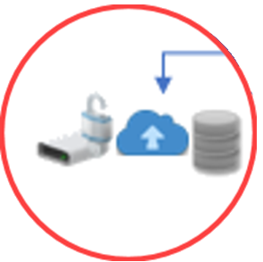
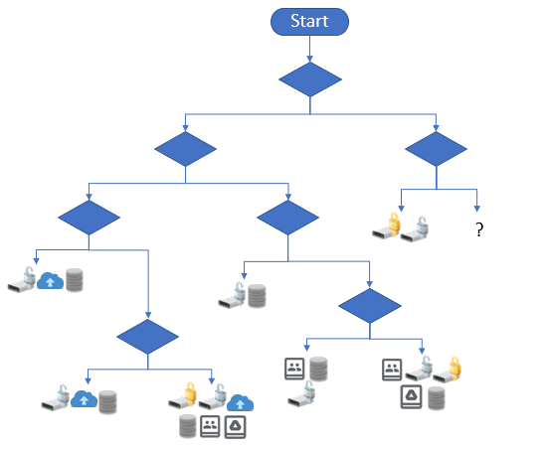
Building the matrices
Step 2: Matrix
System functionality:
Flowchart Failed X
User interaction with records:
Flowchart Failed X
Function 1
Function 2
Function 3
Notes:
Step one was to build the flowchart. Step two was to create a matrix for each of our endpoints that would include the system functionality and user interactivity that did not work in the flowchart. We needed something that would allow us to easily compare and contrast multiple repositories, but still be flexible enough to apply to any records situation. The flowchart took us from nine cars down to three. The matrix would take us from three cars down to one. Where do we start?

Slide 25
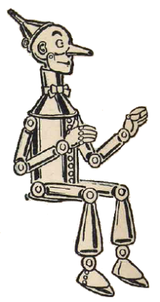
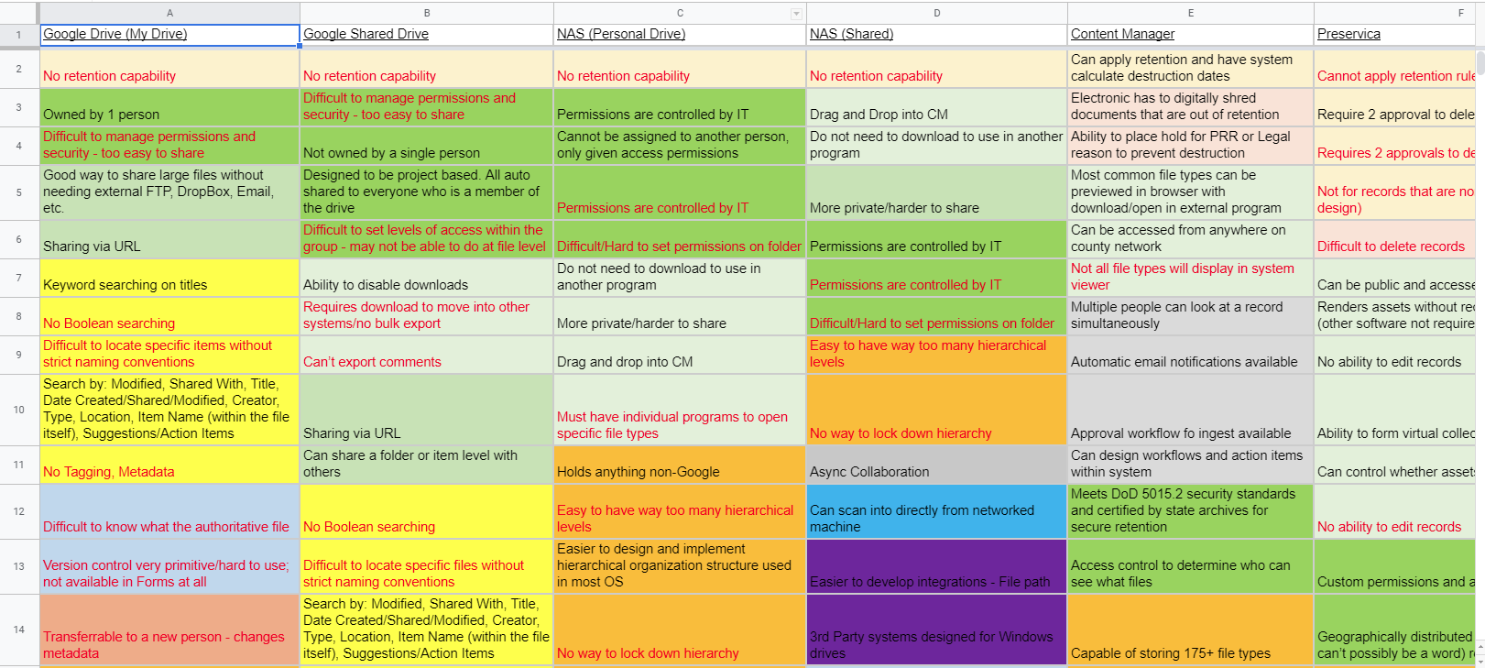
The matrix: initial list
Notes:
A quick note: The following sets of screenshots are for illustrative purposes only, and are therefore too small to read. We’re happy to provide the list on request.
To build our matrices we started by listing system functionality (the second set of characteristics from our epiphany). We asked ourselves What are the features specific to that system (and what are the functions it cannot perform)? For example, we listed items like version control, Boolean searching, and built-in retention management.
The list for each system was extensive, so we went through and sorted the items into categories. The categories were loosely based on NARA’s Universal Electronic Records Management Requirements and ARMA’s Generally Accepted Recordkeeping Principles®, among other resources.
We saw that sometimes the same item was listed in multiple ways so this categorization allowed us to consolidate the items into a more manageable list, and helped us to identify anything that was missing.

Slide 26
The matrix: classify and sort
Notes:
Next, we organized the list by category, and added any additional potential desired or required functionality from the user perspective (the third set of characteristics from our epiphany). For example, users might want to be able to drag and drop files. By thinking about the desired functionality from the user’s point of view in terms of interactivity rather than system capability, we were able to identify anything that we missed when we looked at it from the system perspective.

Slide 27
The matrix: question formatting
Critical: All functionality and interactivity items must be formatted as a question with a yes or no answer.
Examples
Function: version control
“Does it have version control?”
Function: customizable workflows
“Can you customize workflows?”
Notes:
Since the idea was to indicate repository capabilities, we realized that we had to normalize the items in the list into question format where the answer was always either yes or no. For example, the functionality “version control” became “Does it have version control?” We went through line by line to update all functionality and interactivity into yes-no question format.

Slide 28
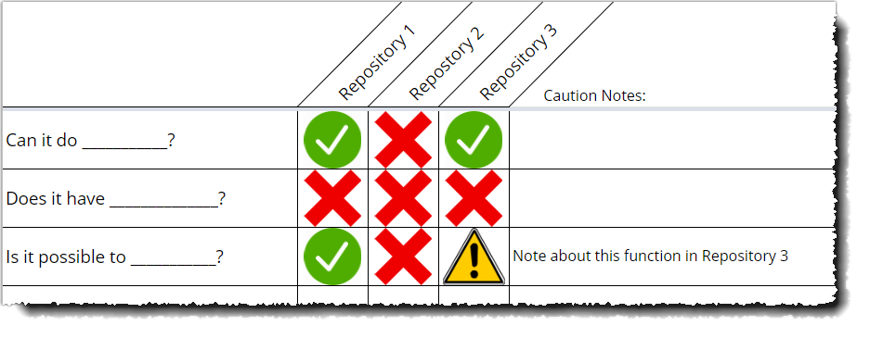
The matrix: consolidation
Repositories
Functions and features
Caution notes
Yes, no, caution
Notes:
We populated everything into a spreadsheet. We listed the possible repositories across the top. We listed the system functionality and desired user interactivity in the left hand column . We went through row by row using symbols to indicate if each system was capable of performing or accommodating each function or interactive item.
We discovered there were some instances where the answer was “Yes, but…” so we marked those with a caution icon, and made a note. A common scenario was that a function was possible but could only be performed by an IT administrator. We felt that a “yes” in that case would be misleading because it requires assistance from someone else, so a caution seemed more appropriate.

Slide 29
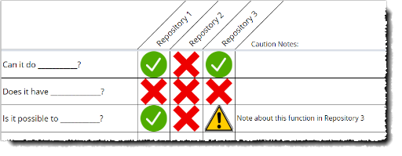
Flowchart → matrix
Flowchart with the 4 critical yes or no questions
Separate matrix for each flowchart endpoint; each matrix includes only the appropriate repositories based on flowchart answers
Matrix 1
Matrix 2
Matrix 3
Notes:
Once we’d filled out the entire grid we duplicated it for each endpoint from our flowchart, and included only those repositories that were appropriate for each set of questions and answers. The matrices vary from two possible repositories to six.

Slide 30
Formatting for users
How do we make this tool user friendly so that people outside our Records Program can use it?
Who are the users?
IT, analysts, records liaisons
Work closely with our team
Comfortable with technology and spreadsheets
Desired tool functionality?
Successful filtering
Printer friendly
Multiple users of a single copy
Considerations?
Glossary
Readability check (plain language)
Color contrast check (digital accessibility)
Color-coding check (digital accessibility)
Notes:
We knew that we wanted to use filtering to make the tool user-friendly. We worked on the formatting until we finally settled on something that would be useful for us, then continued to rework it until we felt we had something that could be used by people outside our group. Up to this point, the understanding was that the tool would only be used by a small set of employees that work closely with us on records matters, not by a general audience. These are mostly colleagues in IT and records liaisons whose role is to help users navigate systems. For this reason we refer to it by the unofficial name “IT Tool” even though it’s not strictly for IT users.
To do that, we made sure that the results were printer friendly. We also made sure that multiple users could access the tool without impacting other users. The majority of our organization uses enterprise Google, so we used Google Sheets for easier access via hyperlinks, rather than requiring downloading files or sharing via email.
We created a glossary and step-by-step instructions. We checked all our questions using a readability tool, checked all the colors for adequate contrast, and made sure it could be used without relying on the colors by using distinct shapes for the icons.

Slide 31
demonstration
Notes:
And now without further ado, we will provide a demonstration of the tool.

Slide 32
demonstration
Notes:
We start by clicking the link to the flowchart, provided in the instructions.

Slide 33
demonstration
Notes:
The flowchart includes definitions, along with a link to the accompanying glossary.
Let’s say that a user has come to us because they have an application that creates a set of records, and they want to know the best place to store them.
We begin at the top by asking are they the official copy? The user tells us yes and we move to the next question.
Do they have long-term or short-term retention? After consulting the retention schedule we determine that they have a retention period of 5 years, so we follow the short-term branch of the flowchart.
Next, we ask if they contain protected information, like PII. The answer is no, so we continue to the last question on this branch: are they essential.
The user says yes, they need them for continuity of operations. That brings us to Endpoint E. We click on Endpoint E and it takes us to the corresponding matrix.

Slide 34
demonstration
Notes:
As you can see, that particular set of questions and answers has provided three acceptable repositories for storing this user’s records. Now we can help them compare and contrast.
All the functionality and interactivity is listed on the left. We gather those that are most desirable to the user and use the filter to narrow it down. We’re able to type in keywords, or scroll through the list.
Our user would prefer to be able to --customize metadata, --search using keywords, --disable the ability to download, --collaborate in real time, --enable version control, --use workflows, --send email notifications, and --apply retention rules.
After adding all the desired items we click OK, and are presented with a much more manageable list, including any notes. We can now print this out or save as a pdf, so that the user can take it with them. They can also use this to compare with the original system that creates the records. The user is able to make a storage decision with all the pertinent information in front of them. They’re able to make decisions and balance their needs with the best available options, without wasting any time considering repositories that are inappropriate.
Now that you’ve seen the tool, I’ll hand it back over to Deidre to talk about the outcomes of user testing, and our next steps to further develop the tool into something that could be used by anyone.

Slide 35
Outcomes & what’s next?
Part 4: deidre thieman
Notes:
Thank you Lauren.
Now that you’ve seen the final IT Tool, so called because of the audience it was originally intended for, and how it works, we wanted to walk you through the Outcomes and Impacts of the project as well as the work there is left to do.

Slide 36
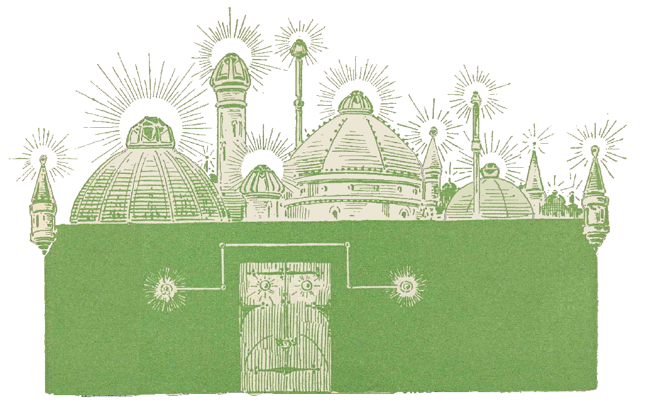
At the gates of the emerald city
Notes:
We arrived at the Gates of the Emerald City, so to speak, and in order to unlock them we needed to get some feedback from outside of the project team, so that we didn’t continue to try and improve the tool without input from those we hoped would use it.
We selected one of our IT Business System Analysts and a Program Communications Specialist from our Asset Management group whose job includes records responsibilities. We’d advised both these people on various records issues over the years and asked if they’d be willing to try the tool out and provide us with their thoughts.
From both, we hoped to hear that the tool would be useful when they were speaking with County users about where to store things. We also requested their likes and dislikes about the tool.

Slide 37
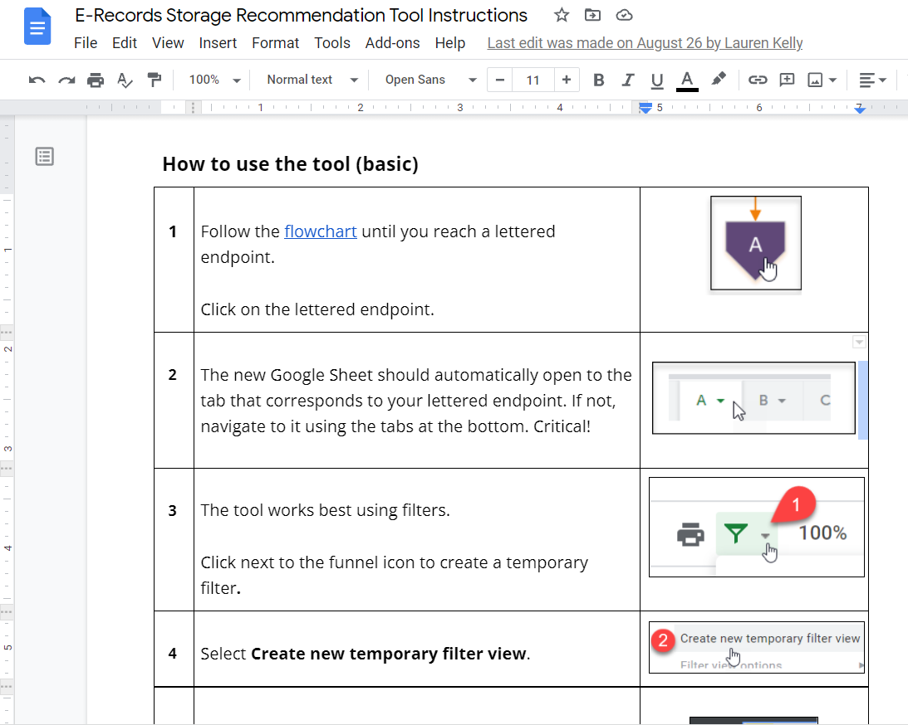
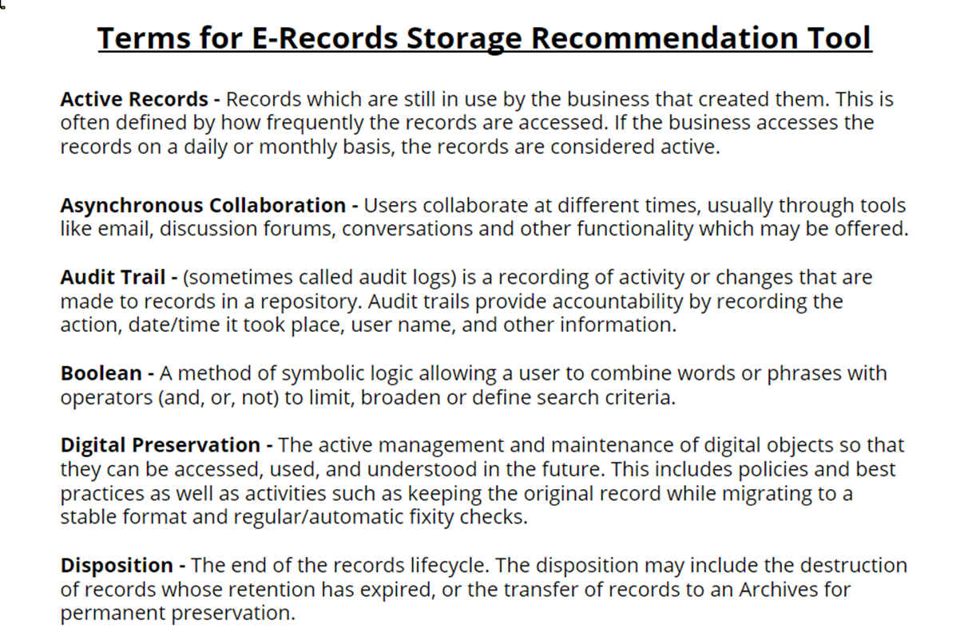
Testing the tool
Glossary
Notes:
We didn’t provide a lot of set up information for our testers, simply asked them if they’d be willing to take a look, and then, if they said yes, we provided them with the Tool Instructions (at left), which contained links to the Glossary, seen at the right. The Glossary was specifically included because we’d come to understand that people often used the same terms to mean very different things, especially between IT and Records. For example, we knew at the beginning of the project that much of staff at the County referred to sending inactive records to the Records Center as “archiving” them, which causes difficulty when you’re trying to differentiate archival processes and systems from records processes and systems.
The initial feedback we received was good, stating that the flowchart and the linking between each element of the tool worked well in Google. We heard that “…the result was very clear and easy to make sense of” and that our user would be comfortable sharing them with “…program managers and the like.”

Slide 38
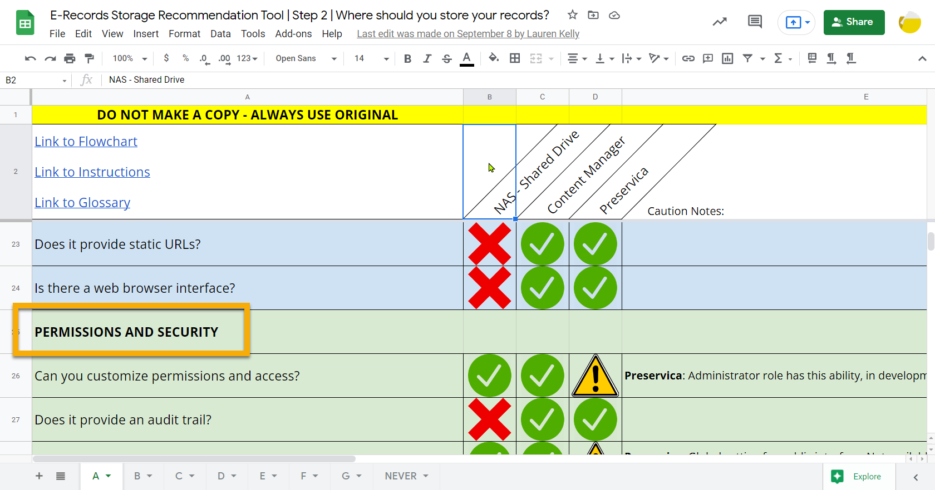
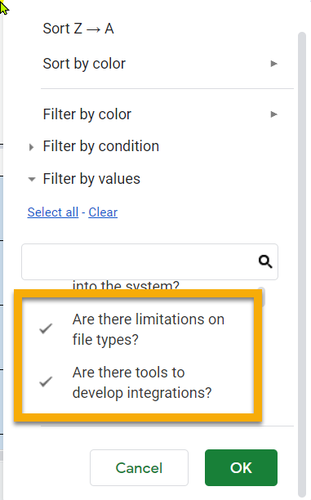
Formatting & filtering issues
Notes:
One tester had some issues with readability on the Google sheet for the matrices which would have to be worked on, but the largest issue seemed to be with filtering the matrices in the Google Sheet, and was a result of Google’s functionality rather then our design.
As you’ve seen, on the sheet itself, the questions are arranged thematically. However when you click to filter, the questions are arranged alphabetically in the filter box, rather then the order that they are on the sheet itself. It was difficult to switch between the two arrangements to locate the filters the tester was looking for. Additionally, if you click outside the filter box, to see something in the Glossary, for example, Google does not save your prior selections in the Filter.

Slide 39
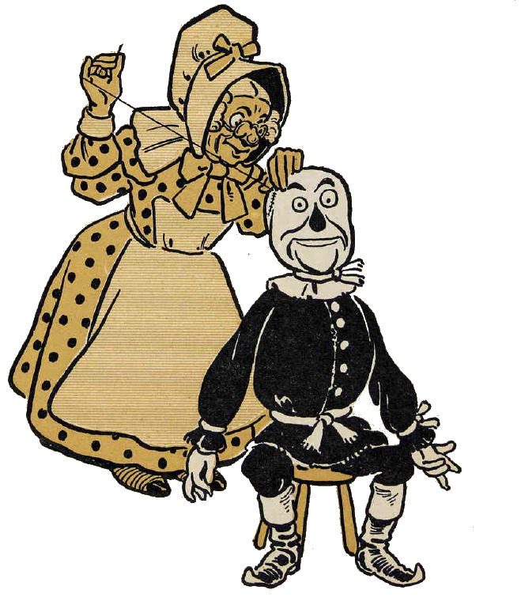
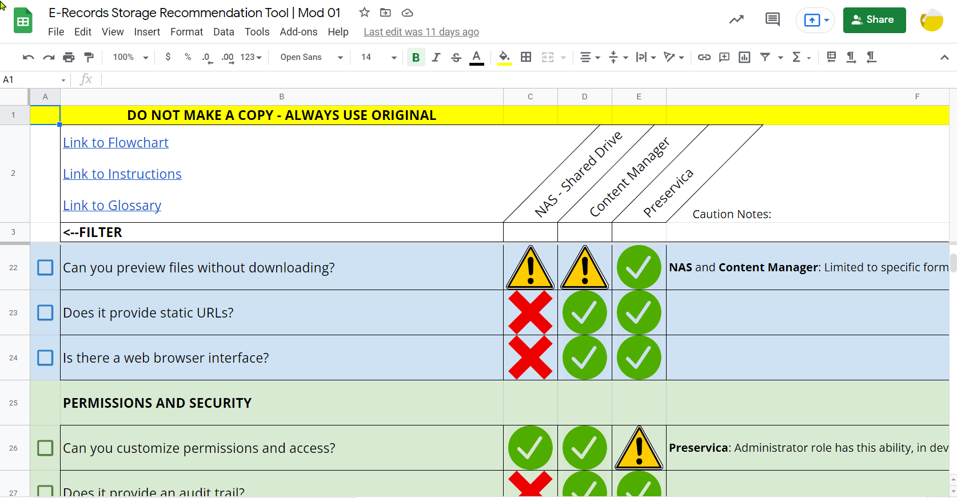
Making repairs
Notes:
We set to work on some repairs, creating a checkbox to the left of each question , so a user could filter by only the checked questions, i.e. see only the systems with functionality they needed for their business use. The only sticking point with this solution was that there was no way to easily clear all selections and start again.

Slide 40
The Magic of Clear All
Notes:
We were aware that Google sheets had the ability to incorporate scripting, and this proved to be the solution to our dilemma. In our latest version of the tool, as you can see in the video, our user can select the criteria most relevant to their records and business needs and then apply a filter to narrow the choices down the systems that possess that functionality. This filtered criteria is then able to be printed or saved to PDF if they need.
Once they have completed their analysis, they can click on the scripted Clear All button to remove the checkmarks and then undo the filter to return to the full sheet of choices. In this way, the sheet is re-useable for many different customers and records situations. While still imperfect, we hope that this addresses the original critique when we send the tool out for the next round of testing.

Slide 41
analysis
Repeatable & Consistent
Used by multiple people for same conclusions
Similar types of records result in same recommendations
Flexible & Scalable
Tested with large and small records sets of various types
For systems holding records also
Easy & Efficient
Records & IT Users able to move through the tool correctly
Instructions for use clear and terms defined appropriately
Empower Users
Do IT customers find it helpful when consulting with their customers
Is there more understanding of what repositories are more appropriate?
Notes:
Now that we’d reached the Emerald City, even if we hadn’t yet reached Oz himself, we checked in on our original goals to make sure the tool was Repeatable & Consistent, Flexible & Scalable, Easy & Efficient and would Empower Users. Although the project team thought that it was, we needed to test the tool again with a broader audience to be certain.
We also wanted to align our project with the County’s values as much as possible. We realized along the way that the whole project was an effort to reduce bias in record keeping. That is if we gave clear and consistent advice that could be applied to multiple types and sizes of records cases while being easy enough for end users to utilize, the selection of records being retained long term and permanently relied much less on perceived importance and much more on consistent decision making and good records management practices.

Slide 42
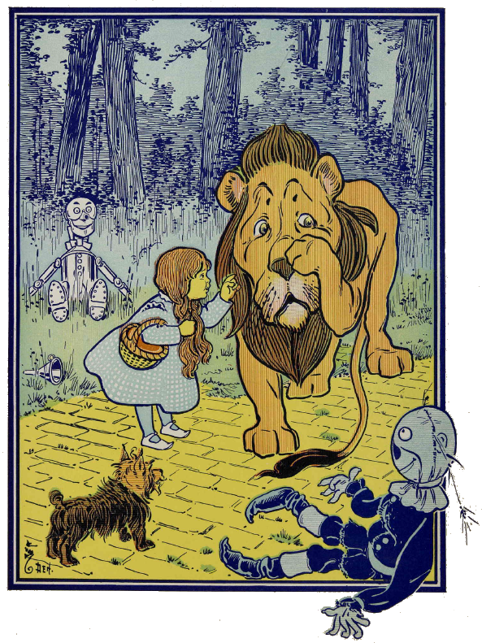
What’s next?
Additional Feedback & Repair
End User Tool
Commons Home
Notes:
So where do we go from here? After all, we reached the Emerald City, but we haven’t had our audience with the Wizard of Oz. The tool is not yet in use. We are collecting additional feedback from other test users to make final improvements to the IT tool.
We are also currently working on a re-design of an intranet website known as Commons where we envision this tool living in an Electronic Records section for staff to use. By putting it in a central, familiar location and preventing copies, we hope to be able to update the tool as needed when new system functionality is discovered or implemented.
Finally, we’d learned from other projects that Records end-users, county staff outside of IT or Records specific functions, respond really well to learning via games and quizzes, so we are resolved to create an end user tool that functions like the IT tool, but is more interactive and fun.
After that we will bring the project to a close, about 3 years since its inception.

Slide 43
An end user tool: brainstorming
Notes:
Although the end user tool is not finished in time to show it to you, we can share a bit about our development process for this as well. On the slide you see our brainstorming. We reasoned that there needed to be a different tool for end users to better facilitate different learning styles. We also knew that tables (like spreadsheets) aren’t terribly friendly for assistive device users and we support the county’s digital accessibility goals, so we hoped to produce the tool in an alternative format, giving end users a choice to determine which they’d like to use.
Words like Quiz style, gamification, and interactive learning dominated our thoughts. At the same time, we had been discussing an authoring tool for creating online Records education, so we combined the two needs and began to evaluate options.

Slide 44
Needed capabilities
Templates
Branching Logic
Digital Accessibility
Interactivity
Ability to have multiple endpoints
Graphical Interface
Notes:
We began with authoring systems that had been successful elsewhere in the county and amongst professional colleagues and contacts. During our evaluations of three different systems, we tested not only their applicability for designing online classes, but also their ease of use and functionality that could be applied to our End User tool. We wanted something that would not have a huge learning curve to use, since we were eager to get our tool designed and published for the benefit of County staff.
We looked at multiple products. Some of the functionality we were looking for was:
- Ability to create interactivity
- Ability to create branching logic
- Preloaded templates
- Non binary endpoints
- Digital Accessibility features

Slide 45
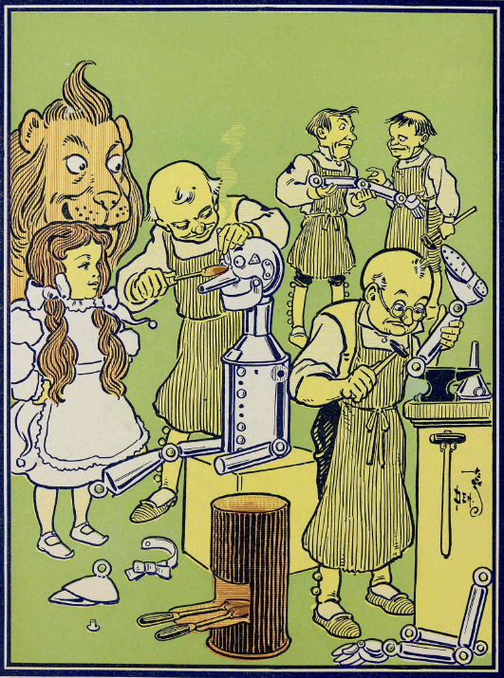
An end user tool: thus far
IT Tool
End User Tool
?
Notes:
As a result of our testing, we identified a system that would be suitable to build our end user tool. The project team now consists of just 2 myself and Lauren, but we look forward to translating the IT tool into an end user tool as time allows.

Slide 46
The fallacy of a single solution
Oh Google!
What do we do with SaaS applications?
Terminology Issues
Isn’t there one place?
Notes:
Through it all we learned that there’s not a single solution to this issue. We hope you enjoyed seeing what our project produced and that there are some useful lessons here for others that exist in complex and unregimented records environments.
We encountered challenges with technological limitations in our Google environment, and challenges with our de-centralized records management environment, but hope that this project and the tools that result from it can be used to assist the county with developing best practices for all the public records it creates and stores.
We didn’t forget about those SaaS systems either. We are working on a project with IT to help those records questions be answered prior to system builds or procurement. Their new form for submitting software to be evaluated now contains a question about whether the system will hold public records, which is a huge win for us.

Slide 47
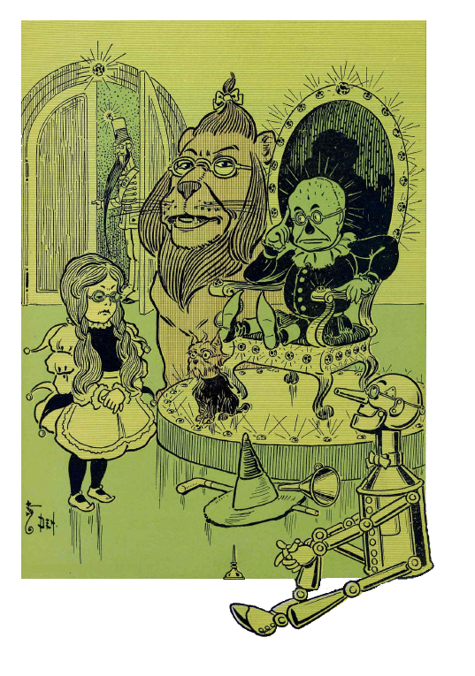
closing
OZ
Multnomah County Records Management & Archives
records@multco.us
Notes:
Now, we are most definitely not Oz, the Great and Terrible, but we are happy to gather round and answer any questions you might have for us.
Thank You.

Slide 48
Questions & Comments

Slide 49
Stay connected & informed
CoSA Website
CoSA Resource Center
CoSA Twitter Handle: @StateArchivists
CoSA Facebook Page
CoSA YouTube Channel

