Slide 1
Hiring at State Archives A CoSA Presentation
Kristina Intinarelli, UIUC iSchool
Meredith Lowe, UW-Madison iSchool

Slide 2
Briefly about us…
Meredith Lowe
Kristina Intinarelli

Slide 3
How does hiring make you feel?
ⓘ
Click Present with Slido or install our Chrome extension to activate this poll while presenting.
Notes:
📣 This is Slido interaction slide, please don't delete it. ✅ Click on 'Present with Slido' and the poll will launch automatically when you get to this slide.

Slide 4
First, poll questions!
When was your most recent hiring process?
Let’s discuss….
Was your last hiring process successful?
Let’s discuss….

Slide 5
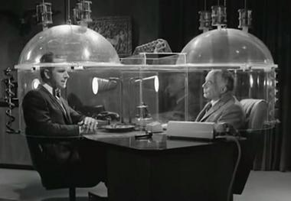
Breakout
Ground Rules
> Cone of silence! (Do not discuss what others say in this meeting.)
> Be present.
> Be kind.
> Approach challenges with curiosity and patience.
Cone of Silence from Episode 1 ("Mr. Big", 1965) of Get Smart. https://en.wikipedia.org/wiki/Cone_of_Silence_%28Get_Smart%29 (accessed 3/28/2024)

Slide 6
Small Group Discussion (8 mins)
Introduce yourselves, elect a volunteer scribe for your group
What do you perceive as the 2-3 biggest challenges to hiring at your organization?
What is your most recent or most memorable hiring victory? This could be something like: you hired the perfect candidate, you were able to improve a hiring process, you advocated for an opening to be approved…

Slide 7
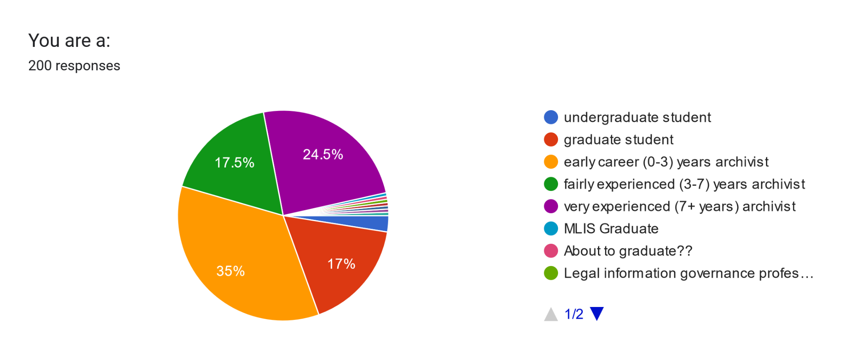
Brief Survey Dive
200 responses to a short survey

Slide 8
Top Reasons Candidates Hesitate to Apply
Salary.
Candidates are deterred if a salary is not listed and many stated that they will not apply at all if no salary range is posted.
Candidates are deterred if they perceive a salary as too low to be livable for the area’s cost of living, or if the education/experience required seems to be out of line with the salary range.
Job duties are unclear, or seem too numerous or varied for one person to realistically achieve successfully
Candidate uncertain whether they would meet the qualifications for consideration
Several comments about AI application reviewing systems not understanding nuanced information, so fearing application will never get to the hiring manager

Slide 9
Other reasons candidates do not apply:
The position is temporary or part-time (or both) - though you may attract certain candidates for these positions, especially those looking for hybrid/remote.
Perception that internal candidates are always favored, regardless of qualifications
The position’s location is perceived to be hostile to their identity or family’s situation, often due to passed legislation

Slide 10
Candidates look for jobs that…
Convey the culture of the work environment and call out attractive elements of the location
Source: CalCareers, https://calcareers.ca.gov/CalHrPublic/Jobs/JobPosting.aspx?JobControlId=423359. Accessed 3/28/2024

Slide 11
Candidates also look for jobs that…
Are stable, permanent positions providing health insurance, paid time off, and retirement benefits
Provide benefits/perks such as:
Relocation assistance, hybrid/remote work schedule, flexible schedule, funding for continuing education, support for service time in professional organizations, etc…
Support and align with them where they are in their career and seem interesting and aligned with their expertise
Notes:
POLL QUESTION Does your state archive offer any of these perks or benefits (all that apply)?

Slide 12
Kristina: Student perspectives: What are they looking for?
Gearing students towards State Archives jobs and considering the audience “traditional students”: - can relocate - early-career explorers - want work with a social justice lens - interested in opportunities to engage with work that reflects ethics and duty of care. _ Flexibility/ hybrid workplaces are attractive. “nontraditional students”: -career changers or professional development driven students - not as interested in relocation - want opportunities to engage with social justice frameworks in archiving - more interested in salary, growth, and “leveling up”. - Flexibility/ hybrid workplaces are attractive.

Slide 13
Student Perspectives cont.
Attracting the right fit and reframing job descriptions: - Writing job descriptions that match audience expectations: - phrases like “early career archivists encouraged to apply” are beneficial - demonstrate workplace culture - how does the work challenge or investigate the status quo? - be clear about flexibility and on-site work expectations - adjust expectations for entry level experience (learning skills on the job)

Slide 14
Getting the word out about State Archive positions:
Reaching students early: - partnering with iSchools for Practicum, Internships - GLAM Career Jam, virtual or in-person job fairs - Virtual informational workshops and presentations - Advertising during graduation cycles, be willing to wait for graduates!
Alternative advertising: - send applications to iSchool communities/ Career Services units - Utilize alternatives like social media (Instagram, Facebook) - pipelining Internship or Practicum opportunities

Slide 15
Small group Discussion
Are any of you already employing some of these strategies, or could you start doing so? Discuss!
What else came to mind during this presentation? What ideas can you share?

