Slide 1
Wrapping Up RATOM: A Summary and Lessons Learned from the Review, Appraisal, and Triage of Mail Project
Use the chat box at the right of the screen to tell us who you are, where you’re from, and who is participating with you today.
(To open the chat window, click on the CHAT icon in the upper right corner.)
Connect to the audio portion of the webinar through your phone line or through VoIP.

Slide 2
WELCOME!
Spring 2021 SERI webinars
May: Building a National Finding Aid Network Update (NANFAN)
June: Building your Resume for the Digital Era
Resource Center
https://www.statearchivists.org/resource-center/resource-library/
Jamie Patrick-Burns
State Archives of North Carolina

Slide 3
SERI ONLINE RECORDINGS
FAQ’s on Bit Rot
https://www.youtube.com/watch?v=a50B801U0RA
Other recordings on YouTube channel

Slide 4
TODAY’S PRESENTERS
Christopher (Cal) Lee
University of North Carolina at Chapel Hill School of Information and Library Science
Sangeeta Desai
State Archives of North Carolina
Kam Woods
University of North Carolina at Chapel Hill School of Information and Library Science

Slide 5
Motivation

Slide 6
Selection and Appraisal
Despite progress on various technologies to support data management and digital preservation, relatively little progress on software support for the core activities of selection and appraisal
Selection/appraisal decisions are based on various patterns
When patterns can be identified algorithmically, software can assist the process
LAMs frequently want to take actions that reflect contextual relationships
Timeline representations and visualizations can also provide useful, high-level views of materials

Slide 7
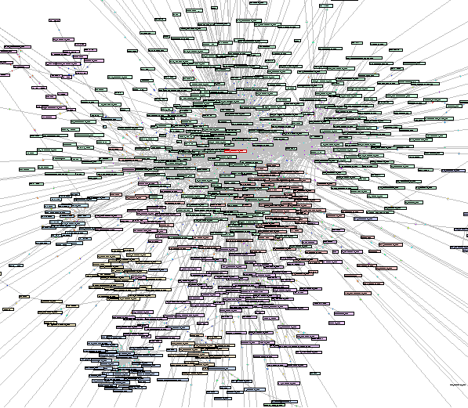
Email
About 50 years of email creation
Hundreds of billions of messages generated every day
Most has little long-term retention value, but some absolutely does
Despite presence of numerous other modalities, email still deeply embedded in activities, serving as massive source of evidence and information
Often found in collections and acquisitions with other types of materials
http://hci.stanford.edu/~jheer/projects/enron/v1/

Slide 8
Review, Appraisal, and Triage of Mail (RATOM)

Slide 9
Review, Appraisal, and Triage of Mail
Funded by Andrew W. Mellon Foundation (2019-2020). Currently extended through 2021.
Developing and aggregating software (including NLP and machine learning) for selection and appraisal of email held in collecting institutions
Support for iterative processing - information discovered at various points in the processing workflow can support further selection, redaction or description actions
Mapping of timestamp, entity, sensitive features and other elements across the tools
Ray Tomlinson
Implemented first email program on ARPANET. Credited with invention of first email system.

Slide 10
Team
UNC
Cal Lee
PI
Eliscia Kinder
Project Manager
Antoine De Torcy
Software Engineer
Kam Woods
Technical Lead (UNC)
SANC
Contract
Camille Tyndall Watson Co-PI
Jamie Patrick-Burns
Investigator
Sangeeta Desai
Technical Lead (NC DAR)
Caktus Group
Software Development

Slide 11
Software Overview
Libratom and the RATOM Iterative Processing Web Tool

Slide 12
Development to date - libratom
Python library to parse and analyze PST, OST, and mbox email formats
Wraps functionality from libpff, Python mailbox, and spaCy 3
Extracts and analyzes email message content and headers; identifies and classifies entities identified in email bodies
Performance scales with processor core count; per-core memory usage never exceeds 1.6GB in default configuration, irrespective of input size
https://www.github.com/libratom/libratom
libpff
email
spaCy 3
Library to access the Personal Folder File (PFF) and the Offline Folder File (OFF) format
multiprocessing
Multi-language NLP processing
Python support modules
libratom
Scalable open source email processing library
sqlite3 database and derived reports
Features generated and stored are VERIFIABLE, REPRODUCIBLE, AND REUSABLE
This facilitating understanding changes in assessments of materials over time.

Slide 13
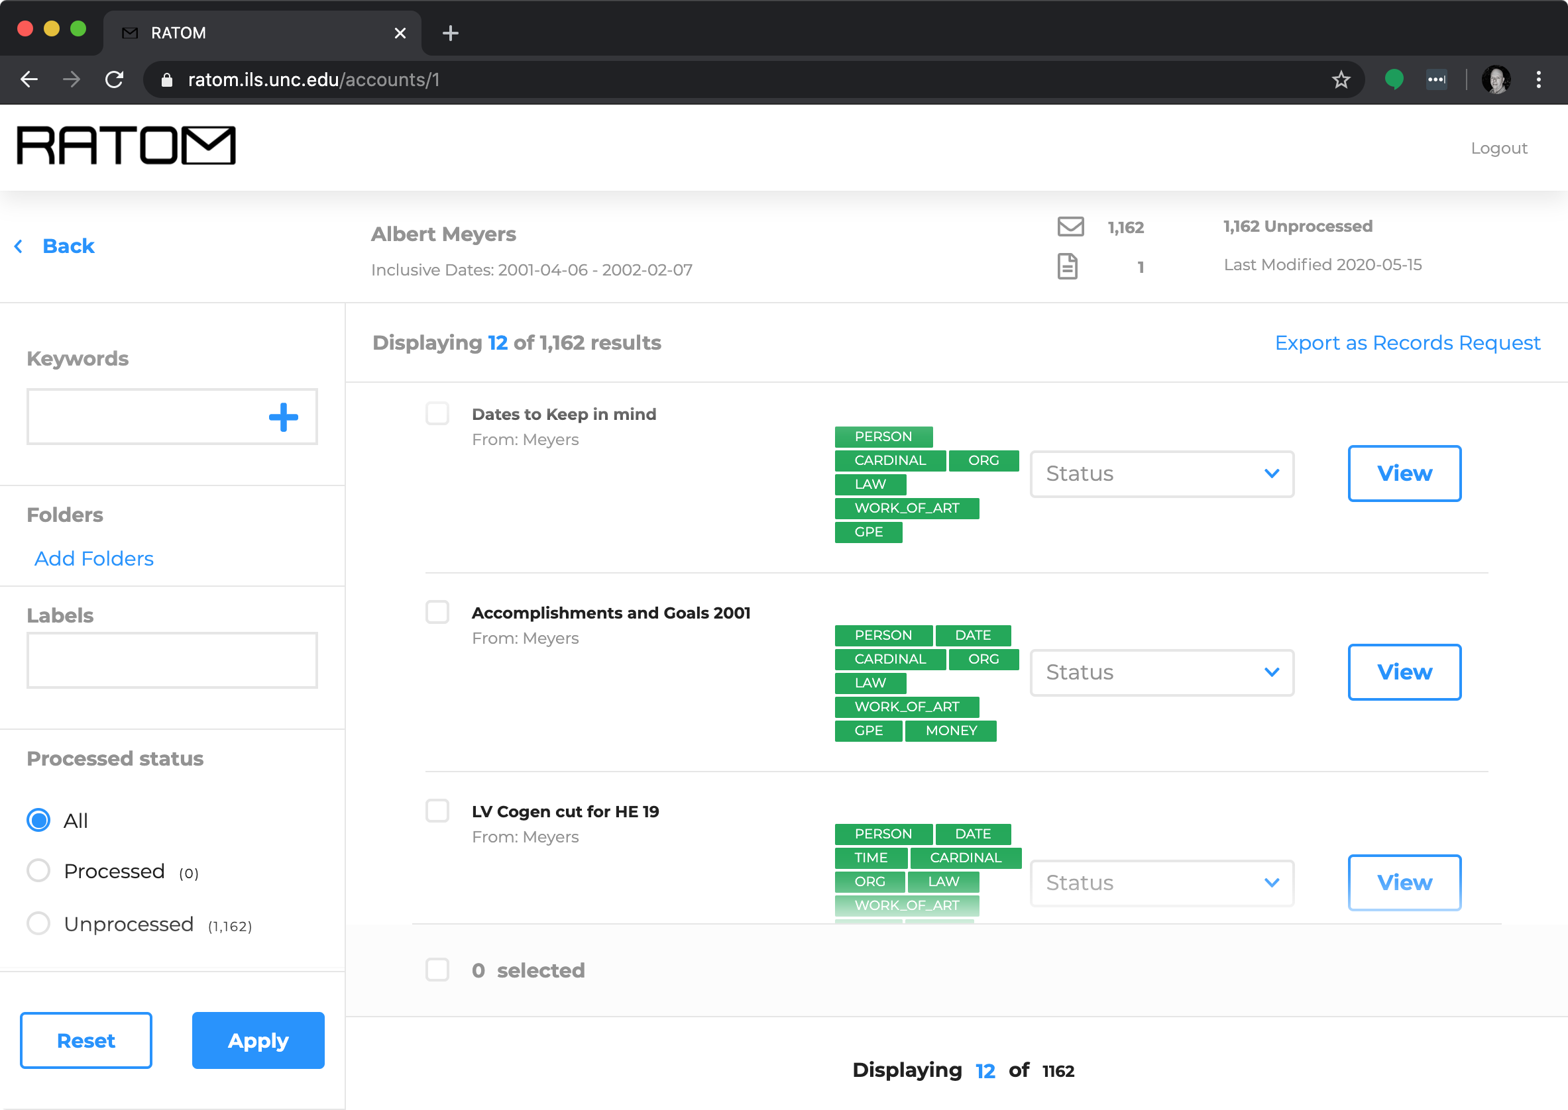
Development to date - Iterative Processing Web Tool
Assist archivists in reviewing email materials for retention and/or release.
Import of email accounts from PSTs and entity identification via libratom
Creation of processing accounts associated with individual email users
Interactive review and tagging of email messages within these accounts (e.g. “record”, “non-record”, “redact”)
Export of selected messages as EML for retention or release
Currently in pre-production at SANC
https://github.com/StateArchivesOfNorthCarolina/ratom-deploy

Slide 14
Using libratom with the CLI and exploring the output

Slide 15
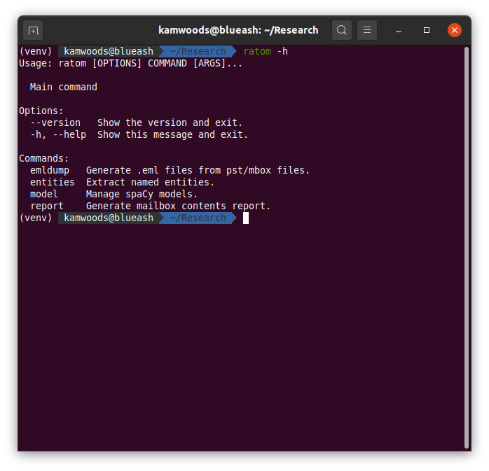
Using libratom with the CLI
The ratom command is a simple CLI for processing email. Multiple subcommands:
entities populates a sqlite3 database from a single email file or directory of files. Responsive feedback on long jobs (timed progress bars) and automatic multi-core job distribution to handle large collections.
model command allows swapping of entity identification model(s) in use, including access to previously released models and multi-language models
report command generates a fast report, populating the sqlite3 database without entities (but optionally including message text and headers)
emldump provides a mechanism for generating EML files using JSON structured message ID lists produced by the web app (may also be used standalone)

Slide 16
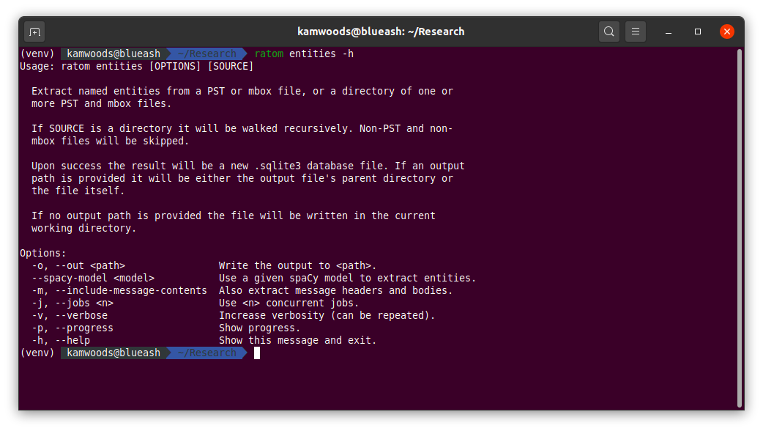
Using libratom with the CLI

Slide 17
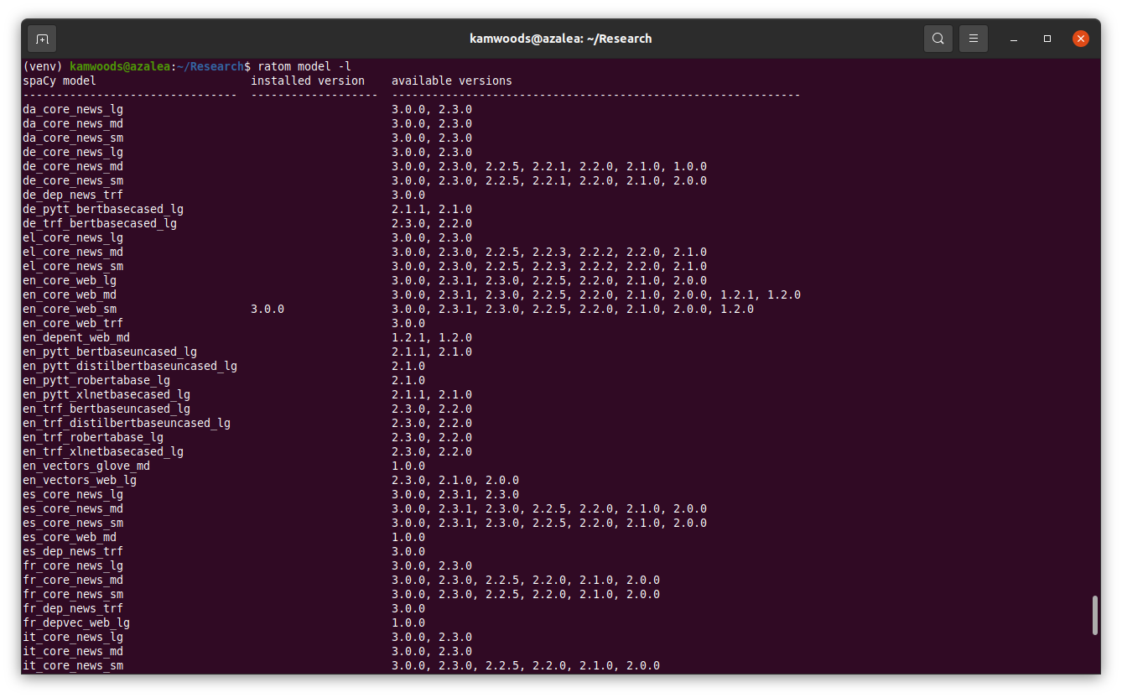
Using libratom with the CLI
New transformer-based pipeline models in spaCy 3.0 provide better NER accuracy. The en_core_web_sm model is still loaded by default in libratom 0.5.0 (default for minimum download overhead) but any other available model can be loaded using the CLI.
https://spacy.io/models/en#en_core_web_trf

Slide 18
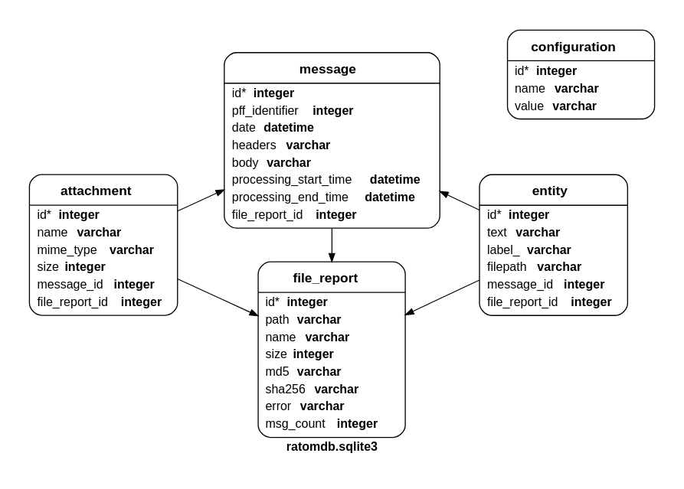
Working with libratom output
Schema as of 0.5.0 - notable features:
Single-file sqlite3 output
Option to include all message text (stripped of markup and inline attachments) and headers in message table
Map 18 unique identity types to locations (message and file) within corpus
MIME types for attachments in attachment table; types are verified vs IANA listed content types and subtypes
Process full Enron corpus in about 1 hour on a 16-core machine; 15-20% improvement over previous release

Slide 19
Exploring the output (Gov. Kaine test corpus)
Example 1:
Entity groups by type, ordered by count.
sqlite> select count(*), label_ from entity group by label_ order by count(*) DESC;
1288056|PERSON
686345|ORG
444841|DATE
362347|CARDINAL
257576|GPE
173187|TIME
60158|MONEY
32378|NORP
31311|ORDINAL
27683|FAC
27122|LOC
24327|PERCENT
23698|WORK_OF_ART
22738|PRODUCT
14511|LAW
11194|EVENT
8163|QUANTITY
586|LANGUAGE
sqlite>
Example 2:
Individual text elements identified by spaCy as "PERSON" that appear more than 10,000 times
Note that the NER processor will return full names as entities when they are encountered. This particular group of entities was simply mentioned only by first or last name a large number of times in the collection.
Entity =/= Identity!
sqlite> select count(*), text from entity where label_ = 'PERSON' group by text having count(*) > 10000 order by count(*) DESC;
41480|Gail
35978|Marilyn
29690|Jaspen
19033|Tavenner
18462|Bill
17264|Barbara
17077|Mark
13858|Wayne
13434|Brian
12723|Rubin
10933|Craig
10767|Leighty
10761|Burns
10371|Heidi
sqlite>

Slide 20
Exploring the output (Gov. Kaine test corpus)
Example 3:
We can use this database to explore data that might pose issues for processing.. For example:
All attachments with identical names that appear in the collection more than 60 times
sqlite> select count(*), name from attachment group by name having count(*) > 60 order by count(*) DESC;
1005|image001.jpg
729|image001.gif
303|Document.pdf
161|Scan001.PDF
157|image002.jpg
152|image002.gif
108|IQFormatFile.txt
85|Blank Bkgrd.gif
82|Jane Woods.vcf
79|image003.gif
74|Karen Remley (karen.remley@vdh.virginia.gov).vcf
68|Robert A Nebiker.vcf
64|image003.jpg
63|sg-0.gif
61|janderson.vcf
Example 4:
Duplicate names don’t always mean duplicate files.
Refining the previous query, we get a better sense of the degree of (possible) duplication.
Of the 1005 “image001.jpg” files identified in the original query, 262 have an identical size of 2,950 bytes. 61 have an identical size of 3,126 bytes.
Of the 303 “Document.pdf” files identified in the original query, 27 have an identical size of 710,730 bytes.
sqlite> select count(*), name, size from attachment group by name, size having count(*) > 25 order by count(*) DESC;
262|image001.jpg|2950
134|image001.gif|1564
106|IQFormatFile.txt|199
85|Blank Bkgrd.gif|145
82|Jane Woods.vcf|163
80|image001.gif|3725
79|image001.jpg|2743
74|Karen Remley (karen.remley@vdh.virginia.gov).vcf|519
68|Robert A Nebiker.vcf|574
...
35|image002.gif|73
34|jim.burns.vcf|348
27|Document.pdf|710730
27|Glazer, Melinda.vcf|294

Slide 21
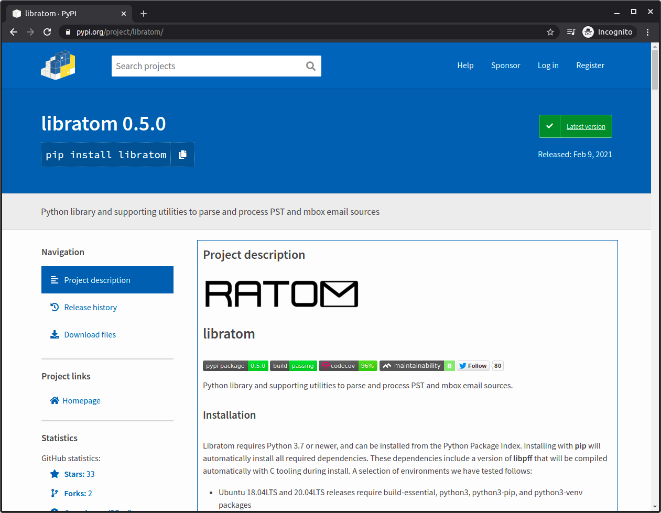
Releases and Code Quality
All releases automatically pushed to PyPI for simple installation in Mac / Win / Linux Python environments
Tested in Python 3.7, 3.8, and 3.9
Codebase scanned and validated (codeclimate, Travis, dependabot, etc) for maintainability, dependencies, and security over time
Code at https://github.com/libratom/libratom
Releases at https://pypi.org/project/libratom
Sample notebooks at https://github.com/libratom/ratom-notebooks

Slide 22
The RATOM Iterative Processing Web Tool

Slide 23
Iterative Processing Web Application
Assist archivists in reviewing email materials for retention and/or release.
Import email accounts from PSTs and entity identification via libratom
Ability to search and filter messages within account (date range, processing status, folder, etc)
Interactive review and tagging of email messages within these accounts (e.g. “record”, “non-record”, “redact”)
Export of selected messages as EML for retention or release
https://github.com/StateArchivesOfNorthCarolina/ratom-deploy

Slide 24
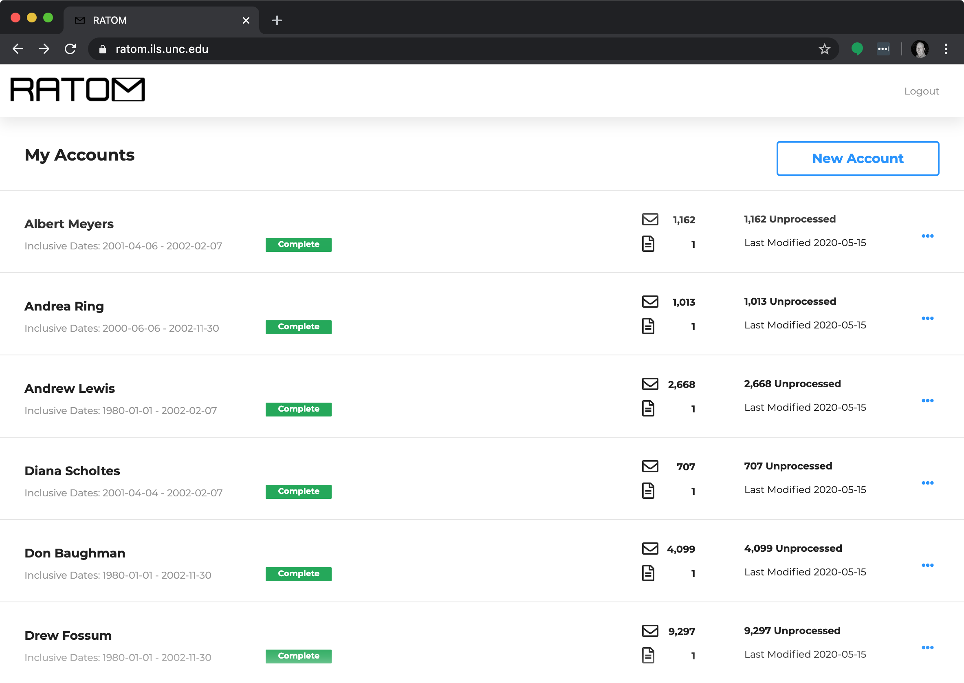
Account View
Allows users to view all accounts loaded into the interface
Multiple .psts can be associated with an individual account
Allows view of inclusive dates, number of messages (including number processed), number of .psts associated with the account, and last modified date on one screen

Slide 25
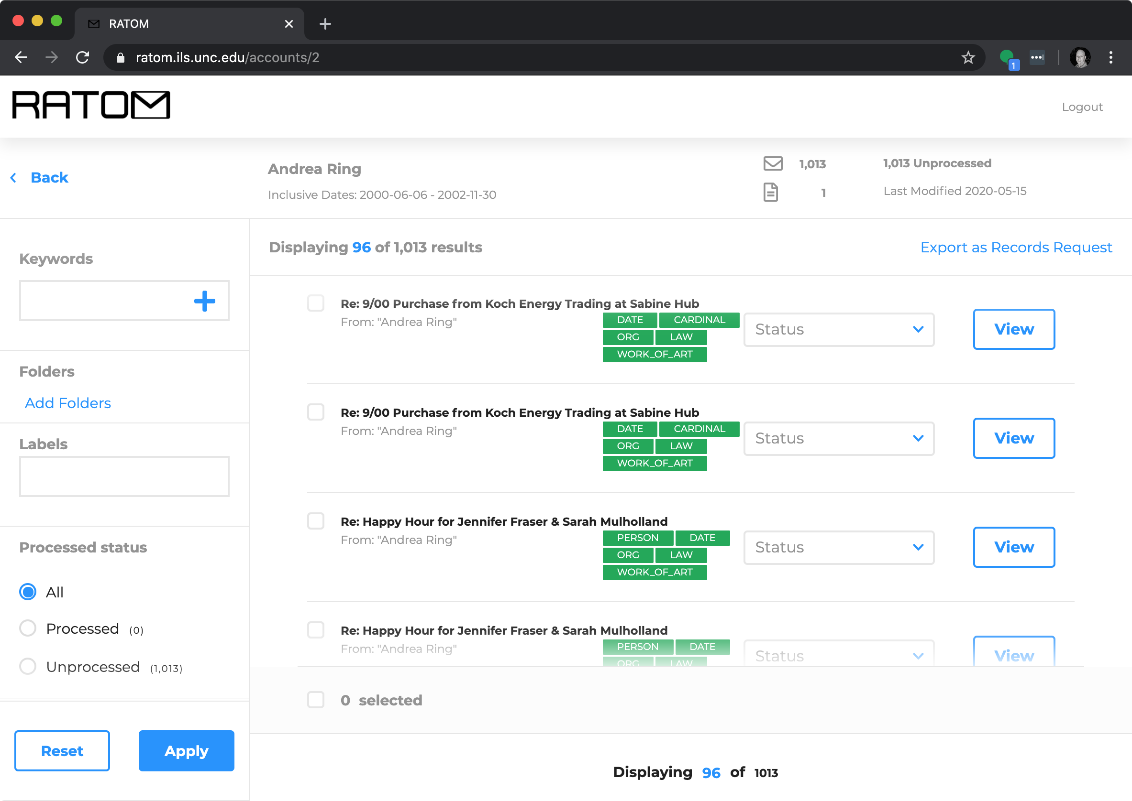
Individual Account
Selecting an account displays an infinite-scroll view of individual messages associated with that account.
Green tags indicate entity classes identified during processing.
Blue tags indicate user-generated classes
Status dropdown allows messages to be marked for retention or redaction (also appears in individual message view).

Slide 26
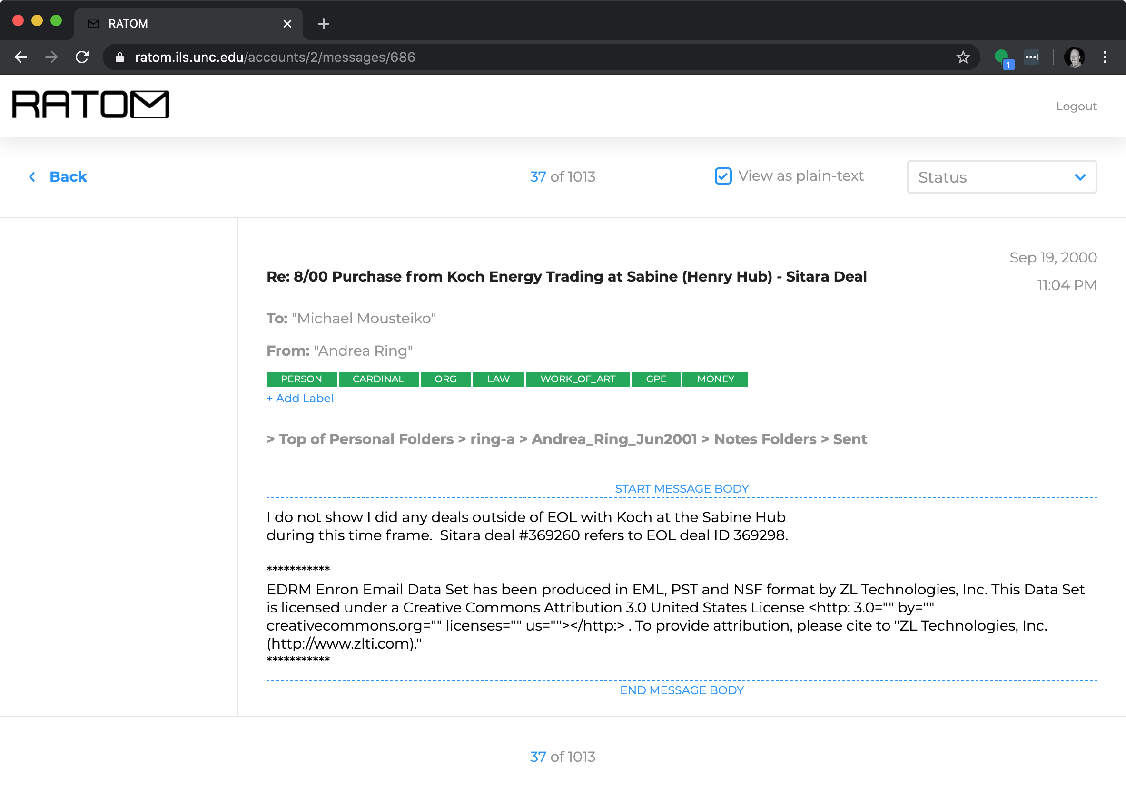
Message View
Header information
Libratom generated tags (green)
User created tags (blue)
Message body (can be viewed as plain text or with HTML markup)
Attachments are indicated by file name

Slide 27
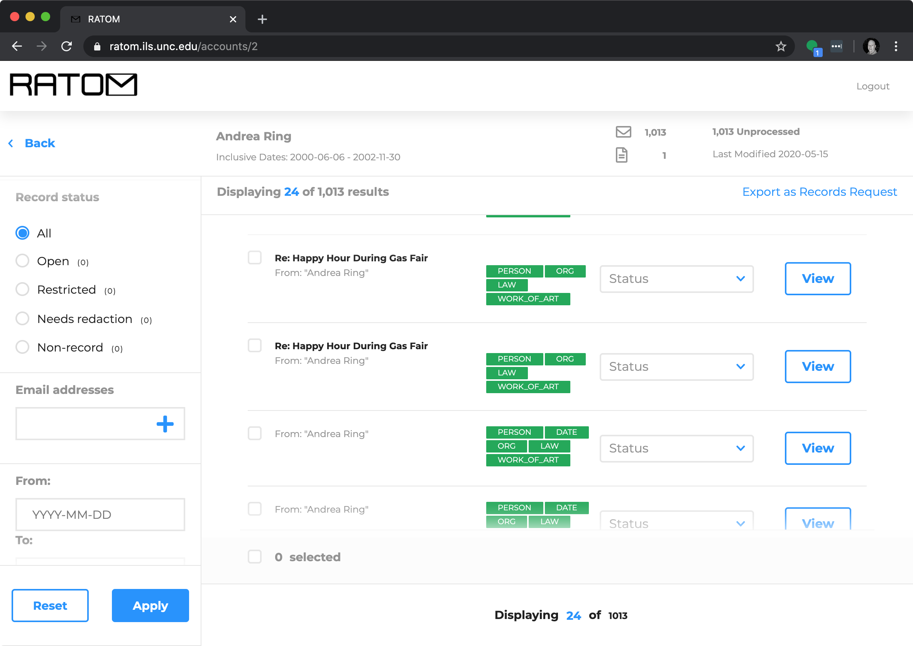
Tagging and Search
Fields Searched:
Keyword
Folder
Label
Processing status (processed v. unprocessed)
Record status (open, restricted, needs redaction, non-record)
Email addresses
Date range

Slide 28
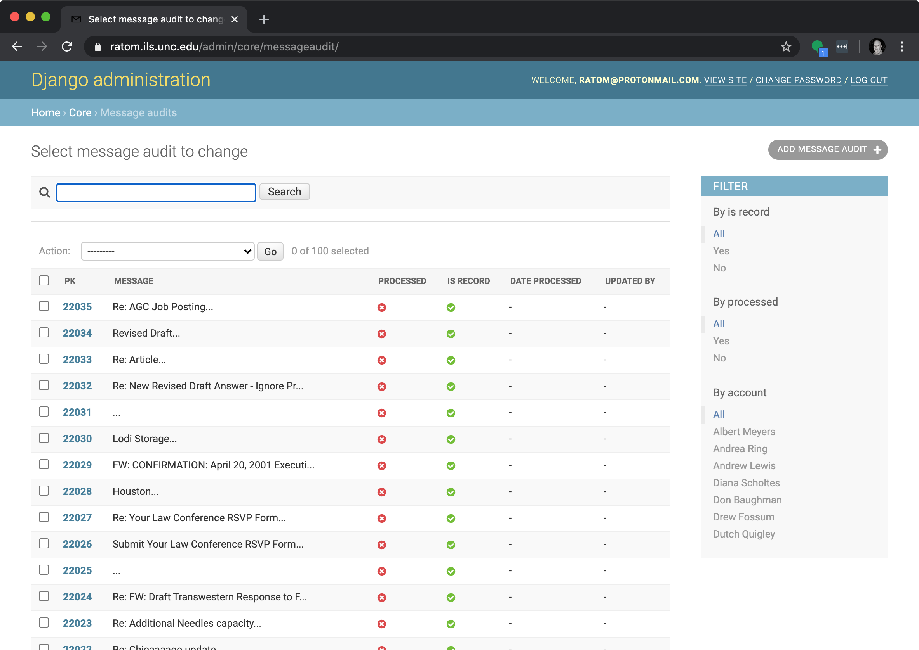
Audit History
Audit histories for individual messages are retained.
This ensures a clear record of initial processing actions and potential changes over time.
Includes action takens and who performed the action

Slide 29
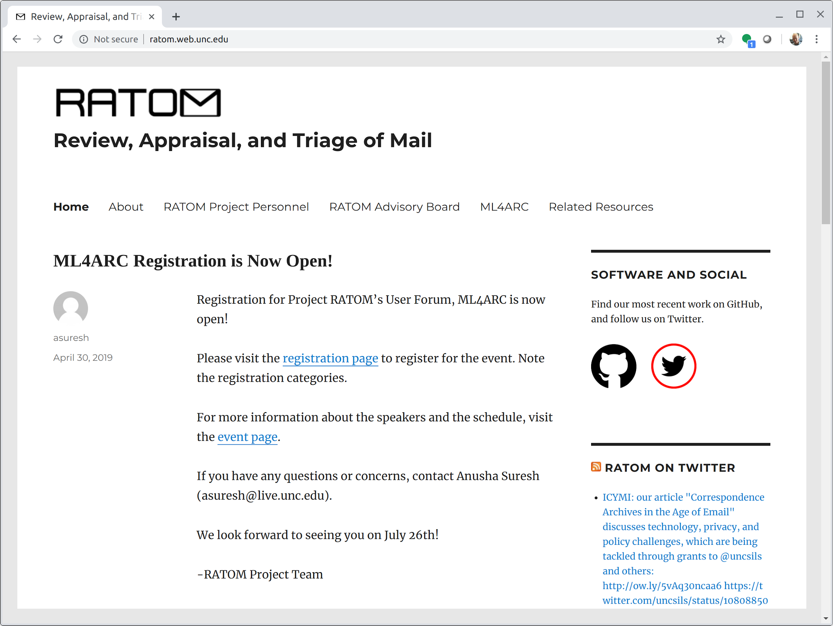
Wrap Up / Questions
Project info, news, and blog posts:
https://ratom.web.unc.edu/
Core library and CLI:
https://github.com/libratom/libratom
Web Service + Interface:
https://github.com/StateArchivesOfNorthCarolina/ratom-deploy
Sample Jupyter notebooks:
https://github.com/libratom/ratom-notebooks
@RATOM_Project

Slide 30
STAY CONNECTED & INFORMED
CoSA Website http://www.statearchivists.org
CoSA Twitter Handle @StateArchivists
CoSA Facebook Page www.facebook.com/CouncilOfStateArchivists

Slide 31
WEBINAR EVALUATION
We appreciate your feedback!
After you exit the webinar, you will automatically be taken to an online webinar evaluation.
Please take a couple of minutes to complete the survey and help us plan future webinars.

