Slide 1
CoSA-NARA Webinar Beginning the process: Reparative Descriptions at NARA, and at the State Archives of North Carolina and the Alabama Department of Archives and History
June 23, 2022
3 pm Eastern
Disclaimer: This webinar is being recorded and will be available for viewing on the CoSA website.

Slide 2
Webinar Agenda
Welcome and Overview
Presentations:
Reparative Descriptions at NARA
Conscious Description at the State Archives of North Carolina
Conscious Description at the Alabama Department of Archives and History
Q and A
Upcoming Programs and Webinars

Slide 3
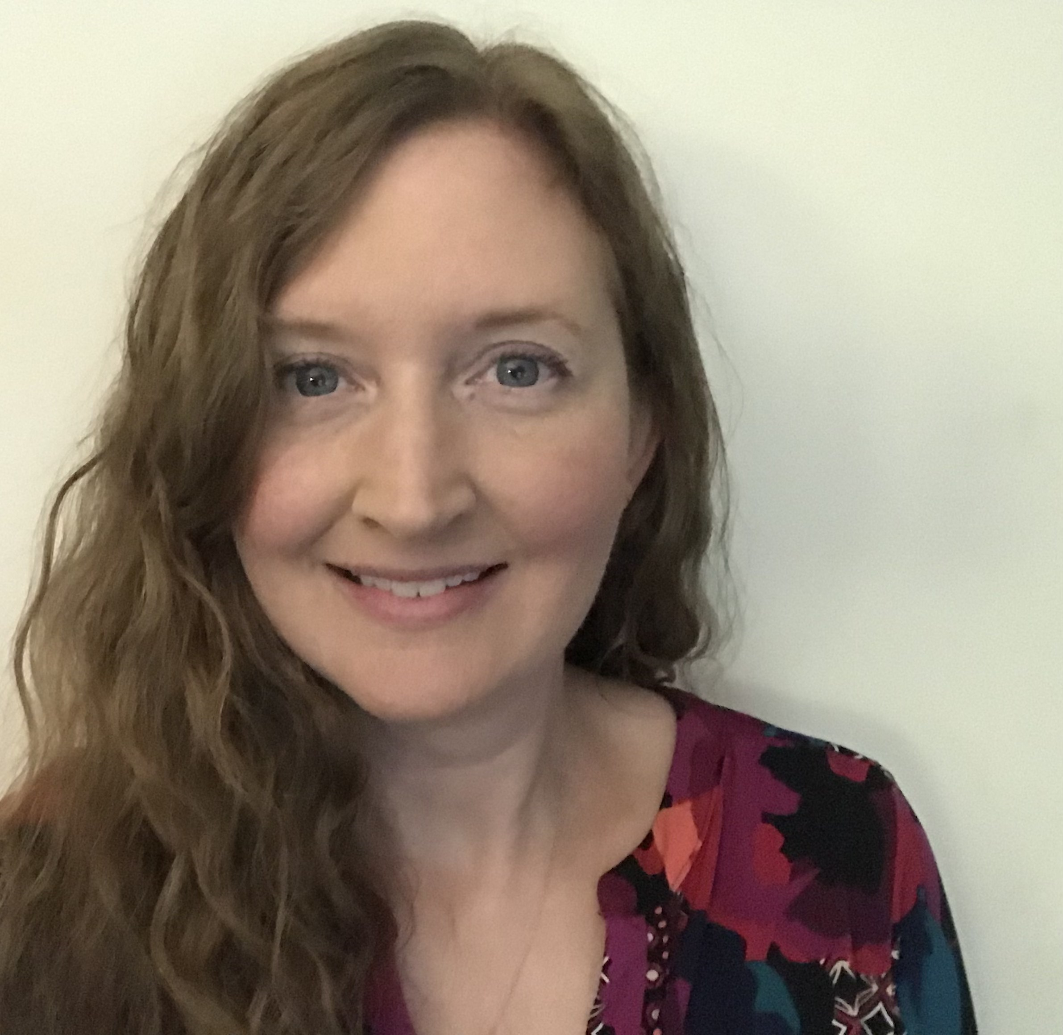
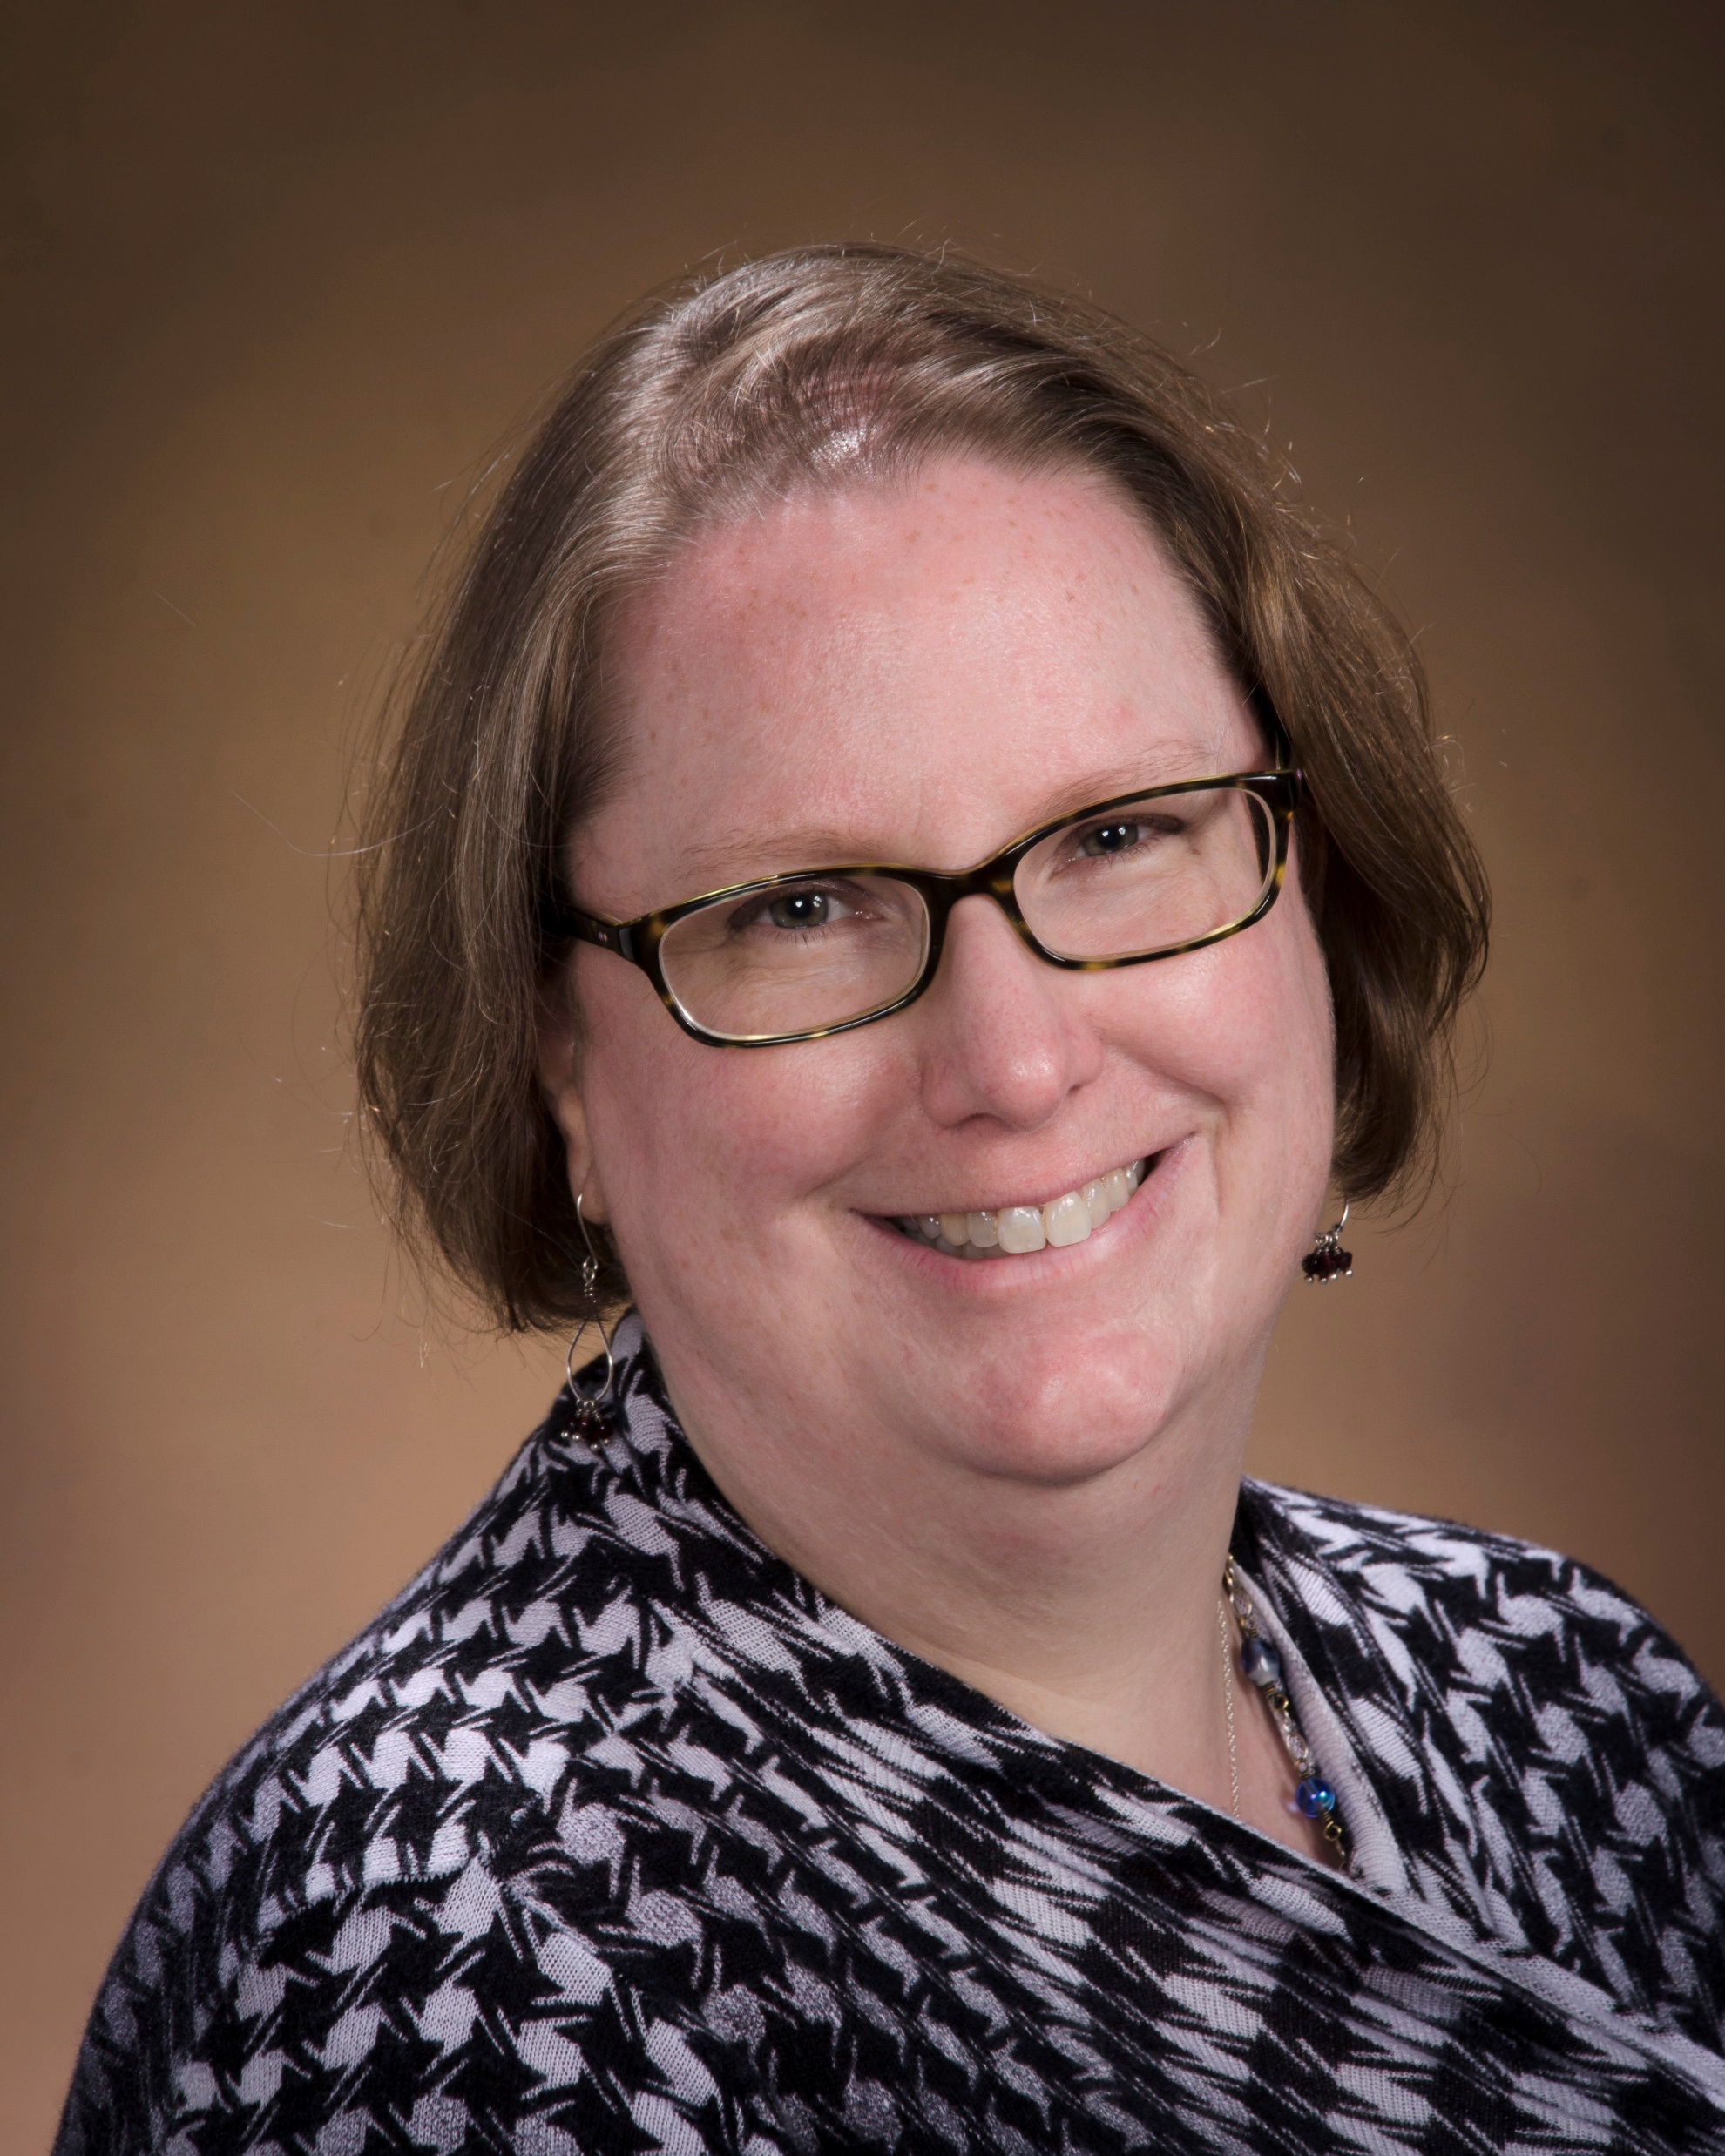
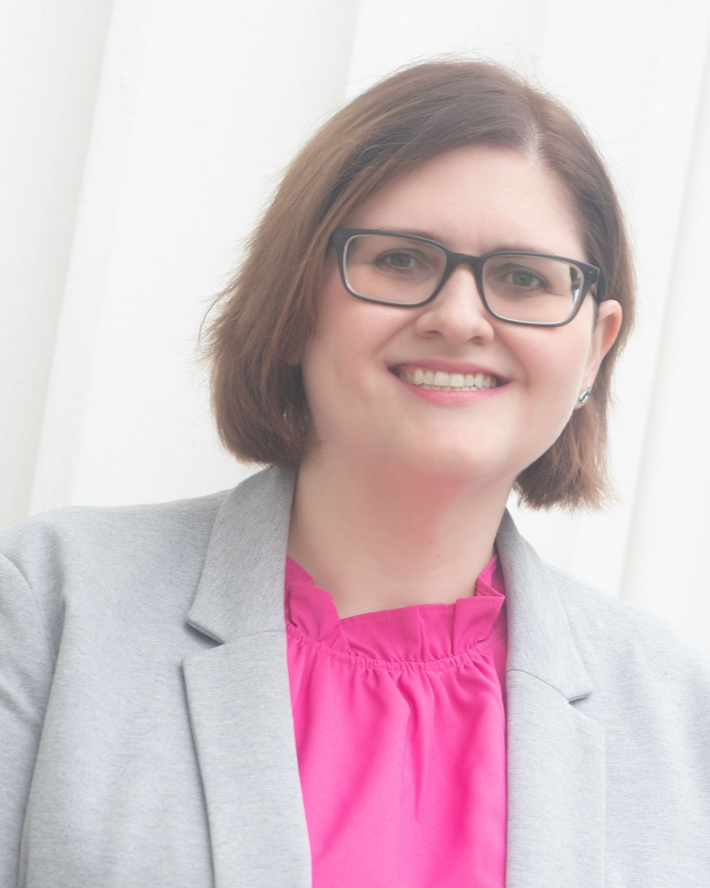
Speakers
Jill Reilly
Digital Engagement Division Director
NARA
Dorothy Gidiere
Archives Collection Coordinator Alabama Department of Archives and History
Ashley Yandell
Head of Digital Services Section State Archives of North Carolina

Slide 4
Reparative Description
at the National Archives and Records Administration
Jill Reilly
Digital Engagement Director, Office of Innovation
and Reparative Description and Digitization Working Group Description Subgroup Lead
June 23, 2022

Slide 5
Overview
Context and Strategy
Engagement with Communities
Reparative Description Principles, Framework, Approach, and Guidance
Pilot
Training
Next Steps

Slide 6
Strategic Goal 1 Make Access Happen
1.1 By FY 2026, NARA will process 85 percent of archival holdings and increase enhanced descriptions to promote equity in discovery and public access to archival records related to underserved communities.
1.3 By FY 2026, NARA will collaborate with traditionally underserved communities to correct outdated descriptions in the National Archives Catalog and prioritize citizen engagement projects that increase access to records that are important to underserved communities.
Apply reparative description to at least 1,000 instances of problematic terms in the Catalog each year;
Host at least one citizen archivist transcription project per year;
Make at least one dataset available for bulk download by a traditionally underserved community or website each year; and
Explore options that would allow users with limited or intermittent internet connections to access records from the Catalog.
Strategic Goal 2 Connect with Customers
2.3 By FY 2026, NARA will deliver a national program of museums, education, and public programming that demonstrates leadership in equity, accessibility, and diversity.
https://www.archives.gov/about/plans-reports/strategic-plan/strategic-plan-2022-2026
Strategic
Alignment

Slide 7
To examine harmful language in legacy descriptions in the National Archives Catalog; to ensure that historical records are described using respectful, accurate, and discoverable terminology; and to develop processes to correct description for under-described and over-described records
To surface records that are pertinent to traditionally underrepresented and underserved communities through digitization
To commit to a fundamental principle of meaningful consultation, engagement, and collaboration with community partners to achieve these goals, particularly with communities that NARA has historically underserved.
Aligned with direction NARA was given to implement Executive Order 13985: Advancing Racial Equity and Support for Underserved Communities Through the Federal Government
Developed RDDWG Work Plan in Collaboration with NARA’s Equity Team
Reparative Description and Digitization
Strategy and Goals

Slide 8
Pilot and iteratively refine
Learn together and share lessons learned
Engage and create intentional feedback loops with stakeholders and staff
Focus on legacy catalog descriptions to start
Crowdsource of harmful terminology (anyone can submit terms for consideration)
Prioritize harmful terminology in consultation with communities
Be transparent and keep track of changes
Provide guidance, training, and support to balance consistency and flexibility
Leverage NARA description community of practice
Description and Authority Services (DAS) Describers
DAS Points of Contact (POCs)
Reparative Description Approach

Slide 9
Creating Engagement Models
August—October 2021
Identified specific communities for engagement and dialogue
Determined areas of focus for NARA to begin work
Selected African American and Puerto Rican communities for initial work
Objective: build a methodology for engagement that is sustainable
Began with internal NARA stakeholders
Identified and created lists of internal NARA experts
Developed questions for discussion
Hosted group meetings and invited feedback in writing
Sought input on external organizations to engage
Invited contributions to future work planning (eg, specific records to prioritize)
Identified additional projects and NARA staff to follow up with and invite their participation

Slide 10
Creating Engagement Models
October 2021—Present
Expanded from internal to external engagement
Benchmarked archives, libraries, and professional research organizations
Identified key organizations specialized in African American and Puerto Rican historical research
Developed questions for discussion
Hosted group meetings and invited feedback in writing
Invited contributions to future work planning (eg, specific records to prioritize)
Invited review and input into specific harmful terminology identified by RDDWG to begin work
Identified opportunities for follow up meetings to review/validate notes
Notes:
External Organization Engagement in 2021/2022:
Association for the Study of African American Life and History (ASALH)
National Museum of African American History and Culture
Historically Black Colleges and Universities (HBCU) Library Alliance
Afro-American Historical and Genealogical Society
Instituto Cultura de Puertorriqueña
Archivo General de Puerto Rico
Recovering the U.S. Hispanic Literary Heritage Project
League of United Latin American Citizens
University of Puerto Rico
Center for Puerto Rican Studies Library & Archive

Slide 11
Creating Engagement Models
Feedback from external organizations incorporated into NARA work planning:
Harmful terminology review
Improve/enhance access projects
Focus on records already digitized and in NARA Catalog
Focus on collaborative projects with institutions
Future digitization proposals
Input on specific records compiled and considered for future projects
Identify opportunities to sustain collaborative relationships over time

Slide 12
Context, Principles, and Guidance
NARA Resources
Guiding Principles for Reparative Description at NARA
Statement on Potentially Harmful Content
Updates on Reparative Description and Digitization
Selected Archival Community Resources

Slide 13
Process for Developing the Standards for Both Archival Descriptions and Authorities
Stakeholders Identify Priority Terms
Research and Review
of Terms - Draft Proposals
Engage Stakeholders - Collaborate on Approach
Publishing Standards and Delivering Training
Pilot
Lifecycle Standards Proposals Review

Slide 14
Authority Files - Approaches
Notes:
Person Names - Biographical Notes
Organization Names - Notes
Organizations (Fed) - Admin History Notes
Terms:
Subjects - Terms
Geographic Names
The US Board of Geographic Names has a process for reviewing proposals to update place names
Vocativ data journalism piece, “Racial Slurs Are Woven Deep into the American Landscape”
Atlantic article, “How to Rename a Place” (January 27, 2022)

Slide 15
Training
Special Reparative Description Training - Intro / 101 for the pilot
Input and feedback from Research Services and Legislative Archives, Presidential Libraries, and Museum Services’ Description and Authority Services Points of Contact (DAS POCs)
Training in late July, synchronous and asynchronous
Follow-up training and consultations offered for units and teams
Surveys and lessons learned workshop for feedback
Pilot begins in August and carries through end of calendar year 2022

Slide 16
Next Steps
Continued engagement with internal and external stakeholders
Reparative description training for DAS POCs to begin this summer
Launch collaborative transcription projects
Work with NARA custodial units on Fiscal Year 2023 work plans
Work planning for RDDWG year two activities

Slide 17
Closing
National Archives Catalog: https://catalog.archives.gov
Reparative Description Updates from the Archives: https://www.archives.gov/research/reparative-description
Contact us: Catalog@nara.gov

Slide 18
Conscious Description at the State Archives of North Carolina
Ashley Yandle
Digital Services Section Manager

Slide 19
Formation of SANC Conscious Description Committee
Committee was created June 2020 and charter created in July.
"Ten-member team composed of membership from all sections with one member serving as team lead..."
"Create roadmap to decenter whiteness, create inclusive and accessible language, and provide greater access to materials documenting the lives of previously marginalized people."

Slide 20
Committee Goals
Survey division resources for marginalizing language in metadata and descriptions
Survey best practices in collection description
Develop curriculum for staff education and development
Create case studies by evaluating existing descriptive language and developing proposals for changes
Develop a plan for sustaining the team’s work/or proposed next steps
Notes:
N_53_16_5828 - Shaw University Library -prob 1900 teen Photo by Albert Barden. From the Albert Barden Collection, State Archives of North Carolina, Raleigh, NC

Slide 21
Literature Review: Foundation
Antracoli, Alexis A., Annalise Berdini, Kelly Bolding, Faith Charlton, Amanda Ferrara, Valencia Johnson, and Katy Rawdon. “Archives for Black Lives in Philadelphia: Anti-Racist Description Resources.” October 2019.
Dean, J. “Conscious Editing of Archival Description at UNC-Chapel Hill.” Journal of the Society for North Carolina Archivists 16 (2019): 41-55.
Berry, Dorothy, et al. “Toward Culturally Competent Archival (Re)Description of Marginalized Histories.” Presented at Archives*Records 2018, the Society of American Archivists conference, August 2018, Washington, DC.

Slide 22
Case Studies
Special Collections: Outer Banks History Center
Government Records: Arrangement and Description Unit

Slide 23
Government Records Case Studies
Studied sample descriptions for state agency records, county records, and governors' records.
Found issues around descriptions of mental health topics, immigration, the American Civil War, and Native and African American communities.
Case studies included original text, suggested changes, and related questions.
Notes:
Guilford County: Alien, Naturalization and Citizenship Records: Alien Registration Record (C.R.046.902.1)

Slide 24
OBHC Case Studies
Studied 5 sample collections.
No Spanish language options for materials about and of interest to Latinx community.
Other issues: descriptions of potentially LGBTQ+ materials; biographical descriptions for female creators; finding books in archives online catalog; descriptions of enslaved peoples.
Notes:
Photo: PhC9_2_20_5
Menhaden fishing aboard the W. A. Mace, ca. 1939. From the Farrell Photo Collection, PhC.9, North Carolina State Archives, Raleigh, NC

Slide 25
Draft Guidance
Language and Representation
Bias
Inclusion
How to approach sensitive subjects
Creation of standardized notes for edited content or future edits
Appendices on edit guidelines specific to types of records
Notes:
N_74_4_86 Suffragists, including Gertrude Weil, far left, Mary Borden Graham, fourth from left, and Rowena Borden, far right, c.1920. From General Negative Collection, North Carolina State Archives.

Slide 26
To-Dos
Finish draft and have it approved through division management
Create training for division staff
Create workflow for how potential text can be brought to the committee for review
Create web page dedicated to Conscious Description on State Archives website; sharing of guidance on this page
Create Conscious Description internships

Slide 27
Challenges
Focus on individual words and phrases or bigger concepts? Providing greater access to people previously missing from descriptions?
Individual committee members have different priorities; how do we meld those into a division-wide plan?
Do we prioritize editing description currently being created (while acknowledging we have a backlog) or edit legacy finding aids where the worst examples are likely present?
Staff changes: Great resignation and retirements both on the committee and in the division.
Different levels of impacts of work: AV materials with item level description vs series or box level for most government records.
Different needs for description in digital collections vs online catalog.
Who is going to do the work? Just arrangement and description staff or can it be share out across the division?

Slide 28
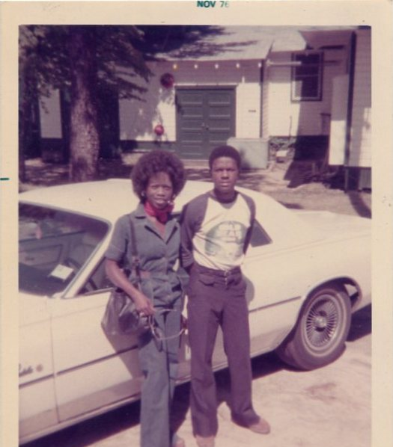
What's Next?
Notes:
CLDW 46.B1.F1.9 - Snapshot of a female African American Women’s Army Corps officer named Von (left) and Malcom Foster (right) standing outside next to a white car as they were preparing to go with WAC 2nd Lt. Bennis M. Blue to attend the Virginia State University versus Morgan State University football game in the fall 1976 season. Blue was stationed at Fort Lee, Virginia, attending quartermaster officer basic training at the time (1976). From Bennis M. Blue Papers, CLDW 46, Cold War Papers, Military Collection, State Archives of North Carolina, Raleigh, N.C.

Slide 29
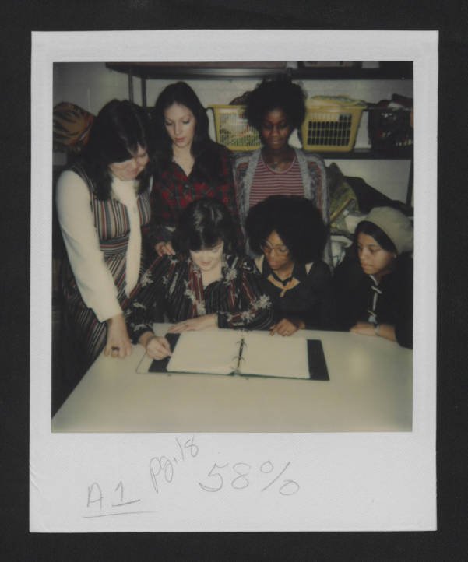
Contact Information
Ashley Yandle
Digital Services Section Manager
State Archives of North Carolina
ashley.yandle@ncdcr.gov
Notes:
Future Homemakers of America: History--Unidentified Photographs (SR_DPI_DVE_FHA_B2F1_History_Unid_Photos_103)

Slide 30
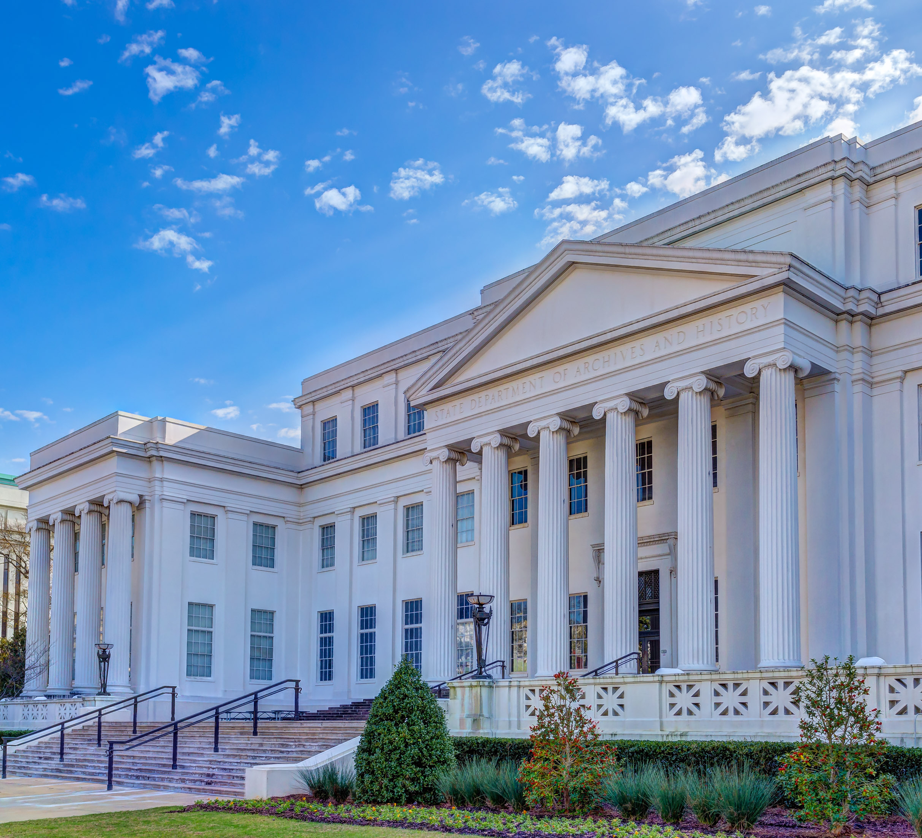
Conscious Description at the Alabama Department of Archives and History
Presented by
Dorothy Gidiere, CA
Archival Collections Coordinator
CoSA Member Webinar
June 23, 2022
Notes:
Good afternoon, everyone! I’m Dorothy Gidiere, Archival Collections Coordinator, at the Alabama Department of Archives and History (ADAH). Today I want to share with you how our conscious description program got started, challenges we’ve discovered along the way, and some ideas about how we could work together.

Slide 31
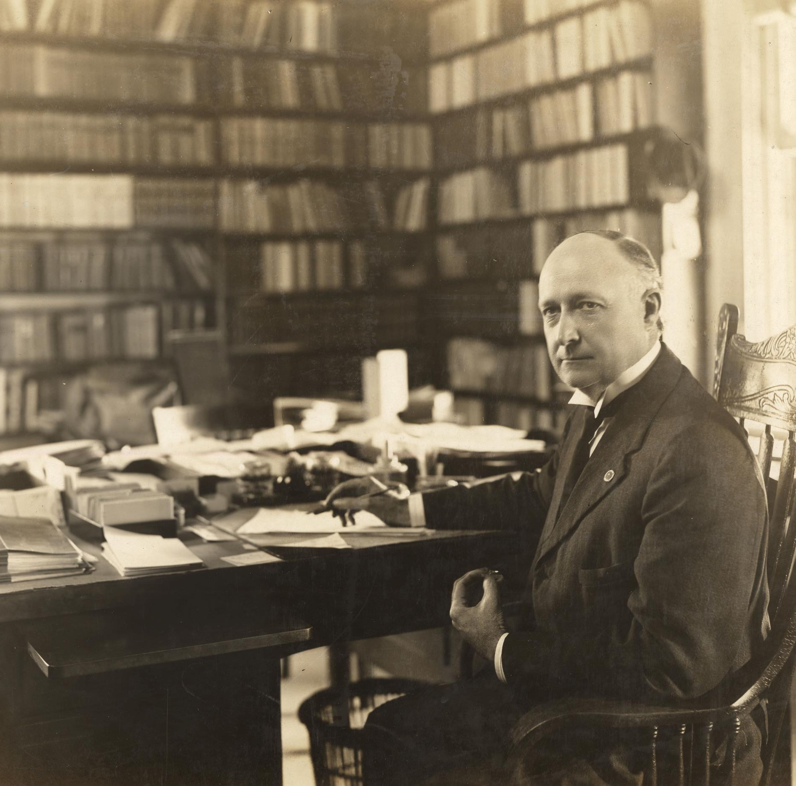
History of the ADAH
Founded in 1901
Thomas McAdory Owen
Independent state agency
Governed by Board of Trustees
Notes:
First, I’d like to give you a brief background about our agency. The ADAH was founded in 1901 by Thomas McAdory Owen and was the nation’s first state-funded, independent state archives agency.

Slide 32
Mission of the ADAH
“We tell the story of the people of Alabama by preserving records and artifacts of historical value and promoting a better understanding of Alabama history.”
Notes:
Our mission is to “tell the story of the people of Alabama by preserving records and artifacts of historical value and promoting a better understanding of Alabama history.”

Slide 33
Thomas M. Owen and Marie Bankhead Owen
Notes:
When our agency was founded, however, our leaders including Thomas Owen and his successor and widow, Marie Bankhead Owen did not preserve the records of all Alabamians. Instead, they focused on the preservation of Confederate history and Lost Cause ideals while declining to document the history of Black Alabamians.

Slide 34
Statement of Recommitment
Issued on June 23, 2020
https://archives.alabama.gov/docs/ADAH_Statement_Recommitment_200623.pdf
Notes:
Two years ago today, on June 23rd, 2020, our Director Steve Murray and Board of Trustees released the Statement of Recommitment in response to the murder of George Floyd. With the Statement of Recommitment our agency acknowledged three truths– first, the existence of systemic racism, second, our agency’s role in declining to acquire and preserve materials documenting the lives and contributions of Black Alabamians, and third, that as a predominantly white institution we cannot know the full measure of fear and frustration experienced by Black Americans.

Slide 35
Conscious Description Program: 2020-2021
Internal committee
Attended webinars
Read professional literature
“Guidelines for Describing Slavery”
Notes:
Before the Statement of Recommitment was issued, I was spending a lot of time thinking about the murder of George Floyd and the subsequent protests for racial equality. What could I do as a privileged white woman both in my personal and professional life? Professionally, the answer for me was to start reviewing how we had described archival collections about Black Alabamians.
I started working with my colleague, Collections Archivist Jaimie Kicklighter, on what has today evolved into our Conscious Description Program. Jaimie and I started brainstorming where to begin in reviewing descriptions about Black Alabamians. Should we start with collections describing slavery or Civil Rights? Internally, we were having separate preliminary discussions about a slavery documentation project, so we decided to develop guidelines for describing slavery to work in tandem with this project. We also formed an informal committee to include our Museum Collections Coordinator Ryan Blocker and Digital Assets Coordinator Meredith McDonough.
Our committee and other Archival Collections staff spent the remainder of 2020 attending many online workshops, webinars, and conference sessions related to conscious description. We also read professional literature and reached out to colleagues to see what they were working on related to conscious description.
At the same time in 2020 and into 2021, we started drafting Guidelines for Describing Slavery. While still a work in progress, the guidelines aim to be a practical guide for processing archivists on preferred terminology and how to use these terms in their descriptive work. They also outline descriptive practices intended to represent the experience of Black Alabamians more fully.

Slide 36
Conscious Description Program: Today
Internal and external review of “Guidelines for Describing Slavery”
Create list of collections to review after approval
Other subject areas to review:
Civil Rights
Indigenous materials
LGBTQ+
Women
Notes:
So where do things stand today? We are on the first round of internal review for the Guidelines for Describing Slavery. Once our internal review is complete, we would like to then conduct an external review and are especially interested in getting feedback from Black archivists and historians. We also hope to compensate our colleagues for their time and expertise. In the meantime, we are continuing to create a list of collections to review when the guidelines are approved. I want the Guidelines for Describing Slavery to serve as a model for other subject areas.

Slide 37
Challenges
Fluctuating political environments
Politicization of language
Competing viewpoints
Subject area authorities
Long-term program, not short-term project
Notes:
We’ve also realized that there are specific challenges in doing conscious description work as government archivists.
First, being the fluctuating political environments that we work in. While this varies by state, we all have to be mindful of both politics and our role as public servants. While the ADAH is an independent state agency, other state archives might face limitations from a parent agency such as a Secretary of State’s Office. Even as an independent state agency, we still receive our funding through the state legislature and must constantly advocate for sustaining our current funding and increasing whenever possible.
Another related challenge is the increasing politicization of language. We’ve had several internal discussions about what to call this work. Currently, we use the phrase “conscious description” to indicate mindfulness in our descriptive work. We avoid the use of “reparative description” out of a concern that “reparative” sounds too similar to “reparations”, which might be off-putting to stakeholders politically opposed to reparations and could derail our work entirely. We also have had conversations about being respectful of our predecessors who were following what were the descriptive standards at the time.
Next, we also have the challenge of competing viewpoints of our constituents. We want to make sure that we are describing collections of underrepresented groups in a way that will increase access, but we know that these changes might alienate others. I believe it is vital to include citations to professional literature when creating description guidelines to demonstrate the mindfulness that went into our decision-making process.
Another challenge when drafting guidelines is deciding who are the authorities in a given subject area? There are many thought leaders and experts, but they don’t always agree on preferred terminology. What are the preferred terms used by underrepresented groups and how do we account for possible disagreements within these groups?
Over the past two years, it’s also become clear that conscious description is a long-term program, not short-term project. Back in 2020, I first approached everything from a project mindset. It became obvious over time, however, that this is our new normal. We need to figure out how to integrate conscious description into our standard workflows. We also need to make sure our approach is sustainable for the long-term and something that can evolve over time. This includes reviewing any approved guidelines at regular intervals such as every three years to ensure they are current.

Slide 38
Let’s Work Together!
Working group or cohort
Share experiences and resources
Talk through challenges
Notes:
So where do we go from here? I would like to see the state archives community form a working group or cohort where we can work together to tackle these challenges. Following the un-conference model used in the Southeastern Archives and Records Conference or SARC, I think active roundtables where practitioners working on conscious description can talk through both successes and challenges would be very helpful.

Slide 39
Thank you!
Dorothy Gidiere, CA
Archival Collections Coordinator
Alabama Department of
Archives and History
dorothy.gidiere@archives.alabama.gov
(334) 353-4746
Notes:
Thank you for your time today! Please feel free to contact me at any time.

Slide 40
Questions and Comments

Slide 41
Upcoming Member Webinars
July 28 - America 250 -A Look at National Plans and Activities in North Carolina and Utah
To register:
https://www.statearchivists.org/programs-education/cosa-webinars

Slide 42
Upcoming SERI Webinars
Watch for the Fall webinar schedule coming soon!
To register:
https://us02web.zoom.us/meeting/register/tZYsde-qpjoqH9xwnKYrc7lJdTCcJOR2cn84

Slide 43
Contact Us
CoSA Website http://www.statearchivists.org
CoSA Resource Center https://www.statearchivists.org/research-resources/resource-center
CoSA Twitter Handle @StateArchivists
CoSA Facebook Page www.facebook.com/CouncilOfStateArchivists
CoSA You Tube https://www.youtube.com/user/StateArchivists/

Slide 44
Sponsors and Funders

Slide 45
Webinar Evaluation
We really do appreciate your feedback!
Please take a moment and respond to the evaluation following this webinar.

