Slide 1
Advocacy for State Archives – Lessons Learned from the Birmingham Public Library
March 25, 2021
3 pm Eastern
Disclaimer: This webinar is being recorded and will be available for viewing on the CoSA website.

Slide 2
Webinar Agenda
Welcome and Overview
Presentation: Pandemic Peril for Archives and Special Collections: An Advocacy Story from Alabama
Q and A
Upcoming Programs and Webinars
Disclaimer: This webinar is being recorded and will be available for viewing on the CoSA website.

Slide 3
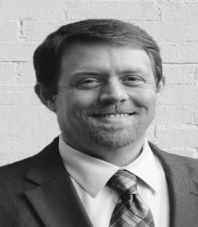
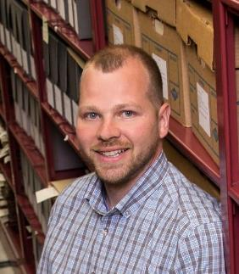
Speakers
Steve Murray, Director
Alabama Department of Archives and History
Bryan Whitledge, Vice Chair
SAA Committee on Public Policy

Slide 4
Pandemic Peril for Archives and Special Collections: An Advocacy Story from Alabama
Steve Murray
Alabama Department of Archives and History
March 25, 2021
Steve.Murray@archives.alabama.gov

Slide 5
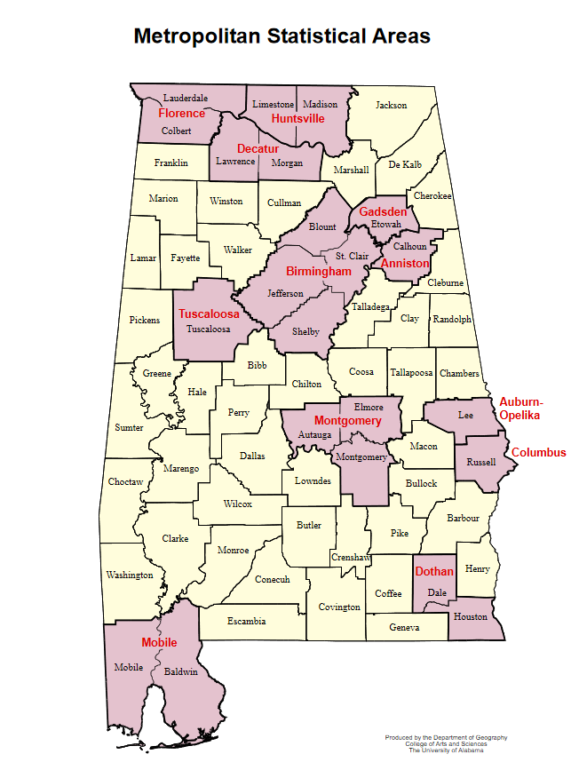

Slide 6
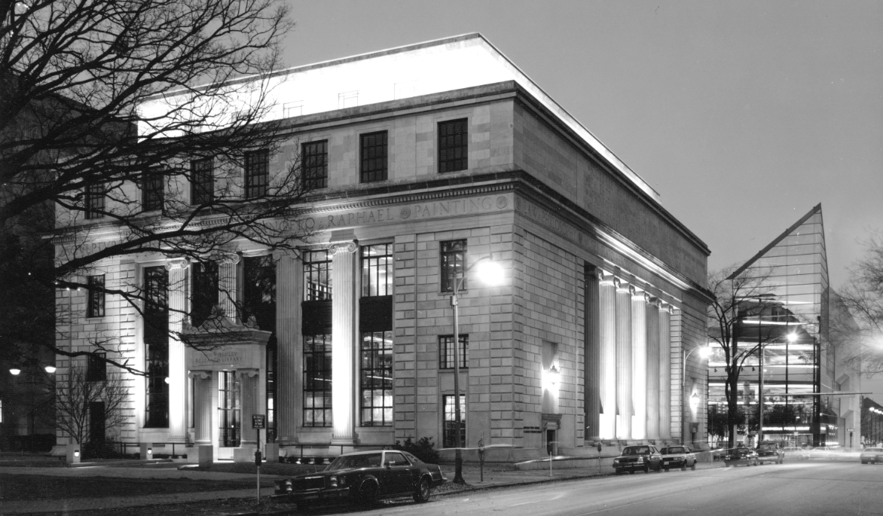
Linn-Henley Research Library,
Birmingham Public Library

Slide 7
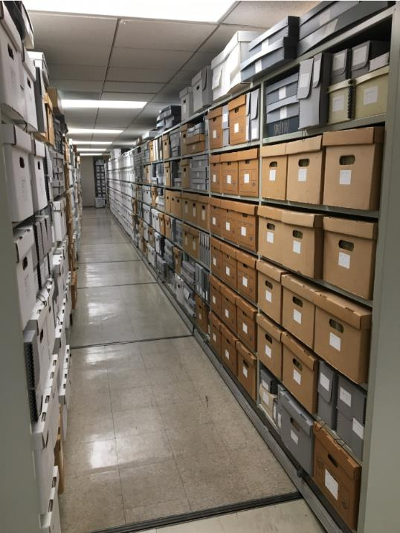
Department of
Archives and Manuscripts

Slide 8
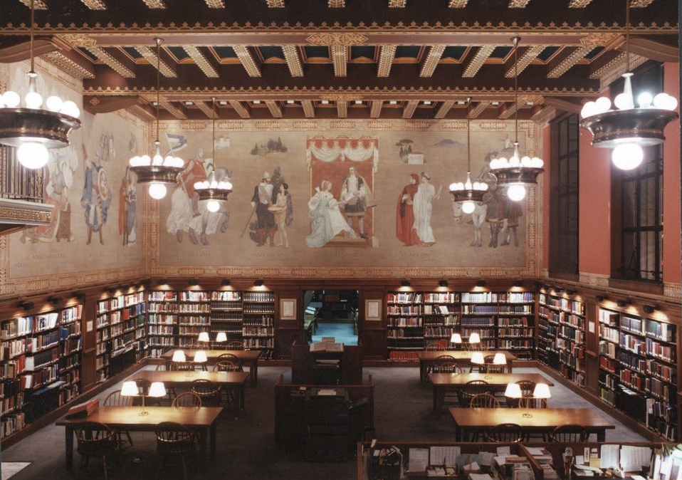
Southern History Department

Slide 9
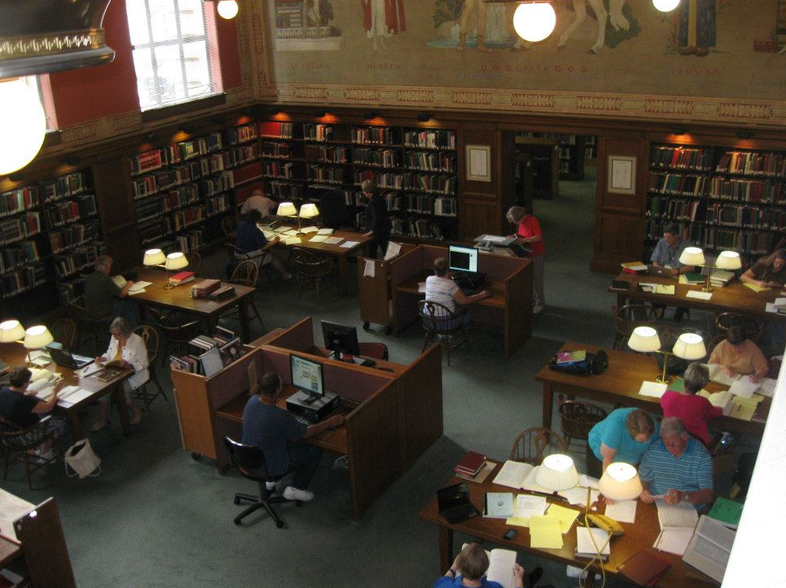

Slide 10
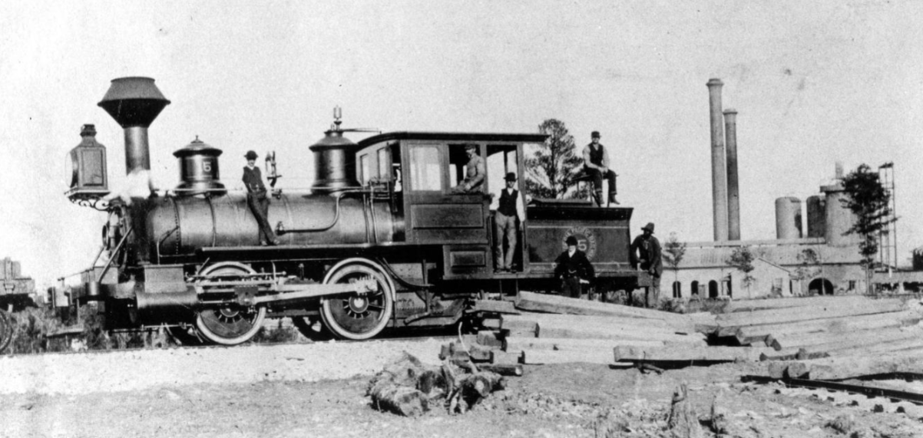

Slide 11
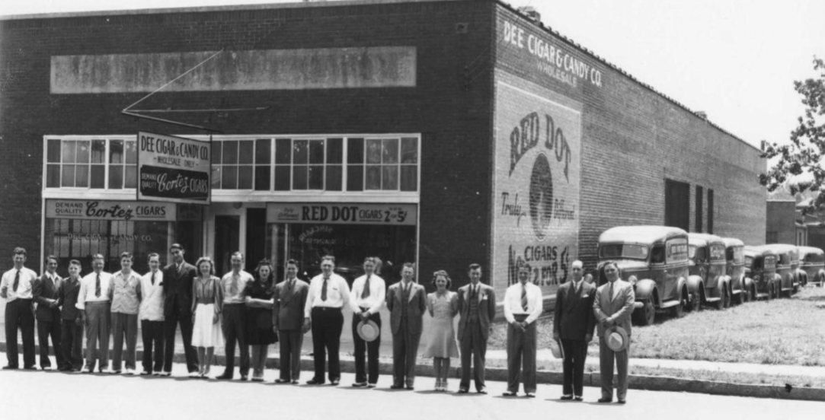

Slide 12
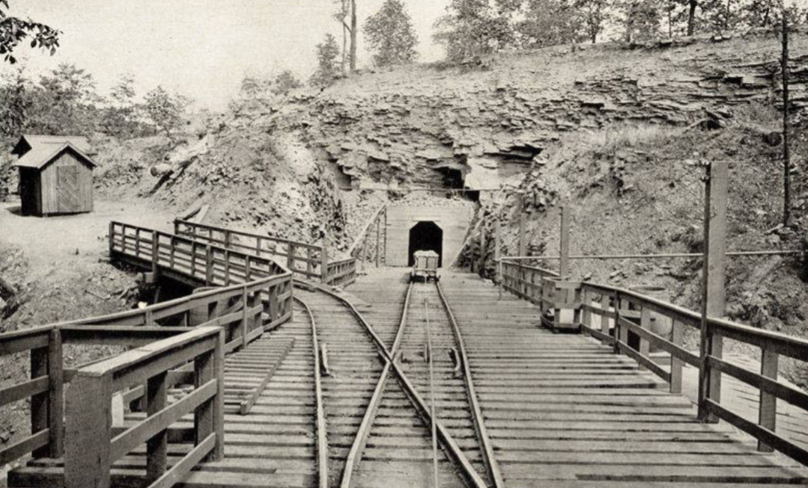

Slide 13
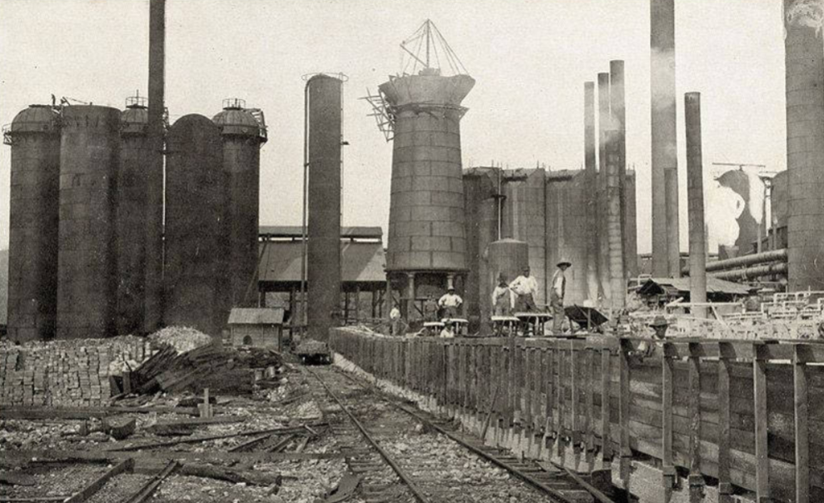

Slide 14
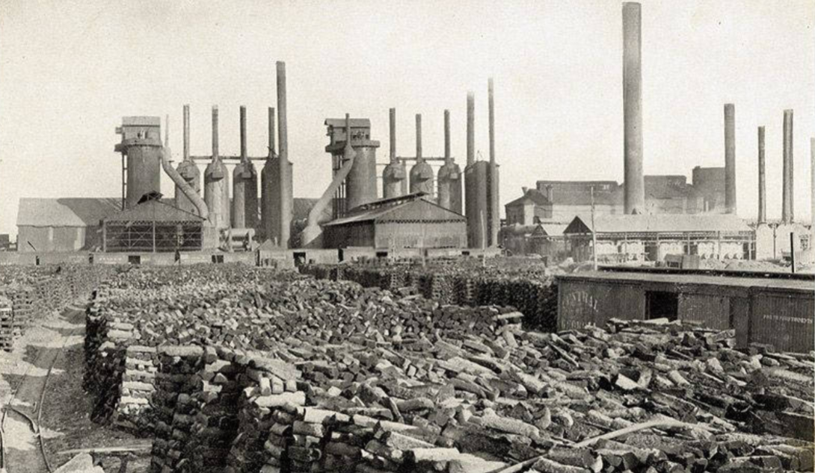

Slide 15
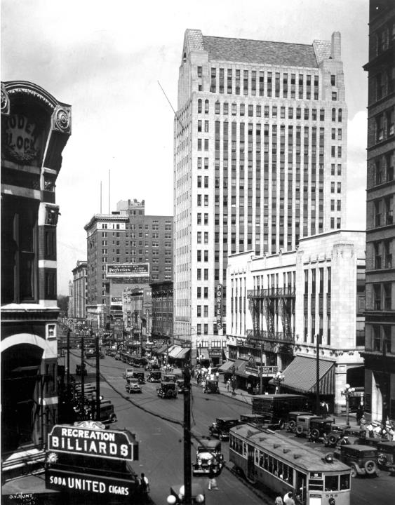

Slide 16
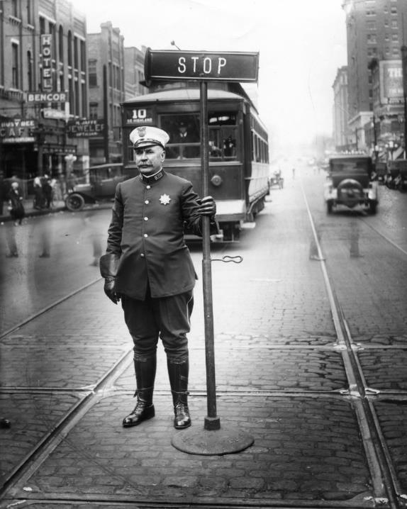

Slide 17
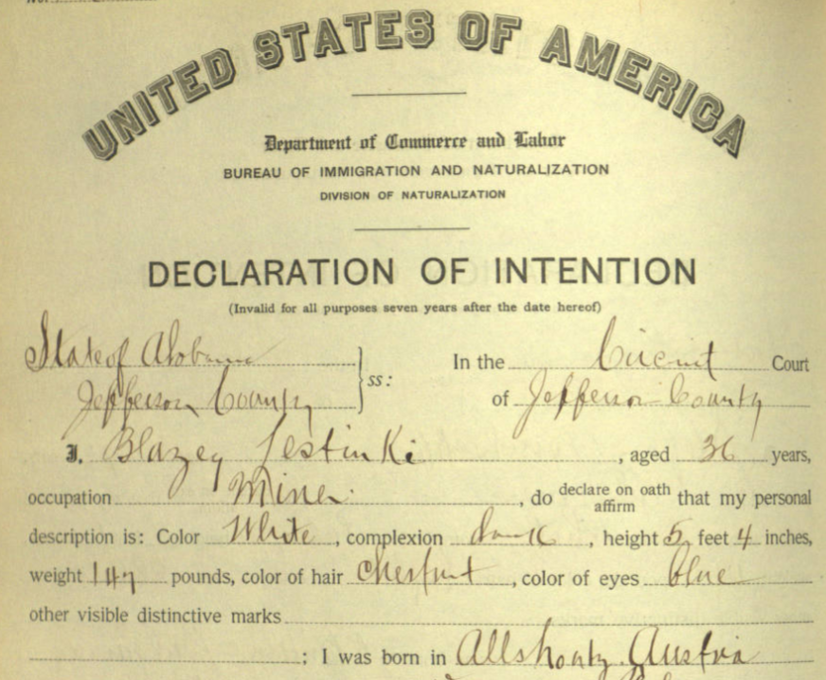

Slide 18
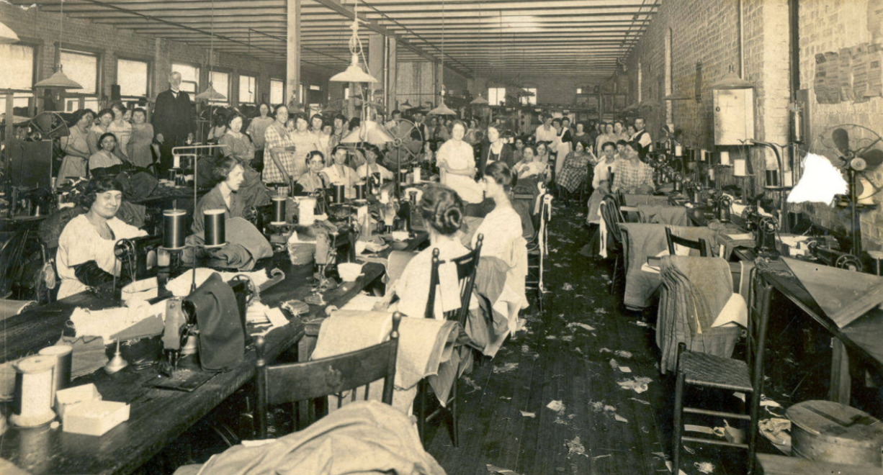

Slide 19
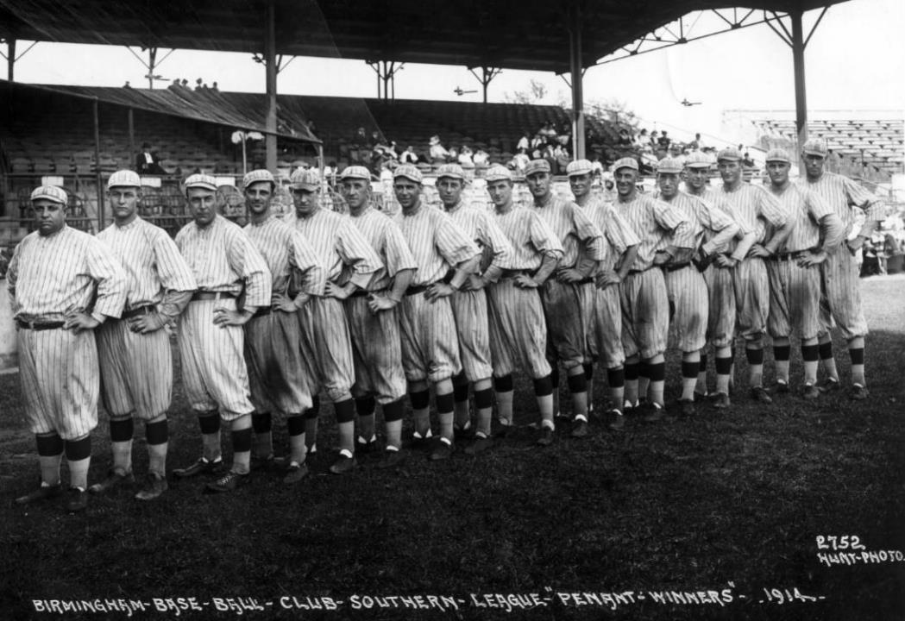

Slide 20
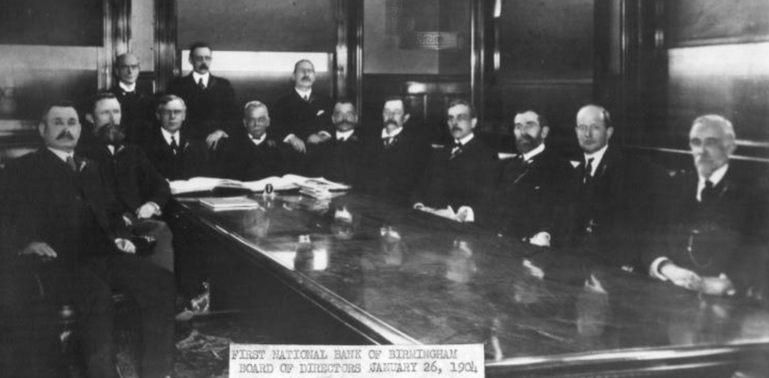

Slide 21
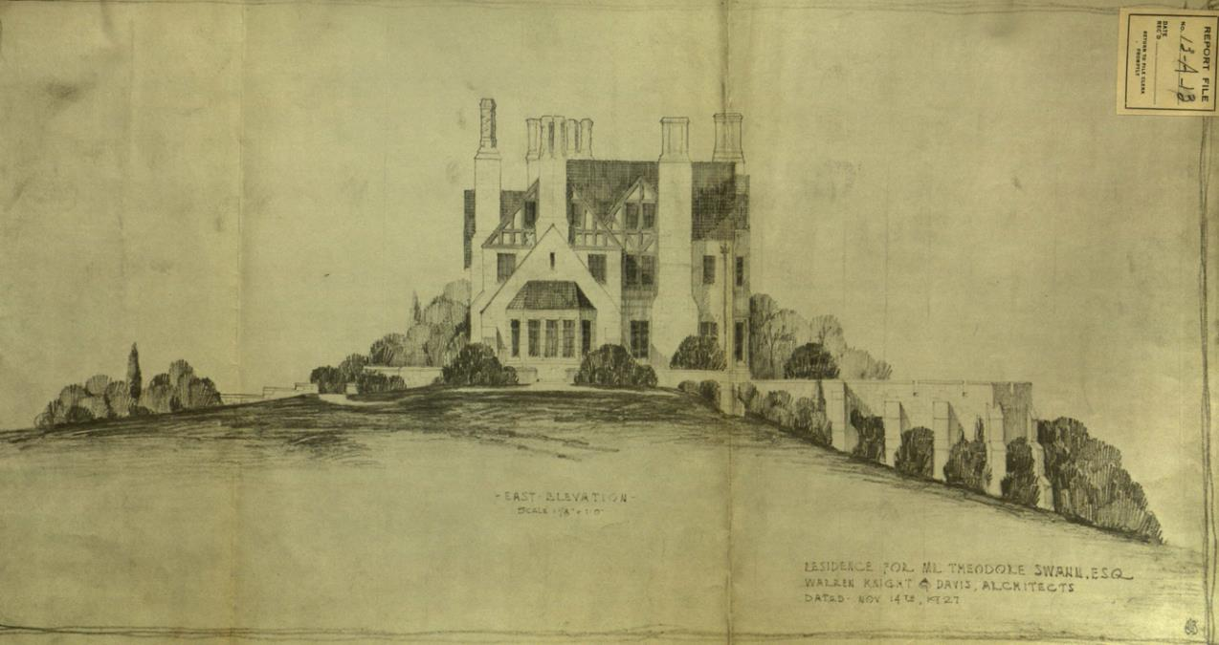

Slide 22
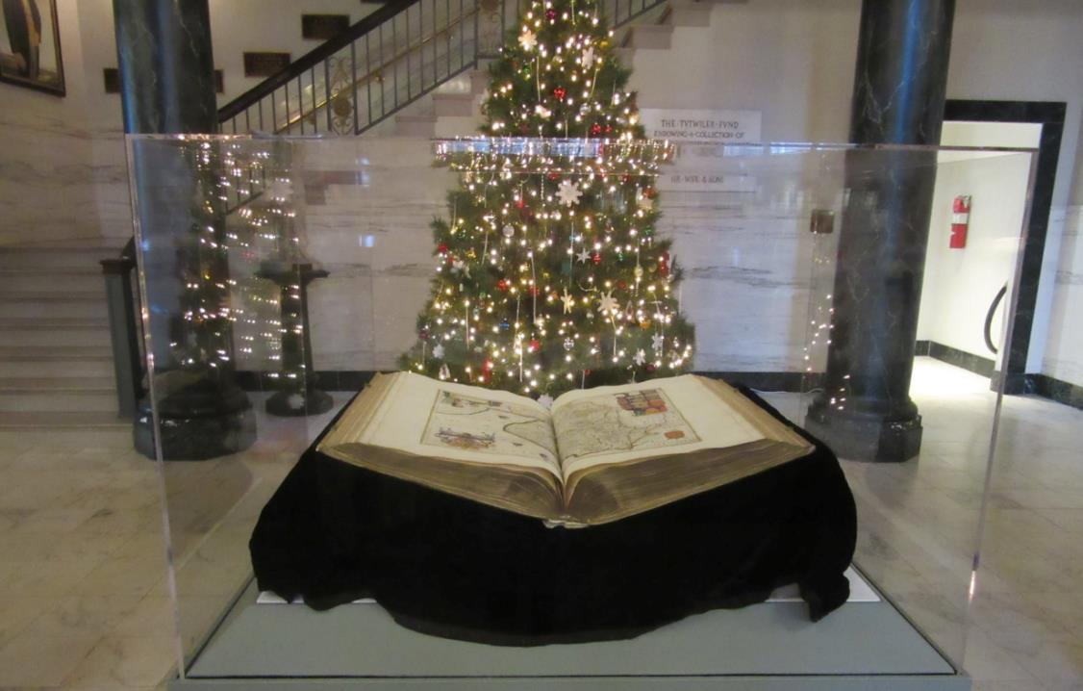

Slide 23
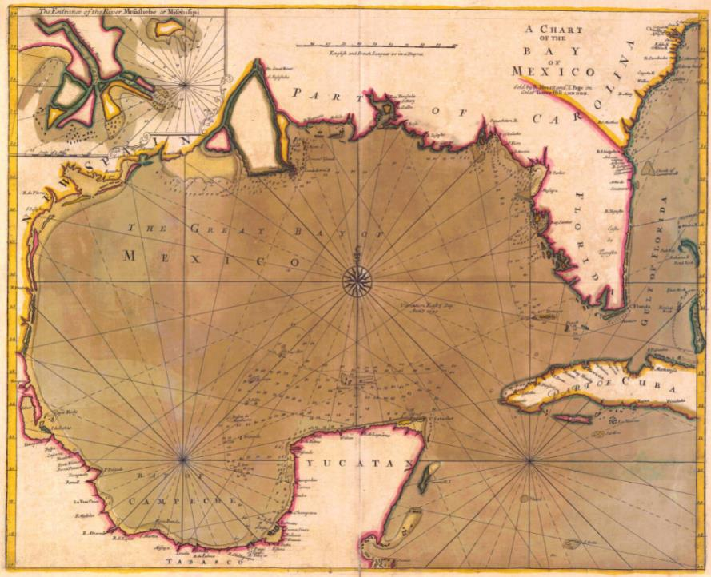

Slide 24
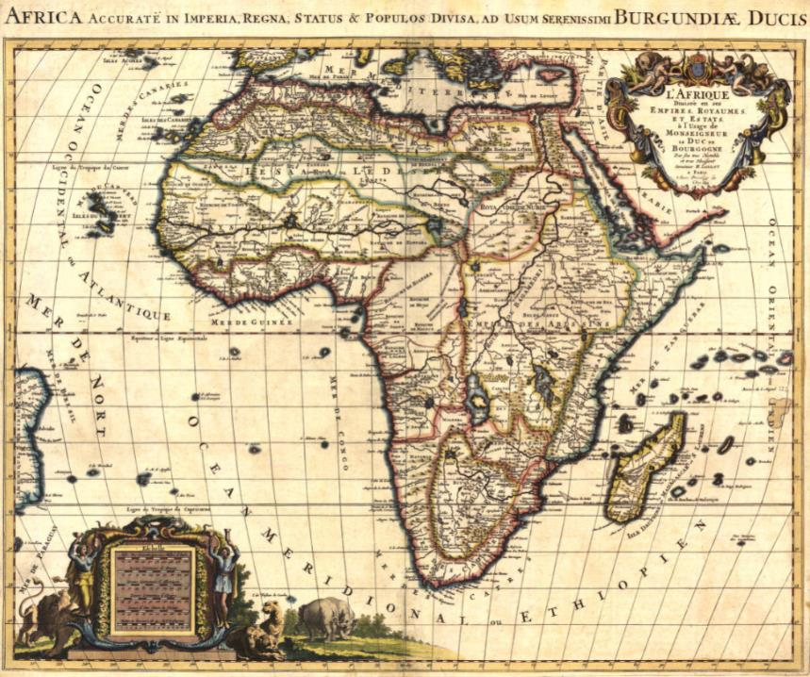

Slide 25
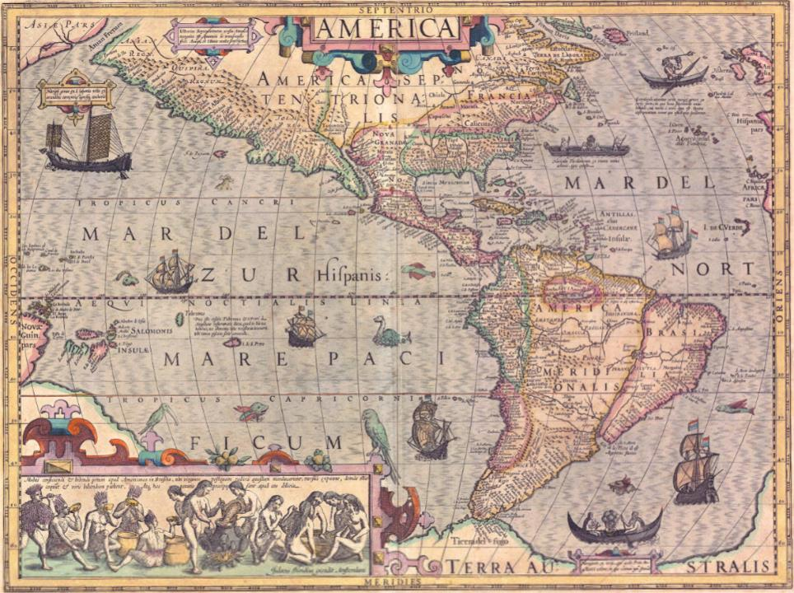

Slide 26
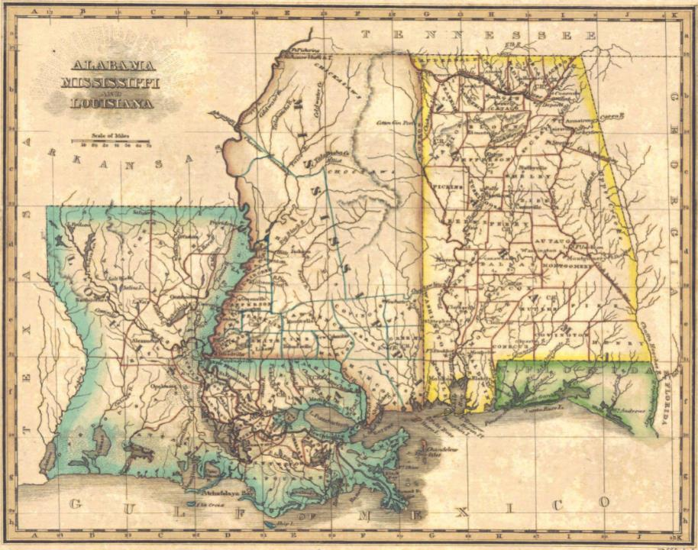

Slide 27
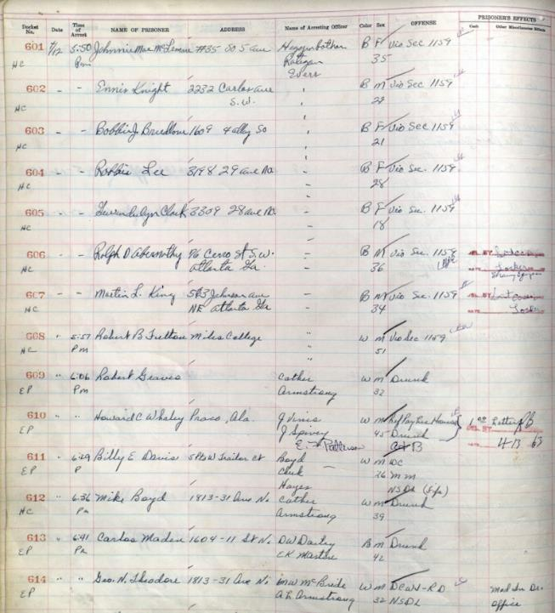

Slide 28
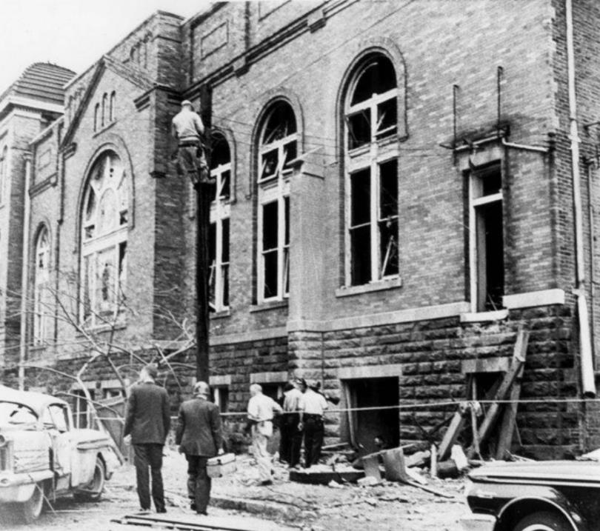

Slide 29
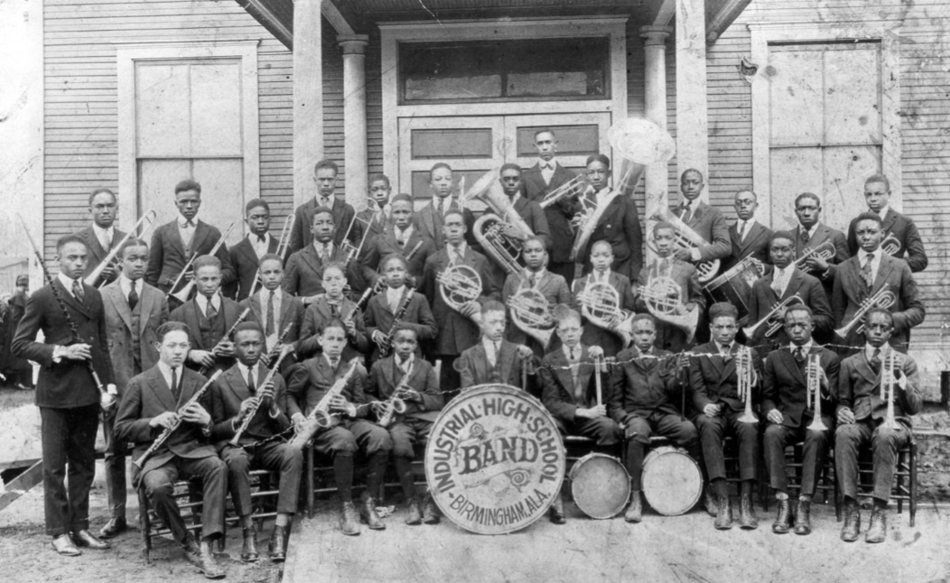

Slide 30
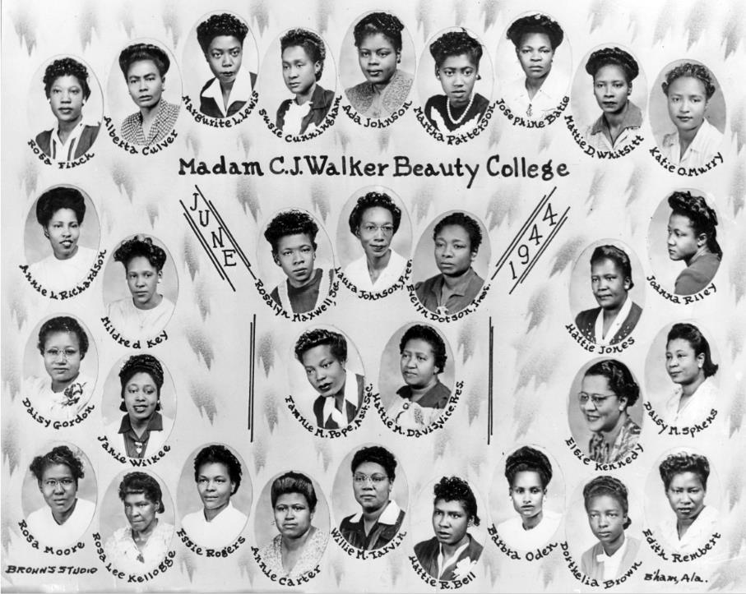

Slide 31
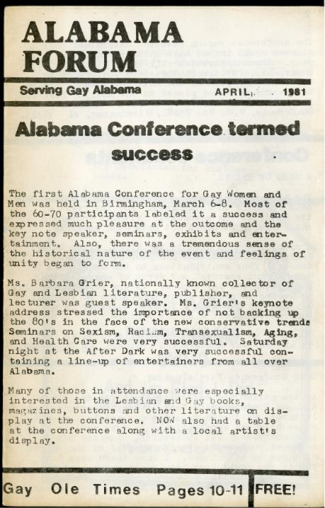
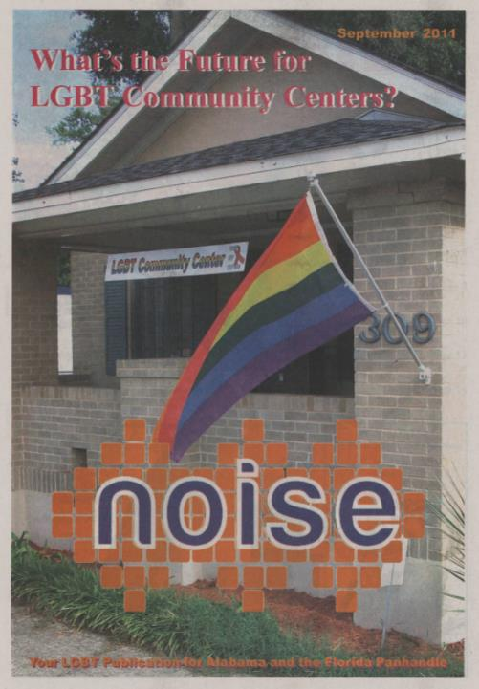

Slide 32
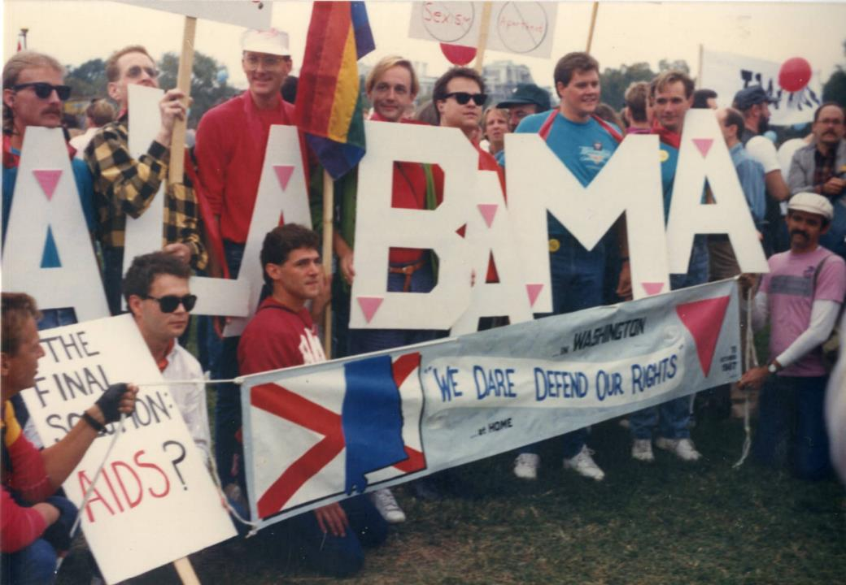
Notes:
1987 March on Washington for Lesbian and Gay Rights

Slide 33
Notes:
1987 March on Washington for Lesbian and Gay Rights

Slide 34
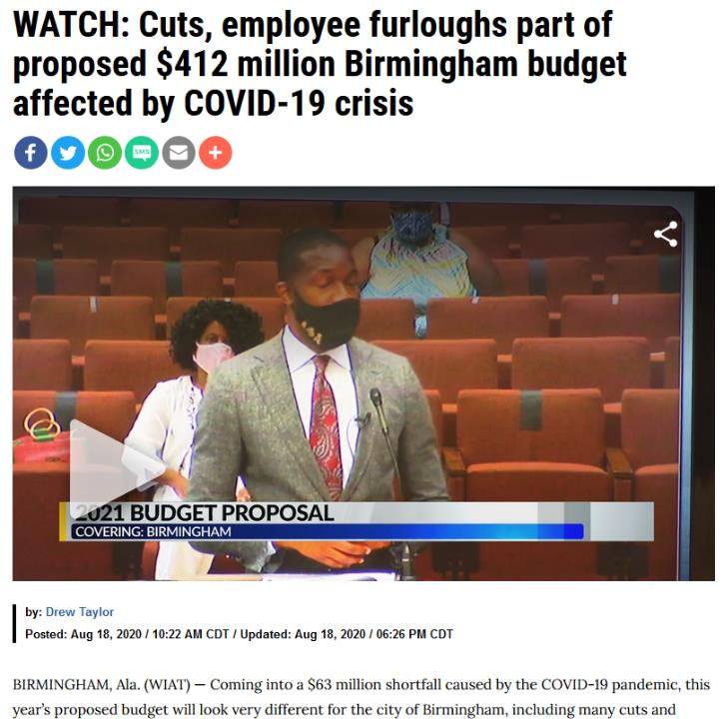

Slide 37
Statement on the Risk to Research Collections
at the Birmingham Public Library
August 24, 2020
Birmingham’s cultural resources deserve broad support, but the collections and operations of the DAM and SHD merit special attention for several reasons.
They include many unique, irreplaceable materials essential for understanding the experiences of Alabamians and the special story of the Birmingham region.
Thousands of visitors come to the BPL annually to find information on the history of their families.
The collections represent a commitment made by the BPL and the City to exercise proper stewardship on behalf of the public.
As the official repository of Birmingham and Jefferson County government, the DAM performs a core function of local government by providing access to the records documenting government actions.

Slide 39
Statewide Advocates
Alabama Department of Archives & History
Alabama Genealogical Society
Alabama Heritage Magazine
Alabama Historical Association
Black Heritage Council
Society of Alabama Archivists
National Advocates
EveryLibrary
Society of American Archivists
Committee on Public Policy
Public Library Archives/Special Collections
American Library Association
Local Stakeholders
Old Birmingham
Civil Rights Birmingham
New Birmingham

Slide 40
Phase II Advocacy Plan
Develop stakeholder lists
Develop memorandum by a recognized third-party authority outlining specific Minimum Standards for Emergency Staffing
Circulate open letter to stakeholder communities requesting action
Automated form letter signed by stakeholders and sent to city officials pointing to the memorandum as the desired course of action

Slide 41
Memorandum on Standards for Emergency Staffing
in Archives and Special Collections
Referenced statement of August 24 by statewide advocates
Called for maintenance of best practices as articulated by national orgs
Provided two tiers of implementation, recognizing fiscal realities
Tier 1: Maintaining the Integrity of Collection and Providing Time-Sensitive Access
Protection against damage and loss
Providing baseline level of reference services for government functions and economic development
Tier 2: Maintaining Full Public Access
Provide service at level expected by patrons, donors, and other stakeholders
Provide adequate resources for succession planning

Slide 42
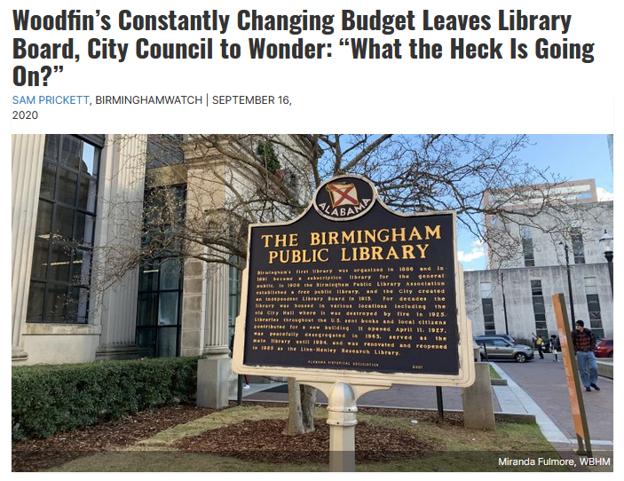
WBHM

Slide 43
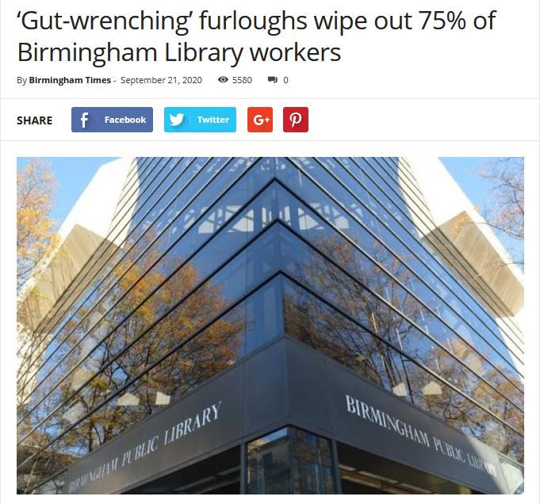
Birmingham Times

Slide 44
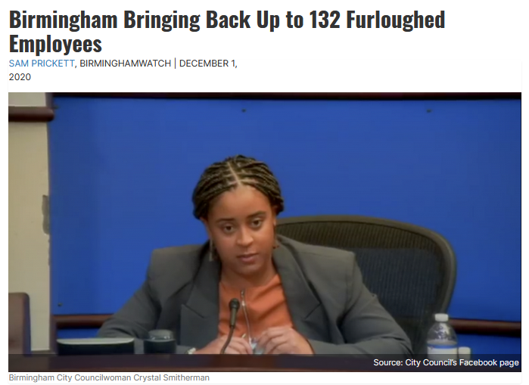
WBHM

Slide 45
Preparing for the Next Crisis
Become informed about funding mechanisms for your local archives or genealogy library.
Determine which local officials have a personal interest in history or genealogy.
Develop a succinct statement of ways the repository serves the community.
Be prepared to articulate the consequences of funding cuts for public services and the integrity of the collections.
Remain involved and promote the restoration of resources when circumstances permit.

Slide 46
Society of American Archivists
Committee on Public Policy
Bryan Whitledge, Vice Chair

Slide 47
Questions and Comments

Slide 48
Upcoming Webinars
April 13: Wrapping Up RATOM: A Summary and Lessons Learned from the Review, Appraisal, and Triage of Mail Project For registration information: https://www.statearchivists.org/programs/state-electronic-records-initiative/seri-webinars/
April 22: CoSA Member Webinar – Marketing Yourself as an Archival Worker
For registration information: https://www.statearchivists.org/programs/cosa-webinar-series/
April 14: "In Conversation With..." - Special Live edition, with Q+A about artificial intelligence in the government archives space – registration information coming soon

Slide 49
Contact Us
CoSA Website http://www.statearchivists.org
CoSA Resource Center https://www.statearchivists.org/resource-center/
CoSA Twitter Handle @StateArchivists
CoSA Facebook Page www.facebook.com/CouncilOfStateArchivists
CoSA You Tube https://www.youtube.com/user/StateArchivists/

Slide 50
Sponsors and Funders

Slide 51
Webinar Evaluation
We really do appreciate your feedback!
When you exit the webinar, you will automatically be taken to an online webinar evaluation. Please take a couple minutes to complete the survey and help us plan future webinars.

