Slide 1
CoSA-NARA Webinar Microfilming in 2023 – Considerations, Challenges, Benefits?
February 23, 2023
3 pm Eastern
Disclaimer: This webinar is being recorded and will be available for viewing on the CoSA website.

Slide 2
Webinar Agenda
Welcome and Overview
Presentations:
Microfilm Digitization projects at NARA
A Case for continued microfilming:
Minnesota Historical Society and Arkansas State Archives
Q and A
Upcoming Programs and Webinars

Slide 3
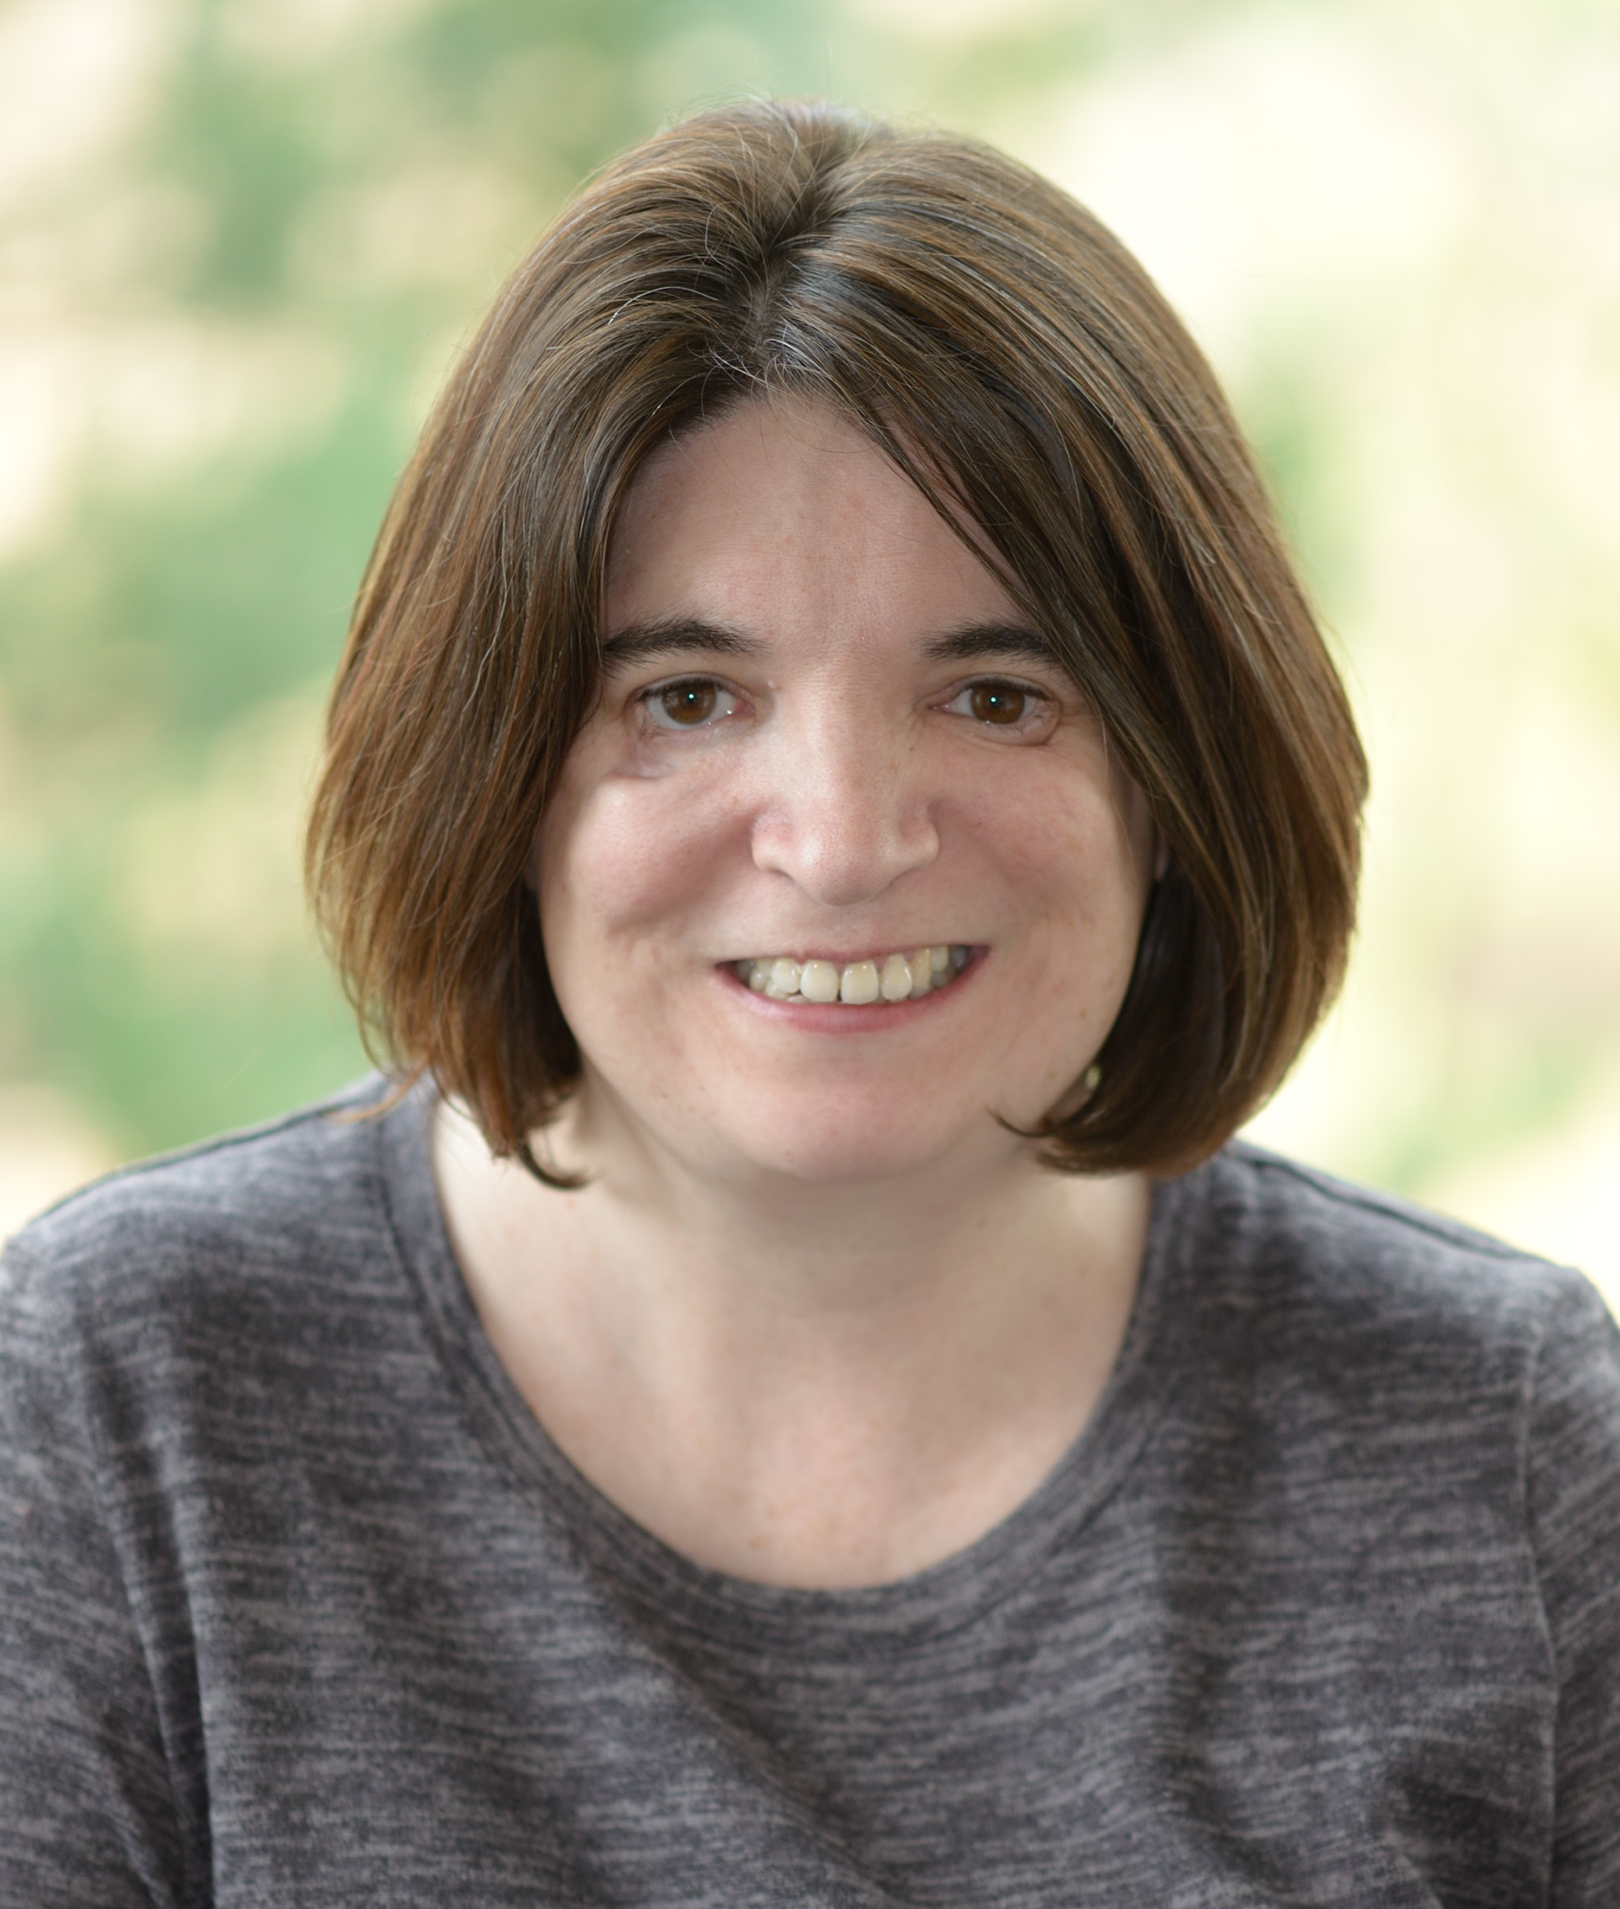
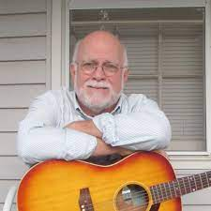
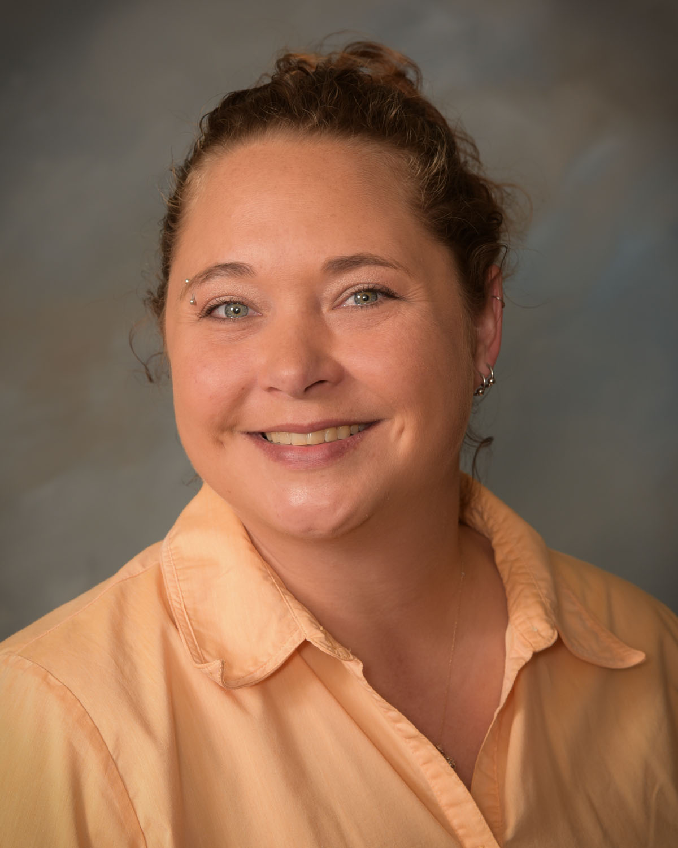
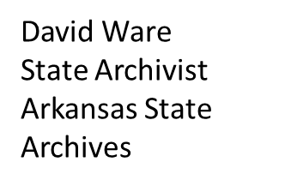
Speakers
Denise Henderson
Director
Digitization for Research Services
NARA
Shawn Rounds
State Archivist
Minnesota
Historical Society
Terra Titsworth
Archival Manager
Imaging and Preservation
Arkansas State Archives

Slide 4
Microfilming in 2023 - Considerations, Challenges, Benefits
Microfilm Operations at the National Archives and Records Administration
Denise Henderson
Director of Digitization
Research Services
NARA

Slide 5
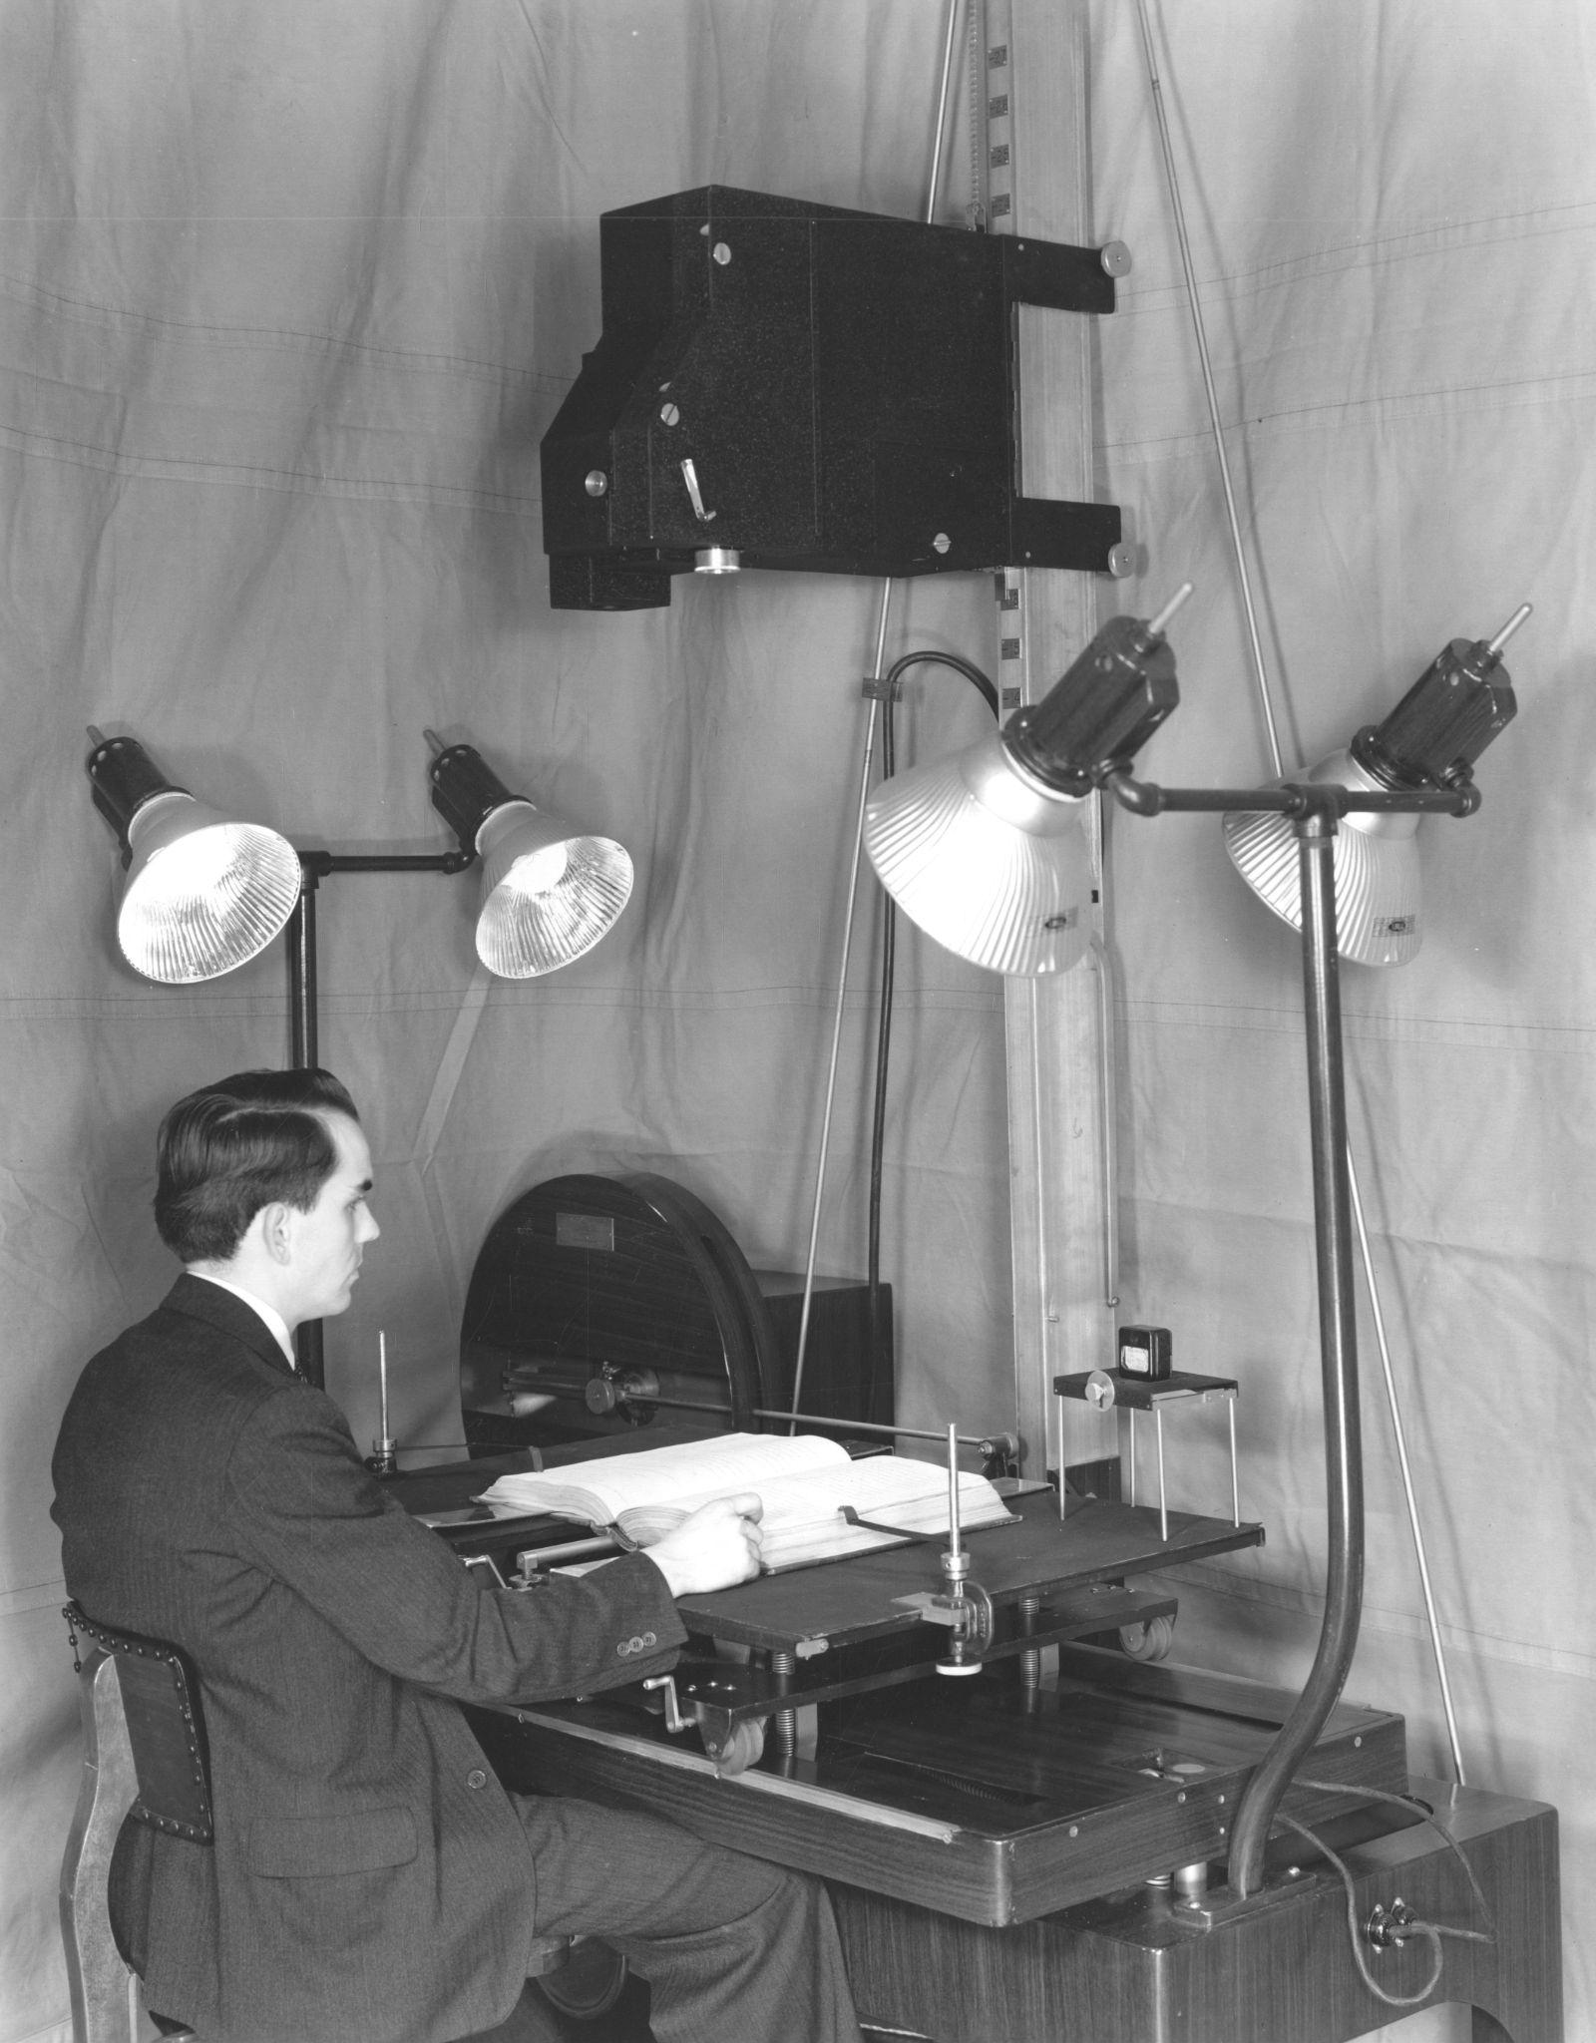
History of Microfilm at NARA
Mid-1930s, NARA began microfilming efforts
By the end of 1941, 75,000 pages of records were microfilmed
By end of 1943, 400,000 pages of records were microfilmed
Photograph of Employee Microfilming a Book, 1937 (NAID 74229383, Local ID: 64-PR-140-8)

Slide 6
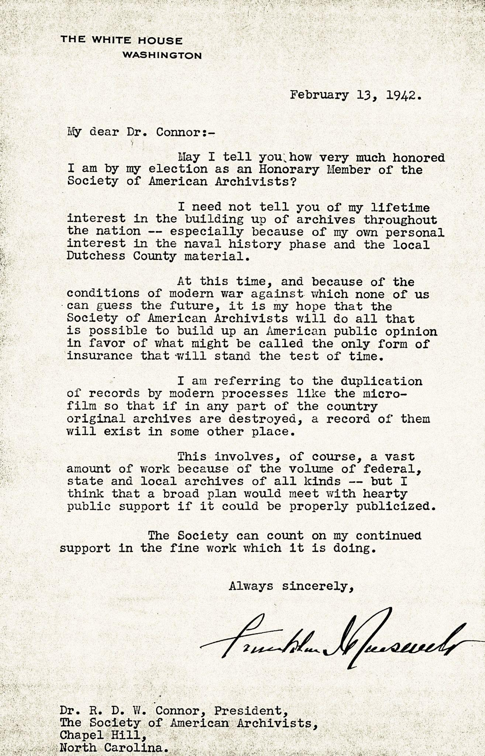
“...the duplication of records by modern processes like the microfilm so that if in any part of the country original archives are destroyed, a record of them will exist in some other place.”
President Franklin Delano Roosevelt Honorary Member of the Society of American Archivists
Letter from President Franklin D. Roosevelt to Robert Diggs Wembly Connor, 13 February 1942, Folder 668, Box 8 in the R. D. W. Connor Papers #2427, Southern Historical Collection, The Wilson Library, University of North Carolina at Chapel Hill.

Slide 7
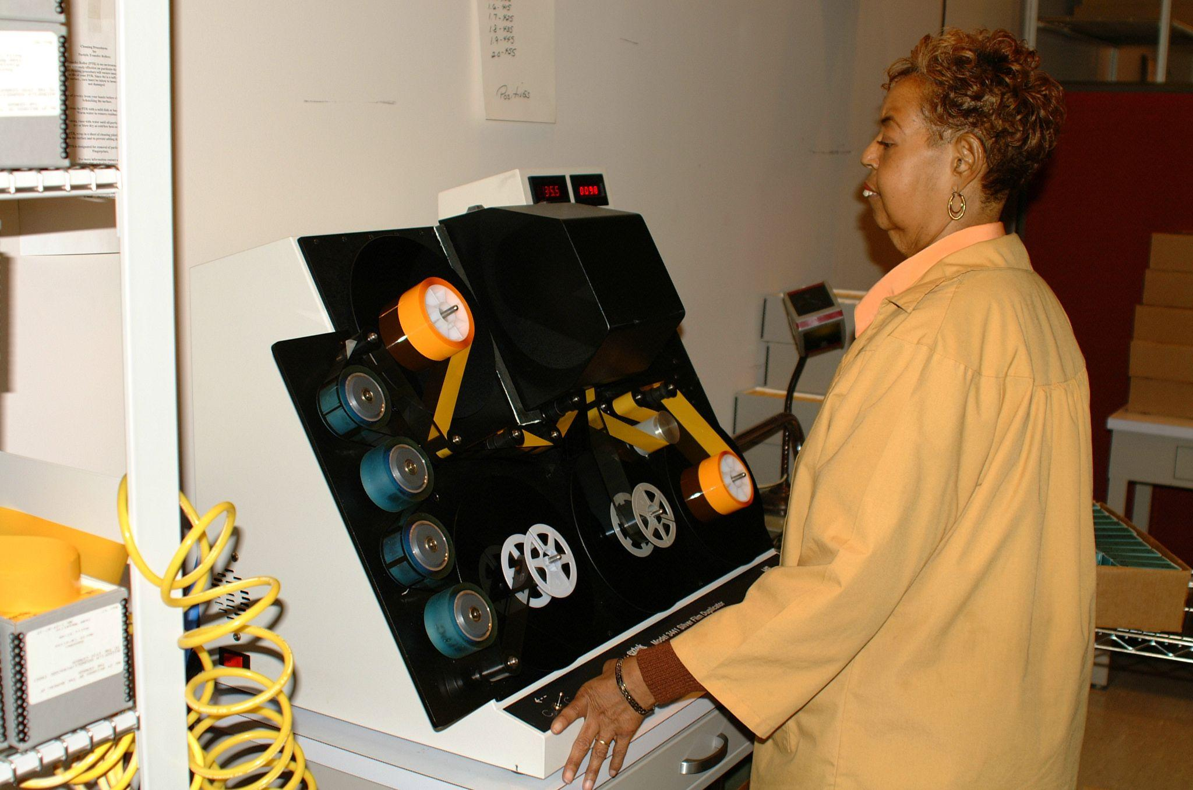
Microfilm printer, 2002 (NAID 66777595, Local ID: 64-CFD-20020204-01-003)

Slide 8
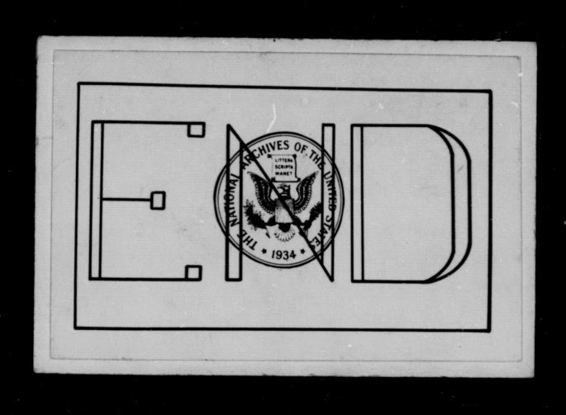
Early-2010s - Program to create NARA microfilm products ended.

Slide 9
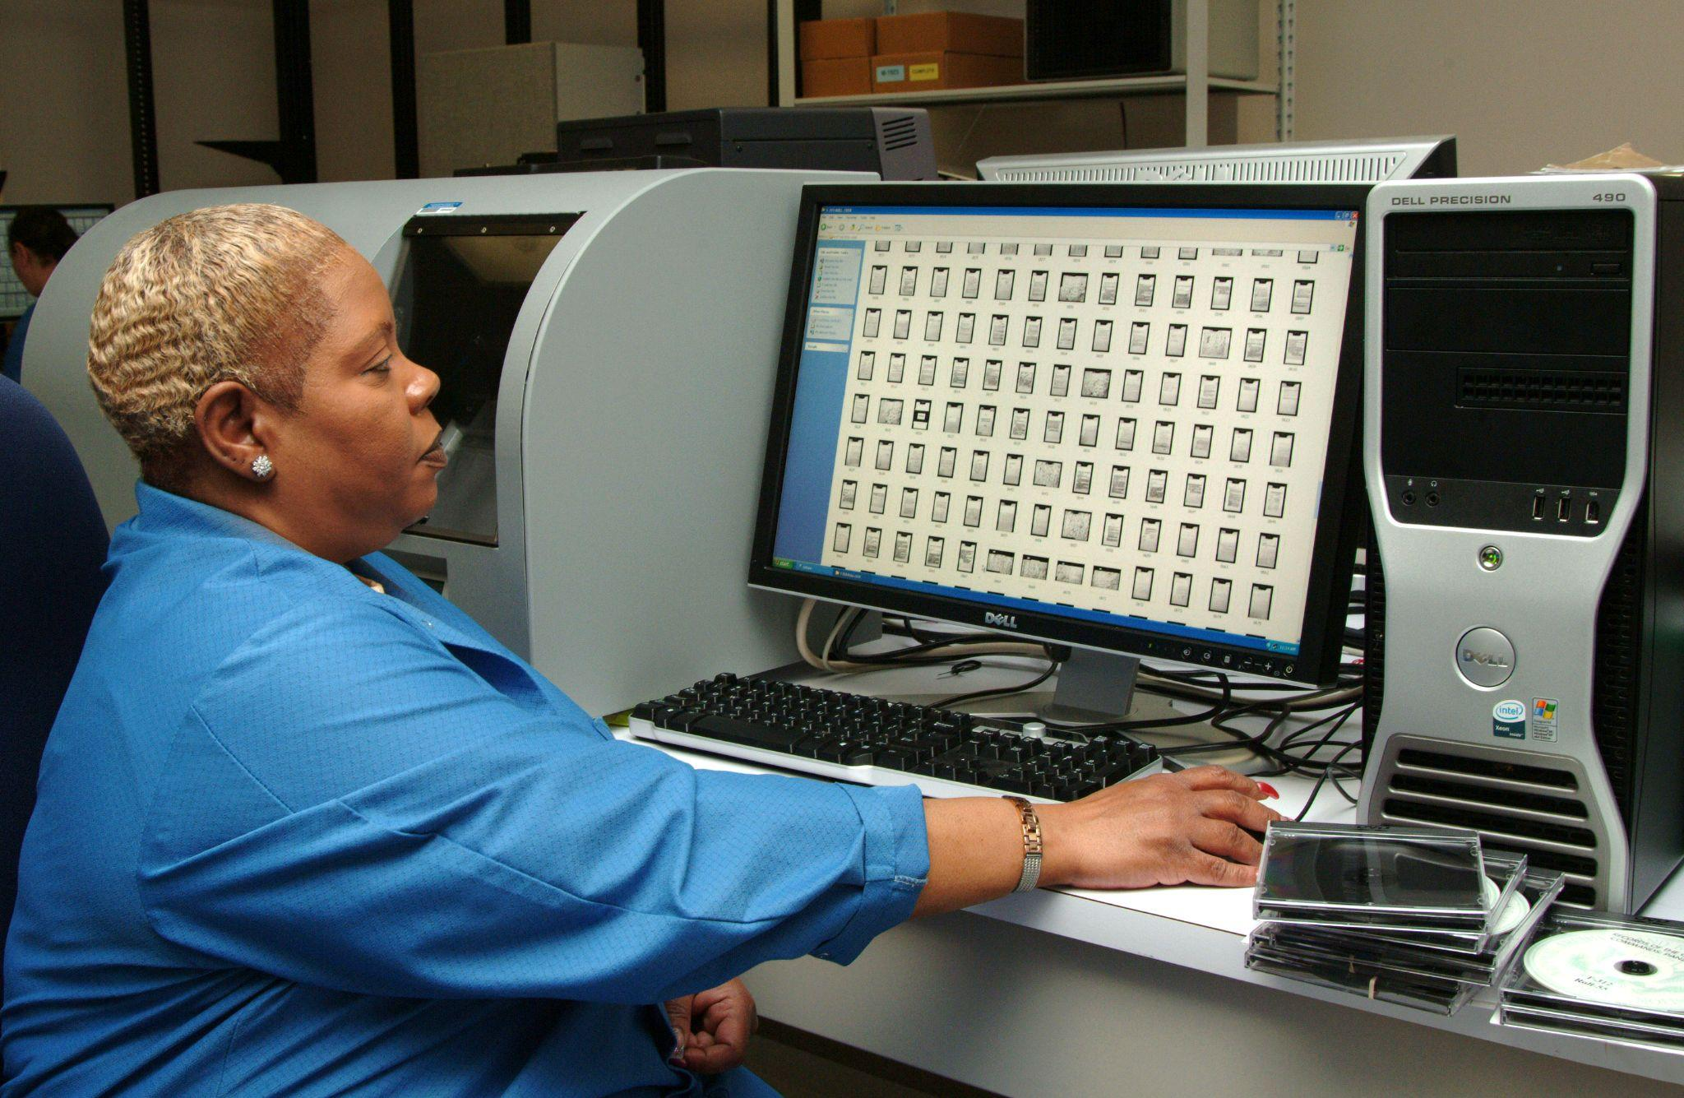
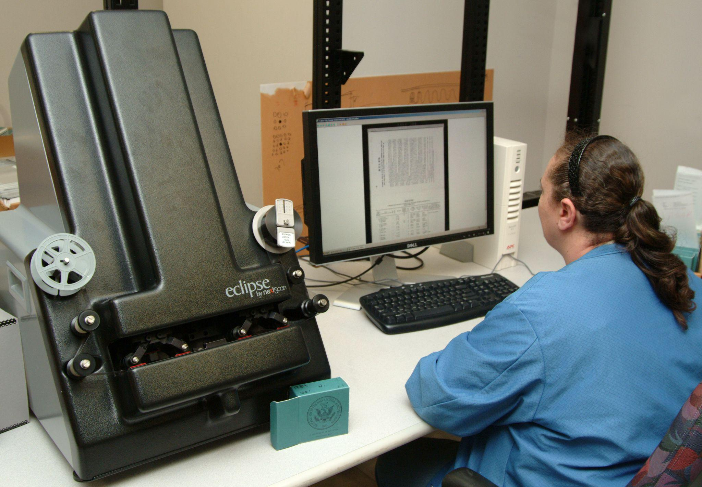
Digitizing Operations, 2009 (NAID 184341168, Local ID: 64-CFDA-20090417-01A and NAID 184341169, Local ID: 64-CFDA-20090417-01B

Slide 10
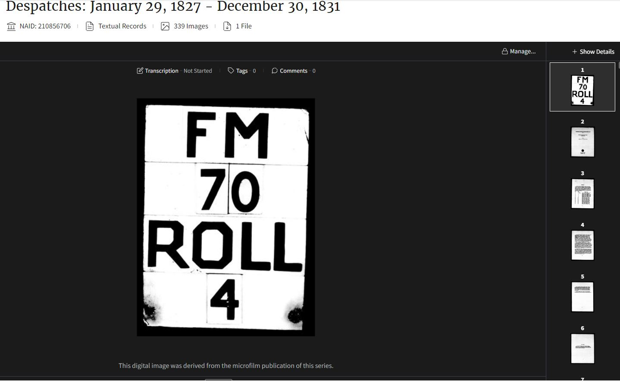
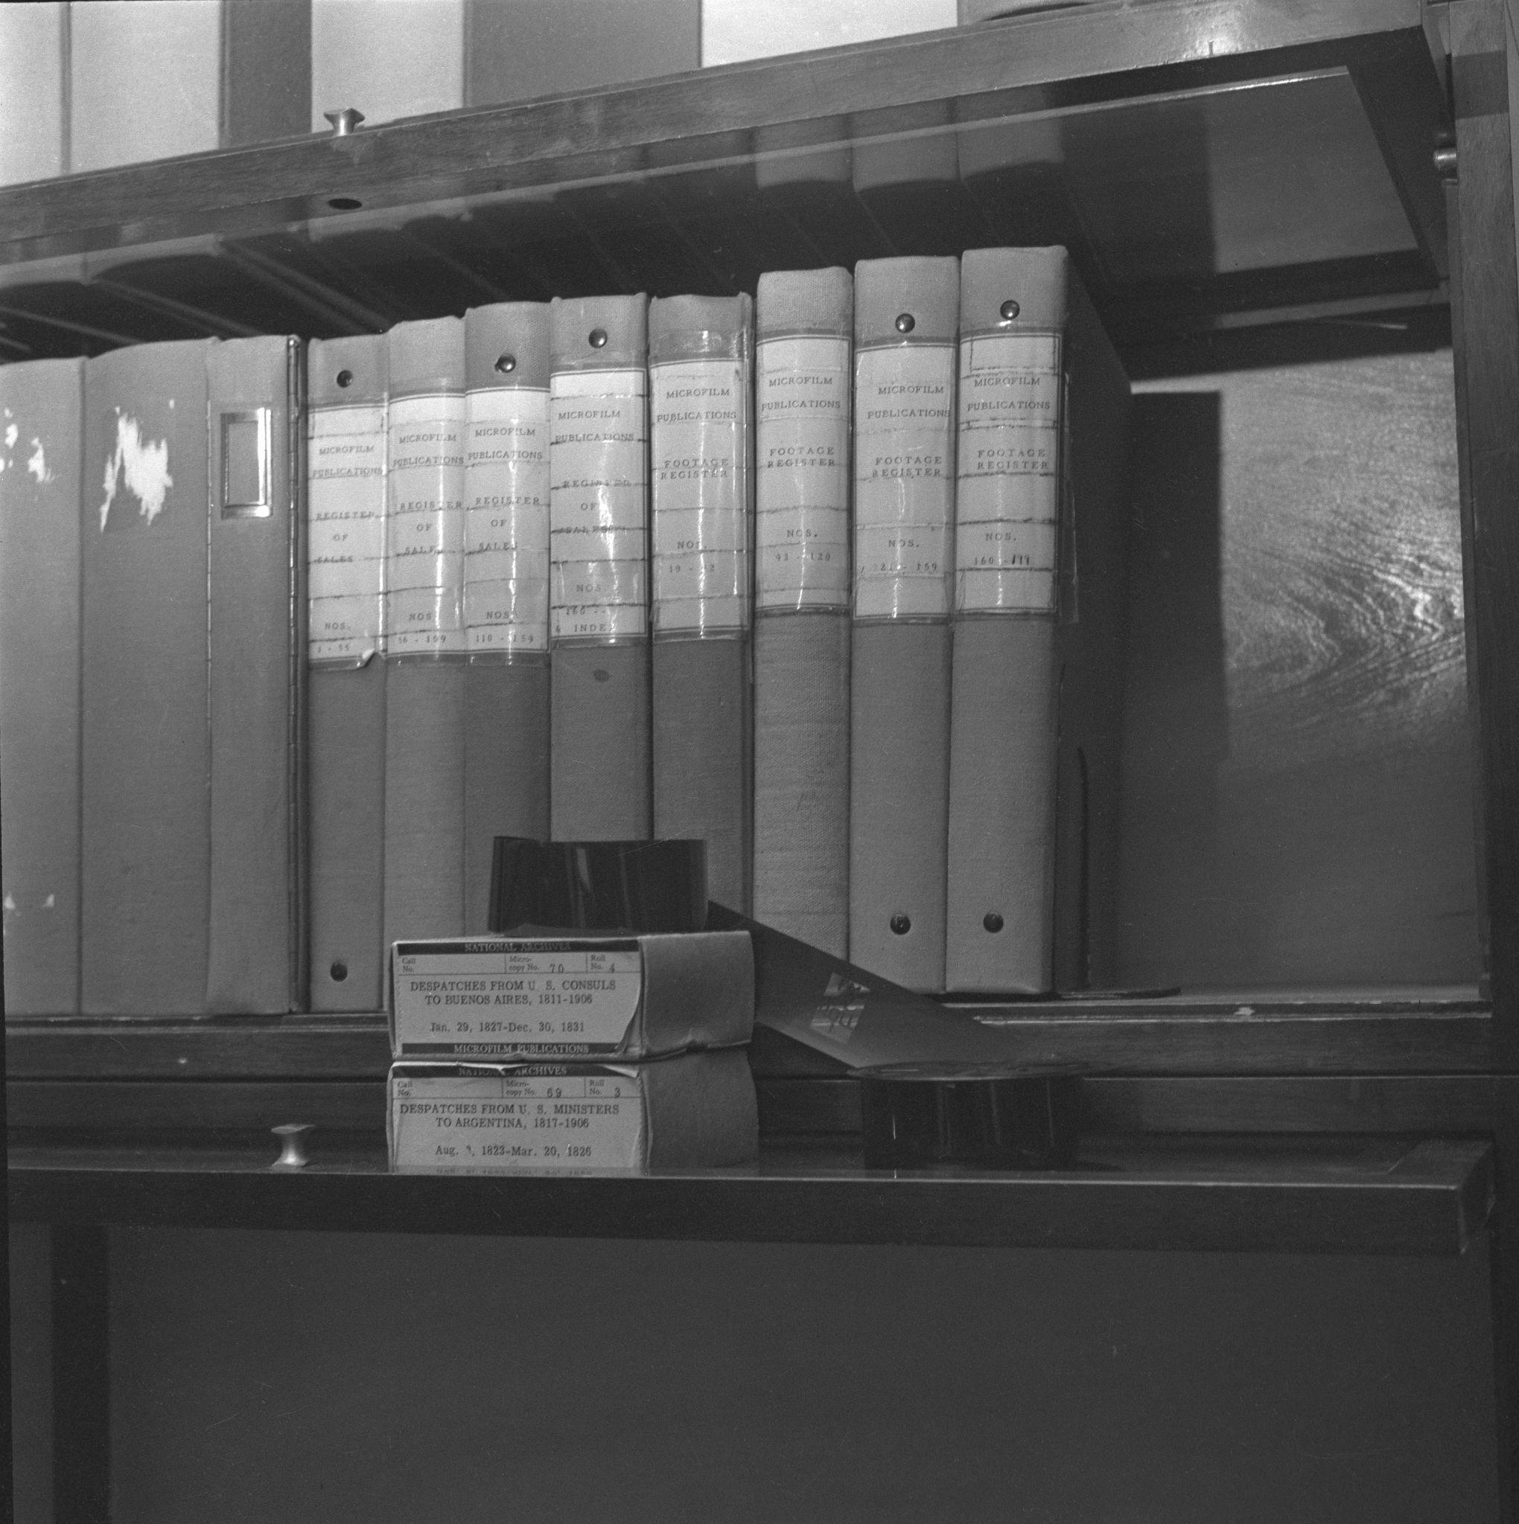
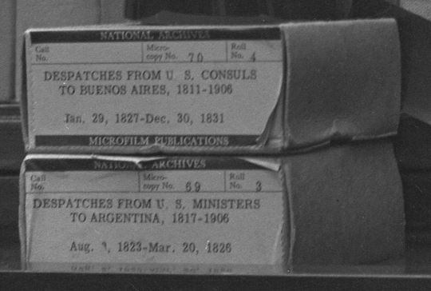
M69 - Despatches from U.S. Ministers to Argentina, 1817-1906
M70 - Despatches from U.S. Consuls in Buenos Aires, Argentina, 1811-1906
M70 Roll 4 digitally available in the National Archives Catalog
Microfilm Publications and Documentation, 1955 (NAID 122213674, Local ID: 64-PR-107-76)

Slide 11
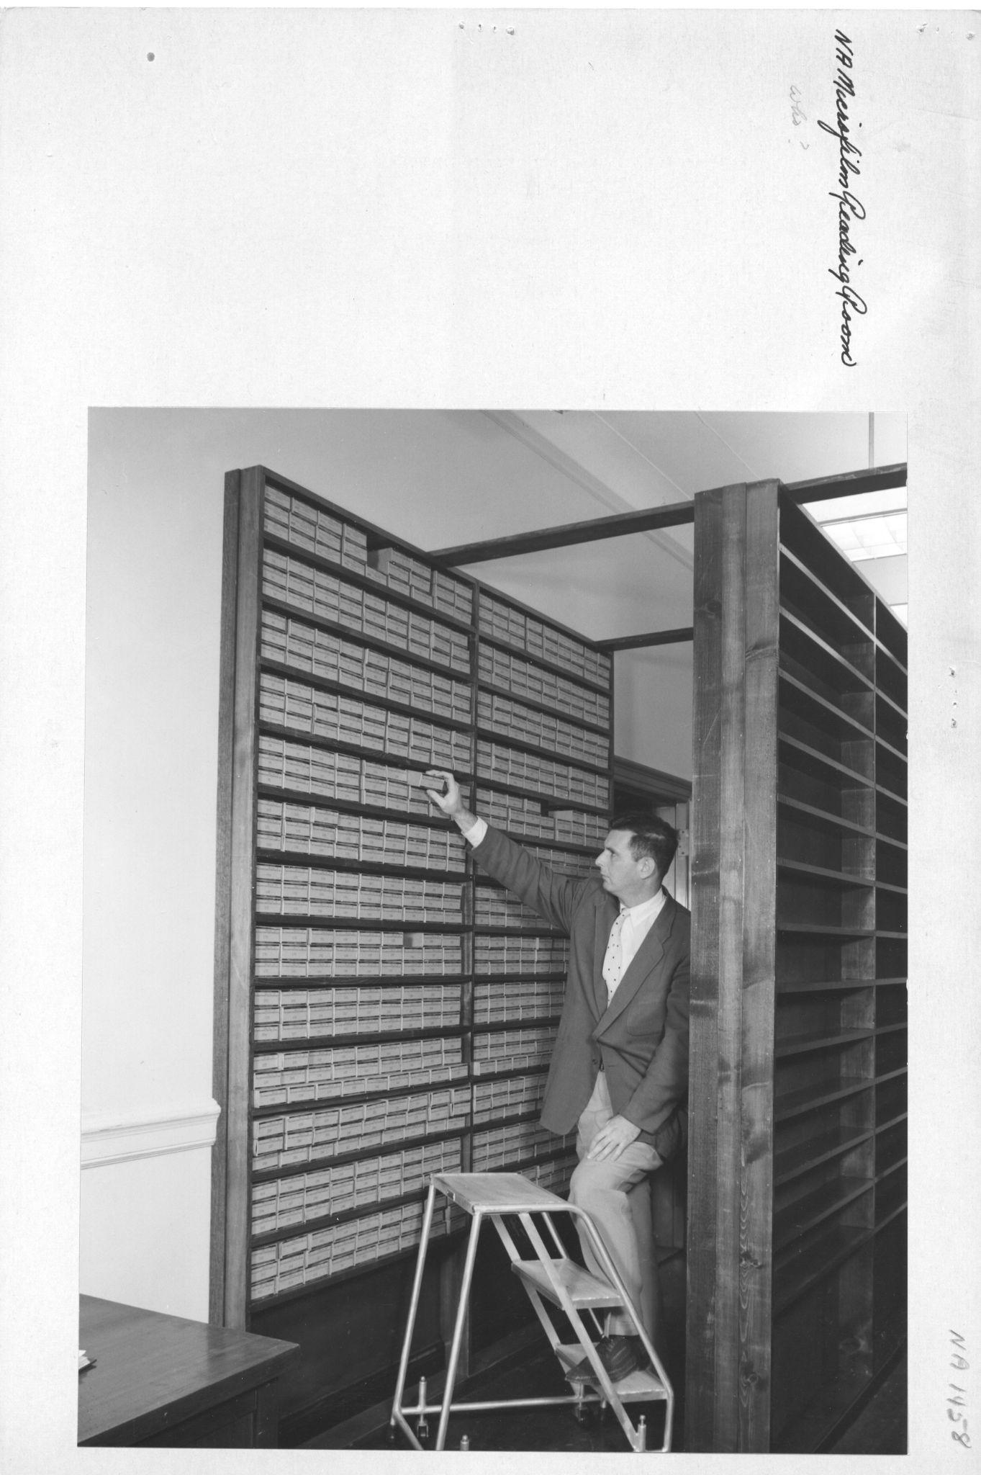
Challenges
Deteriorating film
Metal reels
Lack of supplies and tools
Loss of knowledge
Photograph of National Archives Microfilm Reading Room, 1957 (NAID 12169054, Local ID: 64-NA-1458)

Slide 12
Questions?
Denise Henderson
denise.henderson@nara.gov

Slide 13
Microfilming: Viewpoints from the Minnesota Historical Society and the Arkansas State Archives

Slide 14
Questions and Comments

Slide 15
Upcoming Member Webinars
March 23 - Topics from the Advocacy committee
April 27 – Building or Remodeling Archives: Part 1 - Planning and Prep
May 25 – Topic TBD
June 23 – Building or Remodeling Archives: Part 2 – Construction and Lessons Learned
To register:
https://www.statearchivists.org/programs-education/cosa-webinars

Slide 16
Upcoming SERI Webinars
Watch for the Spring webinar schedule coming soon!
To register:
https://us02web.zoom.us/meeting/register/tZYsde-qpjoqH9xwnKYrc7lJdTCcJOR2cn84

Slide 17
Contact Us
CoSA Website http://www.statearchivists.org
CoSA Resource Center https://www.statearchivists.org/research-resources/resource-center
CoSA Twitter Handle @StateArchivists
CoSA Facebook Page www.facebook.com/CouncilOfStateArchivists
CoSA You Tube https://www.youtube.com/user/StateArchivists/

Slide 18
Sponsors and Funders

Slide 19
Webinar Evaluation
We really do appreciate your feedback!
Please take a moment and respond to the evaluation following this webinar.

