Slide 1
CoSA Shop Talk Webinar
May 13, 2021
3 pm Eastern
APPX Shop Talk Webinar: Managing Archival Holdings with AXAEM
Disclaimer: This webinar is being recorded and will be available for viewing on the CoSA website.

Slide 2
Webinar Agenda
Welcome
Presentations from APPX
Q and A
Announcements

Slide 3
Presenters
APPX
John Selvage
Steve Frizzell

Slide 4
APPX Shop Talk Webinar: Managing Archival Holdings with AXAEM
Steve Frizzell, CEO
John Selvage, PRESIDENT
APPX Software, INC.

Slide 5
APPX Shop Talk Webinar
ABSTRACT
In our two previous ShopTalks, APPX Software has discussed how the AXAEM Archives Management System can be used to manage State Agencies that periodically transfer records to the State Archives and Records Center and how related Record Schedules can be managed and maintained. In this webinar, we will discuss how AXAEM can be used to manage permanent holdings. We will demonstrate how a variety of media types including paper, microfilm, and digital media can be Accessioned, Stored, Processed, Cataloged, and, if necessary, Deaccessioned. AXAEM can help you manage and control every step of the records preservation and storage process. Equally important, AXAEM facilitates public access to your holdings with a searchable online web catalog, searchable records indexes, and dynamically created and updated finding aids.
Powered By

Slide 6
Archives Management with AXAEM
Describing Archival Holdings
Hierarchical Record Descriptions (Record Groups, Series, Subseries)
Online Searchable Catalog of Holdings
Finding Aids Creation and Management
Processing of Records
Archives Inventory Management
Accessioning of records
Deaccessioning of records
Hierarchical Container Management
Space Management
Powered By

Slide 7
Archives Management with AXAEM
Additional Archives Management Modules
Rights Management (Citations, Copyright Statements, Licenses, Permissions)
Appraisal of Records (Objectives, Categories, Themes)
Functions Management (Related Agencies and Related Records)
Programs Management
Projects Management
Microfilm Workorder Management
Digitization Workorder Management (coming soon)
Searchable Index Management
Patron/Research Management
Electronic Records Preservation and Management
Powered By

Slide 8
Describing Archival Holdings
Bibliographic Record Descriptions
Hierarchical Record Descriptions (Record Groups, Series, Subseries)
Online Searchable Catalog of Holdings
Finding Aids Creation and Management
Processing of Records
Powered By

Slide 9
Hierarchical Record Descriptions
EAD Hierarchy (Record Groups, Series, Subseries, etc.)
Support for multiple IDs
Creating Entity (State Agencies, Boards, Commissions, etc.)
EAD Notes (Abstract, Scope & Content, Arrangement, etc.)
Extents Summary
Records date range
Access Points (Local Subject Headings/LOC Subject Headings)
Use and Access Restrictions
Privacy Classification (Public, Private, Confidential, etc.)
Fully Integrated with links to associated Accessions, Deaccessions, Record Center Transfers, Microfilm Workorders, Containers, Electronic Records)
Powered By

Slide 10
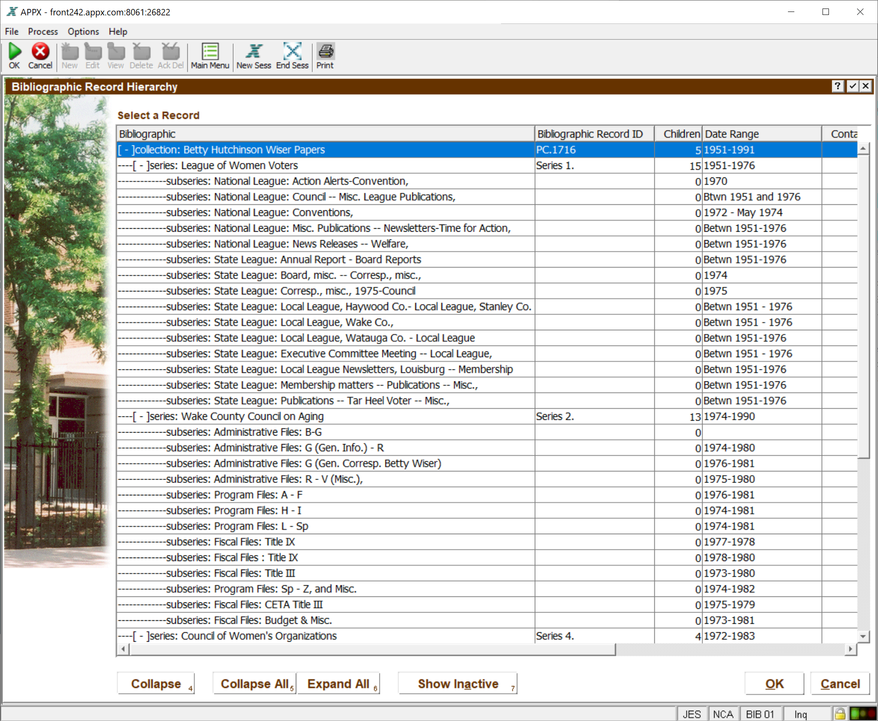
Bibliographic Record Hierarchy
Powered By

Slide 11
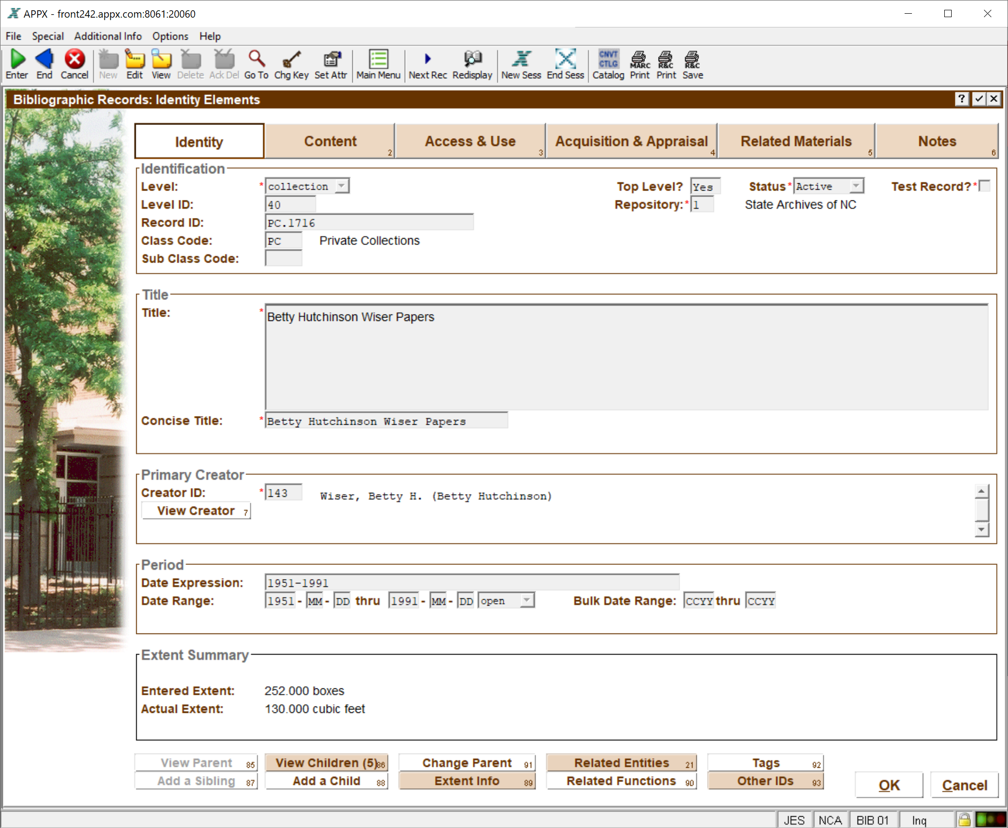
Bibliographic Record Detail
Powered By

Slide 12
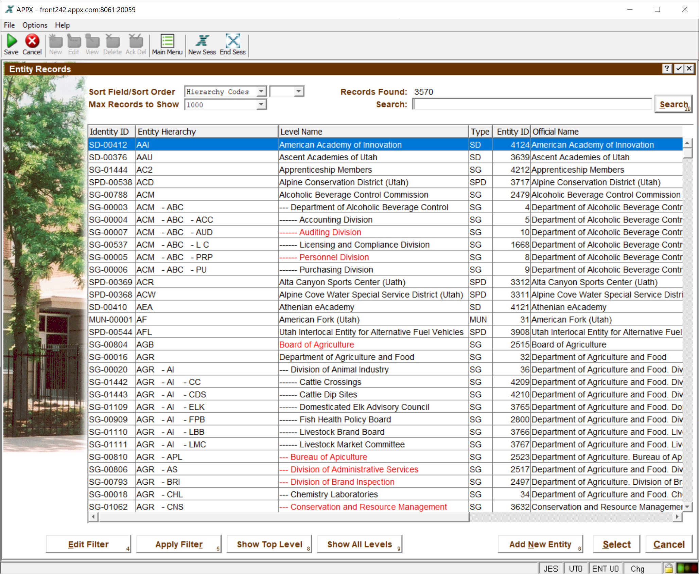
Hierarchical Record Creator
Powered By

Slide 13
Subseries Linked to Associated Containers
Powered By

Slide 14
Online Searchable Catalog
Web Search of archival holdings
Keyword search of all descriptive fields (Solr search engine)
Filtering by facets
Filtering by specific field values
Drill down from summary to detailed information
Link to view related Finding Aid
Try out NC Archives Online Catalog https://archives.ncdcr.gov/search-doc
Powered By

Slide 15
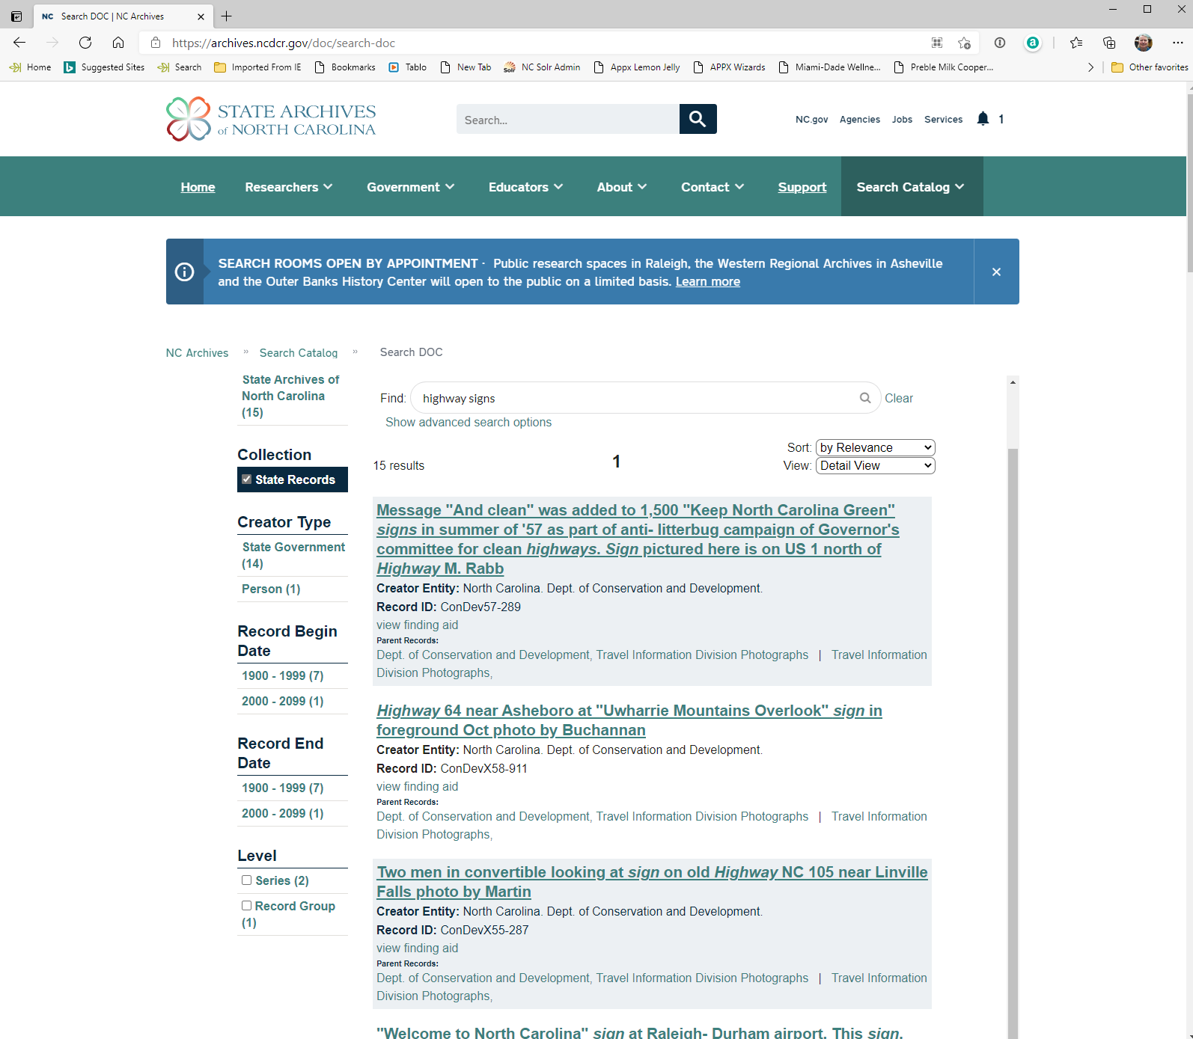
Online Searchable Catalog
Powered By

Slide 16
Finding Aids Creation & Management
Published on Demand after revisions
Create EAD XML file
Create HTML Finding Aid from EAD XML using xslt and Saxon
Preview HTML and XML before publishing to website
Support for multiple Finding Aid formats
Publish HTML/XML to website
History of each published revision of Finding Aid
Option to revert to previously published finding aid
Powered By

Slide 17
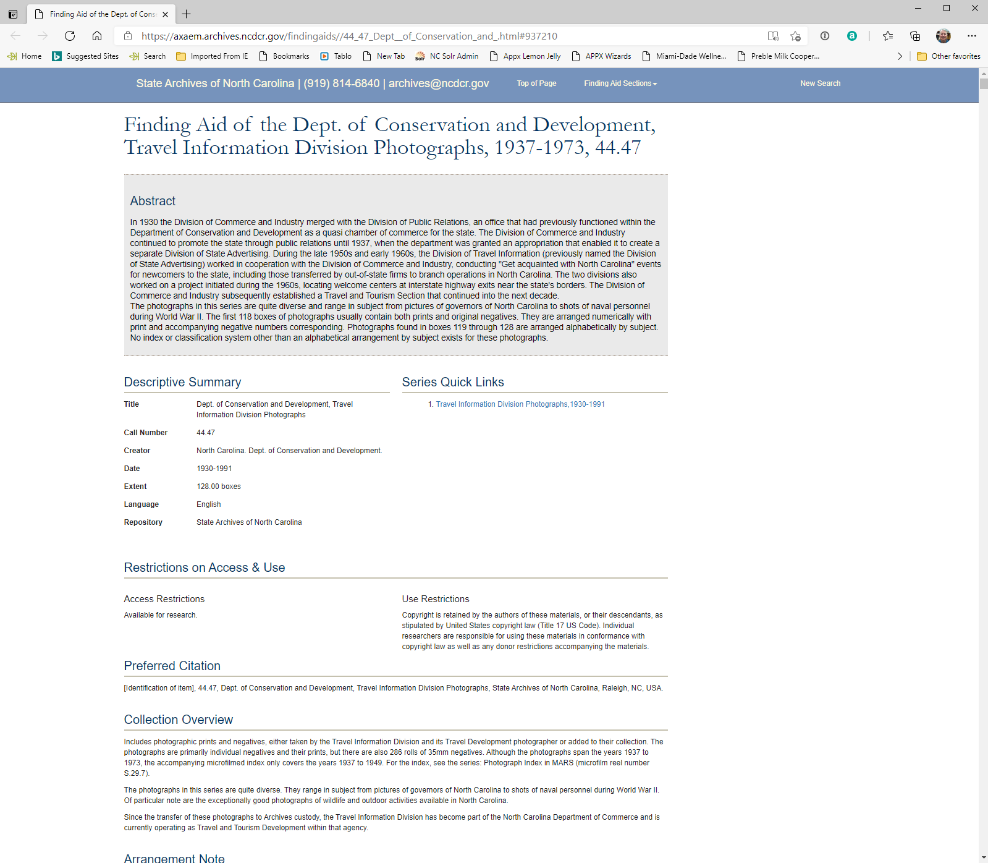
Online Published Finding Aid
Powered By

Slide 18
Processing of Records
Processing of records
Tag Containers with pending tasks (rebox, flatten, clean, label, etc.)
User definable processing tasks
Container search by pending tasks
Create workorders to manage processing tasks
Split/Merge containers
History of tasks by container
Status, Scheduled, Started, Completed, Assigned To, Notes
Monthly, Quarterly, Annual processing metrics
Powered By

Slide 19
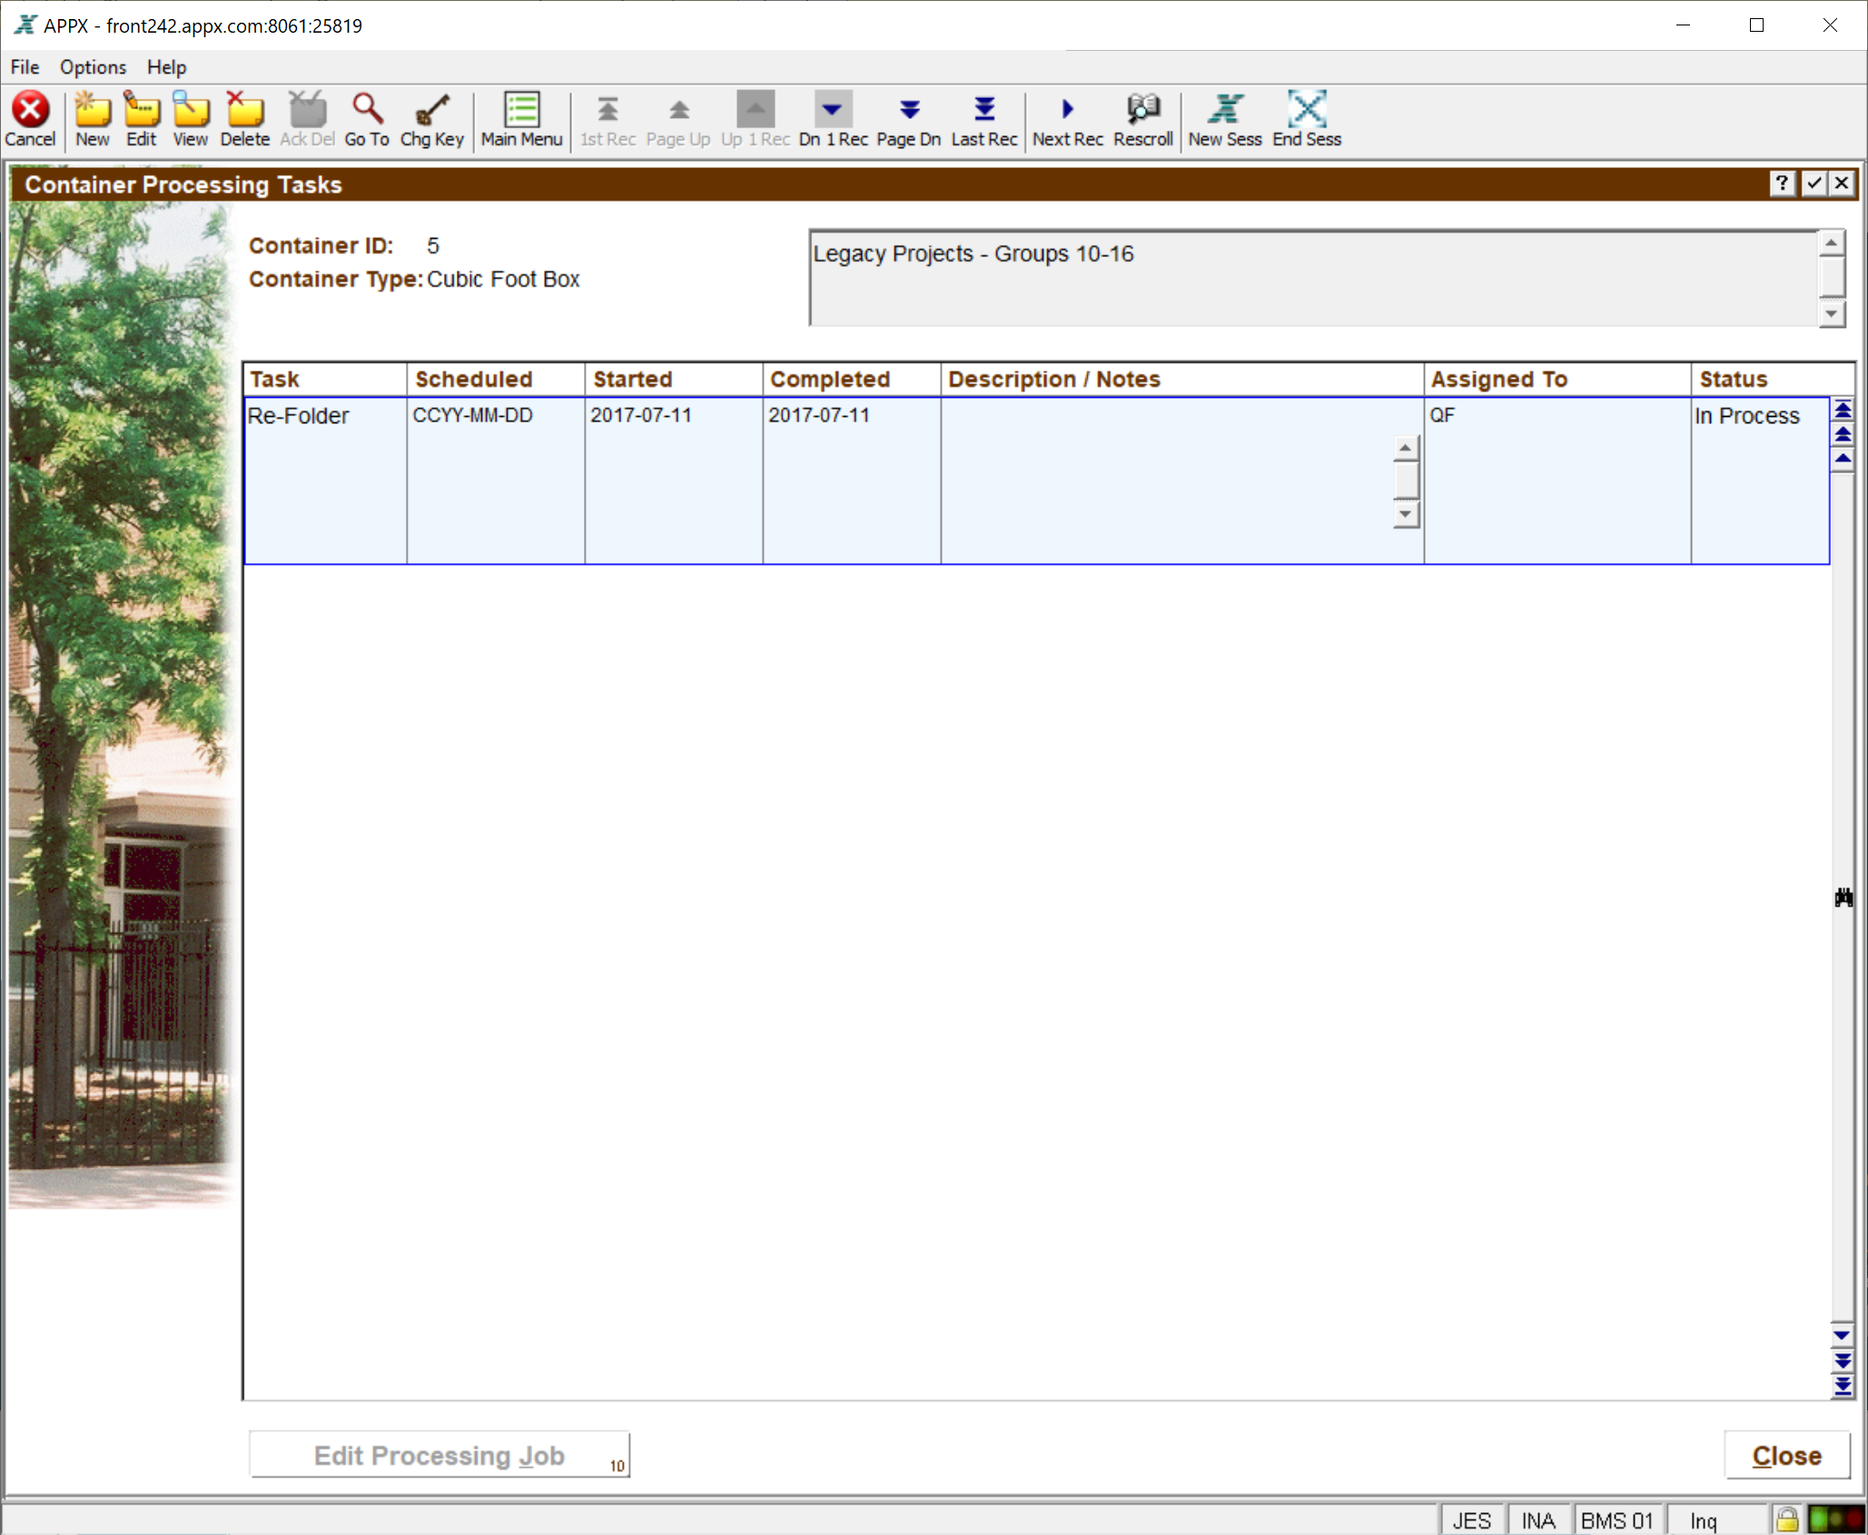
Container Processing Task
Powered By

Slide 20
Archives Inventory Management
Accessioning of records
Deaccessioning of records
Hierarchical Container Management
Space Management
Powered By

Slide 21
Accessions
Historical record of all records accessioned
Accession Sources
Automatically created when records transferred from Records Center
Automatically created by Microfilm Workorders
Manual entry of records transferred directly from Agencies
Manual entry of records received from donors
Creates container records
Calculates extents
Powered By

Slide 22
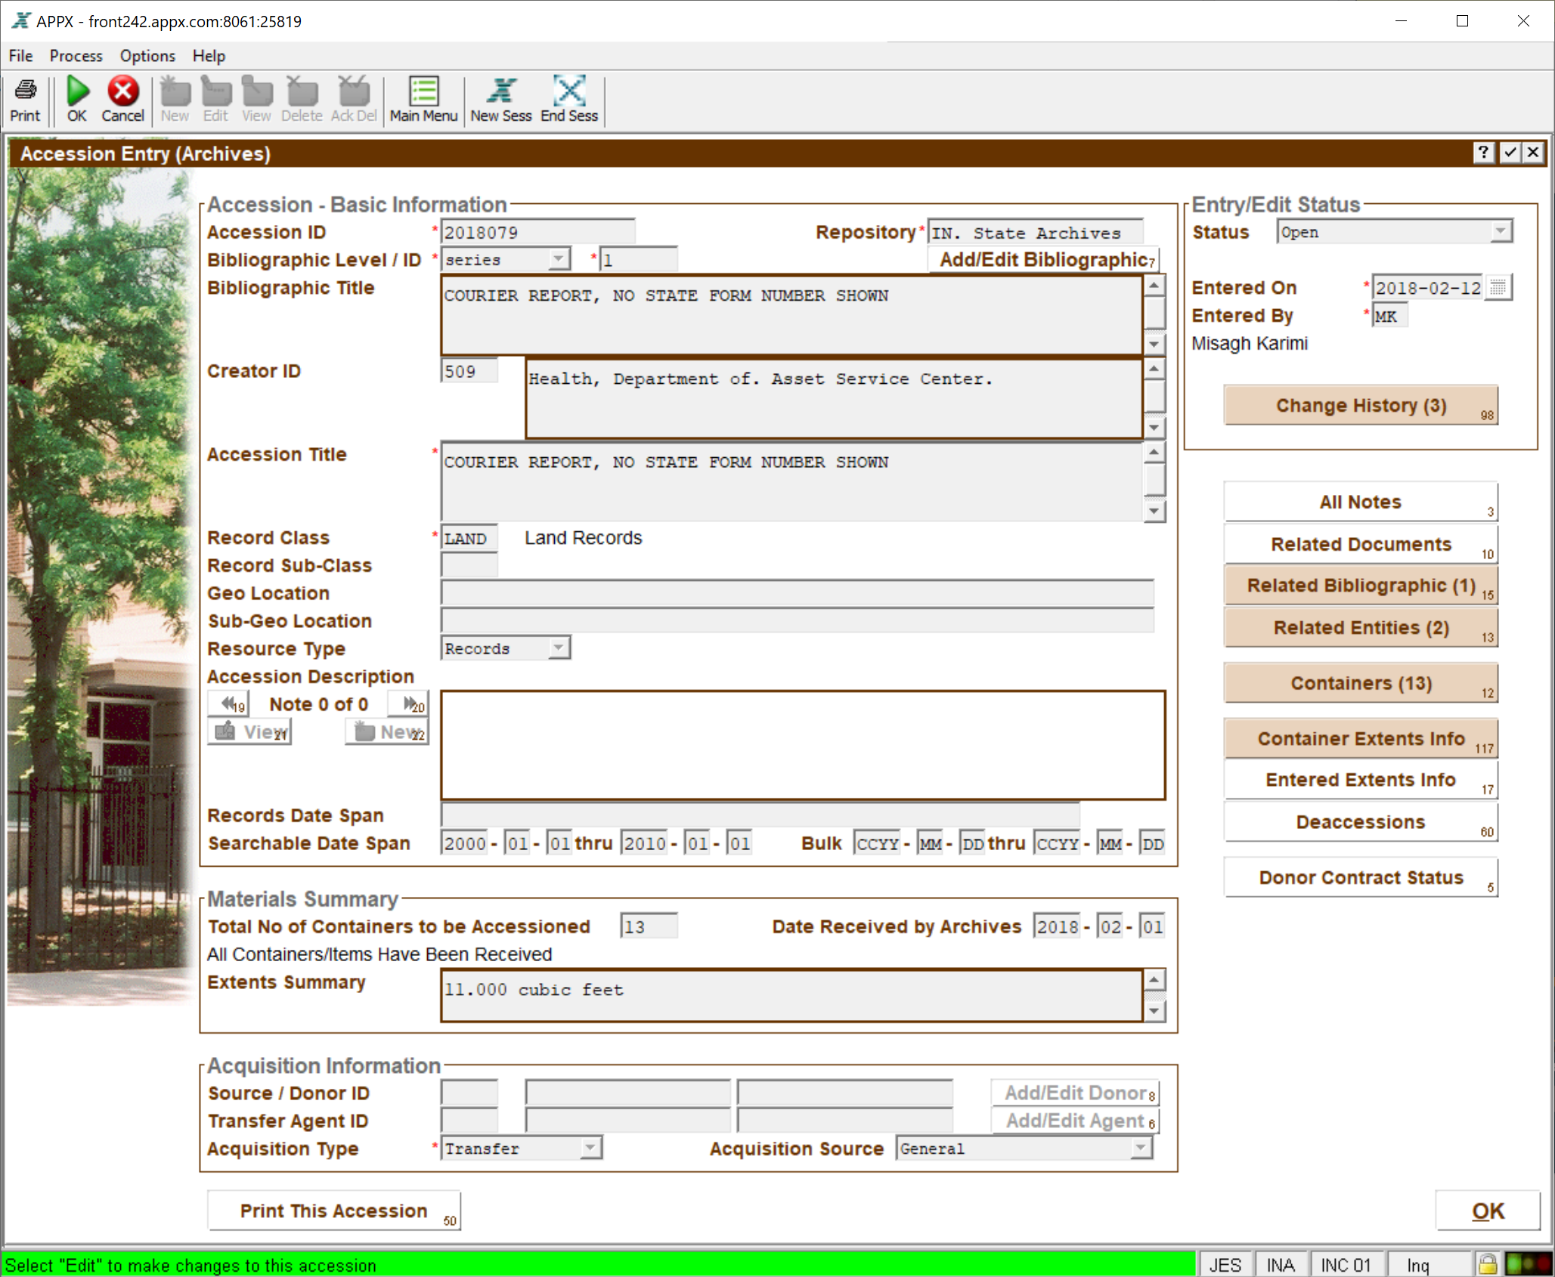
Accession Entry
Powered By

Slide 23
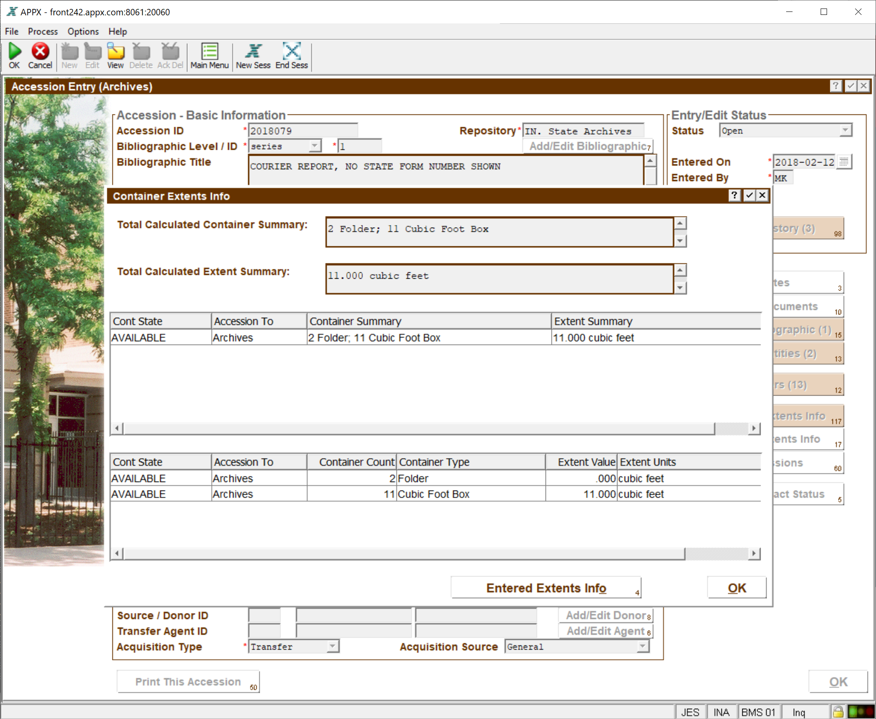
Accession Extents Summary
Powered By

Slide 24
Deaccessions
Deaccessions
Deaccession Approval Workflow
Select Containers By Series, Agency, Accession ID
Container Pull Report
Powered By

Slide 25
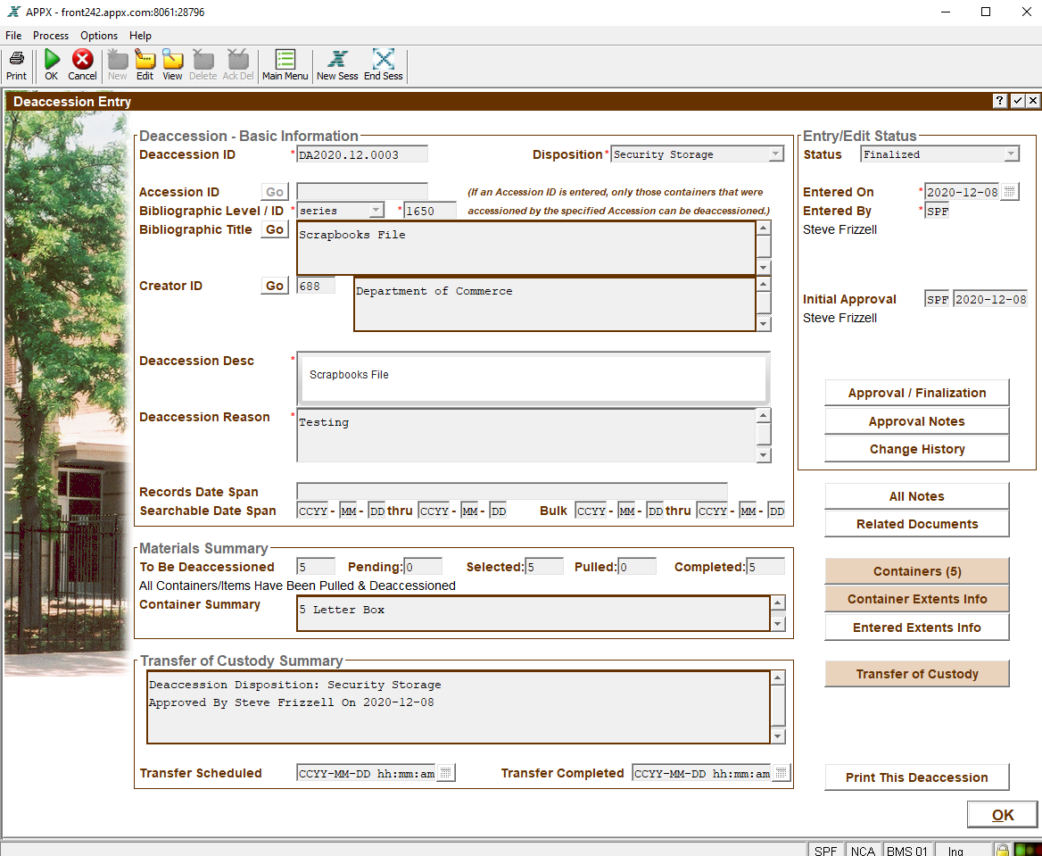
Deaccession Entry
Powered By

Slide 26
Hierarchical Container Management
Hierarchical Container Management
Containers within Containers
User Defined Container Types with extents
User Defined Format Types
Multiple Container IDs
Container description, date range, arrangement, restrictions, and notes
Multiple Label Types and Formats
Barcode support
Container Tracking and Checkout History
Fully integrated with links to related Series, Schedule, Records Center Transfer, Accession, Deaccession, Microfilm Workorder
Powered By

Slide 27
Hierarchical Containers
Powered By

Slide 28
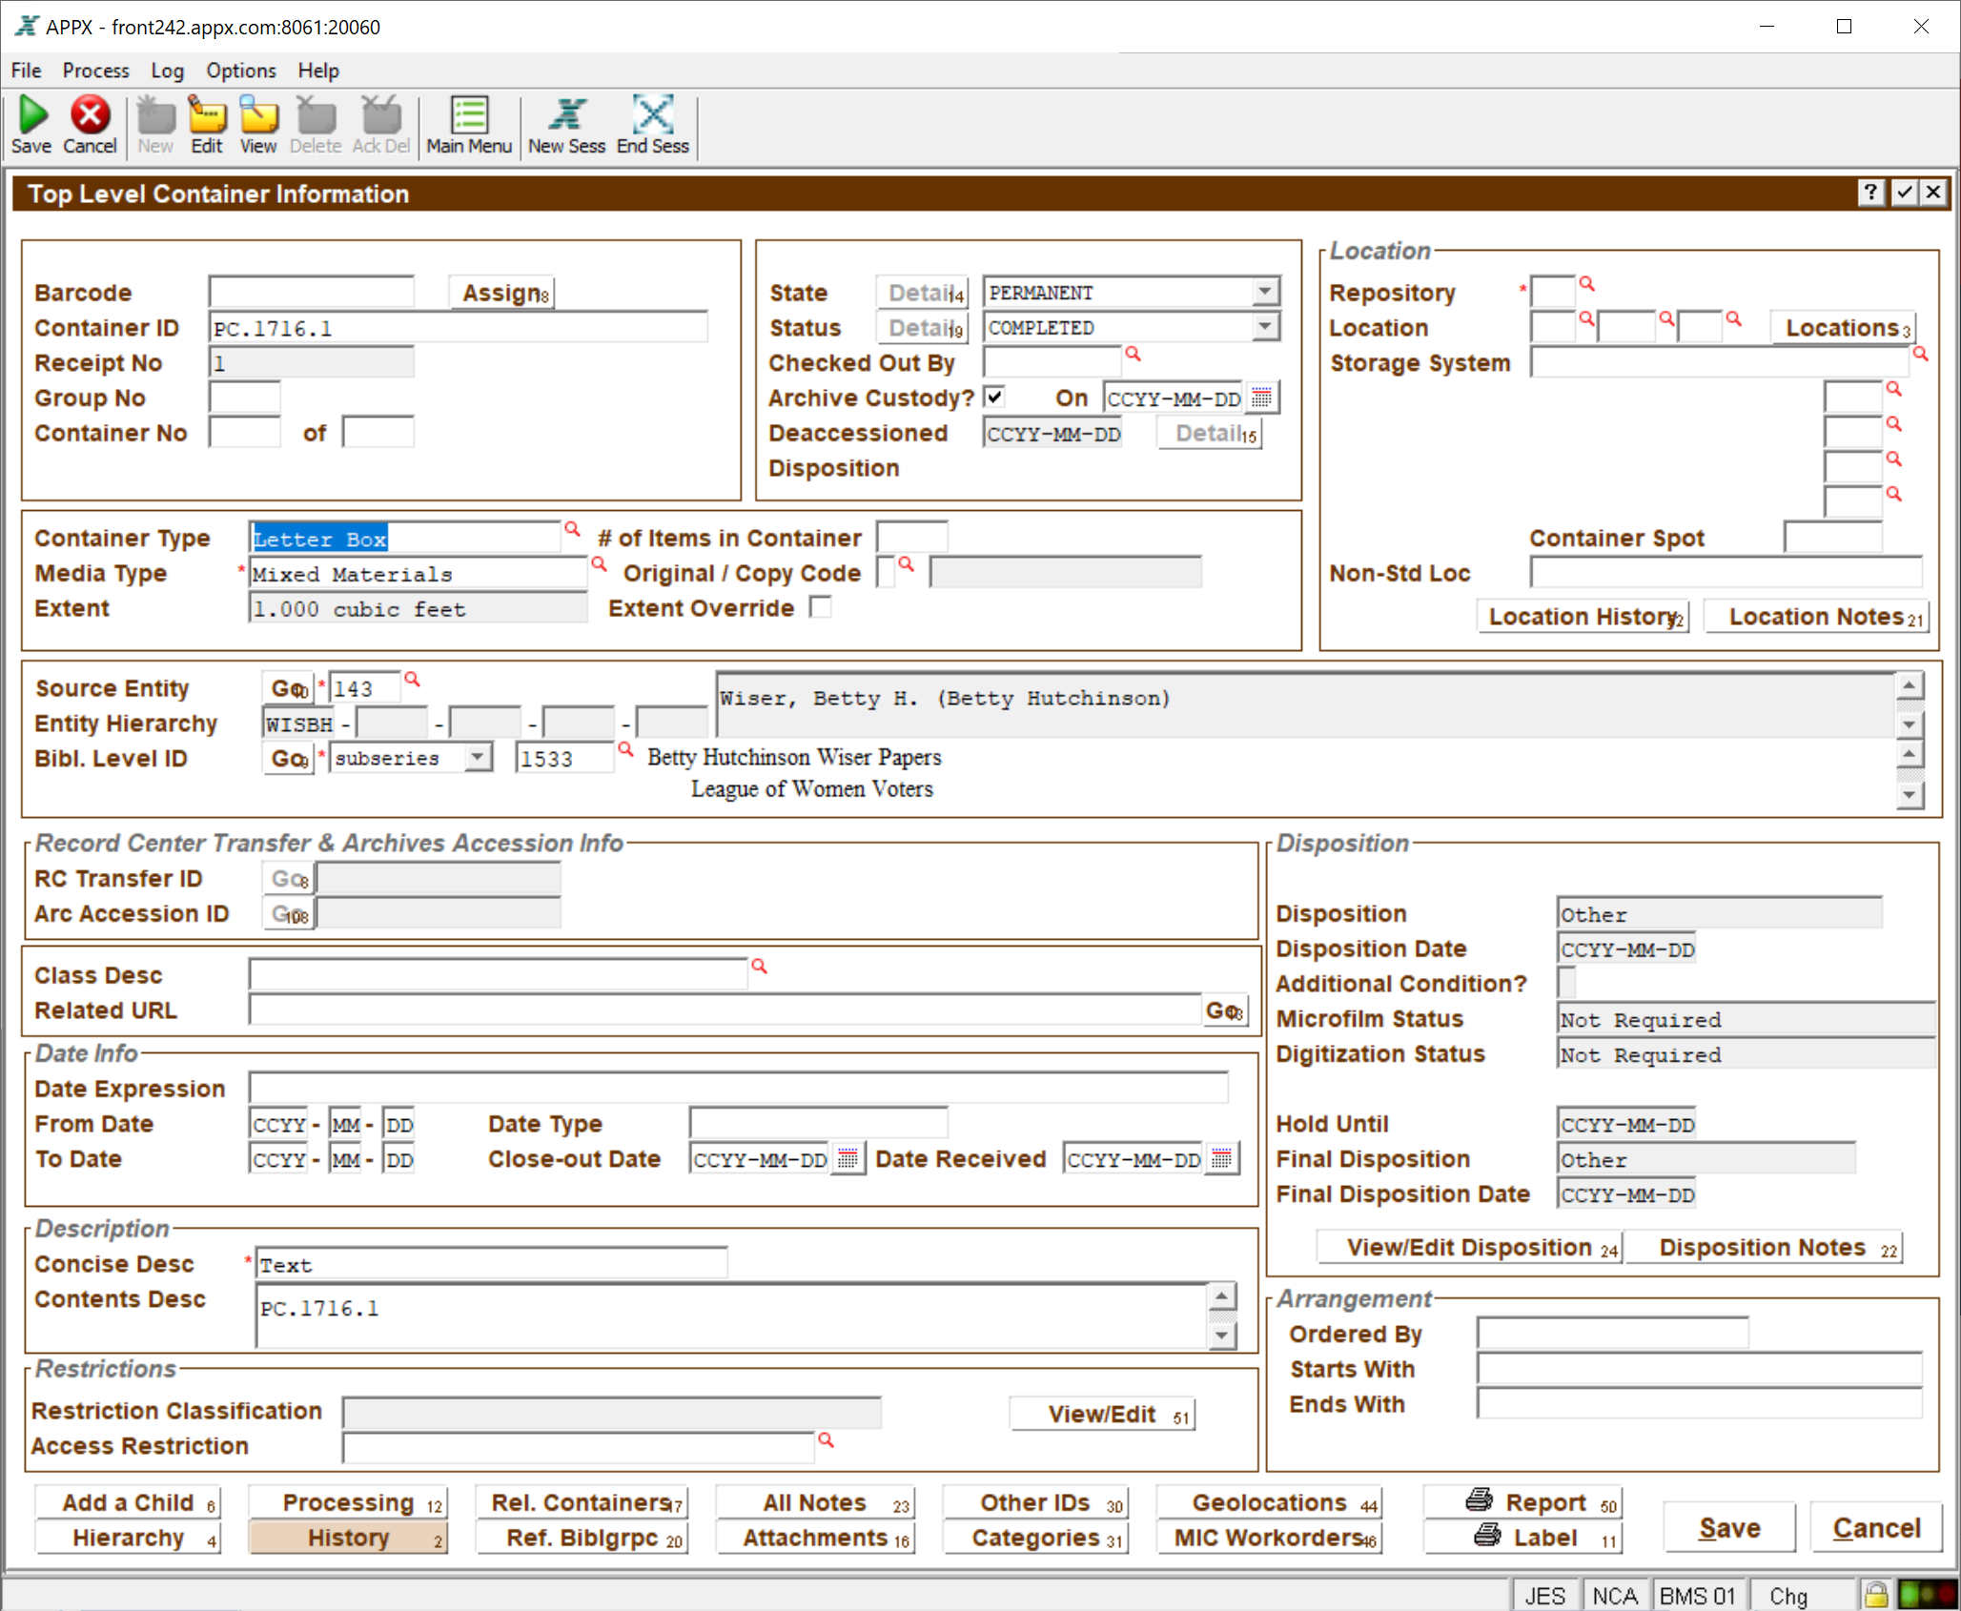
Container Detail
Powered By

Slide 29
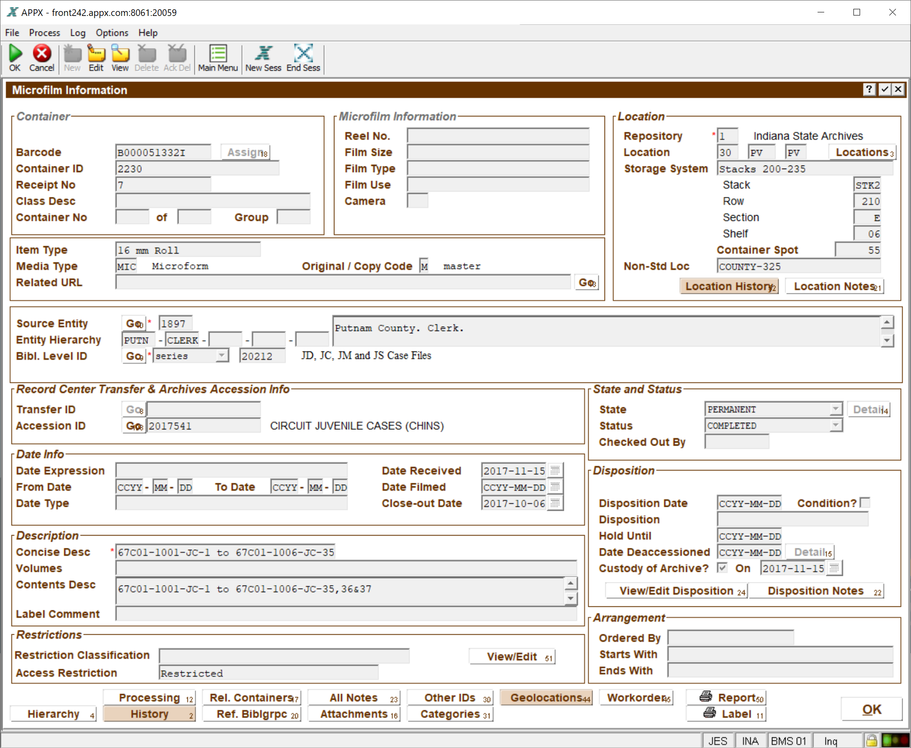
Container Detail (Microfilm)
Powered By

Slide 30
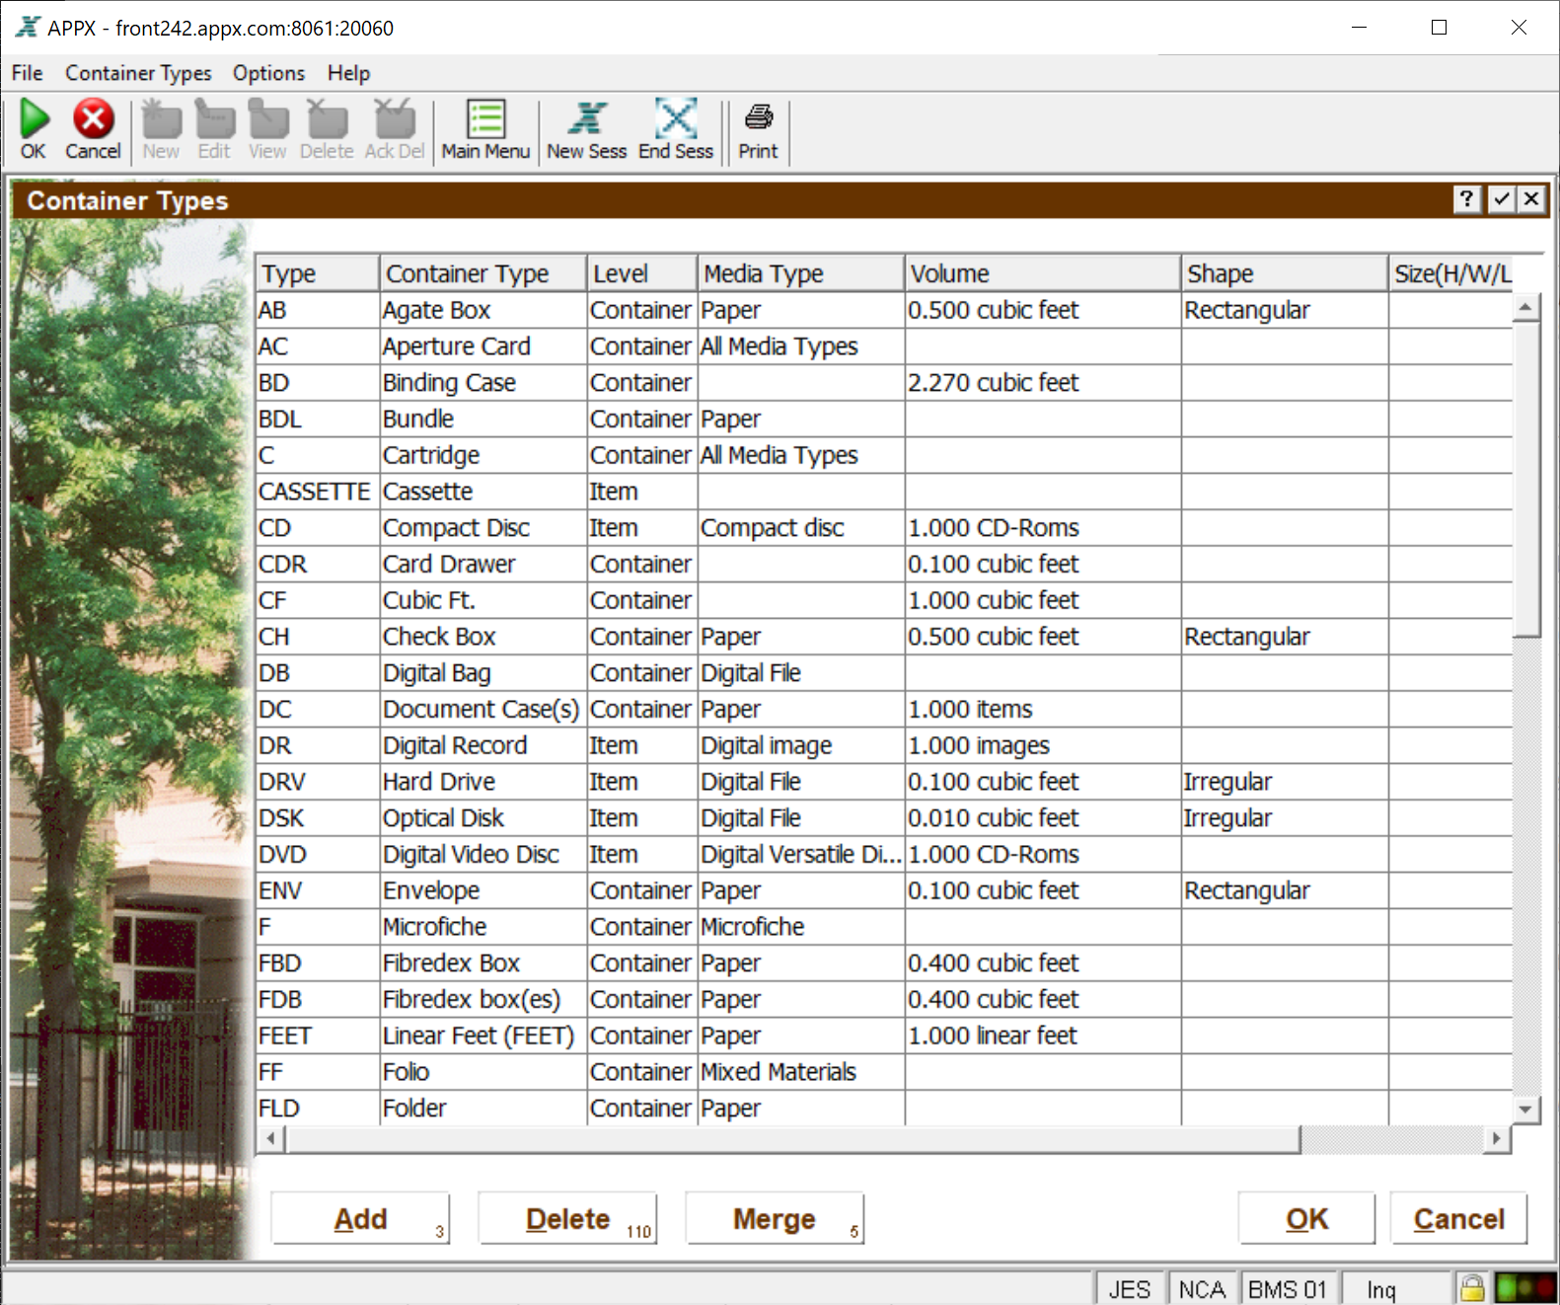
Container Types
Powered By

Slide 31
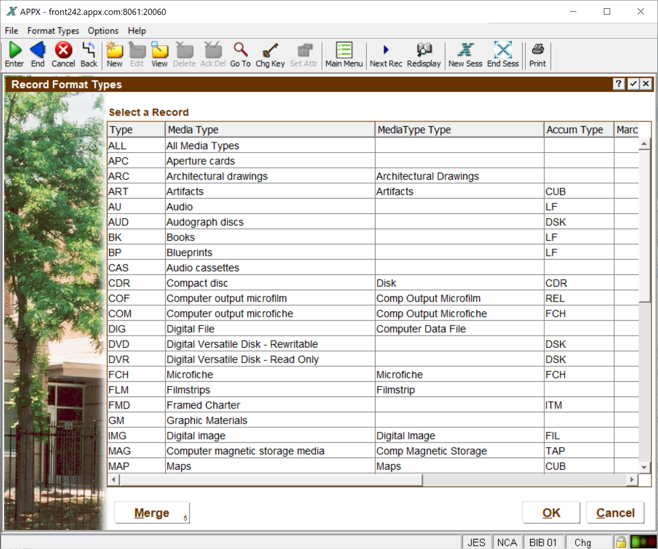
Record Formats
Powered By

Slide 32
Barcode Support
Powered By

Slide 33
Space Management
Space Management
Building, Room, Area
Storage Types
Storage Systems
Shelf capacity and arrangement by box type
Powered By

Slide 34
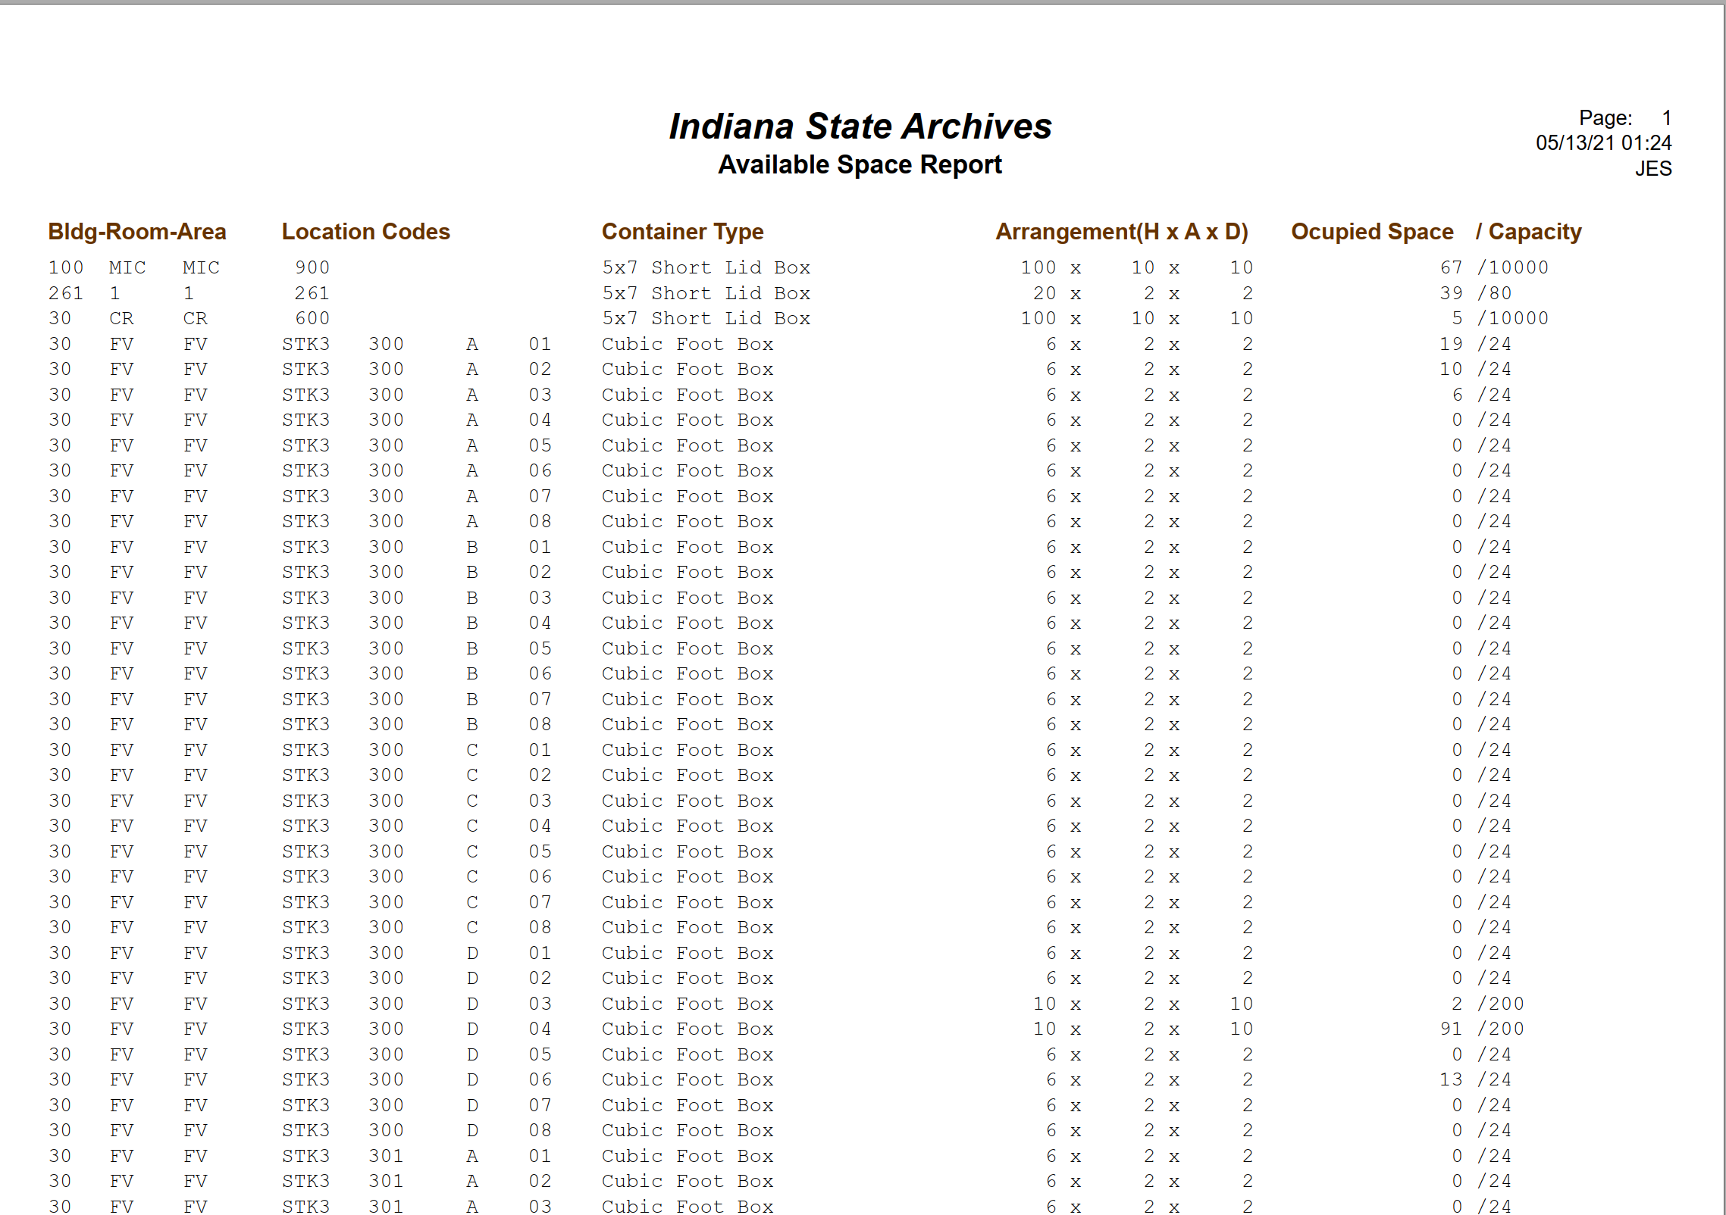
Available Space Report
Powered By

Slide 35
APPX Shop Talk Webinar
For Additional Information About AXAEM:
Contact John Selvage, President
APPX Software, Inc.
info@axaem.com
Powered By

Slide 36
Questions and Comments

Slide 37
Upcoming Webinars
May 27: CoSA Member Webinar – Conscious Editing
For registration information: https://www.statearchivists.org/programs/cosa-webinar-series/

Slide 38
Contact Us
CoSA Website http://www.statearchivists.org
CoSA Resource Center https://www.statearchivists.org/resource-center/
CoSA Twitter Handle @StateArchivists
CoSA Facebook Page www.facebook.com/CouncilOfStateArchivists
CoSA You Tube https://www.youtube.com/user/StateArchivists/

Slide 39
Webinar Evaluation
We really do appreciate your feedback!
When you exit the webinar, you will automatically be taken to an online webinar evaluation. Please take a couple minutes to complete the survey and help us plan future webinars.

