Slide 1
STORY MAPS: A TOOL FOR ENGAGEMENT AND ADVOCACY

Slide 2
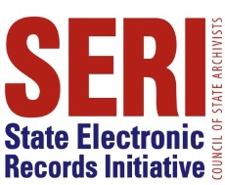
WELCOME!
In the Chat
Who you are and where you’re from
Number of people attending with you
Your electronic records training needs and interests

Slide 3
WELCOME!
Upcoming SERI webinar lineup
TBD
CoSA’s Online Resources
Resource Center
SERI Webinar Recordings on YouTube
SERI Educational Videos on YouTube

Slide 4
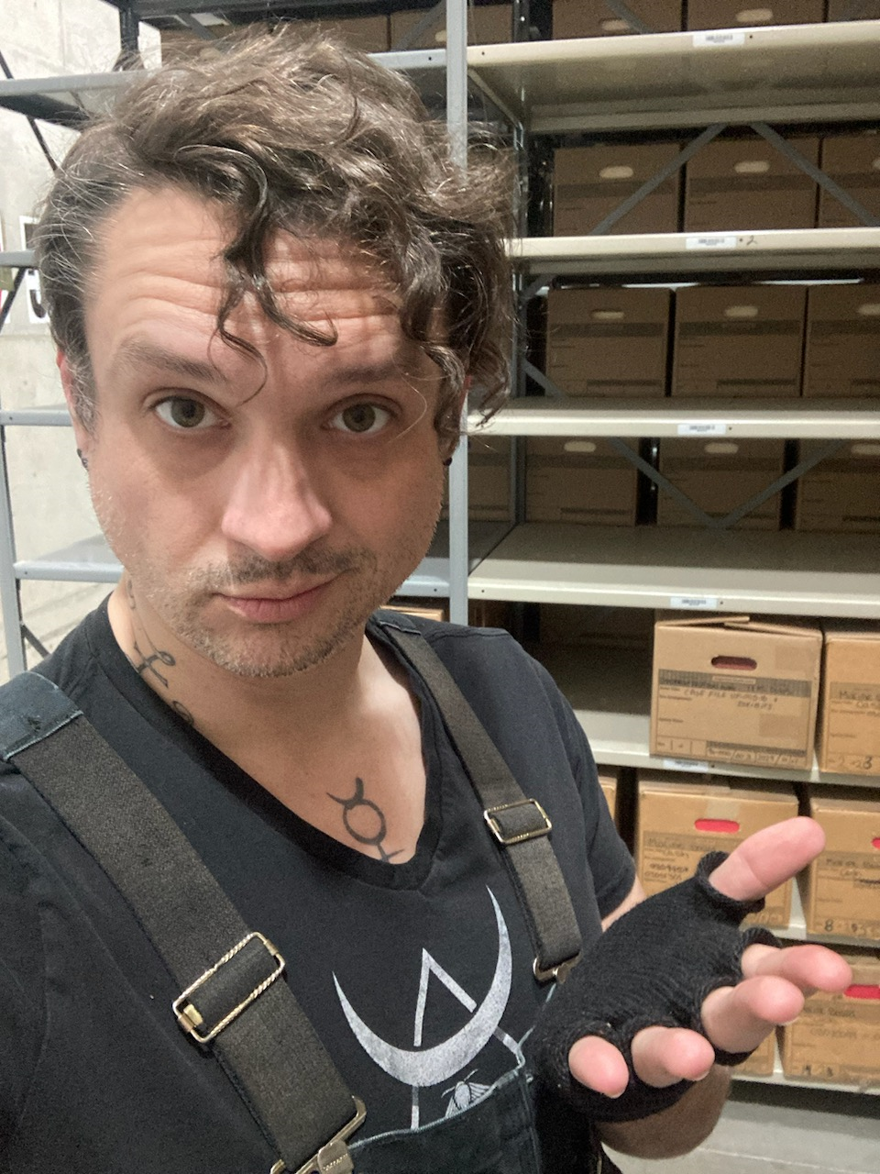
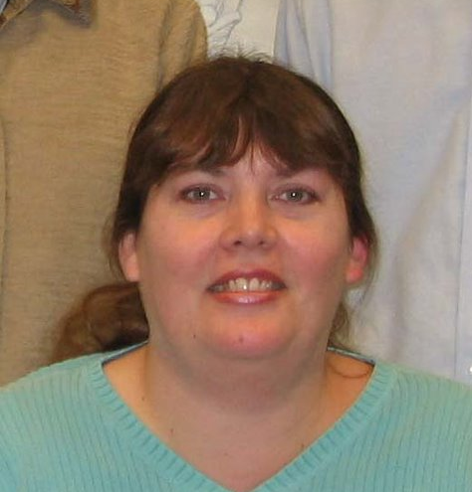
PRESENTERS
LORI ASHLEY
BRETT FULLER
ELIZABETH PERKES
Independent Consultant Tournesol Consulting, LLC
Director, Appraisal and Description Oregon State Archives
Director, Appraisal and Description Maryland State Archives
MODERATOR - KATHERYN BARINGER
Director, Appraisal and Description Maryland State Archives

Slide 5
AUDIENCE & EQUITY
STORYMAPS AS OUTREACH TOOLS
BRETT FULLER, OREGON STATE ARCHIVES’ PUBLIC AFFAIRS SPECIALIST

Slide 7
WHAT CAN STORYMAPS DO FOR OUTREACH?
Connect people to places they may never visit
Engage different learning styles to maximize retention
Hammer important topics that your agency is promoting
Link out to online resources and partner organizations

Slide 8
OREGON STATE PARKS CENTENNIAL STORYMAP

Slide 9
CONNECTING PEOPLE TO PLACE
Storymaps help people access physical spaces they may have difficulties reaching on their own.

Slide 10
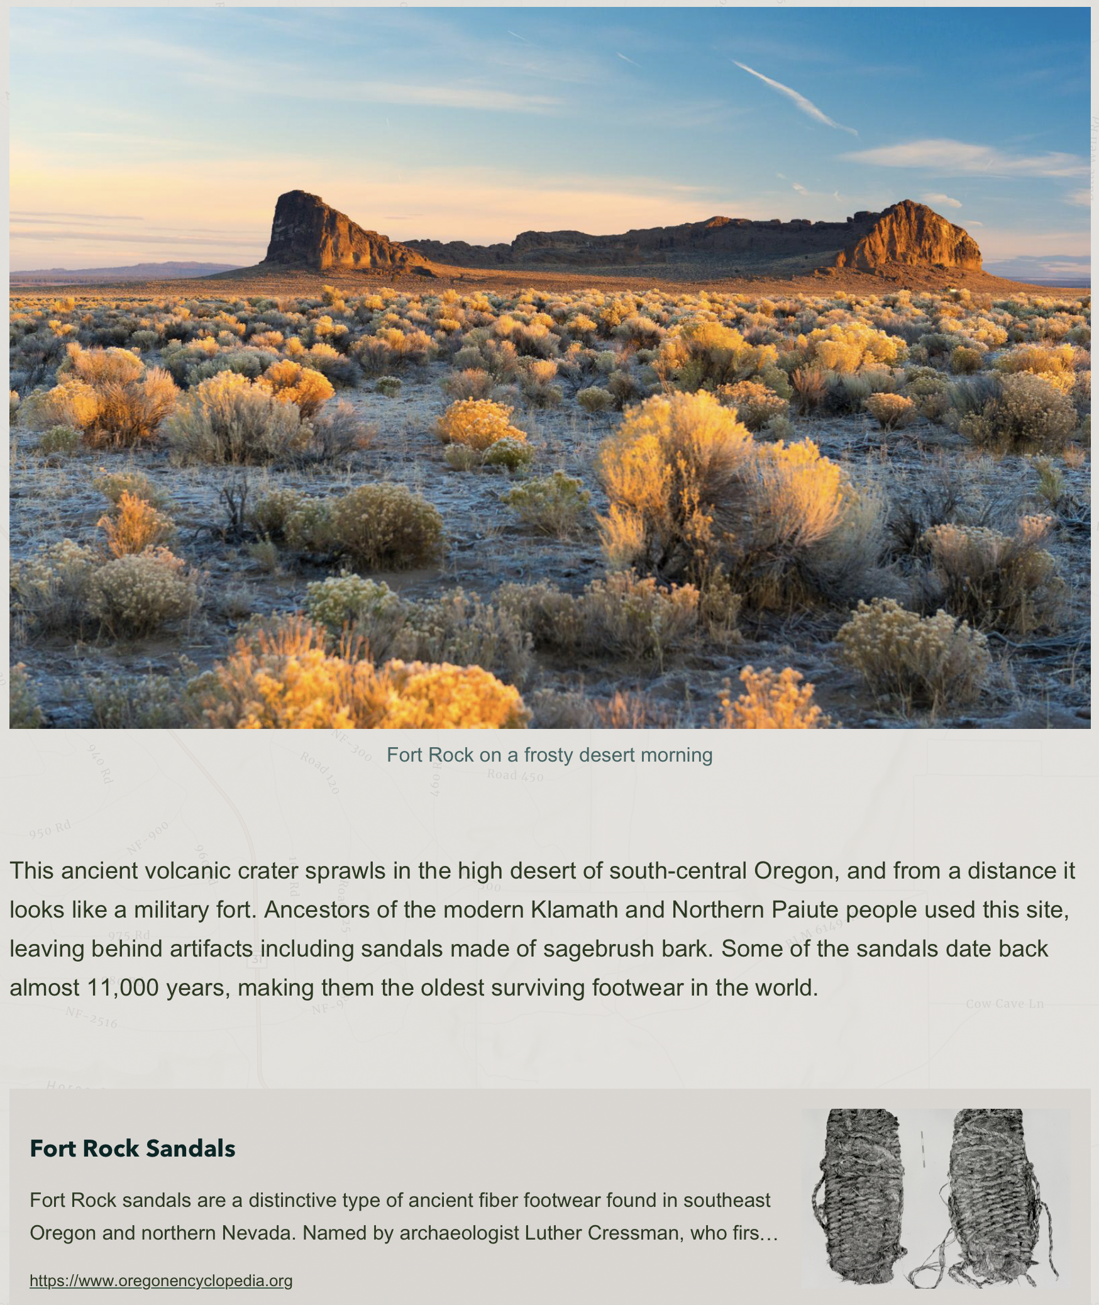
CONNECTING PEOPLE TO PLACE

Slide 11
ENGAGING DIFFERENT LEARNERS

Slide 12
HAMMERING POINTS HOME
Storymaps can effectively convey (and repeat) messages that your organization actively promotes.

Slide 13
HAMMERING POINTS HOME

Slide 14
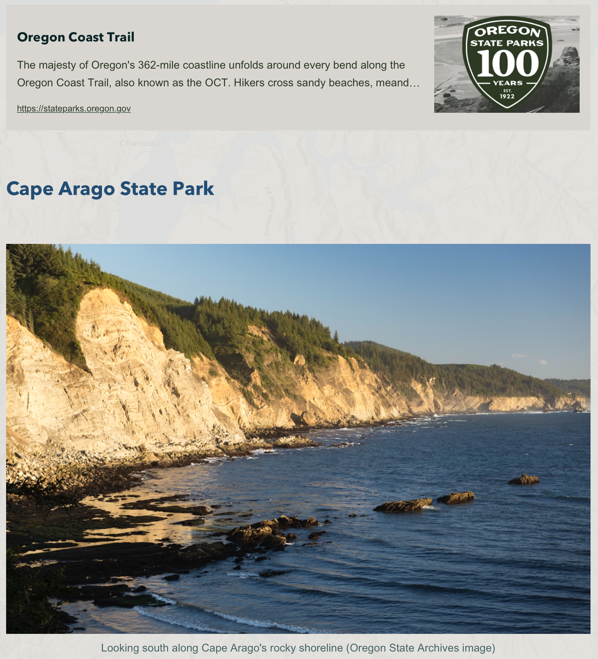
LINKS TO FURTHER LEARNING
Directly connect readers with deeper-dive learning and other partner organizations

Slide 15
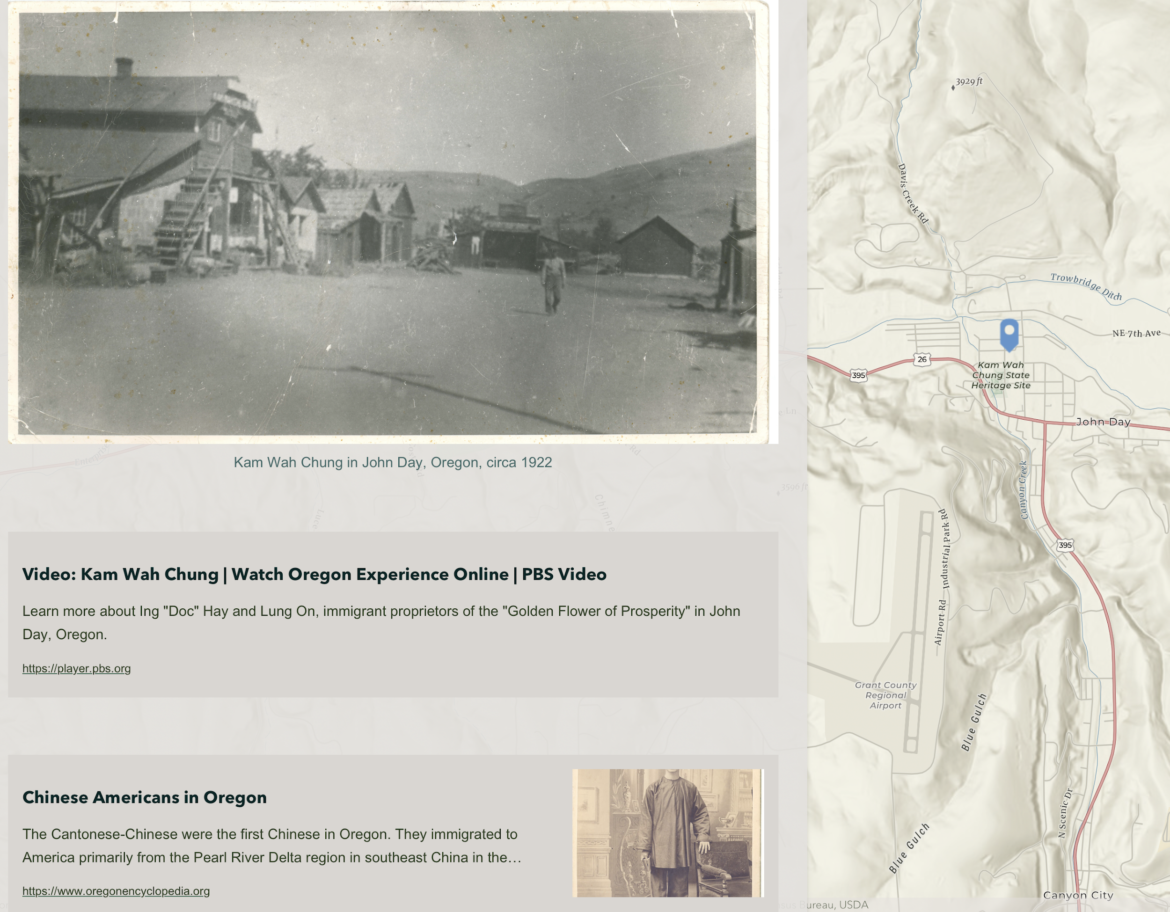
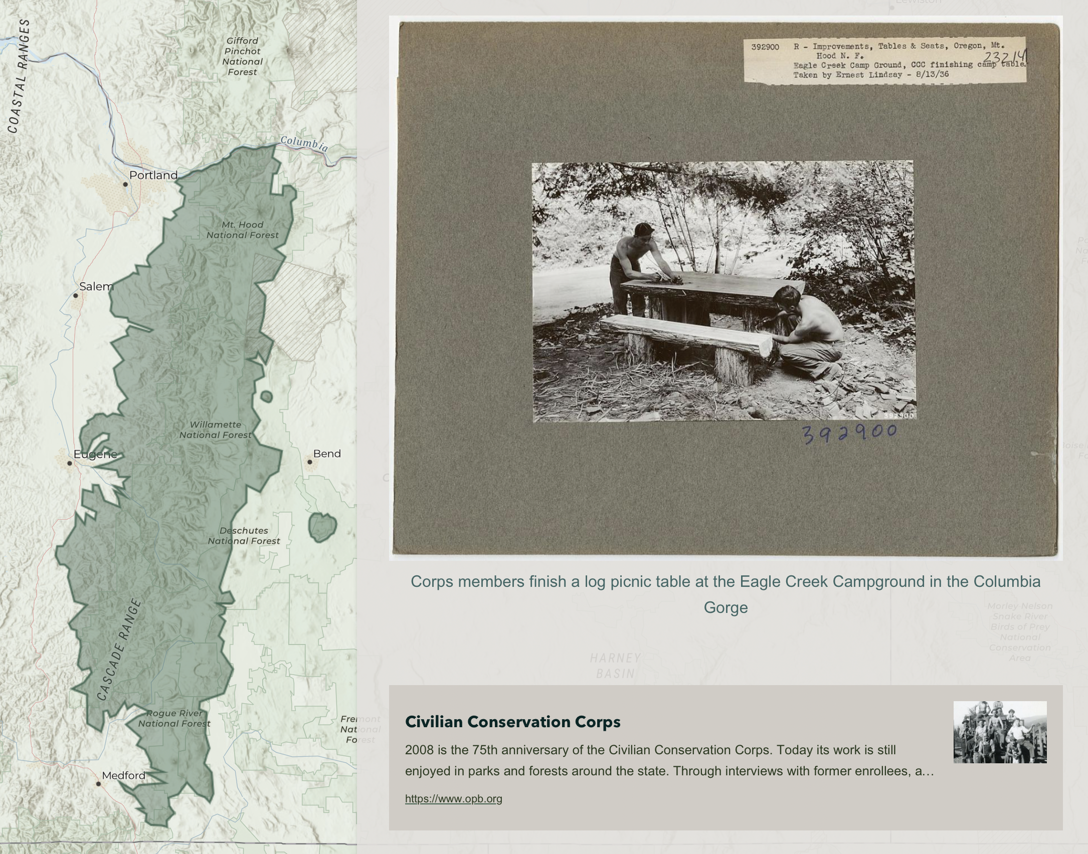
LINKS TO FURTHER LEARNING

Slide 16
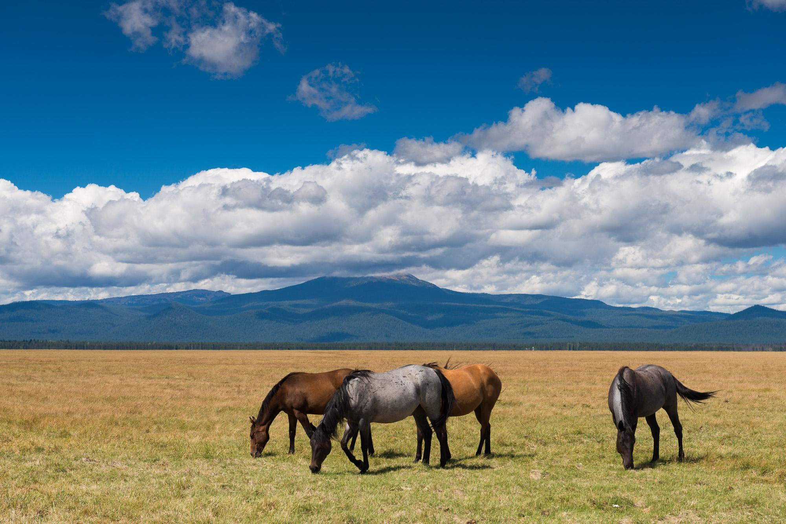
THANK Y’ALL!
BRETT FULLER, OREGON STATE ARCHIVES’ PUBLIC AFFAIRS SPECIALIST

Slide 17
A STORY MAP APPROACH TO DIGITAL PRESERVATION ADVOCACY
LORI ASHLEY
TOURNESOL CONSULTING, LLC
Notes:
Capabilities to preserve the authenticity, integrity, and usability of permanent and long-term (10+ year retention) electronic records and other digital assets by public sector and private organizations alike fall far below the current and ever evolving need. This presentation offers a proven business strategy and adult learning technique that has been customized to help records and archives managers create a shared understanding of long-term digital preservation requirements and capabilities.
The approach uses a base map for leveraging the rich stories and artefacts held by the archives to create a line of sight for stakeholders to understand the impacts of digital transformation and the ‘why’ and ‘what’s needed’ to proactively preserve valued and mandated digital objects. Concepts and content is presented using visuals, dialogue, case study data, and interactive discussions.

Slide 18
SESSION OBJECTIVES
Share a proven business strategy and adult learning technique that helps create a shared sense of urgency and common understanding of the drivers for transformational change
Help records and archives management practitioners establish and sustain trustworthy digital repositories for government records
Share a fictional Story Map and inspire you to build your own

Slide 19
THIS I BELIEVE
Lack of suitable repositories for long-term records retention and preservation is a serious issue facing state and territorial government*
Digital preservation advocacy and practice = change management
A shared and practical understanding of requirements and capabilities is needed to establish and sustain trustworthy digital repositories for government records
* Council of State Archivists MoVE-IT: Modeling Viable Electronic Information Transfers, 2021.

Slide 20
COMMON PUBLIC ARCHIVES CHALLENGES
Pressure from agencies to accept transfer of electronic records
Risk of loss of records stored on short-term media and in legacy applications
Exponential increases in the volume, diversity and complexity of electronic records
Insufficient resources and expertise to develop enterprise-level strategy to manage electronic records and integrate digital preservation requirements into routine government operations and systems
Significant growth in reliance by records creators on third party applications, solutions and services
Limitation of IT infrastructure and software to support records transfer
Current funding does not support a digital preservation program

Slide 21
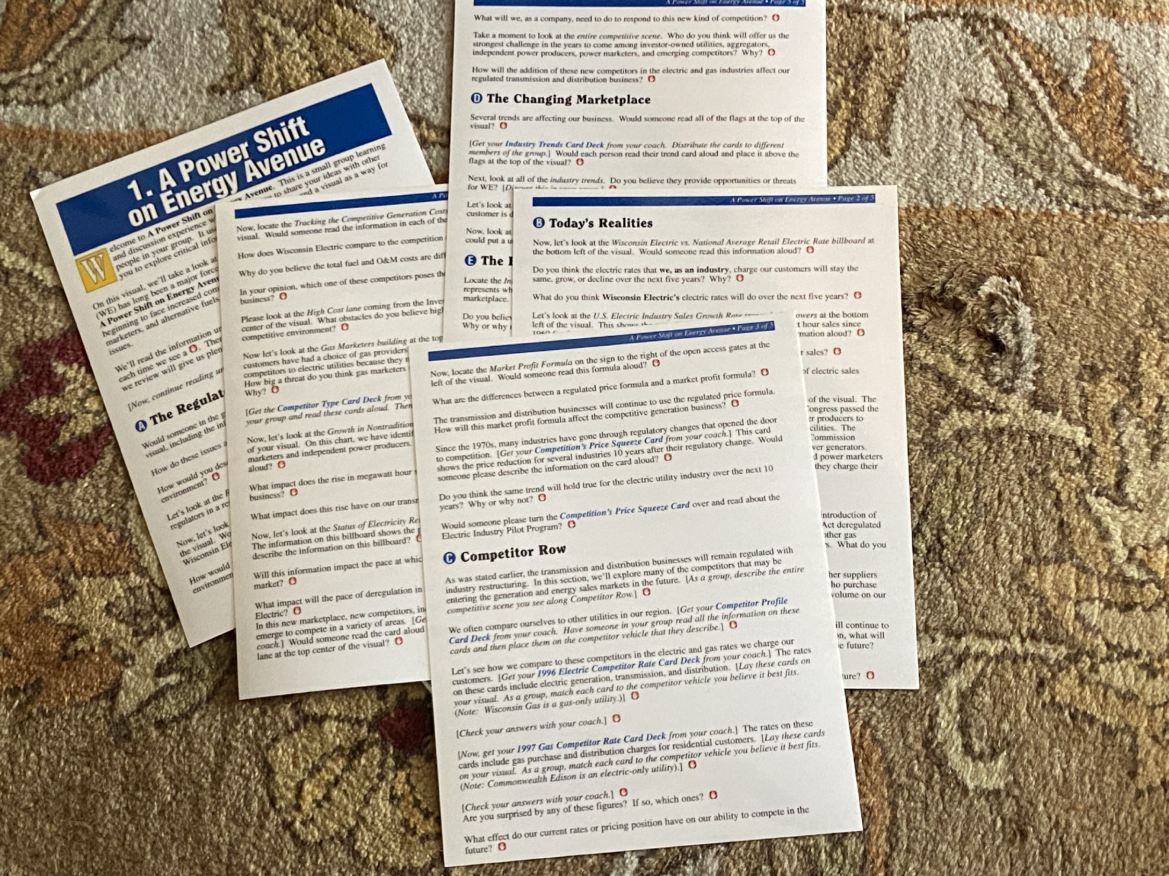
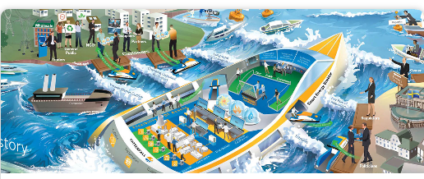
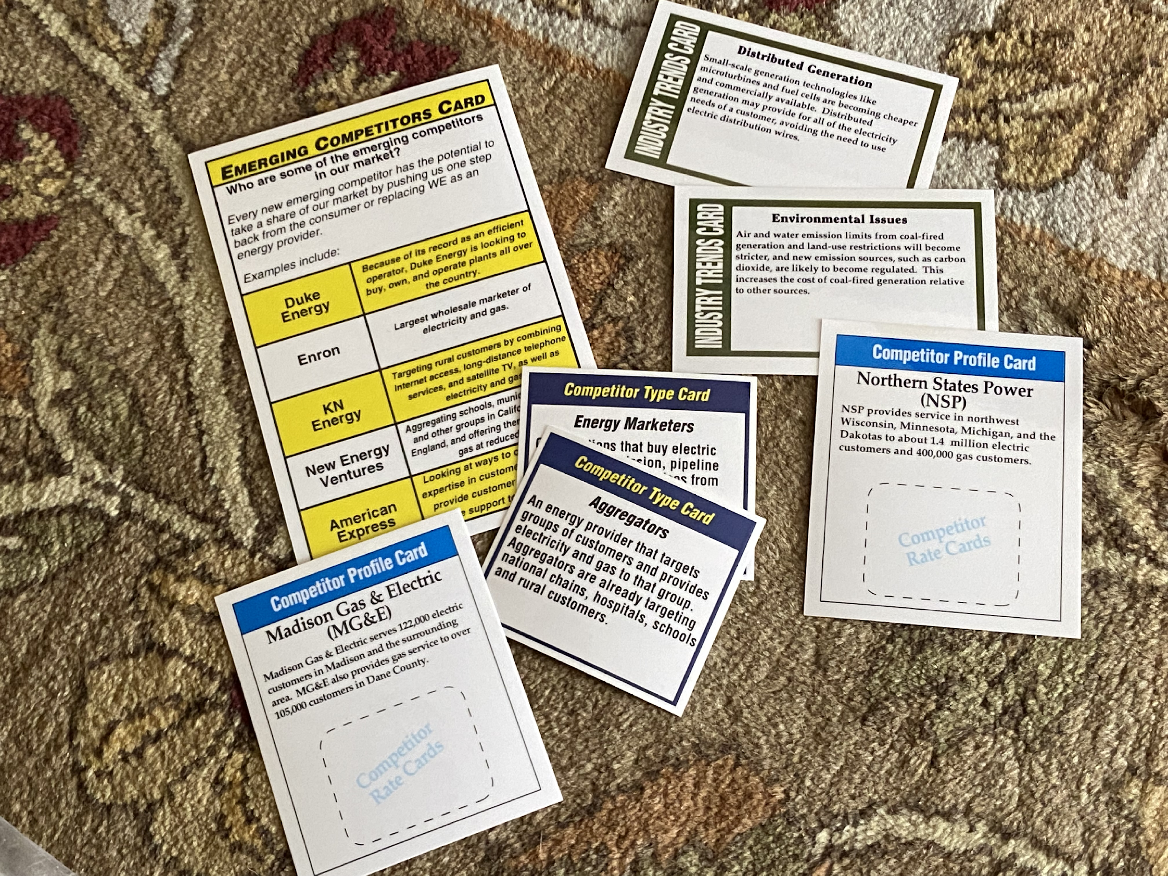
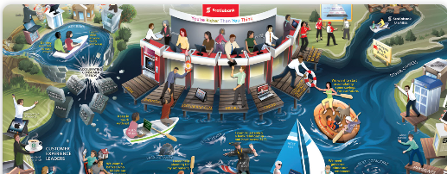
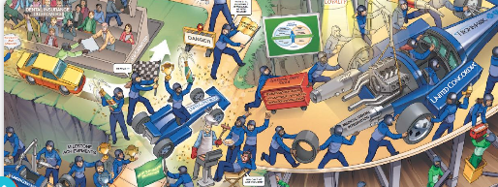
LEARNING MAP EXPERIENCE
See more examples at
Root Learning
www.root.inc

Slide 22
Digital government transformation is the ongoing application of modern technology to improve government performance. Governments at all levels are undergoing digital transformation in order to deliver government services and programs more efficiently, transparently, and cost-effectively.
Source: Is Cloud Fit for Government Archiving? Neville Cannon, Gartner, April 2016
Source: Market Guide for Cloud-Based Preservation in Government, Neville Cannon, Gartner 2015
Governments and associated agencies have important roles to play, not only for the duration of individual lives, as in care, adoption and criminal records, but also in maintaining historical facts and records for generations to come. This, therefore, places additional requirements on government CIOs, architects and archivists to preserve true chronicles as the records’ accuracy and future value will need to be maintained through several technology changes.
….many government bodies and industries must retain data for an individual's life span, perhaps 100-plus years, or indeed forever as might be the case for historical records. These time frames require a different and more systematic approach to preserve both the accessibility and the value of these records. This is the emerging market for digital preservation.
Notes:
https://granicus.com/dictionary/digital-government-transformation/#:~:text=Digital%20government%20transformation%20is%20the,transparently%2C%20and%20cost%2Deffectively.

Slide 23
Deloitte Insights, 2021, Seven pivots for government’s digital transformation How COVID-19 proved the importance of “being” digital

Slide 24
WHAT IF …
Tell me;
I might forget.
Show me;
I may remember.
Involve me,
And I’ll understand.
Stakeholders in our enterprise understood “The Big Picture” of electronic recordkeeping?
There was common understanding of the transformational forces and impacts of digital government?
Stakeholders realized the impact their actions have on our ability to meet recordkeeping mandates in an increasingly digital world?

Slide 25
WHY A STORY MAP?
The Story Map process creates conditions in which people can easily learn and rapidly come to their own conclusions.
The education that comes through the Story Map process challenges people to discuss and deal with key business issues.
They learn by coming to their own conclusions, guided by the questions and the information in the dialogue and on the visual.
To simplify the complex environment of digital recordkeeping
To create a common understanding of why our approach needs to change
To guide participants to work together to proactively respond to the challenges and opportunities presented by digital transformation to adapt our preservation practices and systems for the future

Slide 26
TRUSTED DIGITAL REPOSITORIES AND ALL THAT GO WITH IT!
Infrastructure and resources
Conformance to governance and operational standards
Skilled resources to lead, manage and sustain systems
Governmental changes in laws, mandates and funding

Slide 27
METHODOLOGY

Slide 28
MAP BASE CAN BE REAL OR FICTIONAL
Base map – real for your jurisdiction but fictional for today’s session
Use cartographic features that are commonly understood to convey meaning
Forces of change provide context and momentum for shared and ‘owned’ outcomes
Everyone loves maps!

Slide 29
VISUAL METAPHOR IS FOCAL POINT
Rivers are characterized as:
Forever changing and moving
Lifeline / life force
Mark boundaries and areas in between spaces – symbolically similar to crossroads
Riverbanks are good places to rest/plan/strategize/prepare
Flow outside human control – unstoppable
Navigable

Slide 30
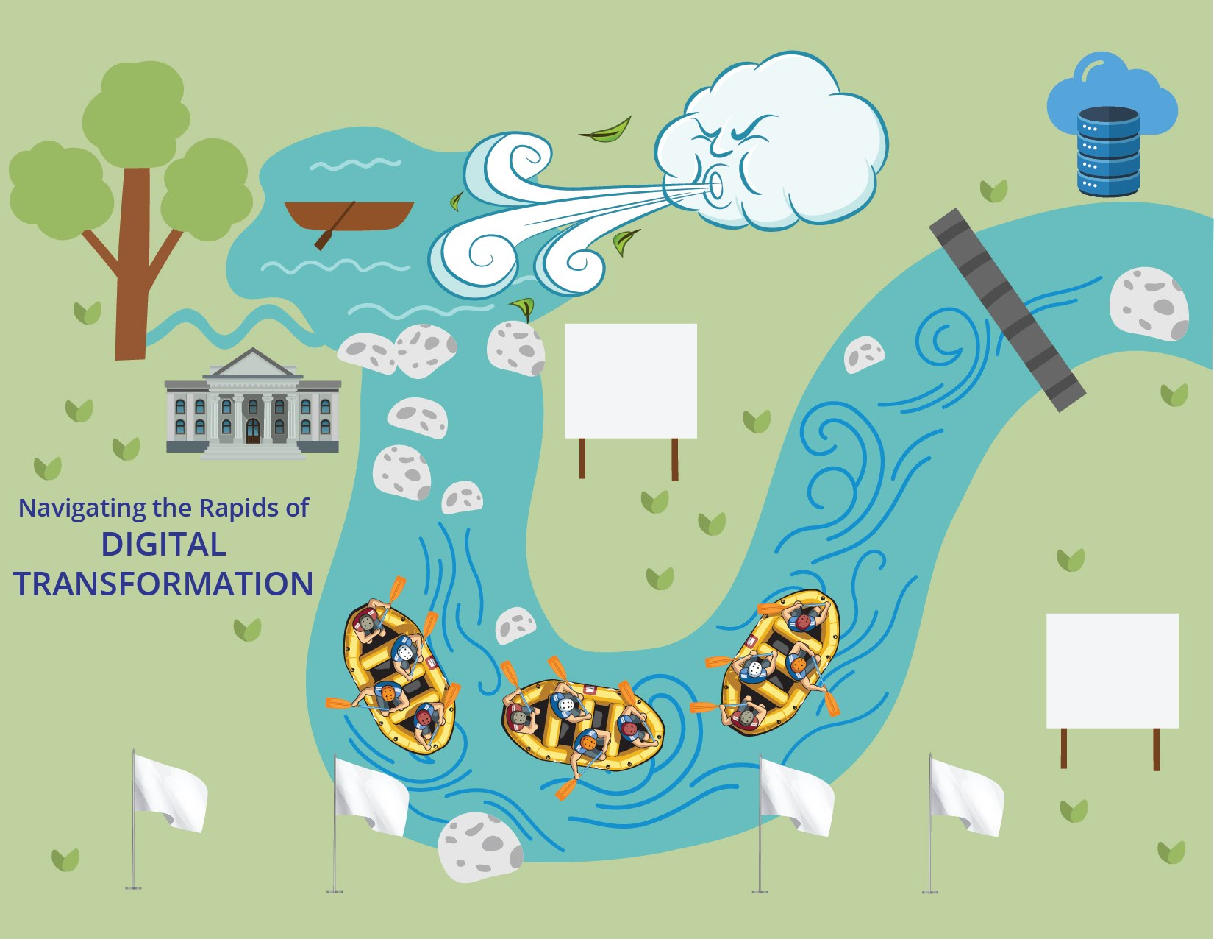

Slide 31
START WITH OVERALL VISUAL
Learning objective – to understand the major changes brought on by digital transformation and the actions needed to modernize and adapt government records and archives management
Visual metaphor is focal point of discussions
Key pieces of data allow dialogue to take place around facts, not opinions
Learning peripherals (card decks) introduce information and increase interactivity
Good facilitation brings the pieces together
Notes:
Welcome to Navigating the Rapids of Digital Transformation.
Objectives - This is a small group learning and discussion experience which allows you to identify impacts and formulate plans to build up your electronic records and digital preservation programs. We will use a visual and discussion questions to explore our records preservation foundations and exchange critical information about the changing information governance/management environment, our stakeholders, and our shared future.
We will begin by looking at how government operations and services are changing, and then discuss why records lifecycle management must adapt and modernize to deliver promised outcomes in the present and future conditions.
We will explore how digital transformation is pushing records creators and custodians to improve the ways we work together to fulfill our duty to manage, protect and preserve recorded evidence of government’s operations and ensure access to our history far into the future.
The government digital transformation journey has been marked by storms and setbacks. Each of us, regardless of where we work within the government enterprise, are experiencing changes in some way, and are called upon to shape the outcome.
Work through the sections of the map, stopping to discuss questions and statistics. There are no wrong answers to the questions. The information you review will give you plenty to talk about in your group.

Slide 32
WINDS OF CHANGE
Hybrid Work Model
Disinformation and Misinformation Campaigns
Cloud Technology
Cyber Security and Privacy
Investments in Automation
Staff and Citizen Expectations
M365 Deployment
Legacy Data Migration
Notes:
Significant forces are reshaping the way that public servants work and government services are delivered to citizens.
From federal to state to local levels of government, information governance and management practices are being transformed by advancing technologies, political and economic trends, cybersecurity and privacy concerns, and shifting citizen and employee expectations.

Slide 33
OUR SHARED HISTORY
Tree
Legislative branch
Judicial branch
Executive branch
Archive
Authority and reputation
Mission and mandate
Secure repository
Trusted custodian
Record sets and collections
Organizational, legal and technological context for government recordkeeping
Flow of information
Agency to agency
Public to government
Government to the public
Leverage the rich stories and artefacts held by the Archives to create a line of sight for stakeholders to understand the impacts of digital transformation and the ‘why’ and ‘what’s needed’ to proactively preserve valued and mandated digital objects far into the future
Notes:
Our foundation – tree is sturdy/ multiple branches, rooted, connections,
Defined boundaries/jurisdiction/geography

Slide 34
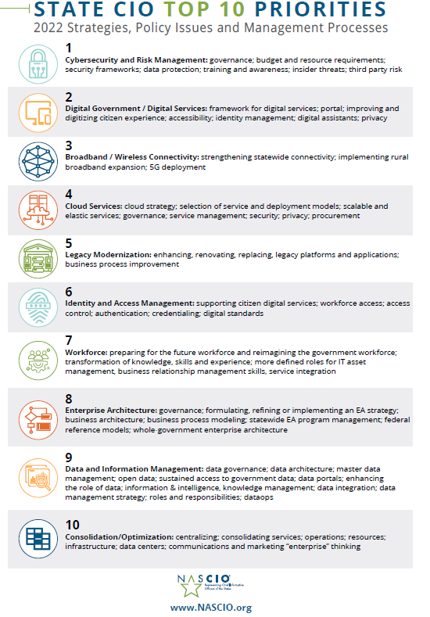
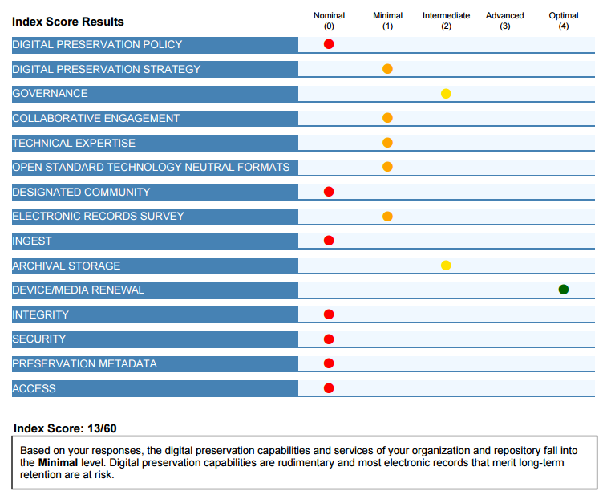
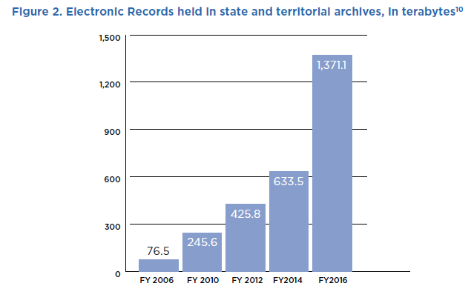
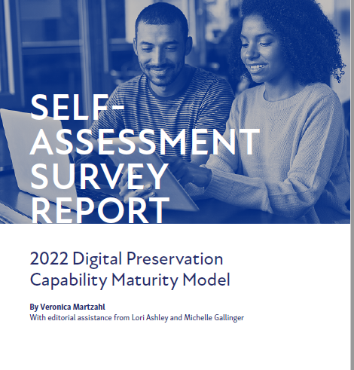
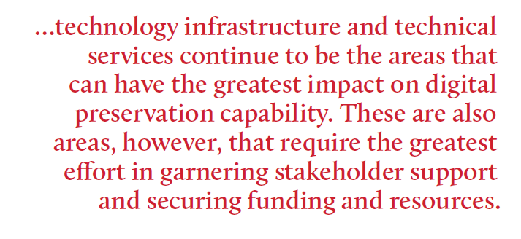
OUR RECORDKEEPING FOUNDATIONS
Small flow of records from the beginning of the jurisdiction
Backlog Lake
Dam under pressure
Billboards marking our journey and circumstances
NARA
Dec 31, 2022
Deadline

Slide 35
MASTERING THE CHANGING RAPIDS
Rafts
Record Producers
Records Custodians
IT Teams
Archivists
Records Managers
Business Analysts
Suppliers, vendors and service providers
Flags (principles & values)
Stakeholder Collaboration*
Understanding of Recordkeeping and Technological Context*
Flexible Workflows*
Shared Terminology* and Goals
*Council of State Archivists. MoVE-IT report, 2021.

Slide 36
BUSINESS PLANNING OPPORTUNITY
Necessary Resources
Budget/Funding
People
Skills and Capabilities
Technical Solutions and Infrastructure
Capacity
Operations
Archival storage
Automated workflows
Practices, Plans and Policies
Guidance for Records Creators and Custodians
Preservation policies
Operational standards and tools
Collections Management
Agency-to-archives transfer agreements
Unbroken archival workflows
Preservation-ready acquisitions
Legacy collection remediation plans

Slide 37
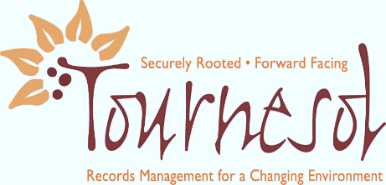
THANK YOU FOR NAVIGATING THE RAPIDS OF DIGITAL TRANSFORMATION
FEEDBACK ALWAYS WELCOME!
LORI ASHLEY
TOURNESOL CONSULTING, LLC
LORIASHLEY@WI.RR.COM
262.470.7788

Slide 38
STORY MAP EXPLAINS UTAH JURISDICTIONAL BOUNDARIES OVER TIME
ELIZABETH PERKES

Slide 39
THE PROBLEM
Court records are very popular among researchers.
Records in Utah are divided up by court district, and listed in finding aids by district number.
District numbers represent completely different geographic areas depending on the dates of the records.
Confusing much?

Slide 40
THE SOLUTION
Old chart comparing court district numbers and counties to year spans.
Requires some deciphering by the researcher
Not especially user-friendly
Best solution: live map interface where clicking tells you how to find records for that time/place.
Lovely but expensive, not in the budget at the moment
Baby steps: start creating the historical geospatial boundaries for use in a map.

Slide 41
WHERE TO FIND HISTORICAL BOUNDARIES
Historical county boundaries for the entire U.S. have been gathered and posted at https://digital.newberry.org/ahcb/.
With that information, our IT department used our court jurisdiction chart and created historical court boundaries as GIS data that can be used in a map.
We created a timeline animation to show how the boundaries have changed at https://youtu.be/wz7SK1mBJlc.

Slide 42
EXPLAINING THE PROBLEM TO RESEARCHERS
In order to describe the situation to researchers in a way they could understand, we created a story map.
https://storymaps.arcgis.com/stories/88b6f2be26d0466b927ea72b1b060842
Since it was posted in November 2020, the story map has received 1,000 hits.
Not clear if these efforts have improved research requests.

Slide 43
ELECTRONIC RESOURCES TELL THE STORY
Storymap includes maps, but also:
Links to catalog entries from other institutions now responsible for records created within the old boundaries.
Nevada State Library, Archives and Public Records
Church History Library of The Church of Jesus Christ of Latter-day Saints
Finding aids of Utah holdings for certain locations on a map, and digital collections.
Geospatial records in Utah holdings comparing boundaries from different years.
Our own electronic records helped tell the story, important to preserving the story.

Slide 44
STORY MAPS AND ADVOCACY
Advocacy for a problem such as digital preservation is always benefitted by good pictures.
Maps bring an issue home for people, as they have a fondness for locations that are personal for them.
When electronic records help tell the story, they become immediately more valuable to the cause.

Slide 45
QUESTIONS & COMMENTS

Slide 46
STAY CONNECTED & INFORMED
CoSA Website
CoSA Resource Center
CoSA Twitter Handle: @StateArchivists
CoSA Facebook Page
CoSA YouTube Channel

