Slide 1
Taking action before it’s too late
Monitoring file formats for risk
April 12, 2022

Slide 2
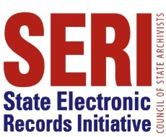
Welcome!
Upcoming SERI webinars
May 10 (3 PM EST): Are you PREPAREd? Insights from Phase 2 of the PREPARE Project
CoSA’s Online Resources
Resource Center
SERI webinar recordings on YouTube
Upcoming CFP Deadlines
April 25: DigiPRES (October 12-13, Baltimore, MD)
Digital preservation videos on YouTube
April 29: Best Practices Exchange (September 26-28, Nashville, TN)

Slide 3
SERI 2022 sponsor

Slide 4
Presenter
Adriane hanson
Head of Digital Stewardship
University of Georgia Libraries
ahanson@uga.edu

Slide 5
Taking action before it’s too late
Monitoring file formats for risk
April 12, 2022
Notes:
This presentation is about determining when to address format obsolescence. Since you're here, you likely have an idea of what that is, but to make sure we're on the same page I'm thinking of format obsolescence as when a format becomes completely unusable, or its meaning changed, due to changes in hardware, software (any aspect of the technology), but also more nebulous reasons like it is no longer common knowledge how to interact with a piece of software.

Slide 6
Motivation
All formats go obsolete
Easiest to address format risk as it emerges
UGA Libraries missing preservation planning function
Time afforded by work from home
Notes:
Obsolesce happens to all formats eventually. We as information professionals need to know when something is becoming at risk so we can take action when it is as easy as it will ever be. Provided the format was somewhat widely adopted, as it goes out of use there will be a market for a little while to encourage developing solutions for all those users to get their files to something new. But if something went obsolete 30 years ago (say it was sitting in my backlog due to access restrictions), it will be harder to find a solution, more expensive because it would require a specialized vendor or doing custom work ourselves and could potentially even be impossible.
Preservation planning, the function that covers monitoring and addressing risk, was (and frankly still is) the area that my institution is most missing from our digital preservation program, since we focused on more immediate needs like storage first. But as our born-digital collections are becoming increasingly important for our researchers, I wanted to develop a process for monitoring their risk so we can proactively decide when to invest the time and resources necessary to take action, even if that ends up being a few years down the road.
In 2020, when for obvious reasons I needed a project to do from home, I decided to spend some time working on this issue - how will we at UGA Libraries figure out a format is at risk before it is too late? Through a lot of reading and experimenting, I developed a process for doing this risk analysis and have run the reports twice, with 2020 and 2021 format data.
If this feels a little familiar, I presented last year at the Best Practices Exchange conference on my research and first round of analysis. I will briefly summarize that information here as a foundation for the rest of this webinar, which will focus on what I've learned in the second round of analysis. The slides for that first presentation, which include my speaker notes, are available through the BPE website: https://bpexchange.files.wordpress.com/2021/05/bpe_2021_slides_hanson.pdf

Slide 7
Agenda
Information Sources
Analysis Workflow and Results
Analyzing the Analysis
Wrap Up
Questions

Slide 8
Information sources
Image by Predrag Kezic from Pixabay
Notes:
I started my work in 2020 by reading whatever I could find about preserving various formats, with an emphasis on sources of information about format characteristics. All together, I found 19 registries that aggregate format information, with different amounts of detail and community support.
BPE slides cover this research in more detail, including a link to a spreadsheet that lists all the resources I gathered.

Slide 9
Selecting format registries
Reputable
Maintained
Ideal
Source
Large
Risk Assessment
Notes:
These are the criteria for what I wanted in an information source. Using one source from NARA and another from LOC.
Reputable sources: information source was not clear for all registries
Well maintained (updated at least annually): risk changes over time
Large number of formats: more sustainable workflow if I have fewer places to look (saves time)
Include risk assessment: able to rely on expertise of others to weigh factors

Slide 10
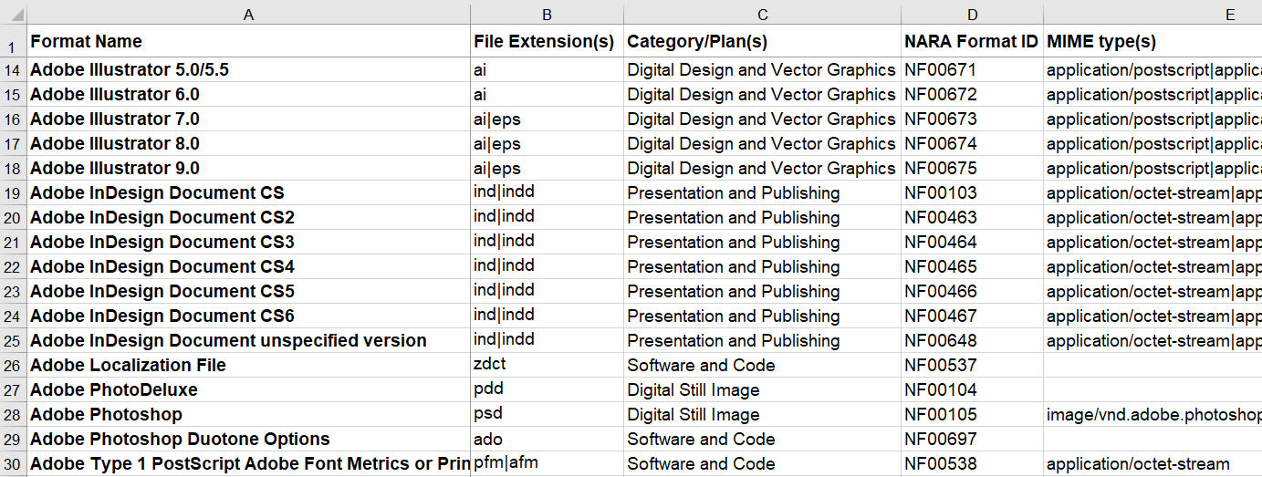
Digital Preservation Framework National Archives (US)
https://github.com/usnationalarchives/digital-preservation
Notes:
Available since September 2019 via GitHub and updated quarterly. They added 125 format versions in the year between my two analyses.
Information for every version of every format they have analyzed is available via a single spreadsheet, which supports easier search and matching. The spreadsheet includes:
Detail about the format
Risk evaluation with low/moderate/high summary
How they plan to transfer, if they do.
Also share Preservation Action Plans (PDFs) with details on 16 categories of formats, such as email or still image. These are primarily definitions of characteristics of that format type, which aid in evaluating the significant properties to maintain during a format migration. They also include NARA-specific recommendations about transfer formats and access methods.

Slide 11
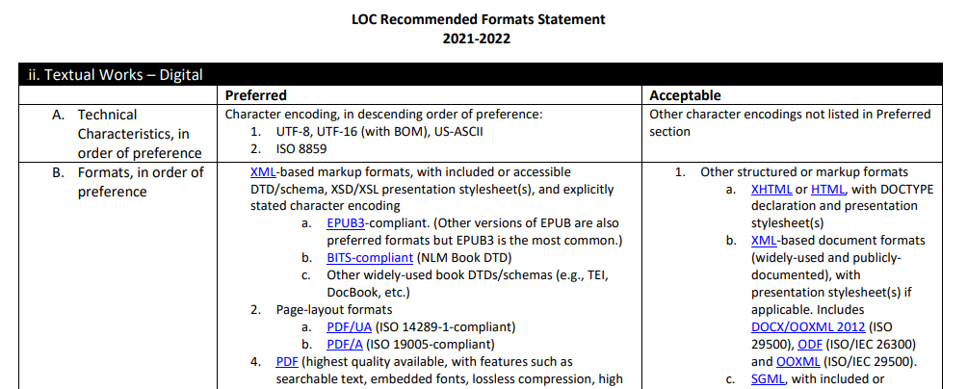
RECOMMENDED FORMATS STATEMENT Library of Congress
https://www.loc.gov/preservation/resources/rfs/
Notes:
We are including a second source to fill in some gaps and to get a second opinion as figuring out our own risk comfort level.
It has been released annually on their website since 2014, including PDF version which gives you a single page to search.
Information is organized by category, such as Datasets, Textual Works (Digital), and web archives. For each category, they list preferred and acceptable formats, as well as additional recommendations about metadata, technical characteristics, and other factors that promote preservation. I extrapolate that a format isn't recommended if it is part of one of these categories but isn't on the list.
It is a little more challenging to match to our holdings, since I have to figure out the category for each format and not just search for the name. But it is doable.

Slide 12
Useability of other sources
Image by Sharon Ang from Pixabay
Notes:
For the purposes of this webinar, I experimented with a few other resources that I planned to use if I needed additional information, in case one of these resources better fits your needs. Other than these four, everything else I looked at in 2020 does not appear to be actively maintained, so they're probably not useful at this point.

Slide 13
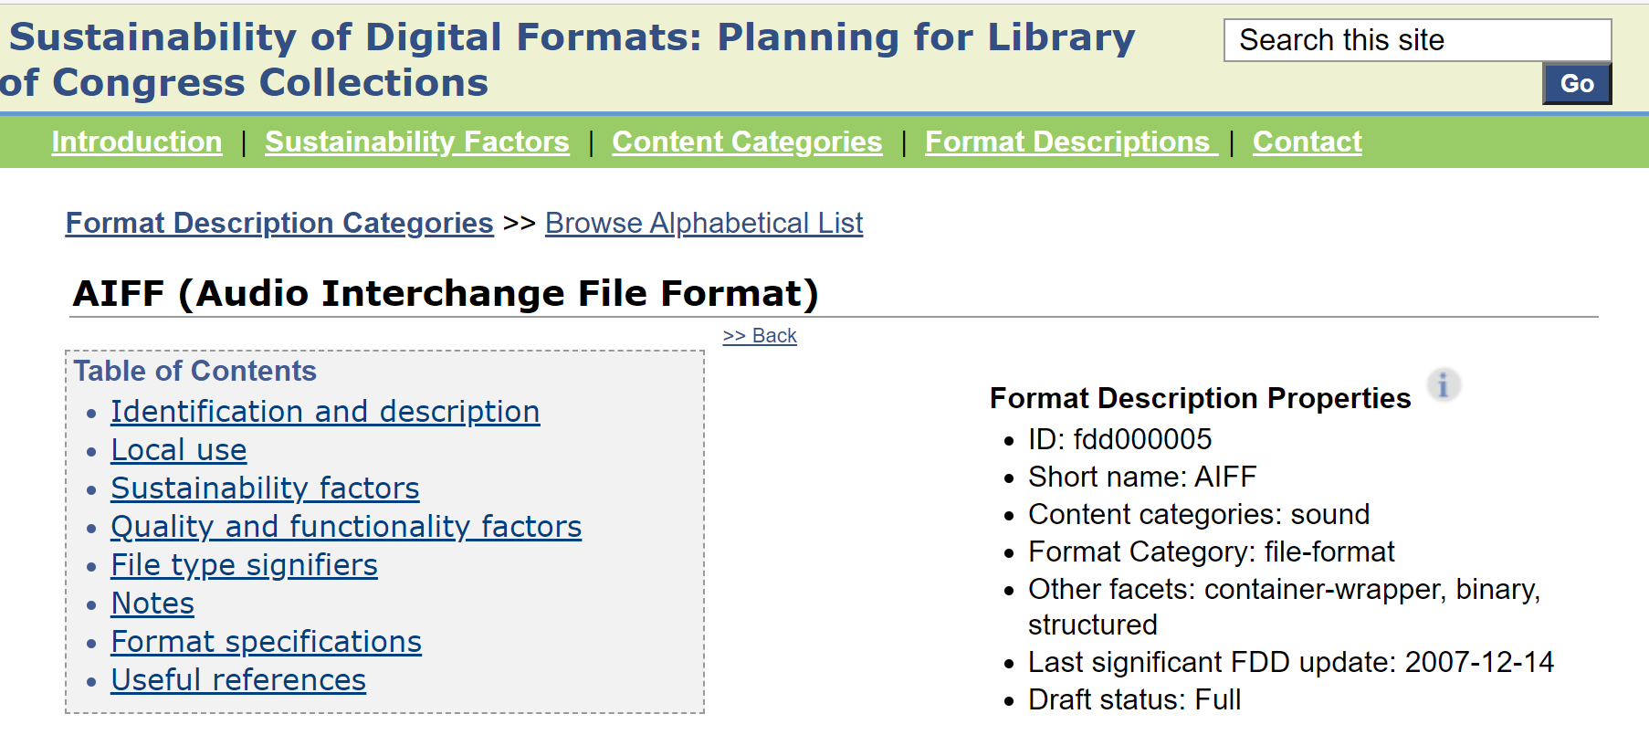
sustainability of digital formats Library of congress
https://www.loc.gov/preservation/digital/formats/
Notes:
It provides an alphabetical listing of the formats covered, which includes 556 format versions. The data itself includes an evaluation of sustainability and quality that could be used for a risk assessment, as well as format information that would help identify significant properties. It also appears to be maintained, with some edits made this year, although a lot of the information is a few years old. The main thing it is missing is a determination of risk, which is why we are using the Recommended Formats Statement instead, even though it has fewer formats.

Slide 14
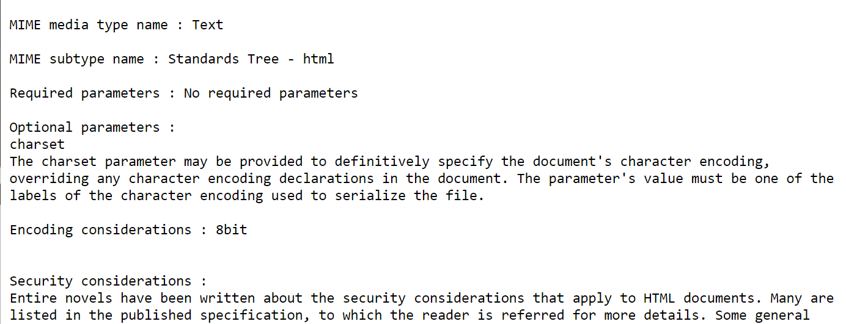
Media Types IANA [Internet Assigned numbers authority]
https://www.iana.org/assignments/media-types/media-types.xhtml
Notes:
This is the official record of mime types. It is actively maintained, and everything is one on page for easy searching. There are also a large number of formats. The information is often sparse, but it does include a discussion of encoding, security, and interoperability risks that could be used as part of a risk assessment. We'll probably only use this for more obscure formats that might only be described here.

Slide 15
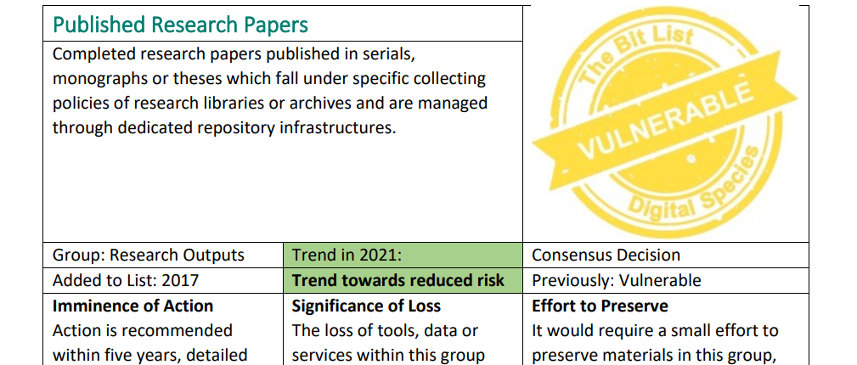
BITLIST OF DIGITALLY ENDANGERED SPECIES Digital Preservation Coalition
https://www.dpconline.org/digipres/champion-digital-preservation/bit-list
Notes:
This resource is compiled every 2 years by global experts assembled by the Digital Preservation Coalition. I was hopeful for this one, since it is explicitly a risk assessment, and the information in it could be helpful for decision making. It includes an estimation of how long we have until an action must be taken to avoid loss and conditions that could increase or decrease the risk, which would inform good actions to take. However, the way it is organized doesn't support the kind of format-based analysis I am trying to do. The risk evaluation is by broader categories that are almost always based on the storage or/or source, such as Current Portable Optical Media, Data Posted to Defunct or Little-used Social Media Platforms, and Unpublished Research Data from Government Researchers, rather than on format. It is still a useful resource for a higher-level look at risk, but not suitable for this analysis.

Slide 16
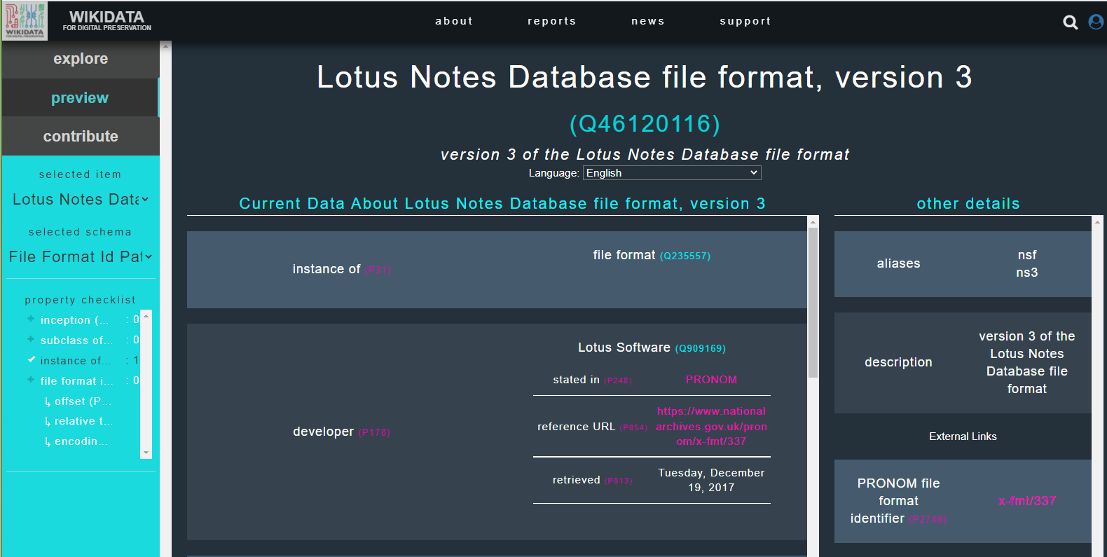
Wikidata for digital preservation
https://wikidp.org/
Notes:
Most useful for us has been Wikidata for Digital Preservation, which is a portal built by a collaboration of different institutions to make it easier to access format information in Wikidata. This overwhelmed me the first time when I was just trying to explore it, but now that I had specific formats to look at, it was much easier. Information is accessed via search, which is a little less convenient than being able to browse an alphabetical list, but not by much. The results are mostly pointers to other information about the format characteristics and it covers over 13,000 file formats, so it is a good place for starting a research journey. You just have to do your own risk analysis based on the information you are gathering.

Slide 17
Analysis workflow
Image by YoannS from Pixabay
Notes:
Once I had my sources of risk information, since I already have format identifications for our holdings in our preservation system, all that was missing was a way to analyze our format data and map it to our two sources. I didn't find a model for this kind of analysis, which is the main reason I'm doing this webinar, so I just started experimenting.

Slide 18
Our Format information
AIPs | Files | GB | Name | Version | Registry | Key | Encoding | AIP List
391 | 566 | 29611 | MPEG-4 |  |  |  | File encoded as: Apple ProRes 422 HQ. | id1, id3, id4, ...
6 | 477 | 38 | TIFF EXIF | 2.2 | PRONOM | x-fmt/387 |  | id1, id13, id33, ...
26 | 64 | 0.006 | WordPerfect Document |  |  |  |  | id9
Notes:
Our format information is primarily generated using FITS, which is a tool developed at Harvard University that combines the output of a dozen other tools for identifying, validating, and/or extracting technical metadata. If you're looking for a tool to use, the fact that FITS combines tools is great for getting an identification for more files. Each tool has its own specialty. It also results in many files with multiple possible format identifications where tools didn't agree, which adds noise to the analysis. Because of how our preservation system currently exports format data, each potential identification is counted like a separate file. Our Media department uses mediainfo instead, because that is customized better to their formats. Regardless of the source, format identifications are stored using one consistent data model in our preservation system, which was built in-house.
We always have the format name, number of AIPs, files and total size of all files in that format, and the ID for every AIP with at least one file in that format. If you aren't an OAIS shop, an AIP is a package of files and the associated metadata needed to preserve them. Depending on the format, I may also know the version, registry name and key (which so far is always PRONOM), and/or AV encoding information.
To do the analysis, I start by exporting the formats reports from our preservation system, which are CSVs. So, if you can get your data to a CSV, you can use the following workflow.

Slide 19
Data Scripts
Reorganize
Calculate data
Add standardized
Summary spreadsheet
https://github.com/uga-libraries/format-report
Notes:
Next, I use a few Python scripts, relying heavily on the pandas library, to do data cleanup and summaries. I used Python because that is the tool that I'm most familiar with for data wrangling and it makes it easy to repeat the analysis over time or with data from different subsets of our holdings. The scripts are available on GitHub if you want to go this route. If scripts aren't your cup of tea, a spreadsheet program would be capable of most of the tasks the scripts are doing.
The scripts:
Reorganize the format information to better support analysis.
Add some additional information calculated from the existing data, like collection number.
Add a standardized format type and format name so I can see trends better by grouping related formats, from a mapping spreadsheet I maintain.
The result is a spreadsheet with many tabs that each summarize the format information in a different way.

Slide 20
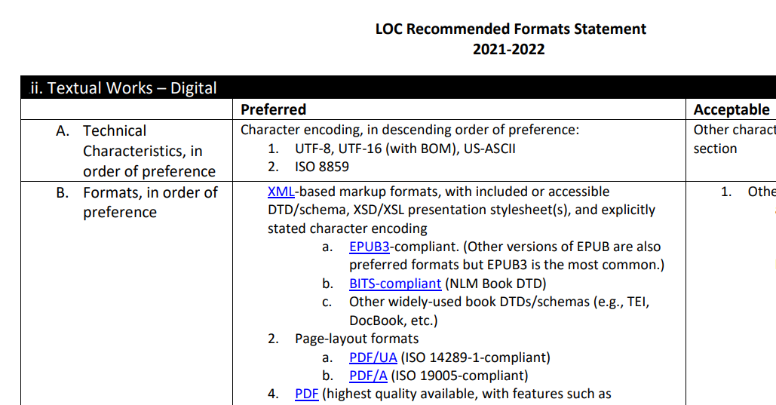
Risk analysis
PDF
Notes:
Then I manually match the most common formats (a tab on the summary spreadsheet) to NARA and LC information. I have ideas for how to use the scripts to do a first pass at matching up our formats to our risk sources to increase how many formats I have time to evaluate, but a person does need to do some interpretation since different tools and registries use different names for the same format. This can be differences in capitalization, if they use acronyms, changes to names over time, and sometimes I couldn't figure out a good reason. The matching is less certain than I expected.

Slide 21
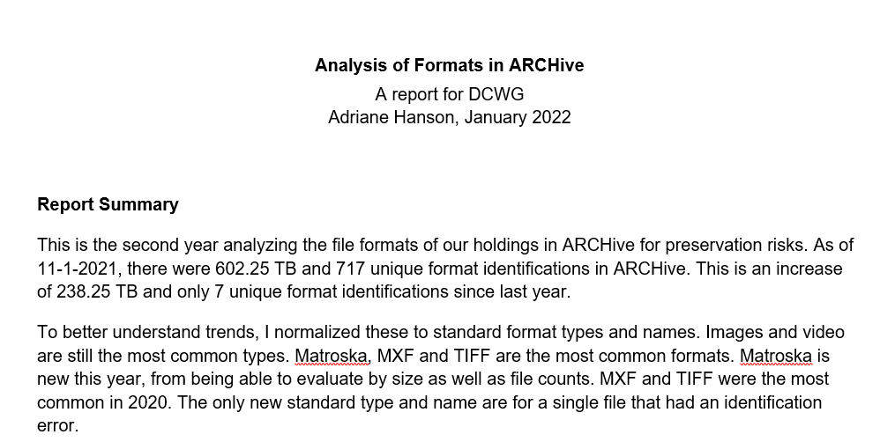
What do we do with it
https://sites.google.com/view/uga-dcwg/home/archive-documentation
Notes:
With all the data compiled, I make a report to summarize the results (with as many visualizations as I can) and present it to my colleagues. The narrative portion is on DCWG's website, where we share all our public information related to our digital preservation program, if you want to take a look. It is then up to the collections folks if they want us to address a risk, factoring in the importance of the holdings, tools available, and staff capacity. We hope to start taking our first preservation actions soon.
And then I repeat the process regularly to identify emerging risks. I'm still figuring out the right frequency.

Slide 22
HOW LONG DOES THIS TAKE?
 | 2020 Hours | 2021 Hours
Research | 71 | 24
Format Analysis | 112 | 17
Risk Analysis | 17 | 5
Report | 19 | 7
Total | 219 | 53
75% Faster!!!
Notes:
The first analysis took me a while, but most of that was research and experimenting with the kinds of analysis I could do with format identification data. Hopefully, through this presentation, I've shortened that learning curve for you. Once I had a process in place, it was much faster. It took 30 hours from exporting the format data to having a completed report. I also spent additional time evaluating the effectiveness of the process. While that was motivated by this webinar, I plan to always budget some time for research, improvements, and evaluation as part of future reporting cycles to keep the process up to date.
With that research time, I anticipate it will be about 50 hours a reporting cycle. I believe that is a reasonable amount of time to devote to something as important as monitoring our formats for risk.

Slide 23
results
Image by Alois Wonaschütz from Pixabay
Notes:
To give you a sense of what can be learned from format identification data, I'll give you a speed run through the results of my most recent analysis, on formats for all files ingested in our preservation system by November 1, 2021.
We don't currently track format information for content that is awaiting processing to go into the preservation system, although we plan to for born-digital in order to start monitoring for risk sooner. We're not concerned about our digitization backlog where we know what formats we selected.

Slide 24
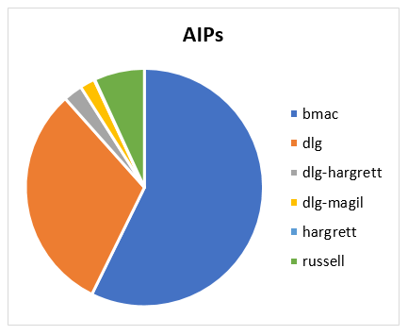
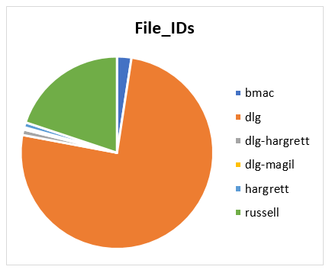
Preservation System usage
20%
31%
92%
57%
76%
Notes:
First, we looked at the overall usage of our preservation system, which is shared by five Libraries units. We could see who is using it more, based on different measures, which impacts which library has the majority. Our media archives (blue) has the most by size or AIP, but our digital library (orange) has the most by file count and our political archives (green), which has most of our born digital collections, also has a significant amount if you look at file count. This helps everyone see the benefit they are getting from the system and may have future implications for cost sharing.

Slide 25
Common Formats
 | Format Type | Format Name | Format ID
Collections | Image; Video | TIFF; Matroska | TIFF 6.0, TIFF 5.0, Matroska
AIPs | Video; Image | MXF; TIFF | MXF, TIFF 6.0
File IDs | Image | TIFF | XML 1.0, TIFF 6.0, PDF 1.4, JPEG 2000 JP2
Size | Video; Image | Matroska; MXF | Matroska; MXF
Notes:
We next looked at what our most common formats were across all our Libraries units. Our data allows us multiple ways to evaluate what is common. We can look at format type, standardized format name, and format identifications (name + version + PRONOM). For each category, we can measure commonness using the number of collections, AIPs, files, and size.
Generally, the same 2-3 were most common regardless of how something was measured, with some additional variation for the rest of the top 5 or 10 for each measure. The three categories also have differences between them. So, some combination of the counts is necessary to get a more complete picture of what is common.
However, our intent behind identifying commonness was to start actively monitoring those types of formats for news of upcoming obsolescence. Given our success using existing risk resources, it is unlikely we'll start doing our own obsolescence research anytime soon. Therefore, I'll likely simplify or drop this section from future analysis to spend the time on mapping more of our formats to the risk resources and analyzing those results more thoroughly.

Slide 26
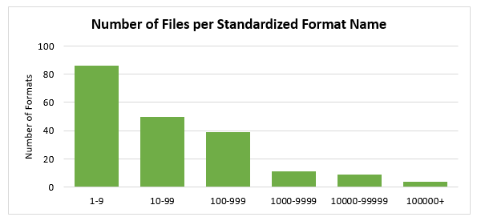
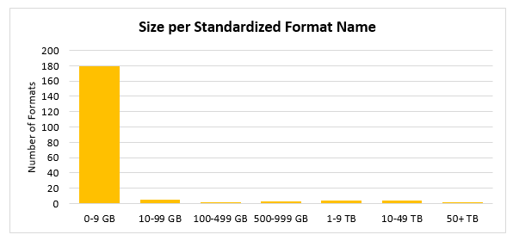
Uncommon Formats
43%
90%
Notes:
I also looked at how many of the formats weren't common. It turned out to be quite a lot. We have less than 10 files in about half of our formats and less than 10 GB in the majority of our formats, whether we look at standardized format name or format identifications.
Having so many uncommon formats is beneficial in the beginning, letting us focus on developing preservation strategies for a small number of common formats to have the greatest impact. Once those are settled, however, it is going to mean doing a similar amount of effort for increasingly small amounts of files and we may need to have a higher bar on how important they are to warrant that kind of intervention.

Slide 27
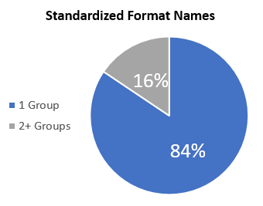
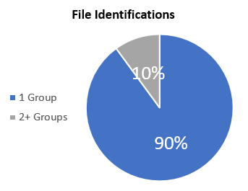
Unit Overlap
Notes:
We have multiple units using the system, so I analyzed for overlap with format types to identify where we might be able to collaborate on preservation work. Unfortunately, the vast majority of our formats [84% standardized name, 90% format ids] are only present in one unit's collections, and typically the same unit.

Slide 28
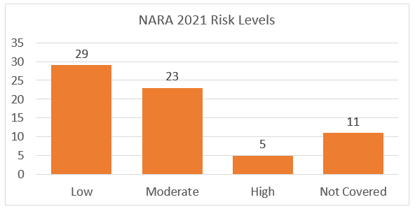
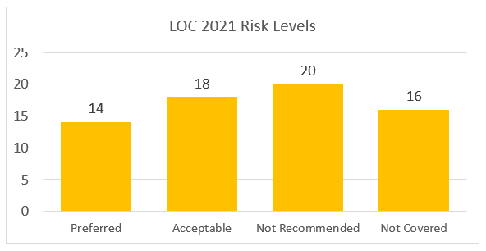
Formats at risk
Notes:
I limited risk analysis to the most common formats in our holdings to keep the amount of time feasible, given that it is currently a manual process. I also used the standardized name, rather than looking at each version. The first year, I reviewed the 30 formats with over 500 files. The second year, with more time since the workflow was already set up, I expected the review to the 68 formats with at least 100 files or 1 GB. Either way, these limits are arbitrary and based on keeping the number of formats to review reasonable. The hope is that if we only have a few files in a format in our holdings that they would be less important, but there is no guarantee that is true. As I continue to streamline the analysis process, I will continue to expand the number of formats I review for risk. Or I may just need to find more time.
NARA: 7% [5 formats] high risk
LOC: 29% [20 formats] not recommended

Slide 29
Other risk indicators
Unknown Binary
(1842 files)
Not in risk sources
(1393 files)
Empty (323 files)
Zip Formats
(1107 files)
Notes:
However, the formats identified as high risk or not recommended are not the only potential formats at risk surfaced by this review. By looking closer at the formats with the threshold for risk analysis, I noticed several other indicators of potential risk that may warrant additional investigation:
Formats identified as "unknown binary", which means they aren't really identified. [1842 files]
Formats identified as "empty", which could be a copying error. [323 files]
Zip formats that are potentially obscuring other at-risk formats within them. [1107 files]
7 formats not in either risk source, so risk is unknown. [1393 files]

Slide 30
Analyzing the analysis
Image by StockSnap from Pixabay
Notes:
Having this webinar on the horizon motivated me to dig into the results further, now that I have 2 years' worth, and reflect on what was helpful and what was maybe unnecessary or could be done in a better way. This next section is a series of questions I posed myself about the process and the answers I came up with.

Slide 31
How often To do this analysis?
2 years?
Notes:
We review our time-sensitive policies (like our disaster plan) annually and so I also picked annually as the initial frequency for format analysis. I didn't want too many new risks to develop in between the reporting cycle.
However, when I repeated the analysis after a year, with over 650,000 new files totaling almost 240 TB, I found the format makeup of our holdings largely stayed the same. We had no completely new formats and only 7 new format identifications, meaning new versions of formats we already had. And while there were some small changes to the order of the most common format types, names, and format ids, there were very few brand-new ones. The risks were also largely unchanged. NARA and LOC did not increase the risk for any format that I reviewed both years. Even though I reviewed more formats in 2021, the ones most at risk had remained the same as 2020: executables and proprietary image formats. There are additional proprietary formats that LOC does not recommend from the new batch of formats, but since they are rated low-moderate risk by NARA, we do not consider them to be as at risk.
At least based on this experience, it appears that the rate of change for both the formats in our collections and the risk of those formats is slow enough that a longer frequency for this report will be acceptable. I am going to try waiting two years before the next analysis, which puts it at the end of 2023, and will re-evaluate the frequency again once I see how much change there is. To supplement this report, and potentially let us wait even longer between doing the analysis of our entire holdings, we plan to add a quick version of this analysis to our accessioning workflow for born-digital archives. These are the most likely to include new at-risk formats, so this way we'll catch them as they come in the door rather than only relying on the holdings report.

Slide 32
Is it worth it to standardize format names?
Yes
Select by standardized name
Select by format identification
68 formats
66 formats
578 format ids
248 format ids
Notes:
The main reason I added a standardized format name, instead of just using the identifier that I already had, is that I was concerned it could leave formats with many versions or name variations out of the risk analysis. I could imagine a scenario where each version of the format just missed the cut, but all of them combined were well within the range for analysis.
To test this out, I created a list of formats that would have been reviewed in 2021 if I used the same criteria, a minimum of 100 files or 1 GB, but using the format identifiers instead. There were two standardized format names [Audio Interchange File Format and Encapsulated PostScript File Format] that were no longer on my assessment list, impacting about 300 files and 3 GB. This time, I wasn't missing very many by skipping standardization, and they both happen to be low risk anyway, but that wouldn't necessarily always be the case. The bigger impact is that before I considered all versions for each standardized format name and now, I would only consider some of them. The names I used for the 2021 assessment cover a combined 578 IDs. By evaluating the frequency of IDs individually, I would have only reviewed 248 (43% of those).
Using the standardized names also saves me some time. Using the names, I had 68 formats to look up, compared to the 248 ids that make the assessment list.
A possible drawback with using names instead of versions is losing some nuance about what is at risk. NARA rates the risk for each version separately. When I look up a standardized format name and different versions have different risks, I have been using the risk associated with the most common version(s) in our collections. Had I looked at the versions individually, 1 GIF and 6 PDF versions would have had a moderate risk rating instead of the low risk that I reported in our assessment, and some of our JPEG, MPEG, and TIFF format versions wouldn't have had an exact match.
Because I can use a script to quickly assign standardization, I think the benefits are worth it. It is faster and expands the number of formats I'm reviewing, giving us a better chance of finding risks. To address the issue of lost nuance, I will start evaluating versions separately if NARA assigns them different risks. And to make it more worthwhile, I will look at updating my standardization rules to make it easier to match to NARA. If the script wasn't handling the standardization, I might stop and come up with other ways to address my concerns about what is included in the risk analysis, because it is time consuming to assign standardization by hand.

Slide 33
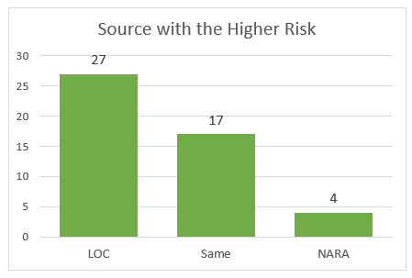
Should we Keep Using the LOC Recommended Formats Statement?
No
NARA only (9)
LOC only (4)
48
Neither Source: 7
Notes:
The reasons we started with using two sources was to increasing coverage (the number of formats we can get risk information for) and providing a more balanced result while we figure out our own opinion on risk.
For coverage, 71% (48) of the names are in both, 19% only in one (9 in NARA only, 4 in LOC only - 2 are actually in it as acceptable and 2 are inferred not recommended; all video), and 10% (7) are in neither. So, we aren't adding that many new covered formats by including LOC.
Of the 48 names in both, they agree on risk 35% of the time (17), NARA has higher risk for 8% (4), and LOC has higher risk for 56% (27). I didn't see a pattern in the types of formats that one ranked higher than others. It does make sense LOC would be more risk averse, since they are picking a limited set of formats that are best for preservation as opposed to doing a holistic look at their holdings like NARA. And what we're trying to do is much more in line with NARA's approach.
Overall, it looks like NARA is mostly meeting our needs. I'll only reference LOC in the future for formats that are not covered by NARA.

Slide 34
do we need a Third risk source?
No
Error in Disk Copying method
Standardization error
Different version in source
8060 relocatable
ISO 9660 CD-ROM filesystem data
RSRC
UDF filesystem data
ISO Media MPEG v. 4
News or mail ASCII
MIME Email (different version of EML)
Notes:
I also looked at the formats that neither covered to see if a third risk source might be useful. I found a few trends in these 7 formats that I didn't match to the sources.
Application ones (4) are file system and other application data storage formats. Maybe we didn't copy from disks in a good way.
Two of them (News or mail - ASCII and ISO Media MPEG v.4) could be matched if I standardized differently.
And there was just one format, MIME Email, where NARA has the other EML version but not this one.
By spending some additional time on better copying or standardization, we'll be able to match them to NARA after all and get risk information. So, we don't need another risk source yet.

Slide 35
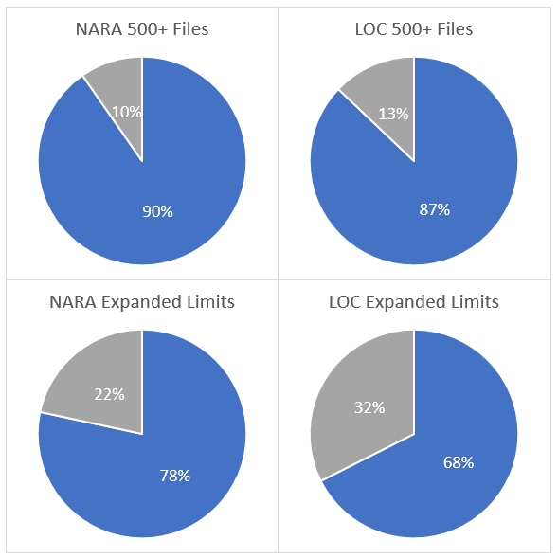
Are the less common formats in the risk sources?
Mostly
Blue: In Source
Gray: Not in Source
Notes:
The next two questions are related to what is left out of the risk analysis by limiting it to the most common. Even with the expanded limits, I reviewed 68 formats and left 128 formats unevaluated. While this sounds like a lot, it impacts about 2100 files (0.1% of holdings) and 3.5 GB (0.001% of holdings). But it is still a lot of formats to have an unknown risk status.
So I got to wondering, is there a more logical way to determine what that limit should be? I hoped that formats that are rarer in our holdings might also be less likely to be in the risk sources, so at some point it wouldn't be worth looking it up. If there is a limit like that, I haven't reached it yet. NARA had a preservation action plan for 78% of the formats added with the expanded limits and 68% were covered by LOC categories. So, there are probably a lot more formats left that I could find a risk level for if I made the time to do the analysis.

Slide 36
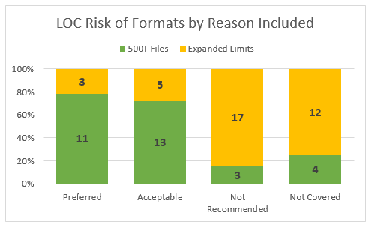
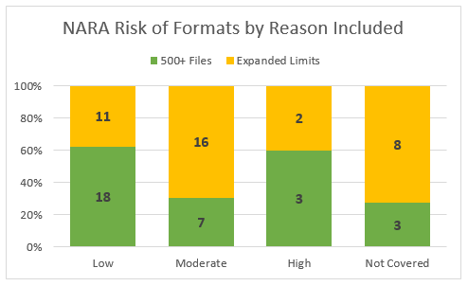
Are the less common formats more likely to be at risk?
Maybe
Notes:
I was also worrying about what we might be missing. What if a format that was rarer for us was also more likely to be at risk, and so my way of selecting formats for review was obscuring some major problems? Comparing the risks for formats with over 500 files to the formats added with the new limits suggested that might be true but wasn't entirely conclusive.
For LOC, the results are clearer. Formats with over 500 files made up 79% of the preferred and 72% of the acceptable formats, while formats from the expansion of the limits made up 85% of those that were not recommended. However, we've been relying more on NARA's results, and there the trend is less clear. Formats with over 500 files make up 62% of low risk but also 60% of the high risk. Formats from the expansion make up 70% of the moderate risk.

Slide 37
How to expand risk analysis limit?
Files
Lower file minimum
Add size minimum
9
21formats
7 formats
Notes:
It does look like I do need to continue expanding my limits for risk review as much as possible, since many will likely be in the risk sources, and they may have an increased chance of being at risk. Even if we decided there wasn't enough content to be worth acting on, it would let us make a proactive decision instead of not realizing the risk was there. And it may turn out that those few files are very important content and worth investing the time to act.
Given that I want to expand the limits again, is it more effective to change the number of files or number of GBs? From my experience so far, it looks like expanding the limit by file count has the most impact. However, there were a few formats that were only added because of size, so depending on your holdings this may also be a valuable option. For us, including a size limit added multiple audiovisual formats, but also a database and email format, that would not have otherwise been considered.

Slide 38
wrap up
Image by 995645 from Pixabay
Notes:
Before we open this up for questions, I want to wrap up with what is working, what is still a challenge, and a few reflections on the process of designing a workflow like this.

Slide 39
What’s good?
Aware of risks
Priorities for new processes
Process getting faster
Repeatable workflow
Notes:
Having this workflow is valuable. Before, we had to rely on the fact that most of our holdings were created recently and were hopefully not at risk yet. Now we know, at least for the most common formats. Alleviates some anxiety.
Priorities for what to figure out: things to migrate, inform workflow moving forward, like unpacking zips or doing some risk analysis sooner.
Repeatable workflow through scripts, documentation, using past report as a template means logistics are getting faster over time and I can increase the number of formats reviewed and get more value.
Can use this workflow in other contexts, like one unit wanting to focus on its own holdings for more nuance or a processor analyzing a particular collection to use formats as content clues that could help with appraisal, description, or deciding what methods to use (email vs. photos).

Slide 40
What’s a challenge?
Refining process
Relying on NARA
Identifying infrequent but important
Determining preservation actions
Notes:
Refining the analysis process: 2 times isn't that much data. Still working on how often to do it, what to group together when we standardize, what to include in the risk analysis, even the method for matching to the risk source.
Relying on NARA: interpreting their decisions for our context (staff differences, researcher needs), deciding what to do about formats they don't cover, and the risk that they will stop sharing (although appear committed to it for now).
Approaching our risk analysis from the perspective of what is important and not just what is frequent. Might need to think about what collections have the highest research value so they can be analyzed more thoroughly.
How do we decide on preservation actions? Born-digital archivist will take the lead on building a model for identifying and testing options.

Slide 41
Designing a process
Define needs for data collection
Iterative improvement
Be open to the unexpected (changing appraisal criteria)
Notes:
Keep a focus on why you are collecting data, to make sure you are filling a need. Sometimes the easiest things to run are not the most helpful. Example: not looking at commonness anymore.
Always keep iterating. Easier to start making improvements when you have something in place and see what it does in real life.
Be open to something unexpected. For us, it was implications for appraisal: before it only seemed worth the effort to review content for appraisal if it was taking up a lot of space to avoid burdening our preservation storage system, but now we realize that contributed to the long tail of formats where we only have a few files. Based on the format names, a lot of these are left over system information from copying from computing environments that aren't useful for future research. They are generally tiny, but they are adding to the burden of monitoring and managing formats for long term preservation. Because of this, we are adding a "technical appraisal" step to accessioning to remove these types of files moving forward.

Slide 42
Questions & Comments

Slide 43
Webinar evaluation
We appreciate your feedback!
After you exit the webinar, you will automatically be taken to an online webinar evaluation.
Please take a couple of minutes to complete the survey and help us plan future webinars.

Slide 44
Stay connected & informed
CoSA Website
CoSA Resource Center
CoSA Twitter Handle: @StateArchivists
CoSA Facebook Page
CoSA YouTube Channel

