Slide 1
CoSA Shop Talk Webinar
October 14, 2021
3 pm Eastern
FamilySearch Shop Talk Webinar: Update on current topics
Disclaimer: This webinar is being recorded and will be available for viewing on the CoSA website.

Slide 2
Webinar Agenda
Welcome
Presentations from FamilySearch
Q and A
Announcements

Slide 3
Presenters
FamilySearch
Manuel Sanhueza
John de Jong
Steve Waters
Rob Jackson

Slide 4
FamilySearch, a century later
CoSA ShopTalk webinar
October 2021

Slide 5
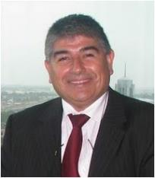
World-class preservation and access that ensures the future of your institution’s records
Manuel Sanhueza Content Manager
SanhuezaMR@FamilySearch.org
Notes:
Congratulations on archival month.

Slide 6
Presentation Outline
From the GSU to FamilySearch
Partnering with Archives Video
FamilySearch as an Archive
Technological advancements in Preservation and Access
1950 Census, a discovery experience
Community Engagement
RootsTech 2022
What is continuing on FamilySearch ?

Slide 7
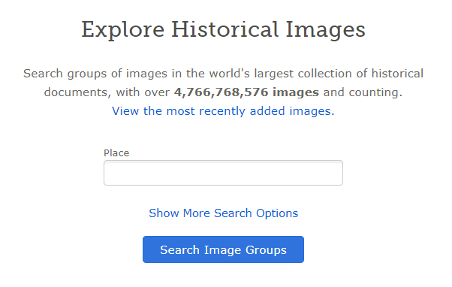
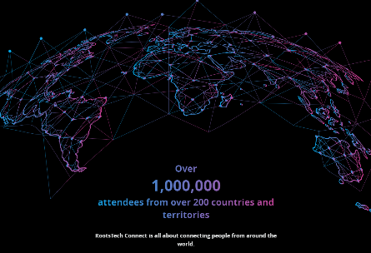
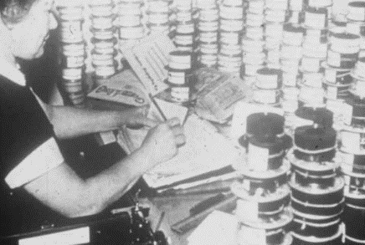
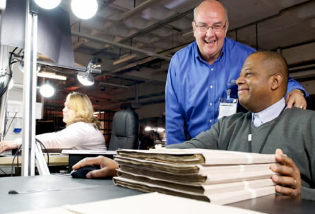
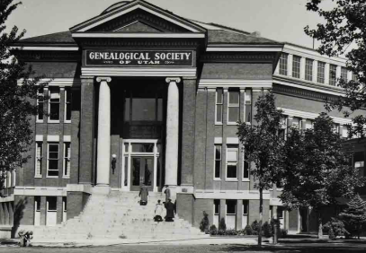
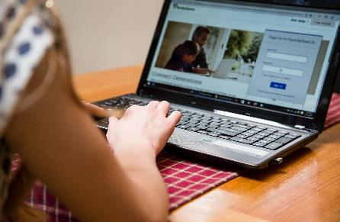
From GSU to FamilySearch
1894 - More than 100 years of experience
1924 Language support - Now 238 countries
1938 Microfilming – 2.4 million rolls
1999 FamilySearch.org
2002 90% digital capture.
2011 RootsTech - 2021 RootsTech Connect
2021 4.7 billion images

Slide 8
“We create inspiring experiences that bring joy to all people as they discover, gather, and connect their family – past, present, and future.”
Our mission is simple

Slide 9
Archivists from around the world describe their relationship with FamilySearch

Slide 10
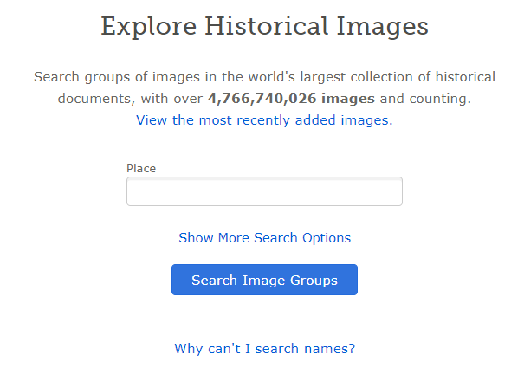
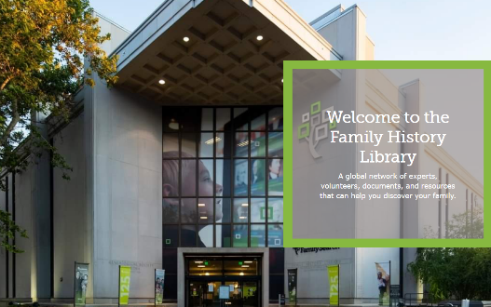
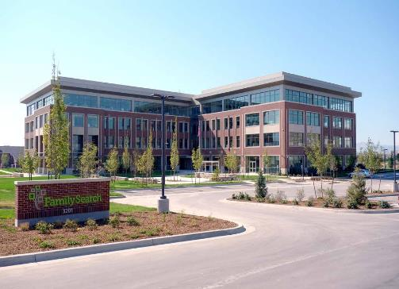
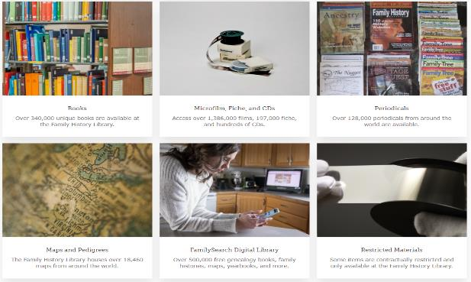
FamilySearch as an Archive
529,221 digital books
8.92 billion searchable names
4.7 billion images
> 1 million images added daily
> 1 million images indexed daily
31.16 million monthly visits
Largest Family History Library

Slide 11
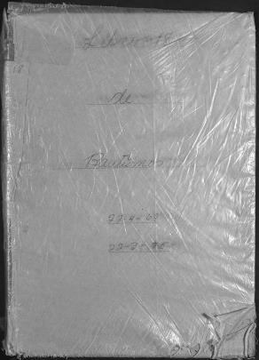
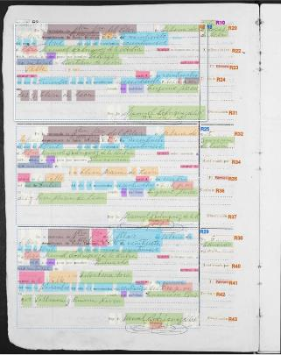
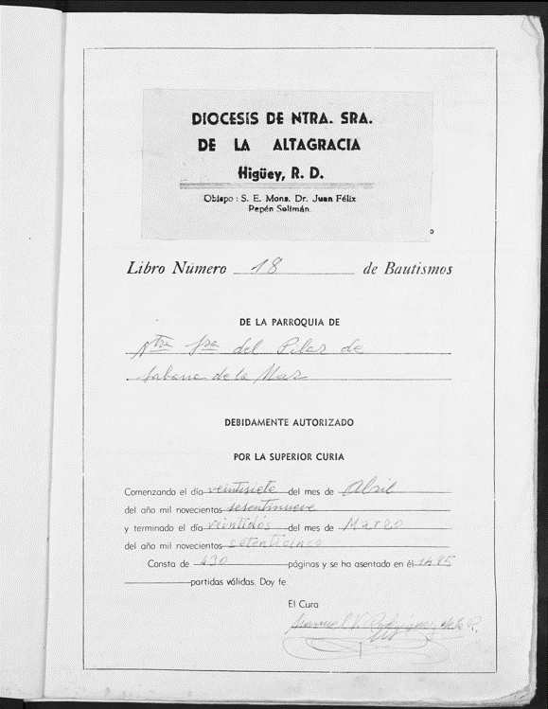
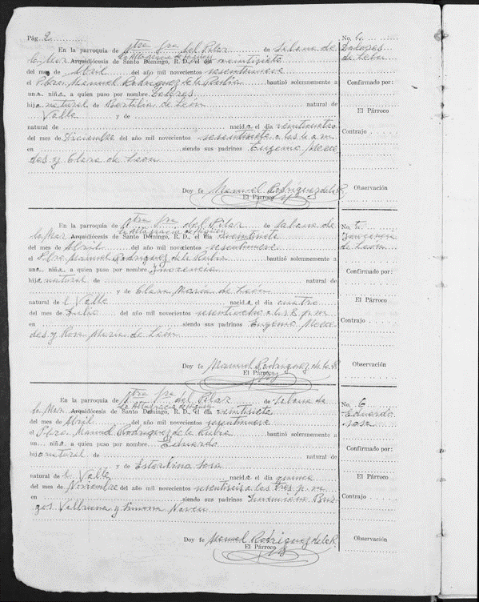
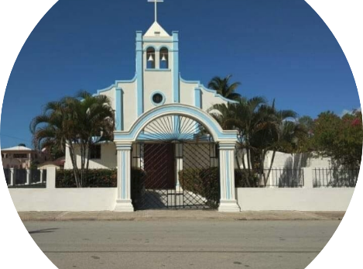
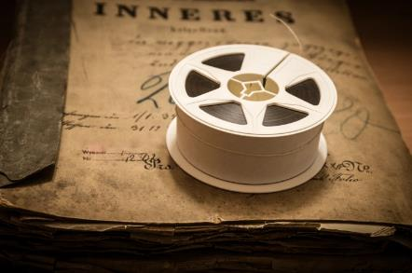
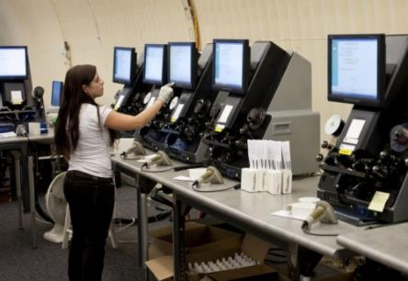
Technological advancements in Records Preservation and Access
83 years of filming
2.4 million digitized microfilms
Infinity process
Aug 13th, original capture
Aug 27th – Ingest process. 2.01 a.m.
Selection – 8.02 a.m. 9.03 a.m CAi

Slide 12
Computer Assisted Indexing

Slide 13
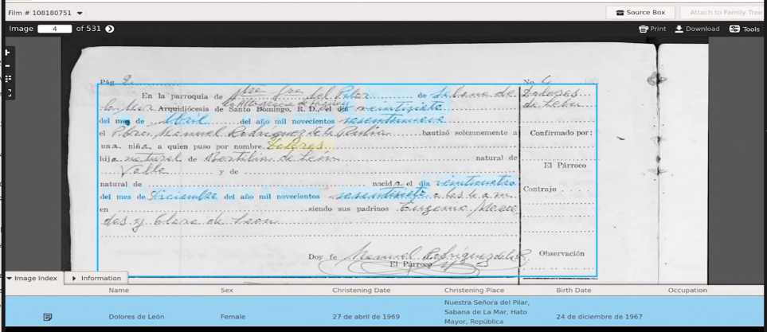
Computer Assisted Indexing

Slide 14
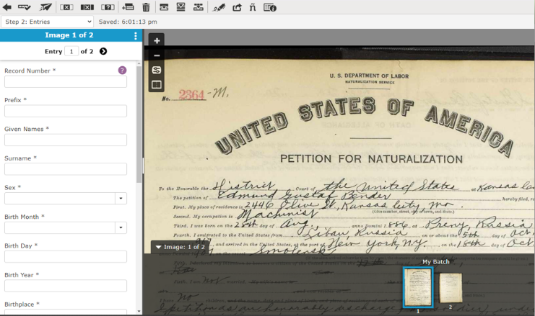
Web indexing

Slide 15
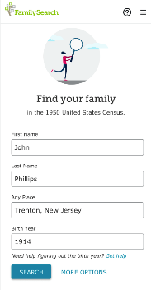
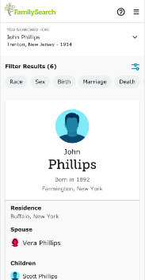
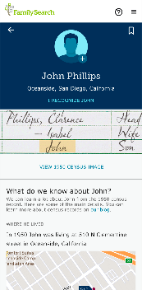
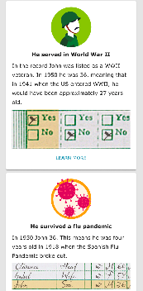
Discovery Experience:
1950 Census
Invitation: Find your family
Goal: Tell the story of the “what life was like in 1950” based upon the record and surrounding historical context.
Features:
View household location on map
Claim your ancestor
Save and share discoveries
Add information to family tree
Connect with others

Slide 16
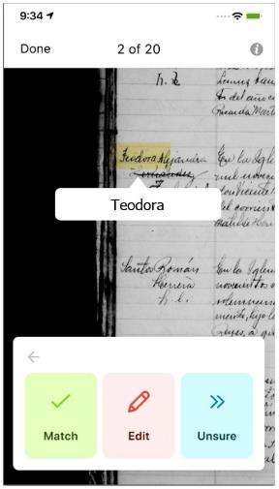
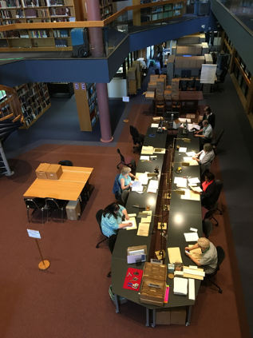
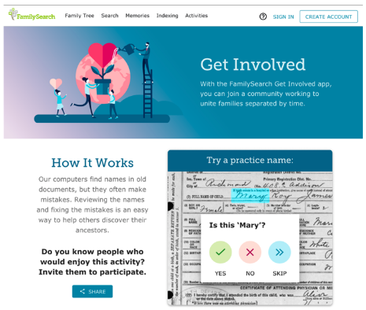
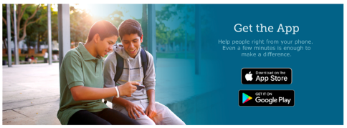
Community Engagement
Document Preparation
Get Involved
Underrepresented Communities
Curation on the Fly

Slide 17
Reclaiming Our African Roots
ROAR

Slide 18
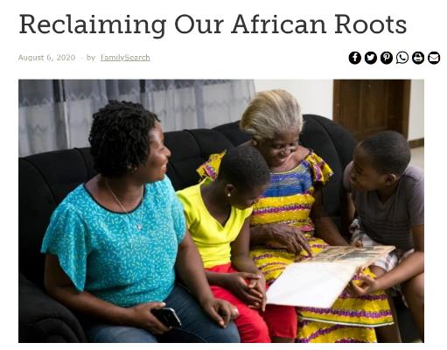
ROAR
A FamilySearch initiative devoted to African American genealogy - specifically in researching those with African Ancestry in the Americas

Slide 19
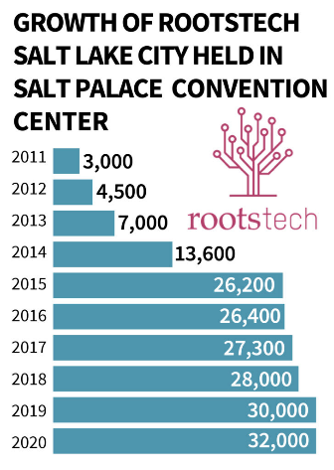
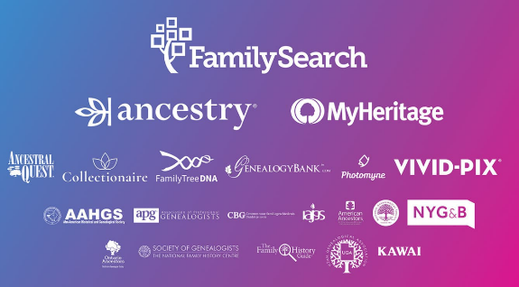
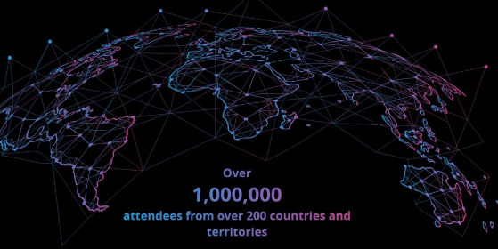
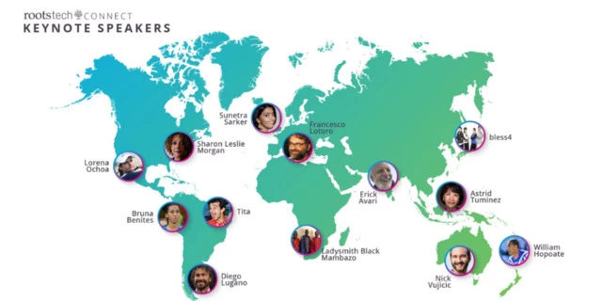
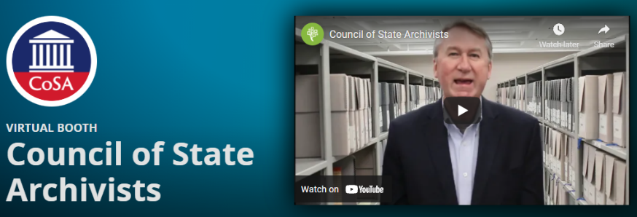
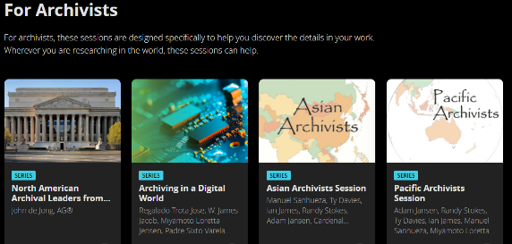
RootsTech 2022
10 Years of experience
From 32,000 to 1.5 million
Worldwide event
Localized content
Archival participation
Participate in 2022
RootsTech Connect is all about connecting people from around the world.

Slide 20
What is continuing on FamilySearch ?
No-cost preservation services that will remain free
On-location camera operations to digitize your records
High-quality, digital copies of your records upon request
Permanent protection against the threat of loss or damage to records
Migration of digitized records to new media formats to ensure accessibility
We are ready to partner with you
Thanks

Slide 21
Questions and Comments

Slide 22
Upcoming Webinars
October 28: “In Conversation with…” Video release
With Dr. Kathrine Skinner of Educopia
For registration information: https://www.statearchivists.org/programs/cosa-webinar-series/

Slide 23
Contact Us
CoSA Website http://www.statearchivists.org
CoSA Resource Center https://www.statearchivists.org/research-resources/resource-center
CoSA Twitter Handle @StateArchivists
CoSA Facebook Page www.facebook.com/CouncilOfStateArchivists
CoSA You Tube https://www.youtube.com/user/StateArchivists/

Slide 24
Webinar Evaluation
We really do appreciate your feedback!
When you exit the webinar, you will automatically be taken to an online webinar evaluation. Please take a couple minutes to complete the survey and help us plan future webinars.

